Slide 1
Network Planner
Example setup

Slide 2
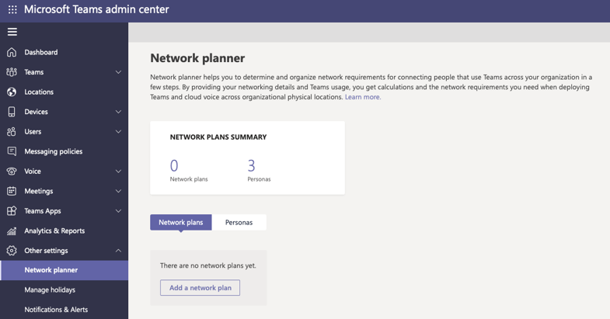
Contoso office information
Seattle HQ
1000 employees
25 Specialized calling only employees
Local internet connection
Local PSTN (Direct routing)
Kirkland Office
400 employees
10 Specialized calling only employees
Remote internet connection through HQ
Remote PSTN connection through HQ
Denver Office
250 employees
50 Specialized calling only employees
Local internet connection
No PSTN connection

Slide 3
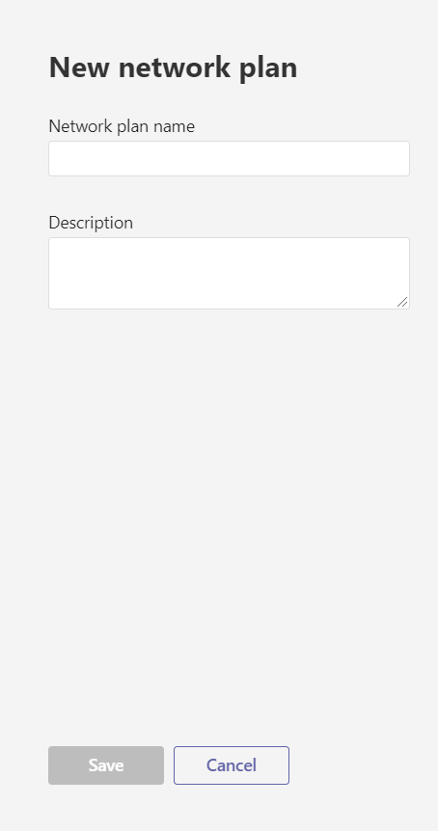
Add a network plan
To get started, click Add a network plan.
In the New network plan pane, add a name and a description for your network plan.
Click Save to continue.

Slide 4
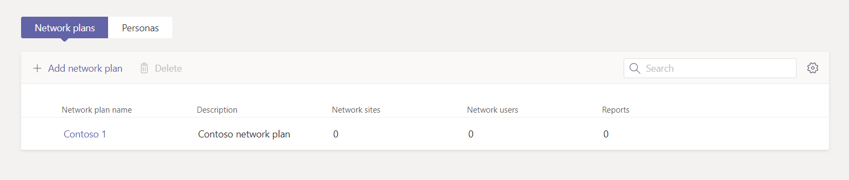
Network plans
After you save your network plan, it’s displayed in your list of network plans.

Slide 5
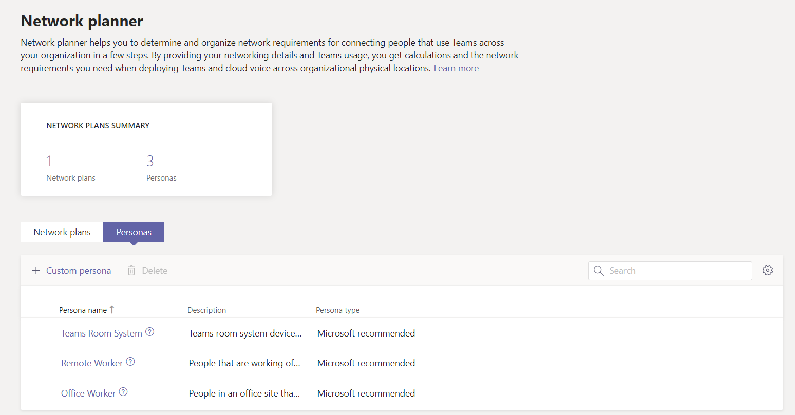
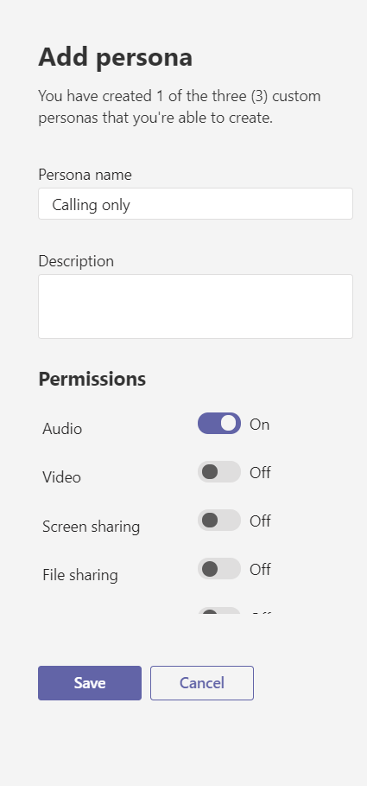
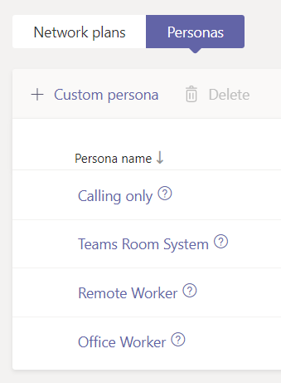
Create your custom personas
On the Network planner page, click the Personas tab, and then click Custom persona. Contoso needs a Calling only persona for some of its employees.
Add a name and a description for this persona and turn on Audio so that it’s the only permission turned on.
Click Save to add the persona to the list.

Slide 6
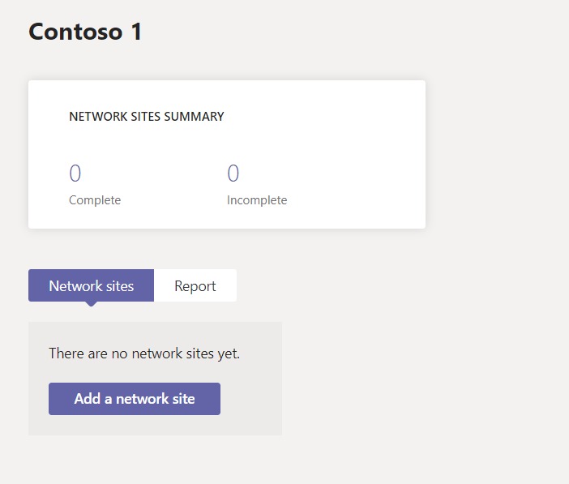
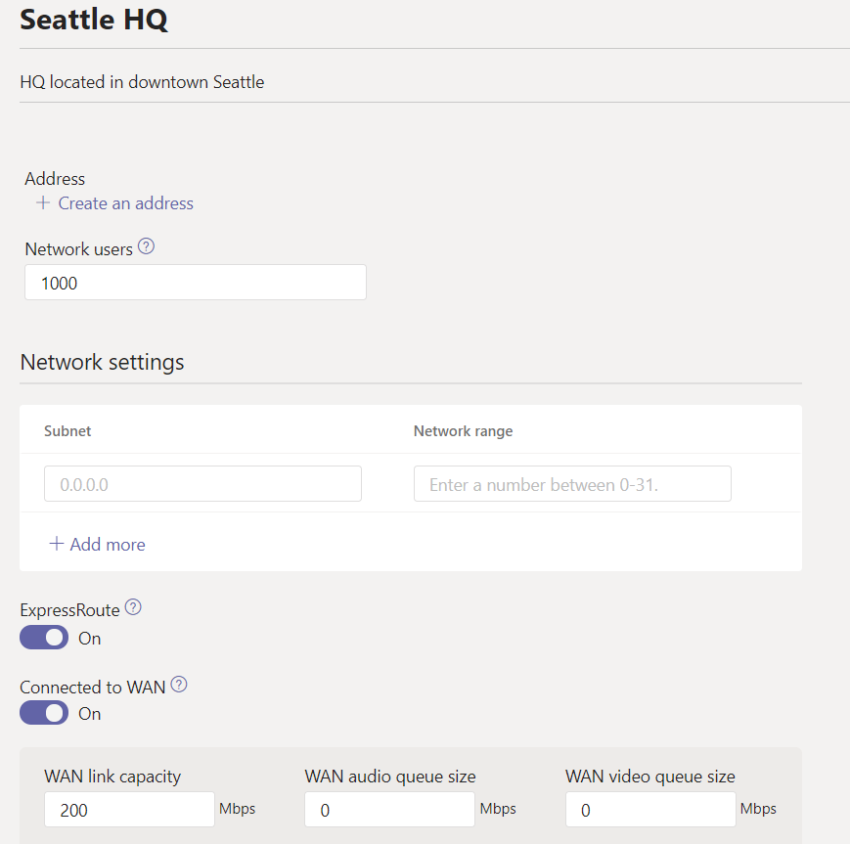
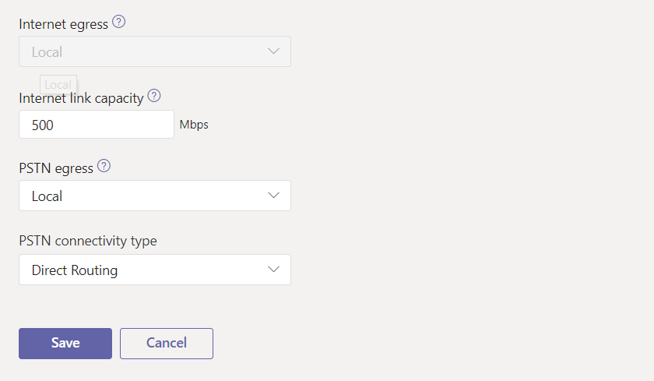
Add sites to your network plan
Click the name of your network plan in the list to start adding sites.
Using the details for the sites listed on slide 2, start filling in the information for each site as you create them.

Slide 7
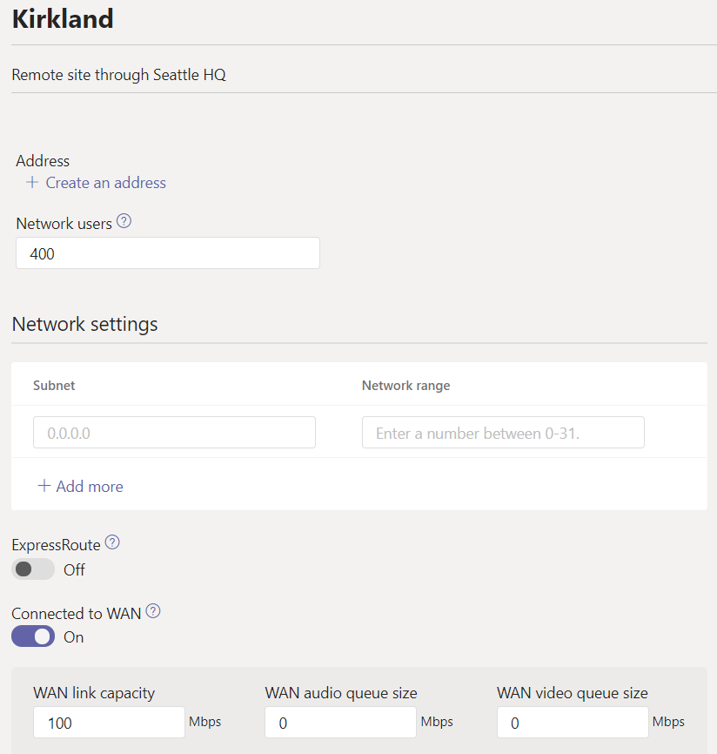
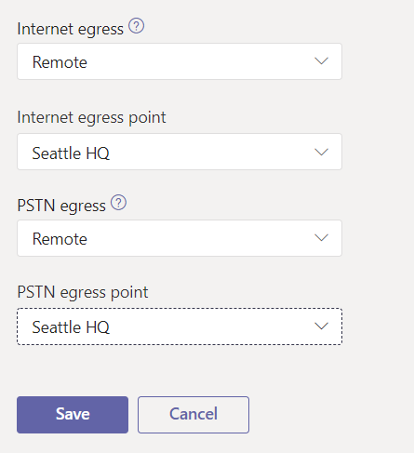
Adding a remote site
Contoso’s Kirkland office remotely connects to the Seattle HQ for internet and PSTN.
For this to be possible, Kirkland and Seattle both must be connected to WAN.
Selecting the Remote option in the dropdowns for Internet and PSTN displays another dropdown with potential egress points for both.

Slide 8
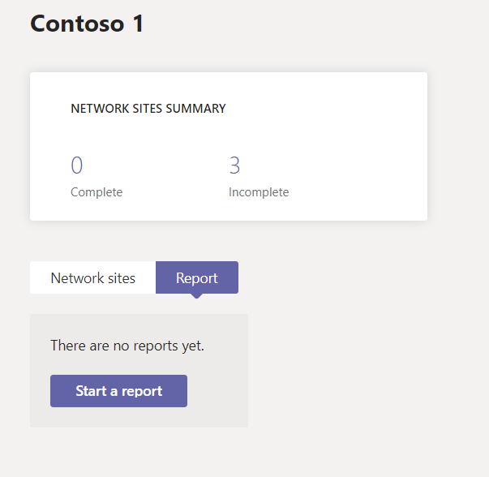
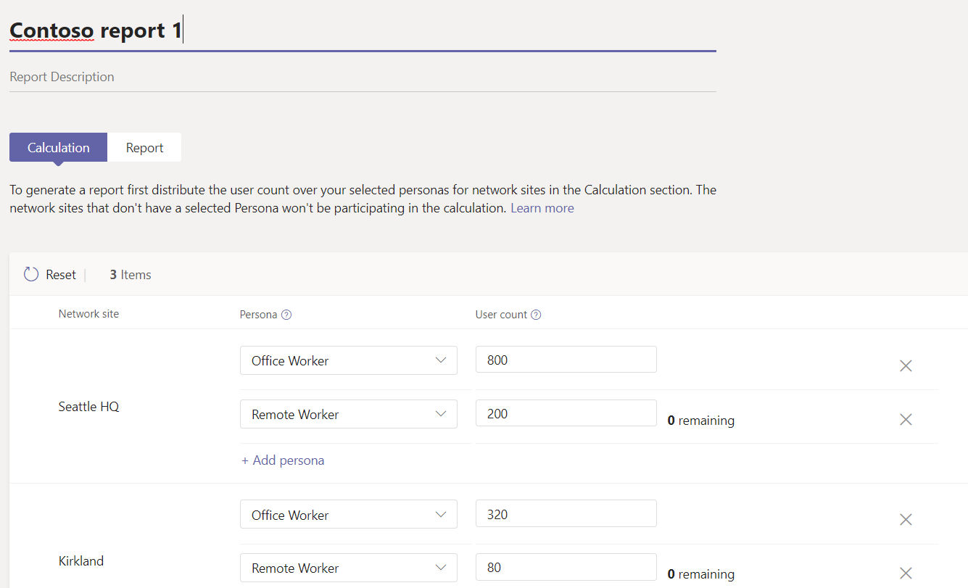
Creating reports
With all your sites added, click the Report tab, and then click Start a report to begin distributing your user count.
When the distribution page opens, add a name and a description for your report.

Slide 9
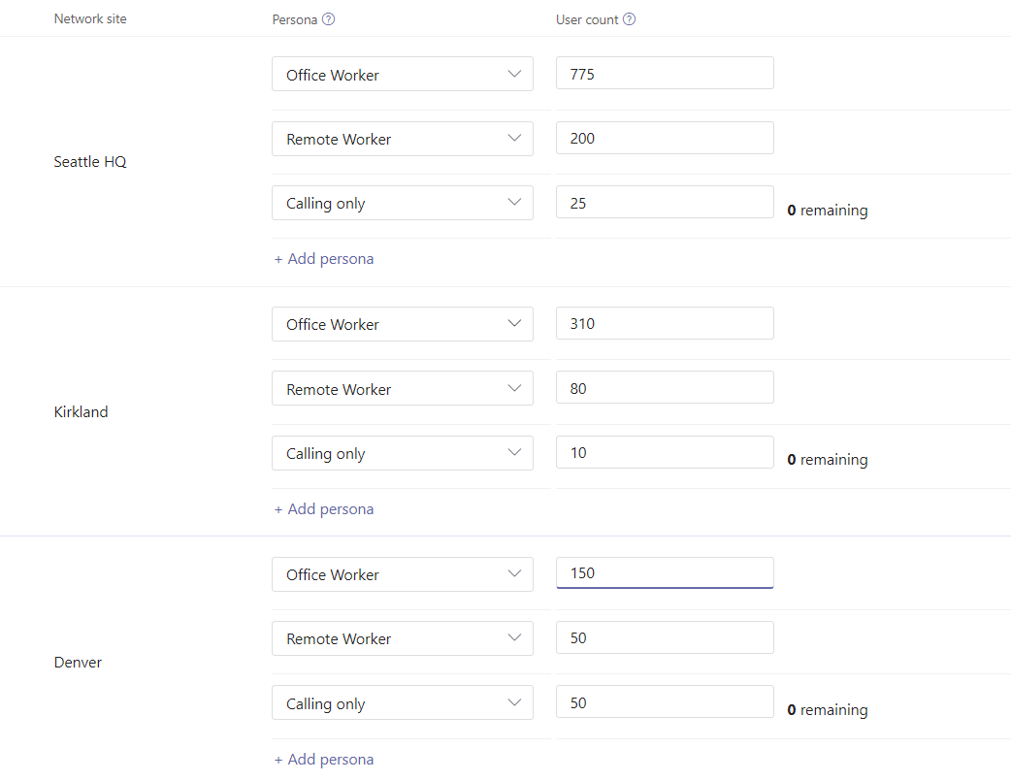
Persona distribution
When you first start a report, the user counts that were set for each site will be distributed automatically – 80% to office workers, 20% to remote workers.
If your organization needs a different set of personas (such as the Calling only one created earlier), this is where you’ll assign the number of users that have permissions that do not match the Microsoft recommended ones.
For Contoso, these Calling only personas are taken out of the number of users in the office.
The resulting distribution looks like the second screenshot.
Click Generate report to see your bandwidth needs.

Slide 10
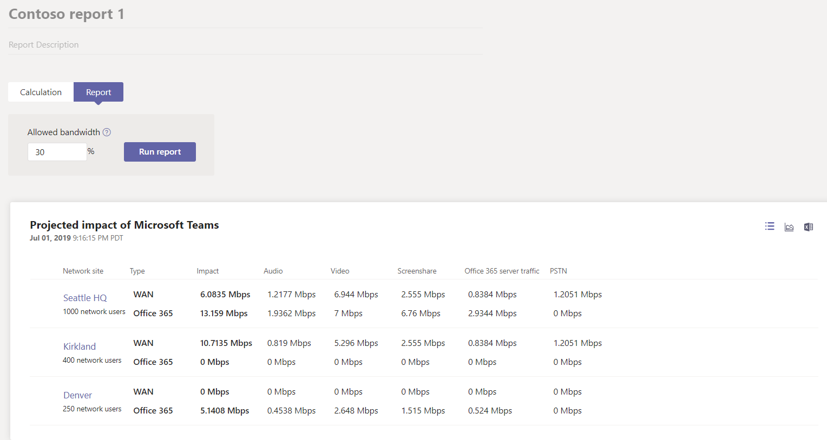
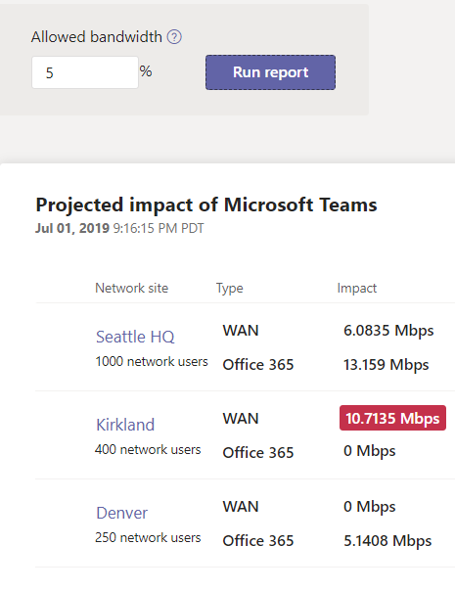
Report output
After clicking Generate report, you’ll see this screen displaying your bandwidth requirements both as overall and modality specific values.
The default value for allowed bandwidth is 30%. Changing this value and clicking Run report highlights in red any areas that need more bandwidth. See the example below.

Slide 11
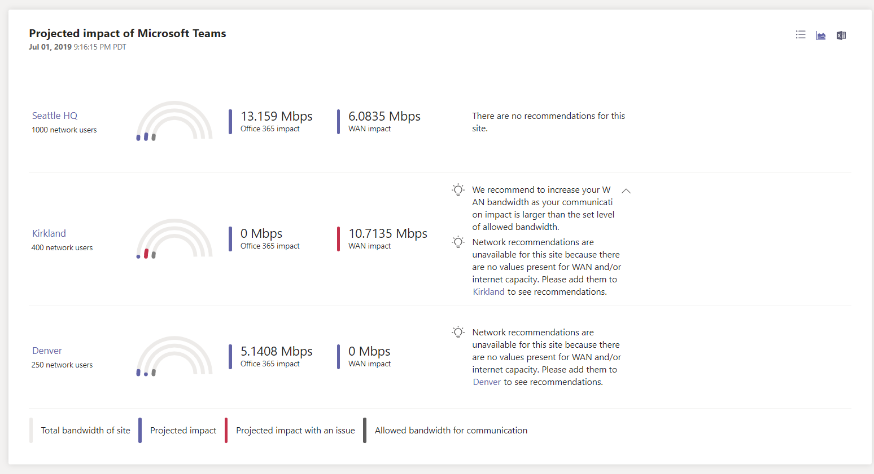
Report output – recommendation view
Clicking the recommendation view icon displays a site list as well as easy-to-read recommendations (if there are any).
Currently, Kirkland’s bandwidth needs to be changed to get the best performance from Microsoft Teams at only 5% of total bandwidth.

Slide 12
Thank you !

