Slide 1

Quantum Entanglement and Quantum Computing
Dr. Kaustav Bhowmick
Electronics & Communication
Engineering

Slide 2


Quantum Entanglement and Quantum Computing
Introduction to Topic
Dr. Kaustav Bhowmick
Electronics & Communication Engineering
Source: Google images

Slide 3
Quantum entanglement & Quantum Computing
Contents
Introduction and History
Data Representation
Operations on Data
Shor’s Algorithm
Conclusion and Open Questions
Source: Google images

Slide 4
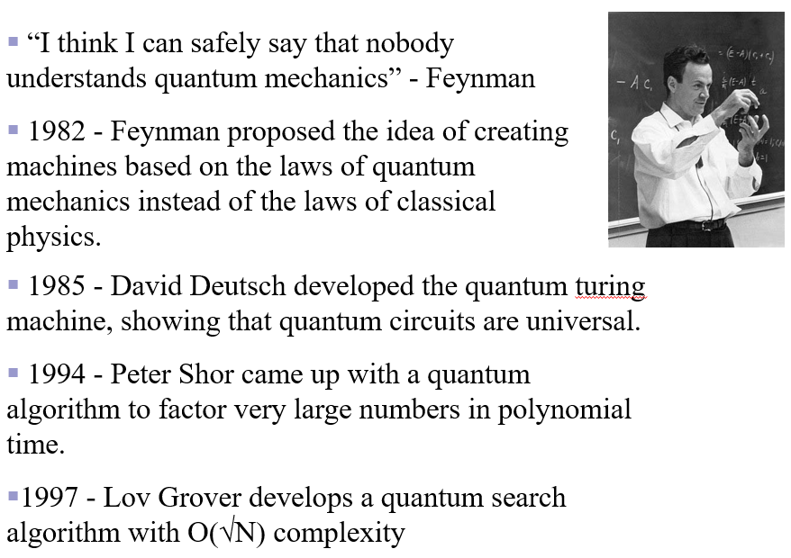
Quantum entanglement & Quantum Computing
Introduction
Source: Google images

Slide 5
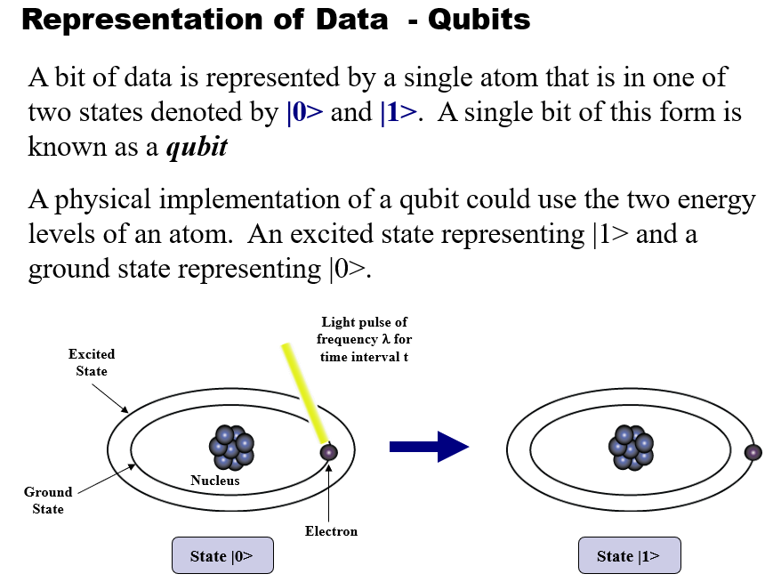
Quantum entanglement & Quantum Computing
Data Representation
https://www.youtube.com/watch?v=B3U1NDUiwSA&t=145s

Slide 6
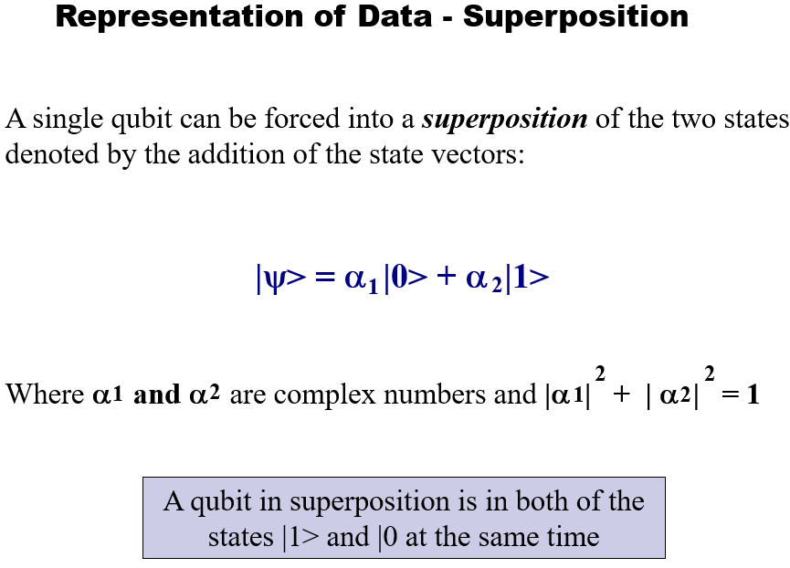
Quantum entanglement & Quantum Computing
Data Representation

Slide 7
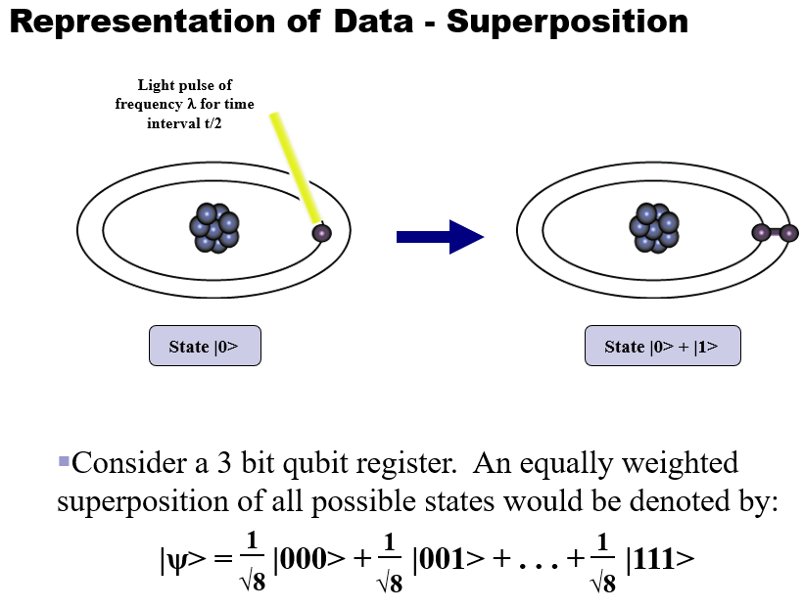
Quantum entanglement & Quantum Computing
Data Representation

Slide 8
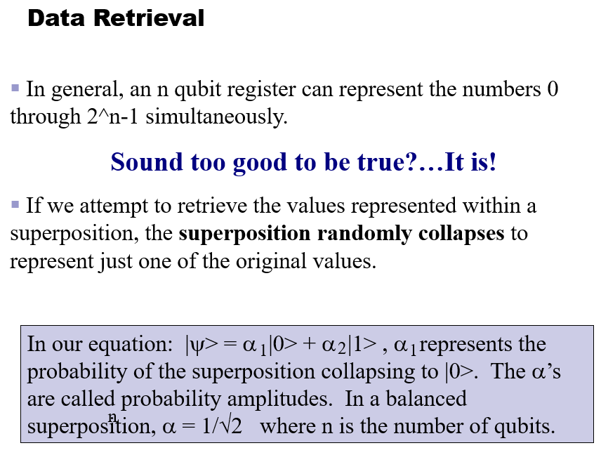
Quantum entanglement & Quantum Computing
Data Representation

Slide 9
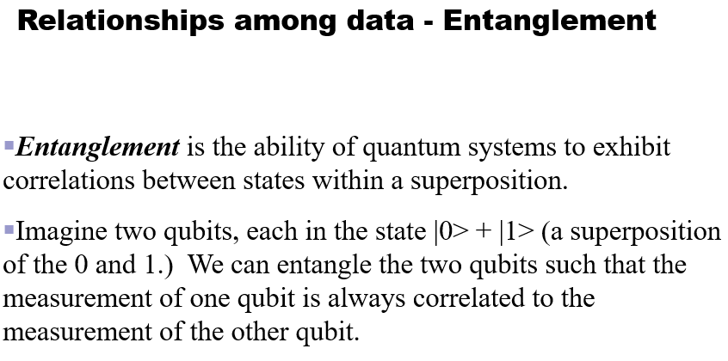
Quantum entanglement & Quantum Computing
Data Representation

Slide 10
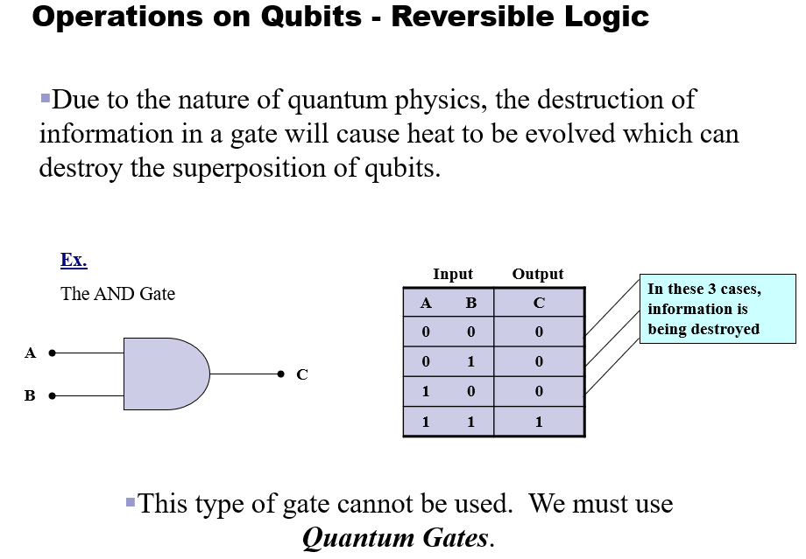
Quantum entanglement & Quantum Computing
Operations on Data

Slide 11
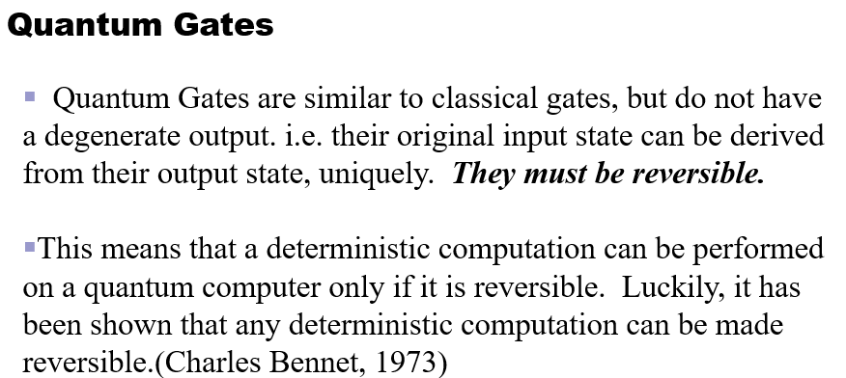
Quantum entanglement & Quantum Computing
Operations on Data

Slide 12
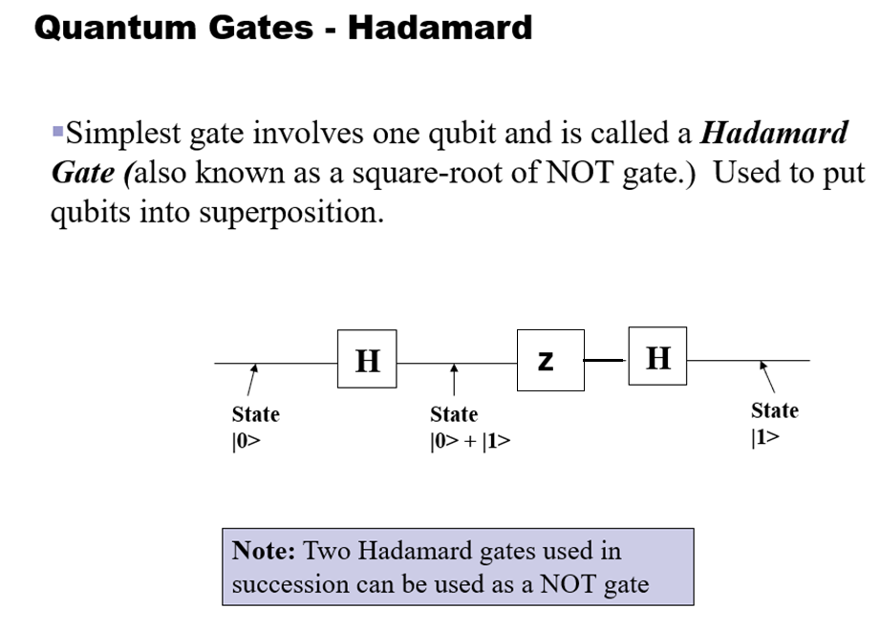
Quantum entanglement & Quantum Computing
Operations on Data

Slide 13
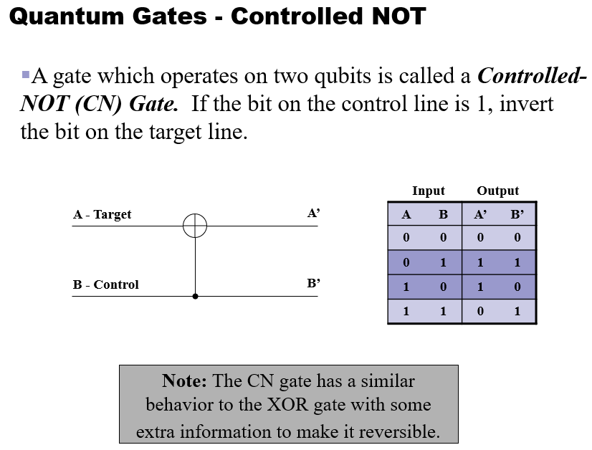
Quantum entanglement & Quantum Computing
Operations on Data

Slide 14
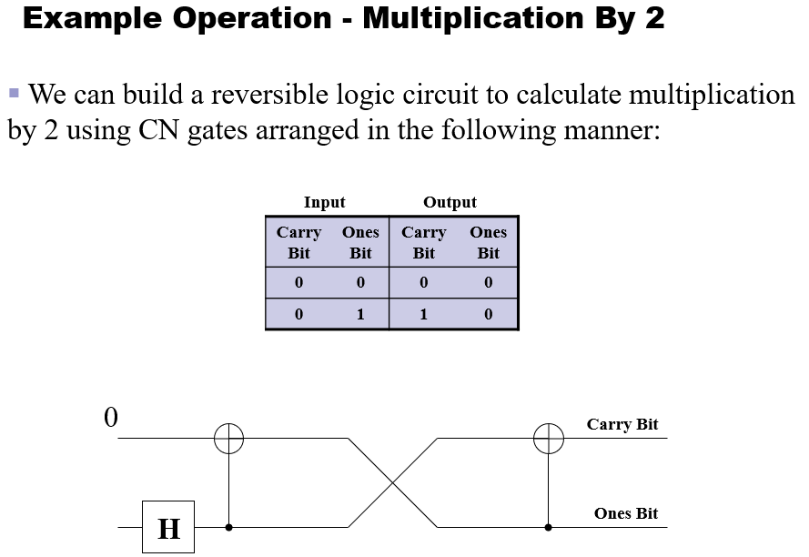
Quantum entanglement & Quantum Computing
Operations on Data

Slide 15
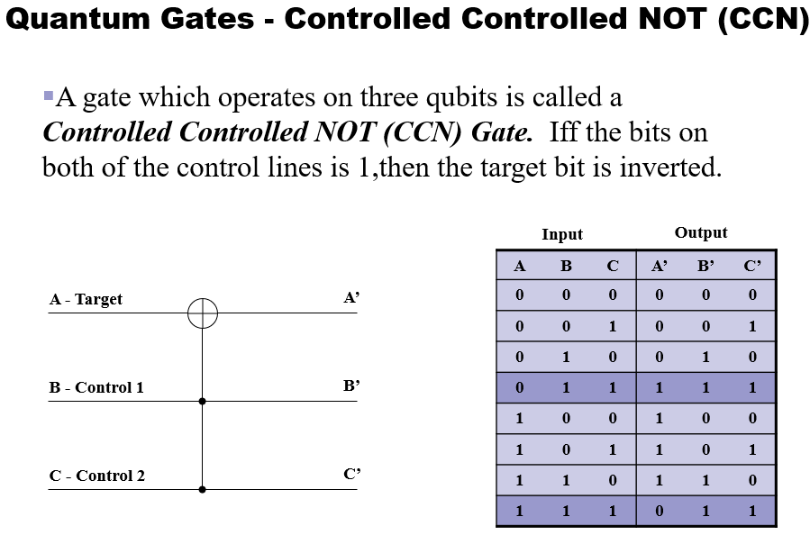
Quantum entanglement & Quantum Computing
Operations on Data

Slide 16
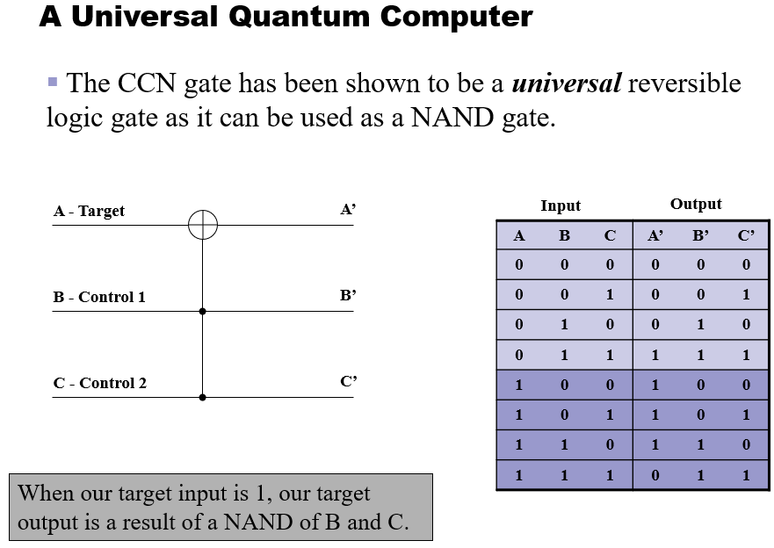
Quantum entanglement & Quantum Computing
Operations on Data

Slide 17
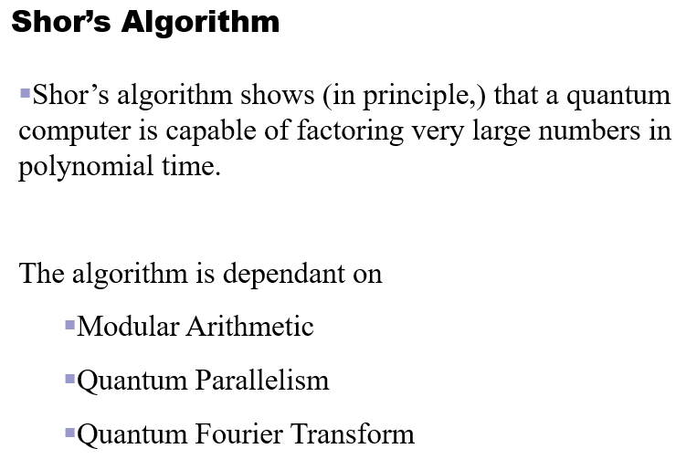
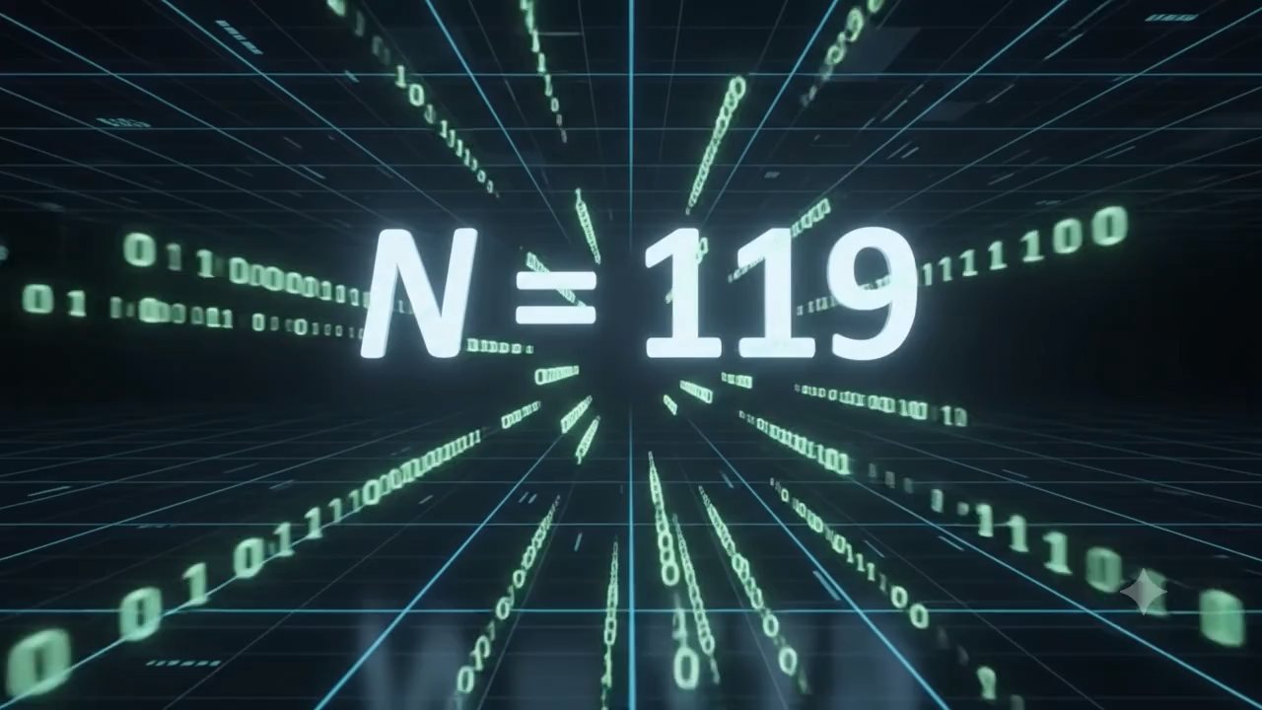
Quantum entanglement & Quantum Computing
Shor’s algorithm

Slide 18
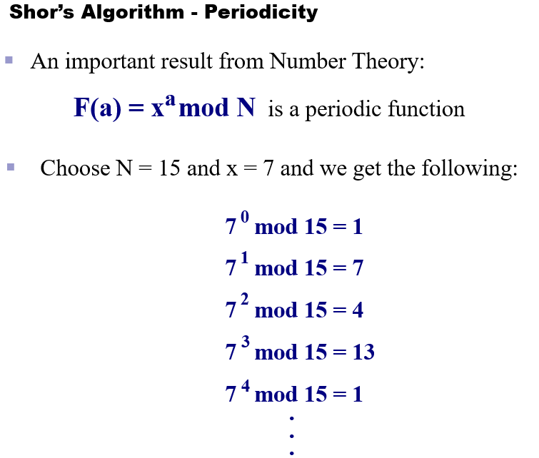
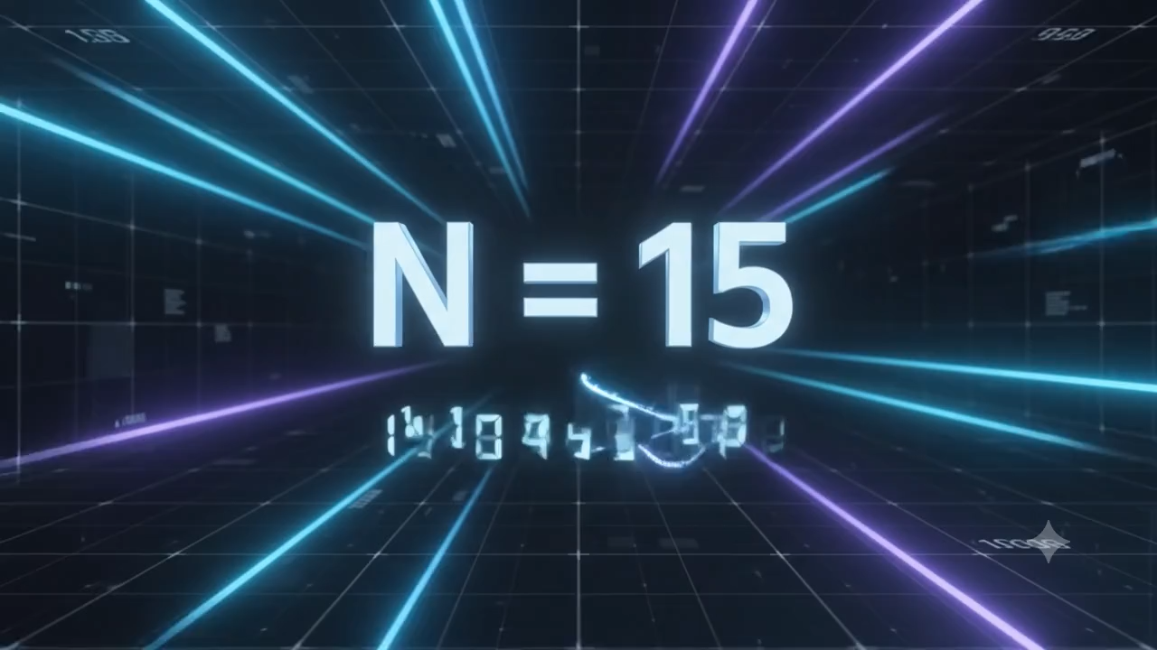
Quantum entanglement & Quantum Computing
Shor’s algorithm

Slide 19
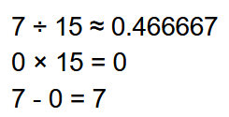
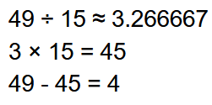
Quantum entanglement & Quantum Computing
Shor’s algorithm

Slide 20
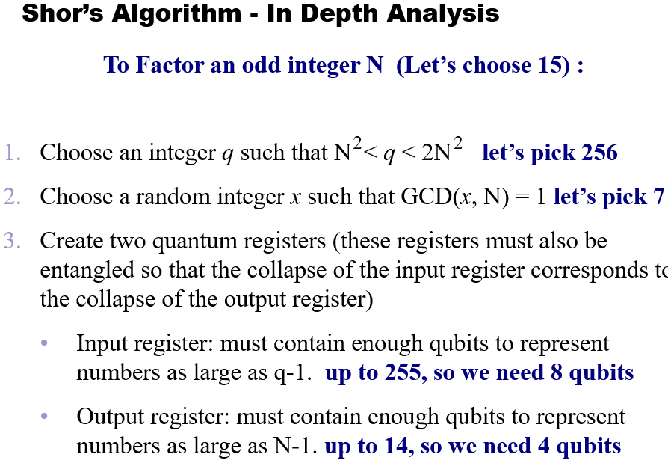
Quantum entanglement & Quantum Computing
Shor’s algorithm

Slide 21
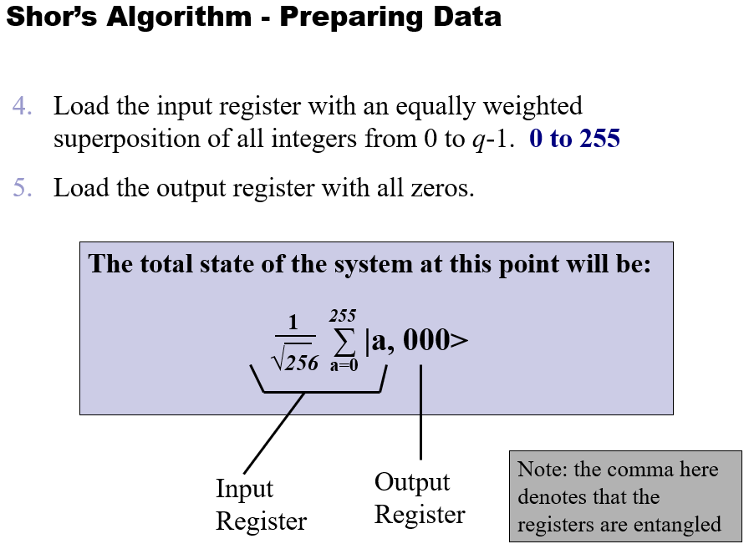
Quantum entanglement & Quantum Computing
Shor’s algorithm

Slide 22
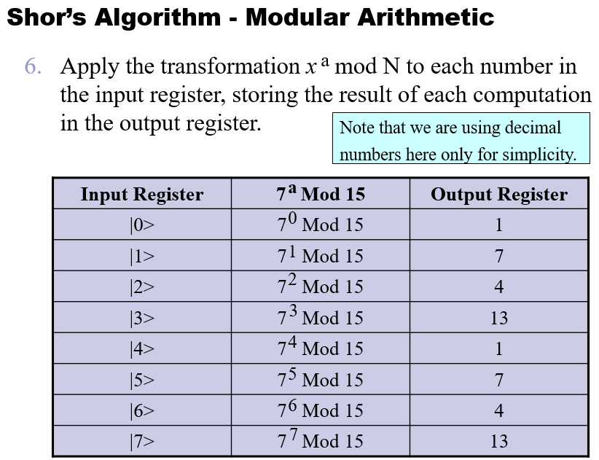
Quantum entanglement & Quantum Computing
Shor’s algorithm

Slide 23
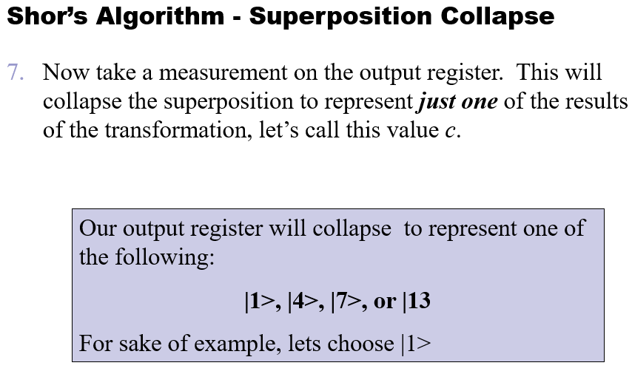
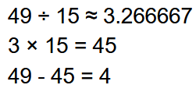
Quantum entanglement & Quantum Computing
Shor’s algorithm

Slide 24
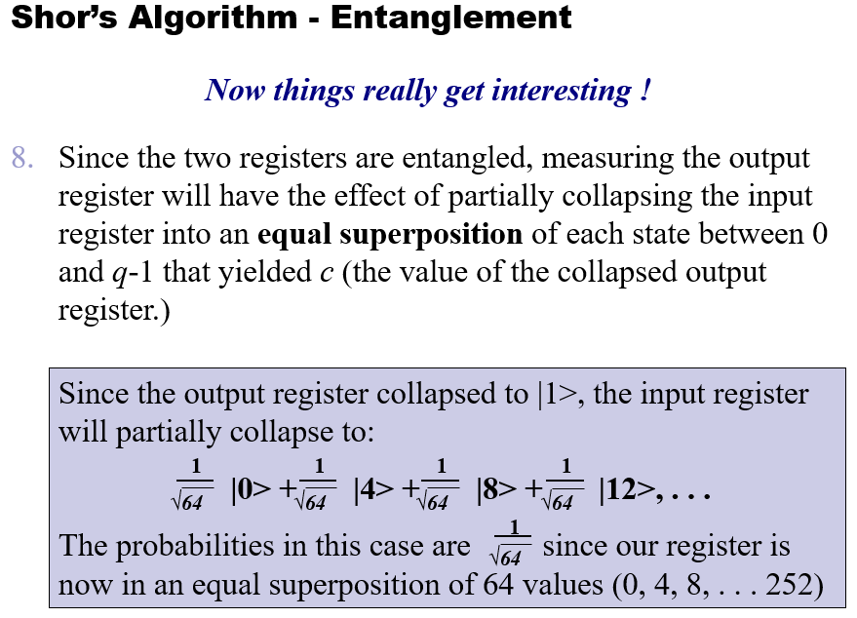
Quantum entanglement & Quantum Computing
Shor’s algorithm

Slide 25
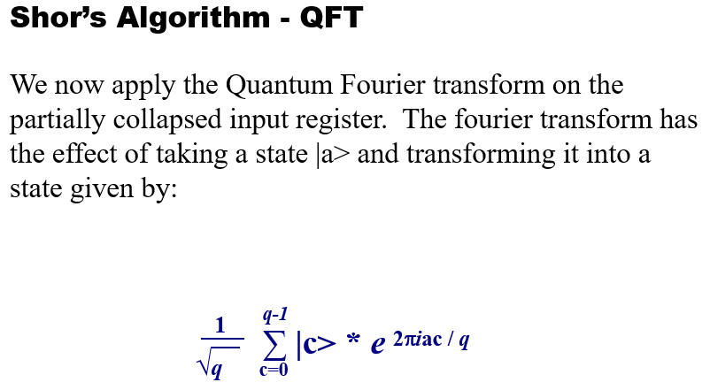
Quantum entanglement & Quantum Computing
Shor’s algorithm

Slide 26
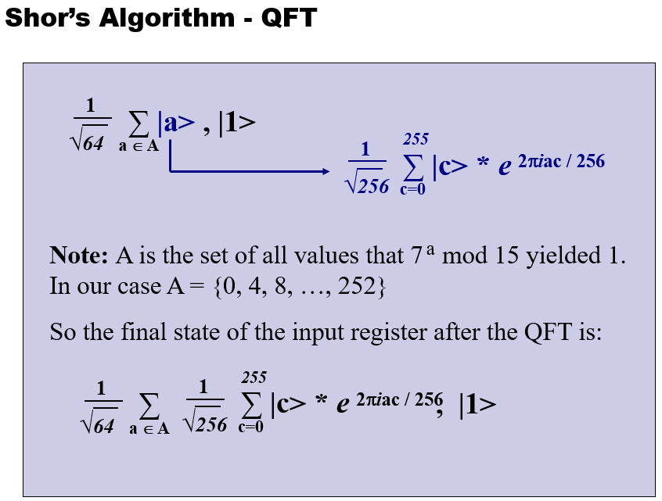
Quantum entanglement & Quantum Computing
Shor’s algorithm

Slide 27
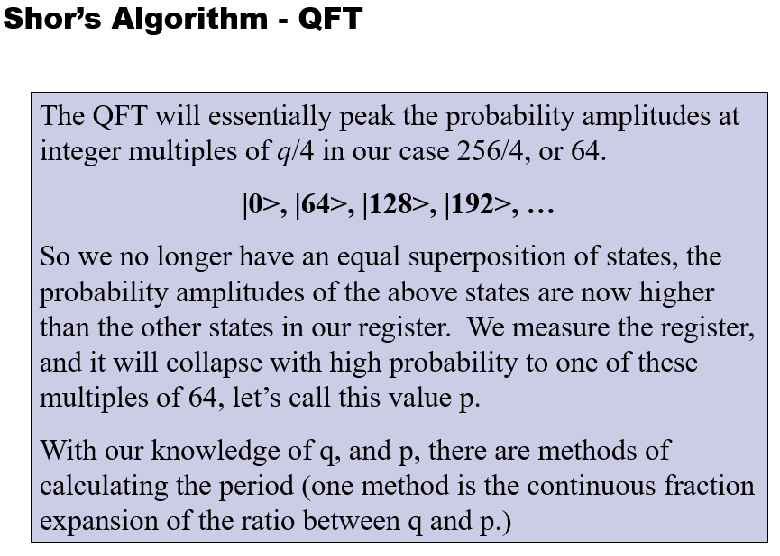
Quantum entanglement & Quantum Computing
Shor’s algorithm

Slide 28
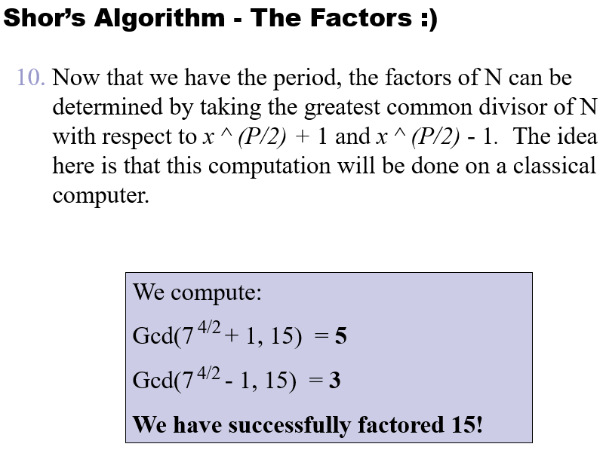
Quantum entanglement & Quantum Computing
Shor’s algorithm

Slide 29
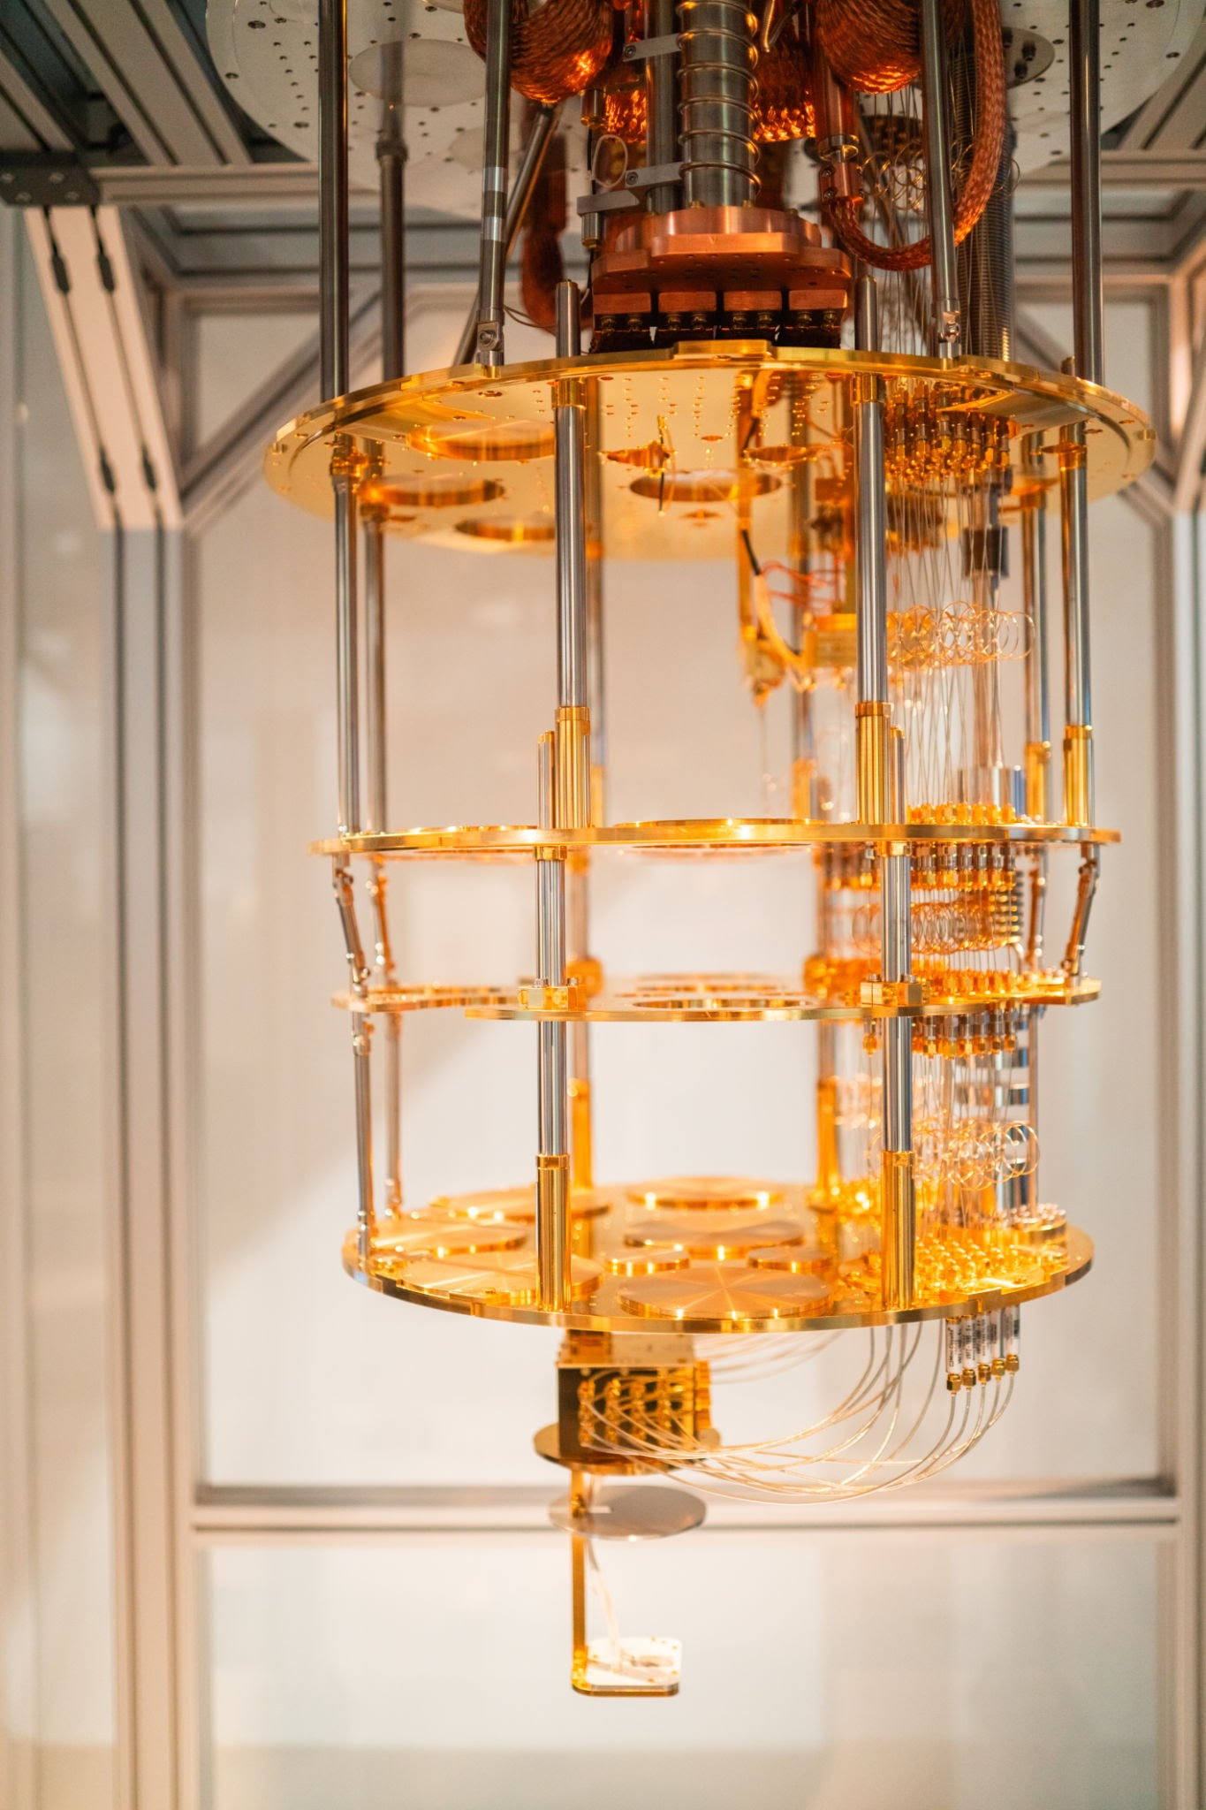
Quantum entanglement & Quantum Computing
Limitations of Quantum computing
1. Decoherence and Fragility
2. High Error Rates and the Need for Correction
3. The No-Cloning Theorem
4. Specialized Problem Solving
5. Programming Complexity
Quantum computers are not designed to replace classical computers for everyday tasks. Instead, they excel at specific, highly complex computational challenges that would take traditional computers thousands or even millions of years to solve. For example:
https://www.youtube.com/watch?v=nlyu68u0zEs
1. Molecular Simulation and Chemistry
2. Complex Optimization Problems
https://www.youtube.com/watch?v=MJXlXFRQfGI
3. Cryptography and Integer Factorization
4. Machine Learning and Pattern Recognition

Slide 30
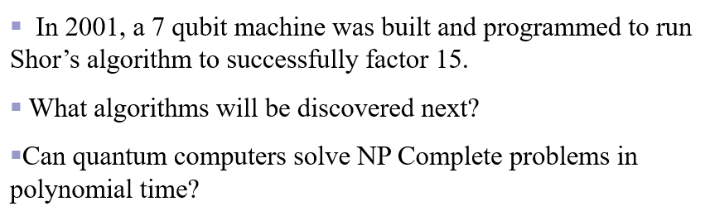
Quantum entanglement & Quantum Computing
Conclusion
https://www.youtube.com/watch?v=wC3KWHV_hiY&t=1s

Slide 31
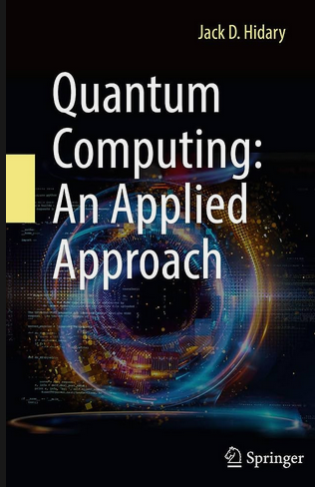
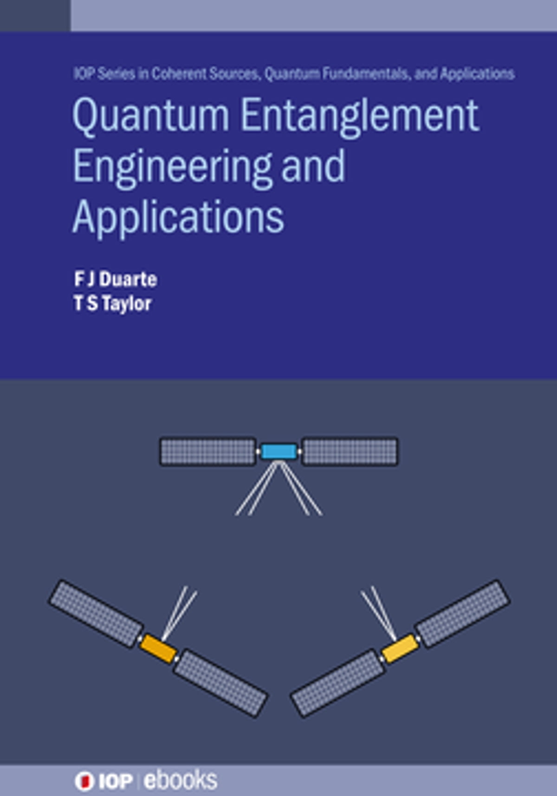
Quantum entanglement & Quantum Computing
Exam Pattern and Textbooks
Internals
ISA01: CBT 40M
ISA02: CBT 40M
A/H/P: Design Task – 10 M
(Design/Executive summary Report)
ESA: Design Task – 50 M (Design/Report submission)

Slide 32
THANK YOU
Dr. Kaustav Bhowmick
Department of Electronics & Communication
Engineering
kaustavbhowmick@pes.edu

