Slide 1

Quantum Entanglement and Quantum Computing
Dr. Kaustav Bhowmick
Electronics & Communication
Engineering

Slide 2


Quantum Entanglement and Quantum Computing
Introduction to Topic
Dr. Kaustav Bhowmick
Electronics & Communication Engineering
Source: Google images

Slide 3
Quantum entanglement & Quantum Computing
Contents
Stern-Gerlach Experiment
Classical and Quantum Mechanics
Source: Google images

Slide 4
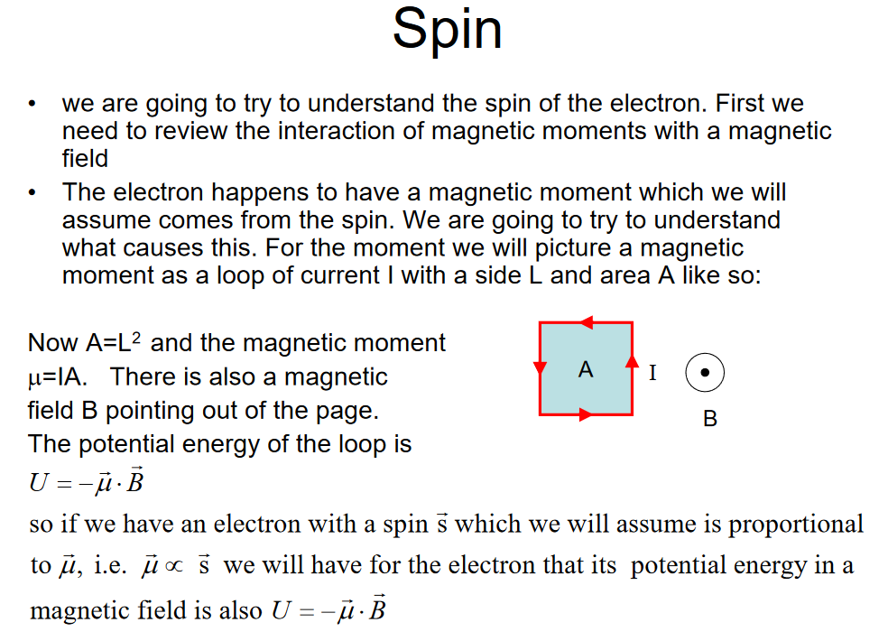
Quantum entanglement & Quantum Computing
1. Stern-Gerlach Experiment

Slide 5
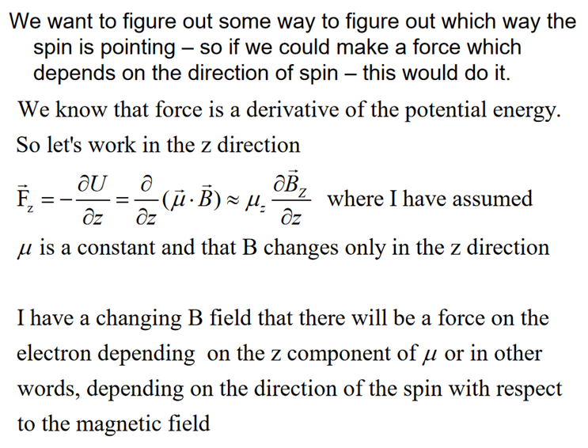
Quantum entanglement & Quantum Computing
1. Stern-Gerlach Experiment

Slide 6
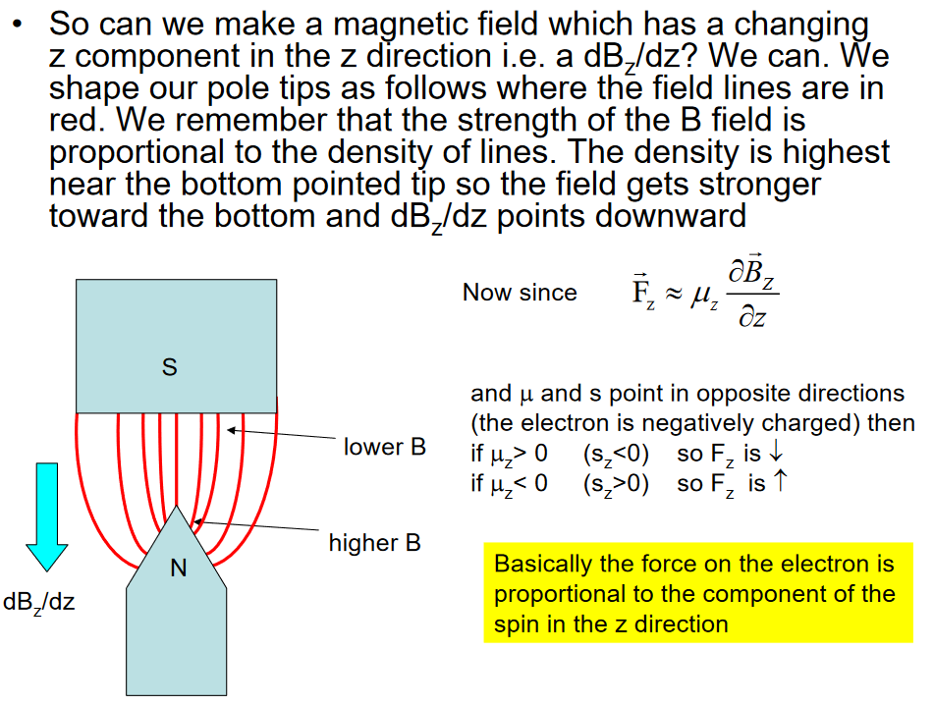
Quantum entanglement & Quantum Computing
1. Stern-Gerlach Experiment

Slide 7
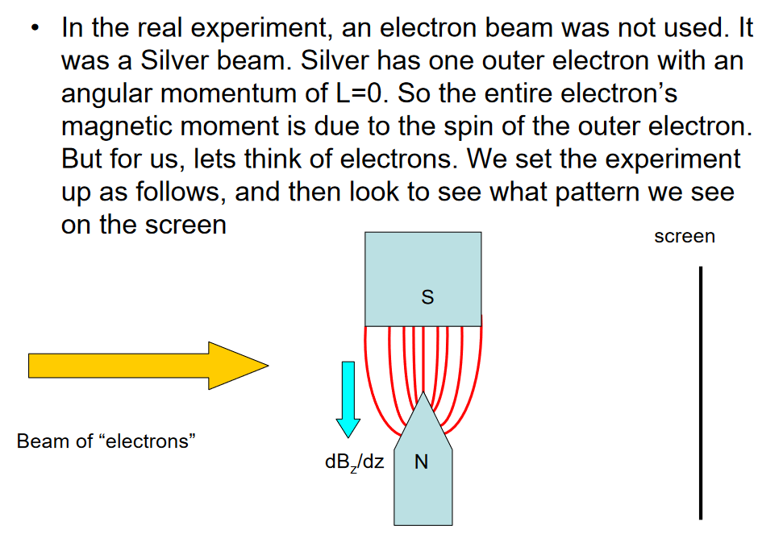
Quantum entanglement & Quantum Computing
1. Stern-Gerlach Experiment

Slide 8
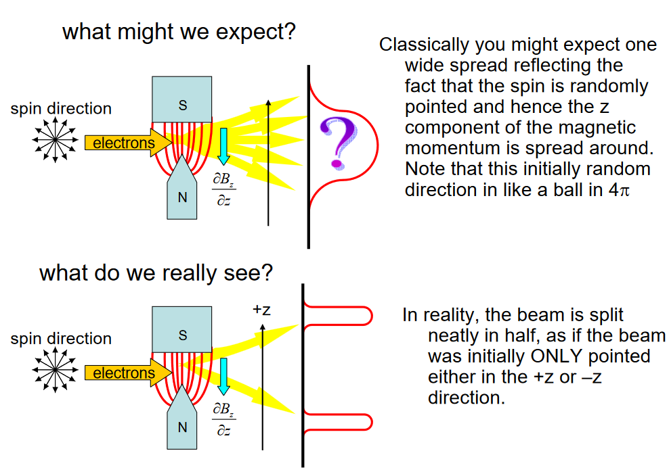
Quantum entanglement & Quantum Computing
1. Stern-Gerlach Experiment

Slide 9
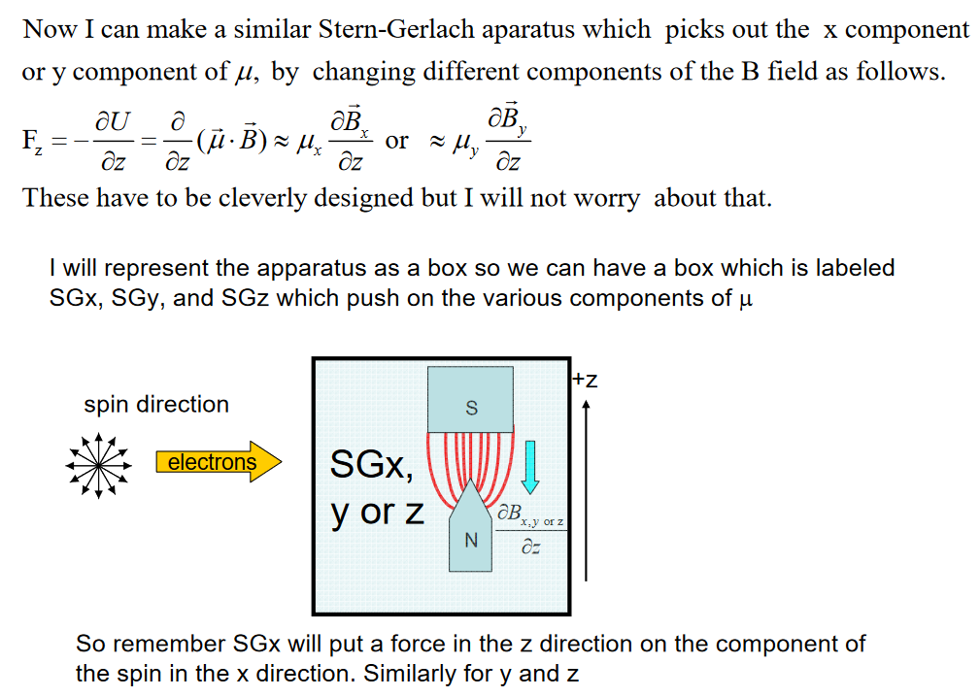
Quantum entanglement & Quantum Computing
1. Stern-Gerlach Experiment

Slide 10
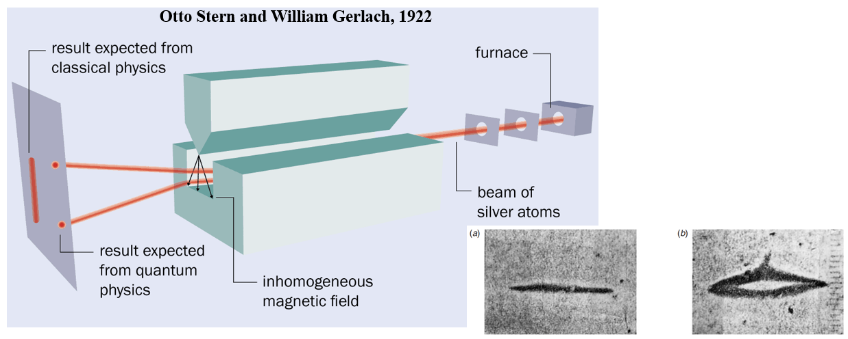
Quantum entanglement & Quantum Computing
1. Stern-Gerlach Experiment

Slide 11
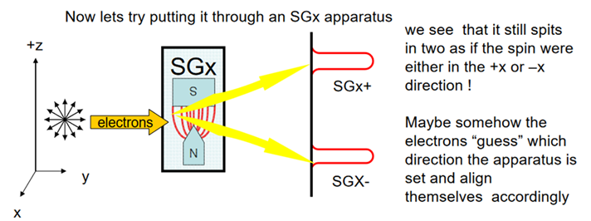
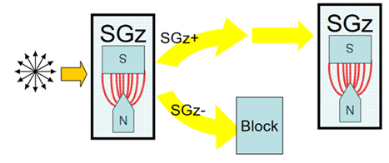
Quantum entanglement & Quantum Computing
1. Stern-Gerlach Experiment

Slide 12
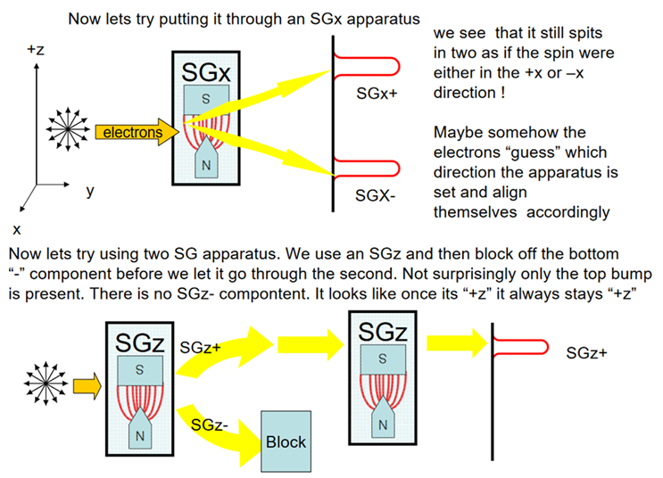
Quantum entanglement & Quantum Computing
1. Stern-Gerlach Experiment

Slide 13
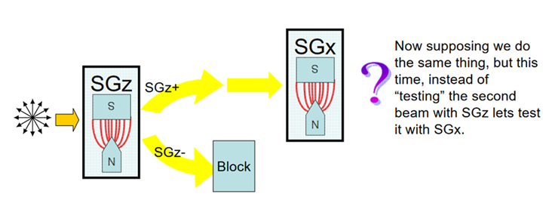
Quantum entanglement & Quantum Computing
1. Stern-Gerlach Experiment

Slide 14
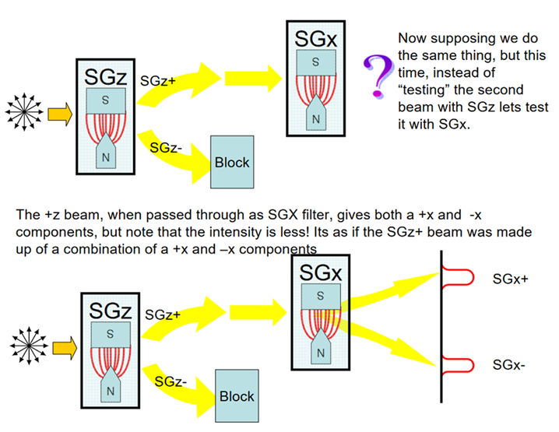
Quantum entanglement & Quantum Computing
1. Stern-Gerlach Experiment

Slide 15
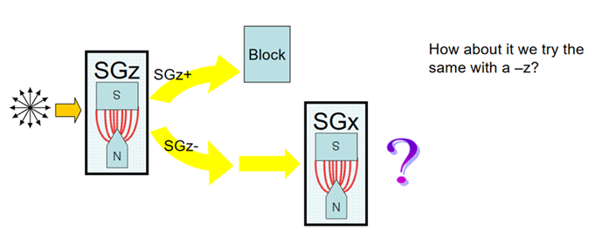
Quantum entanglement & Quantum Computing
1. Stern-Gerlach Experiment

Slide 16
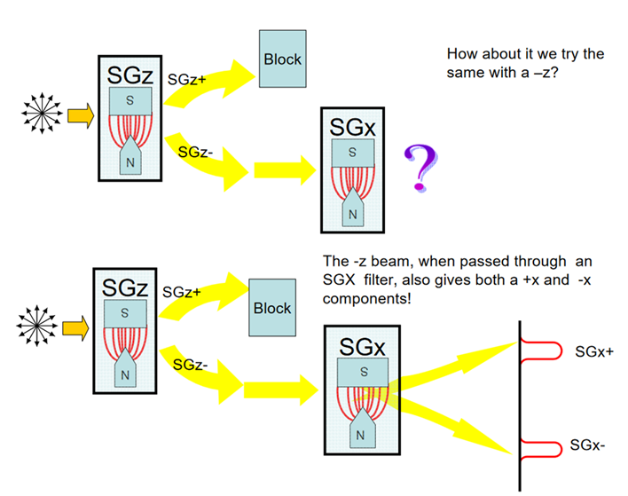
Quantum entanglement & Quantum Computing
1. Stern-Gerlach Experiment

Slide 17
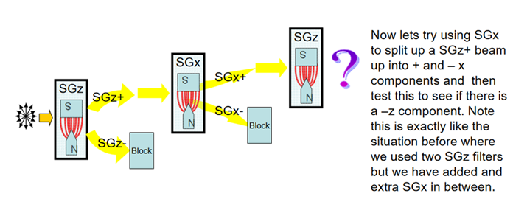
Quantum entanglement & Quantum Computing
1. Stern-Gerlach Experiment

Slide 18
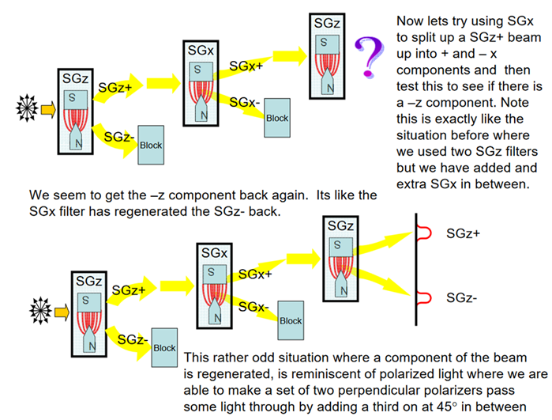
Quantum entanglement & Quantum Computing
1. Stern-Gerlach Experiment

Slide 19
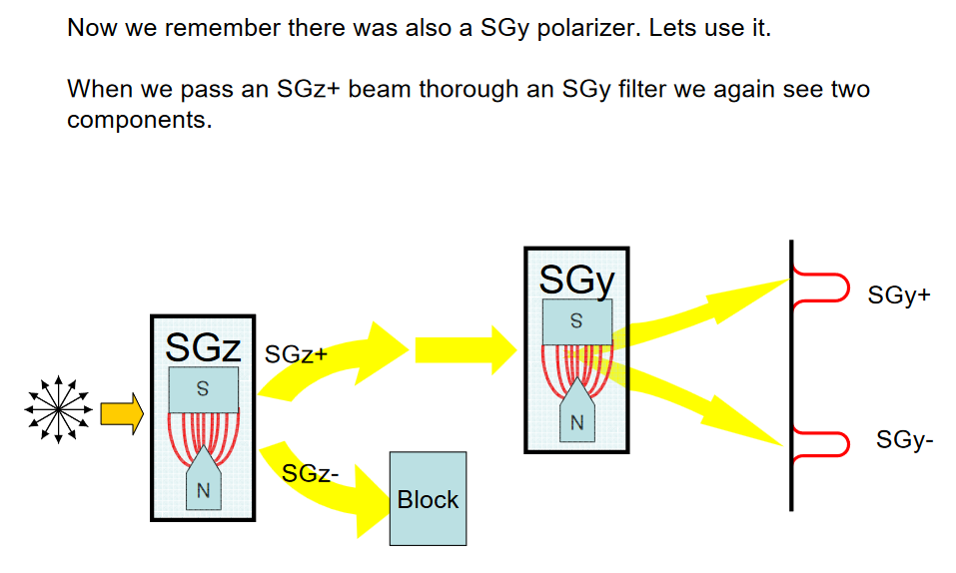
Quantum entanglement & Quantum Computing
1. Stern-Gerlach Experiment

Slide 20
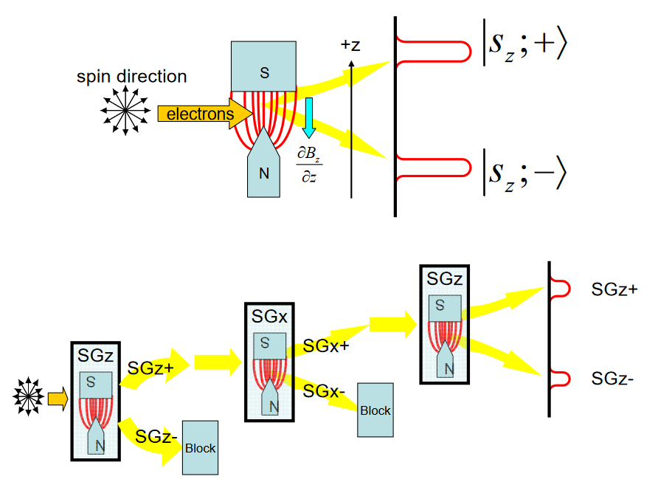
Quantum entanglement & Quantum Computing
1. Stern-Gerlach Experiment

Slide 21
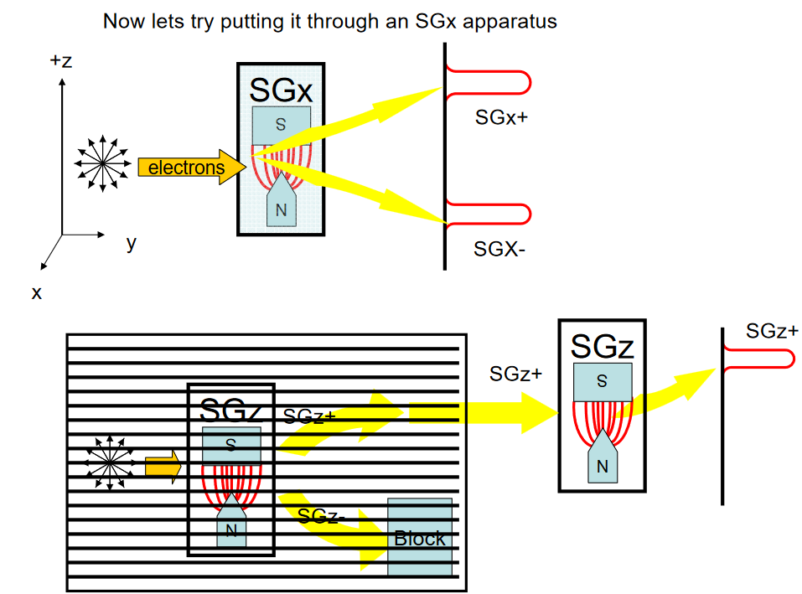
Quantum entanglement & Quantum Computing
1. Stern-Gerlach Experiment

Slide 22
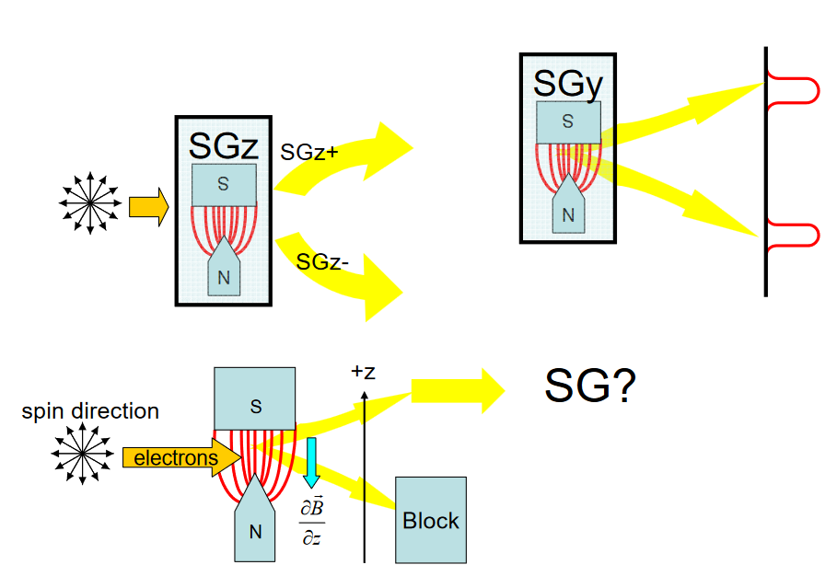
Quantum entanglement & Quantum Computing
1. Stern-Gerlach Experiment

Slide 23
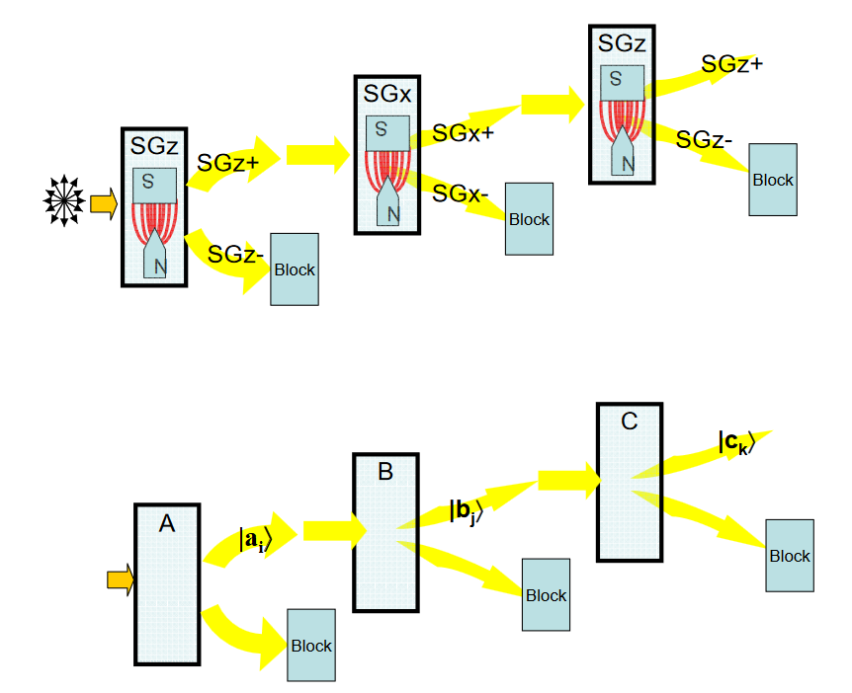
Quantum entanglement & Quantum Computing
1. Stern-Gerlach Experiment

Slide 24
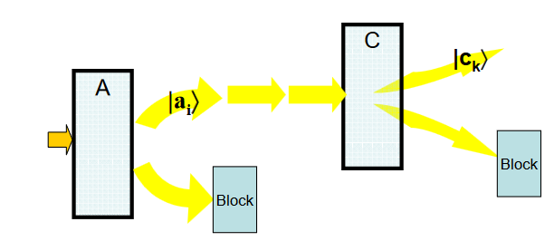
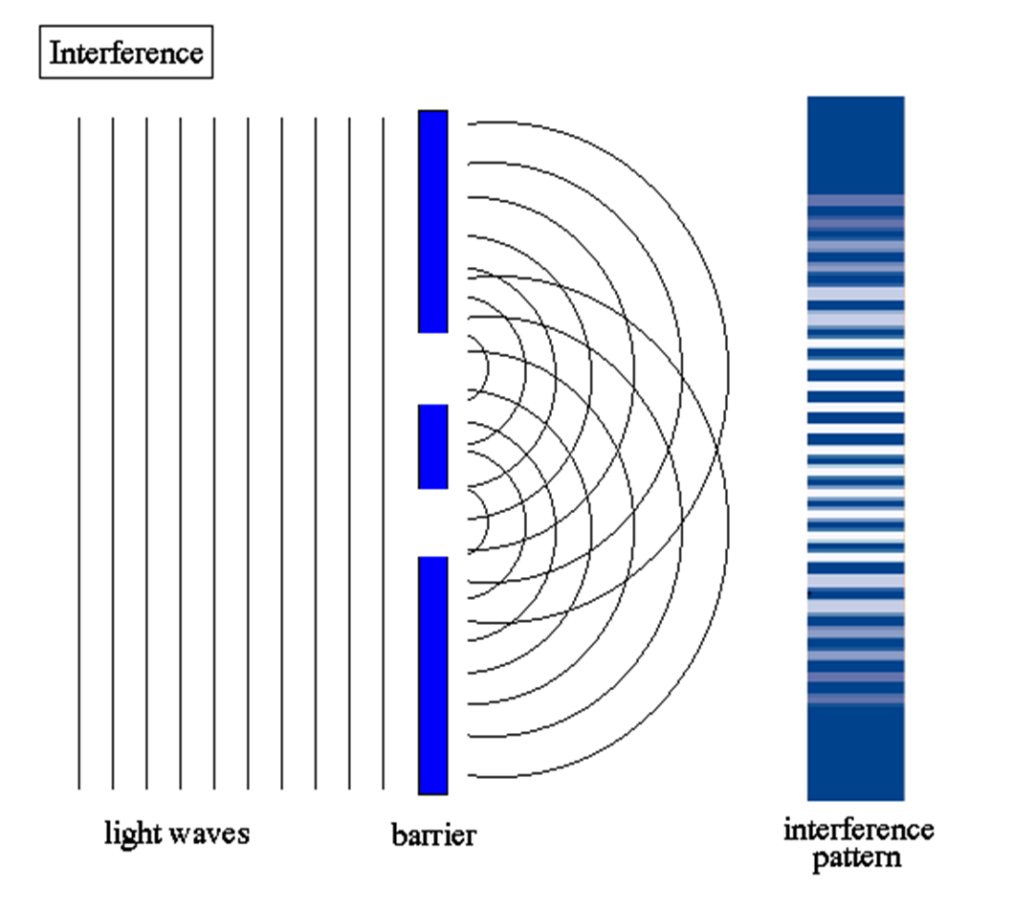
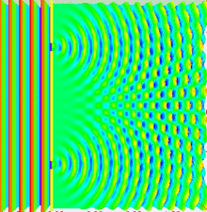
Quantum entanglement & Quantum Computing
1. Stern-Gerlach Experiment

Slide 25
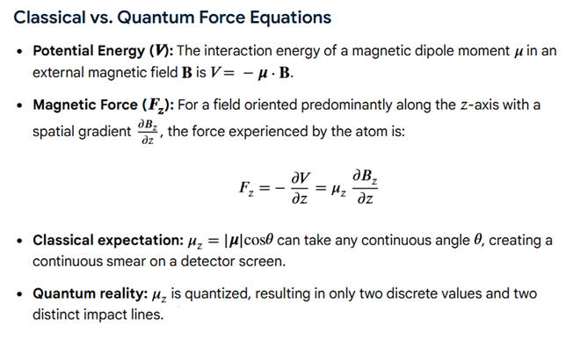
Quantum entanglement & Quantum Computing
1. Stern-Gerlach Experiment: Whats Quantum in it?

Slide 26
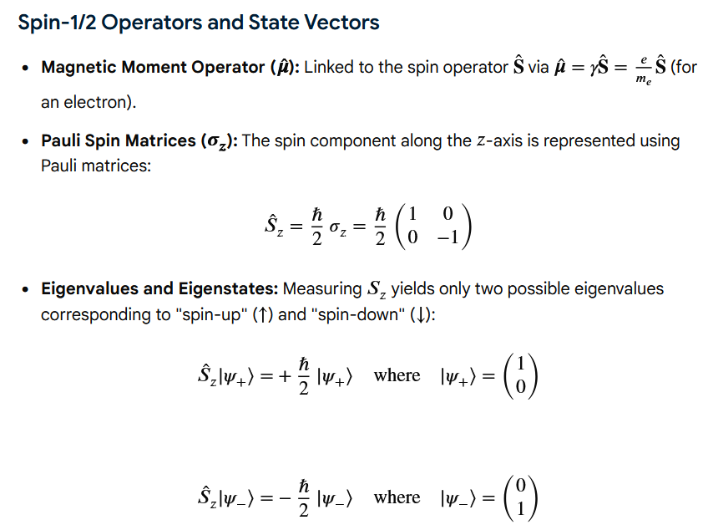
Quantum entanglement & Quantum Computing
1. Stern-Gerlach Experiment: Whats Quantum in it?

Slide 27
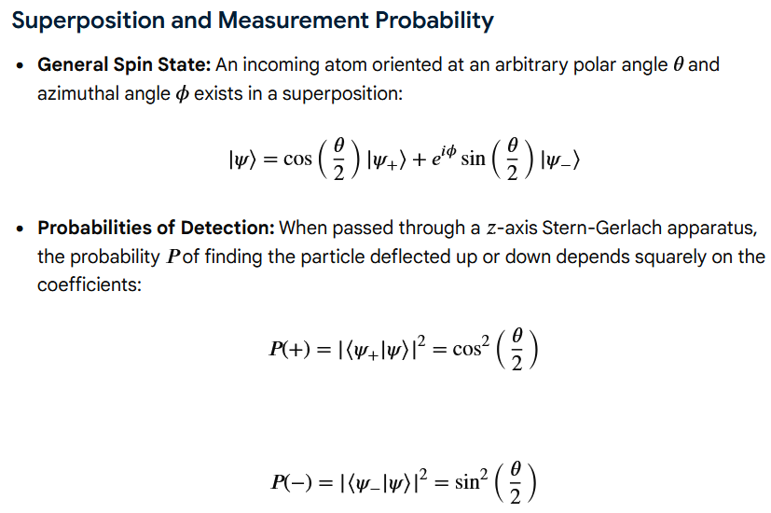
Quantum entanglement & Quantum Computing
1. Stern-Gerlach Experiment: Whats Quantum in it?

Slide 28
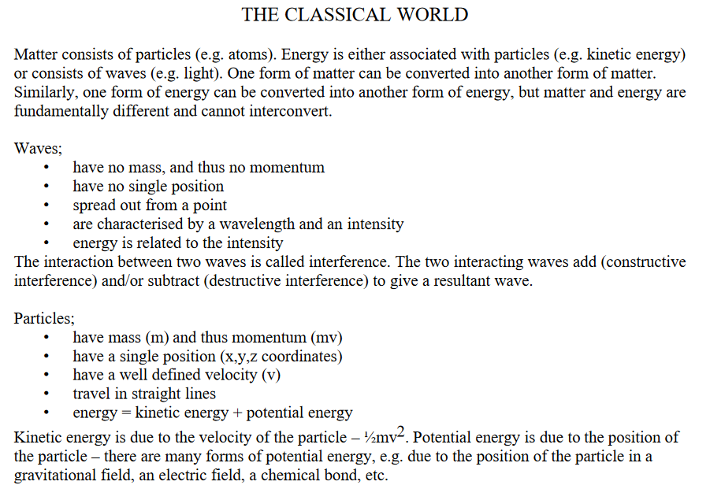
Quantum entanglement & Quantum Computing
2. Classical and Quantum Mechanics

Slide 29
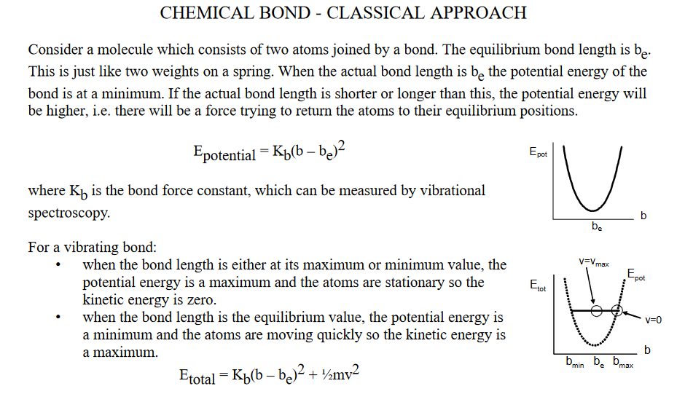
Quantum entanglement & Quantum Computing
2. Classical and Quantum Mechanics

Slide 30
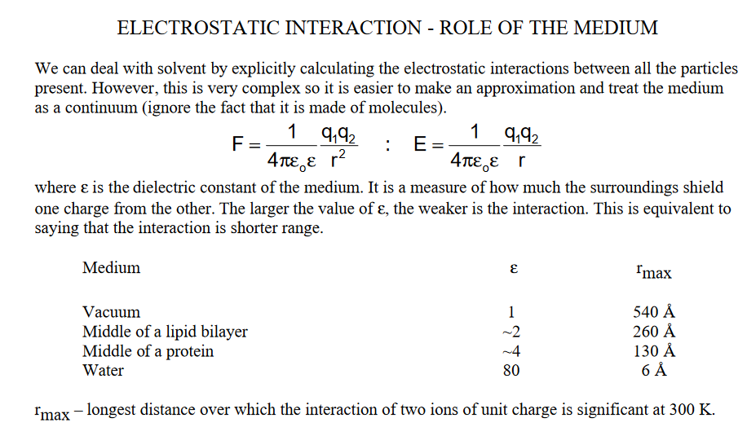
Quantum entanglement & Quantum Computing
2. Classical and Quantum Mechanics

Slide 31
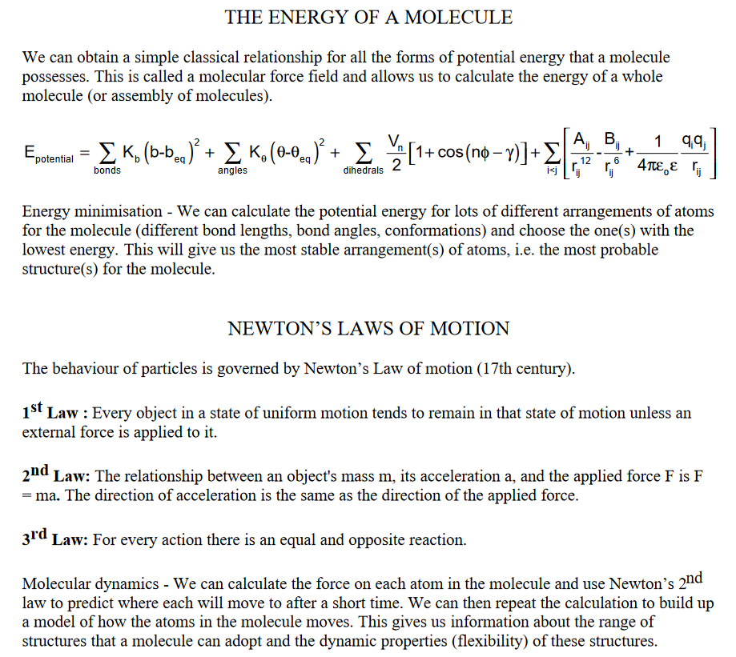
Quantum entanglement & Quantum Computing
2. Classical and Quantum Mechanics

Slide 32
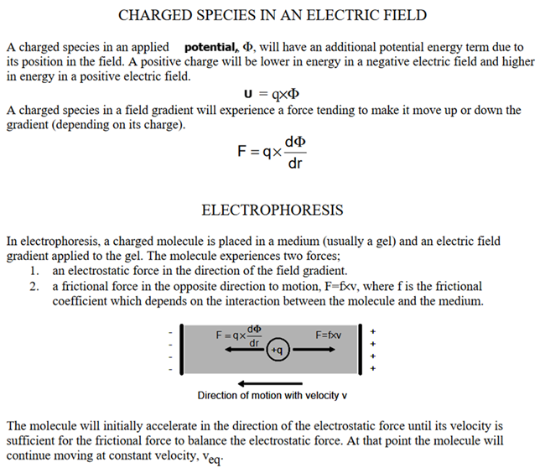
Quantum entanglement & Quantum Computing
2. Classical and Quantum Mechanics

Slide 33
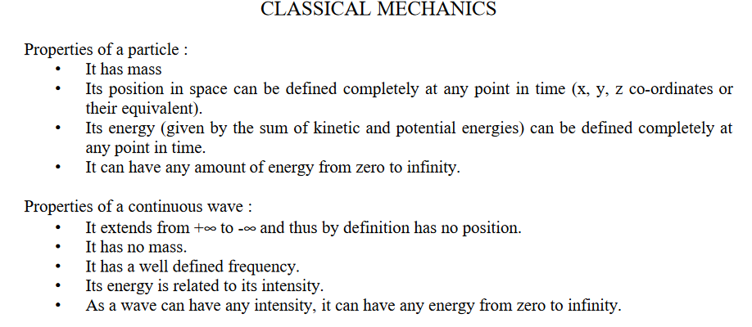
Quantum entanglement & Quantum Computing
2. Classical and Quantum Mechanics

Slide 34
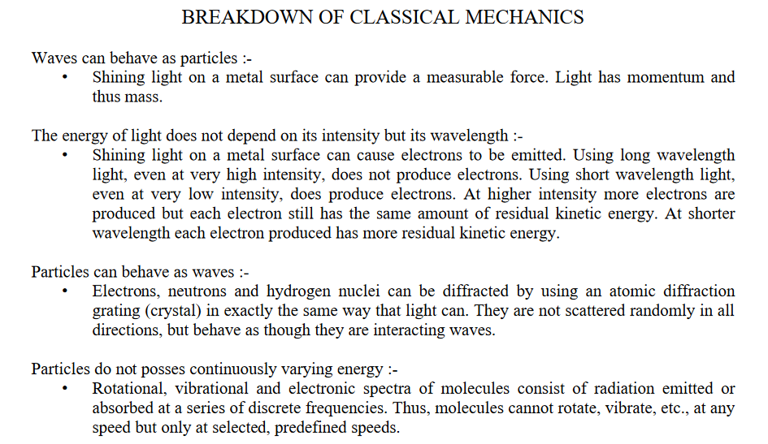
Quantum entanglement & Quantum Computing
2. Classical and Quantum Mechanics

Slide 35
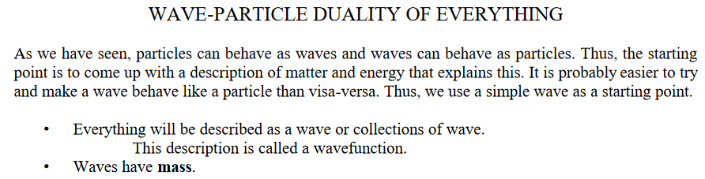
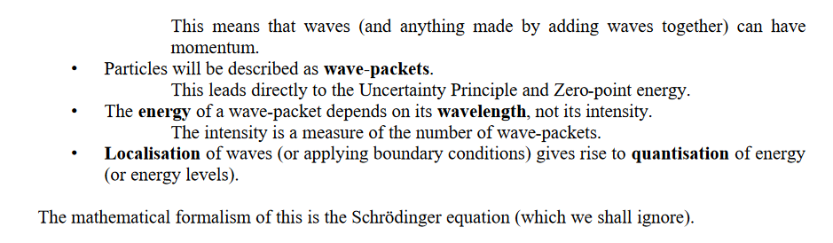
Quantum entanglement & Quantum Computing
2. Classical and Quantum Mechanics

Slide 36
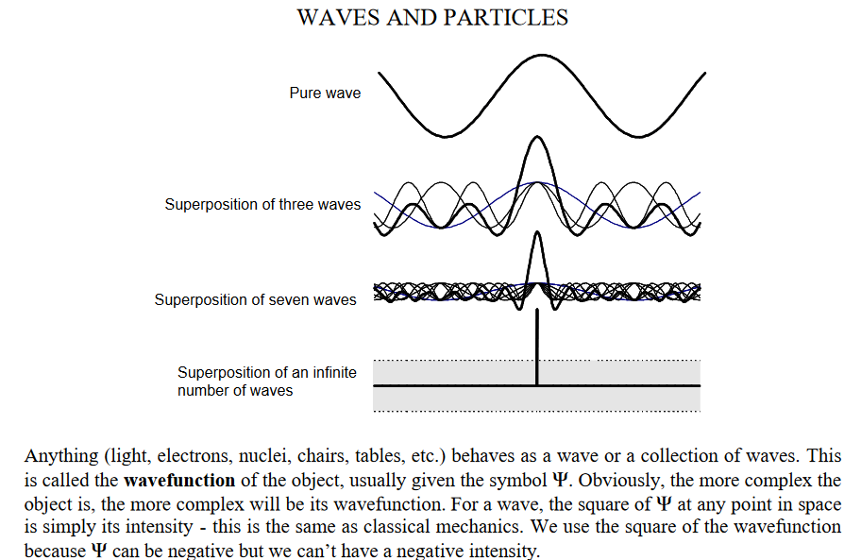
Quantum entanglement & Quantum Computing
2. Classical and Quantum Mechanics

Slide 37
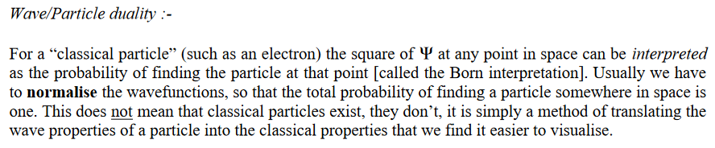
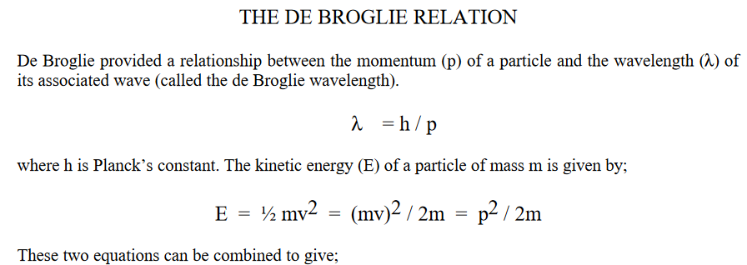

Quantum entanglement & Quantum Computing
2. Classical and Quantum Mechanics

Slide 38
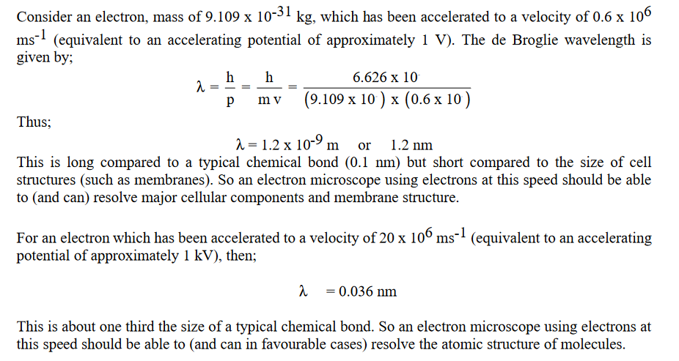
Quantum entanglement & Quantum Computing
2. Classical and Quantum Mechanics

Slide 39
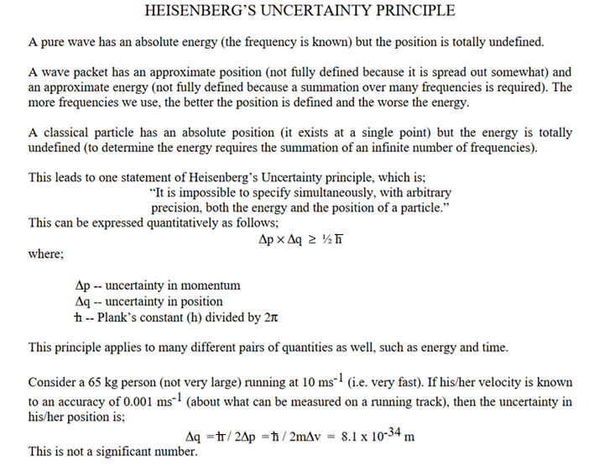
Quantum entanglement & Quantum Computing
2. Classical and Quantum Mechanics

Slide 40
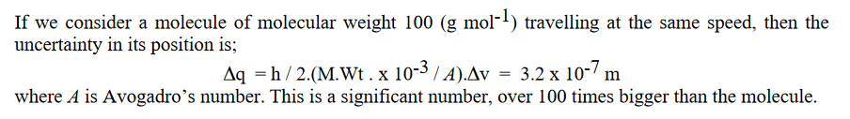
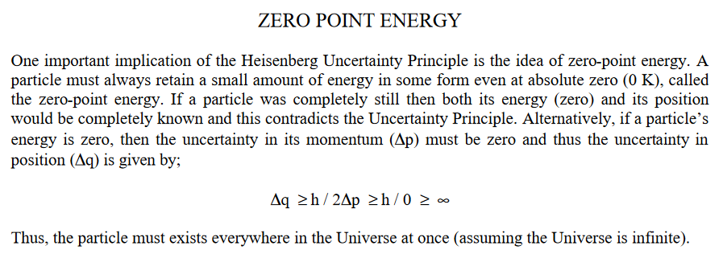
Quantum entanglement & Quantum Computing
2. Classical and Quantum Mechanics

Slide 41
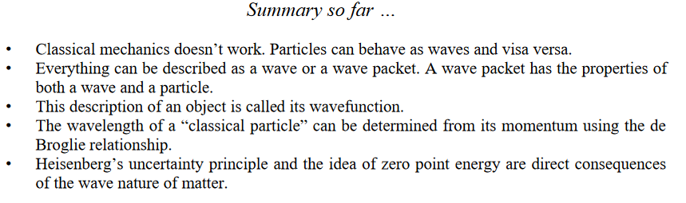
Quantum entanglement & Quantum Computing
2. Classical and Quantum Mechanics

Slide 42
THANK YOU
Dr. Kaustav Bhowmick
Department of Electronics & Communication
Engineering
kaustavbhowmick@pes.edu

