Slide 1

Quantum Entanglement and Quantum Computing
Dr. Kaustav Bhowmick
Electronics & Communication
Engineering

Slide 2


Quantum Entanglement and Quantum Computing
Introduction to Topic
Dr. Kaustav Bhowmick
Electronics & Communication Engineering
Source: Google images

Slide 3
Quantum entanglement & Quantum Computing
Contents
Hilbert Space
Quantum Algebra I

Slide 4
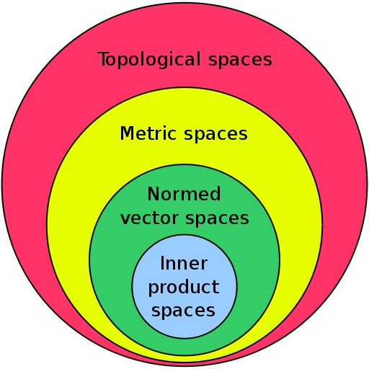
Quantum entanglement & Quantum Computing
1. Hilbert space

Slide 5
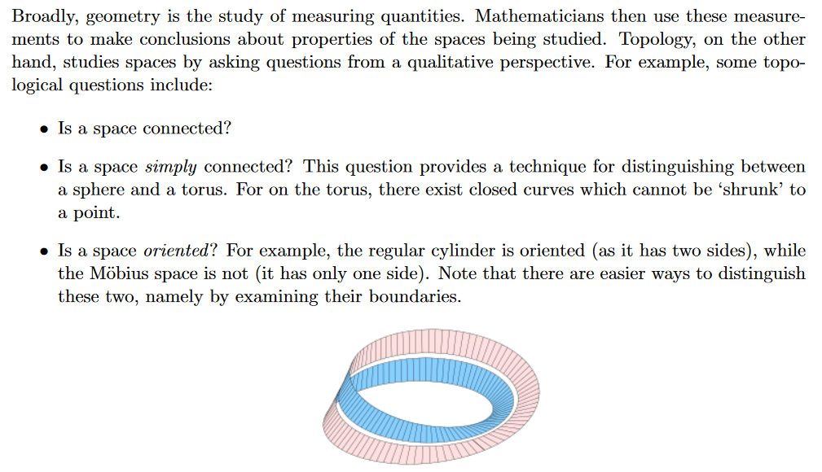
Quantum entanglement & Quantum Computing
1. Hilbert space: topological space and metric space

Slide 6
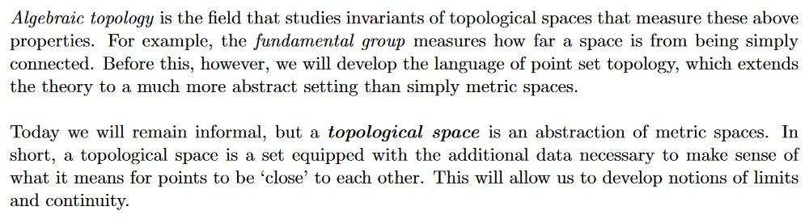
Quantum entanglement & Quantum Computing
1. Hilbert space: topological space and metric space

Slide 7
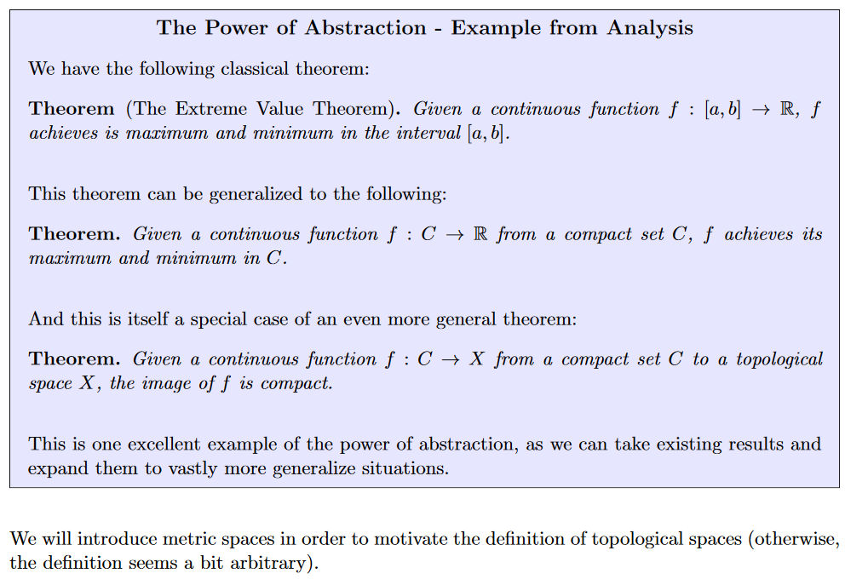
Quantum entanglement & Quantum Computing
1. Hilbert space: topological space and metric space

Slide 8
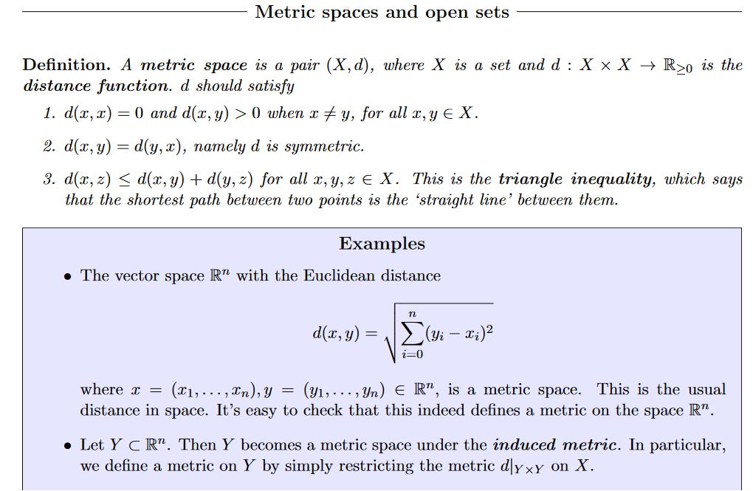
Quantum entanglement & Quantum Computing
1. Hilbert space: topological space and metric space

Slide 9
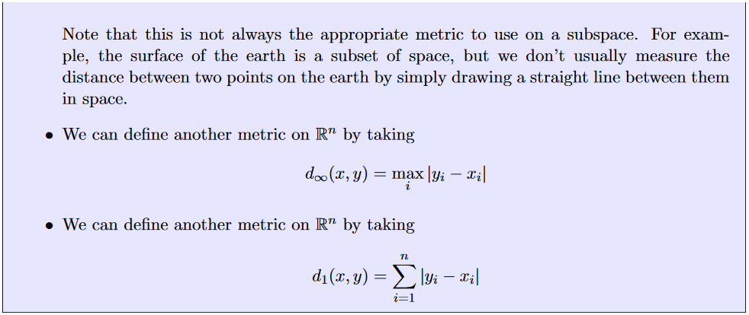
Quantum entanglement & Quantum Computing
1. Hilbert space: topological space and metric space

Slide 10
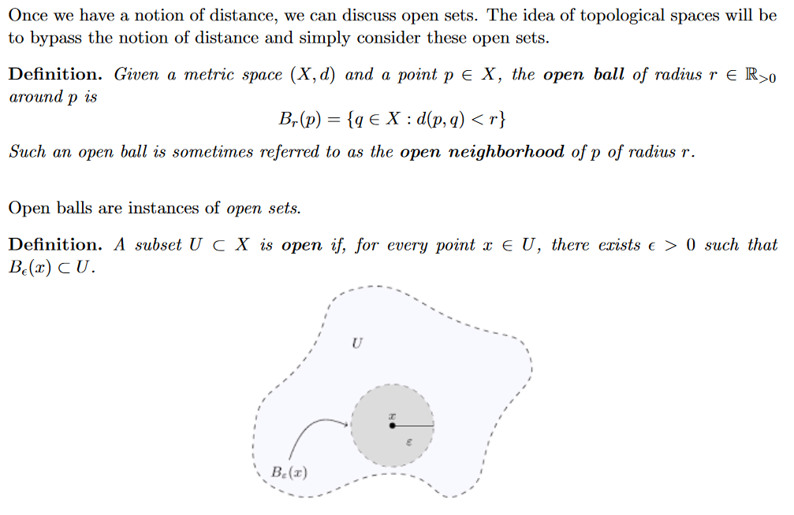
Quantum entanglement & Quantum Computing
1. Hilbert space: topological space and metric space

Slide 11
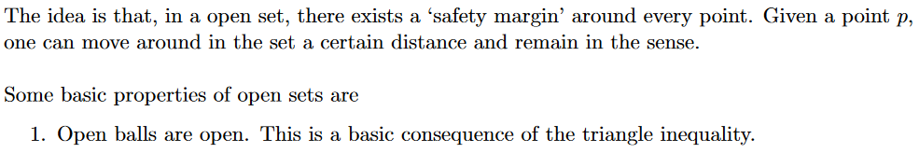
Quantum entanglement & Quantum Computing
1. Hilbert space: topological space and metric space

Slide 12
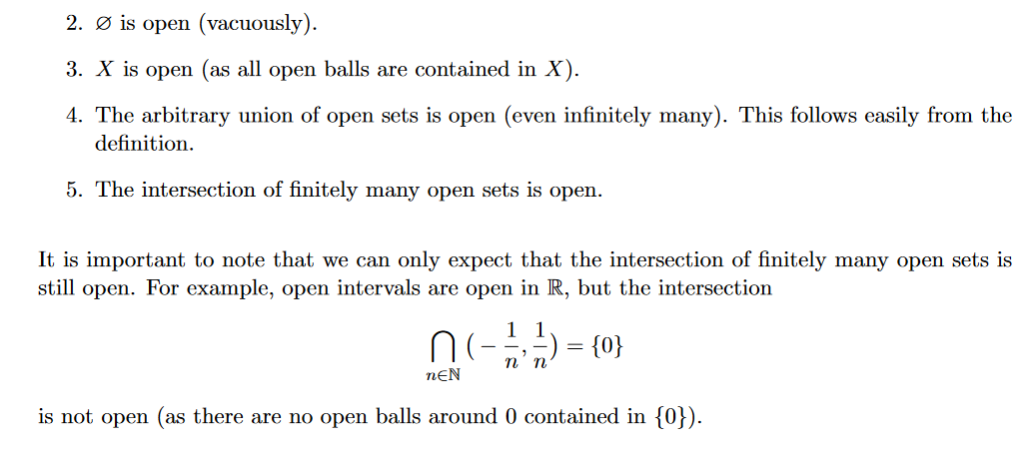
Quantum entanglement & Quantum Computing
1. Hilbert space: topological space and metric space

Slide 13
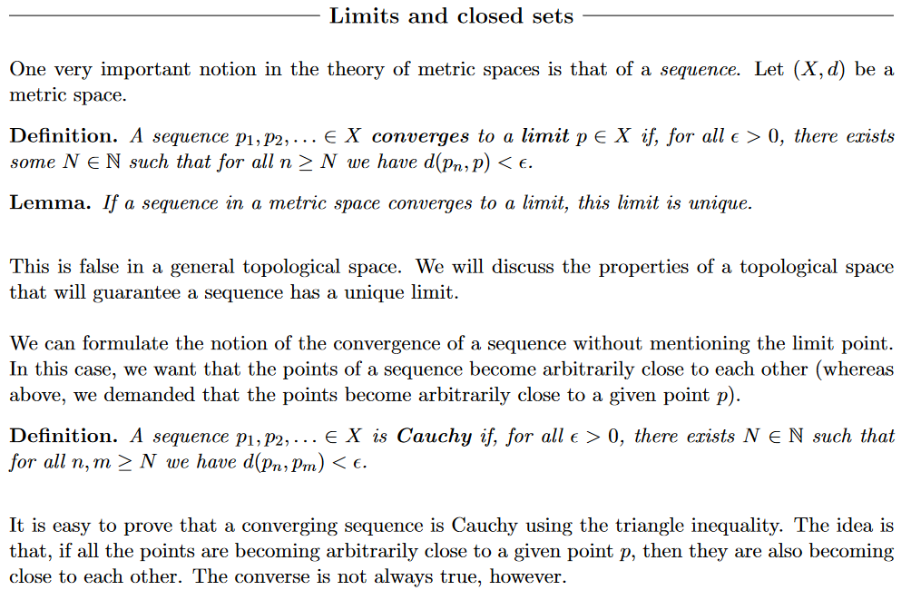
Quantum entanglement & Quantum Computing
1. Hilbert space: topological space and metric space

Slide 14
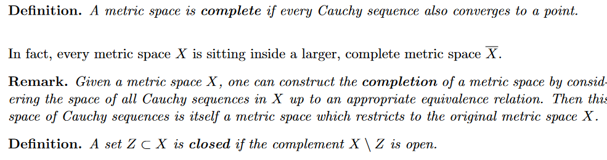
Quantum entanglement & Quantum Computing
1. Hilbert space: topological space and metric space

Slide 15
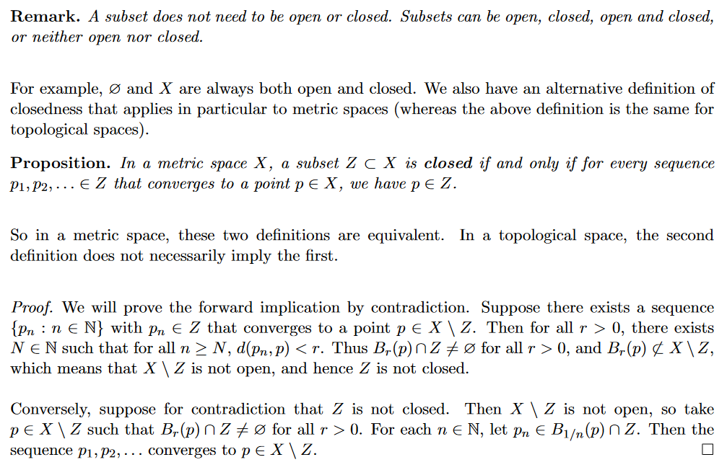
Quantum entanglement & Quantum Computing
1. Hilbert space: topological space and metric space

Slide 16
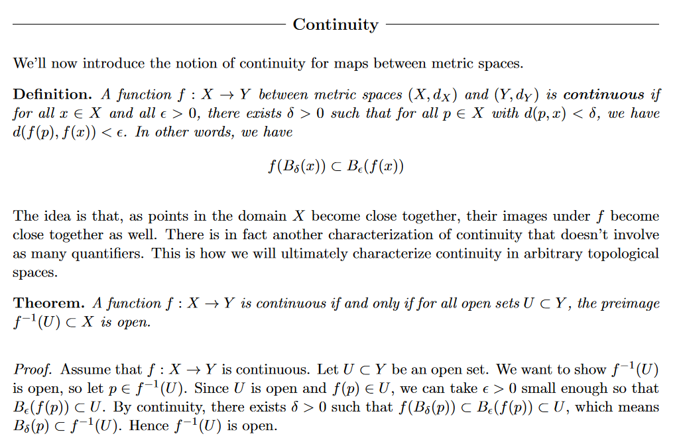
Quantum entanglement & Quantum Computing
1. Hilbert space: topological space and metric space

Slide 17
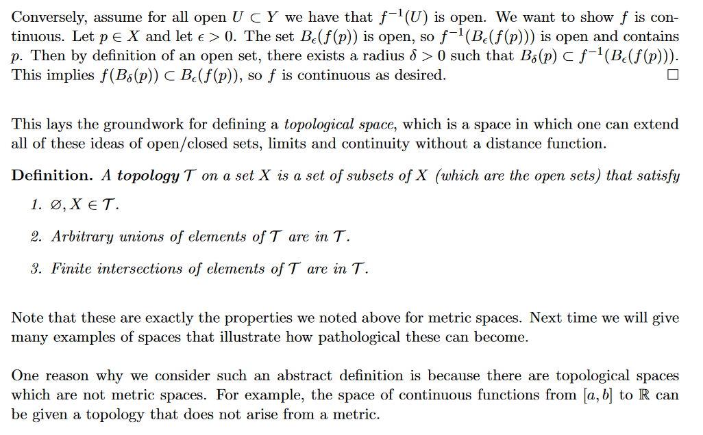
Quantum entanglement & Quantum Computing
1. Hilbert space: topological space and metric space

Slide 18
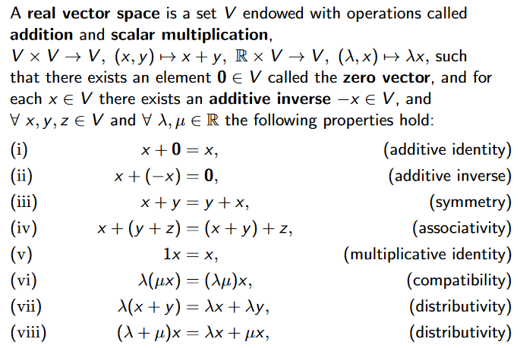
Quantum entanglement & Quantum Computing
1. Hilbert space: Vector space, Normed space, Banach space

Slide 19
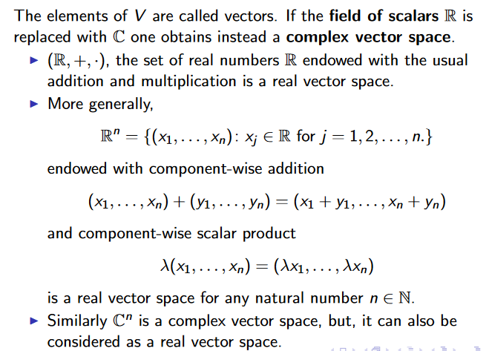
Quantum entanglement & Quantum Computing
1. Hilbert space: Vector space, Normed space, Banach space

Slide 20
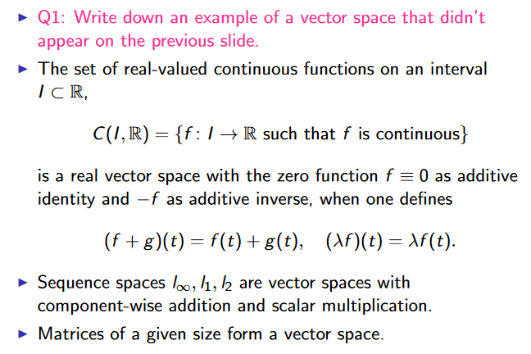
Quantum entanglement & Quantum Computing
1. Hilbert space: Vector space, Normed space, Banach space

Slide 21
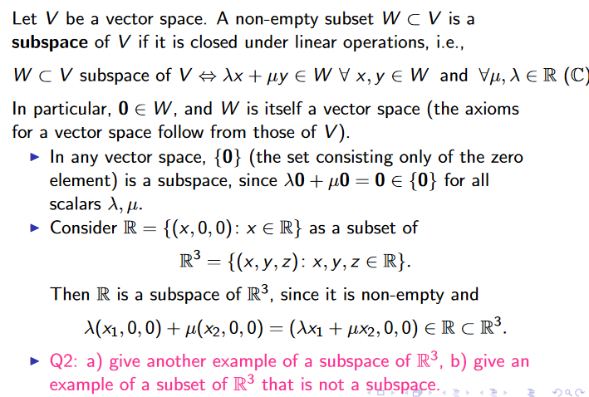
Quantum entanglement & Quantum Computing
1. Hilbert space: Vector space, Normed space, Banach space

Slide 22
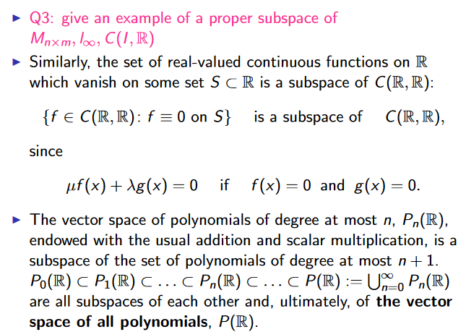
Quantum entanglement & Quantum Computing
1. Hilbert space: Vector space, Normed space, Banach space

Slide 23
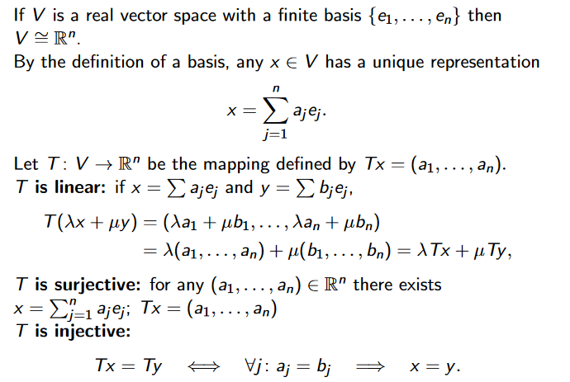
Quantum entanglement & Quantum Computing
1. Hilbert space: Vector space, Normed space, Banach space

Slide 24
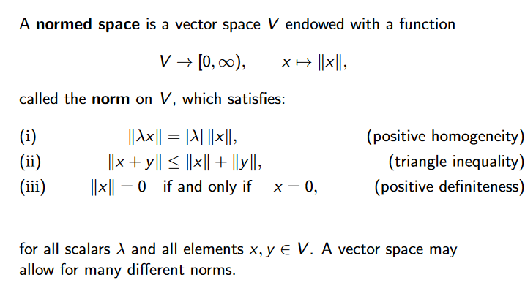
Quantum entanglement & Quantum Computing
1. Hilbert space: Vector space, Normed space, Banach space

Slide 25
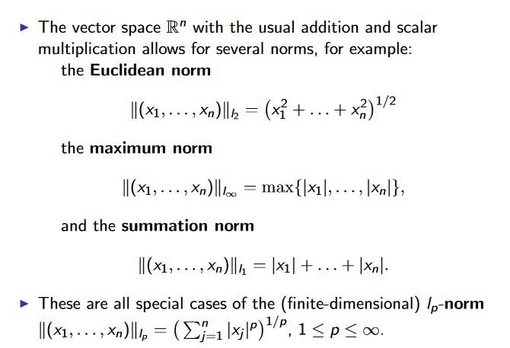
Quantum entanglement & Quantum Computing
1. Hilbert space: Vector space, Normed space, Banach space

Slide 26
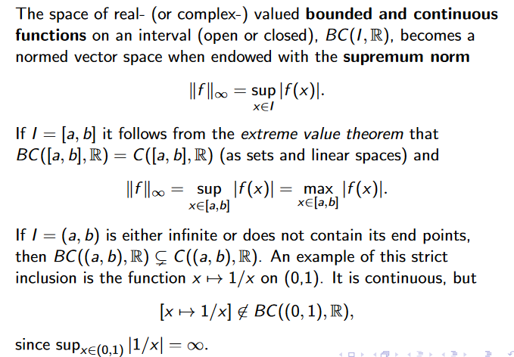
Quantum entanglement & Quantum Computing
1. Hilbert space: Vector space, Normed space, Banach space

Slide 27
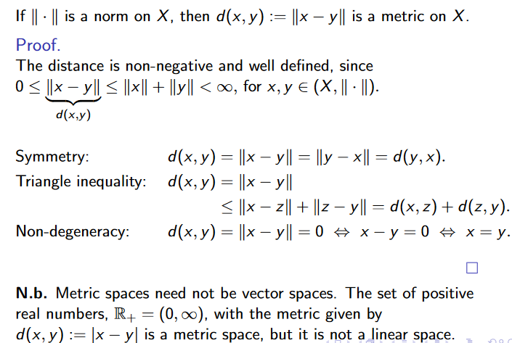
Quantum entanglement & Quantum Computing
1. Hilbert space: Vector space, Normed space, Banach space

Slide 28
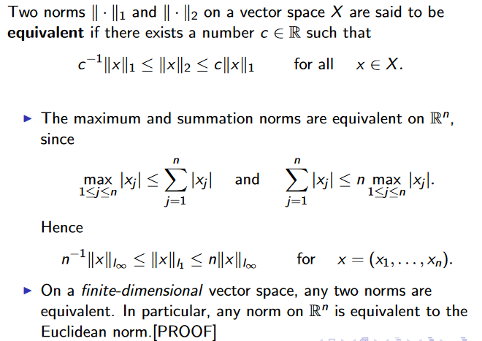
Quantum entanglement & Quantum Computing
1. Hilbert space: Vector space, Normed space, Banach space

Slide 29
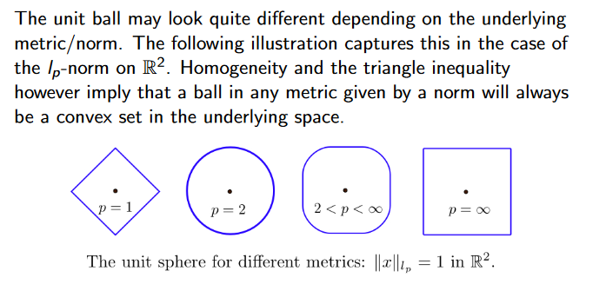
Quantum entanglement & Quantum Computing
1. Hilbert space: Vector space, Normed space, Banach space

Slide 30
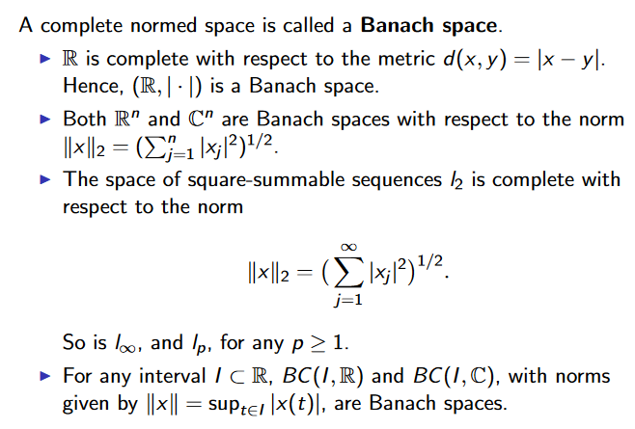
Quantum entanglement & Quantum Computing
1. Hilbert space: Vector space, Normed space, Banach space

Slide 31
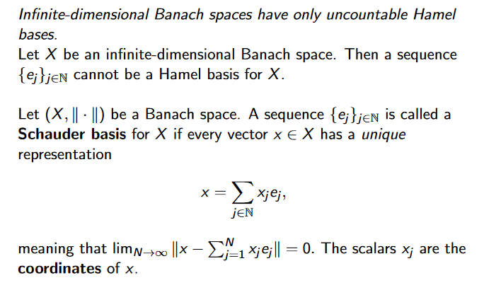
Quantum entanglement & Quantum Computing
1. Hilbert space: Vector space, Normed space, Banach space

Slide 32
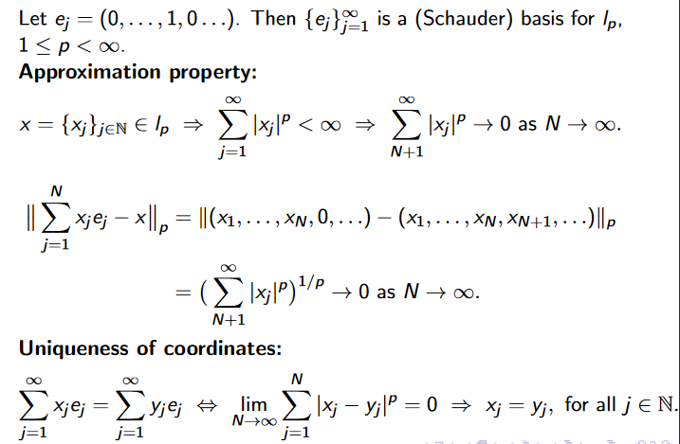
Quantum entanglement & Quantum Computing
1. Hilbert space: Vector space, Normed space, Banach space

Slide 33
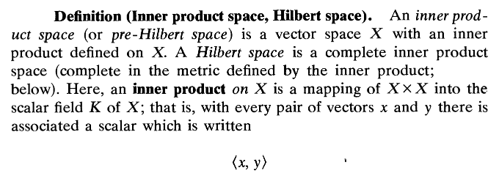
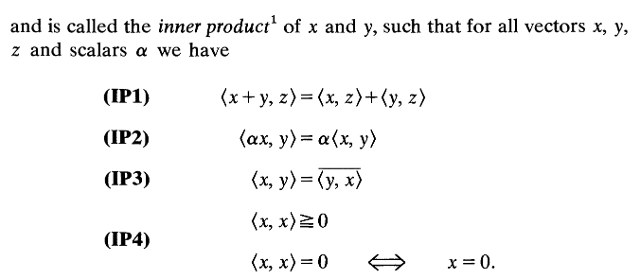
Quantum entanglement & Quantum Computing
1. Hilbert space: Inner product space, Hilbert space

Slide 34
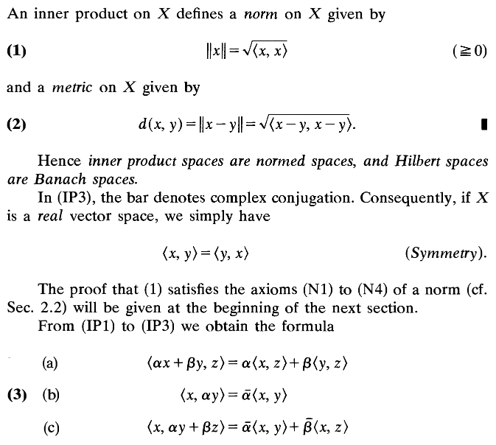
Quantum entanglement & Quantum Computing
1. Hilbert space: Inner product space, Hilbert space

Slide 35
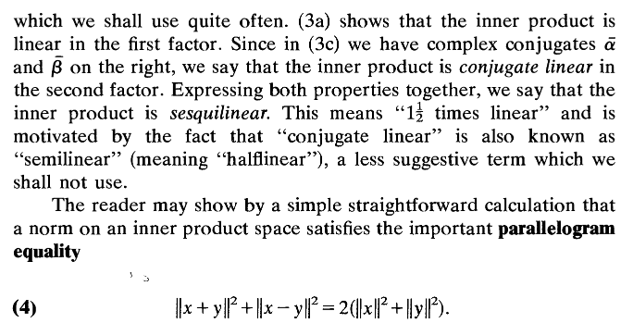
Quantum entanglement & Quantum Computing
1. Hilbert space: Inner product space, Hilbert space

Slide 36
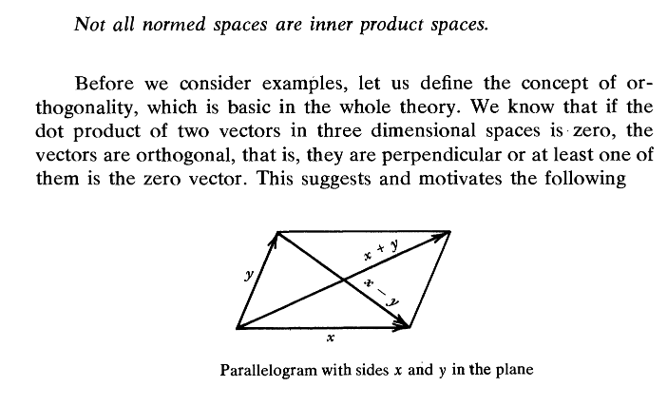
Quantum entanglement & Quantum Computing
1. Hilbert space: Inner product space, Hilbert space

Slide 37
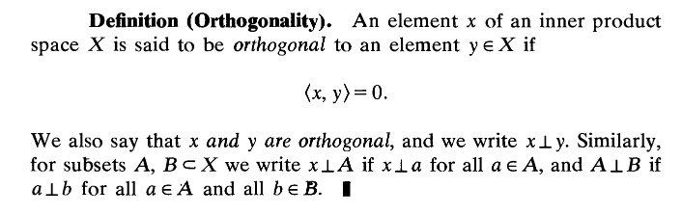
Quantum entanglement & Quantum Computing
1. Hilbert space: Inner product space, Hilbert space

Slide 38

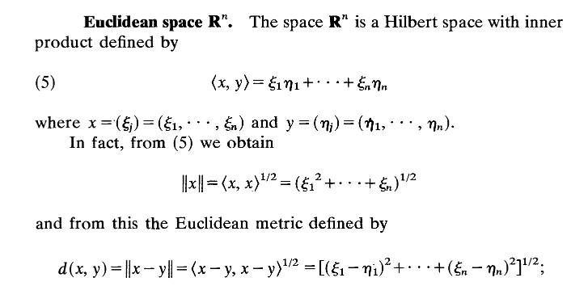
Quantum entanglement & Quantum Computing
1. Hilbert space: Inner product space, Hilbert space

Slide 39
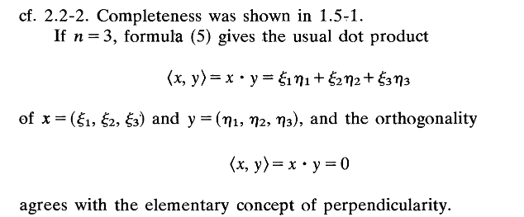
Quantum entanglement & Quantum Computing
1. Hilbert space: Inner product space, Hilbert space

Slide 40
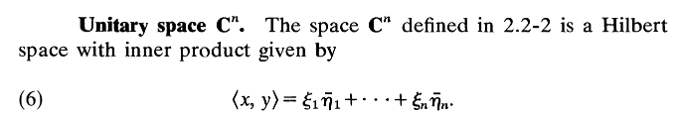
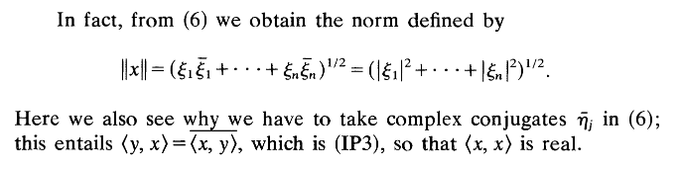
Quantum entanglement & Quantum Computing
1. Hilbert space: Inner product space, Hilbert space

Slide 41
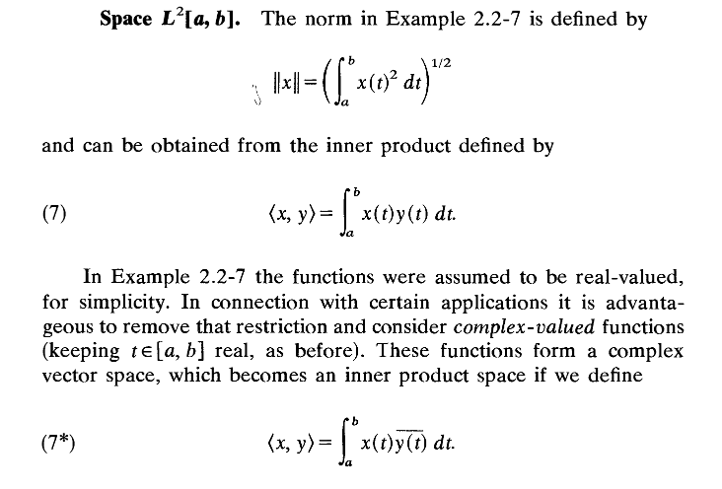
Quantum entanglement & Quantum Computing
1. Hilbert space: Inner product space, Hilbert space

Slide 42
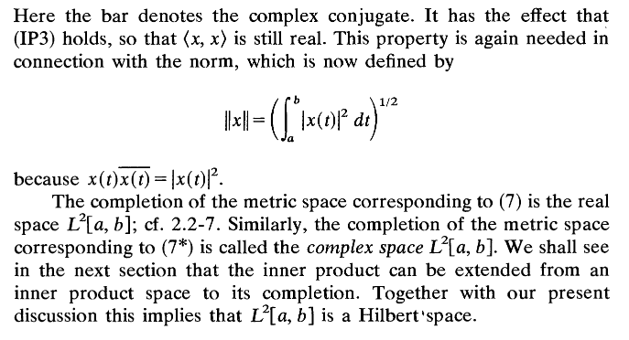
Quantum entanglement & Quantum Computing
1. Hilbert space: Inner product space, Hilbert space

Slide 43
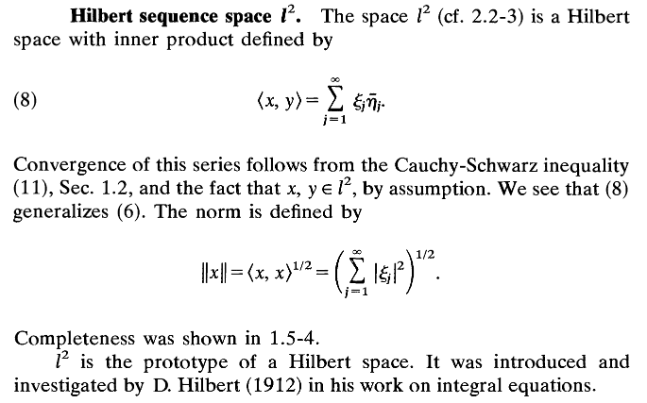
Quantum entanglement & Quantum Computing
1. Hilbert space: Inner product space, Hilbert space

Slide 44
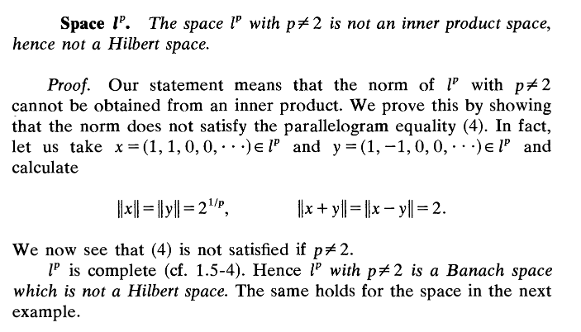
Quantum entanglement & Quantum Computing
1. Hilbert space: Inner product space, Hilbert space

Slide 45

Quantum entanglement & Quantum Computing
1. Hilbert space: Inner product space, Hilbert space

Slide 46
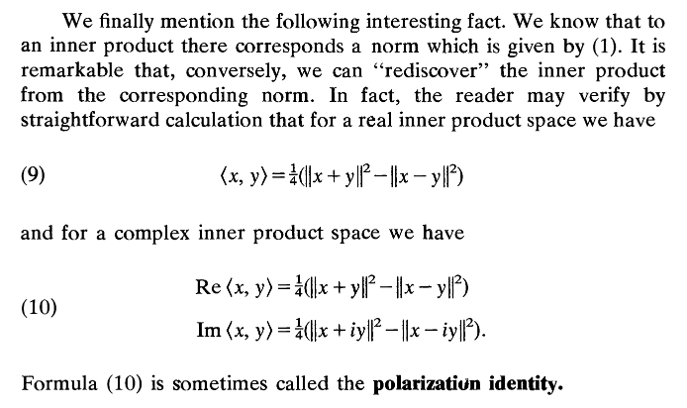
Quantum entanglement & Quantum Computing
1. Hilbert space: Inner product space, Hilbert space

Slide 47

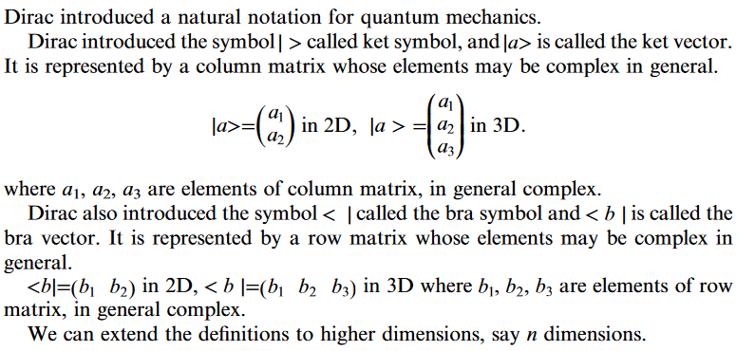
Quantum entanglement & Quantum Computing
2. Quantum Algebra I

Slide 48
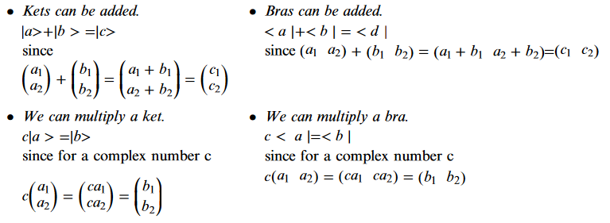
Quantum entanglement & Quantum Computing
2. Quantum Algebra I

Slide 49

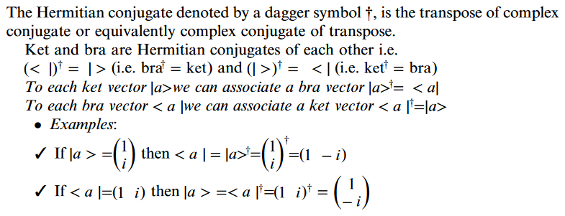
Quantum entanglement & Quantum Computing
2. Quantum Algebra I

Slide 50
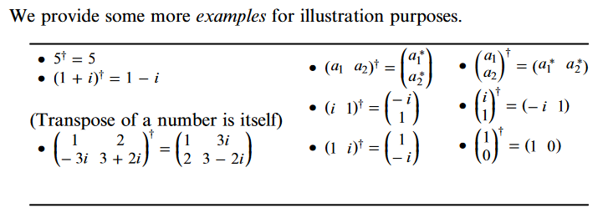
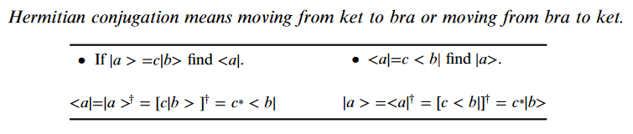
Quantum entanglement & Quantum Computing
2. Quantum Algebra I

Slide 51
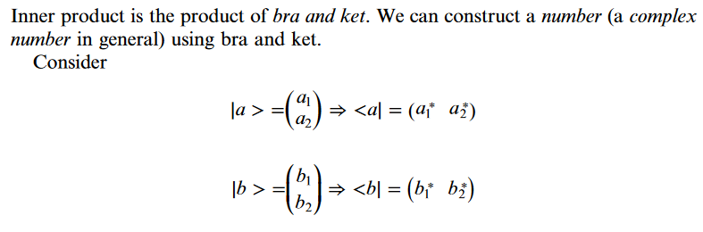
Quantum entanglement & Quantum Computing
2. Quantum Algebra I

Slide 52

Quantum entanglement & Quantum Computing
2. Quantum Algebra I

Slide 53

Quantum entanglement & Quantum Computing
2. Quantum Algebra I

Slide 54


Quantum entanglement & Quantum Computing
2. Quantum Algebra I

Slide 55


Quantum entanglement & Quantum Computing
2. Quantum Algebra I

Slide 56


Quantum entanglement & Quantum Computing
2. Quantum Algebra I

Slide 57



Quantum entanglement & Quantum Computing
2. Quantum Algebra I

Slide 58



Quantum entanglement & Quantum Computing
2. Quantum Algebra I

Slide 59


Quantum entanglement & Quantum Computing
2. Quantum Algebra I

Slide 60

Quantum entanglement & Quantum Computing
2. Quantum Algebra I

Slide 61

Quantum entanglement & Quantum Computing
2. Quantum Algebra I

Slide 62
THANK YOU
Dr. Kaustav Bhowmick
Department of Electronics & Communication
Engineering
kaustavbhowmick@pes.edu

