Slide 1

Quantum Entanglement and Quantum Computing
Dr. Kaustav Bhowmick
Electronics & Communication
Engineering

Slide 2


Quantum Entanglement and Quantum Computing
Introduction to Topic
Dr. Kaustav Bhowmick
Electronics & Communication Engineering
Source: Google images

Slide 3
Quantum entanglement & Quantum Computing
Contents
Quantum maths III
Matrix forms of quantum systems

Slide 4
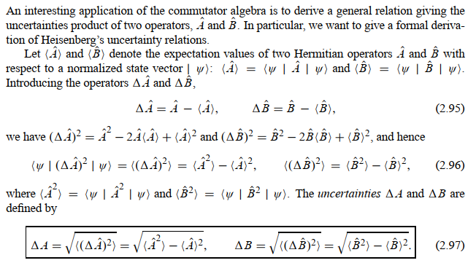
Quantum entanglement & Quantum Computing
1. Quantum maths III

Slide 5
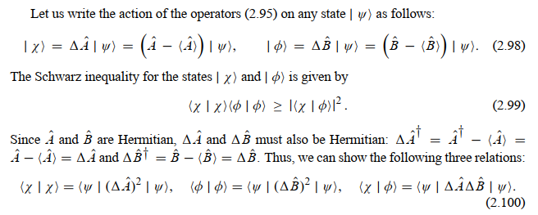
Quantum entanglement & Quantum Computing
1. Quantum maths III

Slide 6
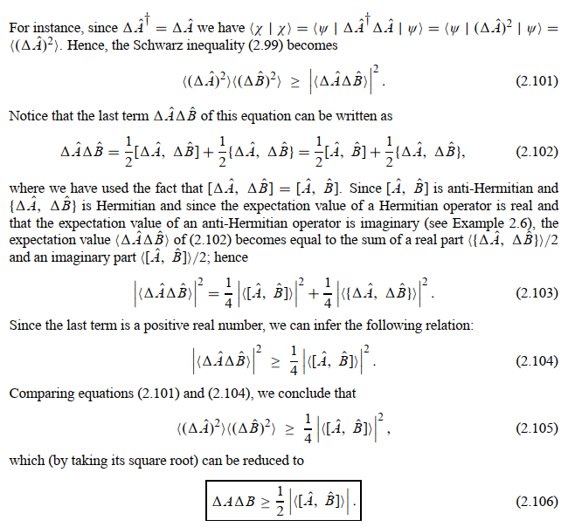
Quantum entanglement & Quantum Computing
1. Quantum maths III

Slide 7
Quantum entanglement & Quantum Computing
1. Quantum maths III: example 9

Slide 8
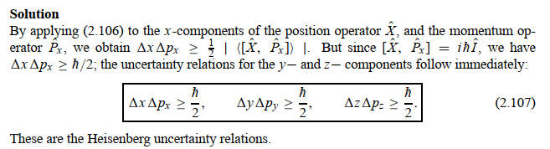
Quantum entanglement & Quantum Computing
1. Quantum maths III: example 9

Slide 9
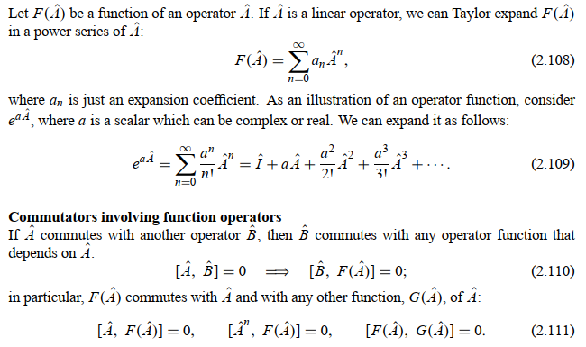
Quantum entanglement & Quantum Computing
1. Quantum maths III

Slide 10
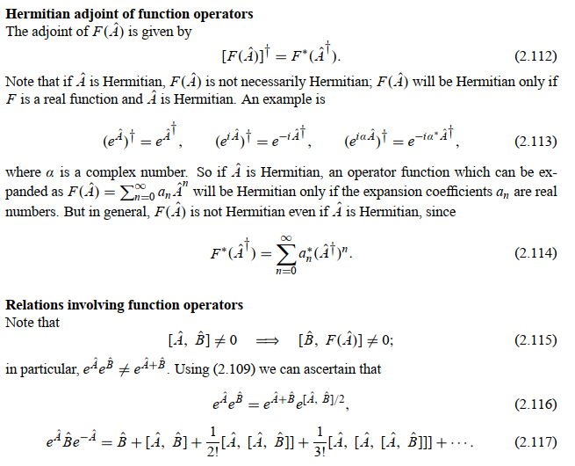
Quantum entanglement & Quantum Computing
1. Quantum maths III

Slide 11

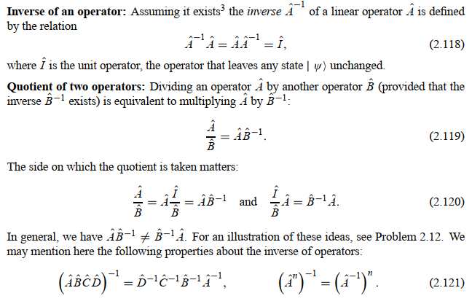
Quantum entanglement & Quantum Computing
1. Quantum maths III

Slide 12
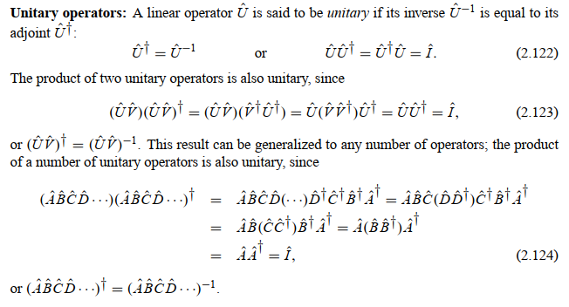
Quantum entanglement & Quantum Computing
1. Quantum maths III

Slide 13
Quantum entanglement & Quantum Computing
1. Quantum maths III: example 10

Slide 14
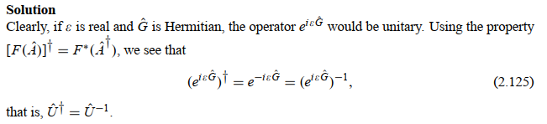
Quantum entanglement & Quantum Computing
1. Quantum maths III: example 10

Slide 15
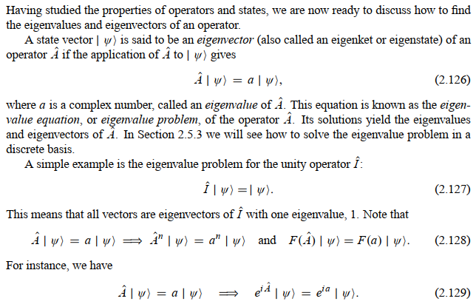
Quantum entanglement & Quantum Computing
1. Quantum maths III

Slide 16
Quantum entanglement & Quantum Computing
1. Quantum maths III: example 11

Slide 17
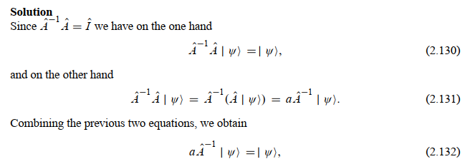
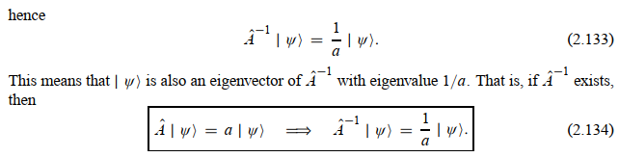
Quantum entanglement & Quantum Computing
1. Quantum maths III: example 11

Slide 18
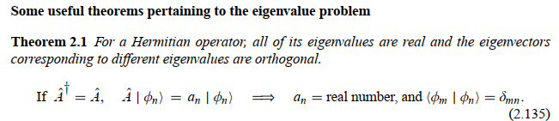
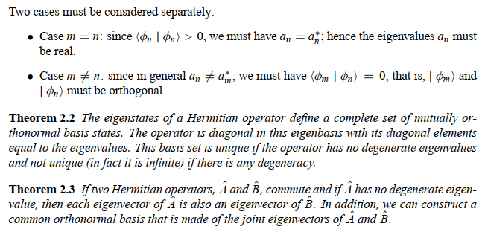
Quantum entanglement & Quantum Computing
1. Quantum maths III

Slide 19
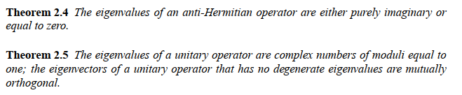
Quantum entanglement & Quantum Computing
1. Quantum maths III

Slide 20

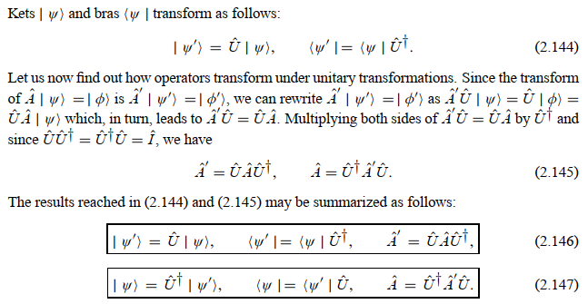
Quantum entanglement & Quantum Computing
1. Quantum maths III

Slide 21
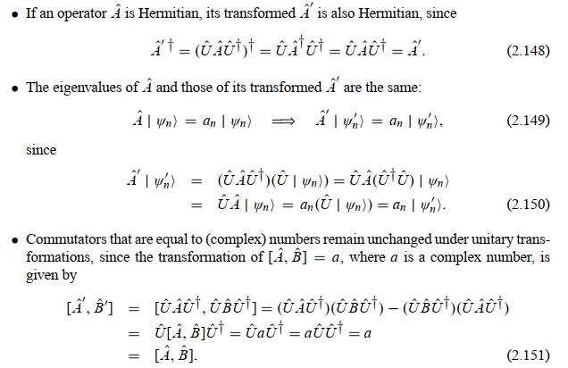
Quantum entanglement & Quantum Computing
1. Quantum maths III

Slide 22
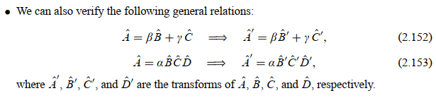
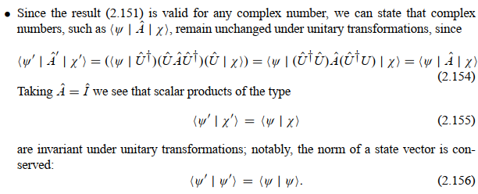
Quantum entanglement & Quantum Computing
1. Quantum maths III

Slide 23
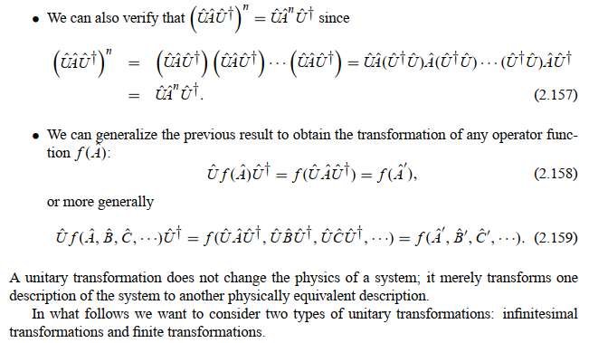
Quantum entanglement & Quantum Computing
1. Quantum maths III

Slide 24
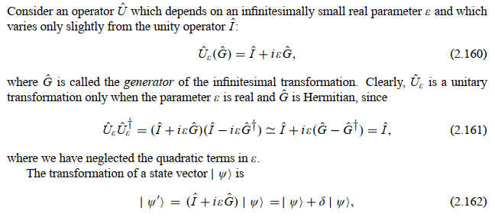
Quantum entanglement & Quantum Computing
1. Quantum maths III

Slide 25
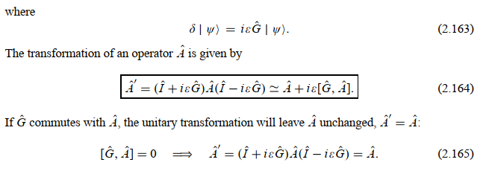
Quantum entanglement & Quantum Computing
1. Quantum maths III

Slide 26

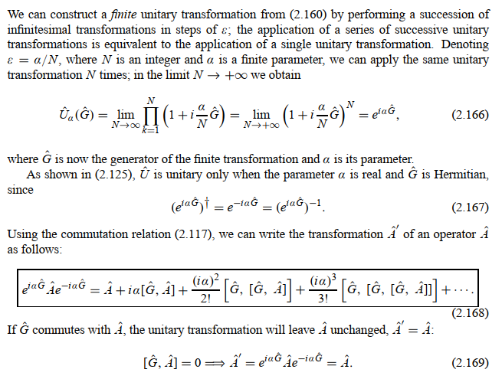
Quantum entanglement & Quantum Computing
1. Quantum maths III

Slide 27
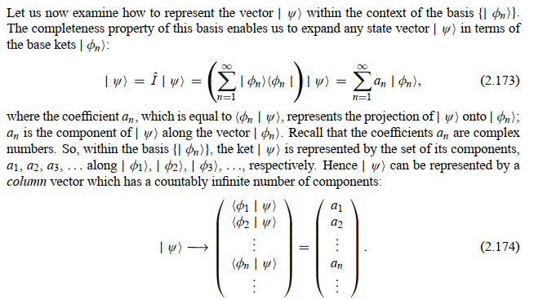
Quantum entanglement & Quantum Computing
2. Matrix forms of quantum systems

Slide 28
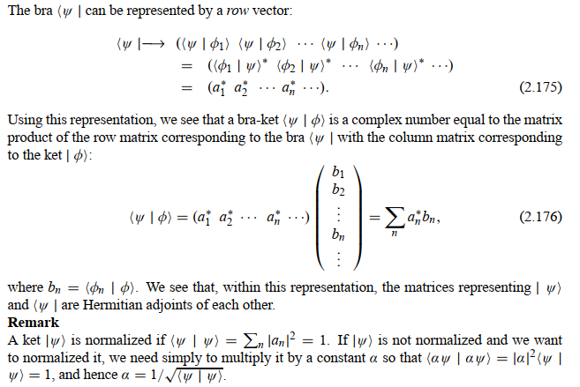
Quantum entanglement & Quantum Computing
2. Matrix forms of quantum systems

Slide 29
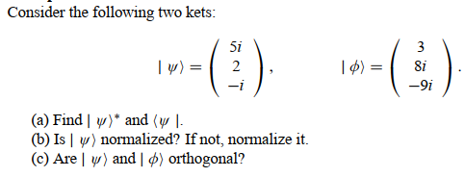
Quantum entanglement & Quantum Computing
2. Matrix forms of quantum systems: example 1

Slide 30
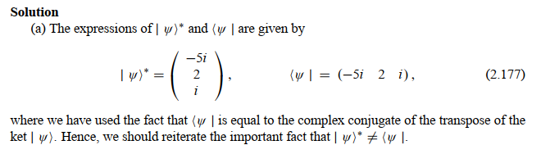
Quantum entanglement & Quantum Computing
2. Matrix forms of quantum systems: example 1

Slide 31
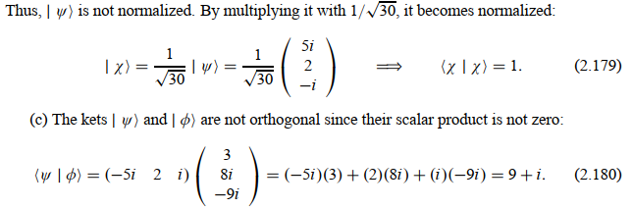
Quantum entanglement & Quantum Computing
2. Matrix forms of quantum systems: example 1

Slide 32
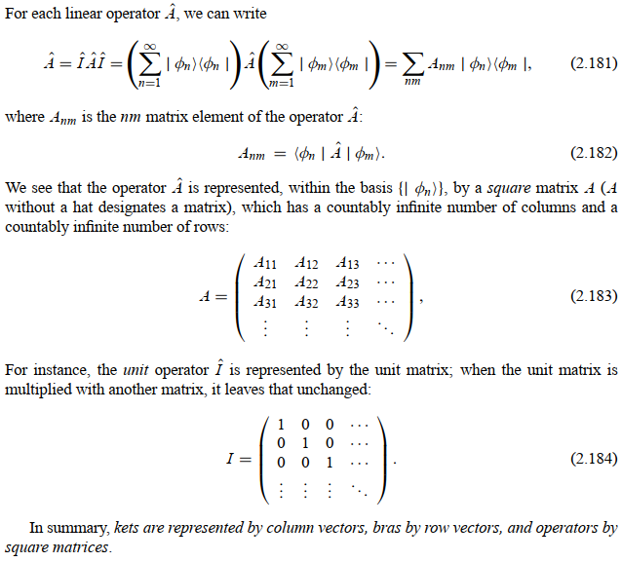
Quantum entanglement & Quantum Computing
2. Matrix forms of quantum systems

Slide 33
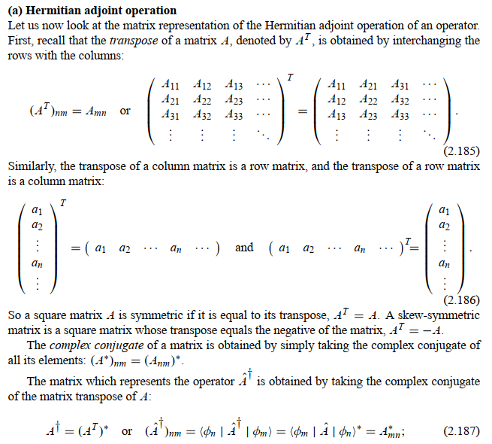
Quantum entanglement & Quantum Computing
2. Matrix forms of quantum systems

Slide 34
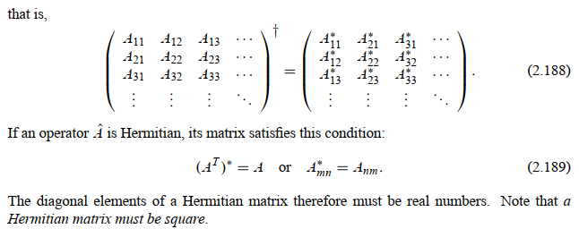
Quantum entanglement & Quantum Computing
2. Matrix forms of quantum systems

Slide 35

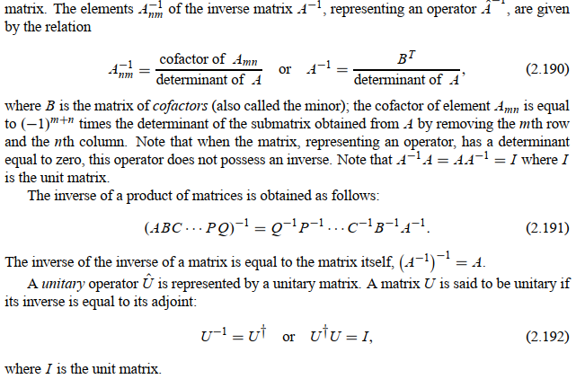
Quantum entanglement & Quantum Computing
2. Matrix forms of quantum systems

Slide 36

Quantum entanglement & Quantum Computing
2. Matrix forms of quantum systems

Slide 37
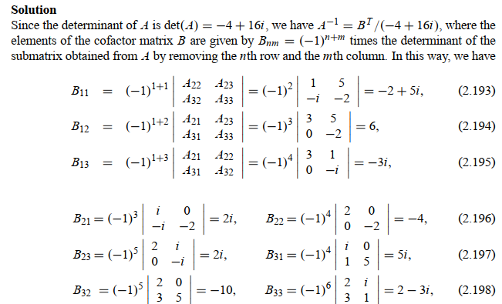
Quantum entanglement & Quantum Computing
2. Matrix forms of quantum systems

Slide 38
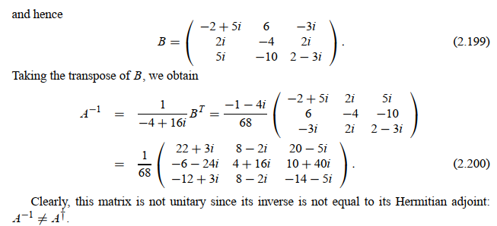
Quantum entanglement & Quantum Computing
2. Matrix forms of quantum systems

Slide 39
THANK YOU
Dr. Kaustav Bhowmick
Department of Electronics & Communication
Engineering
kaustavbhowmick@pes.edu

