Slide 1

Quantum Entanglement and Quantum Computing
Dr. Kaustav Bhowmick
Electronics & Communication
Engineering

Slide 2


Quantum Entanglement and Quantum Computing
Introduction to Topic
Dr. Kaustav Bhowmick
Electronics & Communication Engineering
Source: Google images

Slide 3
Quantum entanglement & Quantum Computing
Contents
Bloch Sphere
Qubits and States

Slide 4
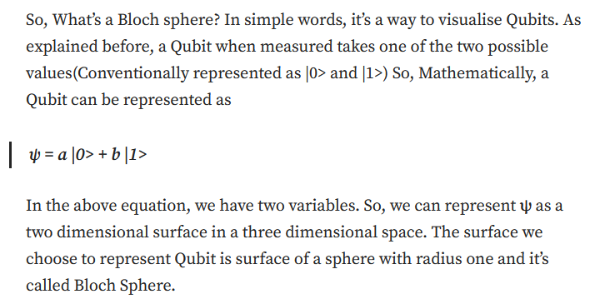
Quantum entanglement & Quantum Computing
1. Bloch sphere

Slide 5
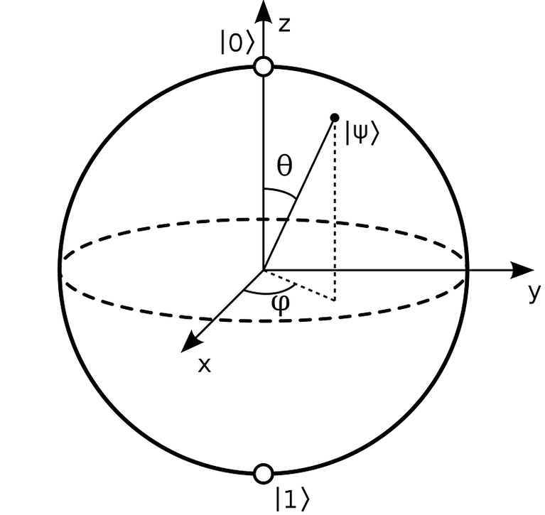
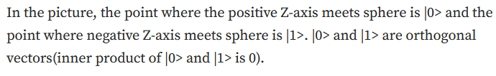
Quantum entanglement & Quantum Computing
1. Bloch sphere

Slide 6
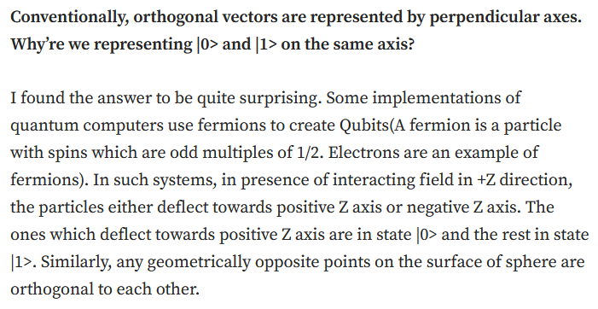
Quantum entanglement & Quantum Computing
1. Bloch sphere

Slide 7
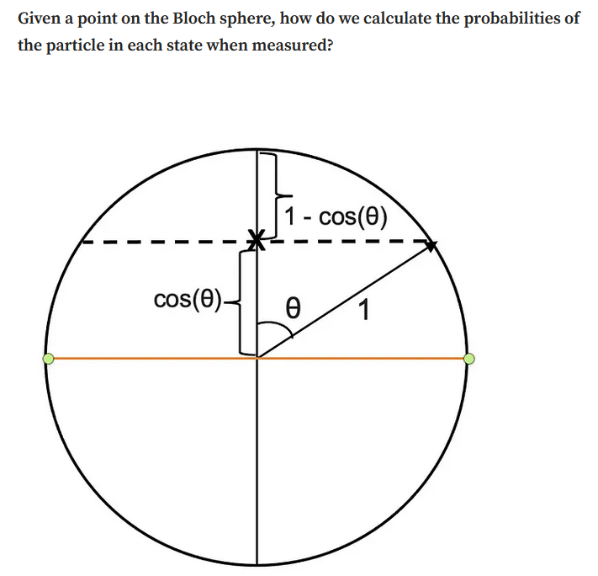
Quantum entanglement & Quantum Computing
1. Bloch sphere

Slide 8
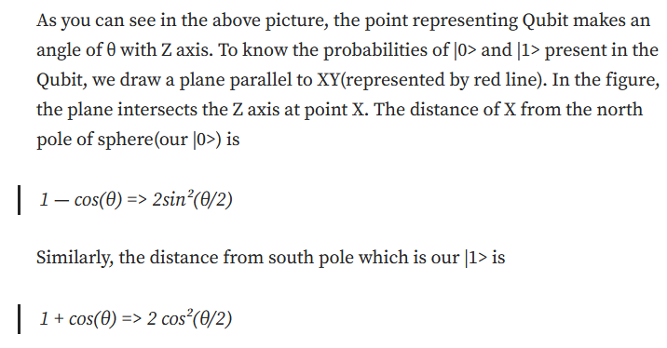
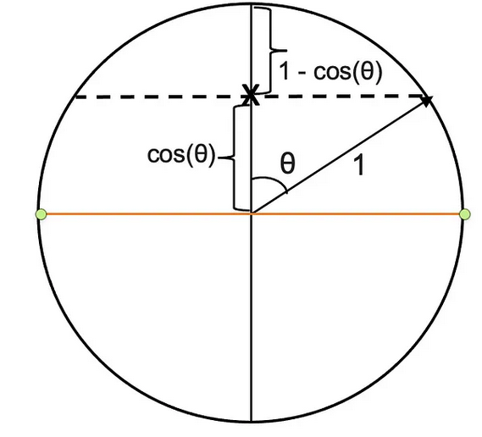
Quantum entanglement & Quantum Computing
1. Bloch sphere

Slide 9
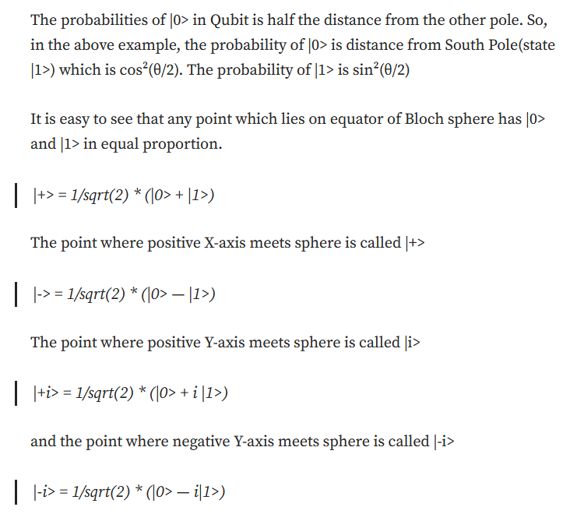
Quantum entanglement & Quantum Computing
1. Bloch sphere

Slide 10
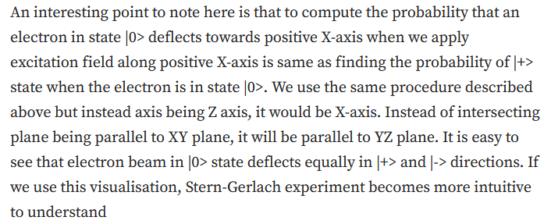
Quantum entanglement & Quantum Computing
1. Bloch sphere

Slide 11
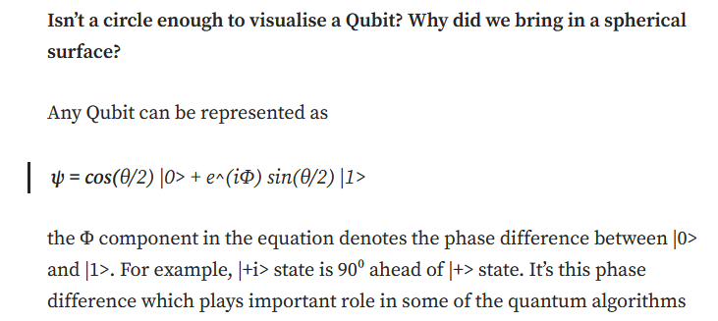
Quantum entanglement & Quantum Computing
1. Bloch sphere

Slide 12
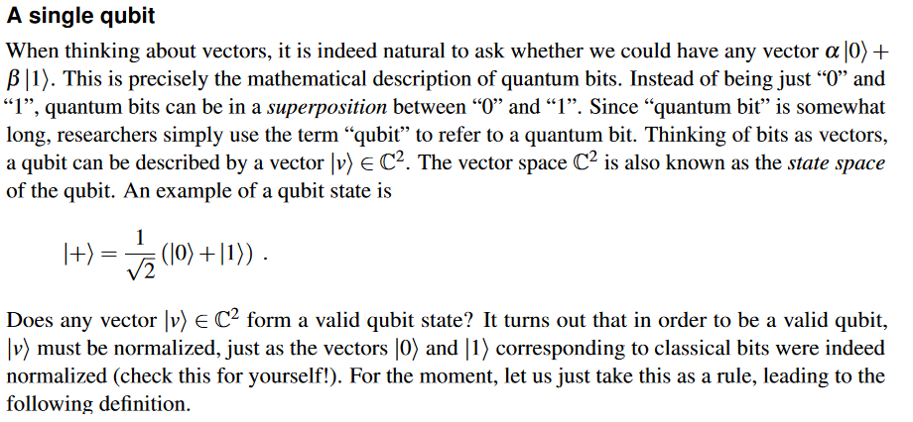
Quantum entanglement & Quantum Computing
2. Qubits and States

Slide 13
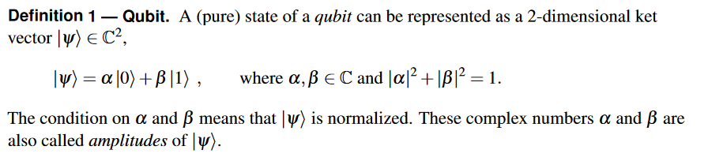
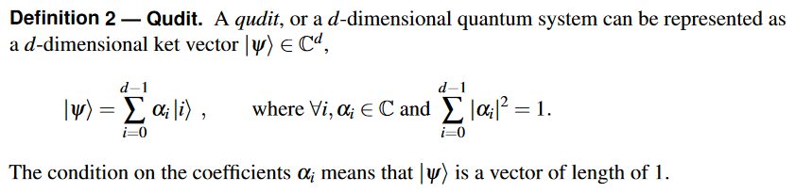
Quantum entanglement & Quantum Computing
2. Qubits and States

Slide 14
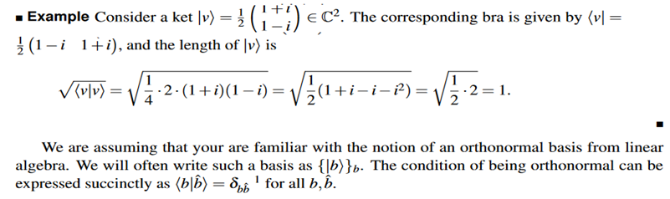
Quantum entanglement & Quantum Computing
2. Qubits and States

Slide 15
Quantum entanglement & Quantum Computing
2. Qubits and States

Slide 16
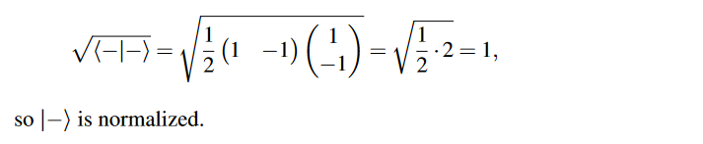
Quantum entanglement & Quantum Computing
2. Qubits and States

Slide 17
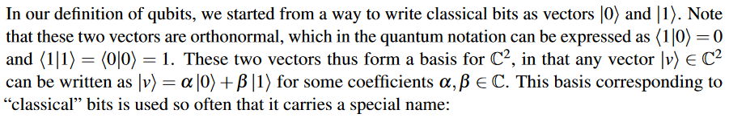
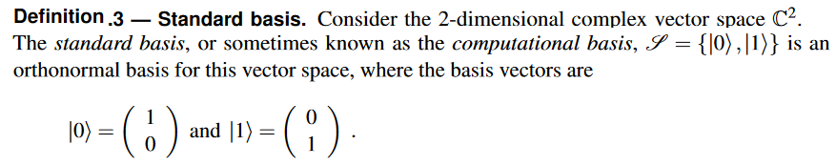
Quantum entanglement & Quantum Computing
2. Qubits and States

Slide 18
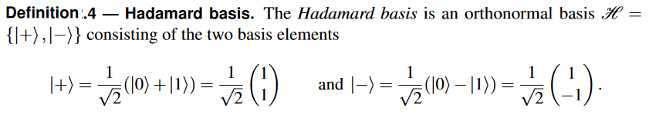
Quantum entanglement & Quantum Computing
2. Qubits and States

Slide 19
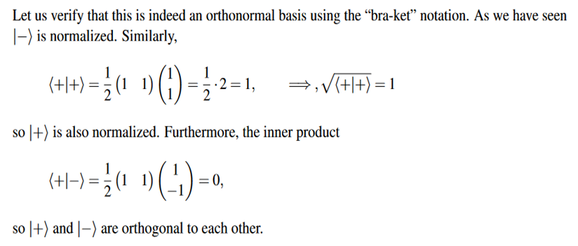
Quantum entanglement & Quantum Computing
2. Qubits and States

Slide 20
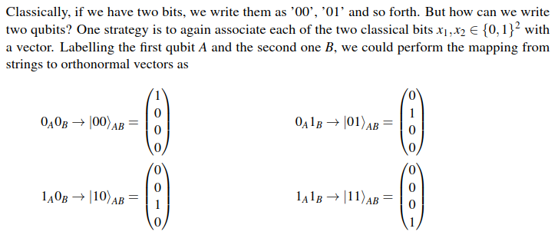
Quantum entanglement & Quantum Computing
2. Qubits and States

Slide 21
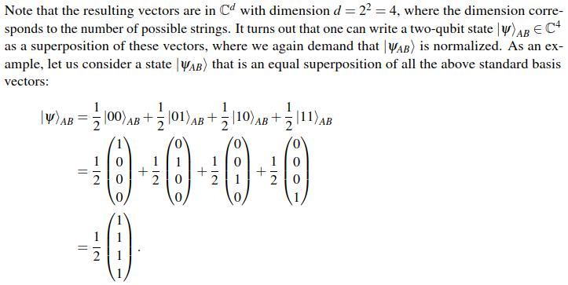
Quantum entanglement & Quantum Computing
2. Qubits and States

Slide 22
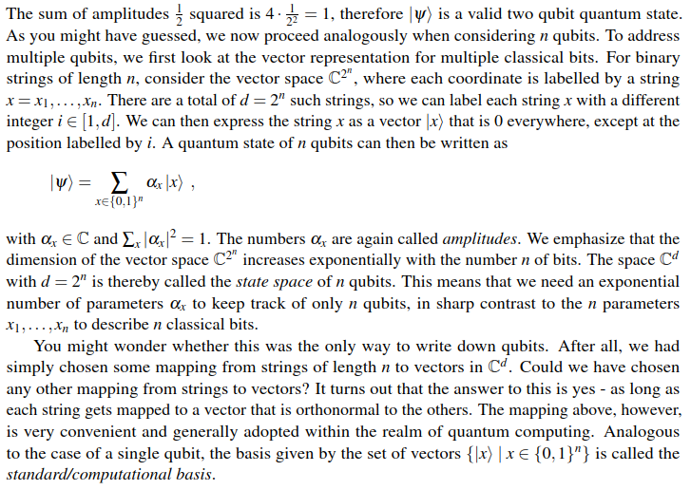
Quantum entanglement & Quantum Computing
2. Qubits and States

Slide 23

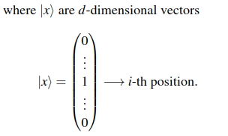
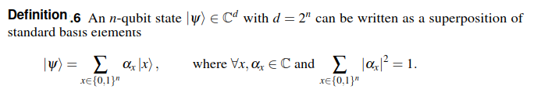
Quantum entanglement & Quantum Computing
2. Qubits and States

Slide 24
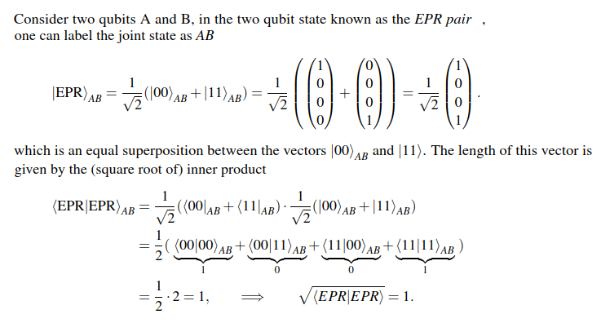
Quantum entanglement & Quantum Computing
2. Qubits and States

Slide 25
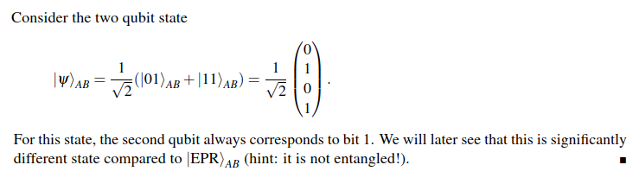
Quantum entanglement & Quantum Computing
2. Qubits and States

Slide 26
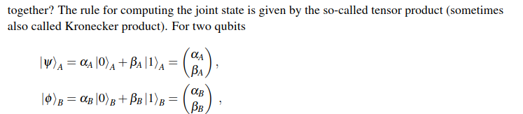
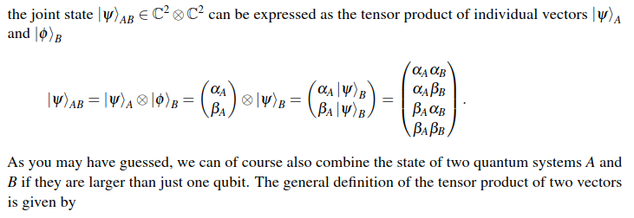
Quantum entanglement & Quantum Computing
2. Qubits and States

Slide 27
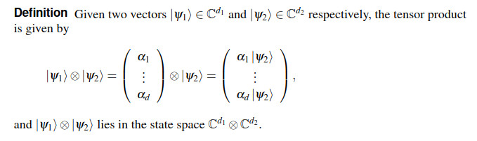
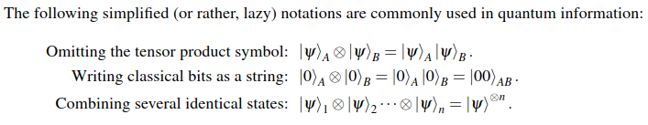
Quantum entanglement & Quantum Computing
2. Qubits and States

Slide 28
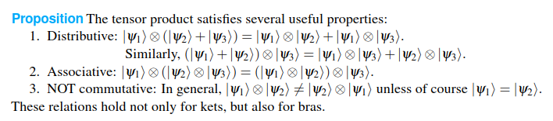
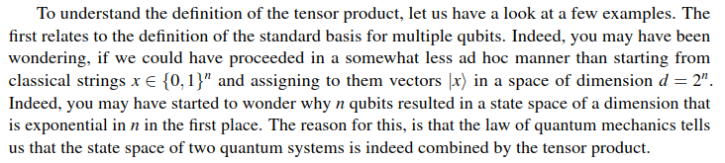
Quantum entanglement & Quantum Computing
2. Qubits and States

Slide 29
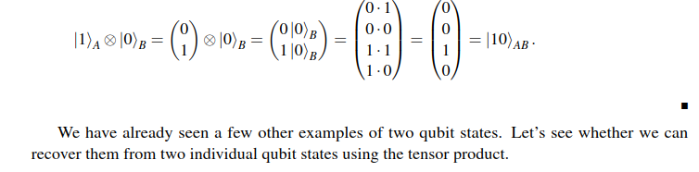
Quantum entanglement & Quantum Computing
2. Qubits and States

Slide 30
Quantum entanglement & Quantum Computing
2. Qubits and States

Slide 31
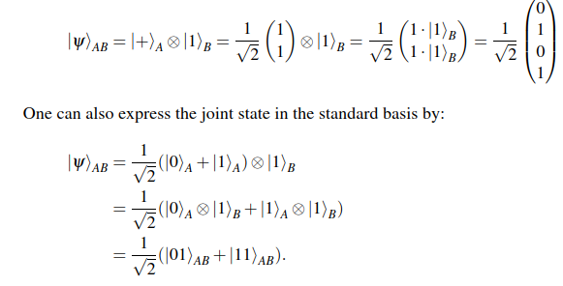
Quantum entanglement & Quantum Computing
2. Qubits and States

Slide 32

Quantum entanglement & Quantum Computing
2. Qubits and States

Slide 33
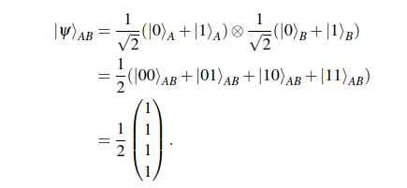
Quantum entanglement & Quantum Computing
2. Qubits and States

Slide 34

Quantum entanglement & Quantum Computing
2. Qubits and States

Slide 35
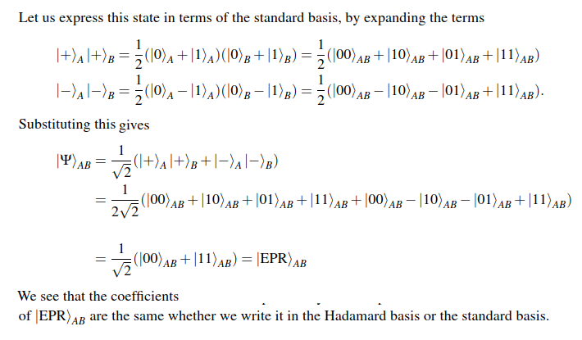
Quantum entanglement & Quantum Computing
2. Qubits and States

Slide 36
THANK YOU
Dr. Kaustav Bhowmick
Department of Electronics & Communication
Engineering
kaustavbhowmick@pes.edu

