Slide 1

Quantum Entanglement and Quantum Computing
Dr. Kaustav Bhowmick
Electronics & Communication
Engineering

Slide 2


Quantum Entanglement and Quantum Computing
Introduction to Topic
Dr. Kaustav Bhowmick
Electronics & Communication Engineering
Source: Google images

Slide 3
Quantum entanglement & Quantum Computing
Contents
Bloch Sphere Representation
SU(2), SU(3)

Slide 4
Quantum entanglement & Quantum Computing
1. Bloch sphere Representation
https://bloch.kherb.io/explain

Slide 5
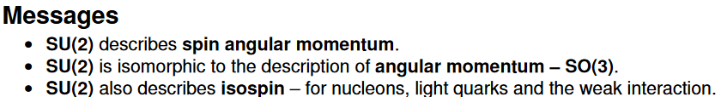
Quantum entanglement & Quantum Computing
2. SU(2) & SU(3)

Slide 6
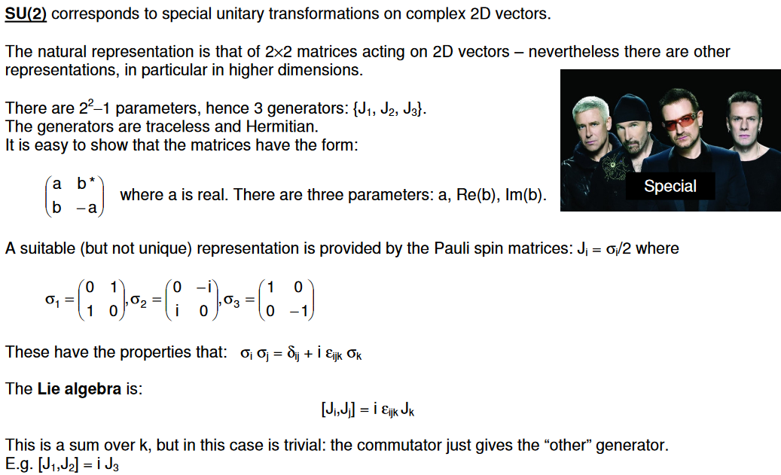
Quantum entanglement & Quantum Computing
2. SU(2) & SU(3)

Slide 7

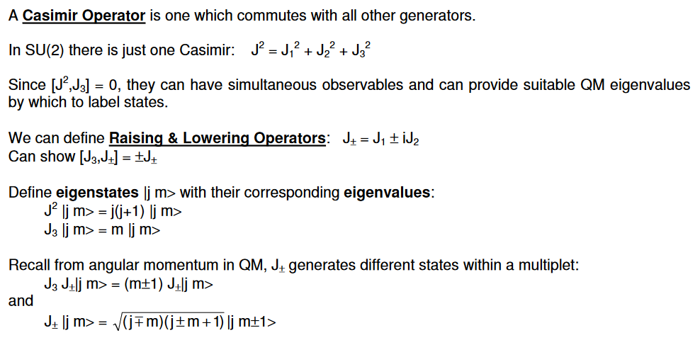
Quantum entanglement & Quantum Computing
2. SU(2) & SU(3)

Slide 8

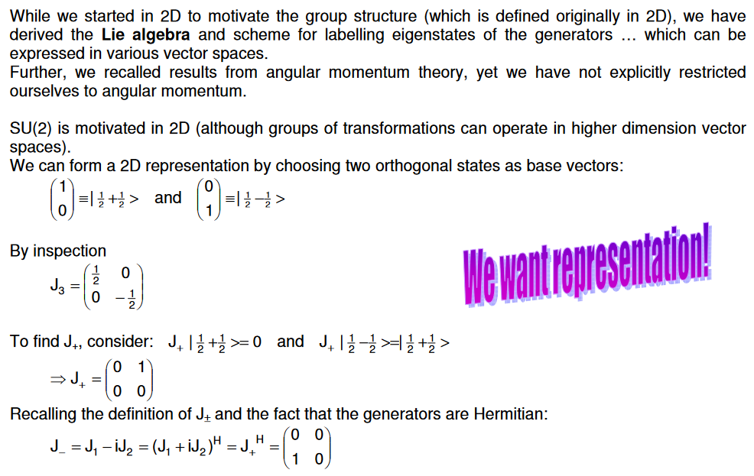
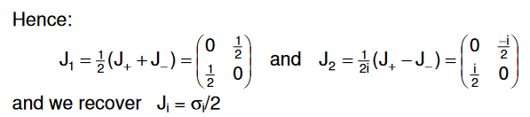
Quantum entanglement & Quantum Computing
2. SU(2) & SU(3)

Slide 9
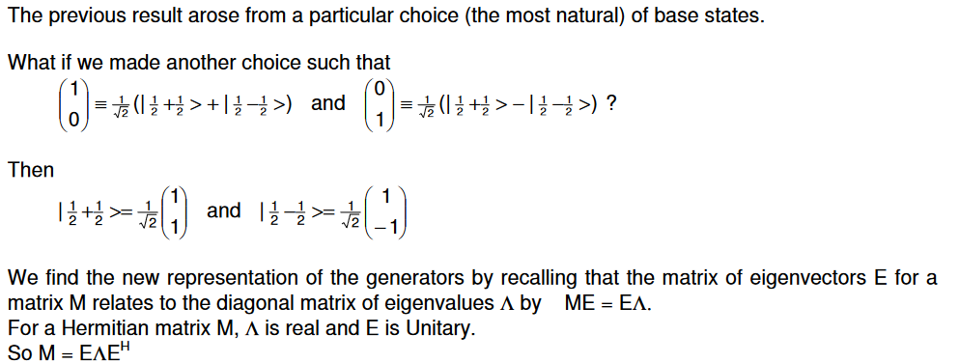
Quantum entanglement & Quantum Computing
2. SU(2) & SU(3)

Slide 10
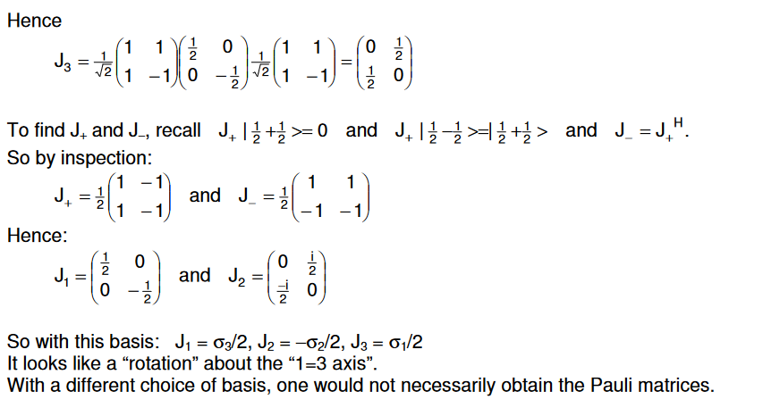
Quantum entanglement & Quantum Computing
2. SU(2) & SU(3)

Slide 11

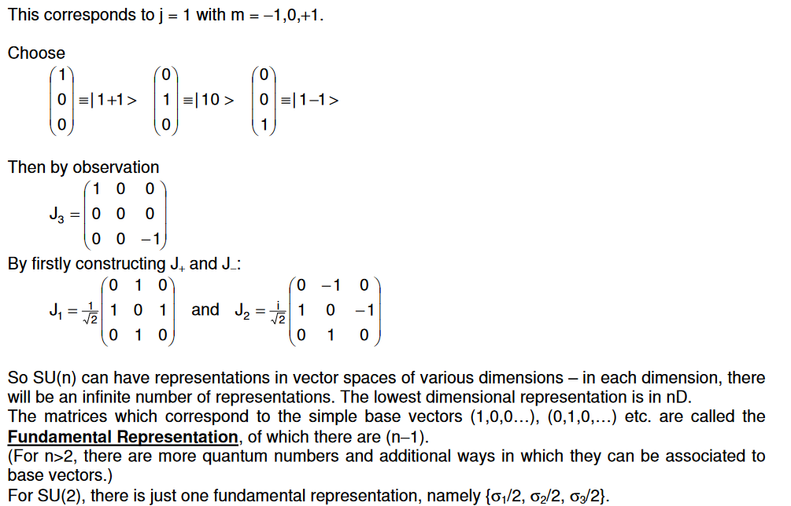
Quantum entanglement & Quantum Computing
2. SU(2) & SU(3)

Slide 12

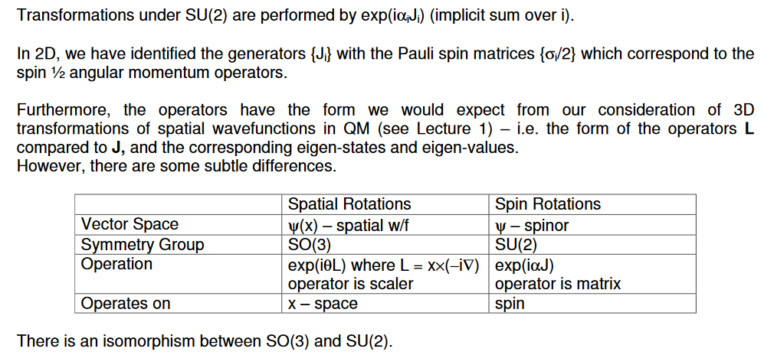
Quantum entanglement & Quantum Computing
2. SU(2) & SU(3)

Slide 13
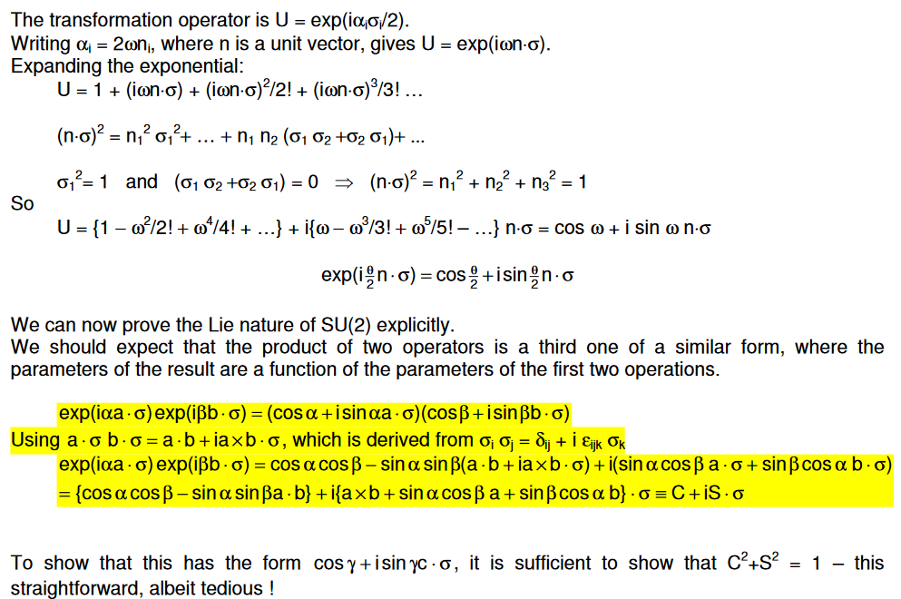
Quantum entanglement & Quantum Computing
2. SU(2) & SU(3)

Slide 14
THANK YOU
Dr. Kaustav Bhowmick
Department of Electronics & Communication
Engineering
kaustavbhowmick@pes.edu

