Slide 1

Quantum Entanglement and Quantum Computing
Dr. Kaustav Bhowmick
Electronics & Communication
Engineering

Slide 2


Quantum Entanglement and Quantum Computing
Entanglement and Quantum Information
Dr. Kaustav Bhowmick
Electronics & Communication Engineering
Source: Google images

Slide 3
Quantum entanglement & Quantum Computing
Contents
Quantum Entanglement
Introduction to classical information theory

Slide 4
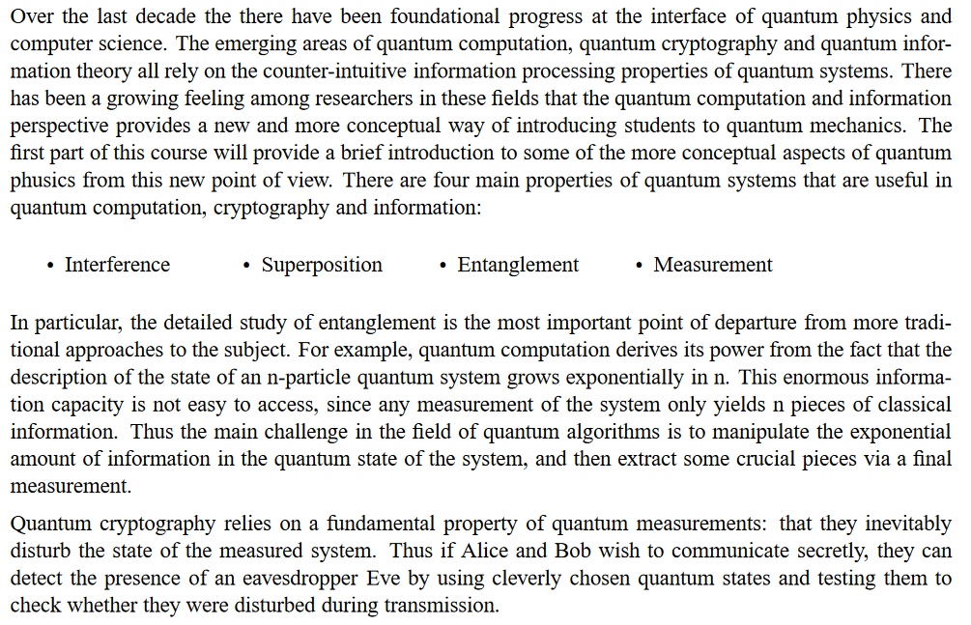
Quantum entanglement & Quantum Computing
1. Quantum Entanglement

Slide 5
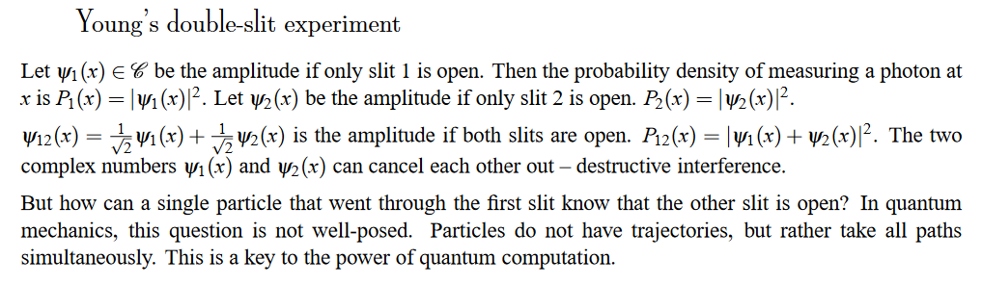
Quantum entanglement & Quantum Computing
1. Quantum Entanglement

Slide 6
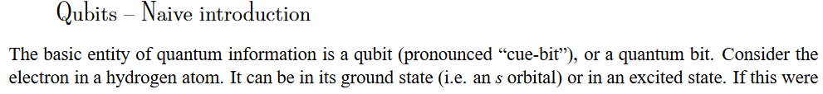
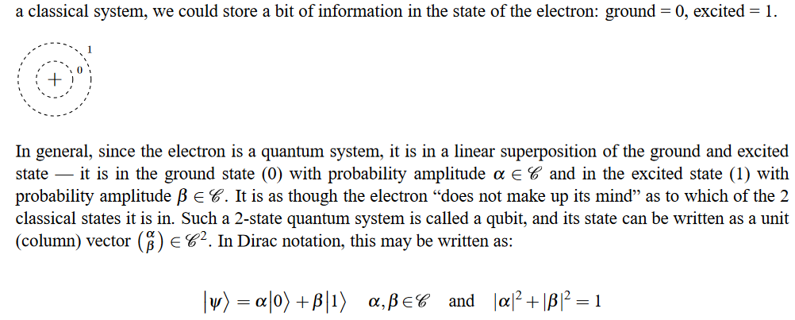
Quantum entanglement & Quantum Computing
1. Quantum Entanglement

Slide 7
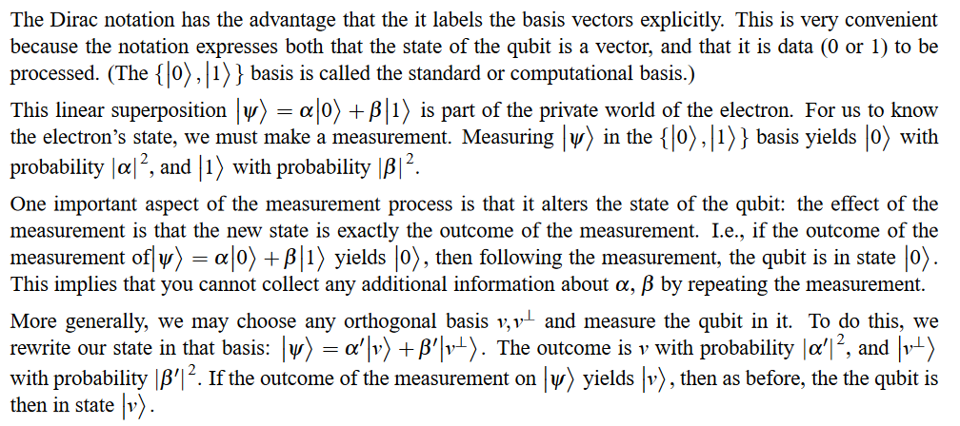
Quantum entanglement & Quantum Computing
1. Quantum Entanglement

Slide 8
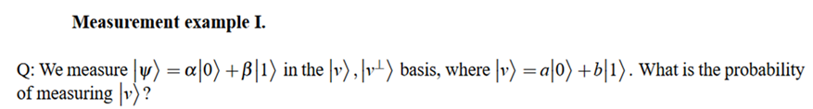
Quantum entanglement & Quantum Computing
1. Quantum Entanglement

Slide 9
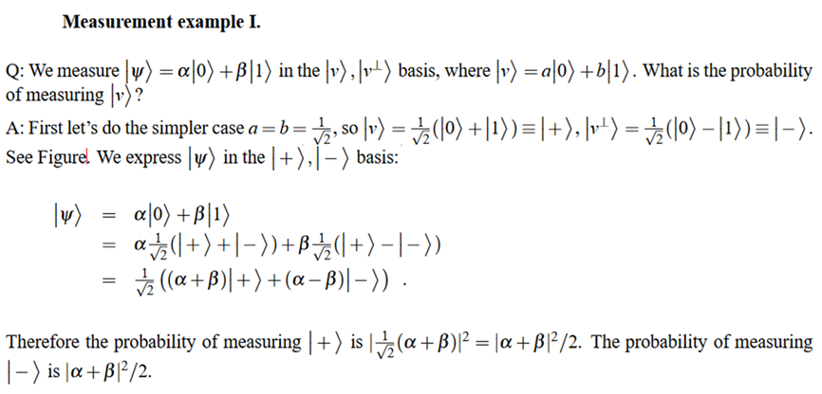
Quantum entanglement & Quantum Computing
1. Quantum Entanglement

Slide 10
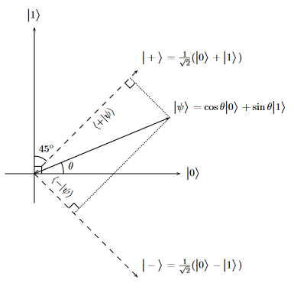
Quantum entanglement & Quantum Computing
1. Quantum Entanglement

Slide 11
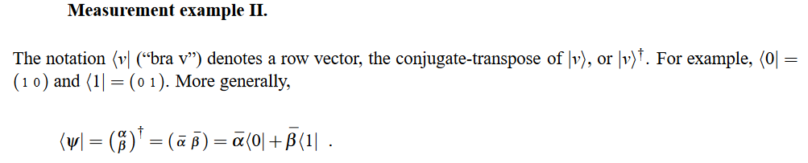
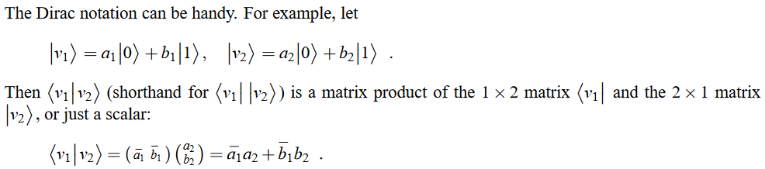
Quantum entanglement & Quantum Computing
1. Quantum Entanglement

Slide 12
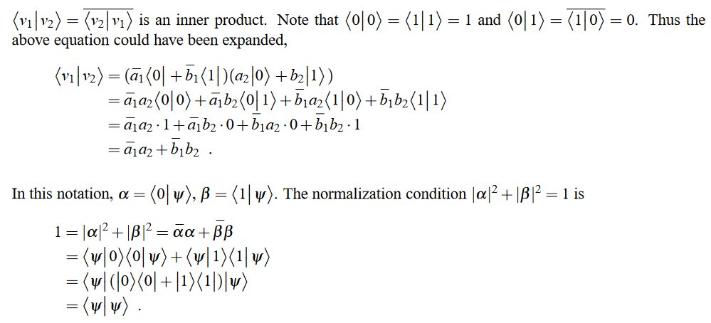
Quantum entanglement & Quantum Computing
1. Quantum Entanglement

Slide 13
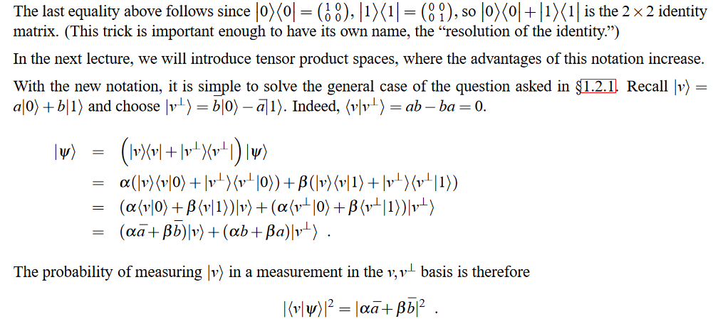
Quantum entanglement & Quantum Computing
1. Quantum Entanglement

Slide 14
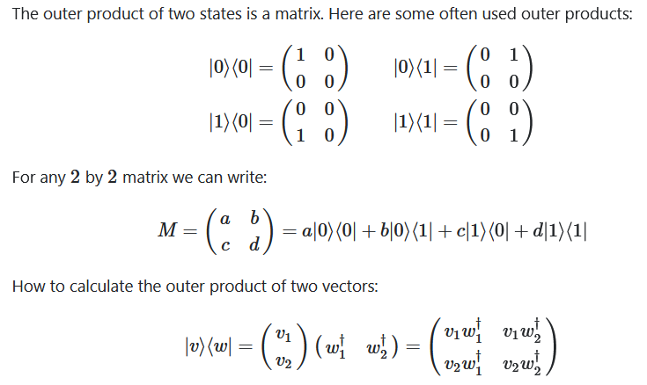
Quantum entanglement & Quantum Computing
1. Quantum Entanglement

Slide 15
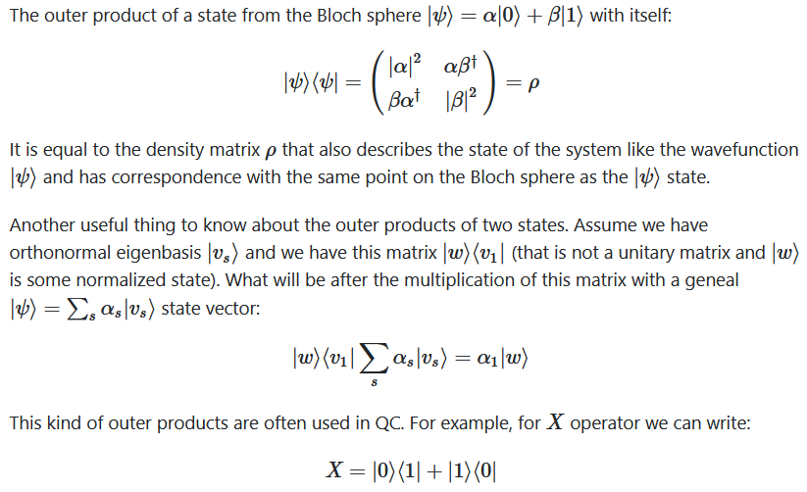
Quantum entanglement & Quantum Computing
1. Quantum Entanglement

Slide 16
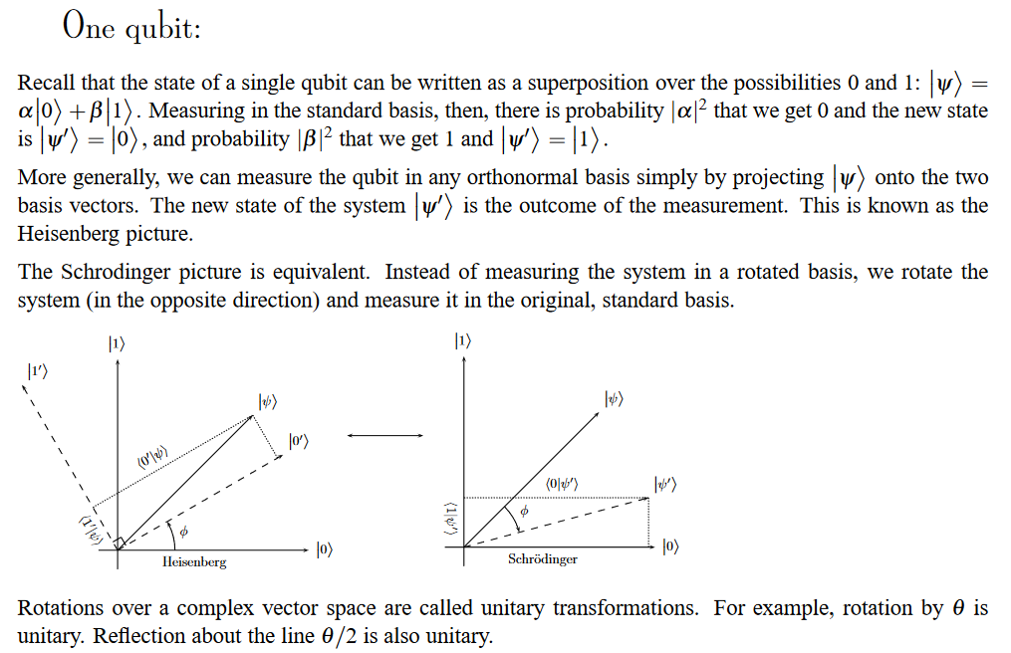
Quantum entanglement & Quantum Computing
1. Quantum Entanglement

Slide 17
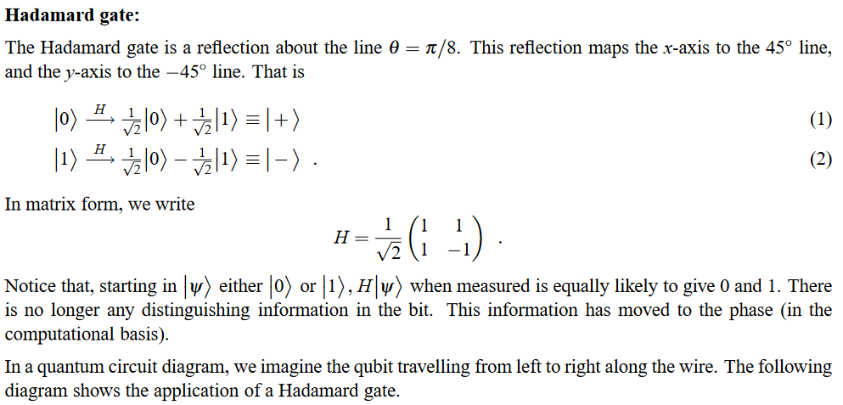

Quantum entanglement & Quantum Computing
1. Quantum Entanglement

Slide 18
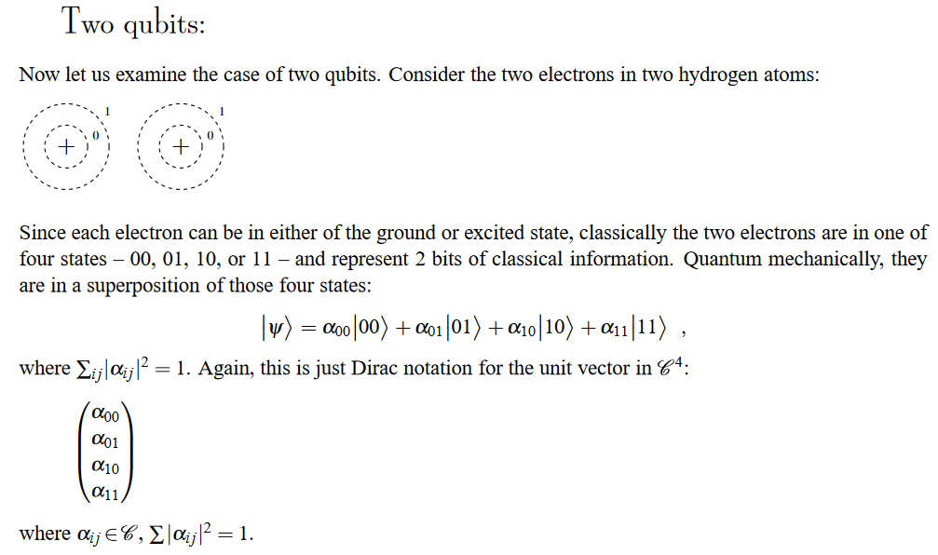
Quantum entanglement & Quantum Computing
1. Quantum Entanglement

Slide 19
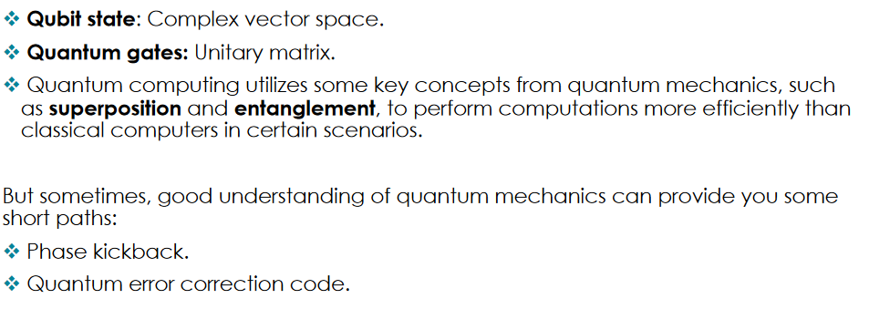
Quantum entanglement & Quantum Computing
1. Quantum Entanglement

Slide 20
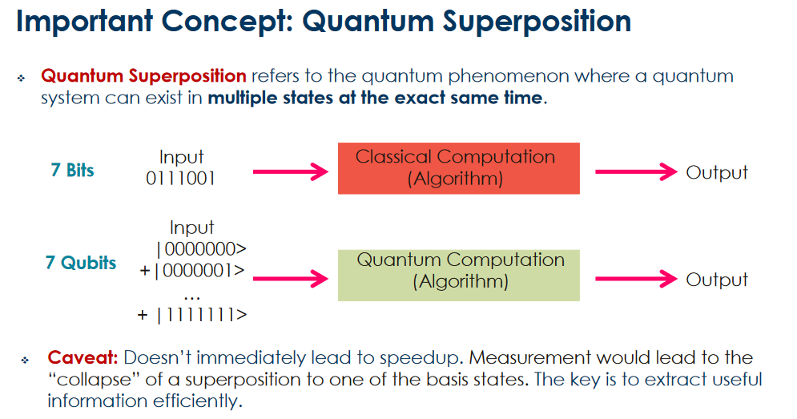
Quantum entanglement & Quantum Computing
1. Quantum Entanglement

Slide 21
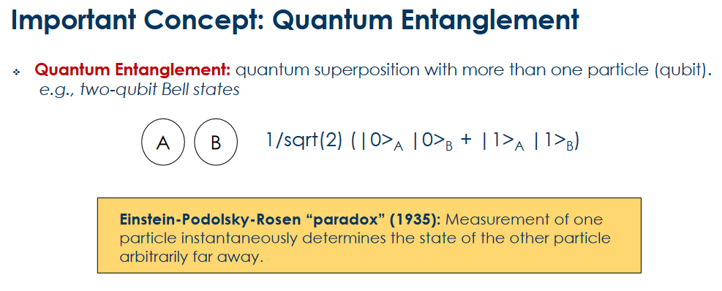
Quantum entanglement & Quantum Computing
1. Quantum Entanglement

Slide 22
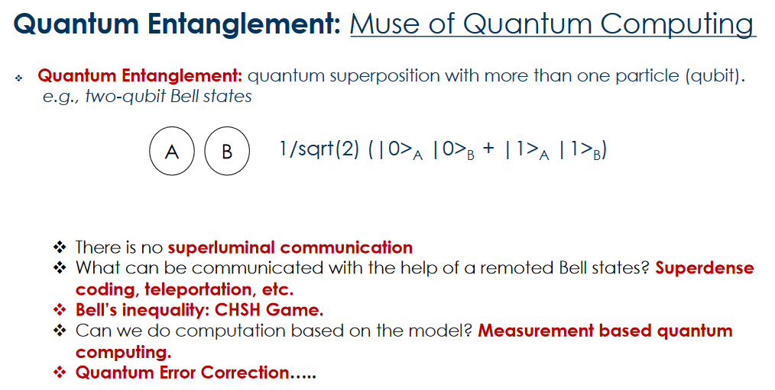
Quantum entanglement & Quantum Computing
1. Quantum Entanglement

Slide 23
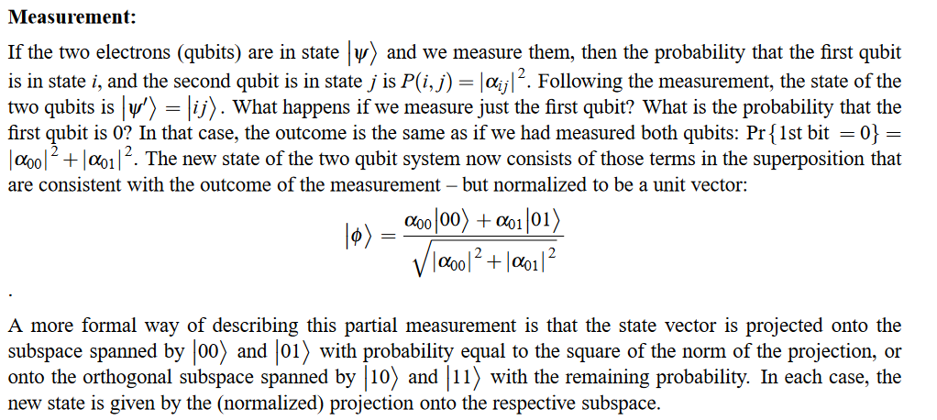
Quantum entanglement & Quantum Computing
1. Quantum Entanglement

Slide 24
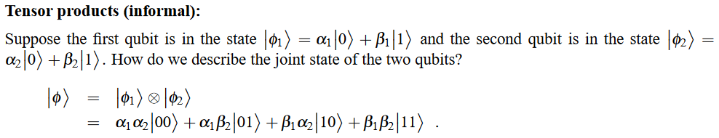
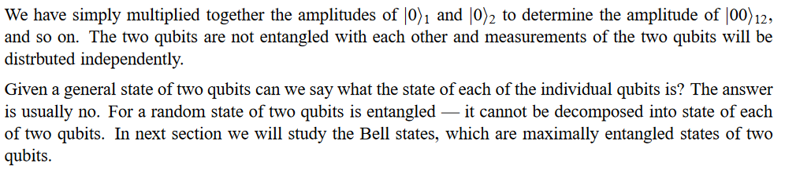
Quantum entanglement & Quantum Computing
1. Quantum Entanglement

Slide 25
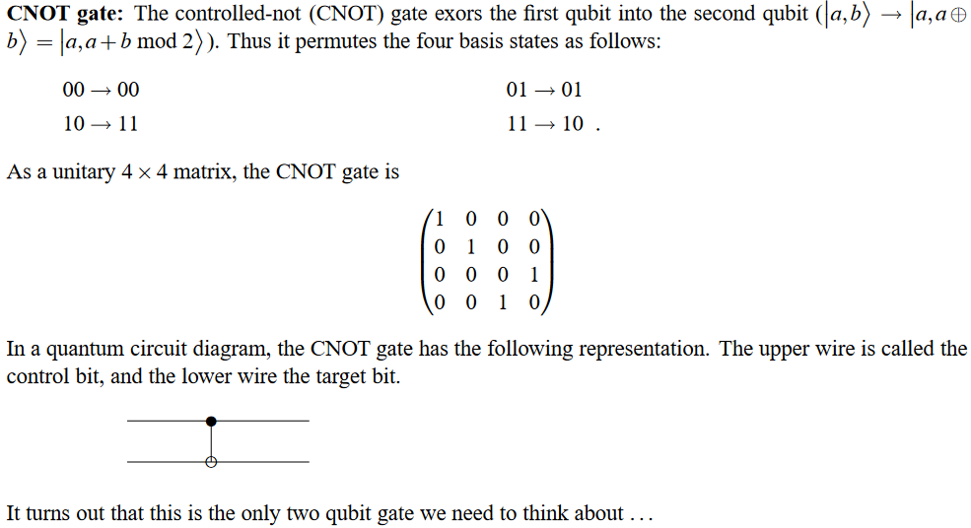
Quantum entanglement & Quantum Computing
1. Quantum Entanglement

Slide 26
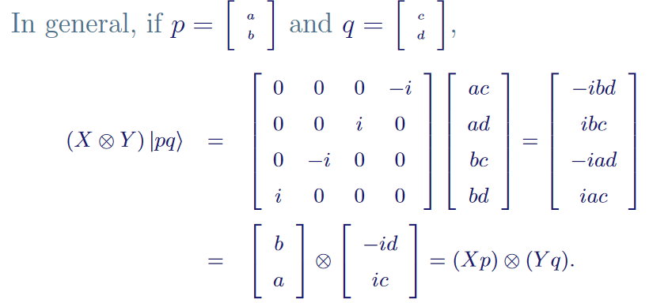
Quantum entanglement & Quantum Computing
1. Quantum Entanglement

Slide 27
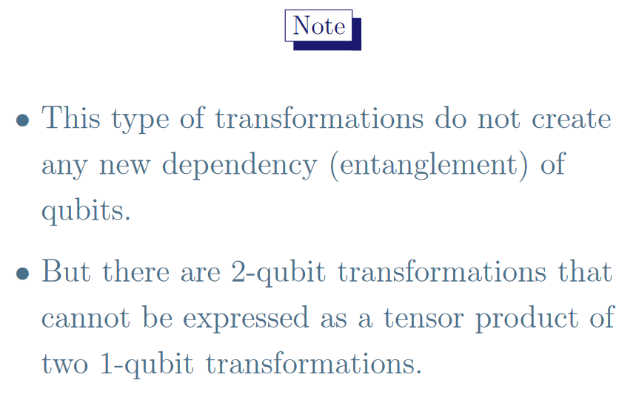
Quantum entanglement & Quantum Computing
1. Quantum Entanglement

Slide 28
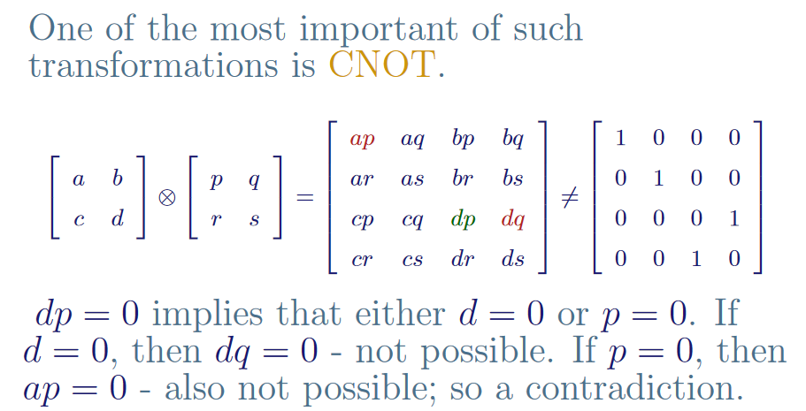
Quantum entanglement & Quantum Computing
1. Quantum Entanglement

Slide 29
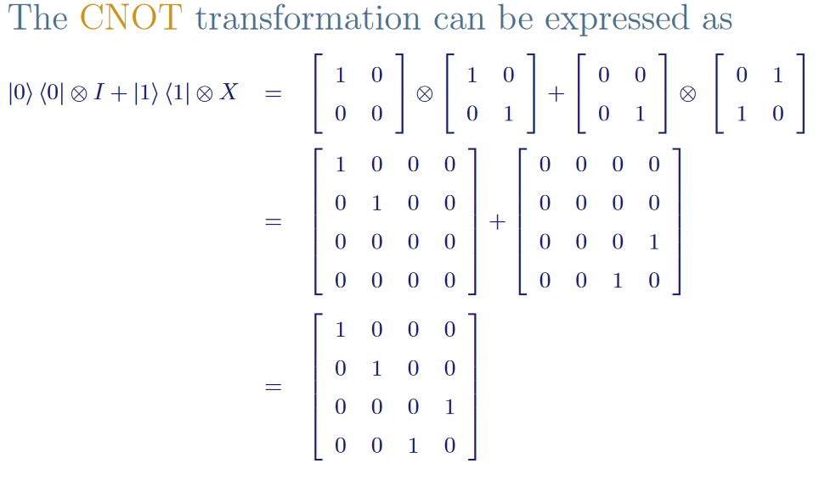
Quantum entanglement & Quantum Computing
1. Quantum Entanglement

Slide 30
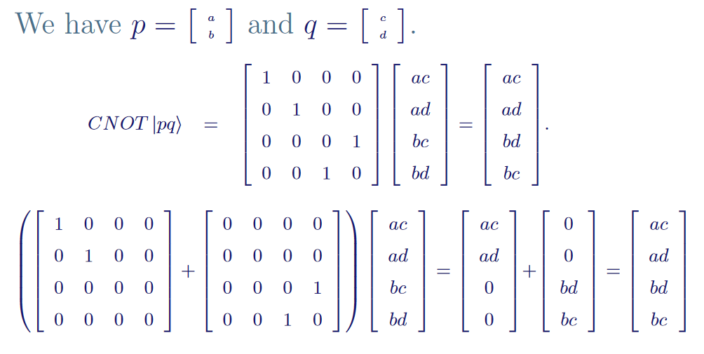
Quantum entanglement & Quantum Computing
1. Quantum Entanglement

Slide 31
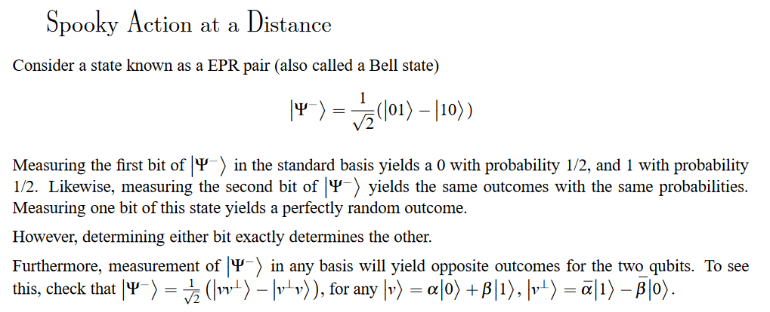
Quantum entanglement & Quantum Computing
1. Quantum Entanglement

Slide 32
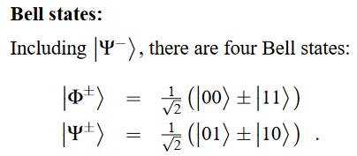
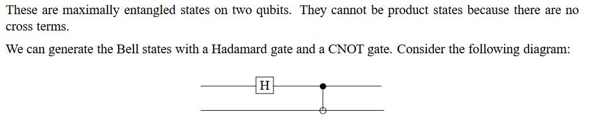
Quantum entanglement & Quantum Computing
1. Quantum Entanglement

Slide 33
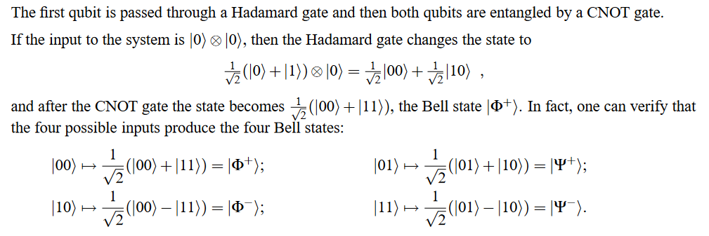
Quantum entanglement & Quantum Computing
1. Quantum Entanglement

Slide 34
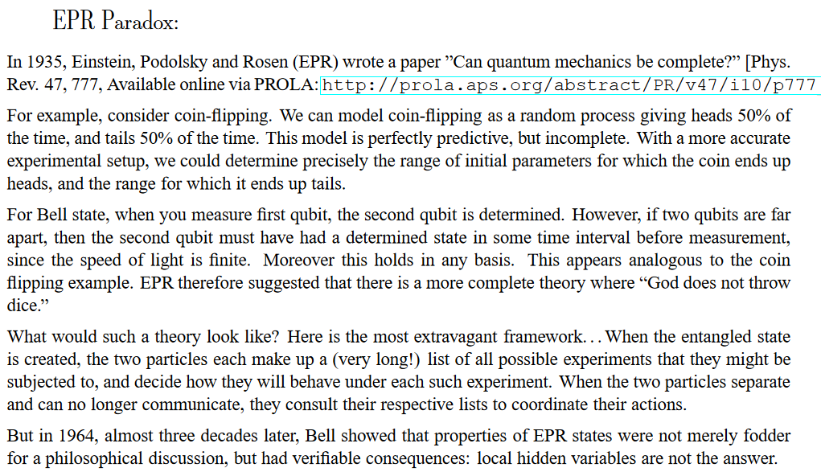
Quantum entanglement & Quantum Computing
1. Quantum Entanglement

Slide 35
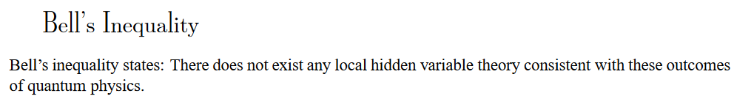
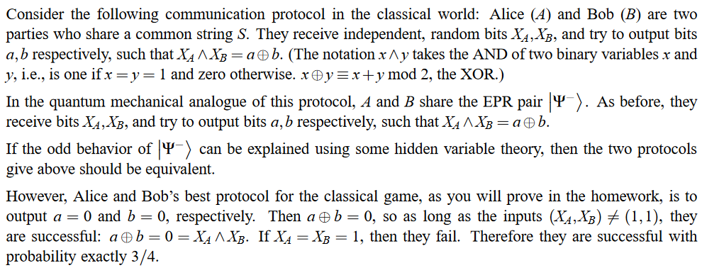
Quantum entanglement & Quantum Computing
1. Quantum Entanglement

Slide 36
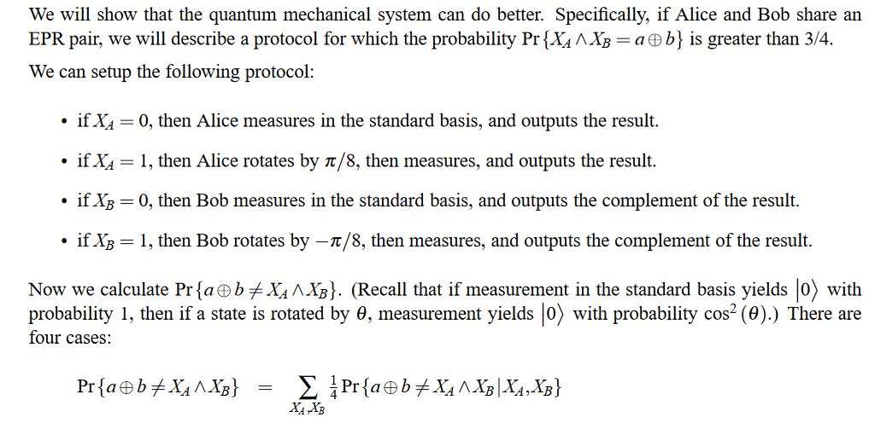
Quantum entanglement & Quantum Computing
1. Quantum Entanglement

Slide 37
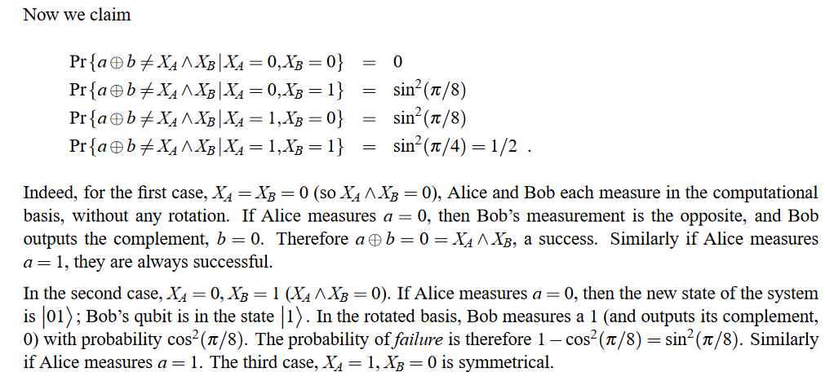
Quantum entanglement & Quantum Computing
1. Quantum Entanglement

Slide 38
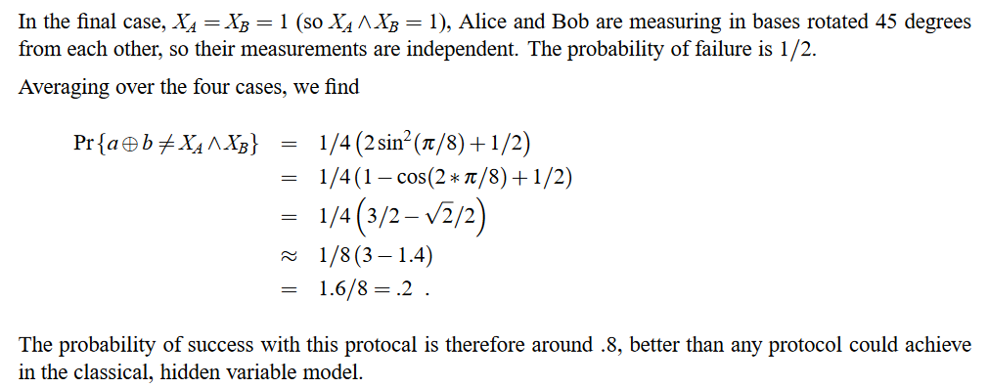
Quantum entanglement & Quantum Computing
1. Quantum Entanglement

Slide 39
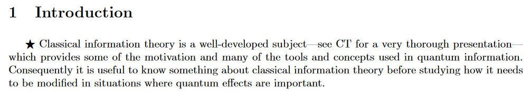
Quantum entanglement & Quantum Computing
2. Introduction to classical information theory

Slide 40
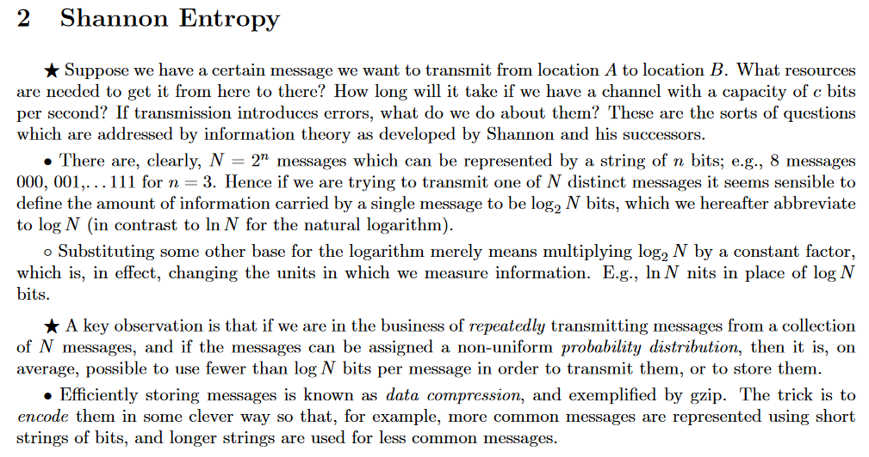
Quantum entanglement & Quantum Computing
2. Introduction to classical information theory

Slide 41
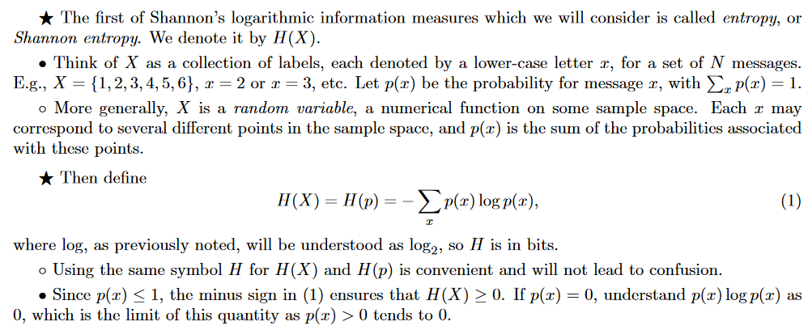
Quantum entanglement & Quantum Computing
2. Introduction to classical information theory

Slide 42
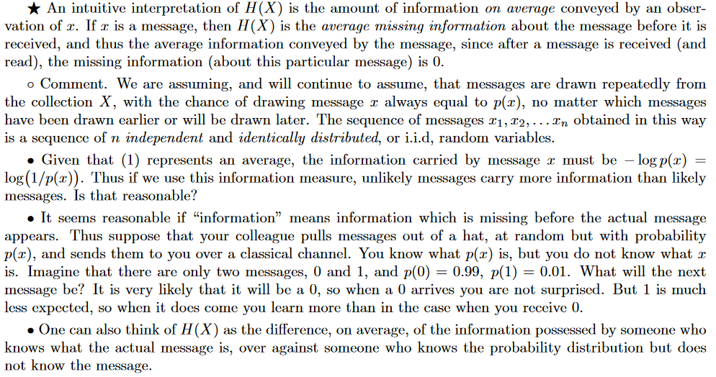
Quantum entanglement & Quantum Computing
2. Introduction to classical information theory

Slide 43
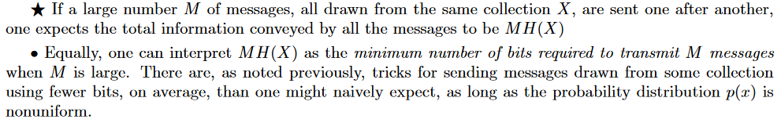
Quantum entanglement & Quantum Computing
2. Introduction to classical information theory

Slide 44
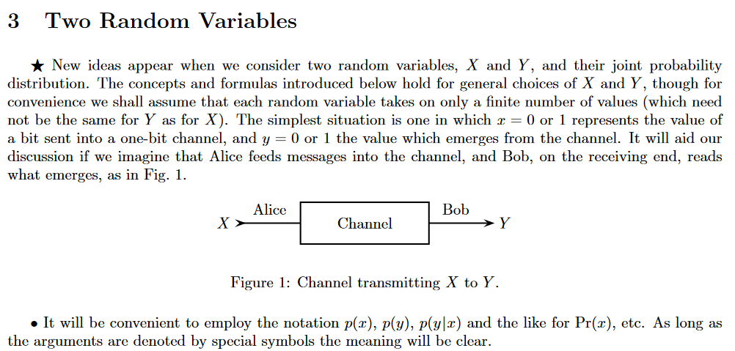
Quantum entanglement & Quantum Computing
2. Introduction to classical information theory

Slide 45
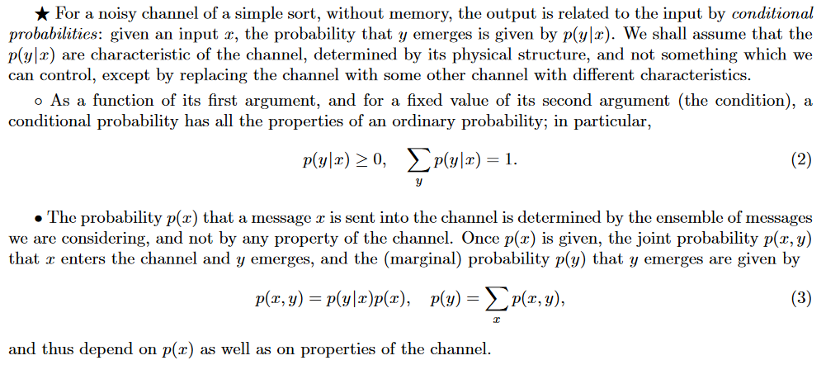
Quantum entanglement & Quantum Computing
2. Introduction to classical information theory

Slide 46
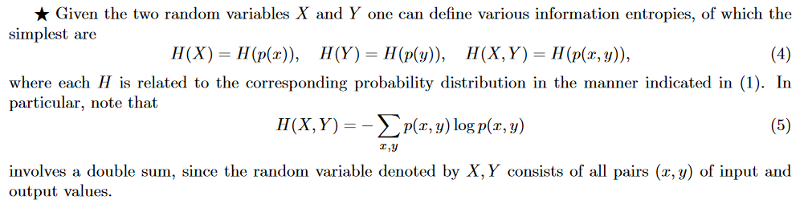
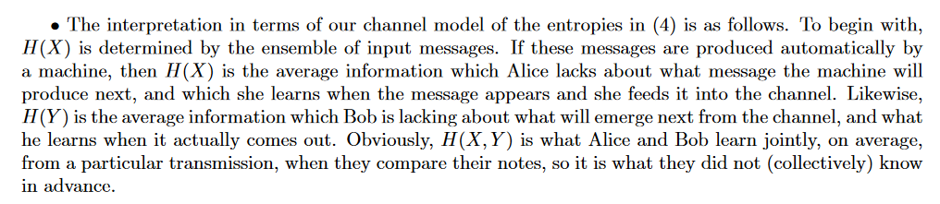
Quantum entanglement & Quantum Computing
2. Introduction to classical information theory

Slide 47
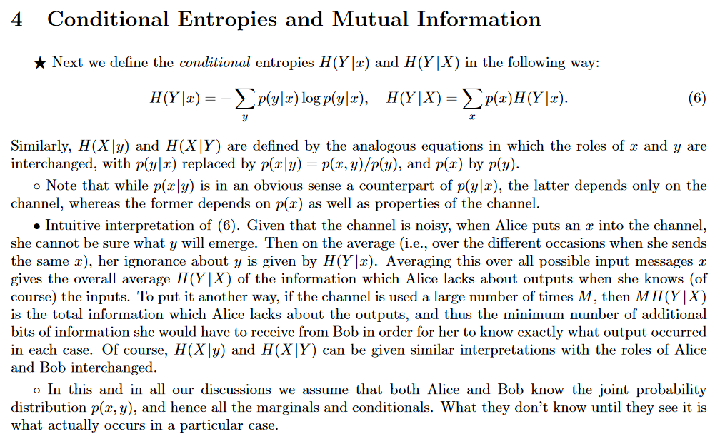
Quantum entanglement & Quantum Computing
2. Introduction to classical information theory

Slide 48

Quantum entanglement & Quantum Computing
2. Introduction to classical information theory

Slide 49

Quantum entanglement & Quantum Computing
2. Introduction to classical information theory

Slide 50

Quantum entanglement & Quantum Computing
2. Introduction to classical information theory

Slide 51


Quantum entanglement & Quantum Computing
2. Introduction to classical information theory

Slide 52

Quantum entanglement & Quantum Computing
2. Introduction to classical information theory

Slide 53

Quantum entanglement & Quantum Computing
2. Introduction to classical information theory

Slide 54
THANK YOU
Dr. Kaustav Bhowmick
Department of Electronics & Communication
Engineering
kaustavbhowmick@pes.edu

