Slide 1

Quantum Entanglement and Quantum Computing
Dr. Kaustav Bhowmick
Electronics & Communication
Engineering

Slide 2

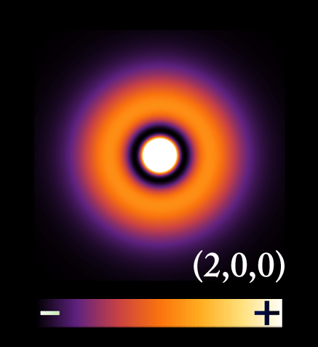
Quantum Entanglement and Quantum Computing
Entanglement and Quantum Information
Dr. Kaustav Bhowmick
Electronics & Communication Engineering
Source: Google images

Slide 3
Quantum entanglement & Quantum Computing
Contents
Classical Information theory
Practice Sums

Slide 4
Quantum entanglement & Quantum Computing
1. Classical Information Theory
Lecture by J. G. Daugman

Slide 5

Quantum entanglement & Quantum Computing
2. Practice Sums : Exercise 1

Slide 6
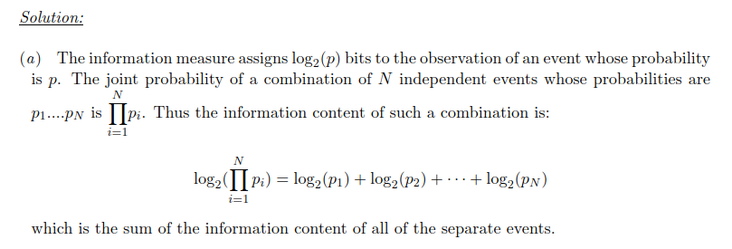
Quantum entanglement & Quantum Computing
2. Practice Sums: Exercise 1

Slide 7
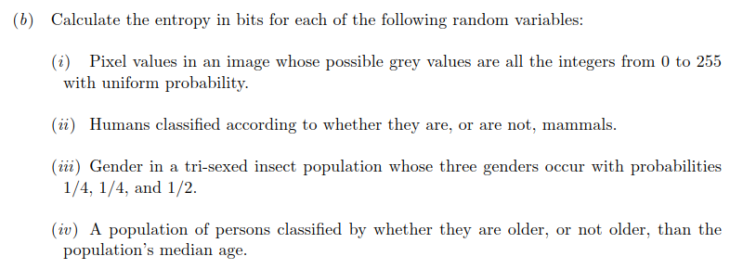
Quantum entanglement & Quantum Computing
2. Practice Sums : Exercise 1

Slide 8
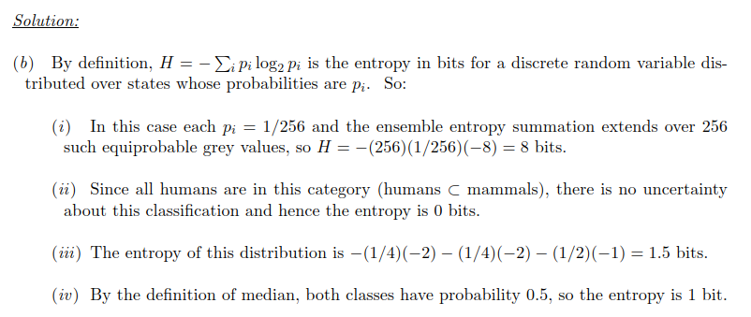
Quantum entanglement & Quantum Computing
2. Practice Sums : Exercise 1

Slide 9
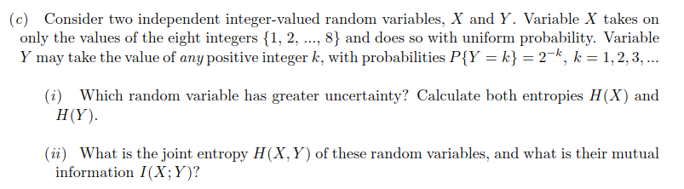
Quantum entanglement & Quantum Computing
2. Practice Sums : Exercise 1

Slide 10
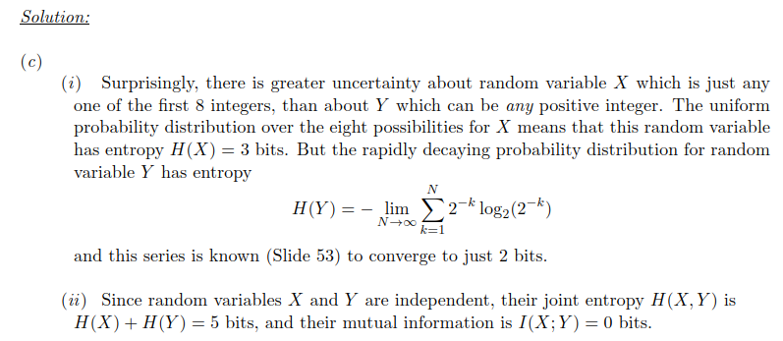
Quantum entanglement & Quantum Computing
2. Practice Sums : Exercise 1

Slide 11

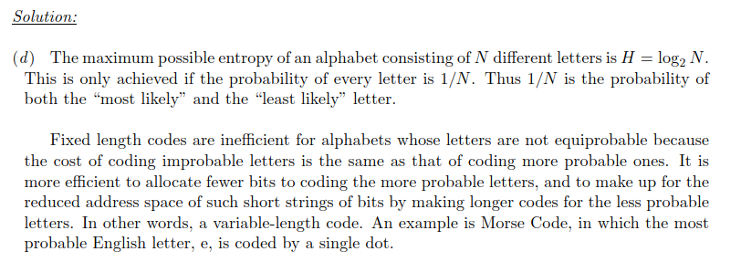
Quantum entanglement & Quantum Computing
2. Practice Sums

Slide 12

Quantum entanglement & Quantum Computing
2. Practice Sums: Exercise 2

Slide 13
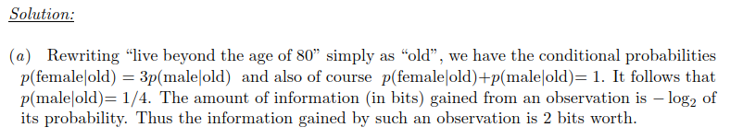
Quantum entanglement & Quantum Computing
2. Practice Sums: Exercise 2

Slide 14
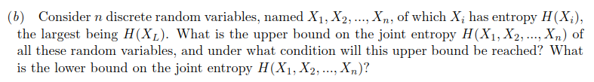
Quantum entanglement & Quantum Computing
2. Practice Sums: Exercise 2

Slide 15
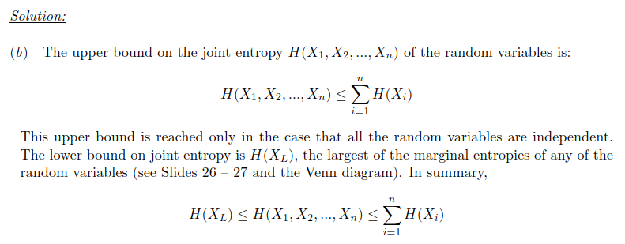
Quantum entanglement & Quantum Computing
2. Practice Sums: Exercise 2

Slide 16
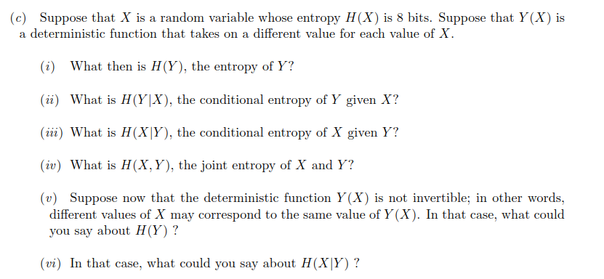
Quantum entanglement & Quantum Computing
2. Practice Sums: Exercise 2

Slide 17
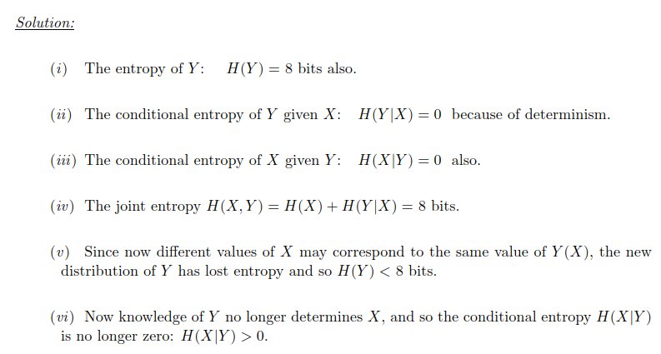
Quantum entanglement & Quantum Computing
2. Practice Sums: Exercise 2

Slide 18
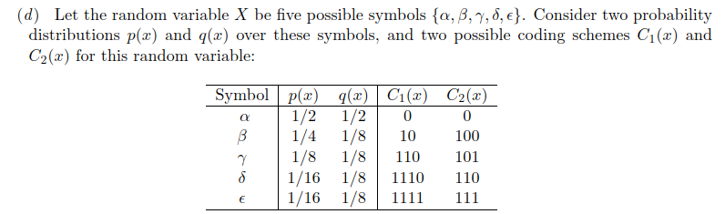
Quantum entanglement & Quantum Computing
2. Practice Sums: Exercise 2

Slide 19
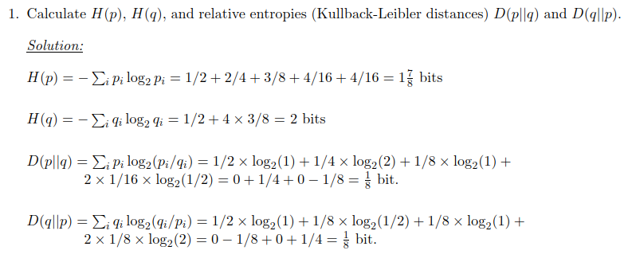
Quantum entanglement & Quantum Computing
2. Practice Sums: Exercise 2

Slide 20
Quantum entanglement & Quantum Computing
2. Practice Sums: Exercise 2

Slide 21
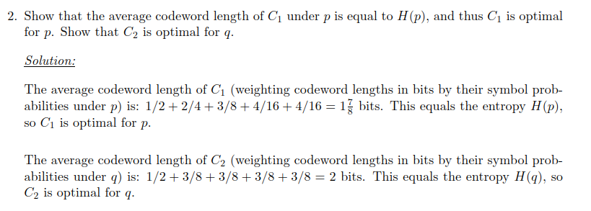
Quantum entanglement & Quantum Computing
2. Practice Sums: Exercise 2

Slide 22
Quantum entanglement & Quantum Computing
2. Practice Sums: Exercise 2

Slide 23
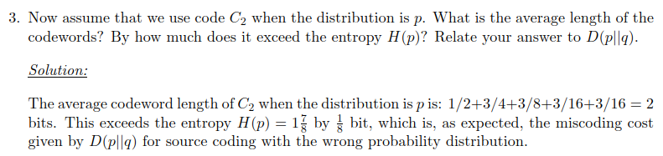
Quantum entanglement & Quantum Computing
2. Practice Sums : Exercise 2

Slide 24
Quantum entanglement & Quantum Computing
2. Practice Sums : Exercise 2

Slide 25
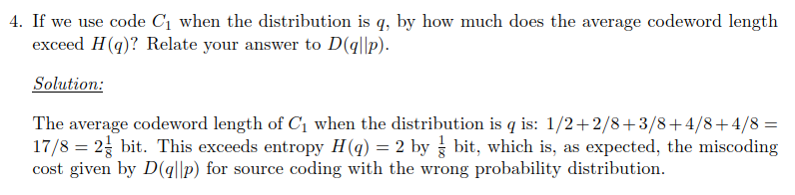
Quantum entanglement & Quantum Computing
2. Practice Sums : Exercise 2

Slide 26
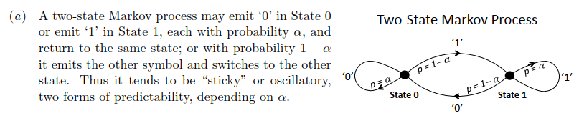
Quantum entanglement & Quantum Computing
2. Practice Sums: Exercise 3

Slide 27
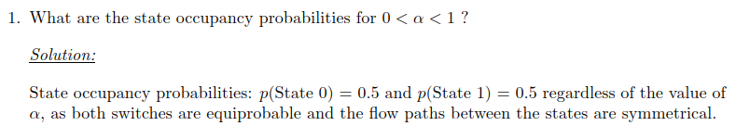
Quantum entanglement & Quantum Computing
2. Practice Sums: Exercise 3

Slide 28
Quantum entanglement & Quantum Computing
2. Practice Sums: Exercise 3

Slide 29
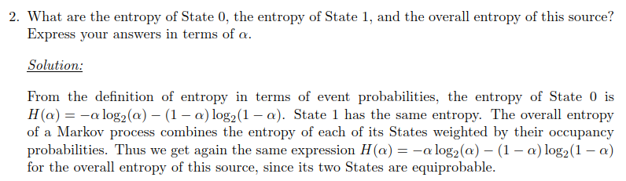
Quantum entanglement & Quantum Computing
2. Practice Sums: Exercise 3

Slide 30
Quantum entanglement & Quantum Computing
2. Practice Sums: Exercise 3

Slide 31
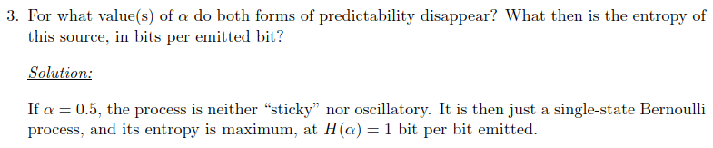
Quantum entanglement & Quantum Computing
2. Practice Sums: Exercise 3

Slide 32
THANK YOU
Dr. Kaustav Bhowmick
Department of Electronics & Communication
Engineering
kaustavbhowmick@pes.edu

