Slide 1

Quantum Entanglement and Quantum Computing
Dr. Kaustav Bhowmick
Electronics & Communication
Engineering

Slide 2

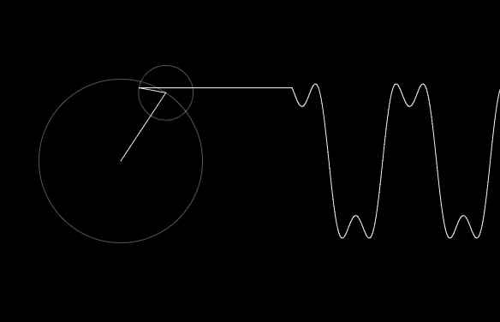
Quantum Entanglement and Quantum Computing
Quantum computing
Dr. Kaustav Bhowmick
Electronics & Communication Engineering
Source: Google images

Slide 3
Quantum entanglement & Quantum Computing
Contents
Classical and Quantum Computing
Quantum Algorithms

Slide 4
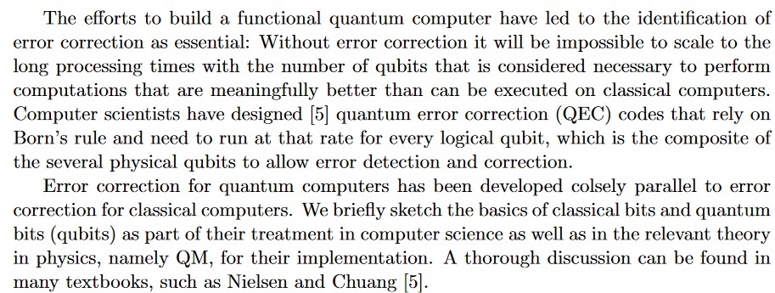
Quantum entanglement & Quantum Computing
1. Classical and Quantum Computing

Slide 5
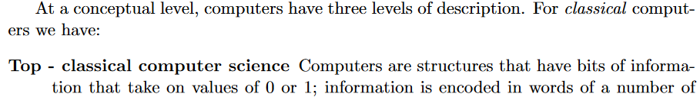
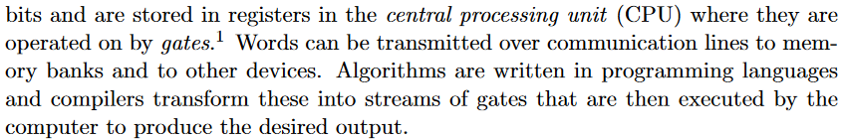
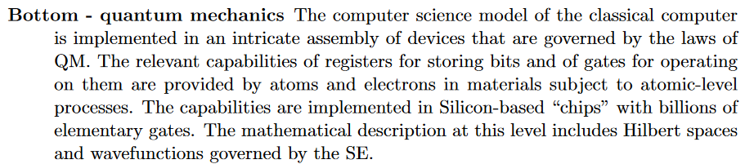
Quantum entanglement & Quantum Computing
1. Classical and Quantum Computing

Slide 6
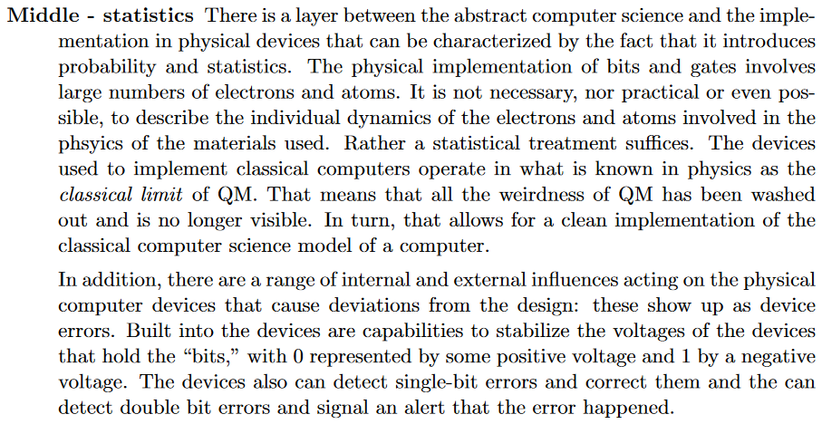
Quantum entanglement & Quantum Computing
1. Classical and Quantum Computing

Slide 7
Quantum entanglement & Quantum Computing
1. Classical and Quantum Computing

Slide 8
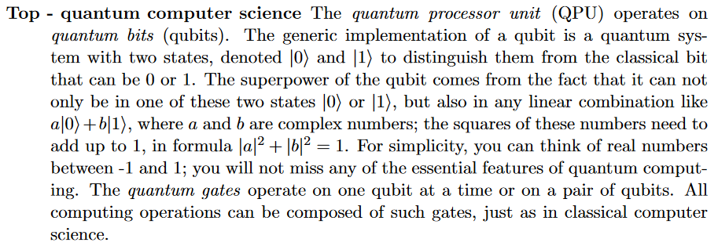
Quantum entanglement & Quantum Computing
1. Classical and Quantum Computing

Slide 9
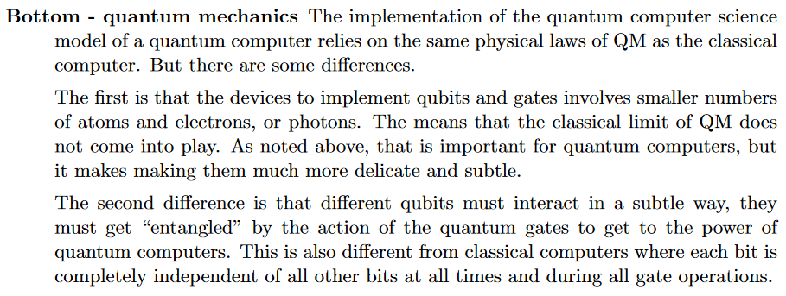
Quantum entanglement & Quantum Computing
1. Classical and Quantum Computing

Slide 10
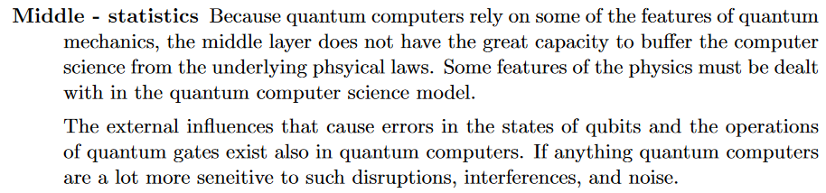
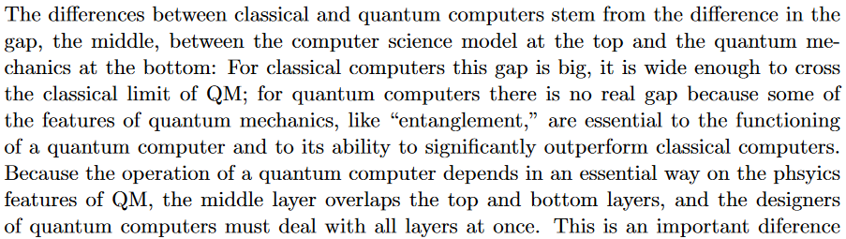
Quantum entanglement & Quantum Computing
1. Classical and Quantum Computing

Slide 11
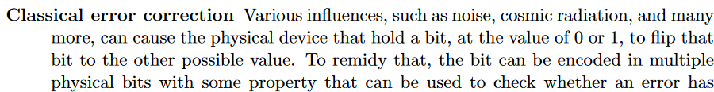
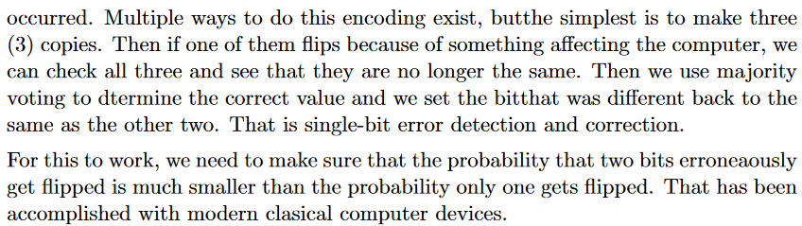
Quantum entanglement & Quantum Computing
1. Classical and Quantum Computing

Slide 12
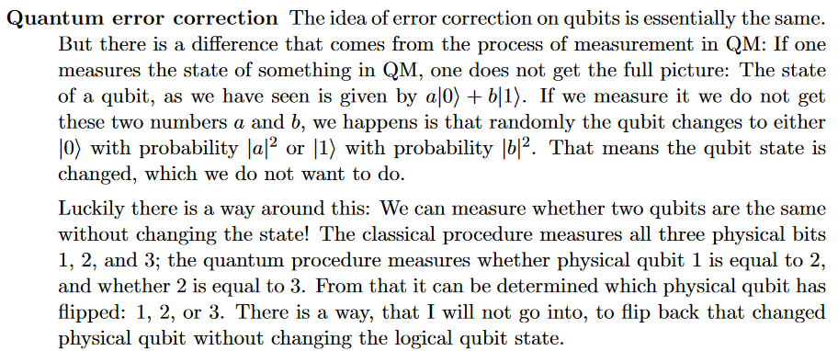
Quantum entanglement & Quantum Computing
1. Classical and Quantum Computing

Slide 13
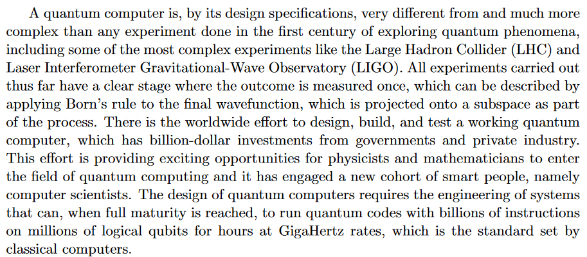
Quantum entanglement & Quantum Computing
1. Classical and Quantum Computing

Slide 14

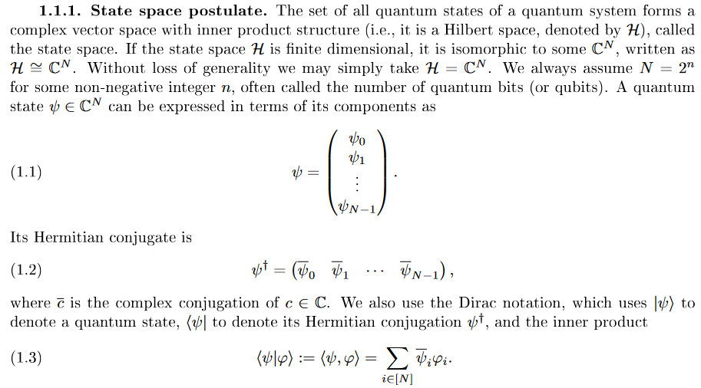
Quantum entanglement & Quantum Computing
2. Quantum Algorithms

Slide 15
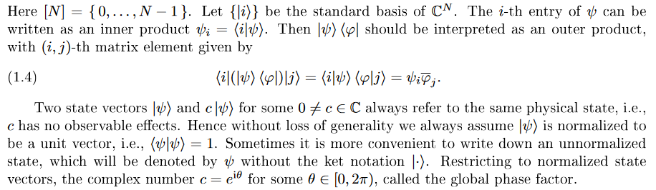
Quantum entanglement & Quantum Computing
2. Quantum Algorithms

Slide 16
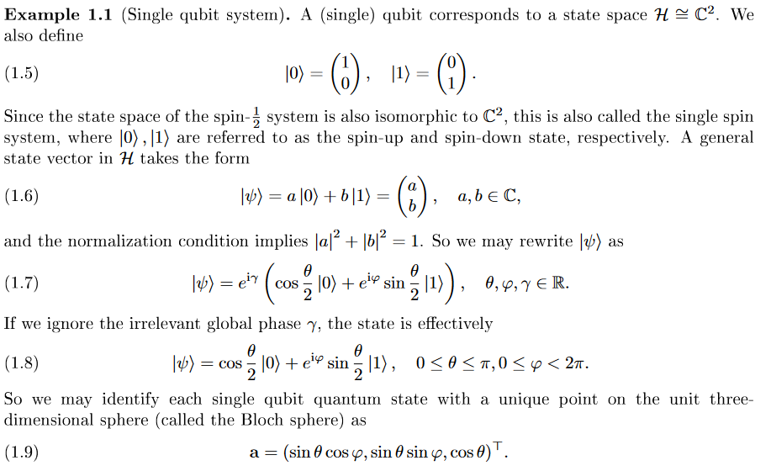
Quantum entanglement & Quantum Computing
2. Quantum Algorithms

Slide 17
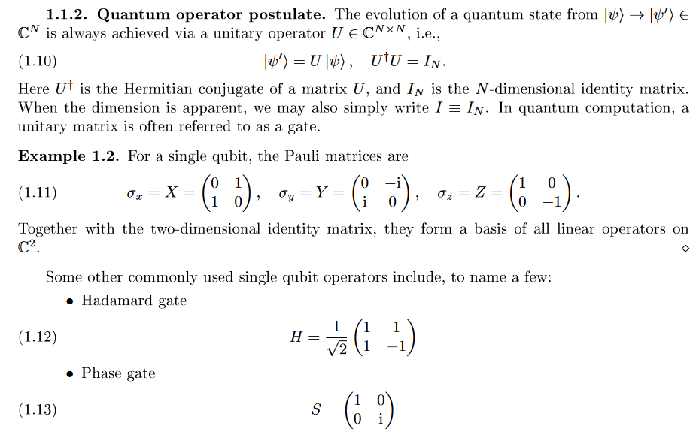
Quantum entanglement & Quantum Computing
2. Quantum Algorithms

Slide 18
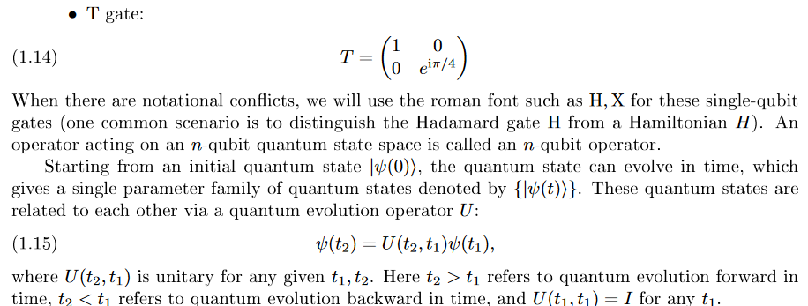
Quantum entanglement & Quantum Computing
2. Quantum Algorithms

Slide 19
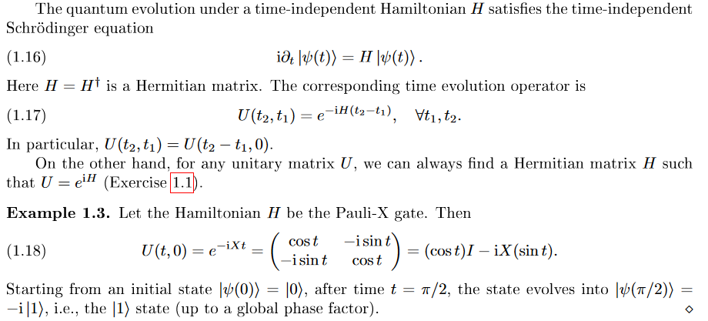
Quantum entanglement & Quantum Computing
2. Quantum Algorithms

Slide 20
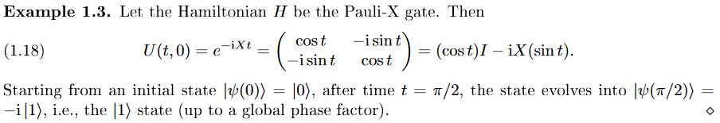
Quantum entanglement & Quantum Computing
2. Quantum Algorithms

Slide 21
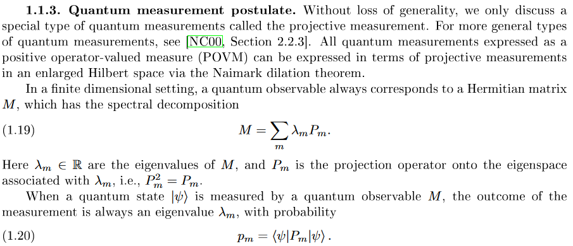
Quantum entanglement & Quantum Computing
2. Quantum Algorithms

Slide 22
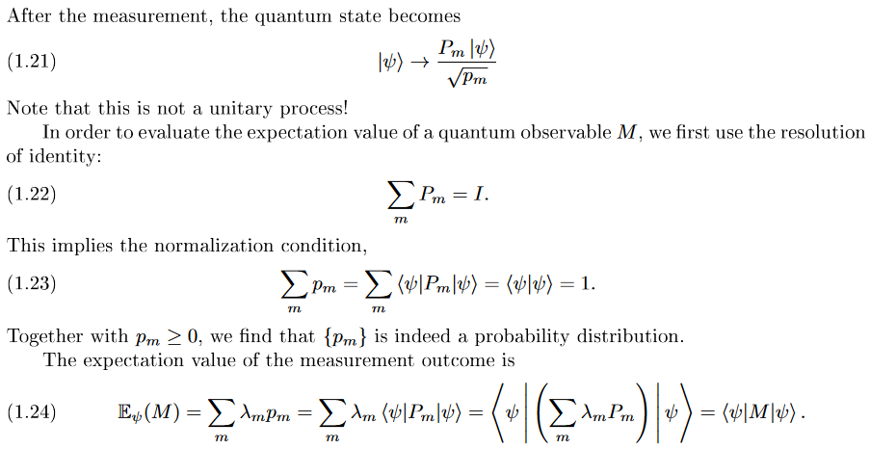
Quantum entanglement & Quantum Computing
2. Quantum Algorithms

Slide 23
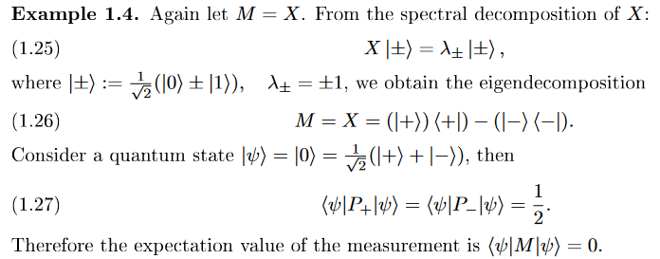
Quantum entanglement & Quantum Computing
2. Quantum Algorithms

Slide 24
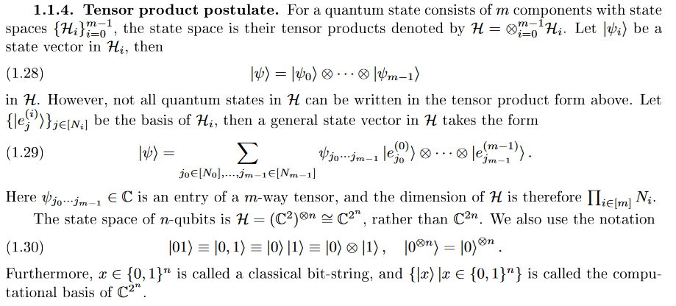
Quantum entanglement & Quantum Computing
2. Quantum Algorithms

Slide 25
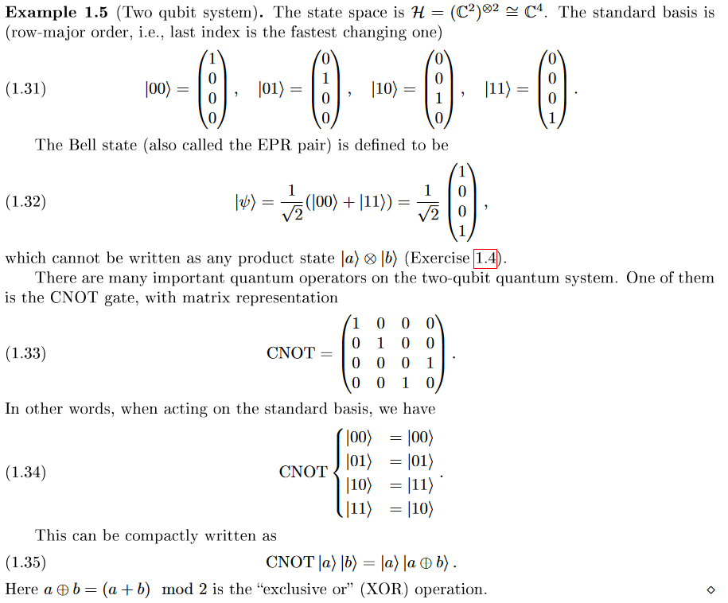
Quantum entanglement & Quantum Computing
2. Quantum Algorithms

Slide 26
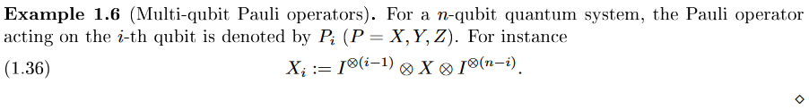
Quantum entanglement & Quantum Computing
2. Quantum Algorithms

Slide 27
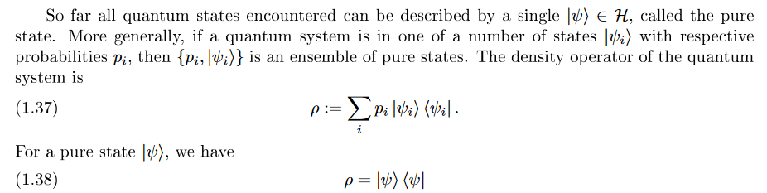
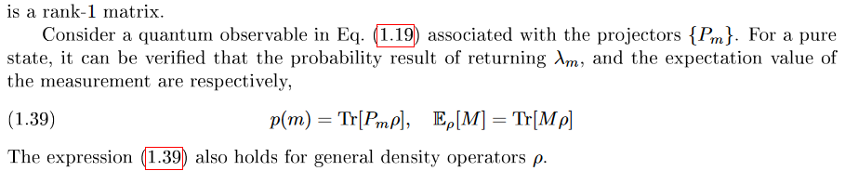
Quantum entanglement & Quantum Computing
2. Quantum Algorithms

Slide 28
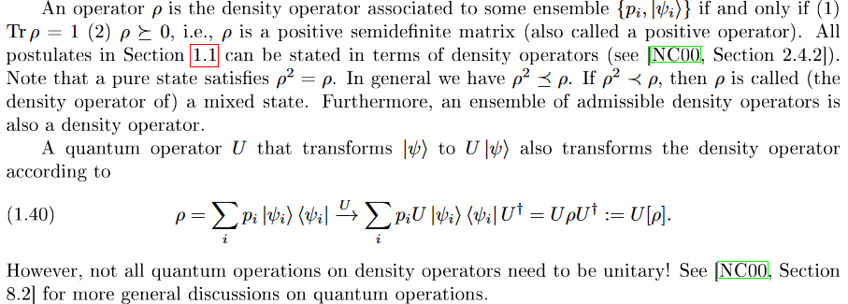
Quantum entanglement & Quantum Computing
2. Quantum Algorithms

Slide 29
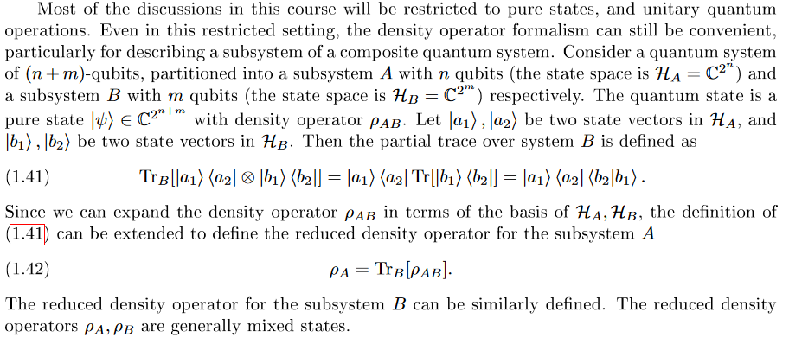
Quantum entanglement & Quantum Computing
2. Quantum Algorithms

Slide 30
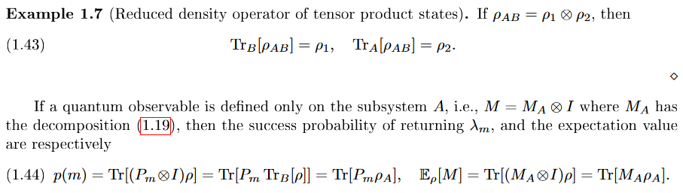
Quantum entanglement & Quantum Computing
2. Quantum Algorithms

Slide 31
THANK YOU
Dr. Kaustav Bhowmick
Department of Electronics & Communication
Engineering
kaustavbhowmick@pes.edu

