Slide 1

Quantum Entanglement and Quantum Computing
Dr. Kaustav Bhowmick
Electronics & Communication
Engineering

Slide 2

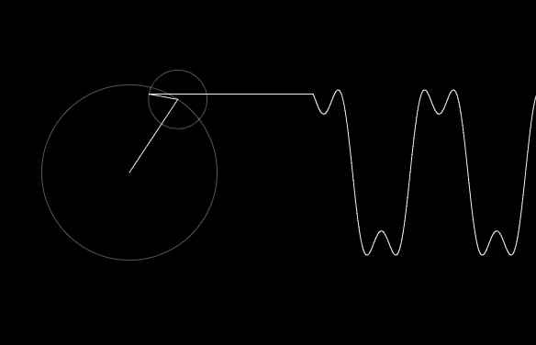
Quantum Entanglement and Quantum Computing
Quantum computing
Dr. Kaustav Bhowmick
Electronics & Communication Engineering
Source: Google images

Slide 3
Quantum entanglement & Quantum Computing
Contents
Quantum circuits
Quantum Fourier Transform

Slide 4
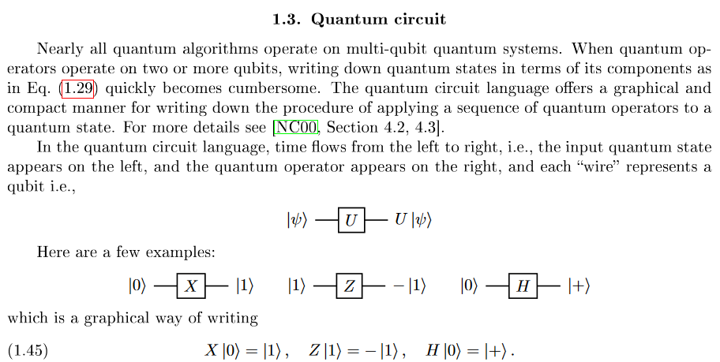
Quantum entanglement & Quantum Computing
1. Quantum Circuit

Slide 5
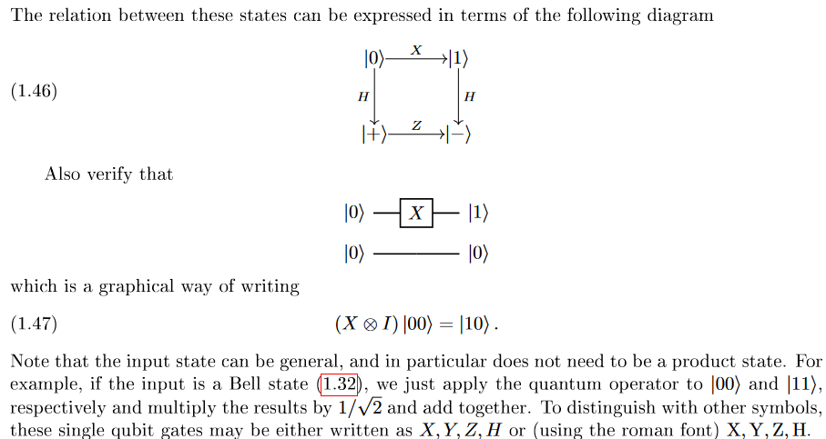
Quantum entanglement & Quantum Computing
1. Quantum Circuit

Slide 6
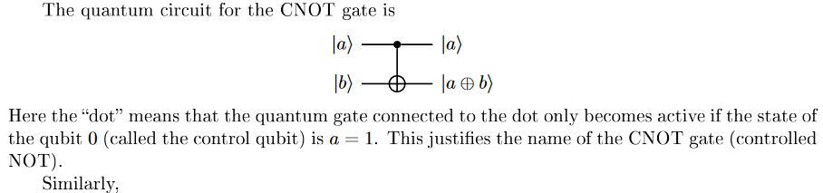
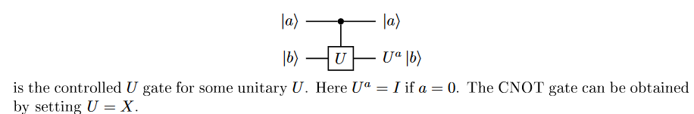
Quantum entanglement & Quantum Computing
1. Quantum Circuit

Slide 7
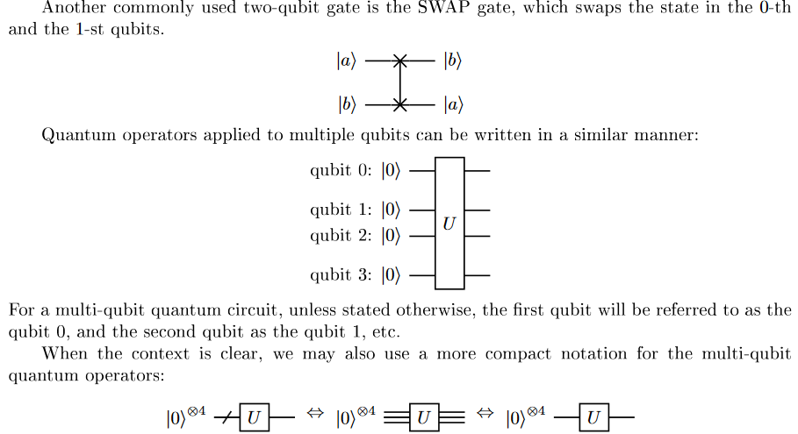
Quantum entanglement & Quantum Computing
1. Quantum Circuit

Slide 8
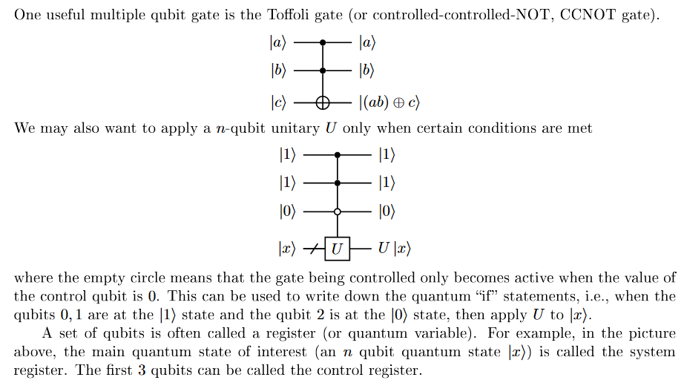
Quantum entanglement & Quantum Computing
1. Quantum Circuit

Slide 9
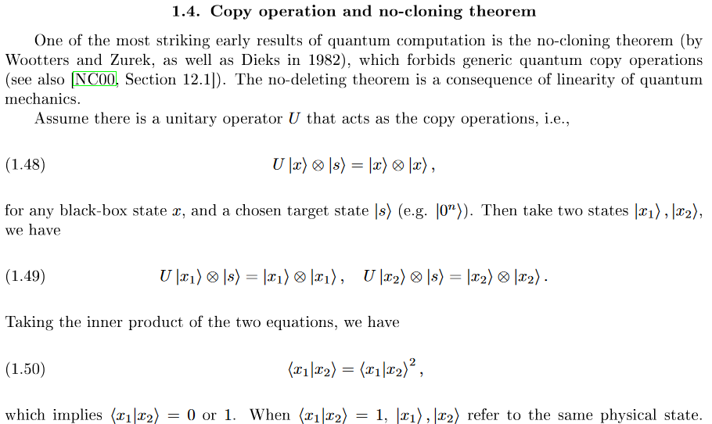
Quantum entanglement & Quantum Computing
1. Quantum Circuit

Slide 10
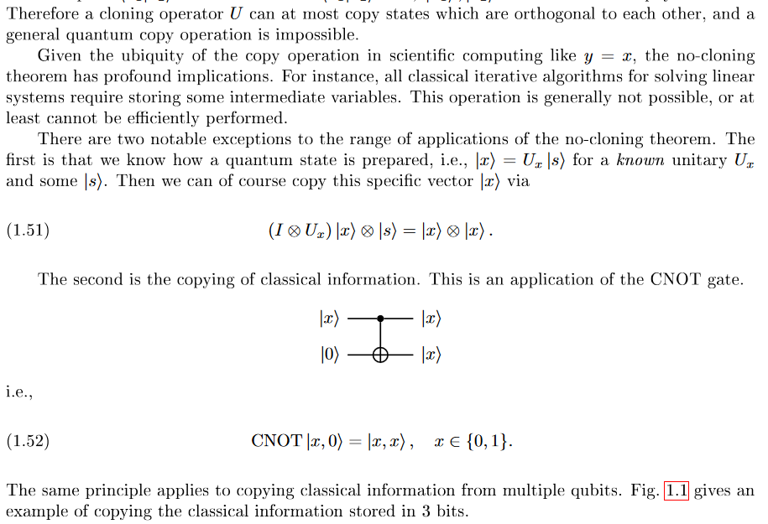
Quantum entanglement & Quantum Computing
1. Quantum Circuit

Slide 11
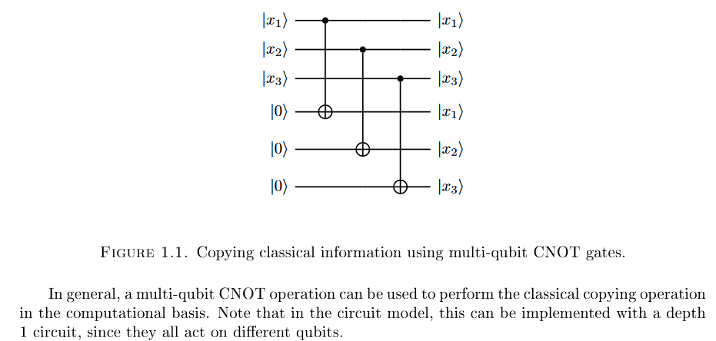
Quantum entanglement & Quantum Computing
1. Quantum Circuit

Slide 12
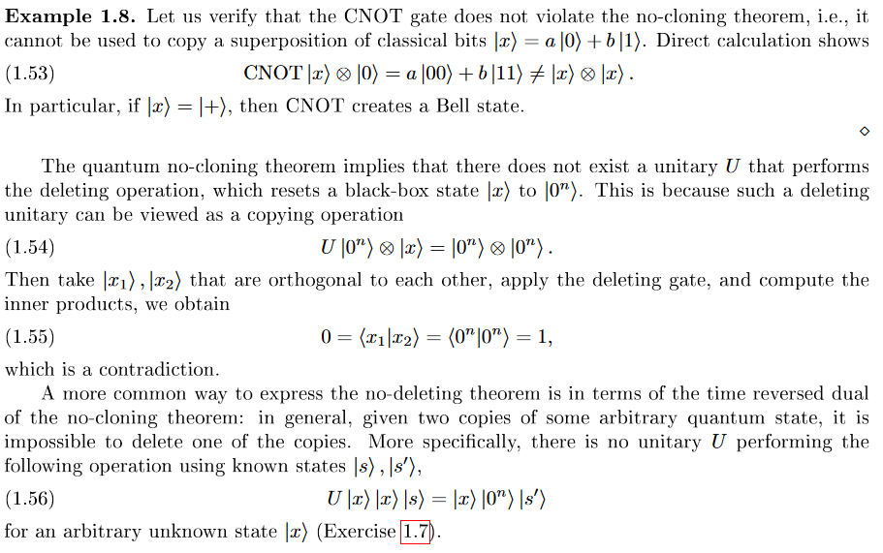
Quantum entanglement & Quantum Computing
1. Quantum Circuit

Slide 13
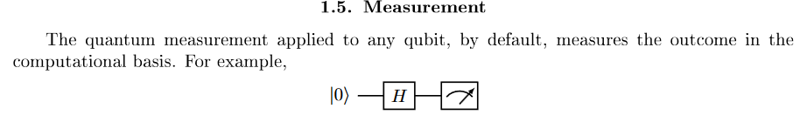
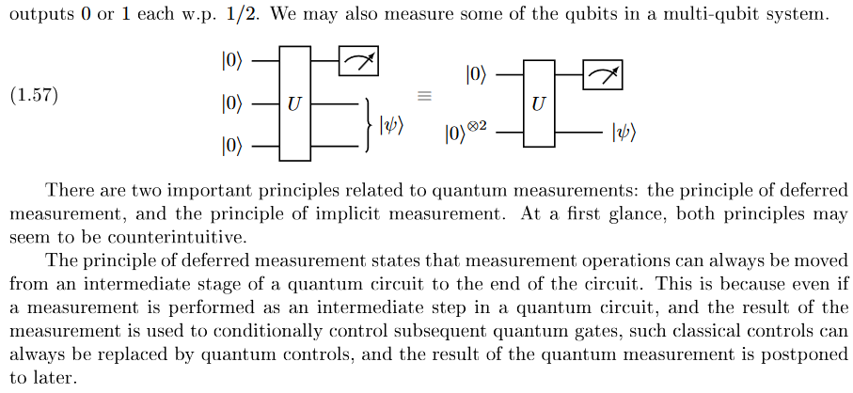
Quantum entanglement & Quantum Computing
1. Quantum Circuit

Slide 14
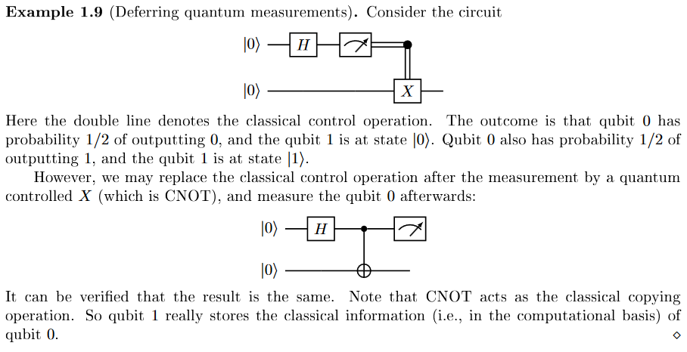
Quantum entanglement & Quantum Computing
1. Quantum Circuit

Slide 15
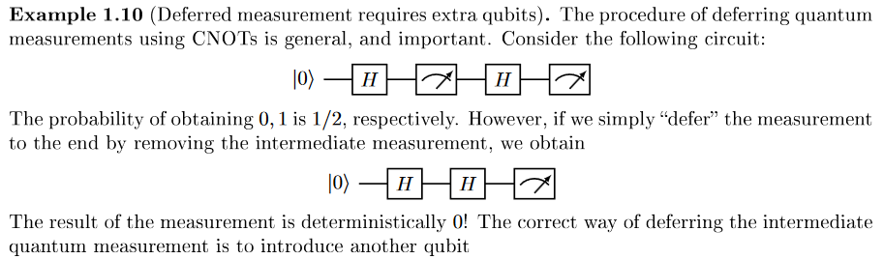
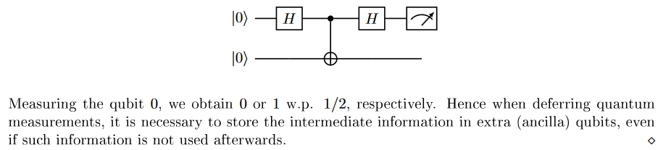
Quantum entanglement & Quantum Computing
1. Quantum Circuit

Slide 16
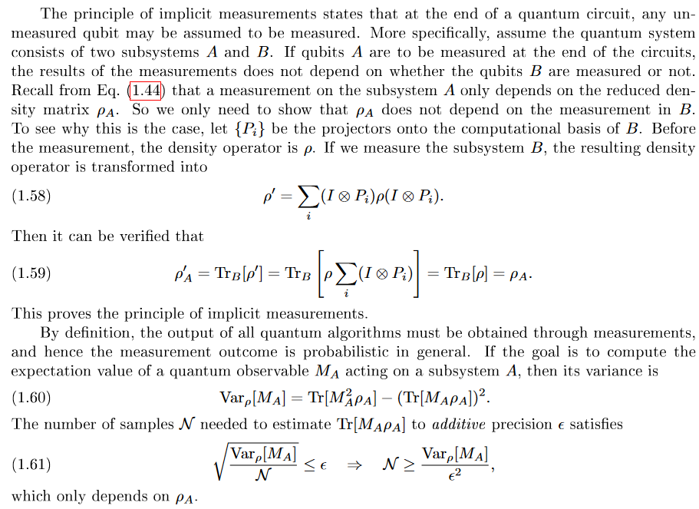
Quantum entanglement & Quantum Computing
1. Quantum Circuit

Slide 17
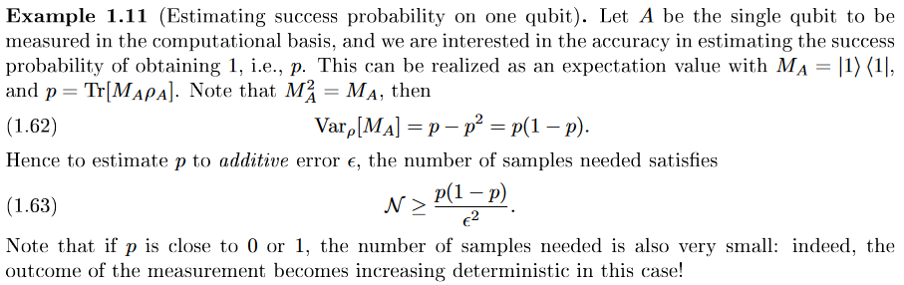
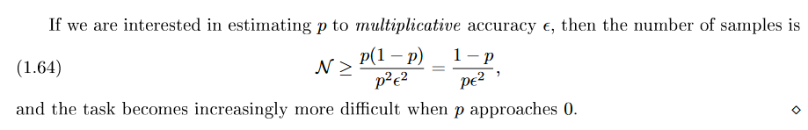
Quantum entanglement & Quantum Computing
1. Quantum Circuit

Slide 18
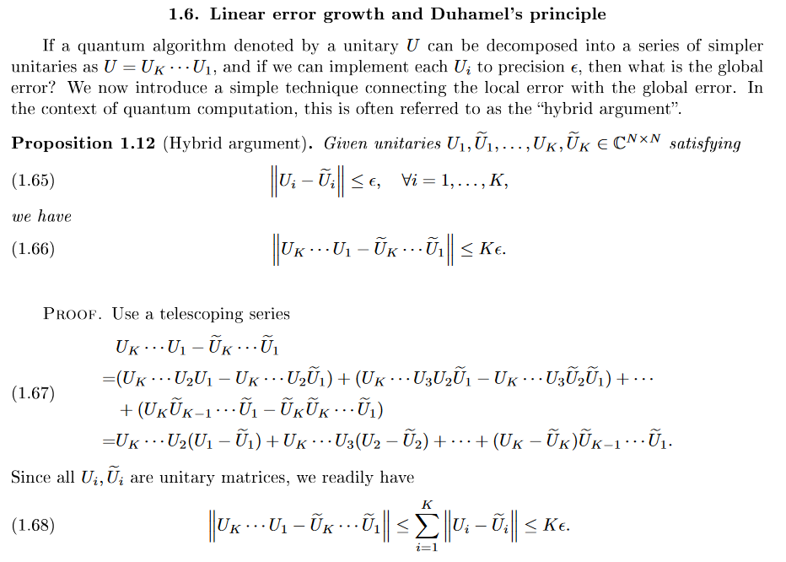
Quantum entanglement & Quantum Computing
1. Quantum Circuit

Slide 19
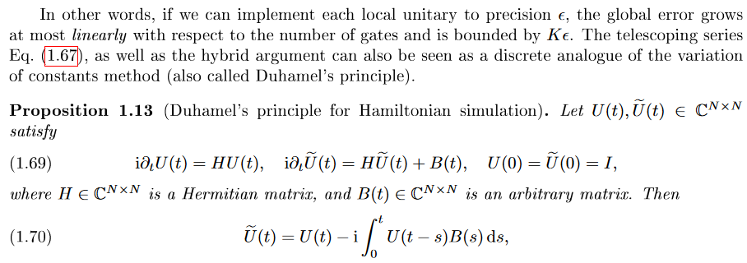
Quantum entanglement & Quantum Computing
1. Quantum Circuit

Slide 20
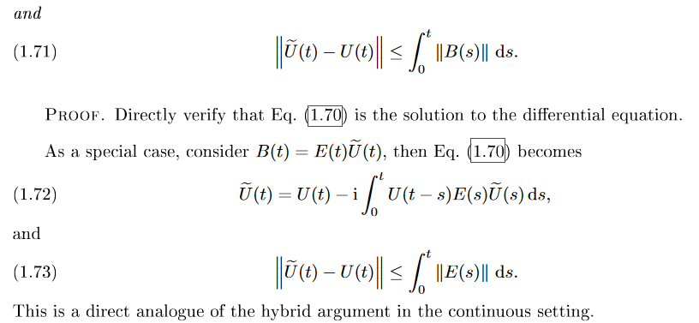
Quantum entanglement & Quantum Computing
1. Quantum Circuit

Slide 21
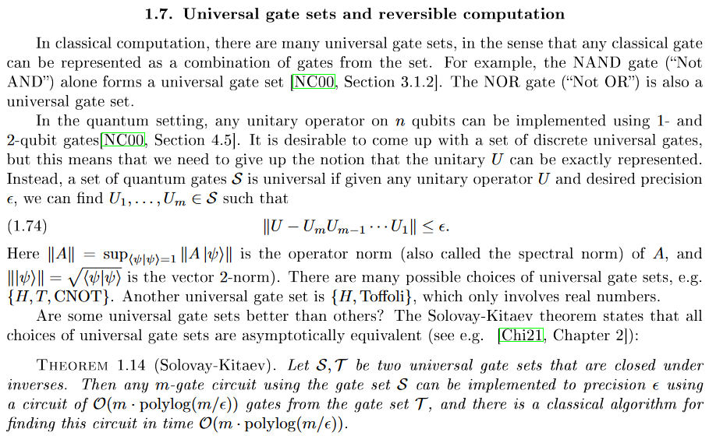
Quantum entanglement & Quantum Computing
1. Quantum Circuit

Slide 22
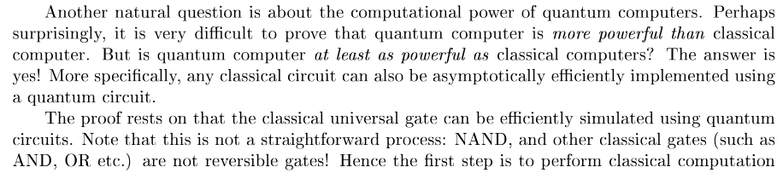
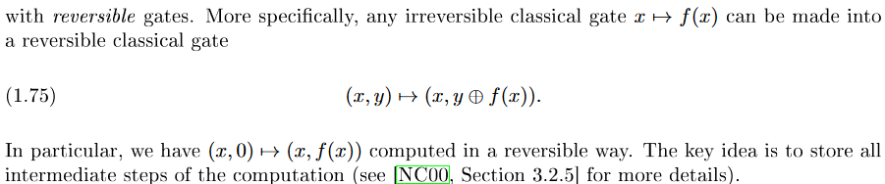
Quantum entanglement & Quantum Computing
1. Quantum Circuit

Slide 23
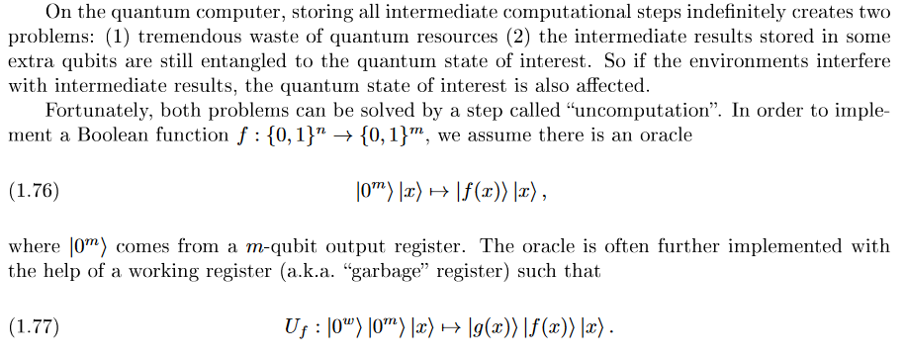
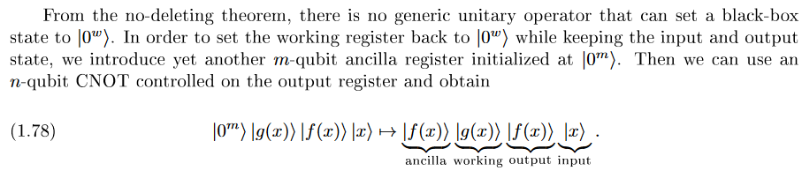
Quantum entanglement & Quantum Computing
1. Quantum Circuit

Slide 24
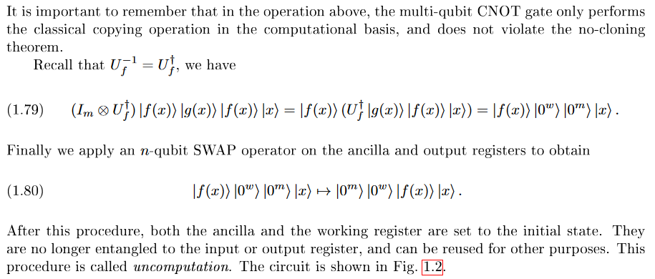
Quantum entanglement & Quantum Computing
1. Quantum Circuit

Slide 25
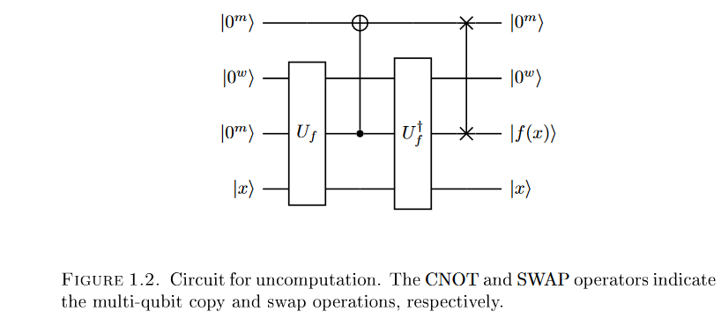
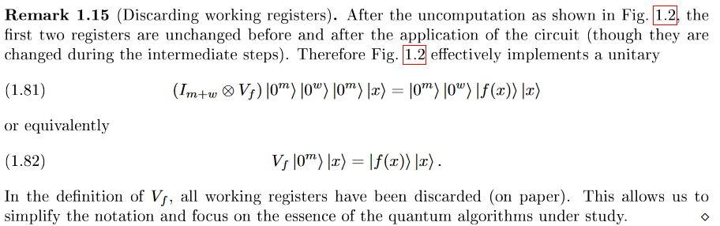
Quantum entanglement & Quantum Computing
1. Quantum Circuit

Slide 26
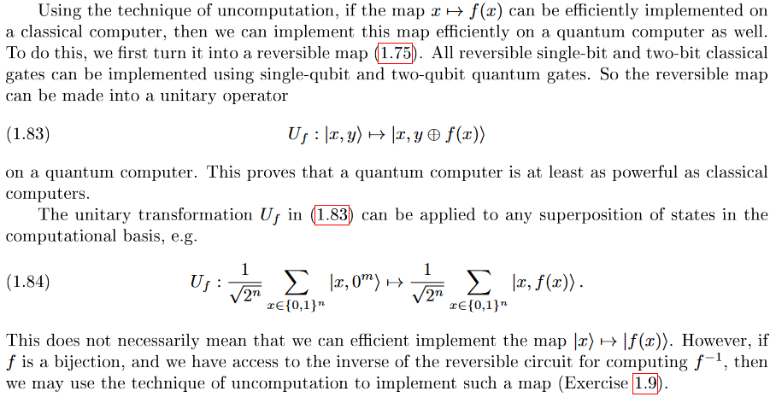
Quantum entanglement & Quantum Computing
1. Quantum Circuit

Slide 27
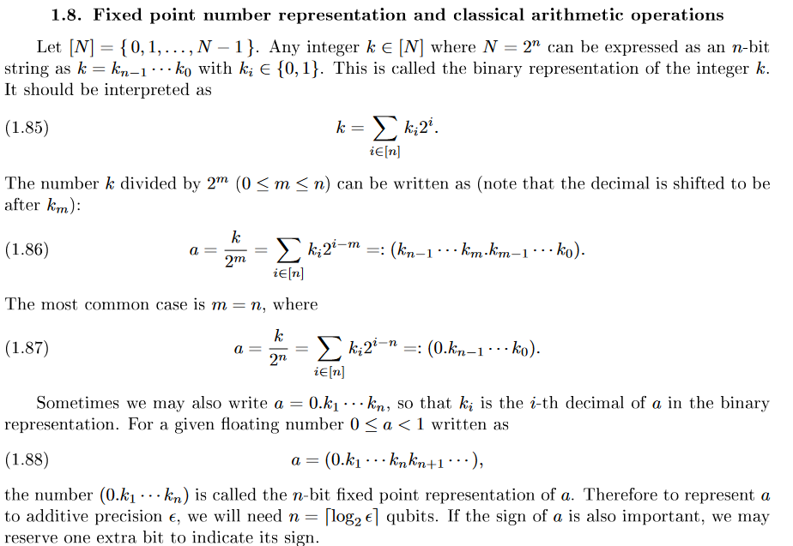
Quantum entanglement & Quantum Computing
1. Quantum Circuit

Slide 28
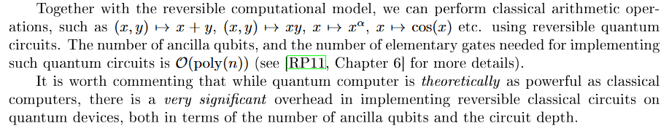
Quantum entanglement & Quantum Computing
1. Quantum Circuit

Slide 29
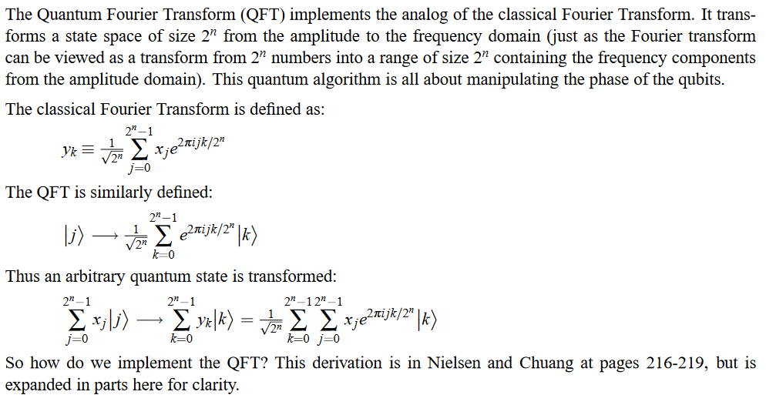
Quantum entanglement & Quantum Computing
2. Quantum Fourier Transform

Slide 30
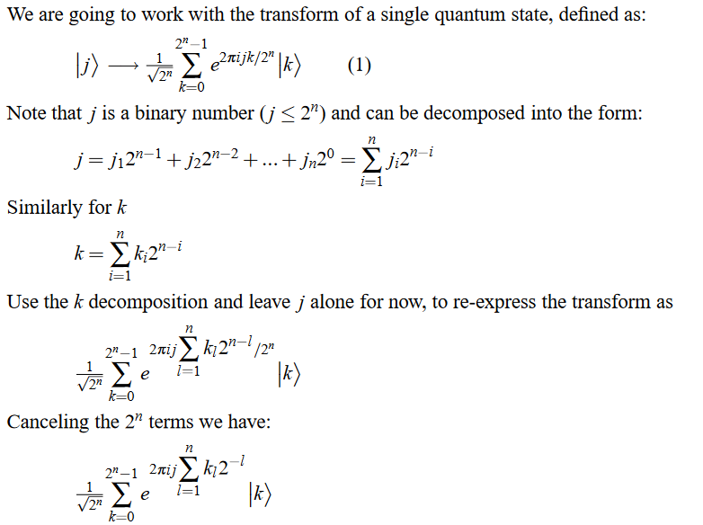
Quantum entanglement & Quantum Computing
2. Quantum Fourier Transform

Slide 31
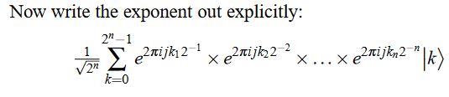
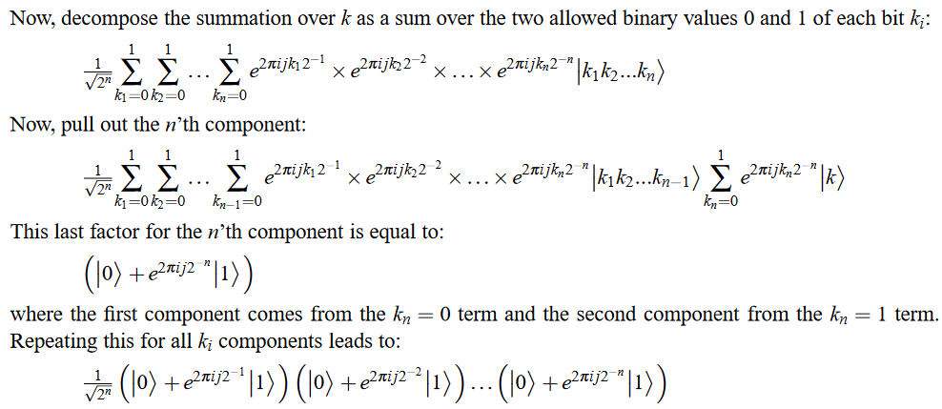
Quantum entanglement & Quantum Computing
2. Quantum Fourier Transform

Slide 32
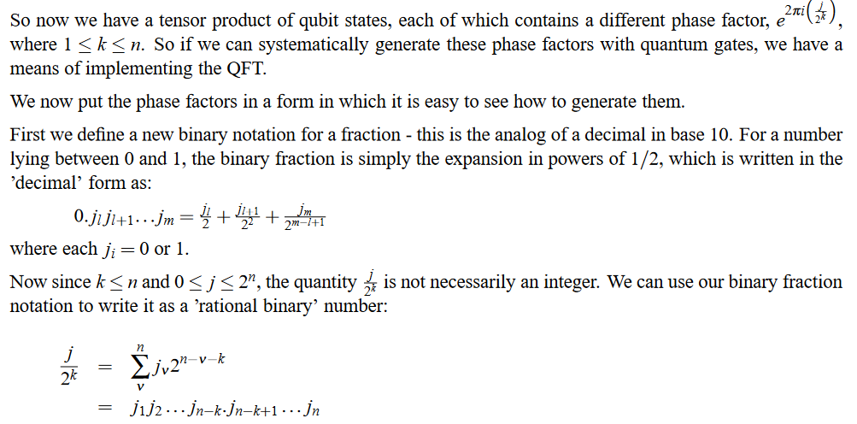
Quantum entanglement & Quantum Computing
2. Quantum Fourier Transform

Slide 33
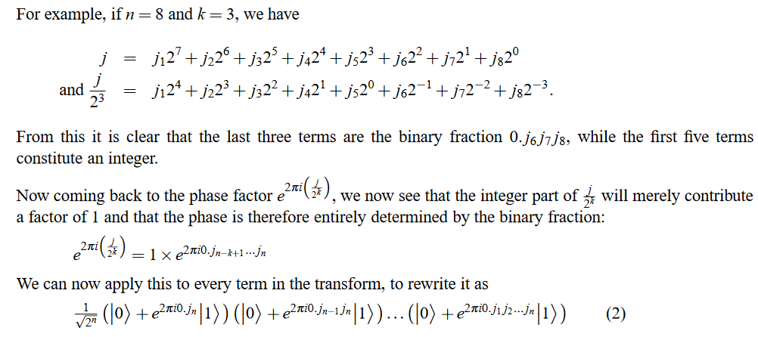
Quantum entanglement & Quantum Computing
2. Quantum Fourier Transform

Slide 34
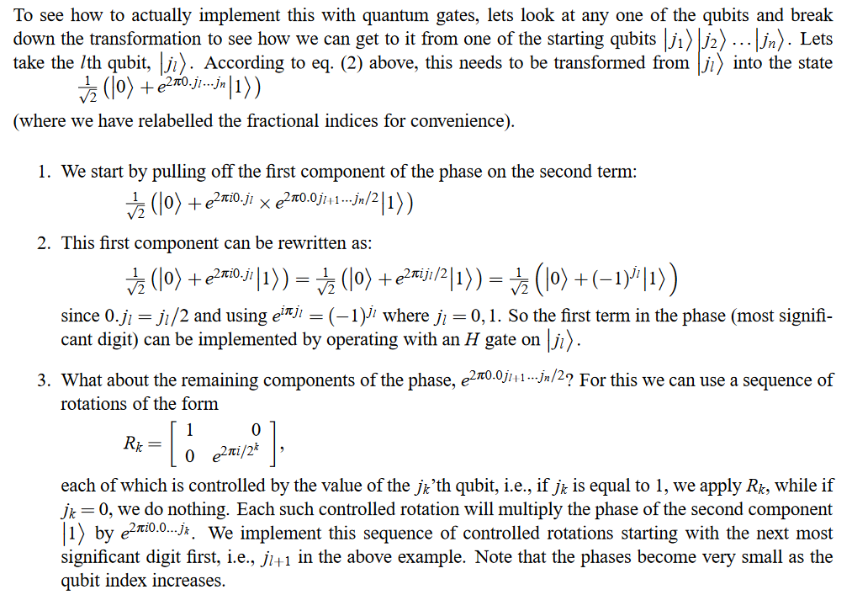
Quantum entanglement & Quantum Computing
2. Quantum Fourier Transform

Slide 35
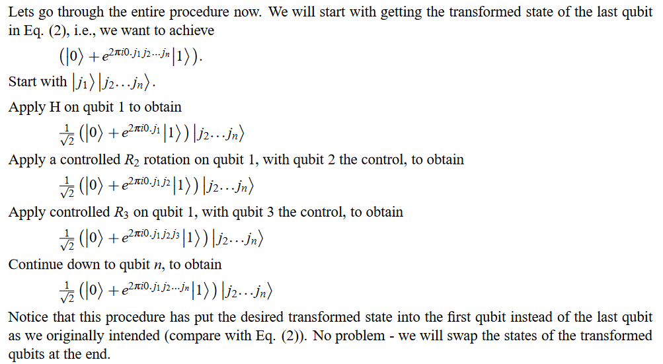
Quantum entanglement & Quantum Computing
2. Quantum Fourier Transform

Slide 36
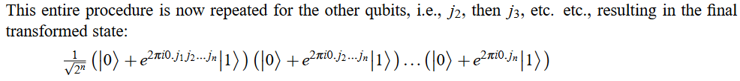
Quantum entanglement & Quantum Computing
2. Quantum Fourier Transform

Slide 37
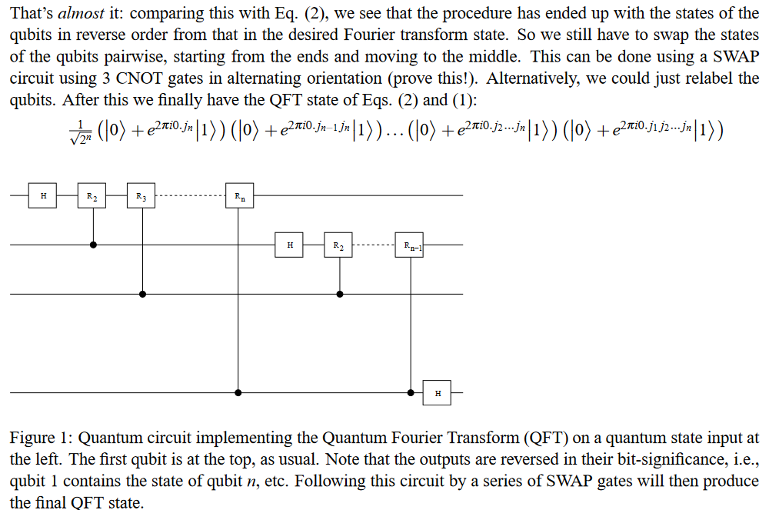
Quantum entanglement & Quantum Computing
2. Quantum Fourier Transform

Slide 38
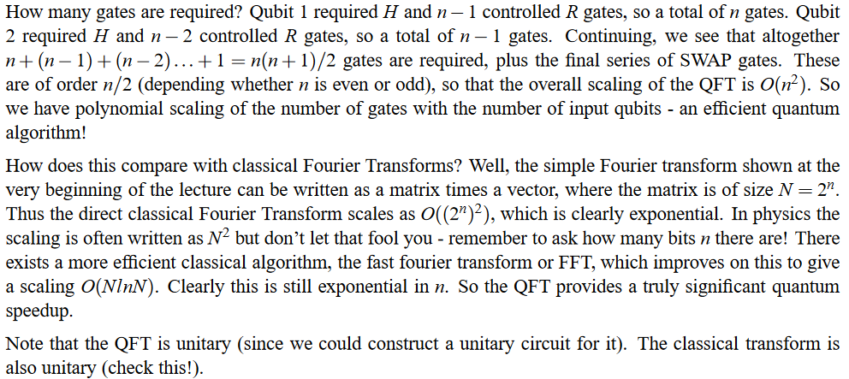
Quantum entanglement & Quantum Computing
2. Quantum Fourier Transform
https://jonathan-hui.medium.com/qc-quantum-fourier-transform-45436f90a43

Slide 39
THANK YOU
Dr. Kaustav Bhowmick
Department of Electronics & Communication
Engineering
kaustavbhowmick@pes.edu

