Slide 1

Quantum Entanglement and Quantum Computing
Dr. Kaustav Bhowmick
Electronics & Communication
Engineering

Slide 2


Quantum Entanglement and Quantum Computing
Entanglement and Quantum Information
Dr. Kaustav Bhowmick
Electronics & Communication Engineering
Source: Google images

Slide 3
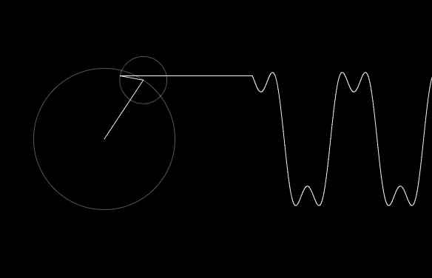
Quantum entanglement & Quantum Computing
Contents
Quantum phase estimation
QFT using phase estimation

Slide 4
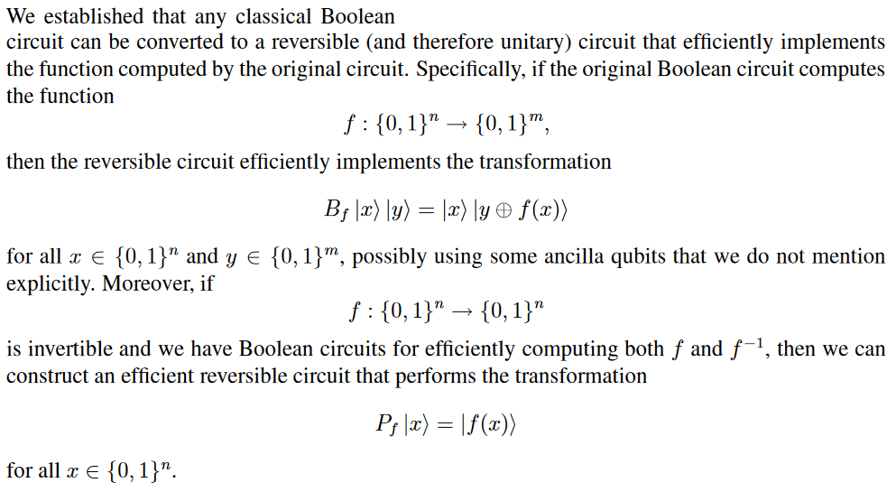
Quantum entanglement & Quantum Computing
1. Quantum Phase Estimation

Slide 5
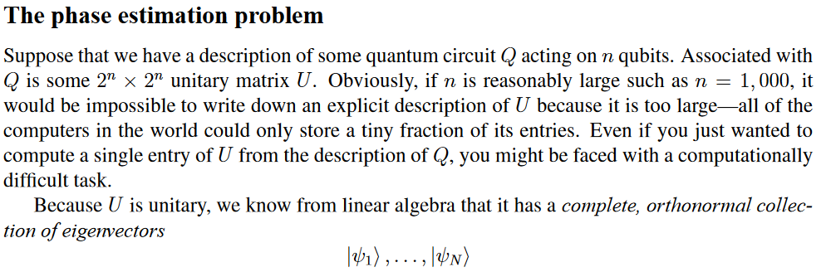
Quantum entanglement & Quantum Computing
1. Quantum Phase Estimation

Slide 6
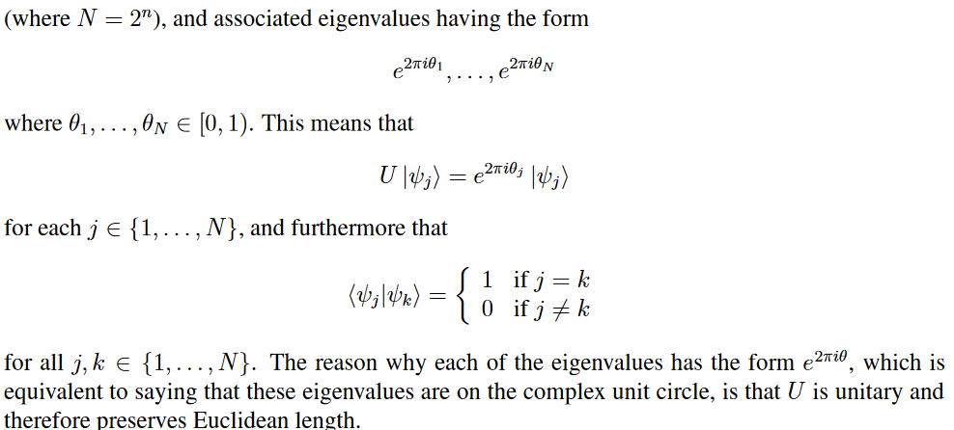
Quantum entanglement & Quantum Computing
1. Quantum Phase Estimation

Slide 7
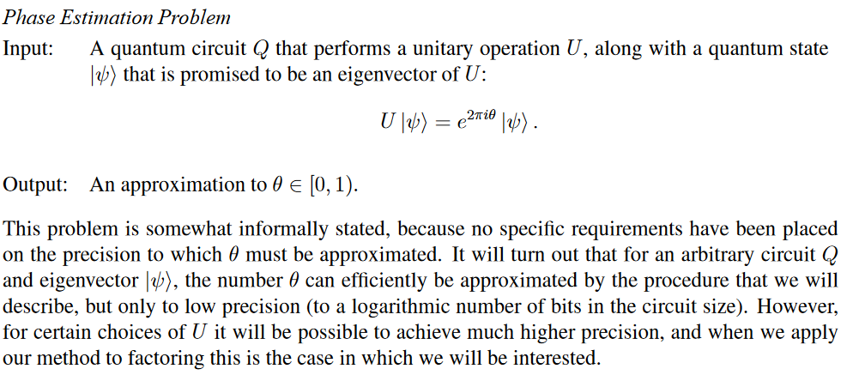
Quantum entanglement & Quantum Computing
1. Quantum Phase Estimation

Slide 8
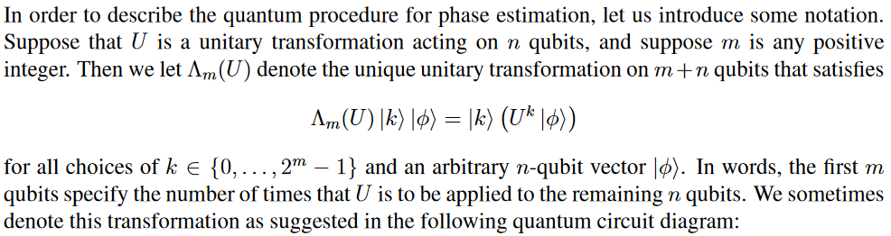
Quantum entanglement & Quantum Computing
1. Quantum Phase Estimation

Slide 9
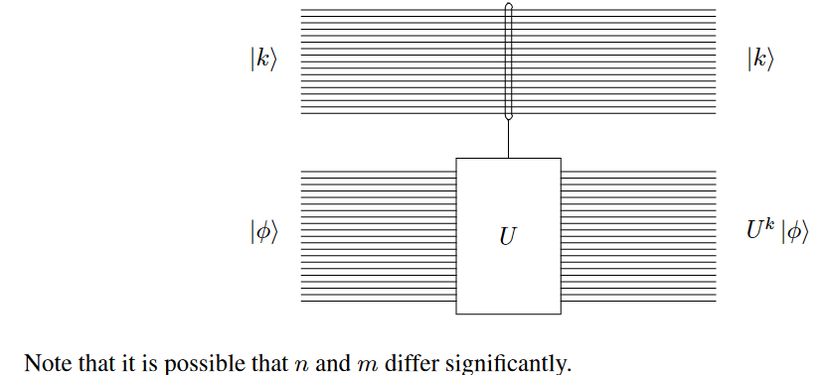
Quantum entanglement & Quantum Computing
1. Quantum Phase Estimation

Slide 10
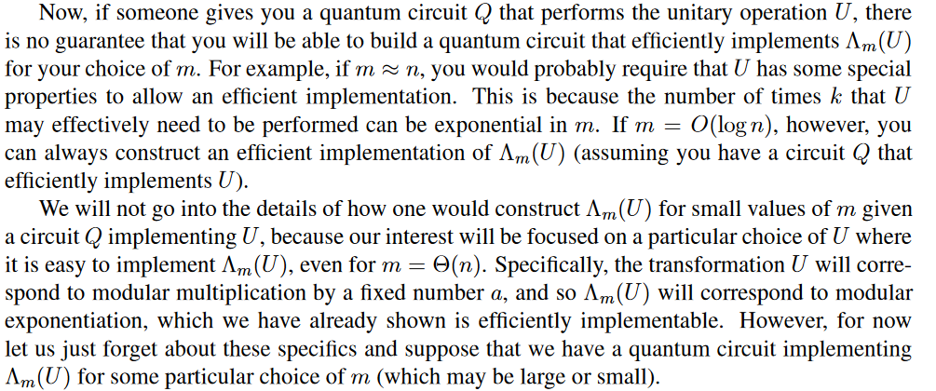
Quantum entanglement & Quantum Computing
1. Quantum Phase Estimation

Slide 11
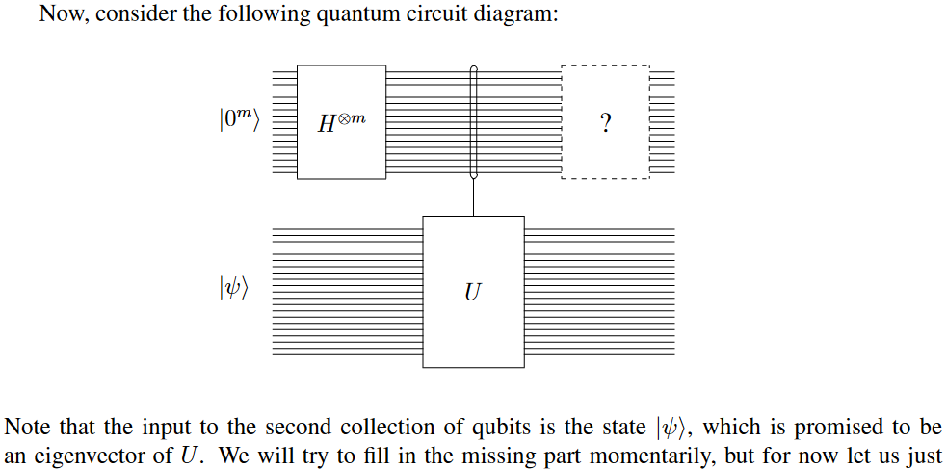
Quantum entanglement & Quantum Computing
1. Quantum Phase Estimation

Slide 12
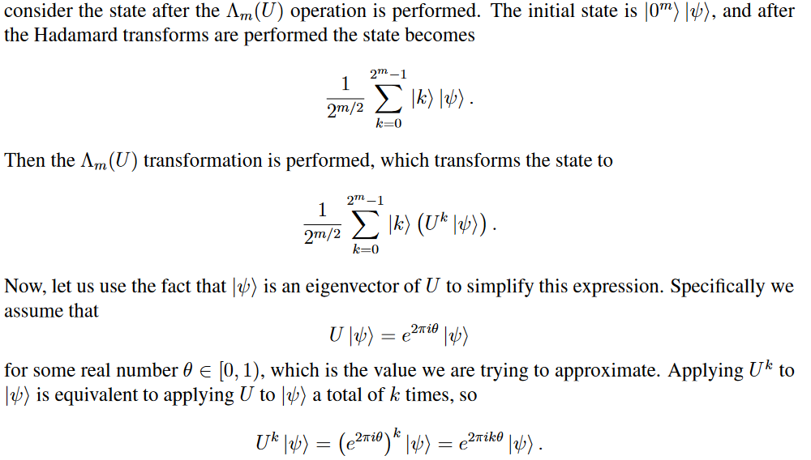
Quantum entanglement & Quantum Computing
1. Quantum Phase Estimation

Slide 13
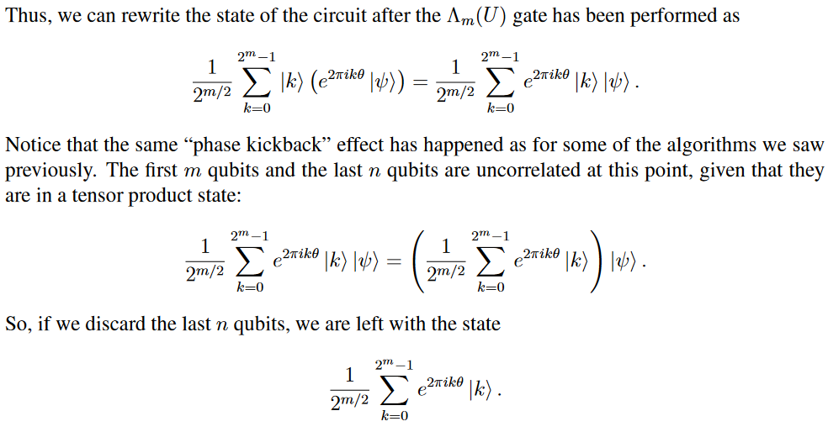
Quantum entanglement & Quantum Computing
1. Quantum Phase Estimation

Slide 14
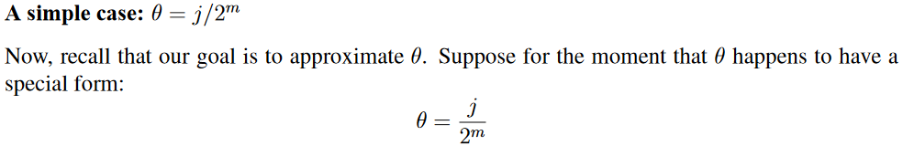
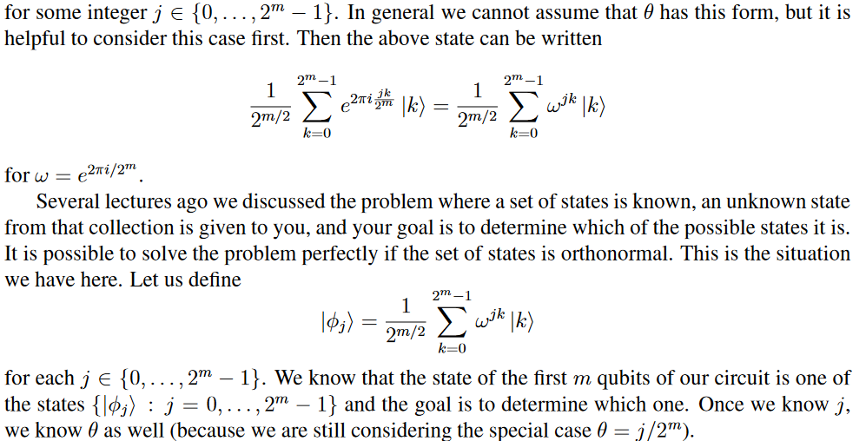
Quantum entanglement & Quantum Computing
1. Quantum Phase Estimation

Slide 15
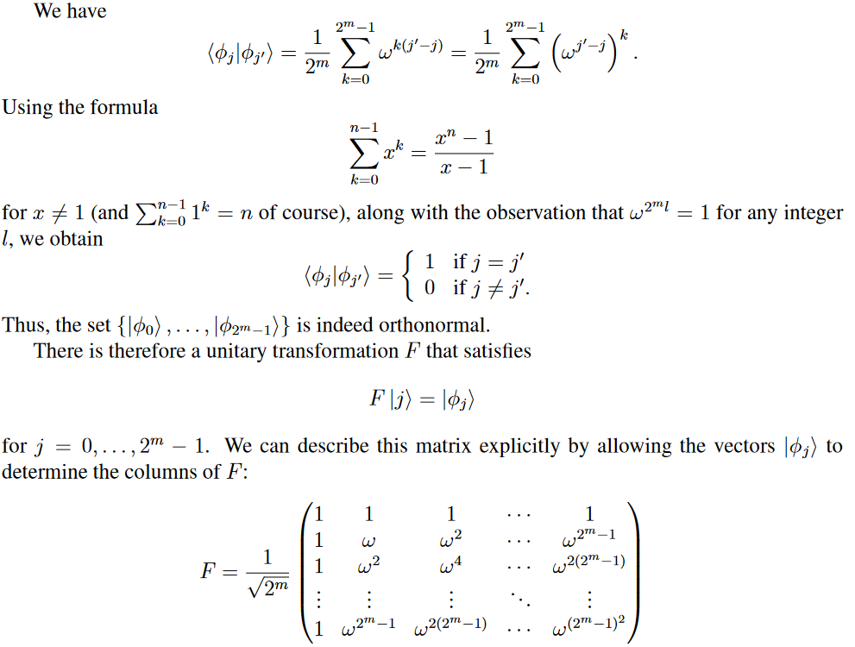
Quantum entanglement & Quantum Computing
1. Quantum Phase Estimation

Slide 16
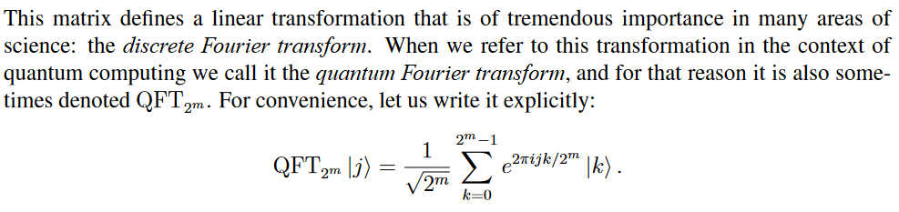
Quantum entanglement & Quantum Computing
1. Quantum Phase Estimation

Slide 17
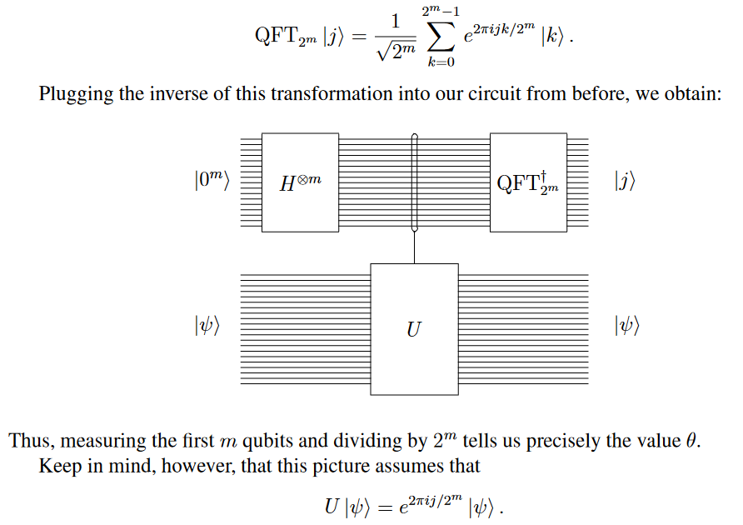
Quantum entanglement & Quantum Computing
1. Quantum Phase Estimation

Slide 18
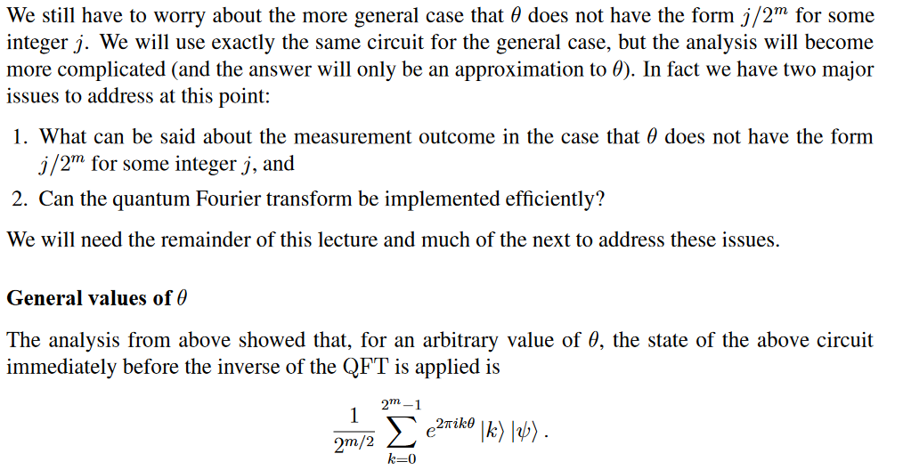
Quantum entanglement & Quantum Computing
1. Quantum Phase Estimation

Slide 19
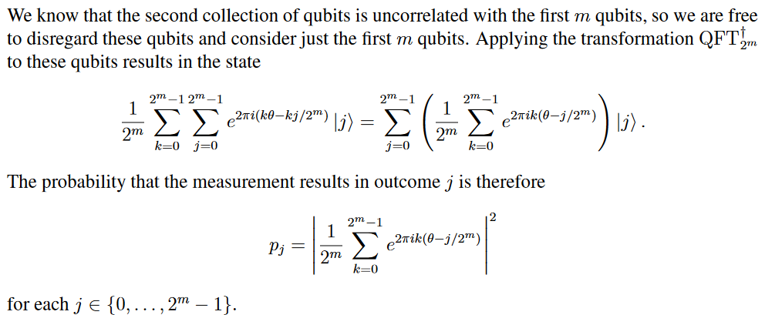
Quantum entanglement & Quantum Computing
1. Quantum Phase Estimation

Slide 20
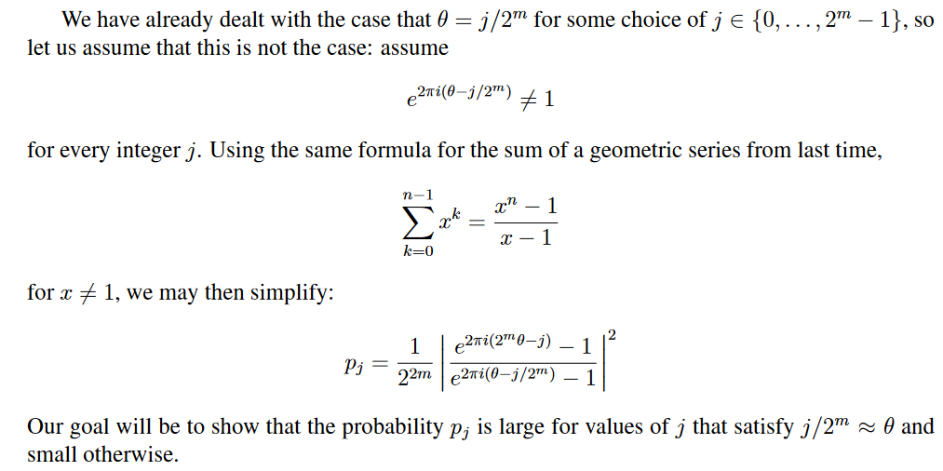
Quantum entanglement & Quantum Computing
1. Quantum Phase Estimation

Slide 21
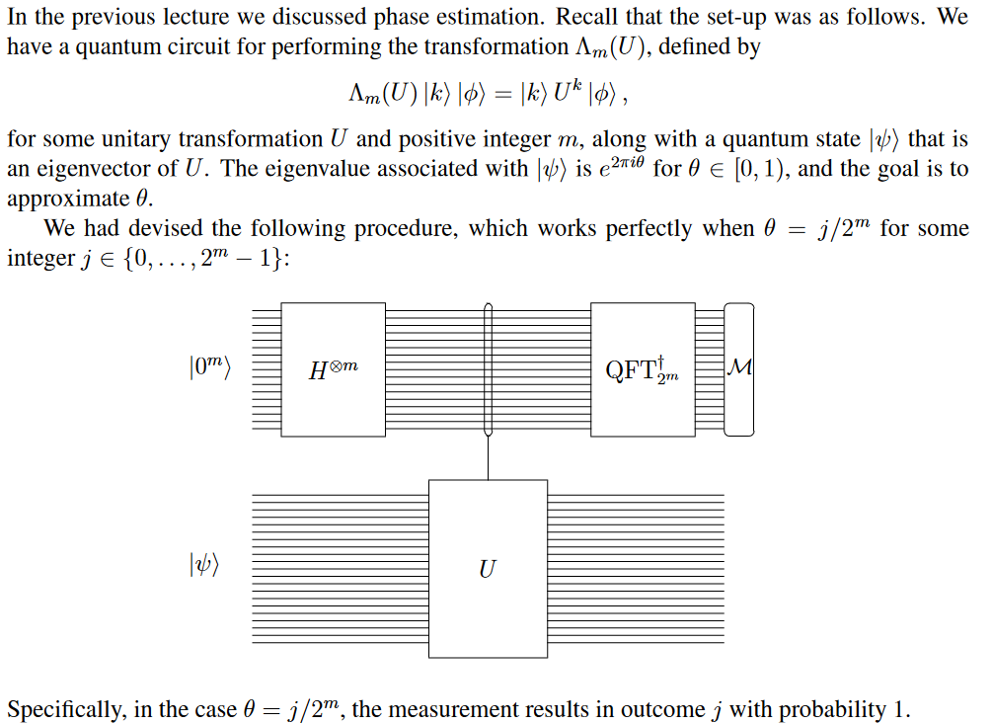
Quantum entanglement & Quantum Computing
2. QFT using Phase estimation

Slide 22
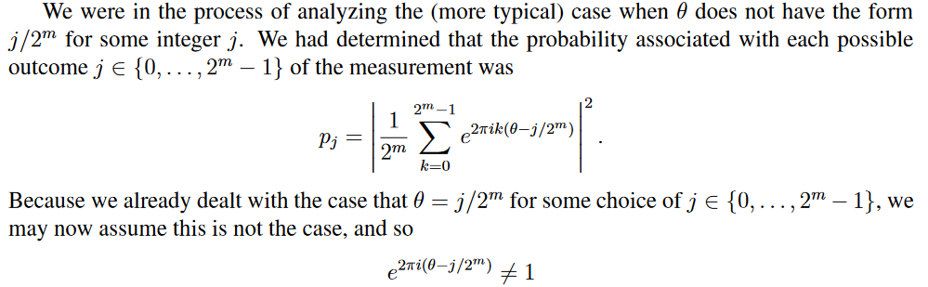
Quantum entanglement & Quantum Computing
2. QFT using Phase estimation

Slide 23
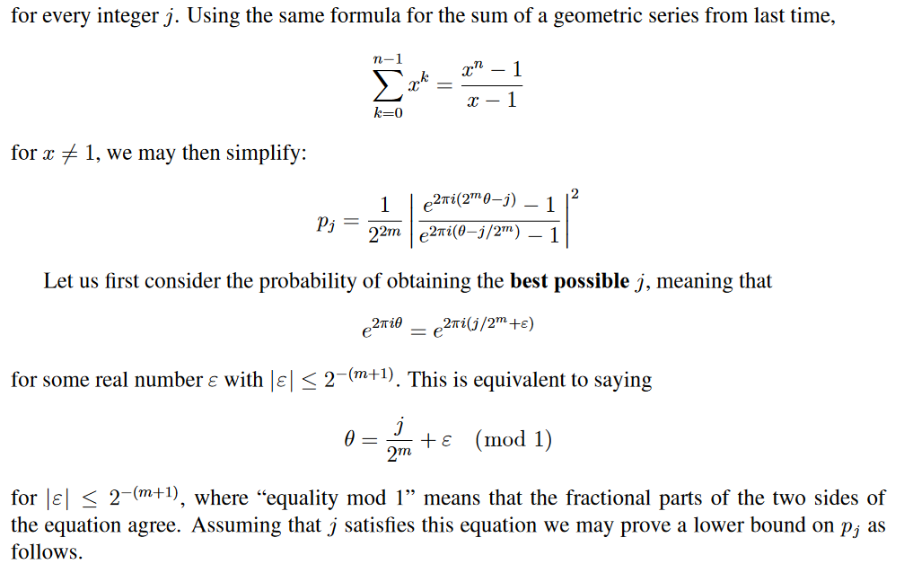
Quantum entanglement & Quantum Computing
2. QFT using Phase estimation

Slide 24
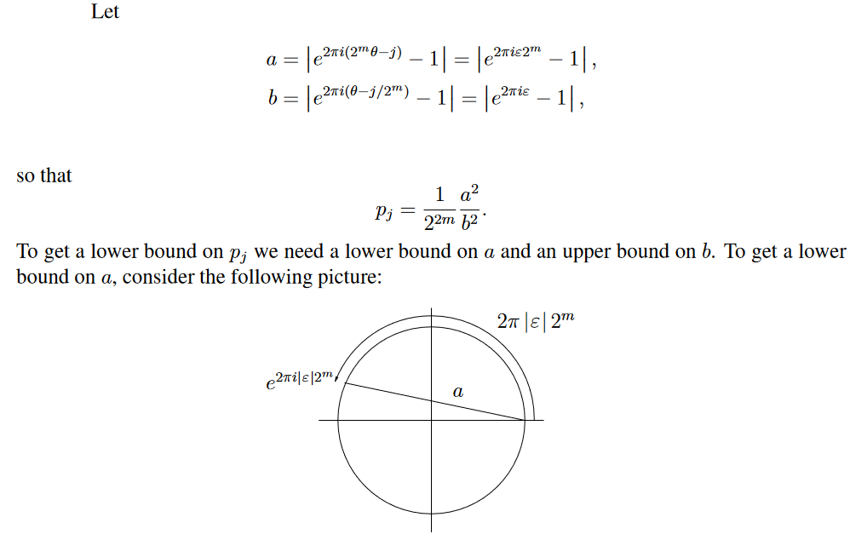
Quantum entanglement & Quantum Computing
2. QFT using Phase estimation

Slide 25
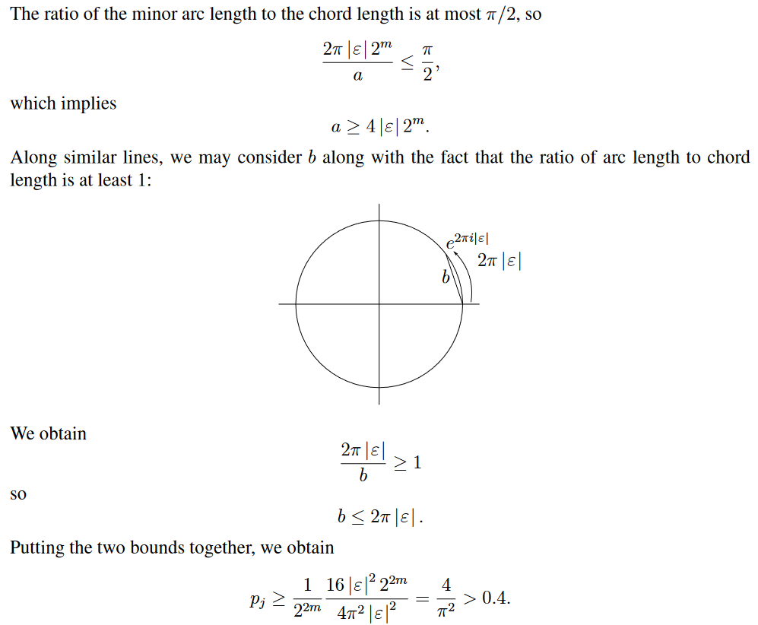
Quantum entanglement & Quantum Computing
2. QFT using Phase estimation

Slide 26
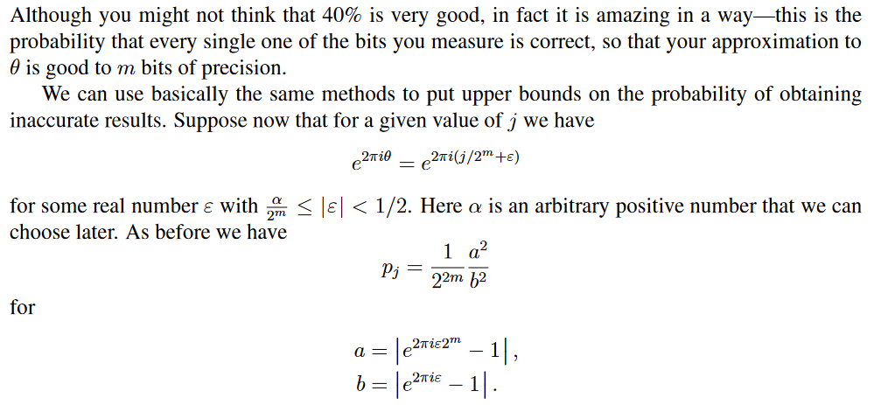
Quantum entanglement & Quantum Computing
2. QFT using Phase estimation

Slide 27
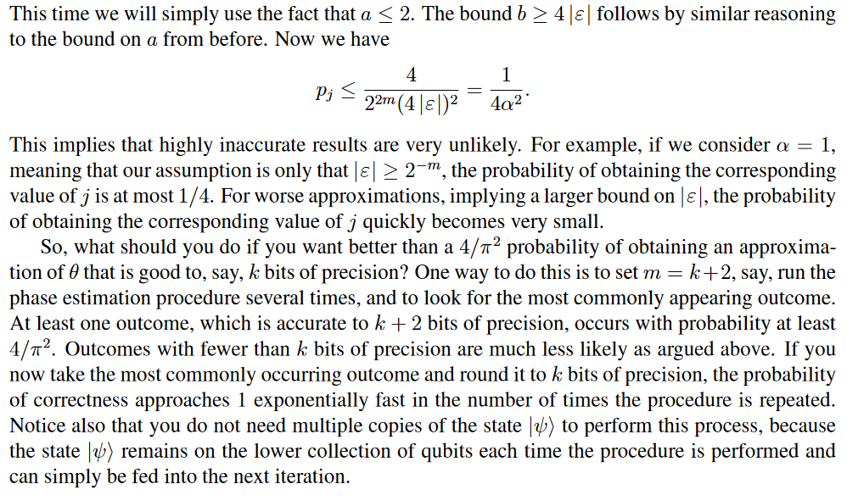
Quantum entanglement & Quantum Computing
2. QFT using Phase estimation

Slide 28
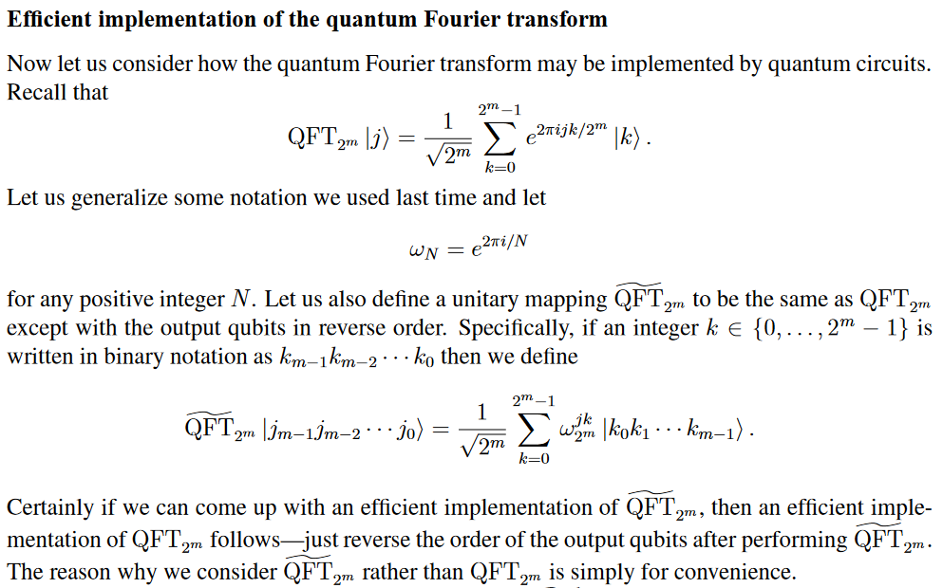
Quantum entanglement & Quantum Computing
2. QFT using Phase estimation

Slide 29
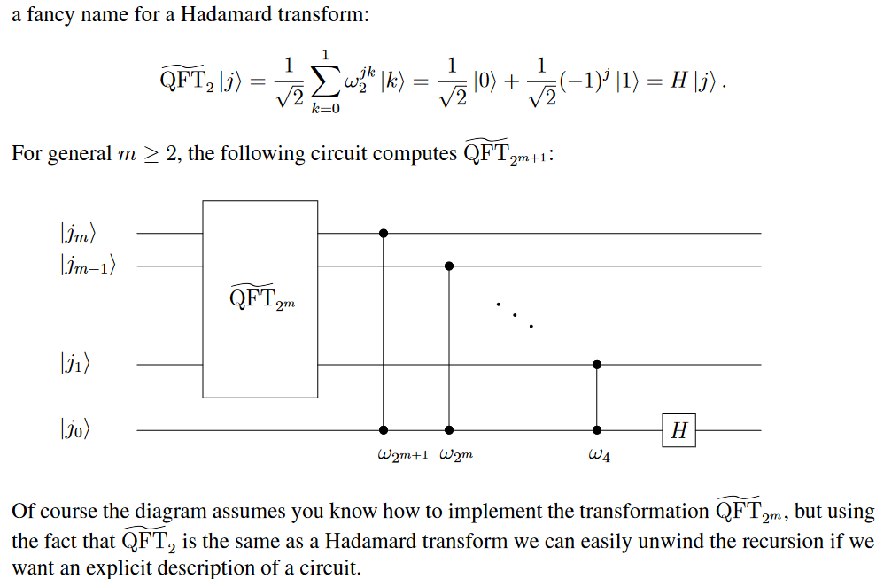
Quantum entanglement & Quantum Computing
2. QFT using Phase estimation

Slide 30
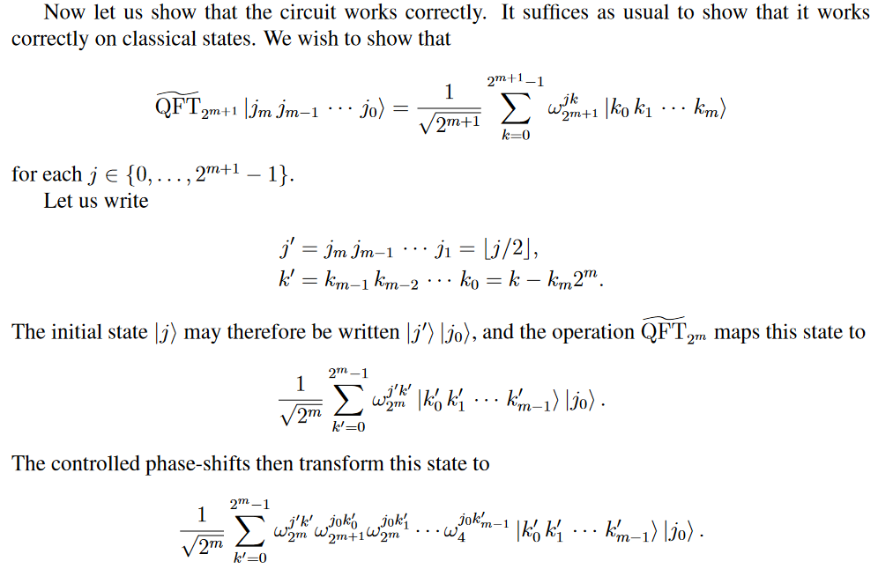
Quantum entanglement & Quantum Computing
2. QFT using Phase estimation

Slide 31
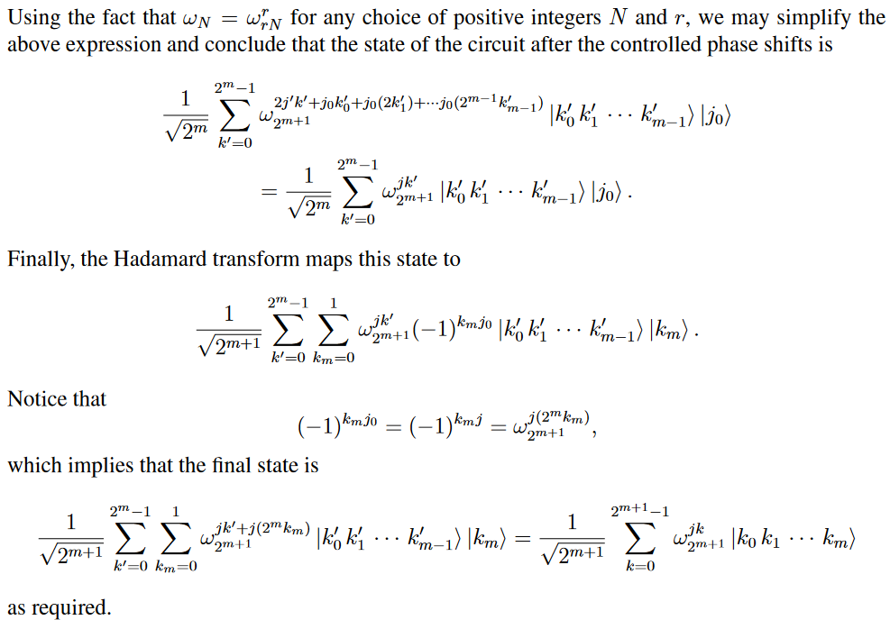
Quantum entanglement & Quantum Computing
2. QFT using Phase estimation

Slide 32
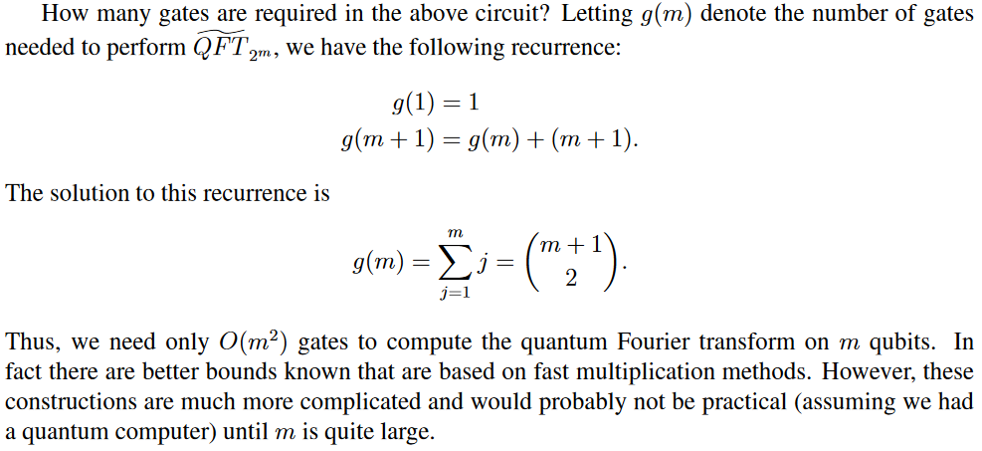
Quantum entanglement & Quantum Computing
2. QFT using Phase estimation

Slide 33
THANK YOU
Dr. Kaustav Bhowmick
Department of Electronics & Communication
Engineering
kaustavbhowmick@pes.edu

