Slide 1

Quantum Entanglement and Quantum Computing
Dr. Kaustav Bhowmick
Electronics & Communication
Engineering

Slide 2

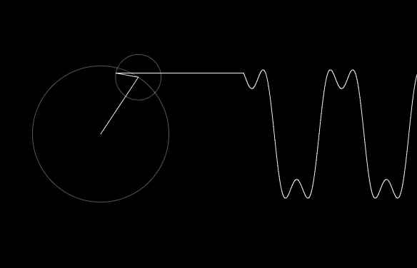
Quantum Entanglement and Quantum Computing
Entanglement and Quantum Information
Dr. Kaustav Bhowmick
Electronics & Communication Engineering
Source: Google images

Slide 3
Quantum entanglement & Quantum Computing
Contents
Grover’s algorithm
Simon’s algorithm

Slide 4
Quantum entanglement & Quantum Computing
1. Grover’s algorithm
Quantum algorithms can be classified based on the techniques used. They are classified as follows:
Algorithms based on Phase Estimation — These include algorithms like Shor’s algorithm, HHL algorithm etc.
Algorithms based on amplitude amplification — These include Grover’s algorithm, Oblivious Amplitude Amplification etc.
Algorithms based on quantum walks — This family of algorithms include algorithms for searching, Hamiltonian Simulation etc.
Adiabatic Algorithm — This family consists of many algorithms for searching, solving linear systems etc.
Hybrid quantum-classical algorithms — This family includes variational algorithms like VQE, QAOA, VQLS etc.

Slide 5
Quantum entanglement & Quantum Computing
1. Grover’s algorithm
Grover’s algorithm, is a member of amplitude amplification based algorithms.
The Grover’s search problem
The problem that Grover’s algorithm deals with is as follows:
Suppose you have an unstructured list of N items which means the list is not sorted and lacks any kind of pattern or structure. We want to search for an element in this list, what is the best known classical solution we have?
Since the list is unstructured, the best we can do is a linear search and in the worst case it will take O(N) time. But with Grover’s algorithm, it turns out that we can do this in O(√N). Thus Grover's algorithm gives a quadratic speedup which becomes significant when we use a list with many elements.

Slide 6
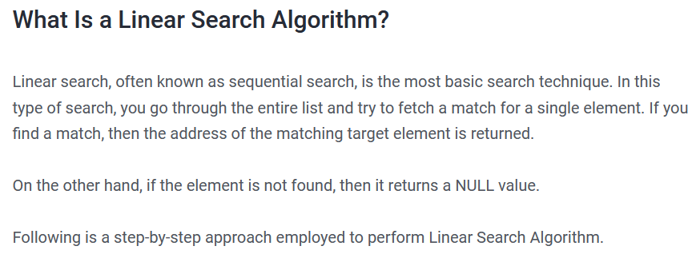
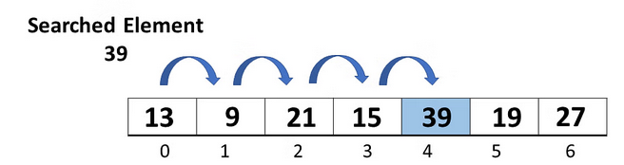
Quantum entanglement & Quantum Computing
1. Grover’s algorithm

Slide 7
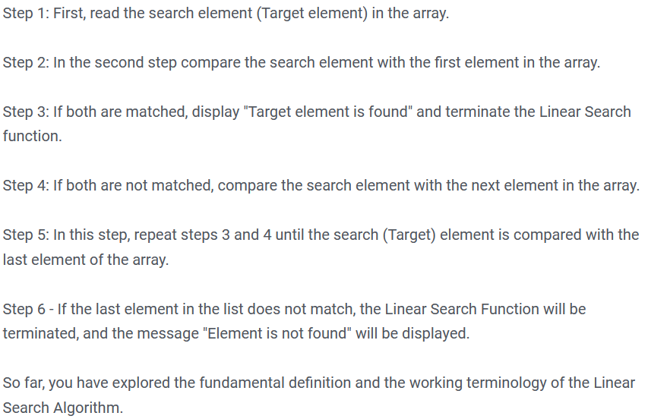
Quantum entanglement & Quantum Computing
1. Grover’s algorithm

Slide 8
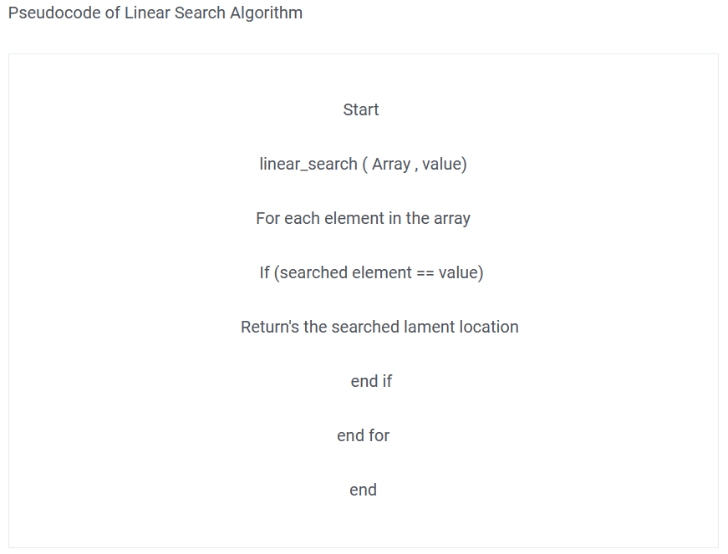
Quantum entanglement & Quantum Computing
1. Grover’s algorithm

Slide 9
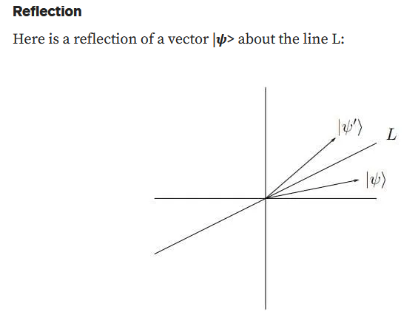
Quantum entanglement & Quantum Computing
1. Grover’s algorithm

Slide 10
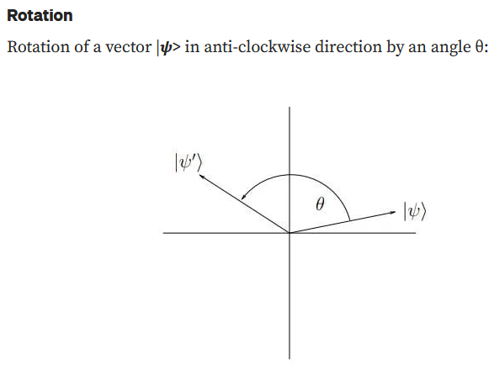
Quantum entanglement & Quantum Computing
1. Grover’s algorithm

Slide 11
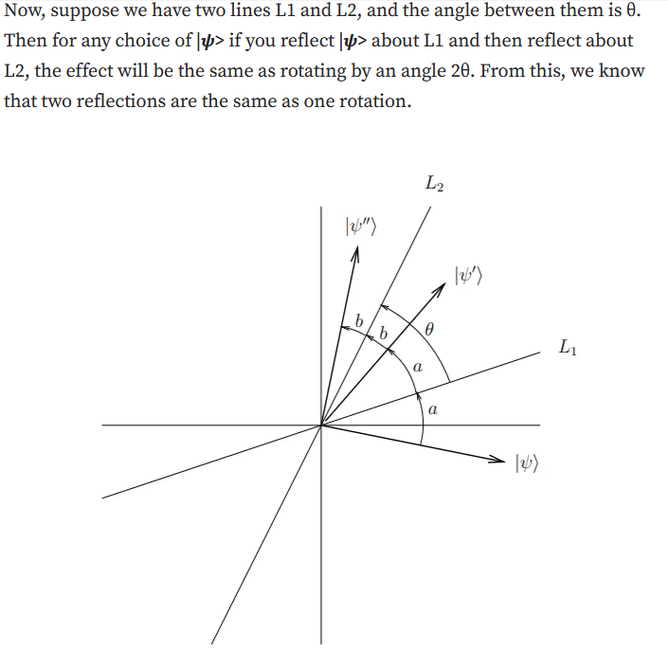
Quantum entanglement & Quantum Computing
1. Grover’s algorithm

Slide 12

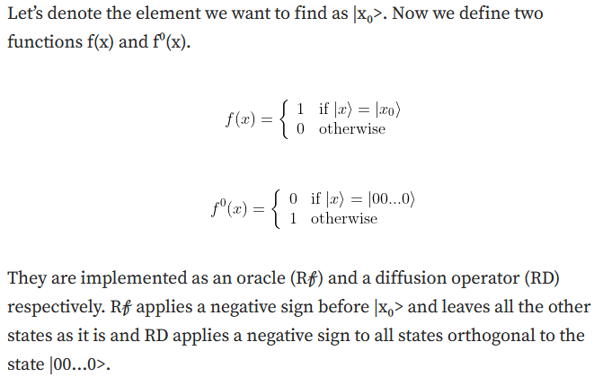
Quantum entanglement & Quantum Computing
1. Grover’s algorithm

Slide 13
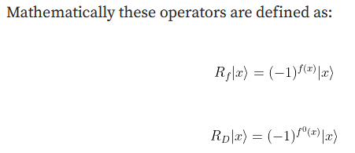
Quantum entanglement & Quantum Computing
1. Grover’s algorithm

Slide 14
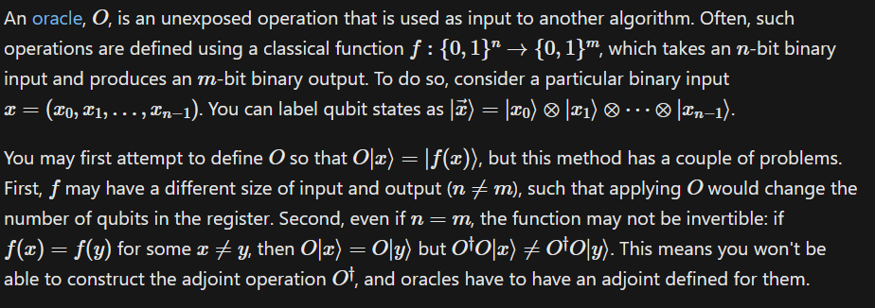
Quantum entanglement & Quantum Computing
1. Grover’s algorithm

Slide 15

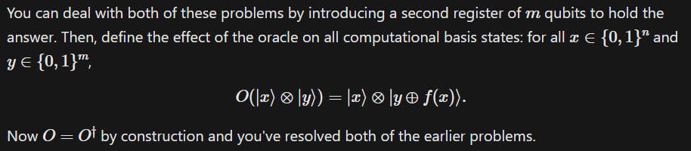
Quantum entanglement & Quantum Computing
1. Grover’s algorithm
1

Slide 16
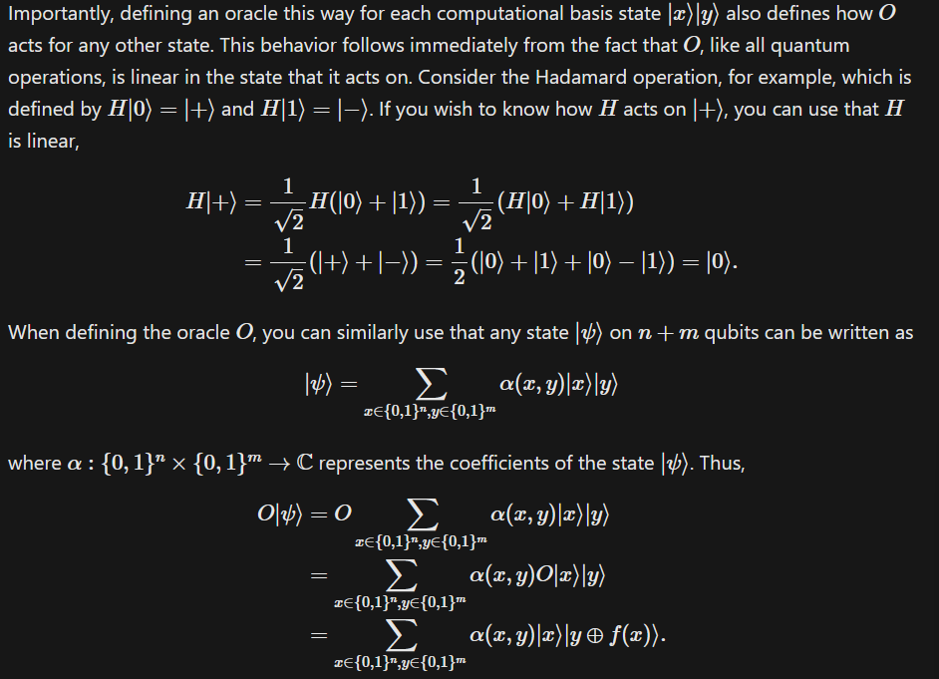
Quantum entanglement & Quantum Computing
1. Grover’s algorithm

Slide 17
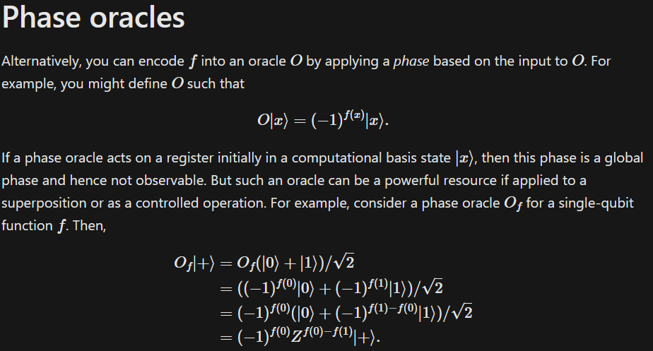
Quantum entanglement & Quantum Computing
1. Grover’s algorithm

Slide 18
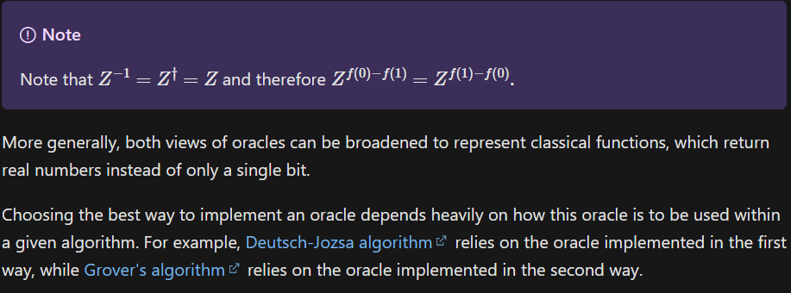
Quantum entanglement & Quantum Computing
1. Grover’s algorithm

Slide 19
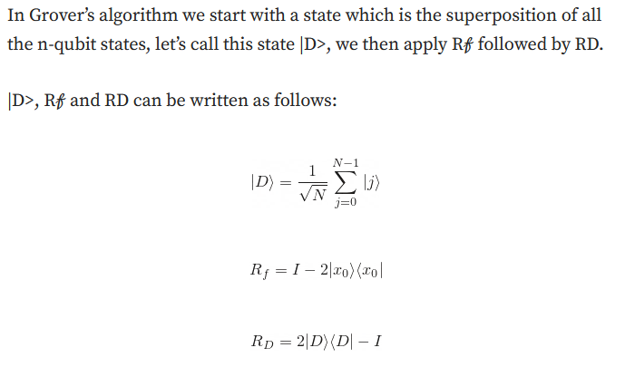
Quantum entanglement & Quantum Computing
1. Grover’s algorithm

Slide 20
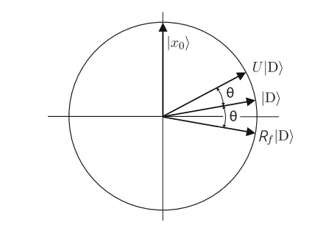
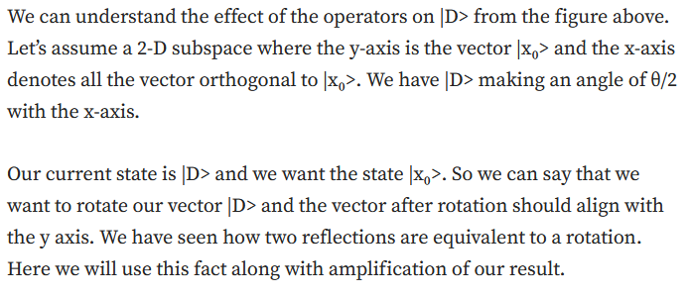
Quantum entanglement & Quantum Computing
1. Grover’s algorithm

Slide 21
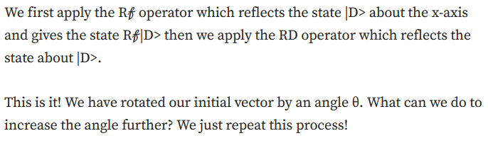
Quantum entanglement & Quantum Computing
1. Grover’s algorithm

Slide 22

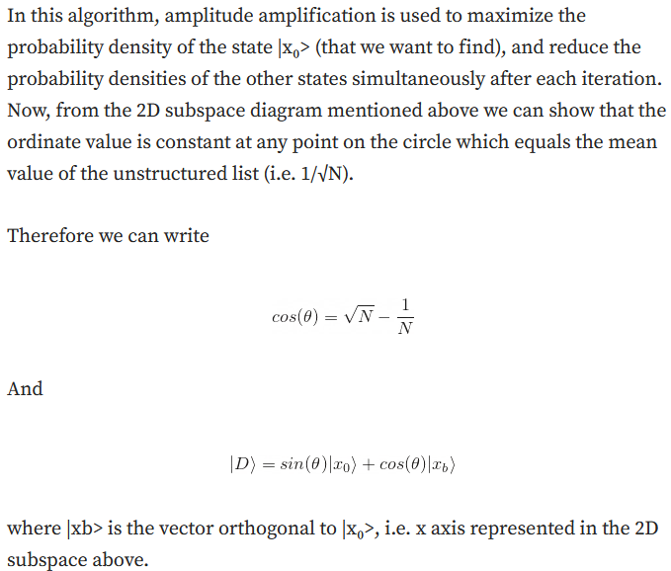
Quantum entanglement & Quantum Computing
1. Grover’s algorithm

Slide 23
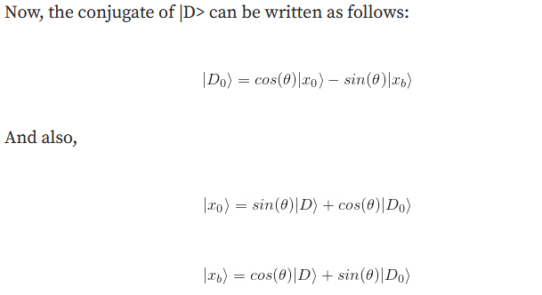
Quantum entanglement & Quantum Computing
1. Grover’s algorithm

Slide 24
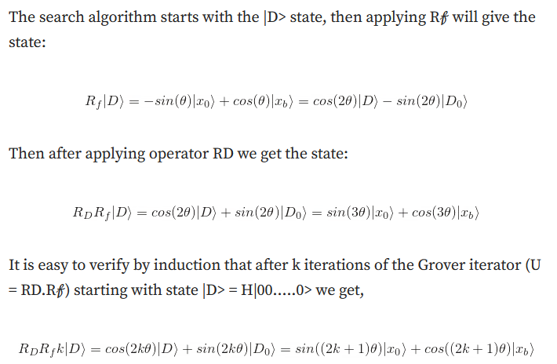
Quantum entanglement & Quantum Computing
1. Grover’s algorithm

Slide 25
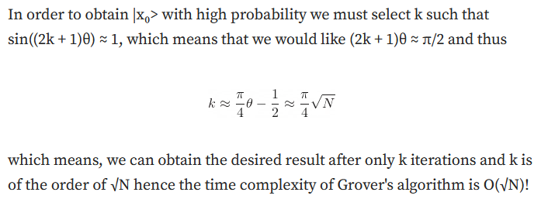
Quantum entanglement & Quantum Computing
1. Grover’s algorithm
Grover algorithm for search of more than one element
https://quantumcomputing.stackexchange.com/questions/5318/grover-algorithm-for-more-than-one-element
Implementation: https://cnot.io/quantum_algorithms/grover/grovers_algorithm.html

Slide 26
Quantum entanglement & Quantum Computing
2. Simon’s algorithm
Directly from Daniel Simon:
https://aws.amazon.com/blogs/quantum-computing/simons-algorithm/

Slide 27
THANK YOU
Dr. Kaustav Bhowmick
Department of Electronics & Communication
Engineering
kaustavbhowmick@pes.edu

