Slide 1

Quantum Entanglement and Quantum Computing
Dr. Kaustav Bhowmick
Electronics & Communication
Engineering

Slide 2


Quantum Entanglement and Quantum Computing
Introduction to Topic
Dr. Kaustav Bhowmick
Electronics & Communication Engineering
Source: Google images

Slide 3
Quantum entanglement & Quantum Computing
Contents
Dirac-notation
Basis algebra

Slide 4
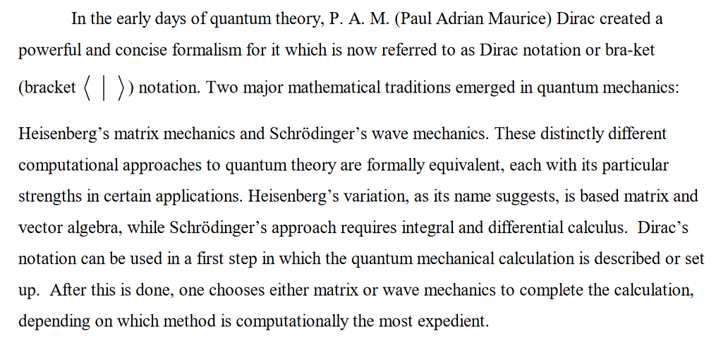
Quantum entanglement & Quantum Computing
1. Dirac-Notation

Slide 5

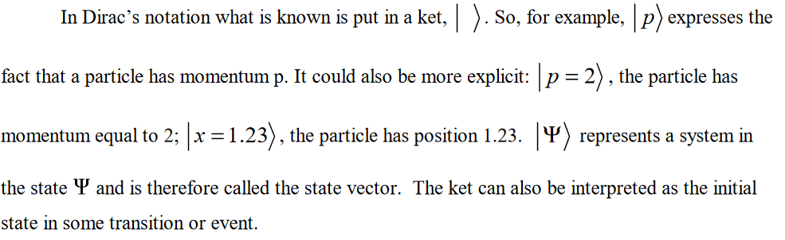
Quantum entanglement & Quantum Computing
1. Dirac-Notation

Slide 6
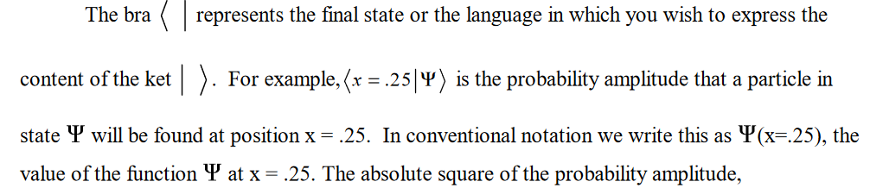
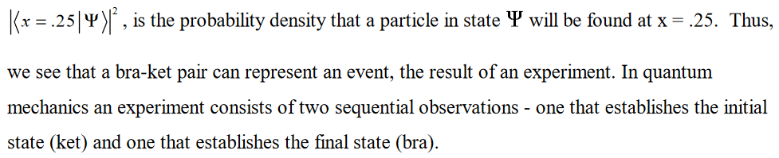
Quantum entanglement & Quantum Computing
1. Dirac-Notation

Slide 7
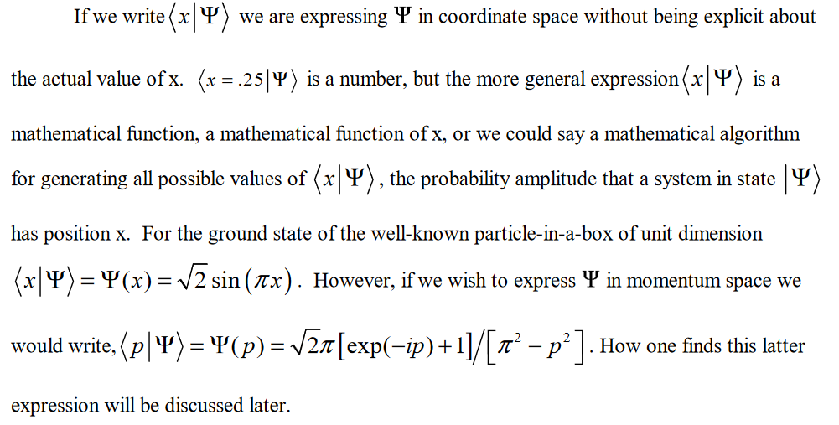
Quantum entanglement & Quantum Computing
1. Dirac-Notation

Slide 8
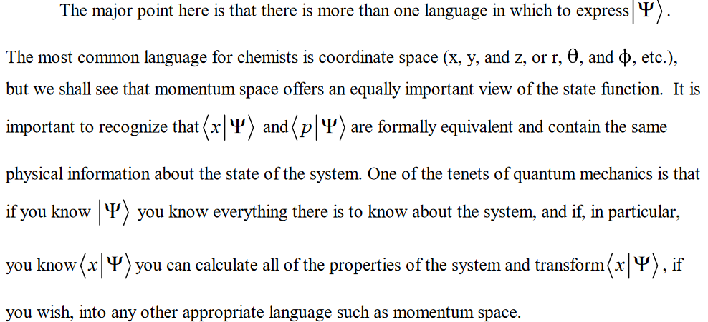
Quantum entanglement & Quantum Computing
1. Dirac-Notation

Slide 9
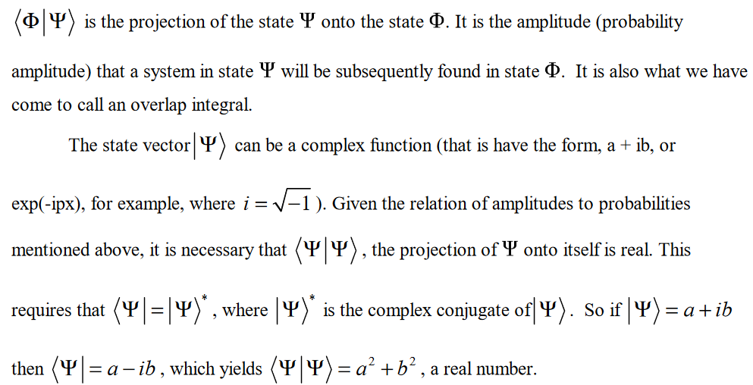
Quantum entanglement & Quantum Computing
1. Dirac-Notation

Slide 10

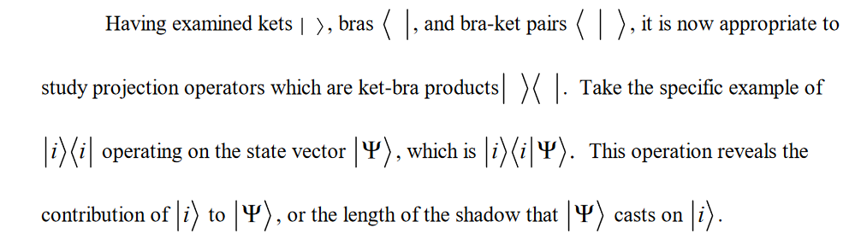
Quantum entanglement & Quantum Computing
1. Dirac-Notation

Slide 11
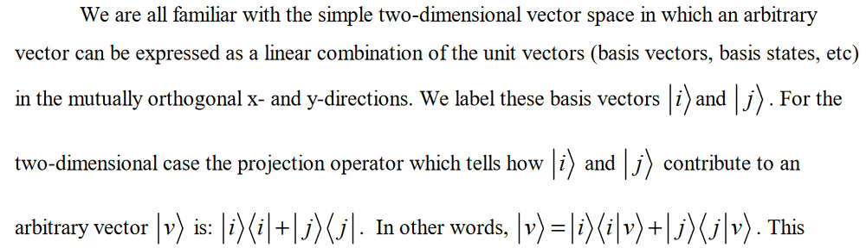
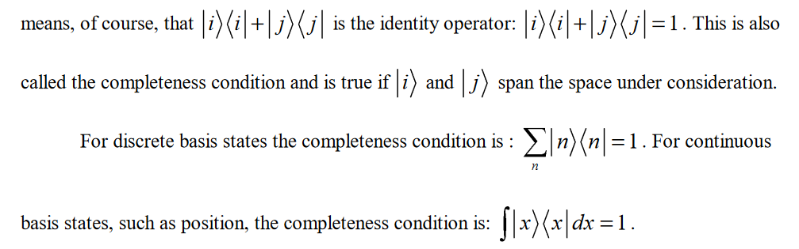
Quantum entanglement & Quantum Computing
1. Dirac-Notation

Slide 12
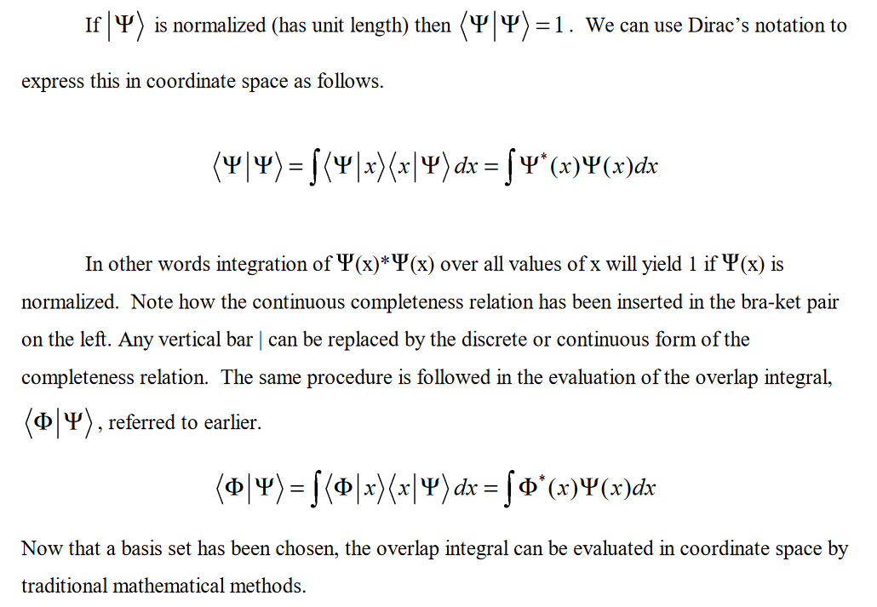
Quantum entanglement & Quantum Computing
1. Dirac-Notation

Slide 13
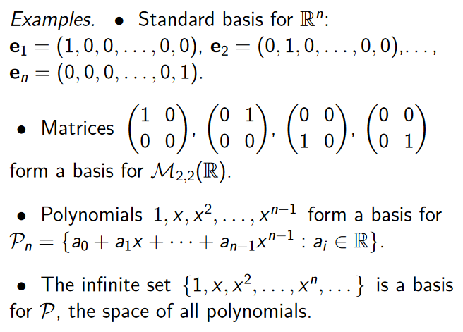
Quantum entanglement & Quantum Computing
2. Basis Algebra

Slide 14
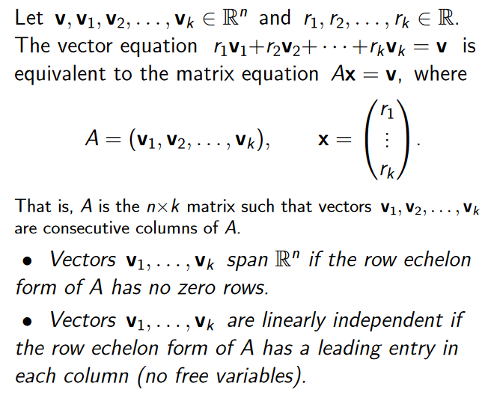
Quantum entanglement & Quantum Computing
2. Basis Algebra

Slide 15
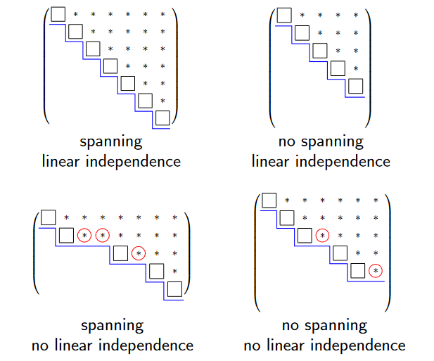
Quantum entanglement & Quantum Computing
2. Basis Algebra

Slide 16
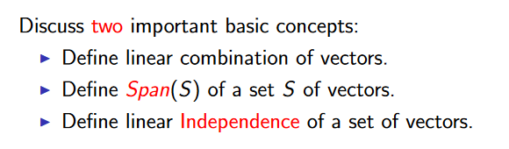
Quantum entanglement & Quantum Computing
2. Basis Algebra

Slide 17
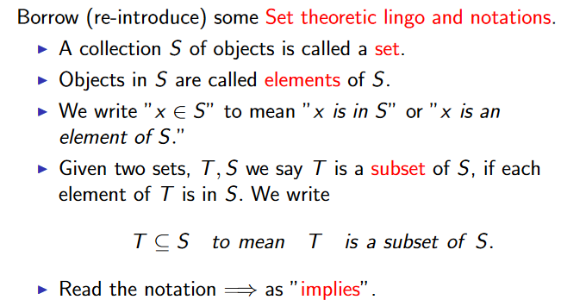
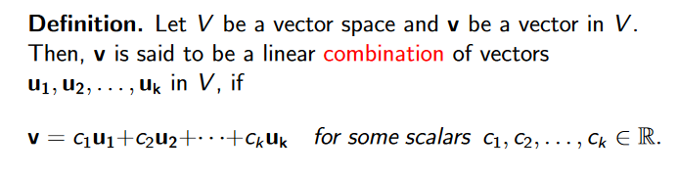
Quantum entanglement & Quantum Computing
2. Basis Algebra

Slide 18

Quantum entanglement & Quantum Computing
2. Basis Algebra : Linear combination example

Slide 19
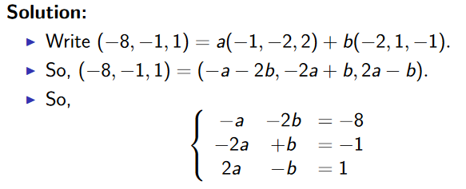
Quantum entanglement & Quantum Computing
2. Basis Algebra : Linear combination example

Slide 20
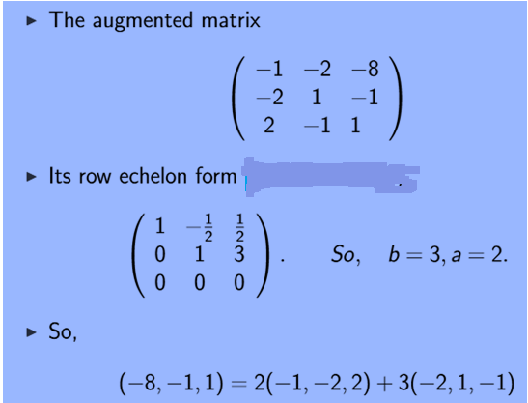
Quantum entanglement & Quantum Computing
2. Basis Algebra : Linear combination example
https://www.wikihow.com/Reduce-a-Matrix-to-Row-Echelon-Form

Slide 21

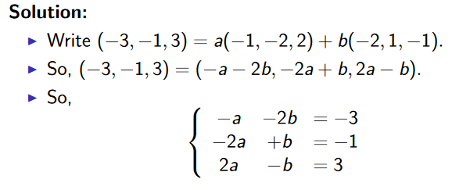
Quantum entanglement & Quantum Computing
2. Basis Algebra : Linear Combination example 2
http://www.math.odu.edu/~bogacki/cgi-bin/lat.cgi

Slide 22
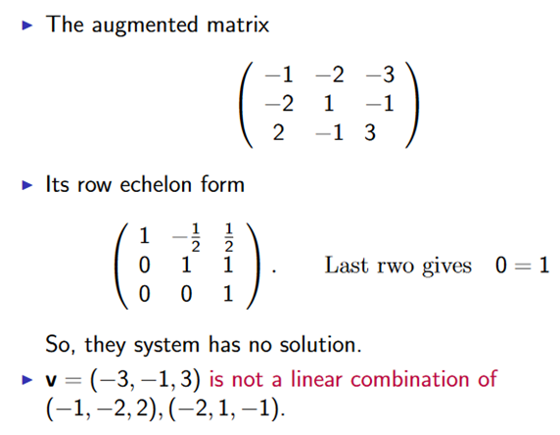
Quantum entanglement & Quantum Computing
2. Basis Algebra : Linear Combination example 2

Slide 23
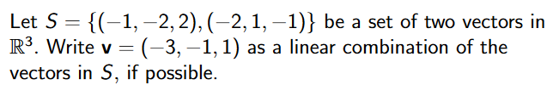
Quantum entanglement & Quantum Computing
2. Basis Algebra: Linear Combination example 3

Slide 24
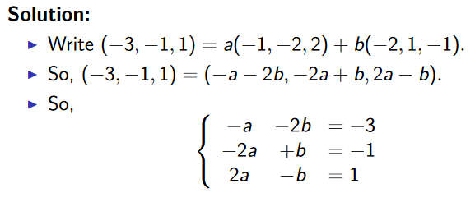
Quantum entanglement & Quantum Computing
2. Basis Algebra: Linear Combination example 3

Slide 25
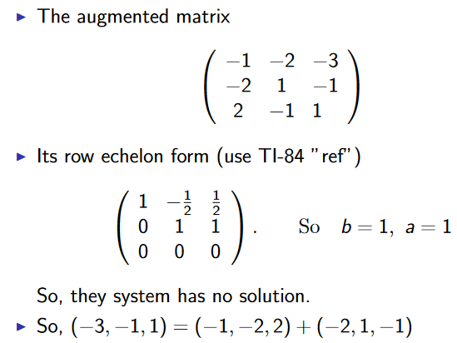
Quantum entanglement & Quantum Computing
2. Basis Algebra: Linear Combination example 3

Slide 26

Quantum entanglement & Quantum Computing
2. Basis Algebra: Linear Combination example 4

Slide 27
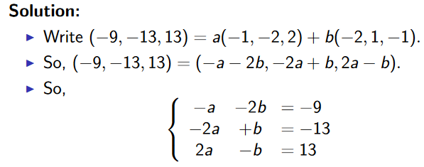
Quantum entanglement & Quantum Computing
2. Basis Algebra: Linear Combination example 4

Slide 28
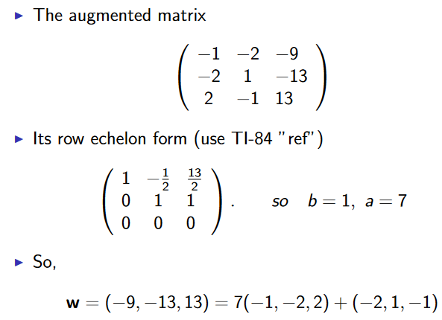
Quantum entanglement & Quantum Computing
2. Basis Algebra: Linear Combination example 4

Slide 29

Quantum entanglement & Quantum Computing
2. Basis Algebra

Slide 30
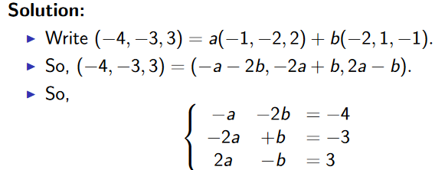
Quantum entanglement & Quantum Computing
2. Basis Algebra

Slide 31
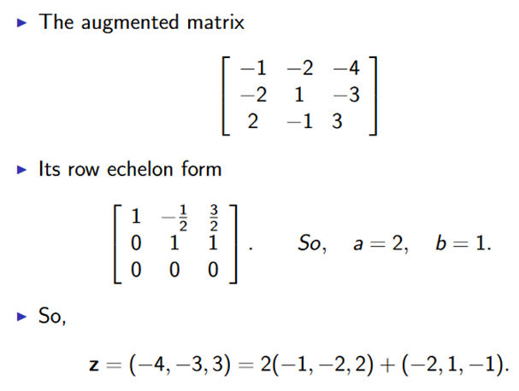
Quantum entanglement & Quantum Computing
2. Basis Algebra

Slide 32
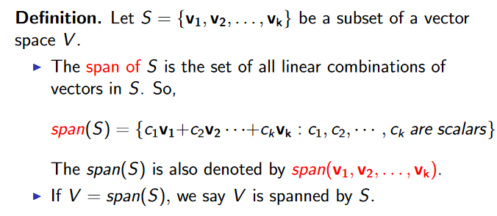
Quantum entanglement & Quantum Computing
2. Basis Algebra: Span of a Sets

Slide 33
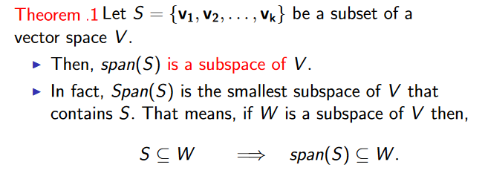
Quantum entanglement & Quantum Computing
2. Basis Algebra: Span of a Sets

Slide 34
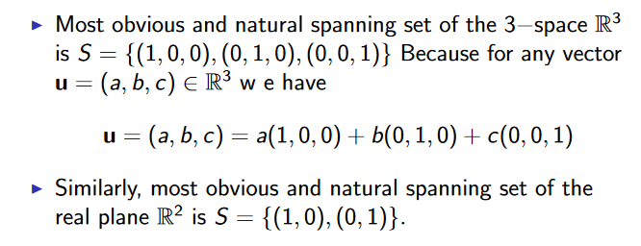
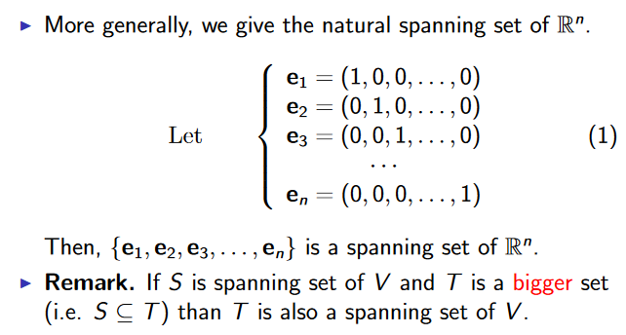
Quantum entanglement & Quantum Computing
2. Basis Algebra: Span of a Sets

Slide 35
Quantum entanglement & Quantum Computing
2. Basis Algebra: Spanning set example 1

Slide 36
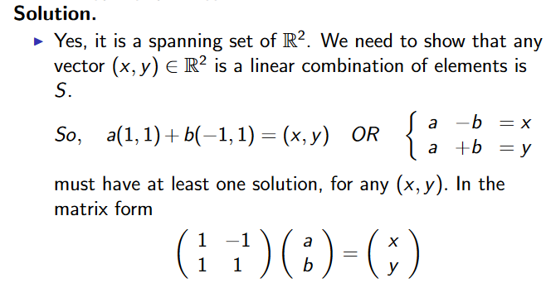
Quantum entanglement & Quantum Computing
2. Basis Algebra: Spanning set example 1

Slide 37
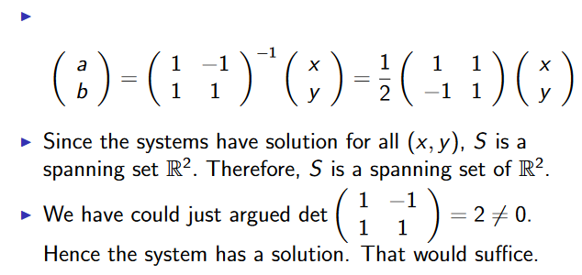
Quantum entanglement & Quantum Computing
2. Basis Algebra: Spanning set example 1

Slide 38
Quantum entanglement & Quantum Computing
2. Basis Algebra: Spanning set example 2

Slide 39
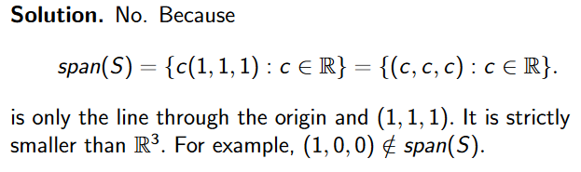
Quantum entanglement & Quantum Computing
2. Basis Algebra: Spanning set example 2

Slide 40
Quantum entanglement & Quantum Computing
2. Basis Algebra: Spanning set example 3

Slide 41
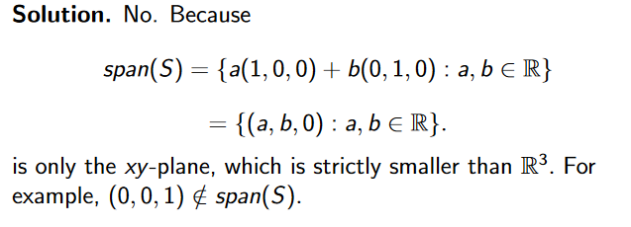
Quantum entanglement & Quantum Computing
2. Basis Algebra: Spanning set example 3

Slide 42

Quantum entanglement & Quantum Computing
2. Basis Algebra: Spanning set example 4

Slide 43
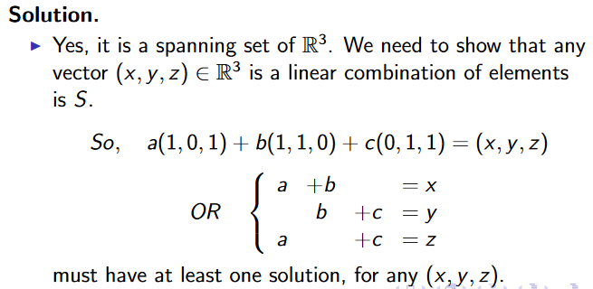
Quantum entanglement & Quantum Computing
2. Basis Algebra: Spanning set example 4

Slide 44
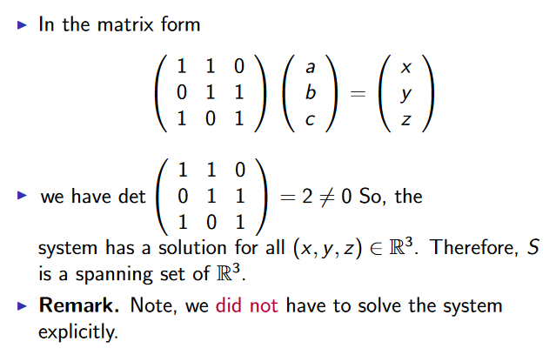
Quantum entanglement & Quantum Computing
2. Basis Algebra: Spanning set example 4

Slide 45

Quantum entanglement & Quantum Computing
2. Basis Algebra: Spanning set example 5

Slide 46
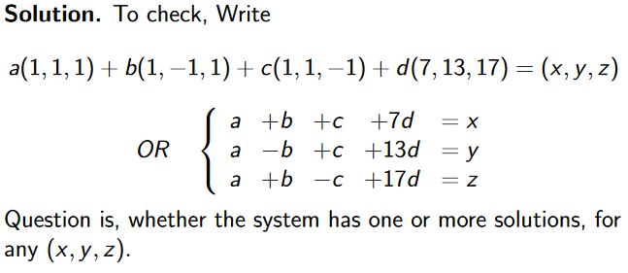
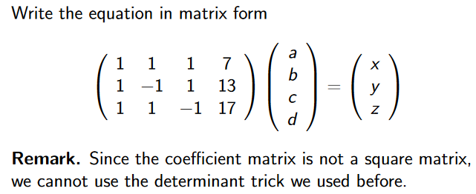
Quantum entanglement & Quantum Computing
2. Basis Algebra: Spanning set example 5

Slide 47
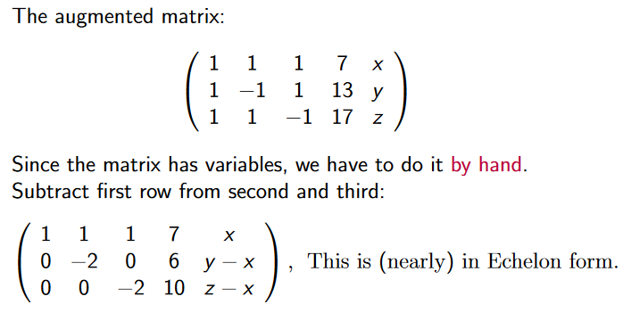
Quantum entanglement & Quantum Computing
2. Basis Algebra: Spanning set example 5

Slide 48
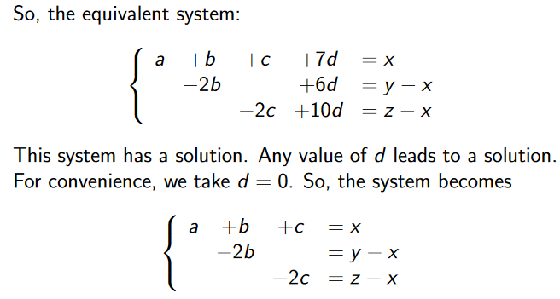
Quantum entanglement & Quantum Computing
2. Basis Algebra: Spanning set example 5

Slide 49
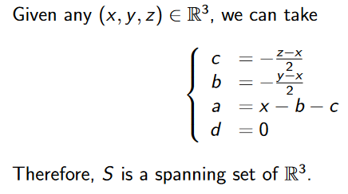
Quantum entanglement & Quantum Computing
2. Basis Algebra: Spanning set example 5

Slide 50
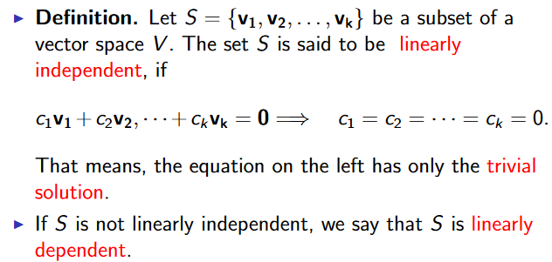
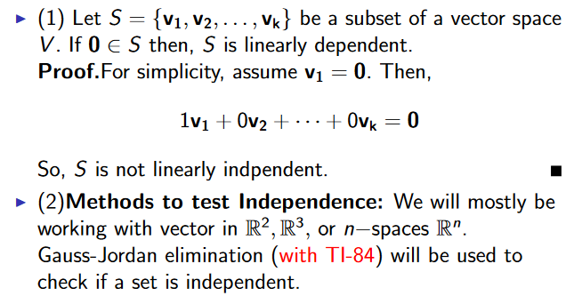
Quantum entanglement & Quantum Computing
2. Basis Algebra: Linear Independence

Slide 51
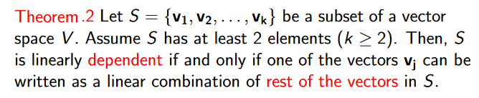
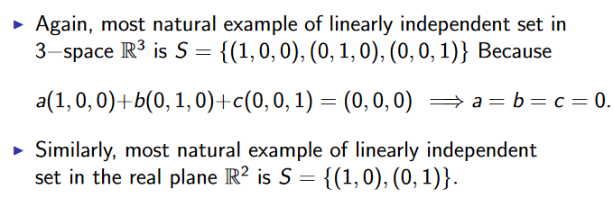
Quantum entanglement & Quantum Computing
2. Basis Algebra: Linear Independence

Slide 52
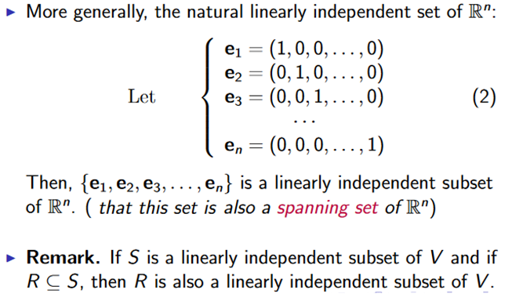
Quantum entanglement & Quantum Computing
2. Basis Algebra: Linear Independence

Slide 53
Quantum entanglement & Quantum Computing
2. Basis Algebra: Linear Independence example 1

Slide 54
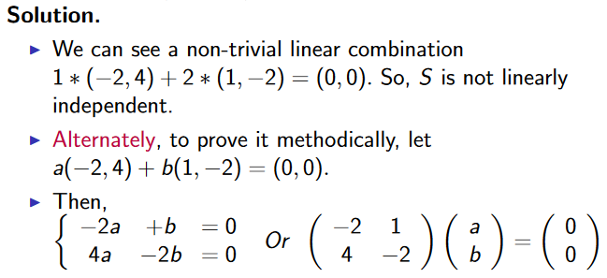
Quantum entanglement & Quantum Computing
2. Basis Algebra: Linear Independence example 1

Slide 55
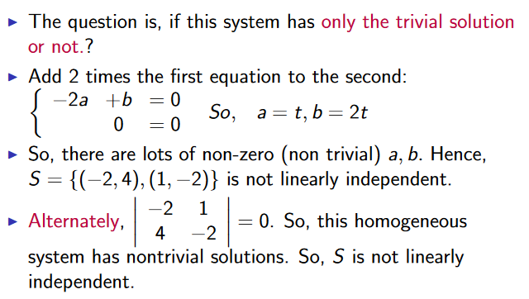
Quantum entanglement & Quantum Computing
2. Basis Algebra: Linear Independence example 1

Slide 56

Quantum entanglement & Quantum Computing
2. Basis Algebra: Linear Independence example 2

Slide 57

Quantum entanglement & Quantum Computing
2. Basis Algebra: Linear Independence example 2

Slide 58

Quantum entanglement & Quantum Computing
2. Basis Algebra: Linear Independence example 2
https://www.cuemath.com/algebra/augmented-matrix/

Slide 59
Quantum entanglement & Quantum Computing
2. Basis Algebra: Linear Independence example 3

Slide 60

Quantum entanglement & Quantum Computing
2. Basis Algebra: Linear Independence example 3

Slide 61
THANK YOU
Dr. Kaustav Bhowmick
Department of Electronics & Communication
Engineering
kaustavbhowmick@pes.edu

