Slide 1

Quantum Entanglement and Quantum Computing
Dr. Kaustav Bhowmick
Electronics & Communication
Engineering

Slide 2


Quantum Entanglement and Quantum Computing
Introduction to Topic
Dr. Kaustav Bhowmick
Electronics & Communication Engineering
Source: Google images

Slide 3
Quantum entanglement & Quantum Computing
Contents
Basis vectors and change of basis
Quantum computational Basis states

Slide 4
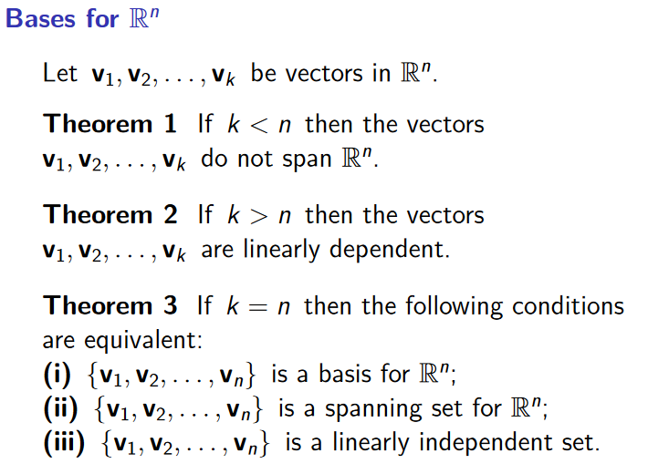
Quantum entanglement & Quantum Computing
1. Basis vector and change of basis

Slide 5
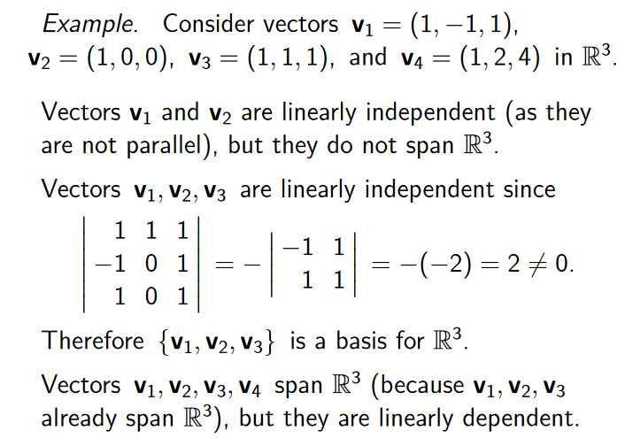
Quantum entanglement & Quantum Computing
1. Basis vector and change of basis

Slide 6
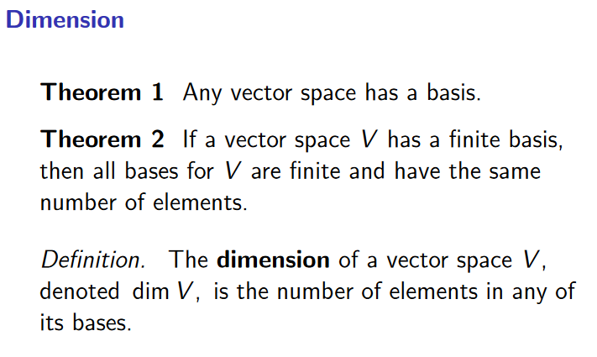
Quantum entanglement & Quantum Computing
1. Basis vector and change of basis

Slide 7
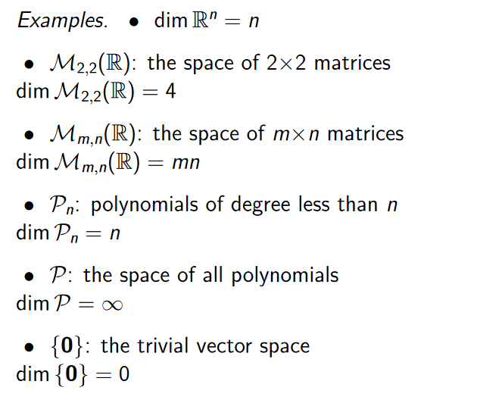
Quantum entanglement & Quantum Computing
1. Basis vector and change of basis

Slide 8
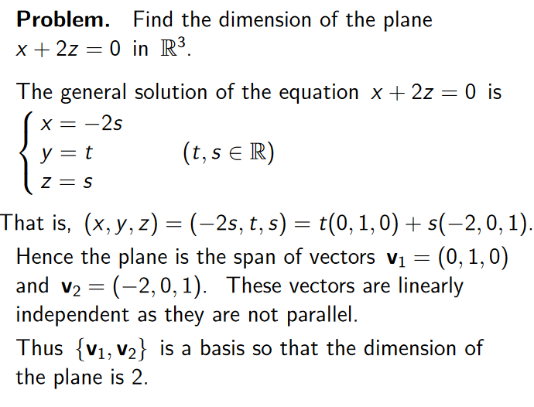
Quantum entanglement & Quantum Computing
1. Basis vector and change of basis

Slide 9
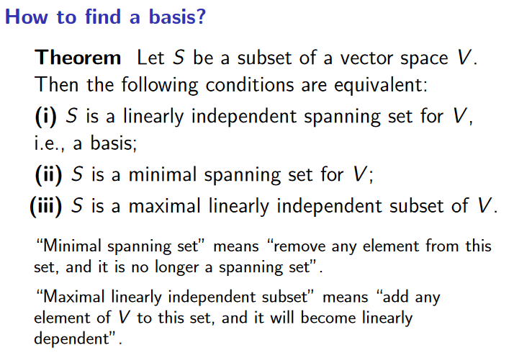
Quantum entanglement & Quantum Computing
1. Basis vector and change of basis

Slide 10
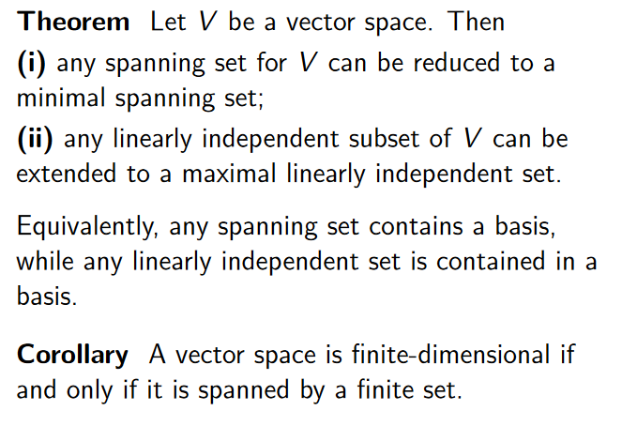
Quantum entanglement & Quantum Computing
1. Basis vector and change of basis

Slide 11
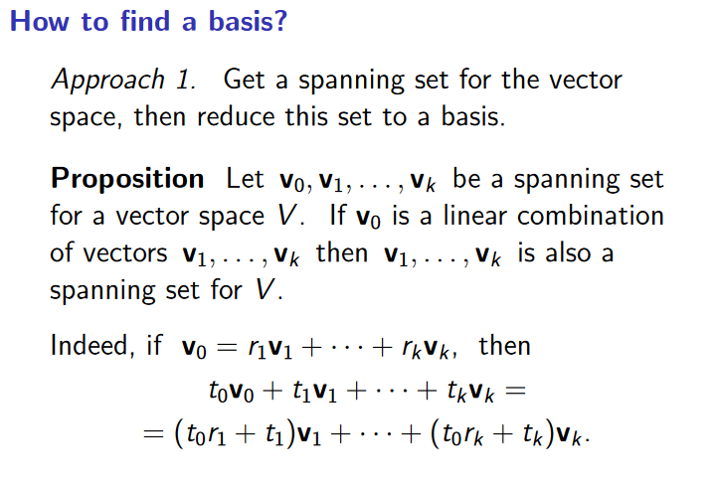
Quantum entanglement & Quantum Computing
1. Basis vector and change of basis

Slide 12
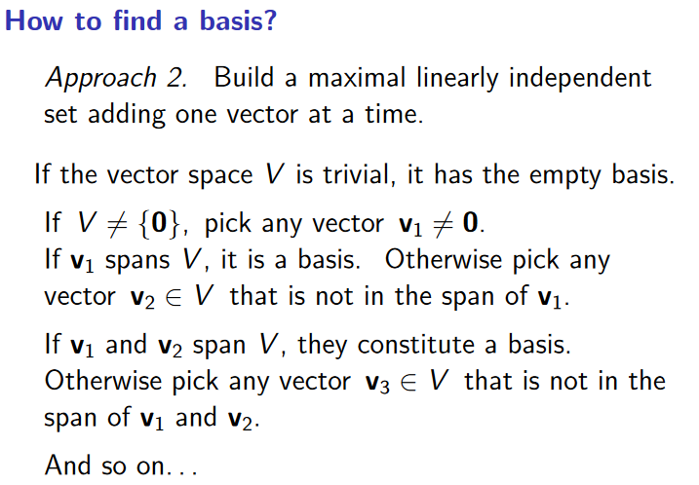
Quantum entanglement & Quantum Computing
1. Basis vector and change of basis

Slide 13
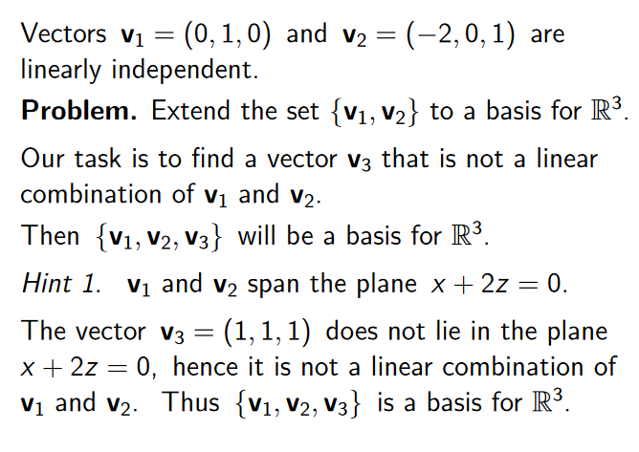
Quantum entanglement & Quantum Computing
1. Basis vector and change of basis

Slide 14
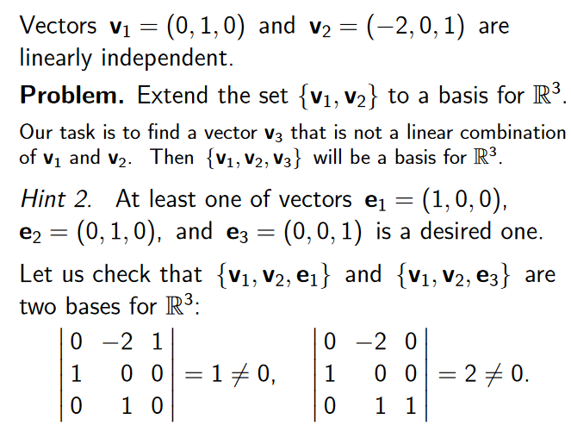
Quantum entanglement & Quantum Computing
1. Basis vector and change of basis

Slide 15
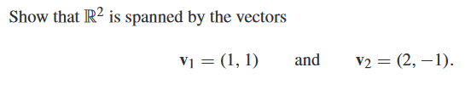
Quantum entanglement & Quantum Computing
1. Basis algebra and change of basis: Spanning set example 1

Slide 16
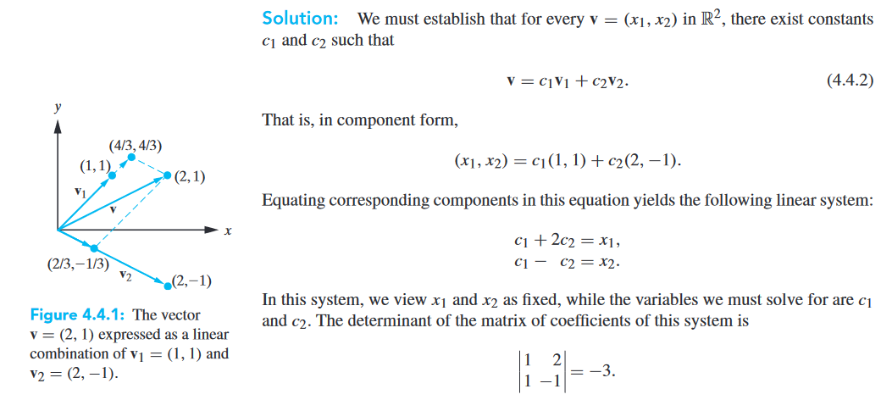
Quantum entanglement & Quantum Computing
1. Basis algebra and change of basis: Spanning set example 1

Slide 17
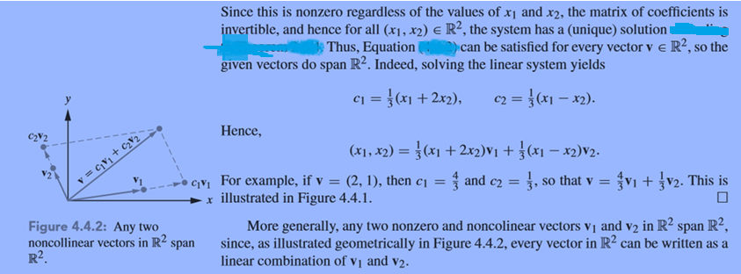
Quantum entanglement & Quantum Computing
1. Basis algebra and change of basis: Spanning set example 1
The determinant is a single number that summarizes a square matrix. It tells you if a matrix has an inverse, how much it scales space, and helps solve equations.
A determinant of zero means the matrix cannot be inverted. It collapses space into a flat line or plane.
The absolute value of the determinant shows the factor by which area (in 2D) or volume (in 3D) changes. A negative sign indicates that the orientation of space is flipped or reversed.

Slide 18
Quantum entanglement & Quantum Computing
1. Basis algebra and change of basis: Spanning set example 2

Slide 19
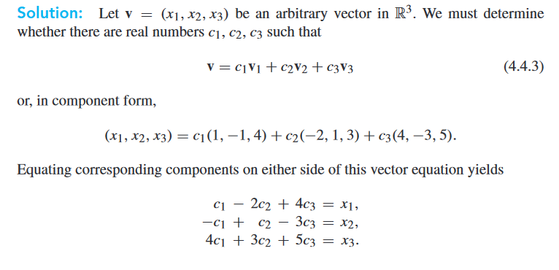
Quantum entanglement & Quantum Computing
1. Basis algebra and change of basis: Spanning set example 2

Slide 20
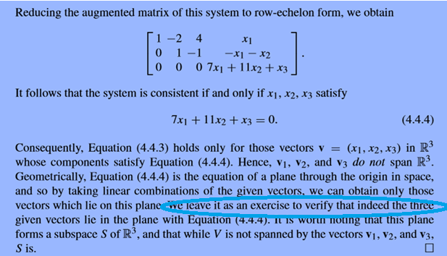
Quantum entanglement & Quantum Computing
1. Basis algebra and change of basis: Spanning set example 2

Slide 21
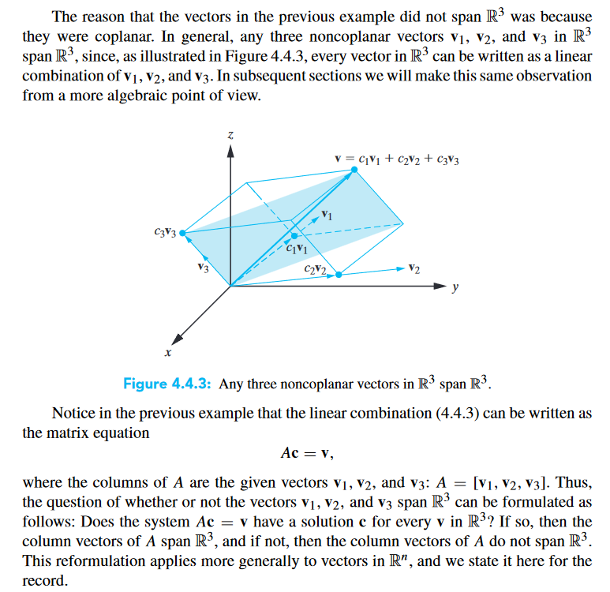
Quantum entanglement & Quantum Computing
1. Basis algebra and change of basis: Spanning set example 2

Slide 22
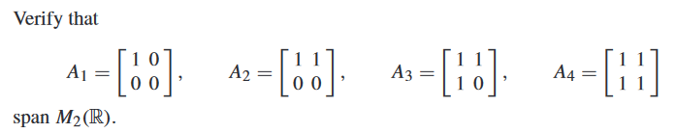
Quantum entanglement & Quantum Computing
1. Basis algebra and change of basis: Spanning set example 3

Slide 23
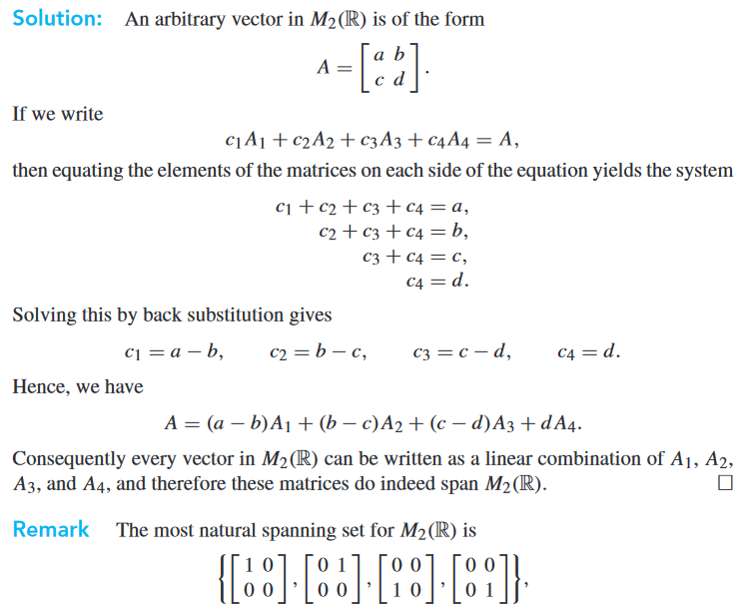
Quantum entanglement & Quantum Computing
1. Basis algebra and change of basis: Spanning set example 3

Slide 24
Quantum entanglement & Quantum Computing
1. Basis algebra and change of basis: Spanning set example 4

Slide 25
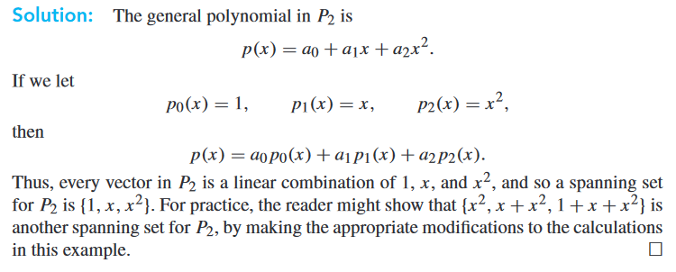
Quantum entanglement & Quantum Computing
1. Basis algebra and change of basis: Spanning set example 4

Slide 26
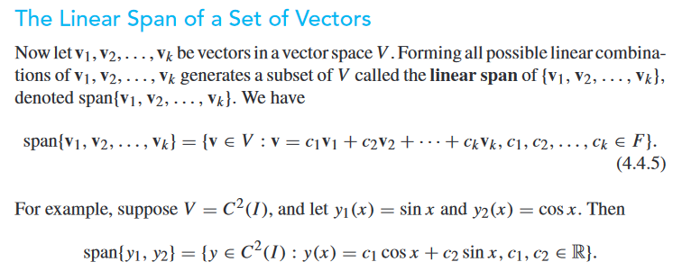

Quantum entanglement & Quantum Computing
1. Basis algebra and change of basis

Slide 27

Quantum entanglement & Quantum Computing
1. Basis algebra and change of basis: Spanning set example 5

Slide 28
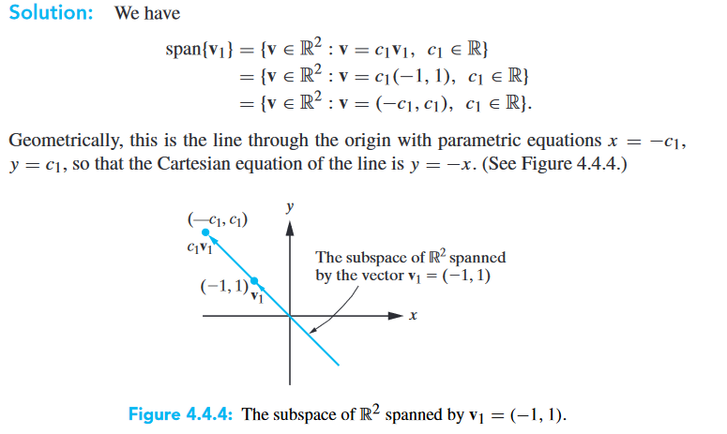
Quantum entanglement & Quantum Computing
1. Basis algebra and change of basis: Spanning set example 5

Slide 29

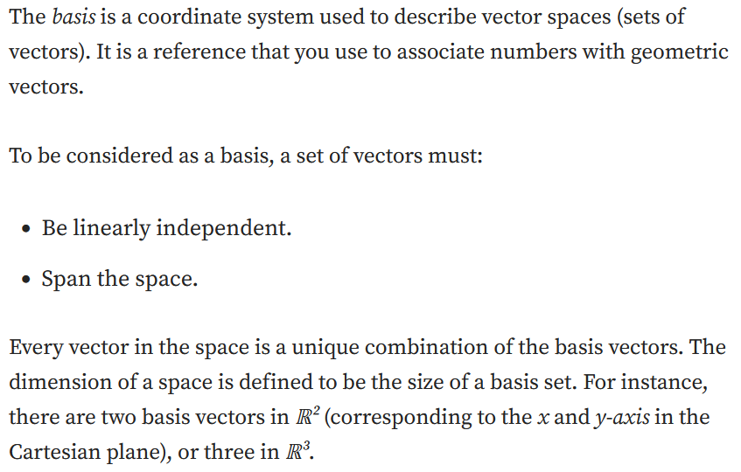
Quantum entanglement & Quantum Computing
1. Basis algebra and change of basis

Slide 30
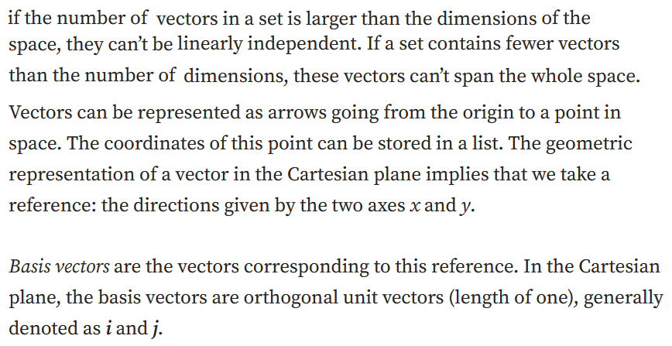
Quantum entanglement & Quantum Computing
1. Basis algebra and change of basis

Slide 31
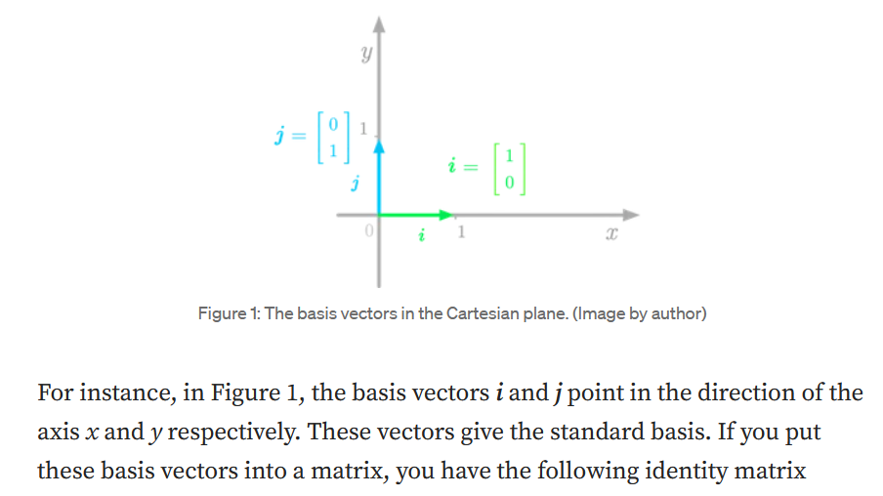
Quantum entanglement & Quantum Computing
1. Basis algebra and change of basis

Slide 32
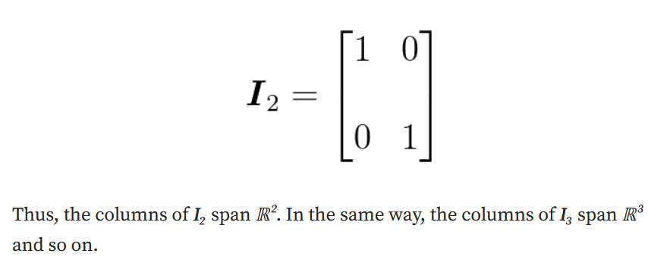
Quantum entanglement & Quantum Computing
1. Basis algebra and change of basis

Slide 33

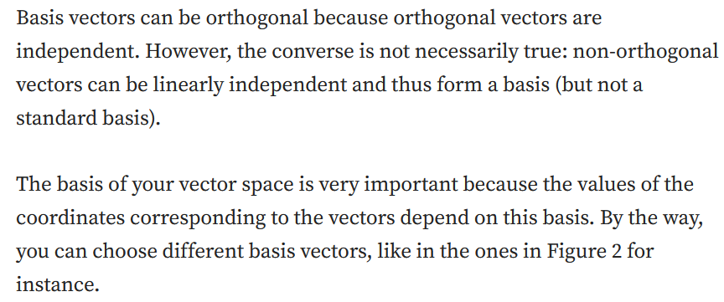
Quantum entanglement & Quantum Computing
1. Basis algebra and change of basis

Slide 34
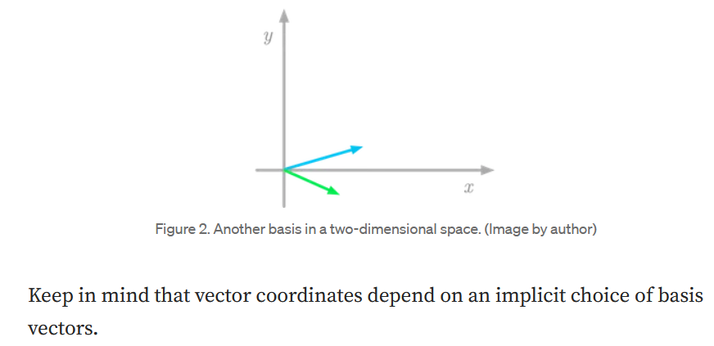
Quantum entanglement & Quantum Computing
1. Basis algebra and change of basis

Slide 35

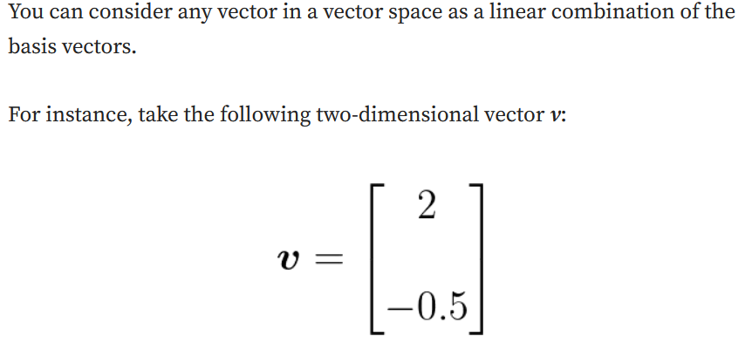
Quantum entanglement & Quantum Computing
1. Basis algebra and change of basis

Slide 36
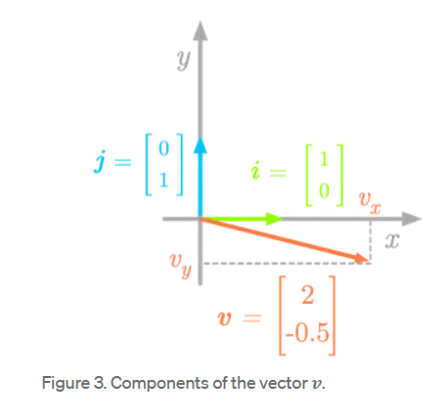
Quantum entanglement & Quantum Computing
1. Basis algebra and change of basis

Slide 37
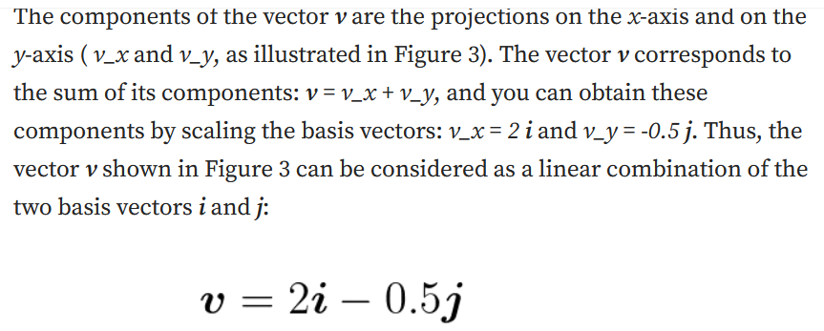
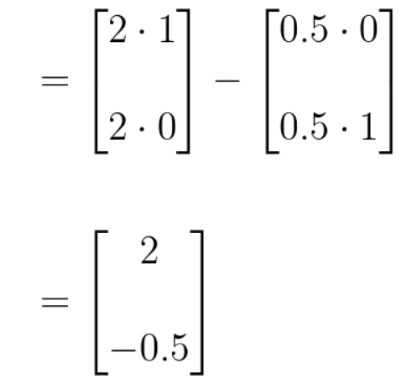
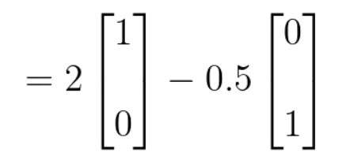
Quantum entanglement & Quantum Computing
1. Basis algebra and change of basis

Slide 38

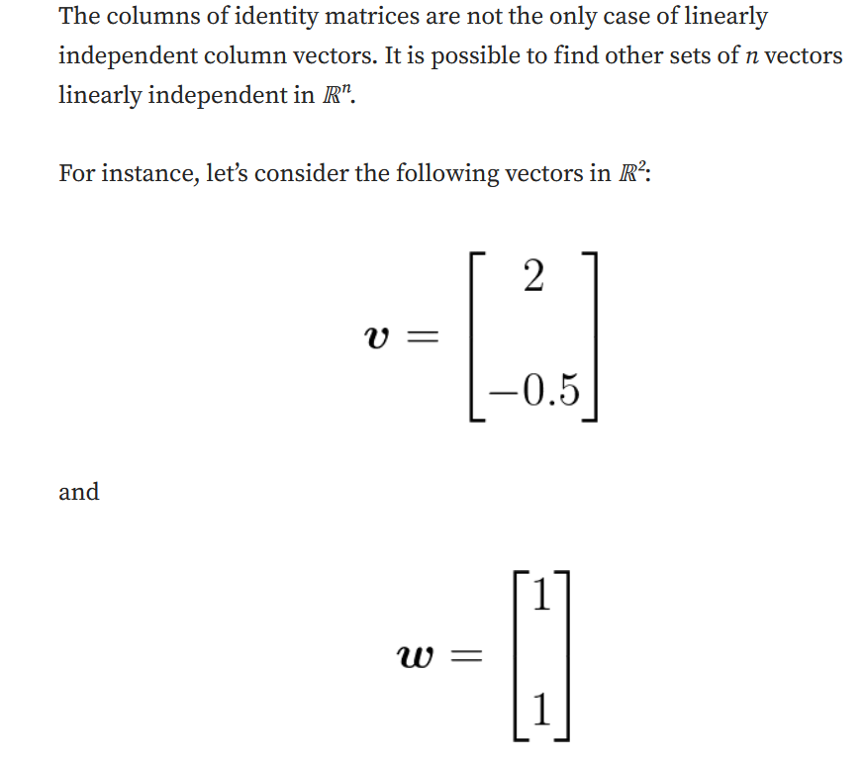
Quantum entanglement & Quantum Computing
1. Basis algebra and change of basis

Slide 39
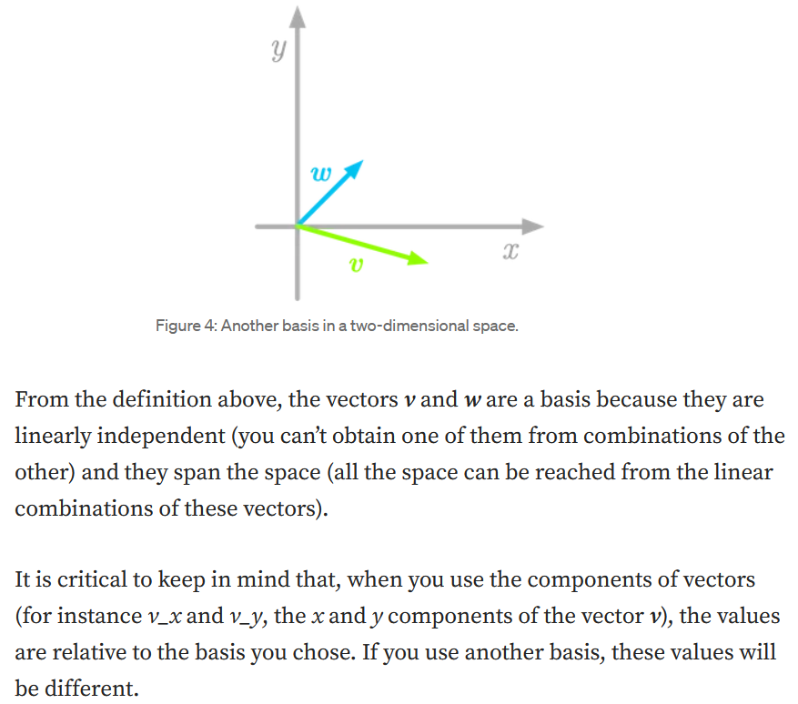
Quantum entanglement & Quantum Computing
1. Basis algebra and change of basis

Slide 40
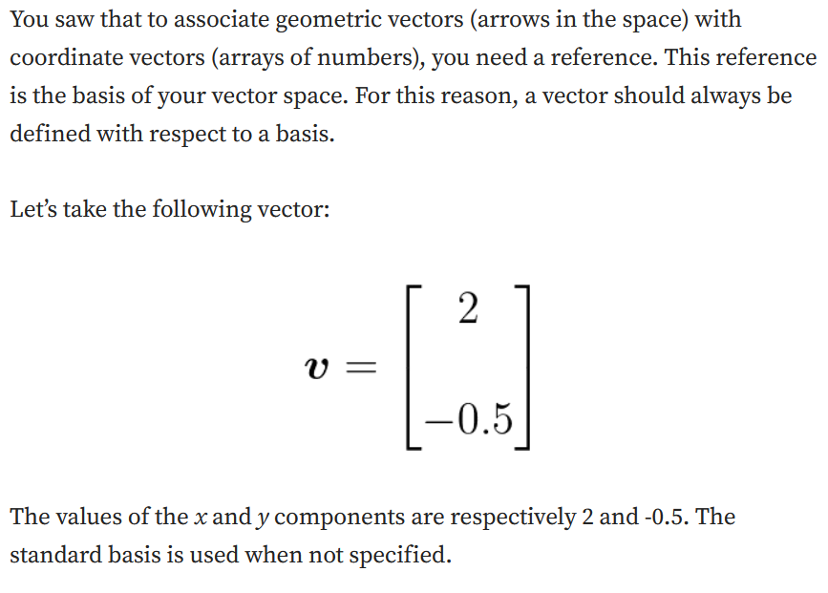
Quantum entanglement & Quantum Computing
1. Basis algebra and change of basis

Slide 41
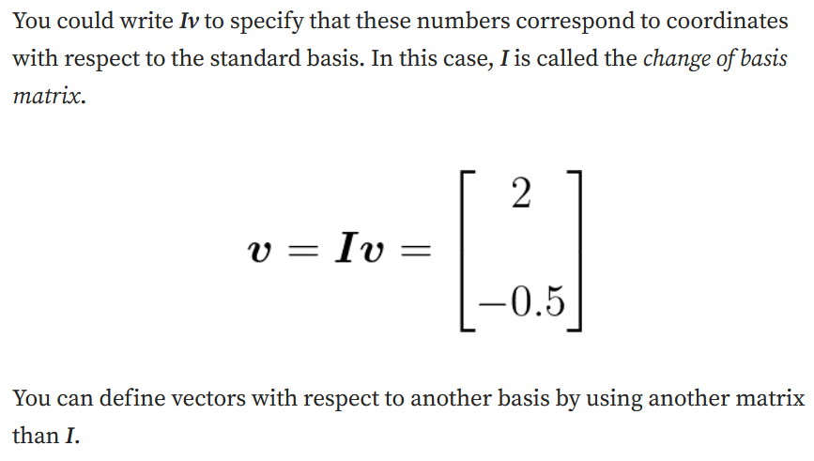
Quantum entanglement & Quantum Computing
1. Basis algebra and change of basis

Slide 42
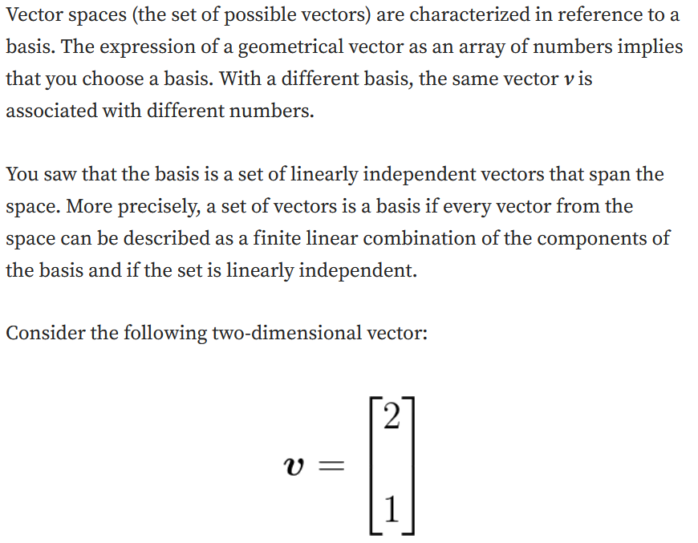
Quantum entanglement & Quantum Computing
1. Basis algebra and change of basis

Slide 43
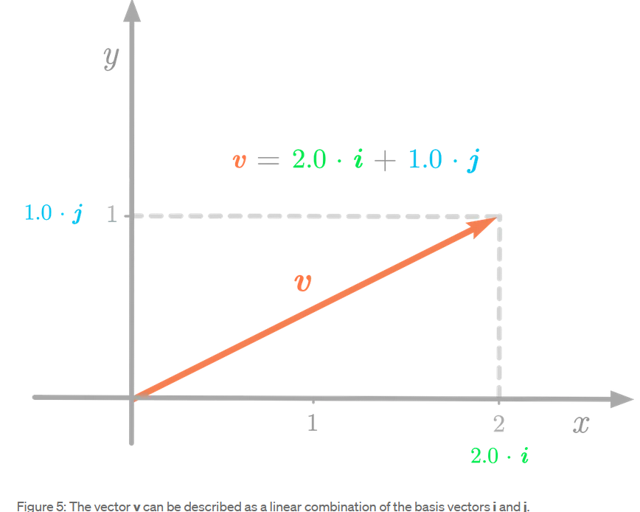
Quantum entanglement & Quantum Computing
1. Basis algebra and change of basis

Slide 44
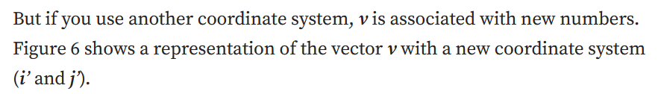
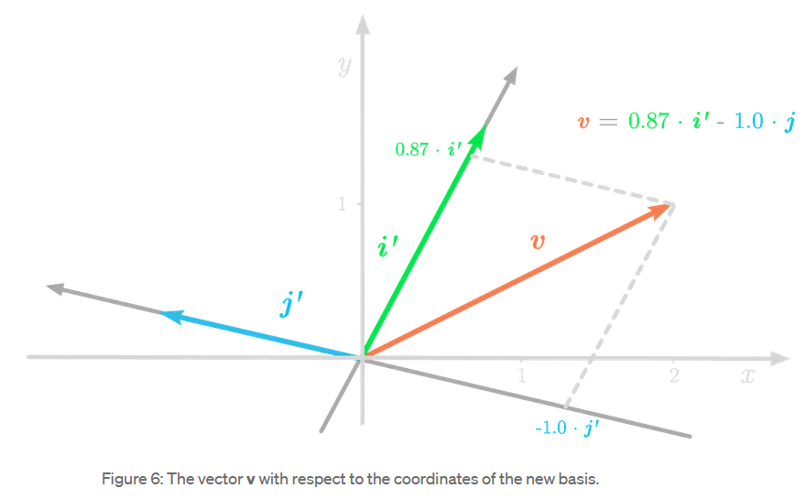
Quantum entanglement & Quantum Computing
1. Basis algebra and change of basis

Slide 45
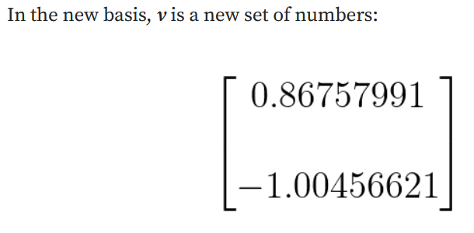
Quantum entanglement & Quantum Computing
1. Basis algebra and change of basis

Slide 46

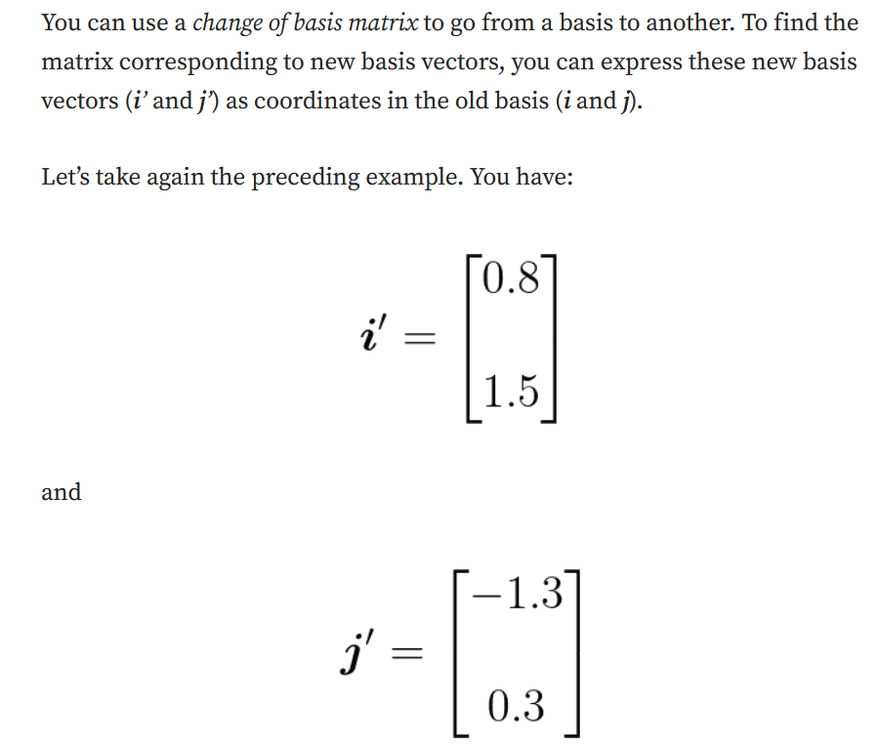
Quantum entanglement & Quantum Computing
1. Basis algebra and change of basis

Slide 47
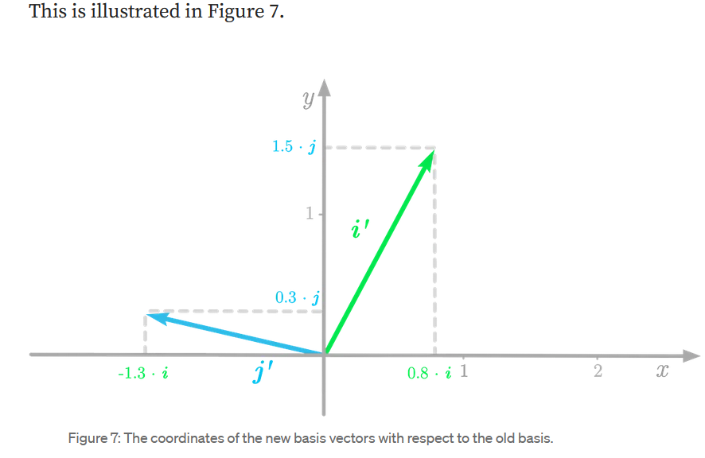
Quantum entanglement & Quantum Computing
1. Basis algebra and change of basis

Slide 48
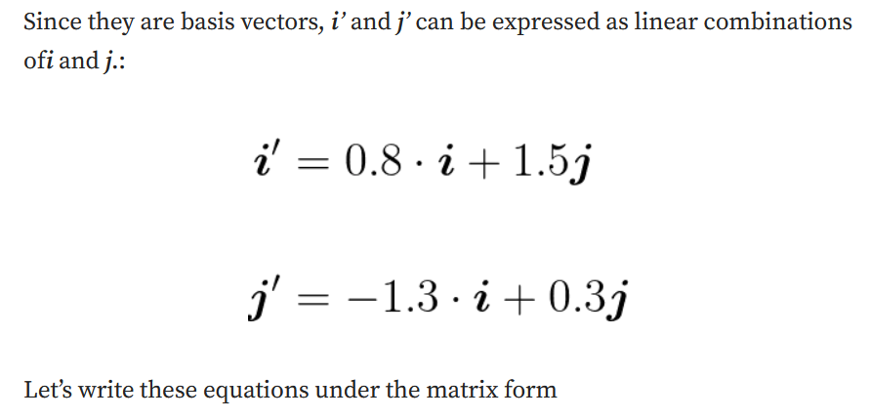
Quantum entanglement & Quantum Computing
1. Basis algebra and change of basis

Slide 49
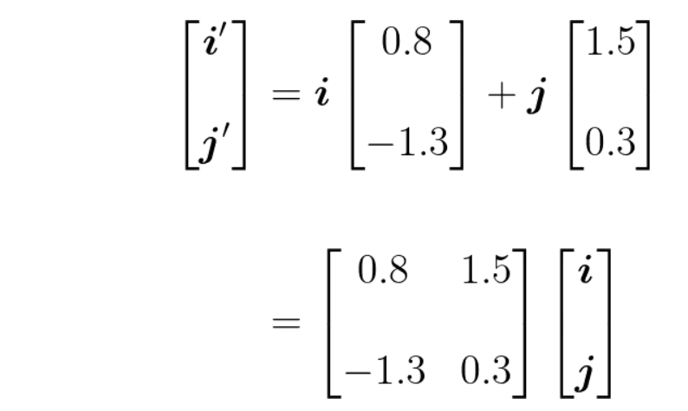
Quantum entanglement & Quantum Computing
1. Basis algebra and change of basis

Slide 50
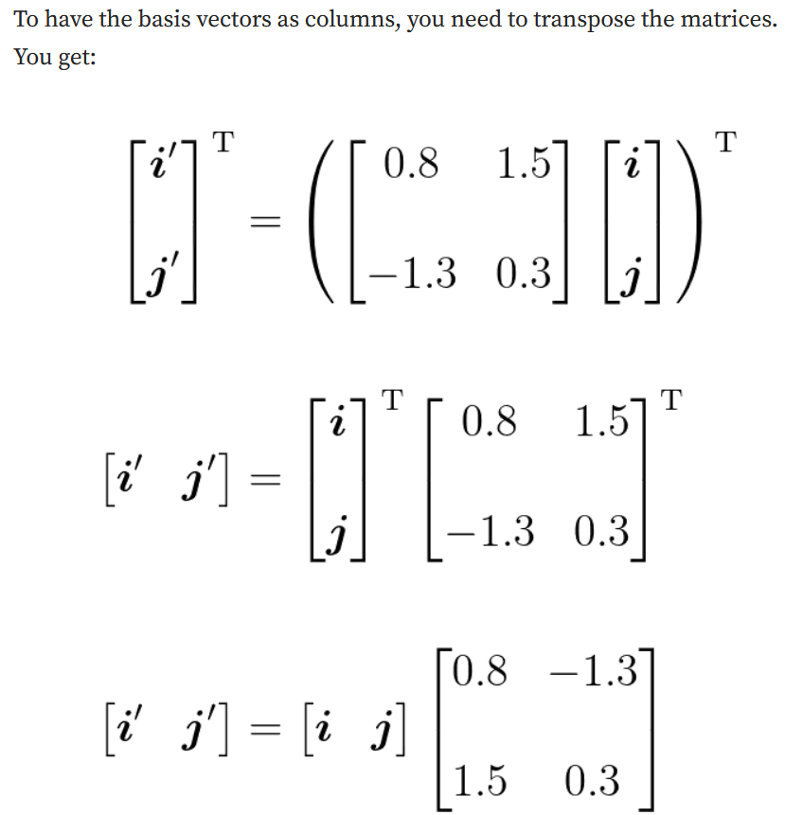
Quantum entanglement & Quantum Computing
1. Basis algebra and change of basis

Slide 51
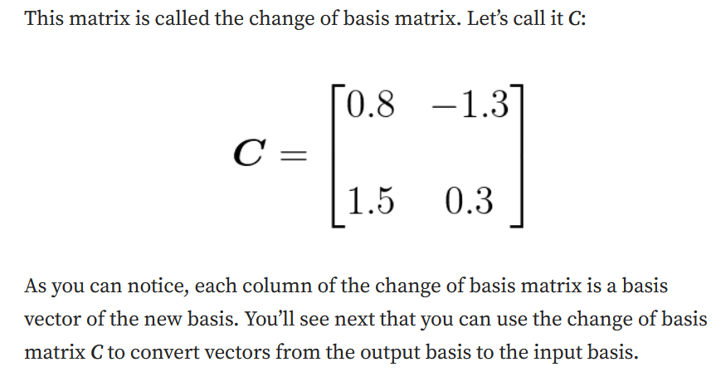
Quantum entanglement & Quantum Computing
1. Basis algebra and change of basis

Slide 52
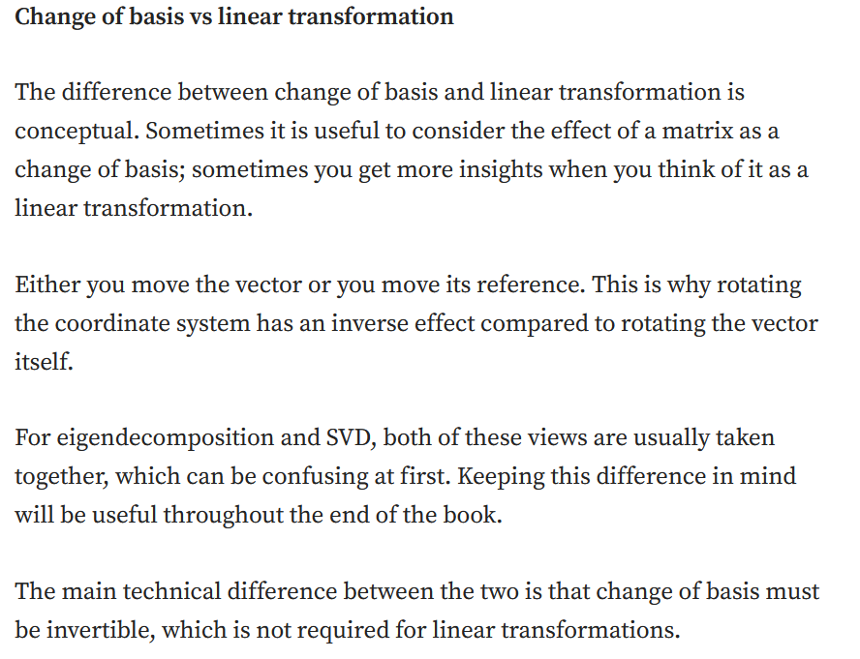
Quantum entanglement & Quantum Computing
1. Basis algebra and change of basis

Slide 53

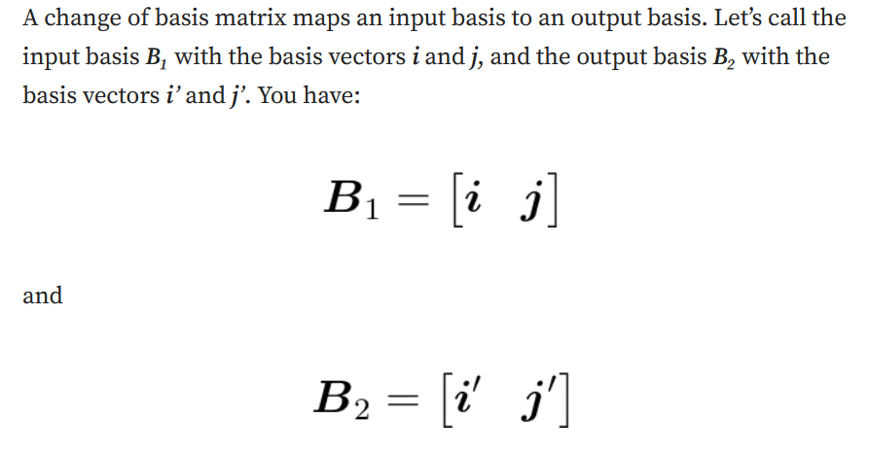
Quantum entanglement & Quantum Computing
1. Basis algebra and change of basis

Slide 54

Quantum entanglement & Quantum Computing
1. Basis algebra and change of basis

Slide 55

Quantum entanglement & Quantum Computing
1. Basis algebra and change of basis

Slide 56

Quantum entanglement & Quantum Computing
1. Basis algebra and change of basis

Slide 57

Quantum entanglement & Quantum Computing
1. Basis algebra and change of basis

Slide 58

Quantum entanglement & Quantum Computing
1. Basis algebra and change of basis

Slide 59

Quantum entanglement & Quantum Computing
1. Basis algebra and change of basis

Slide 60

Quantum entanglement & Quantum Computing
1. Basis algebra and change of basis

Slide 61

Quantum entanglement & Quantum Computing
1. Basis algebra and change of basis

Slide 62

Quantum entanglement & Quantum Computing
1. Basis algebra and change of basis

Slide 63

Quantum entanglement & Quantum Computing
1. Basis algebra and change of basis

Slide 64

Quantum entanglement & Quantum Computing
2. Quantum computational Basis states

Slide 65

Quantum entanglement & Quantum Computing
2. Quantum computational Basis states

Slide 66

Quantum entanglement & Quantum Computing
2. Quantum computational Basis states

Slide 67

Quantum entanglement & Quantum Computing
2. Quantum computational Basis states

Slide 68
THANK YOU
Dr. Kaustav Bhowmick
Department of Electronics & Communication
Engineering
kaustavbhowmick@pes.edu

