Slide 1

Quantum Entanglement and Quantum Computing
Dr. Kaustav Bhowmick
Electronics & Communication
Engineering

Slide 2


Quantum Entanglement and Quantum Computing
Introduction to Topic
Dr. Kaustav Bhowmick
Electronics & Communication Engineering
Source: Google images

Slide 3
Quantum entanglement & Quantum Computing
Contents
Quantum maths II

Slide 4
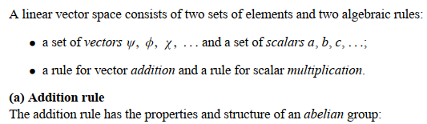
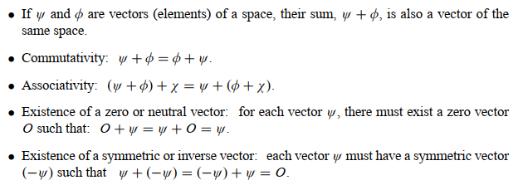
Quantum entanglement & Quantum Computing
Quantum Maths II

Slide 5
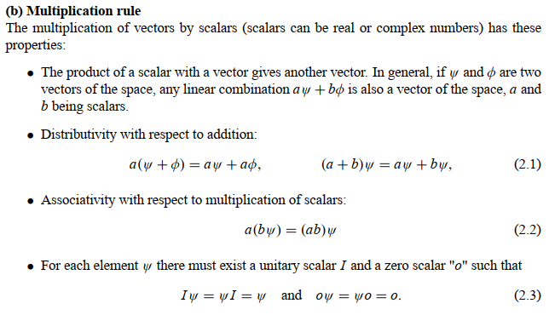
Quantum entanglement & Quantum Computing
Quantum Maths II

Slide 6

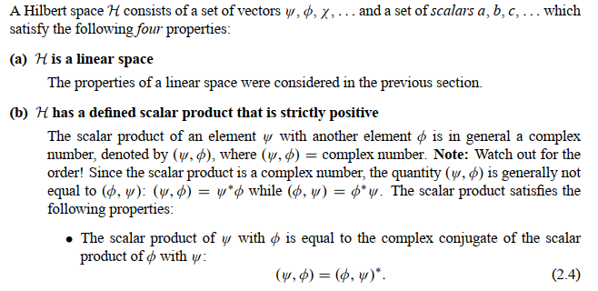
Quantum entanglement & Quantum Computing
Quantum Maths II

Slide 7
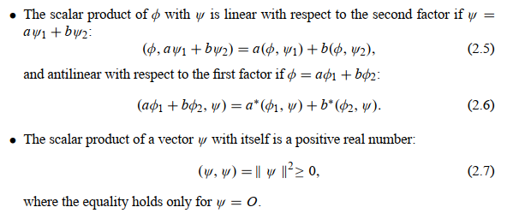
Quantum entanglement & Quantum Computing
Quantum Maths II

Slide 8
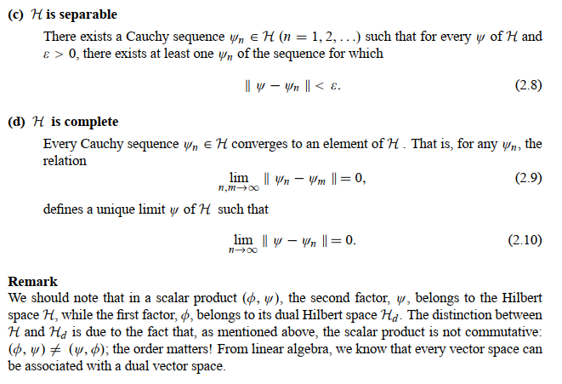
Quantum entanglement & Quantum Computing
Quantum Maths II

Slide 9
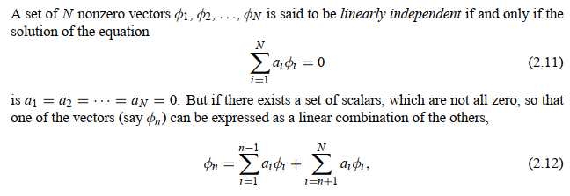
Quantum entanglement & Quantum Computing
Quantum Maths II

Slide 10
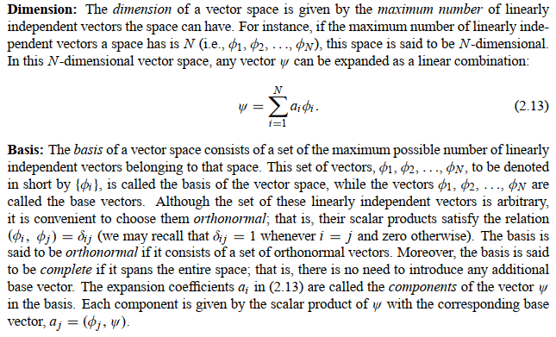
Quantum entanglement & Quantum Computing
Quantum Maths II

Slide 11
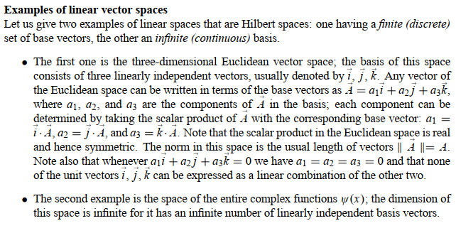
Quantum entanglement & Quantum Computing
Quantum Maths II

Slide 12
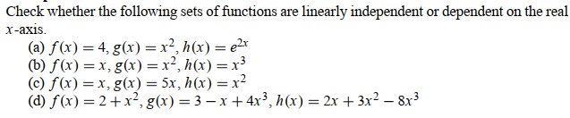
Quantum entanglement & Quantum Computing
Quantum Maths II: example 1

Slide 13
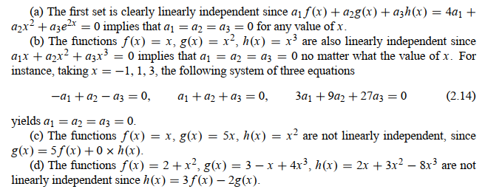
Quantum entanglement & Quantum Computing
Quantum Maths II: example 1

Slide 14
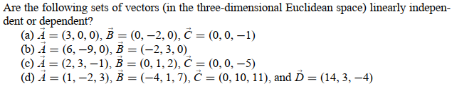
Quantum entanglement & Quantum Computing
Quantum Maths II: example 2

Slide 15
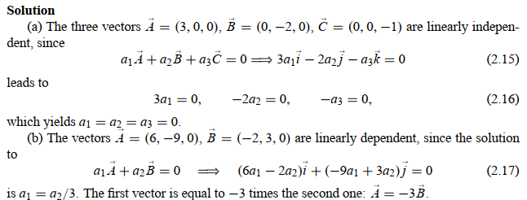
Quantum entanglement & Quantum Computing
Quantum Maths II: example 2

Slide 16
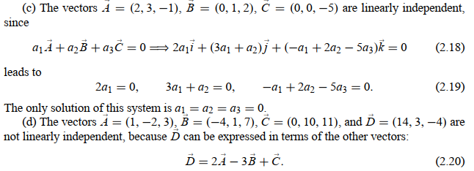
Quantum entanglement & Quantum Computing
Quantum Maths II: example 2

Slide 17
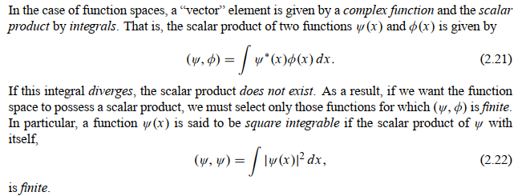
Quantum entanglement & Quantum Computing
Quantum Maths II

Slide 18
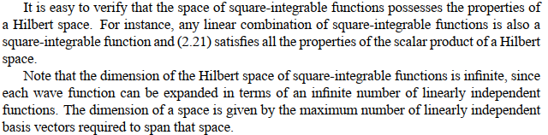
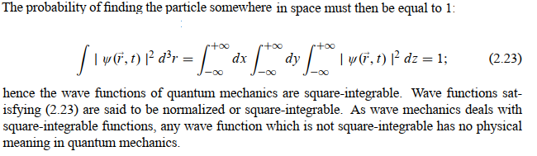
Quantum entanglement & Quantum Computing
Quantum Maths II

Slide 19

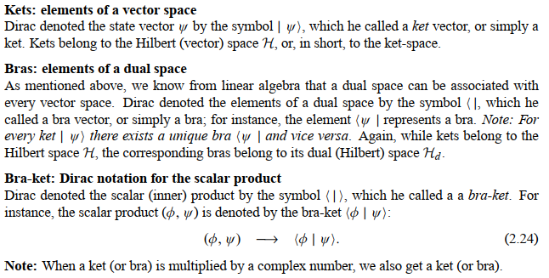
Quantum entanglement & Quantum Computing
Quantum Maths II

Slide 20
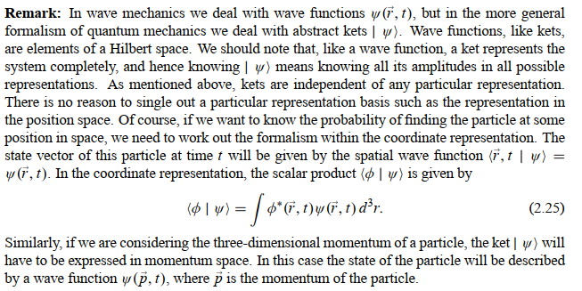
Quantum entanglement & Quantum Computing
Quantum Maths II

Slide 21
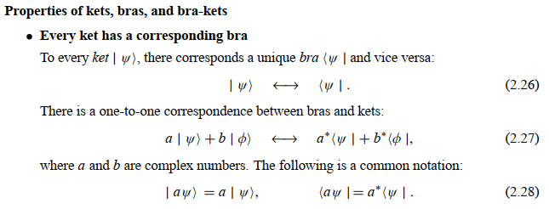
Quantum entanglement & Quantum Computing
Quantum Maths II

Slide 22
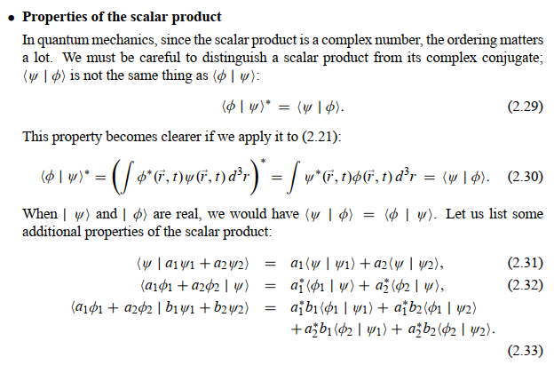
Quantum entanglement & Quantum Computing
Quantum Maths II

Slide 23
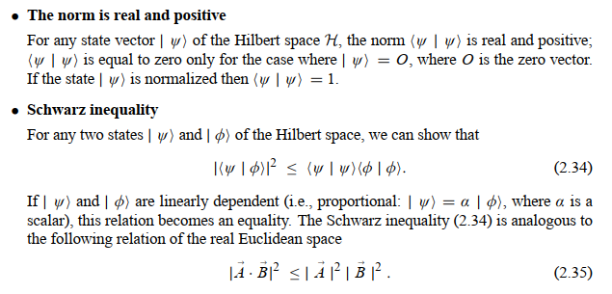
Quantum entanglement & Quantum Computing
Quantum Maths II

Slide 24
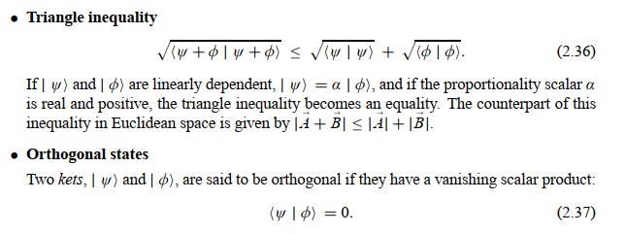
Quantum entanglement & Quantum Computing
Quantum Maths II

Slide 25
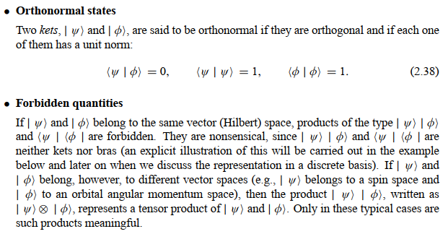
Quantum entanglement & Quantum Computing
Quantum Maths II

Slide 26
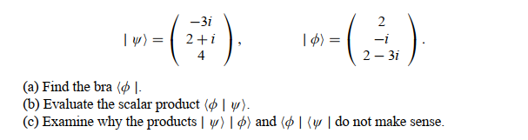
Quantum entanglement & Quantum Computing
Quantum Maths II: Example 3

Slide 27
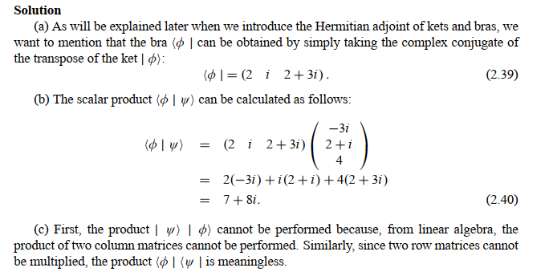
Quantum entanglement & Quantum Computing
Quantum Maths II: Example 3

Slide 28
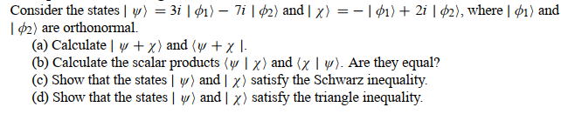
Quantum entanglement & Quantum Computing
Quantum Maths II: Example 4

Slide 29
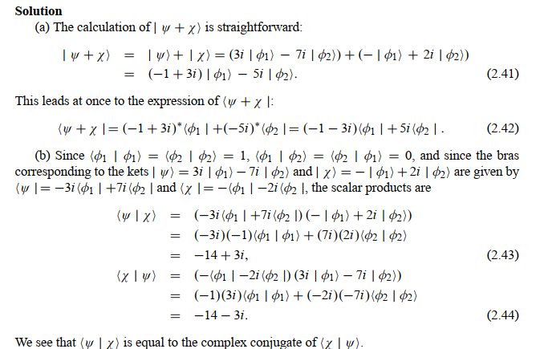
Quantum entanglement & Quantum Computing
Quantum Maths II: Example 4

Slide 30
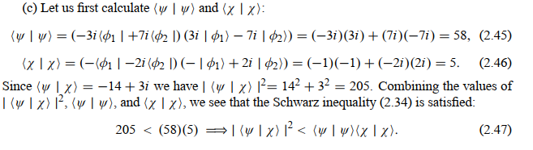
Quantum entanglement & Quantum Computing
Quantum Maths II: Example 4

Slide 31
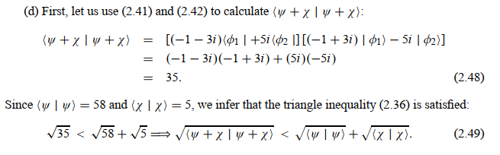
Quantum entanglement & Quantum Computing
Quantum Maths II: Example 4

Slide 32

Quantum entanglement & Quantum Computing
Quantum Maths II: Example 5

Slide 33
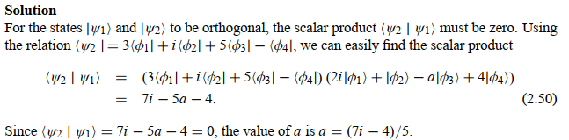
Quantum entanglement & Quantum Computing
Quantum Maths II: Example 5

Slide 34
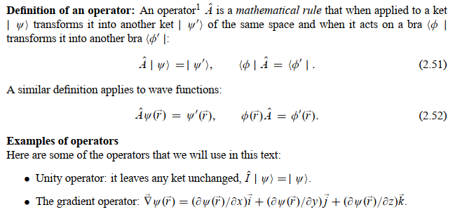
Quantum entanglement & Quantum Computing
Quantum Maths II:

Slide 35

Quantum entanglement & Quantum Computing
Quantum Maths II:

Slide 36
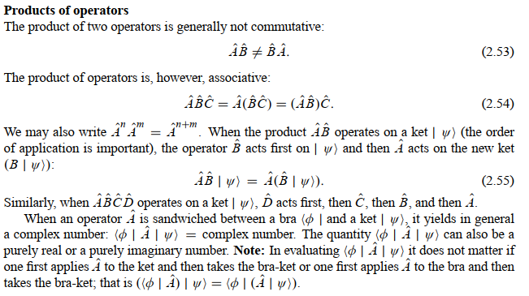
Quantum entanglement & Quantum Computing
Quantum Maths II:

Slide 37
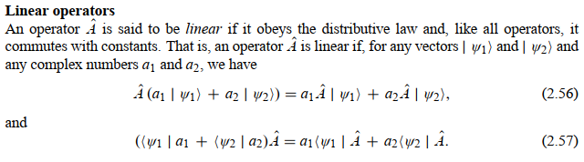
Quantum entanglement & Quantum Computing
Quantum Maths II:

Slide 38
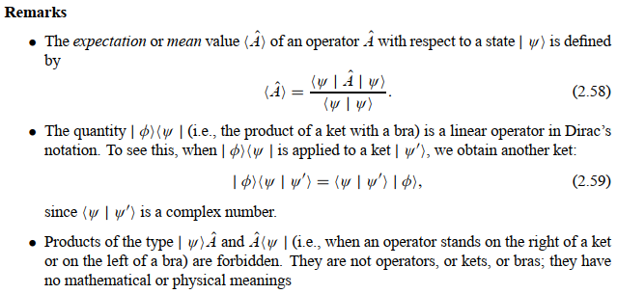
Quantum entanglement & Quantum Computing
Quantum Maths II:

Slide 39

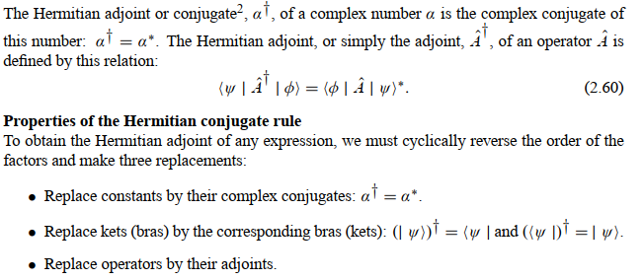
Quantum entanglement & Quantum Computing
Quantum Maths II:

Slide 40
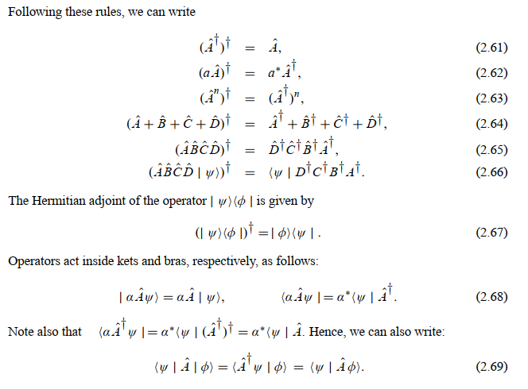
Quantum entanglement & Quantum Computing
Quantum Maths II:

Slide 41
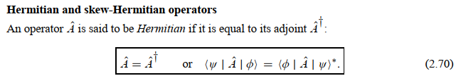
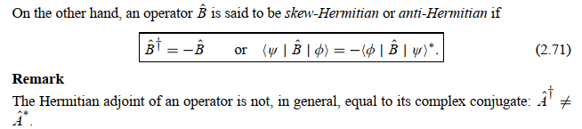
Quantum entanglement & Quantum Computing
Quantum Maths II:

Slide 42
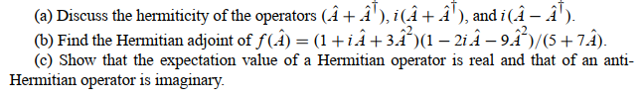
Quantum entanglement & Quantum Computing
Quantum Maths II: Example 6

Slide 43
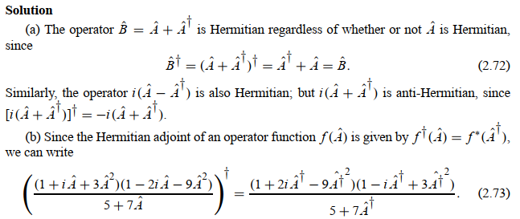
Quantum entanglement & Quantum Computing
Quantum Maths II: Example 6

Slide 44
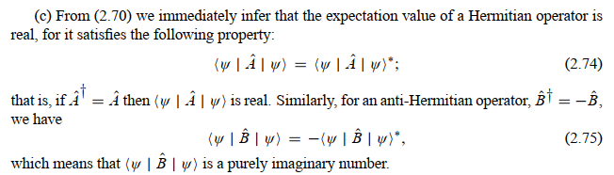
Quantum entanglement & Quantum Computing
Quantum Maths II: Example 6

Slide 45

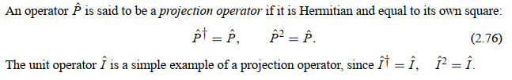
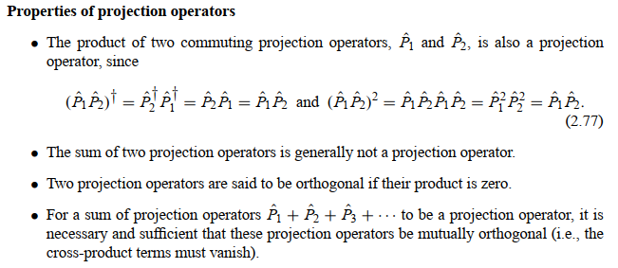
Quantum entanglement & Quantum Computing
Quantum Maths II:

Slide 46
Quantum entanglement & Quantum Computing
Quantum Maths II: Example 7

Slide 47
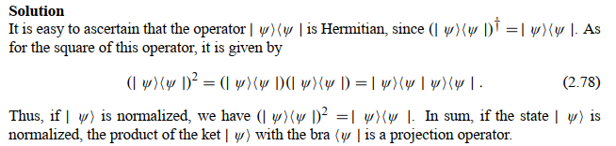
Quantum entanglement & Quantum Computing
Quantum Maths II: Example 7

Slide 48
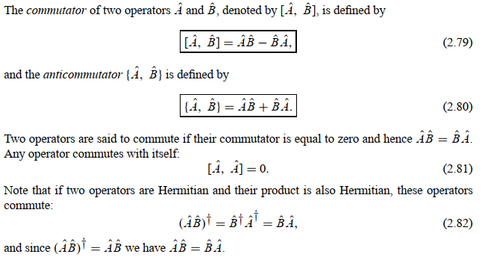
Quantum entanglement & Quantum Computing
Quantum Maths II:

Slide 49
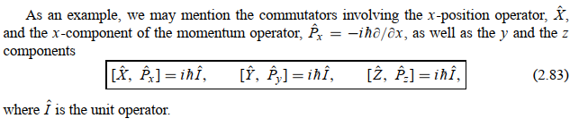
Quantum entanglement & Quantum Computing
Quantum Maths II:

Slide 50
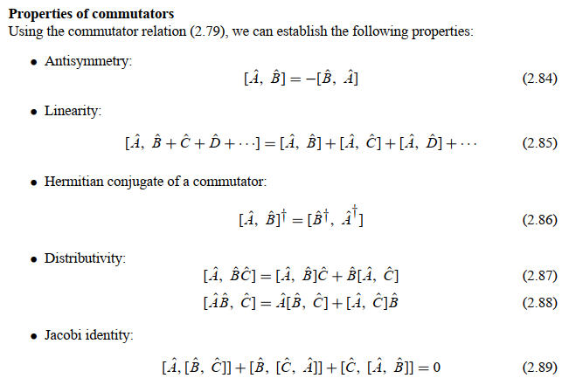
Quantum entanglement & Quantum Computing
Quantum Maths II:

Slide 51
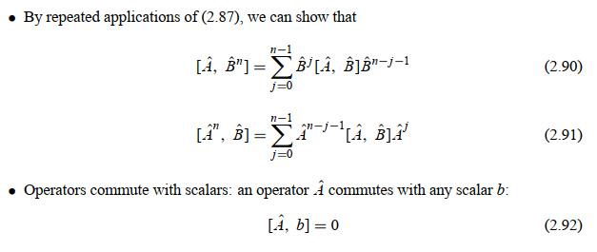
Quantum entanglement & Quantum Computing
Quantum Maths II:

Slide 52
Quantum entanglement & Quantum Computing
Quantum Maths II: Example 8

Slide 53
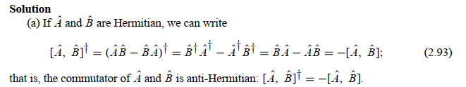
Quantum entanglement & Quantum Computing
Quantum Maths II: Example 8

Slide 54

Quantum entanglement & Quantum Computing
Quantum Maths II: Example 8

Slide 55
THANK YOU
Dr. Kaustav Bhowmick
Department of Electronics & Communication
Engineering
kaustavbhowmick@pes.edu

