Slide 1

Quantum Entanglement and Quantum Computing
Dr. Kaustav Bhowmick
Electronics & Communication
Engineering

Slide 2


Quantum Entanglement and Quantum Computing
Introduction to Topic
Dr. Kaustav Bhowmick
Electronics & Communication Engineering
Source: Google images

Slide 3
Quantum entanglement & Quantum Computing
Contents
Density operator, Pure and Mixed States
Traces of Density Matrix

Slide 4
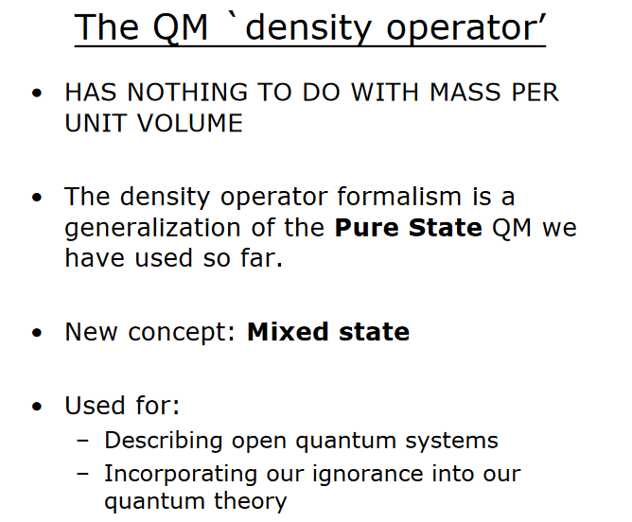
Quantum entanglement & Quantum Computing
1. Density operator, Pure and Mixed States

Slide 5
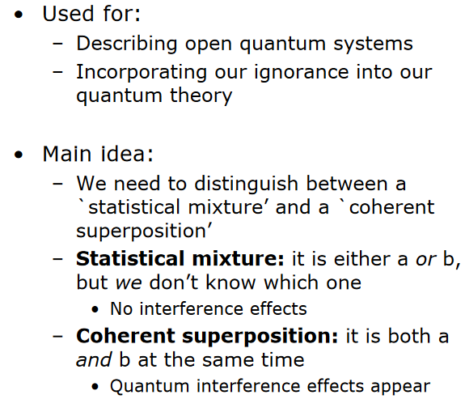
Quantum entanglement & Quantum Computing
1. Density operator, Pure and Mixed States

Slide 6
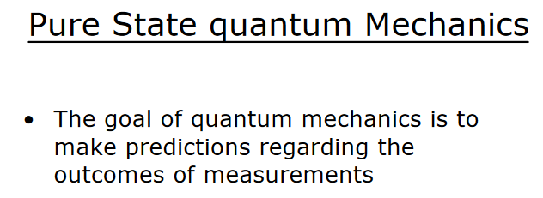
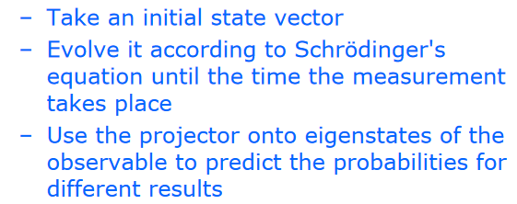
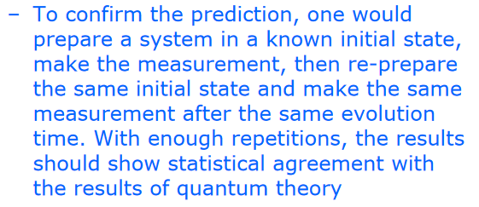
Quantum entanglement & Quantum Computing
1. Density operator, Pure and Mixed States

Slide 7
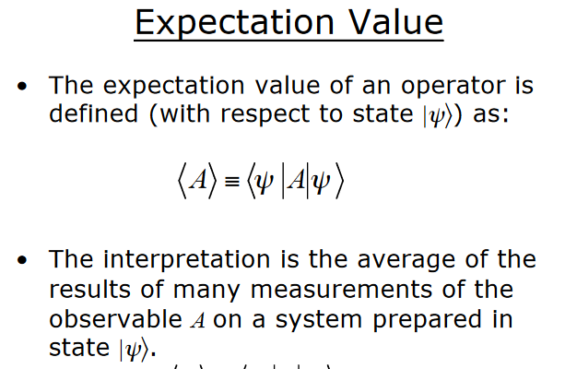
Quantum entanglement & Quantum Computing
1. Density operator, Pure and Mixed States

Slide 8
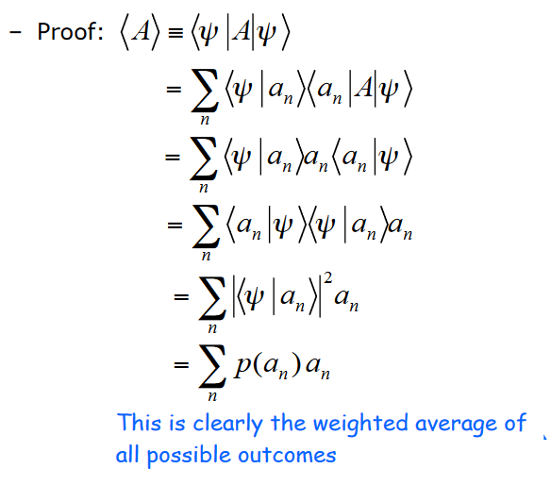
Quantum entanglement & Quantum Computing
1. Density operator, Pure and Mixed States

Slide 9

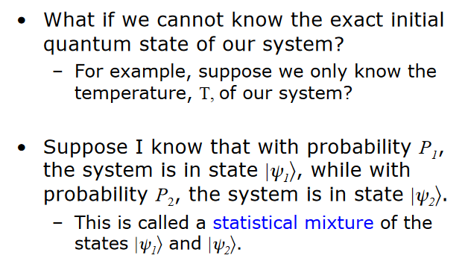
Quantum entanglement & Quantum Computing
1. Density operator, Pure and Mixed States

Slide 10
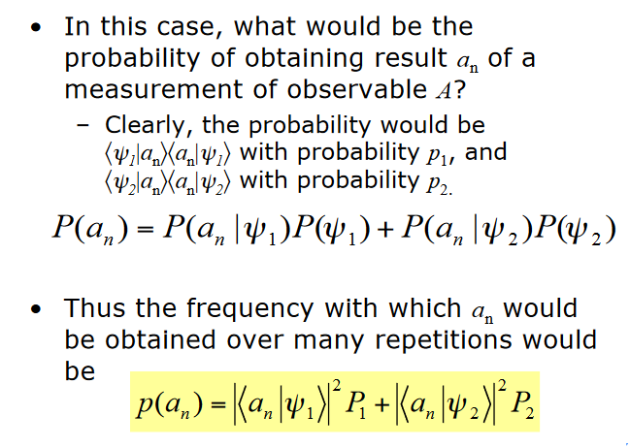
Quantum entanglement & Quantum Computing
1. Density operator, Pure and Mixed States

Slide 11

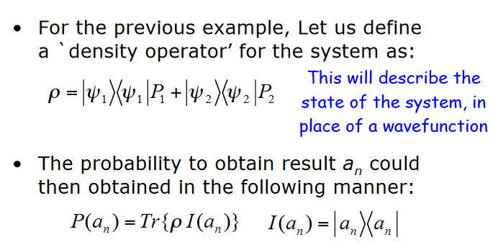
Quantum entanglement & Quantum Computing
1. Density operator, Pure and Mixed States

Slide 12
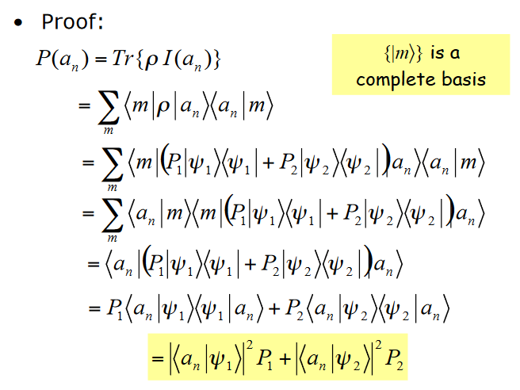
Quantum entanglement & Quantum Computing
1. Density operator, Pure and Mixed States

Slide 13

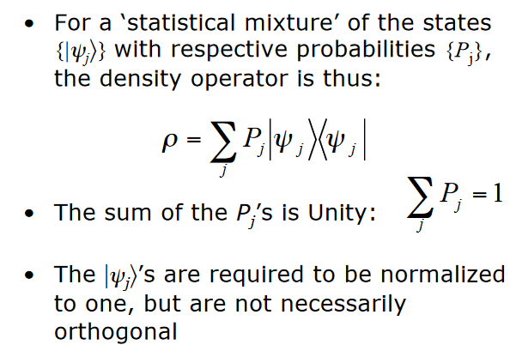
Quantum entanglement & Quantum Computing
1. Density operator, Pure and Mixed States

Slide 14
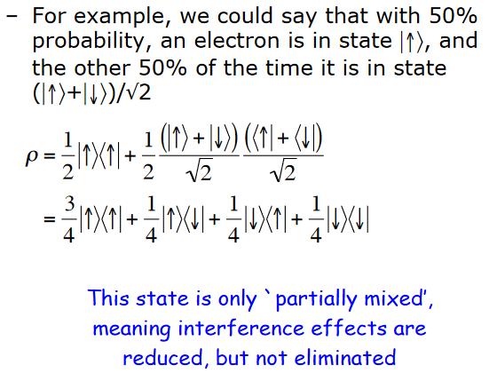
Quantum entanglement & Quantum Computing
1. Density operator, Pure and Mixed States

Slide 15

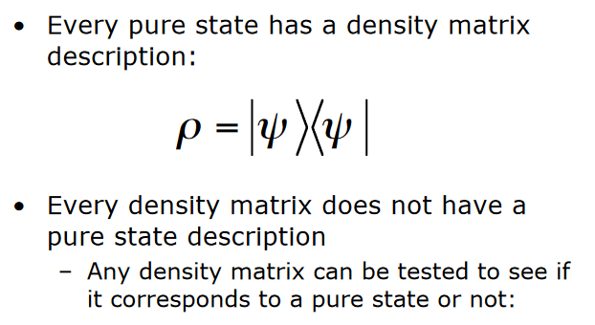
Quantum entanglement & Quantum Computing
1. Density operator, Pure and Mixed States

Slide 16
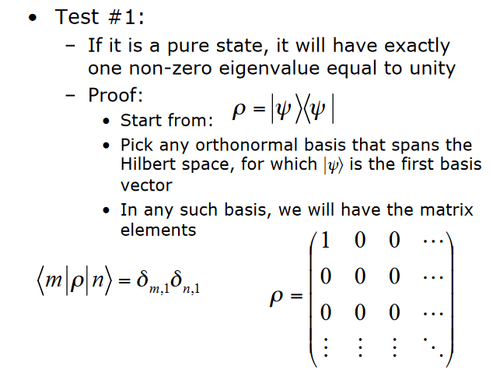
Quantum entanglement & Quantum Computing
1. Density operator, Pure and Mixed States

Slide 17

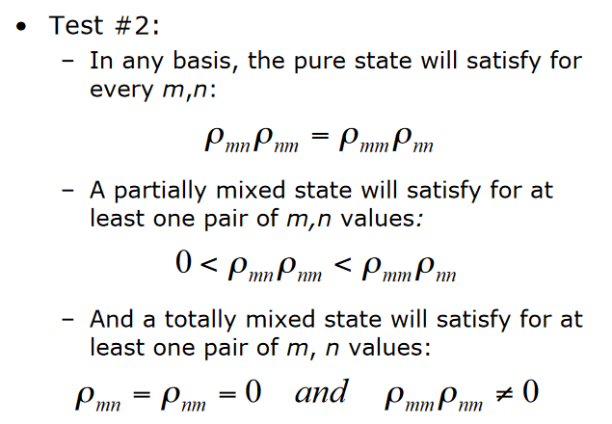
Quantum entanglement & Quantum Computing
1. Density operator, Pure and Mixed States

Slide 18
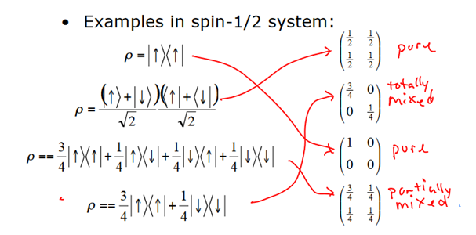
Quantum entanglement & Quantum Computing
1. Density operator, Pure and Mixed States

Slide 19

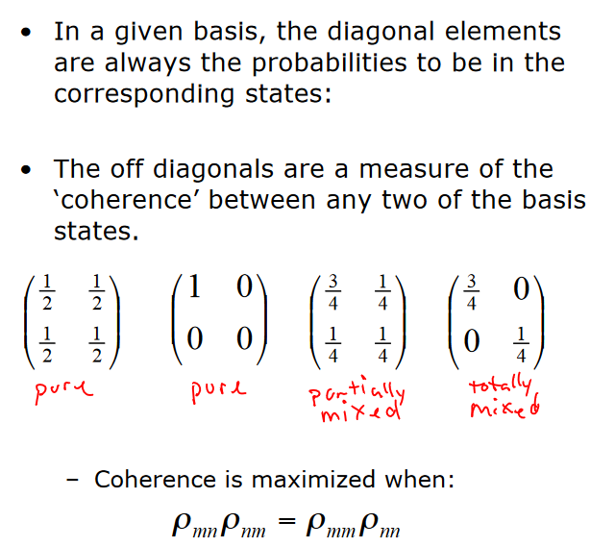
Quantum entanglement & Quantum Computing
1. Density operator, Pure and Mixed States

Slide 20
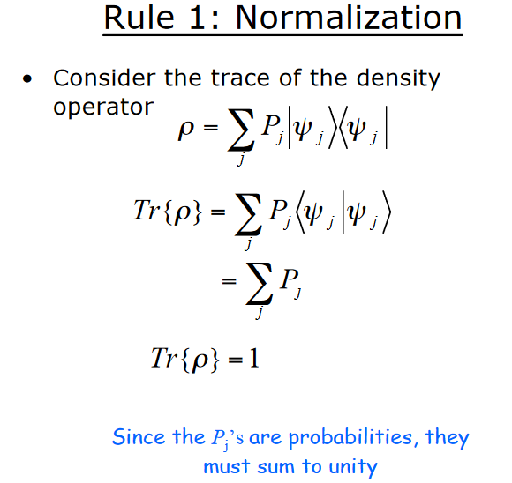
Quantum entanglement & Quantum Computing
2. Traces of Density Matrix

Slide 21

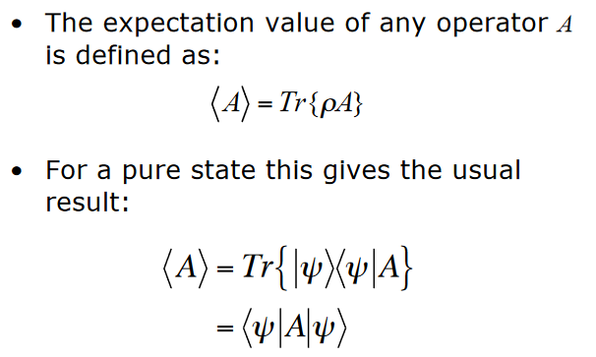
Quantum entanglement & Quantum Computing
2. Traces of Density Matrix

Slide 22
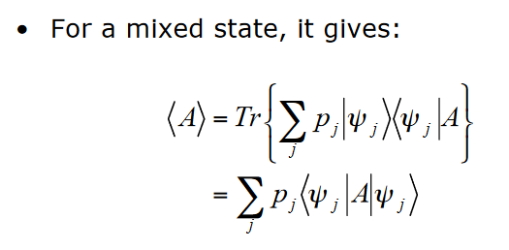
Quantum entanglement & Quantum Computing
2. Traces of Density Matrix

Slide 23

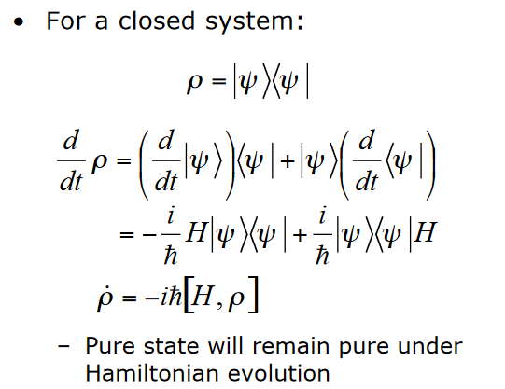
Quantum entanglement & Quantum Computing
2. Traces of Density Matrix

Slide 24
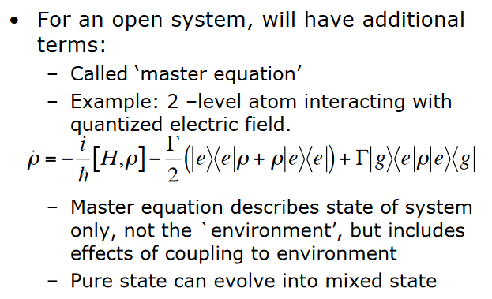
Quantum entanglement & Quantum Computing
2. Traces of Density Matrix

Slide 25
Quantum entanglement & Quantum Computing
2. Traces of Density Matrix

Slide 26
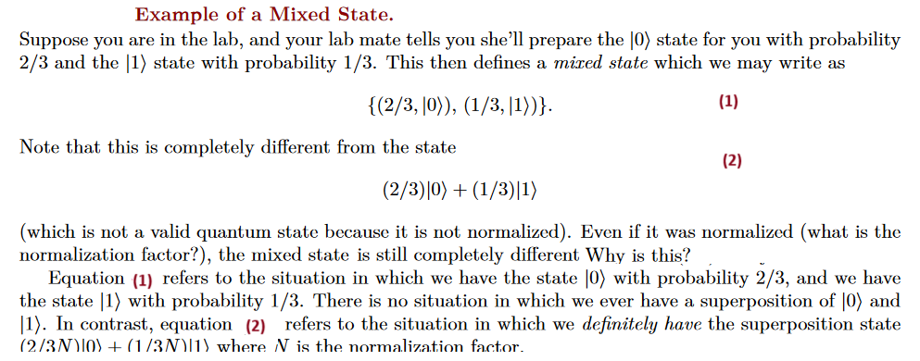
Quantum entanglement & Quantum Computing
2. Traces of Density Matrix

Slide 27
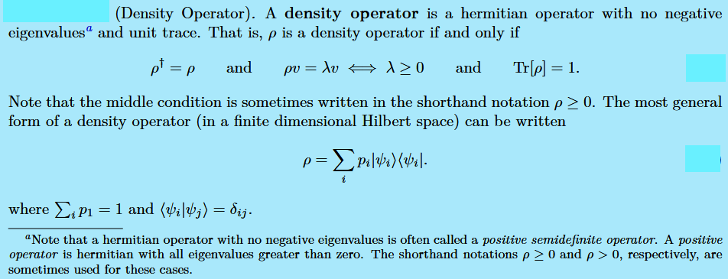
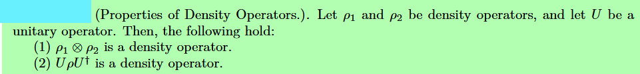
Quantum entanglement & Quantum Computing
2. Traces of Density Matrix

Slide 28
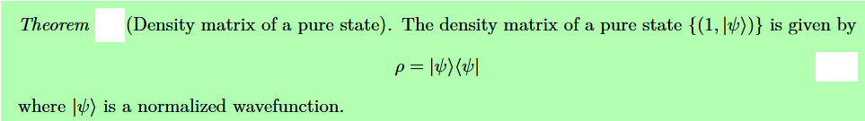
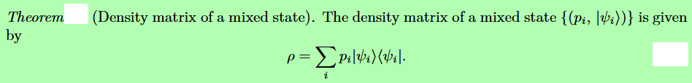
Quantum entanglement & Quantum Computing
2. Traces of Density Matrix

Slide 29
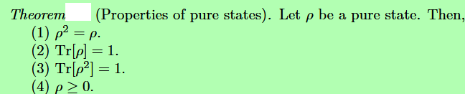
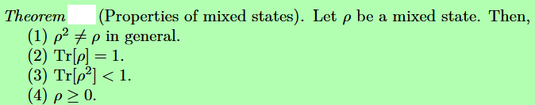
Quantum entanglement & Quantum Computing
2. Traces of Density Matrix

Slide 30
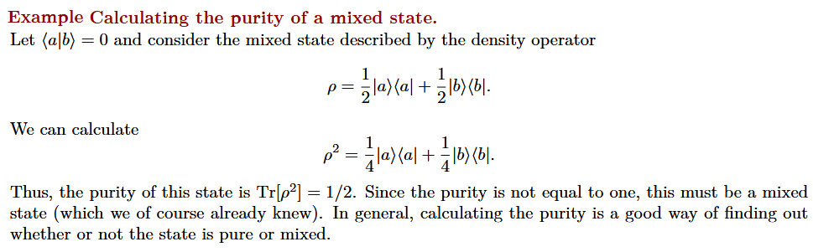
Quantum entanglement & Quantum Computing
2. Traces of Density Matrix

Slide 31
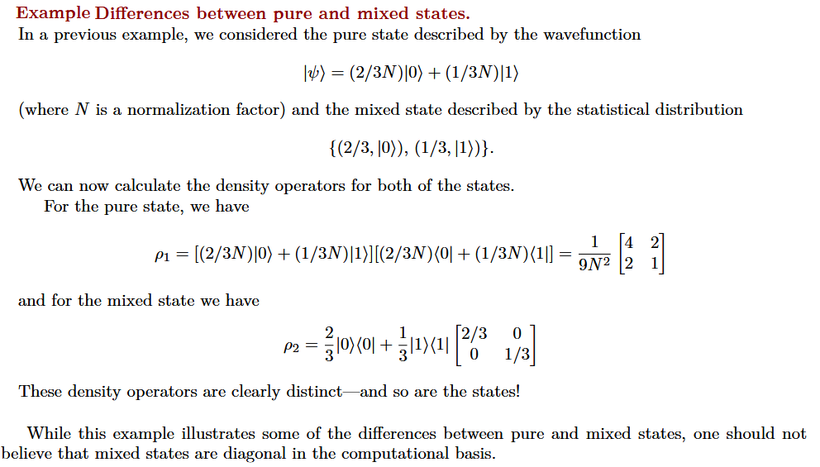
Quantum entanglement & Quantum Computing
2. Traces of Density Matrix

Slide 32

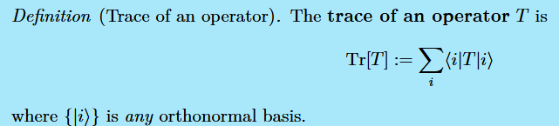
Quantum entanglement & Quantum Computing
2. Traces of Density Matrix

Slide 33
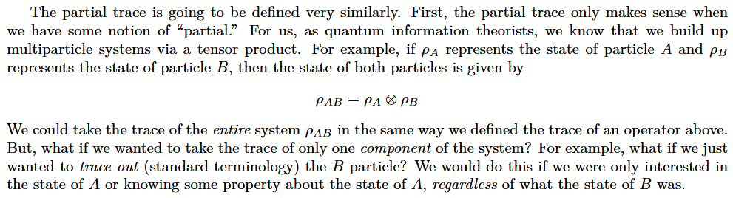
Quantum entanglement & Quantum Computing
2. Traces of Density Matrix

Slide 34
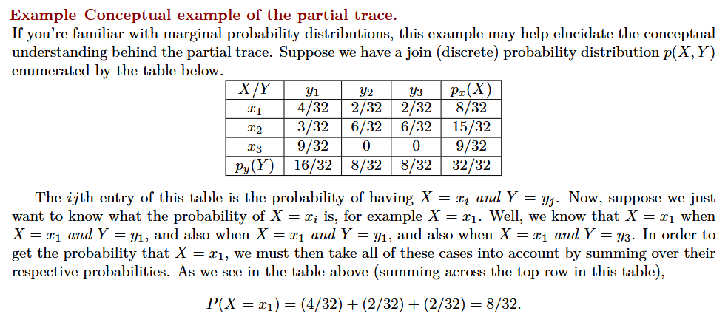
Quantum entanglement & Quantum Computing
2. Traces of Density Matrix

Slide 35
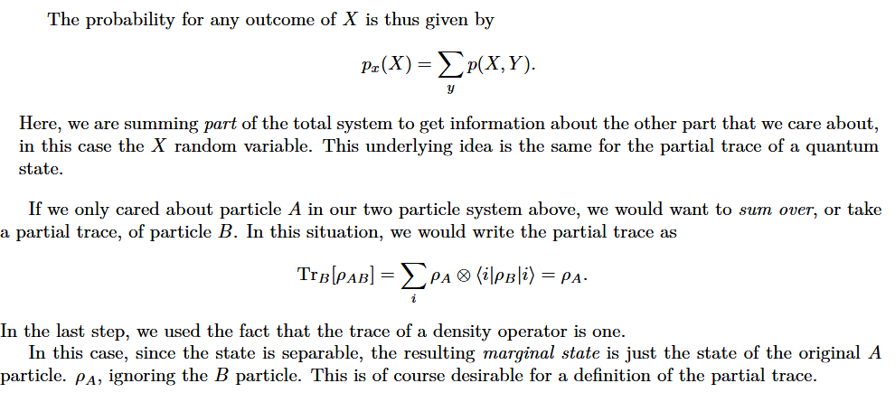
Quantum entanglement & Quantum Computing
2. Traces of Density Matrix

Slide 36
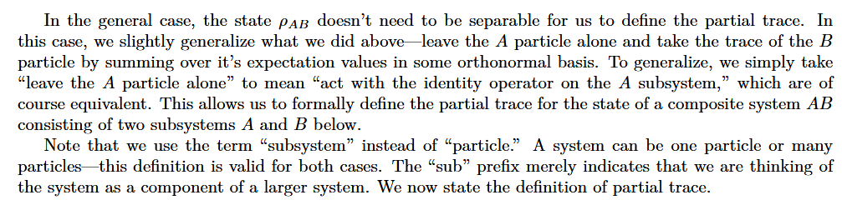
Quantum entanglement & Quantum Computing
2. Traces of Density Matrix

Slide 37
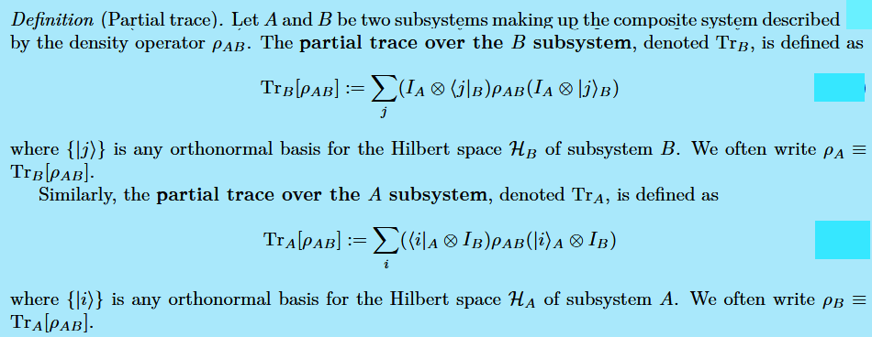
Quantum entanglement & Quantum Computing
2. Traces of Density Matrix

Slide 38
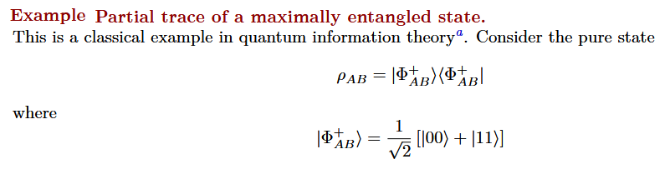
Quantum entanglement & Quantum Computing
2. Traces of Density Matrix

Slide 39
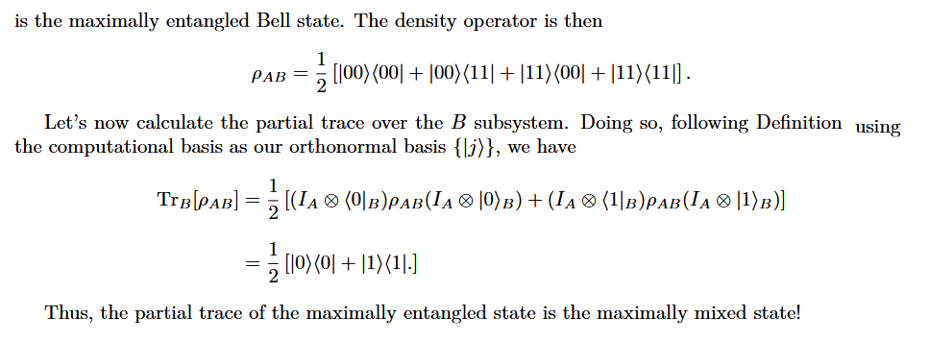
Quantum entanglement & Quantum Computing
2. Traces of Density Matrix

Slide 40
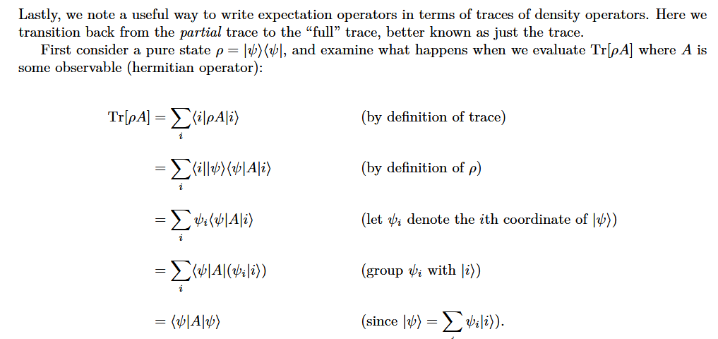
Quantum entanglement & Quantum Computing
2. Traces of Density Matrix

Slide 41
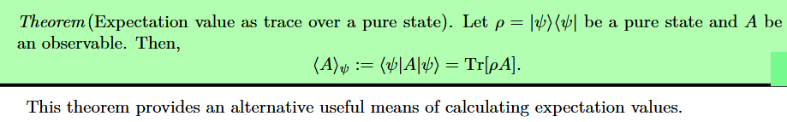
Quantum entanglement & Quantum Computing
2. Traces of Density Matrix

Slide 42
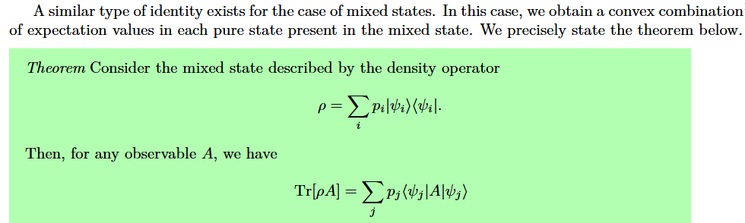
Quantum entanglement & Quantum Computing
2. Traces of Density Matrix

Slide 43
THANK YOU
Dr. Kaustav Bhowmick
Department of Electronics & Communication
Engineering
kaustavbhowmick@pes.edu

