Slide 1

Quantum Entanglement and Quantum Computing
Dr. Kaustav Bhowmick
Electronics & Communication
Engineering

Slide 2


Quantum Entanglement and Quantum Computing
Introduction to Topic
Dr. Kaustav Bhowmick
Electronics & Communication Engineering
Source: Google images

Slide 3
Quantum entanglement & Quantum Computing
Contents
Superposition of Quantum States
Introduction to Quantum Gates

Slide 4
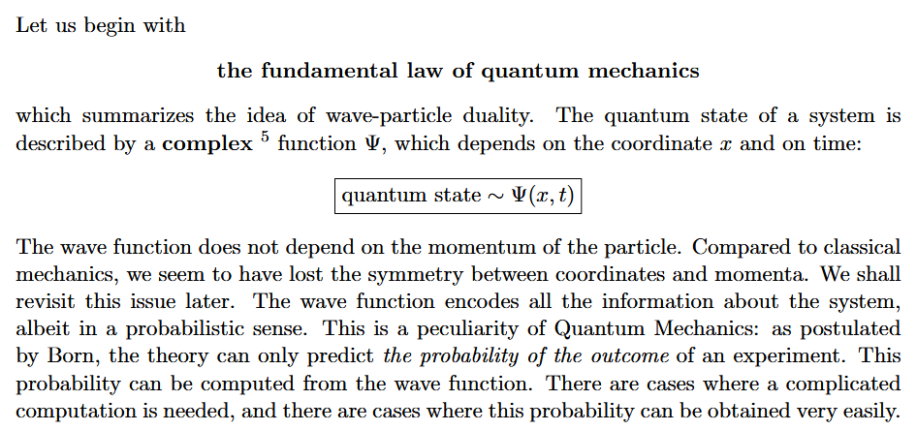
Quantum entanglement & Quantum Computing
1. Superposition of Quantum States

Slide 5
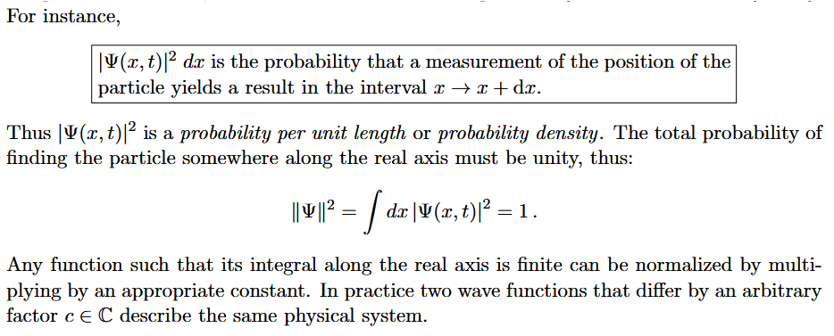
Quantum entanglement & Quantum Computing
1. Superposition of Quantum States

Slide 6
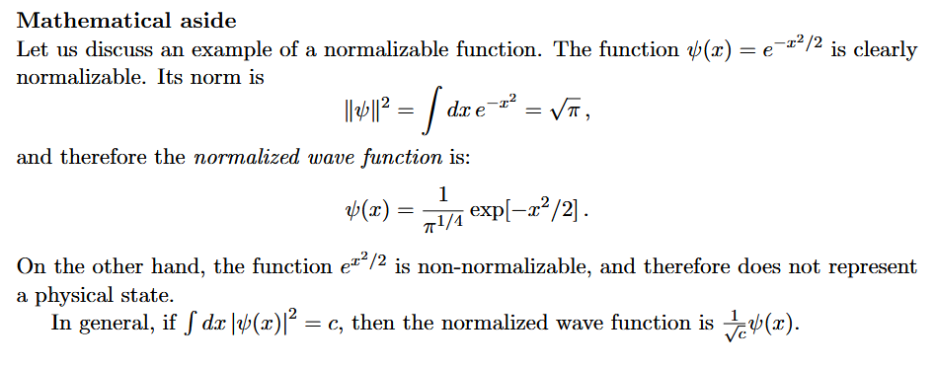
Quantum entanglement & Quantum Computing
1. Superposition of Quantum States

Slide 7
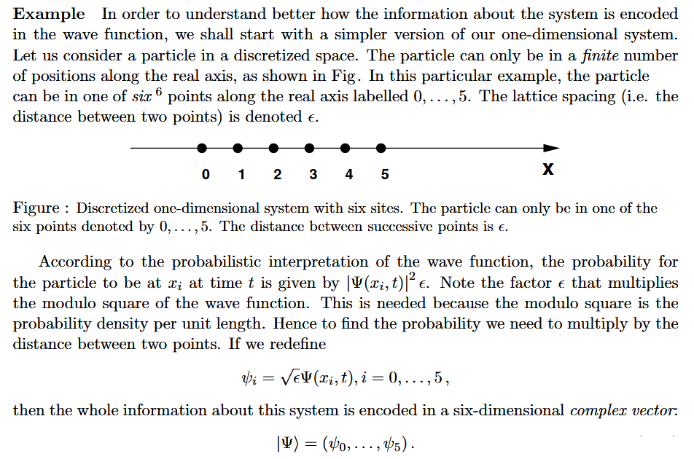
Quantum entanglement & Quantum Computing
1. Superposition of Quantum States

Slide 8
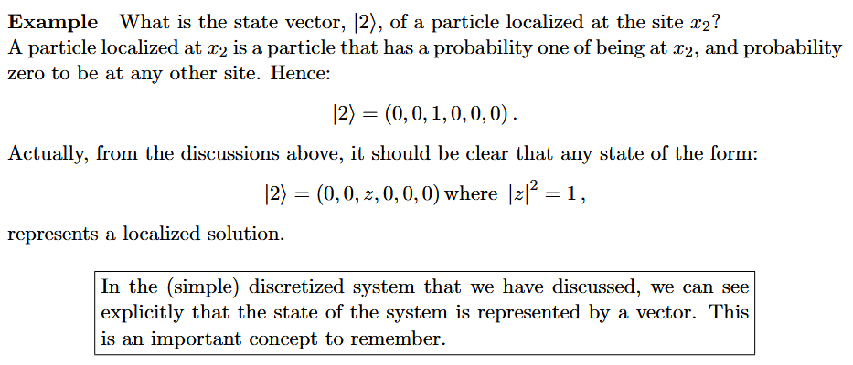
Quantum entanglement & Quantum Computing
1. Superposition of Quantum States

Slide 9
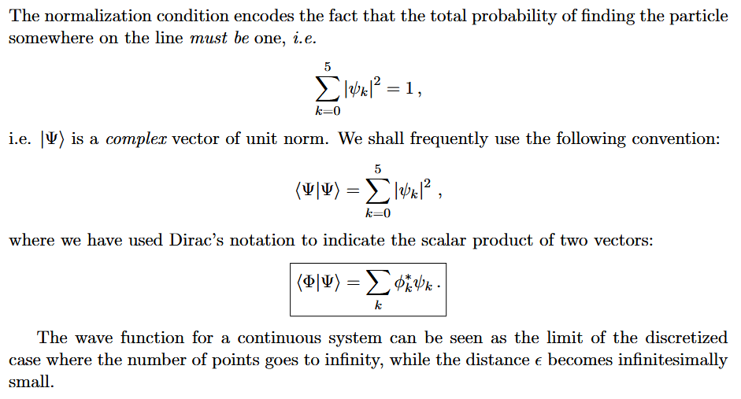
Quantum entanglement & Quantum Computing
1. Superposition of Quantum States

Slide 10
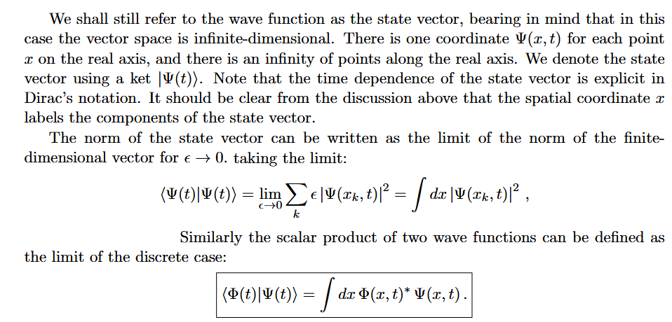
Quantum entanglement & Quantum Computing
1. Superposition of Quantum States

Slide 11
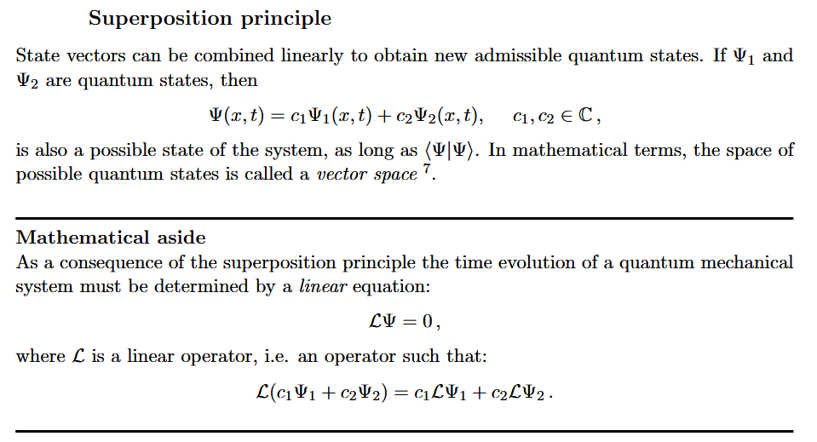
Quantum entanglement & Quantum Computing
1. Superposition of Quantum States

Slide 12
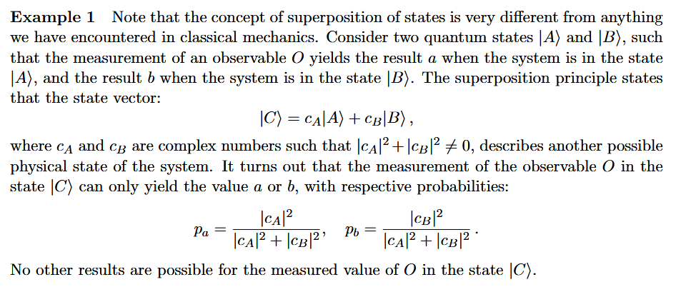
Quantum entanglement & Quantum Computing
1. Superposition of Quantum States

Slide 13
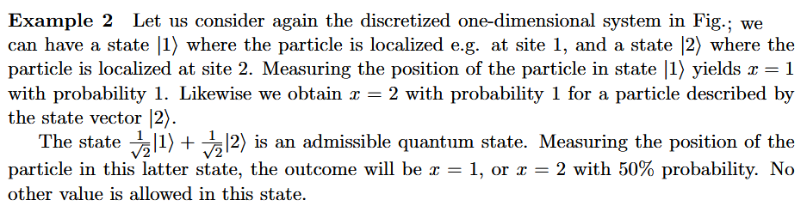
Quantum entanglement & Quantum Computing
1. Superposition of Quantum States

Slide 14
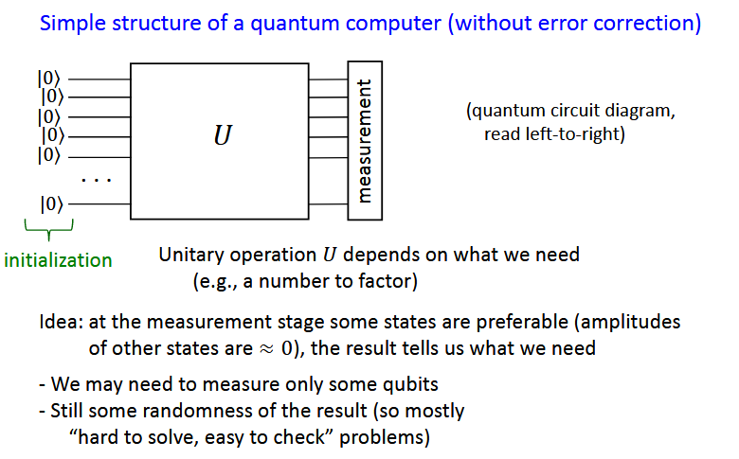
Quantum entanglement & Quantum Computing
2. Introduction to Quantum Gates

Slide 15
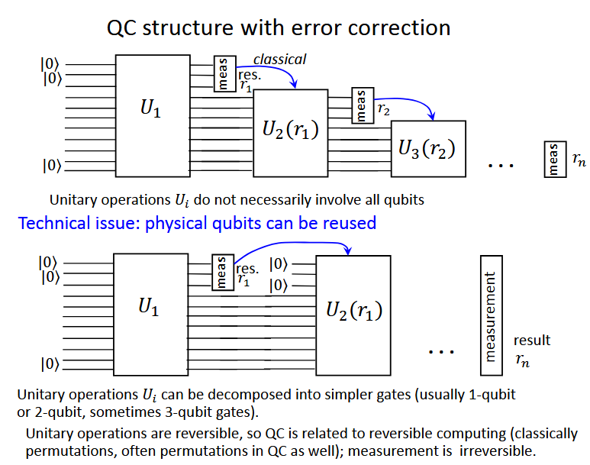
Quantum entanglement & Quantum Computing
2. Introduction to Quantum Gates

Slide 16
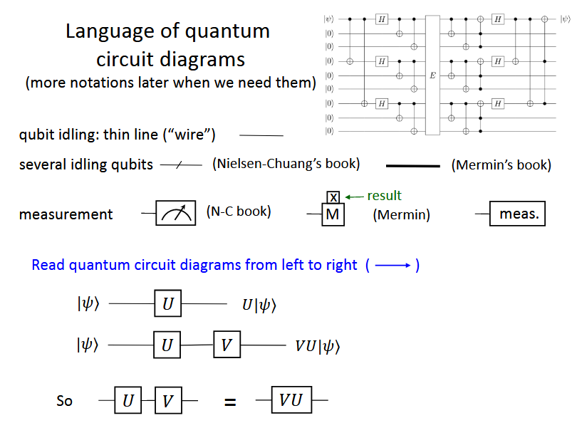
Quantum entanglement & Quantum Computing
2. Introduction to Quantum Gates

Slide 17
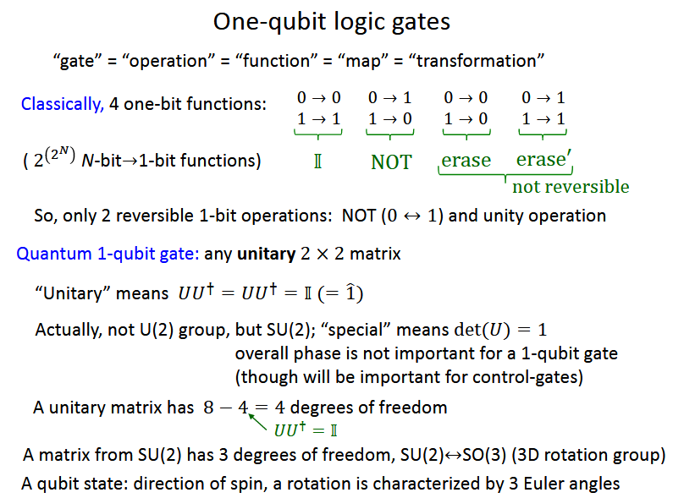
Quantum entanglement & Quantum Computing
2. Introduction to Quantum Gates

Slide 18
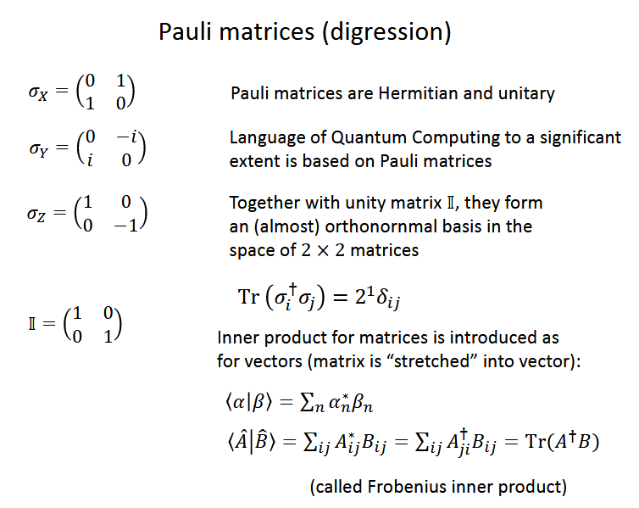
Quantum entanglement & Quantum Computing
2. Introduction to Quantum Gates

Slide 19
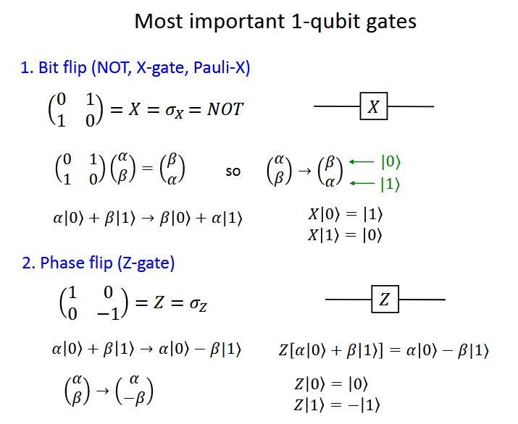
Quantum entanglement & Quantum Computing
2. Introduction to Quantum Gates

Slide 20
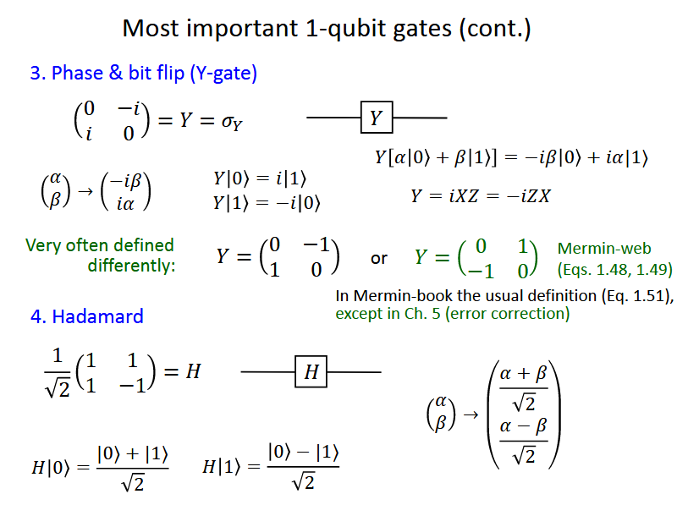
Quantum entanglement & Quantum Computing
2. Introduction to Quantum Gates

Slide 21
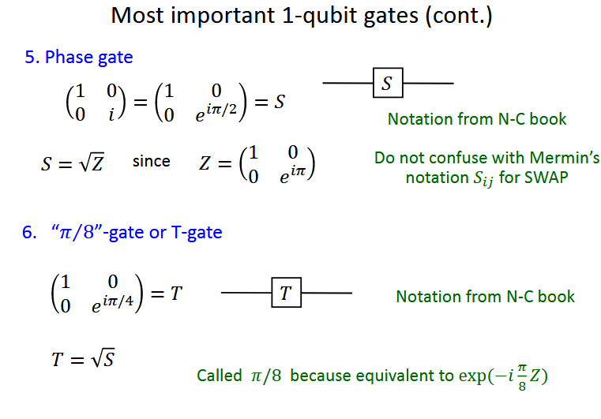
Quantum entanglement & Quantum Computing
2. Introduction to Quantum Gates

Slide 22
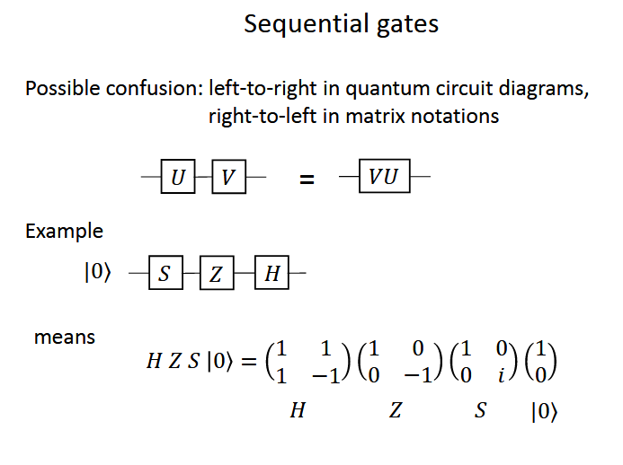
Quantum entanglement & Quantum Computing
2. Introduction to Quantum Gates

Slide 23
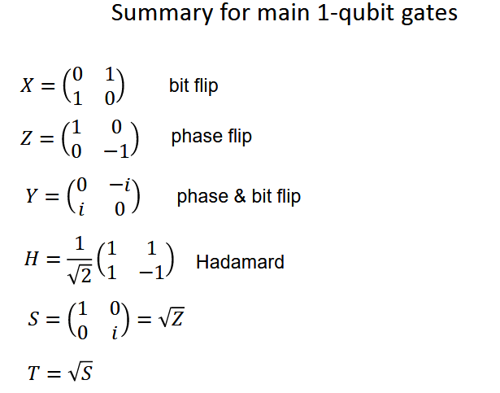
Quantum entanglement & Quantum Computing
2. Introduction to Quantum Gates

Slide 24
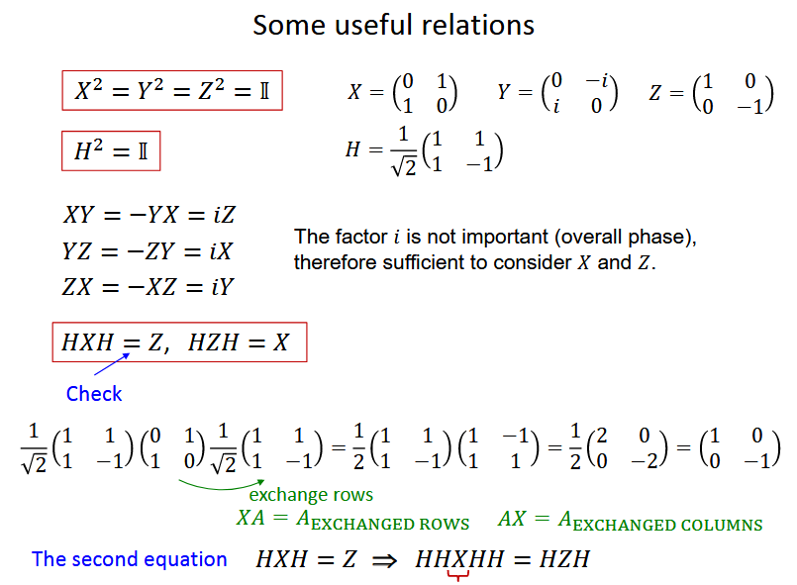
Quantum entanglement & Quantum Computing
2. Introduction to Quantum Gates

Slide 25
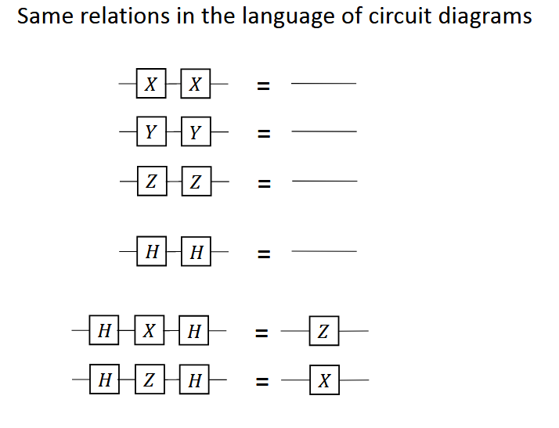
Quantum entanglement & Quantum Computing
2. Introduction to Quantum Gates

Slide 26
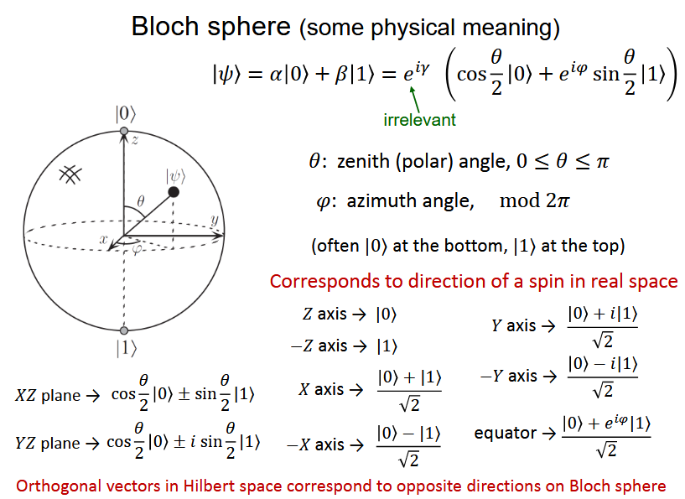
Quantum entanglement & Quantum Computing
2. Introduction to Quantum Gates

Slide 27
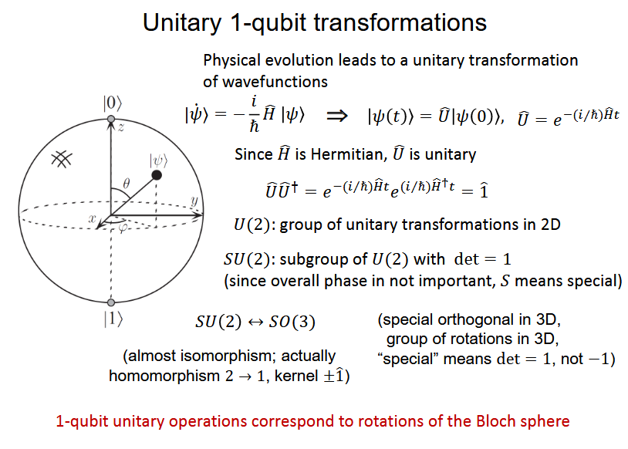
Quantum entanglement & Quantum Computing
2. Introduction to Quantum Gates

Slide 28
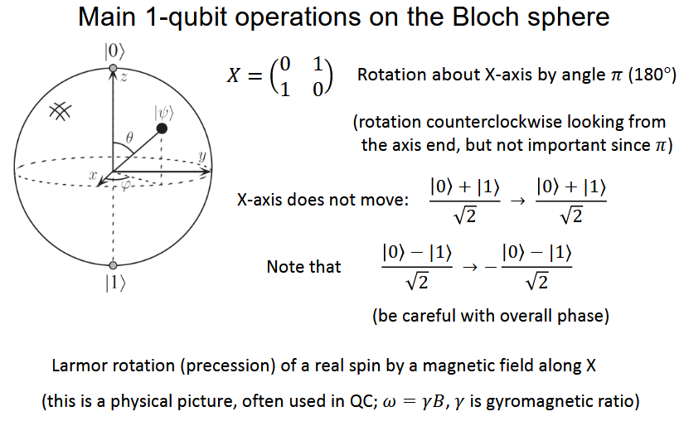
Quantum entanglement & Quantum Computing
2. Introduction to Quantum Gates

Slide 29
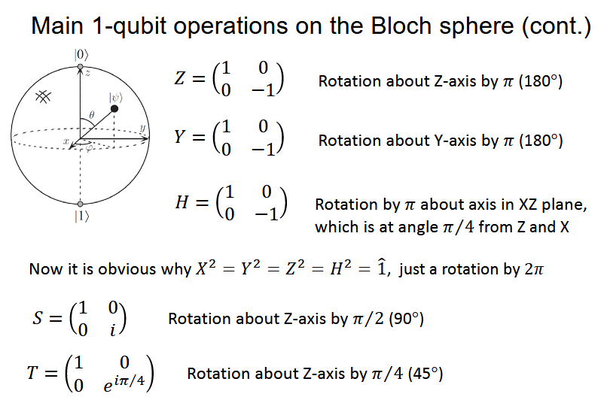
Quantum entanglement & Quantum Computing
2. Introduction to Quantum Gates

Slide 30
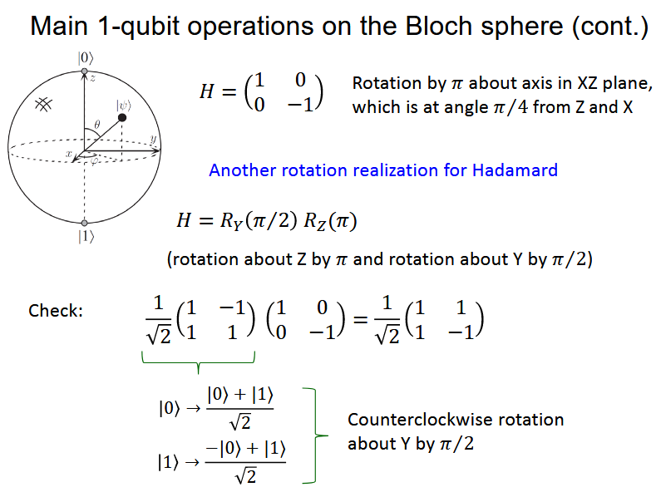
Quantum entanglement & Quantum Computing
2. Introduction to Quantum Gates

Slide 31
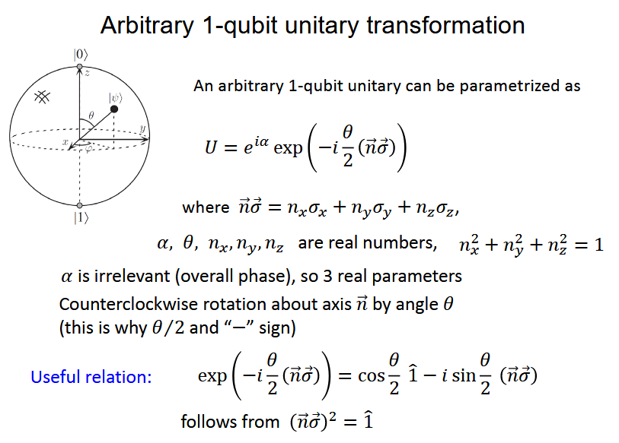
Quantum entanglement & Quantum Computing
2. Introduction to Quantum Gates

Slide 32
THANK YOU
Dr. Kaustav Bhowmick
Department of Electronics & Communication
Engineering
kaustavbhowmick@pes.edu

