Slide 1

Quantum Entanglement and Quantum Computing
Dr. Kaustav Bhowmick
Electronics & Communication
Engineering

Slide 2

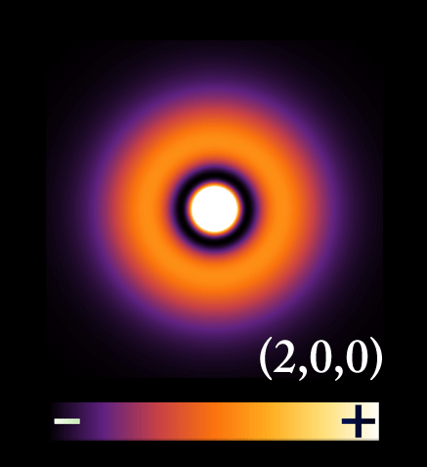
Quantum Entanglement and Quantum Computing
Entanglement and Quantum Information
Dr. Kaustav Bhowmick
Electronics & Communication Engineering
Source: Google images

Slide 3
Quantum entanglement & Quantum Computing
Contents
Some practice on concepts
Measurement Operator

Slide 4
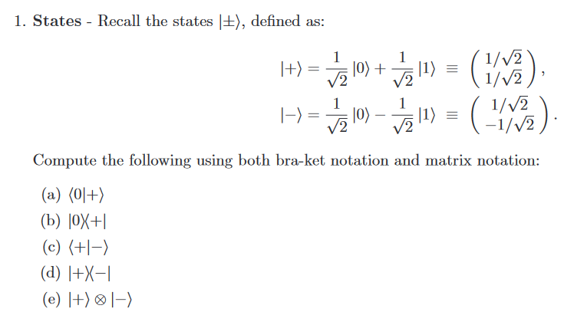
Quantum entanglement & Quantum Computing
Some Practice on concepts: Basics

Slide 5


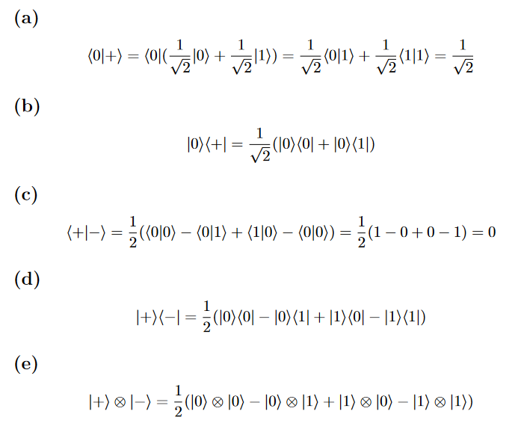
Quantum entanglement & Quantum Computing
Some Practice on concepts: Basics

Slide 6
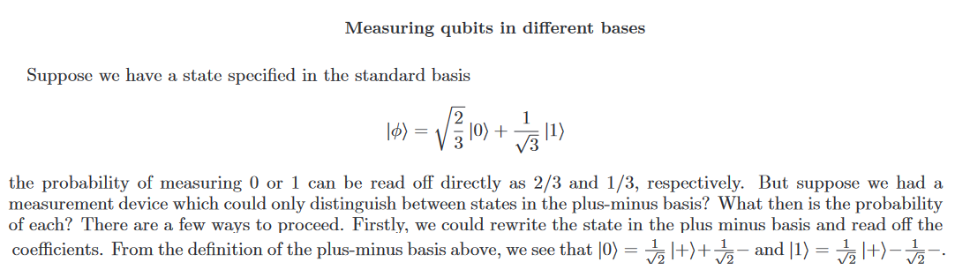
Quantum entanglement & Quantum Computing
Some Practice on concepts: Basics

Slide 7
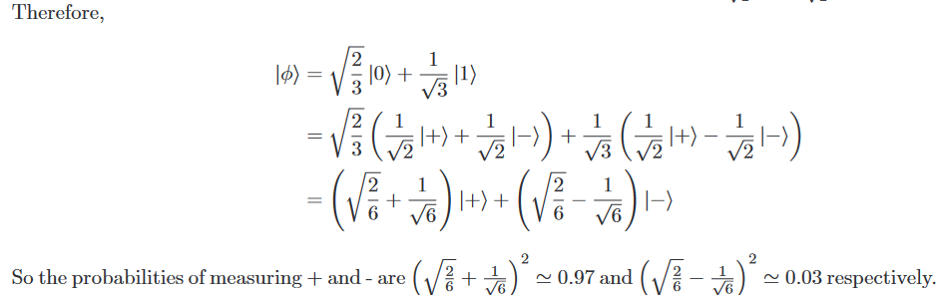
Quantum entanglement & Quantum Computing
Some Practice on concepts: Basics

Slide 8
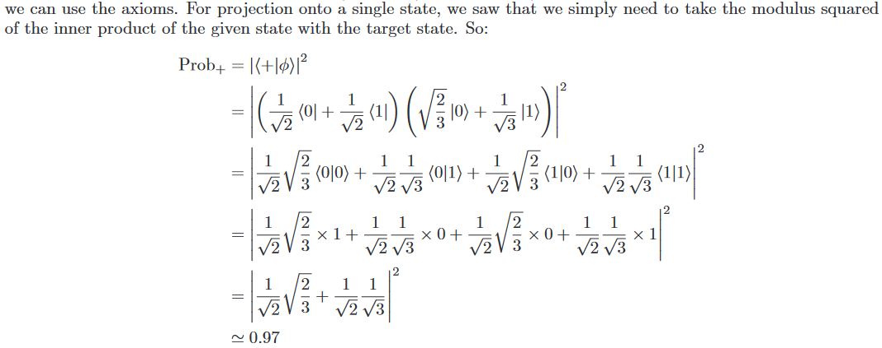
Quantum entanglement & Quantum Computing
Some Practice on concepts: Basics
* Try now for $\left\langle − | φ\right\rangle$

Slide 9
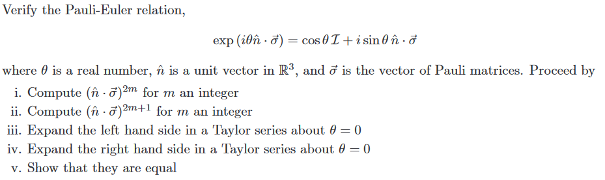
Quantum entanglement & Quantum Computing
Some Practice on concepts: Basics Problem 2

Slide 10
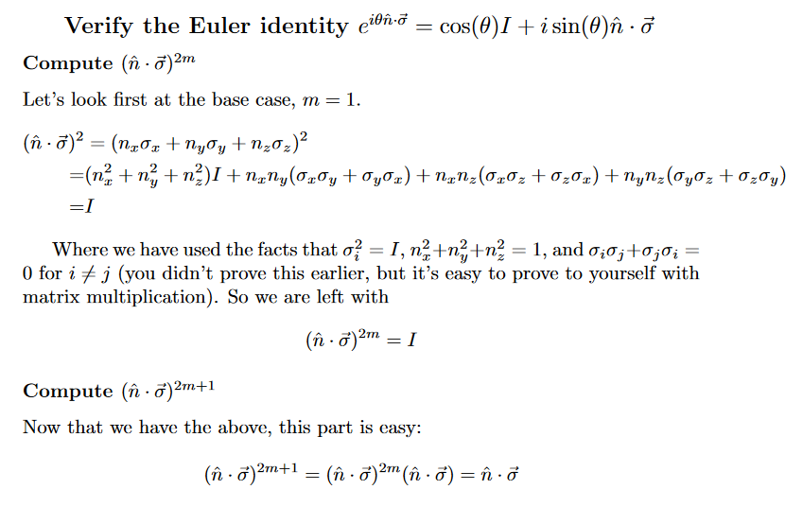
Quantum entanglement & Quantum Computing
Some Practice on concepts: Basics Solution 2

Slide 11
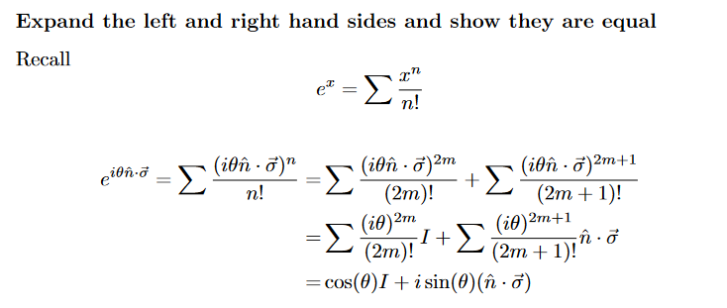
Quantum entanglement & Quantum Computing
Some Practice on concepts: Basics Solution 2

Slide 12
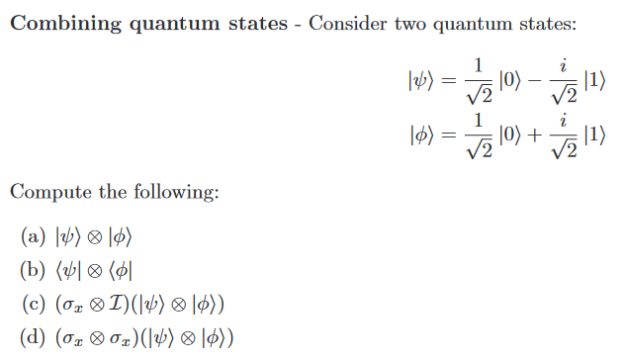
Quantum entanglement & Quantum Computing
Some Practice on concepts: Basics Problem 3

Slide 13
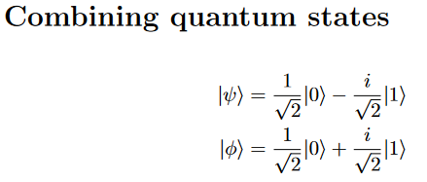
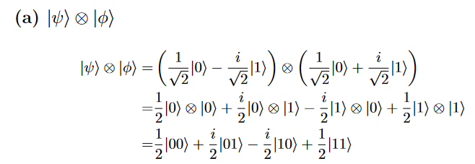
Quantum entanglement & Quantum Computing
Some Practice on concepts: Basics Solution 3

Slide 14
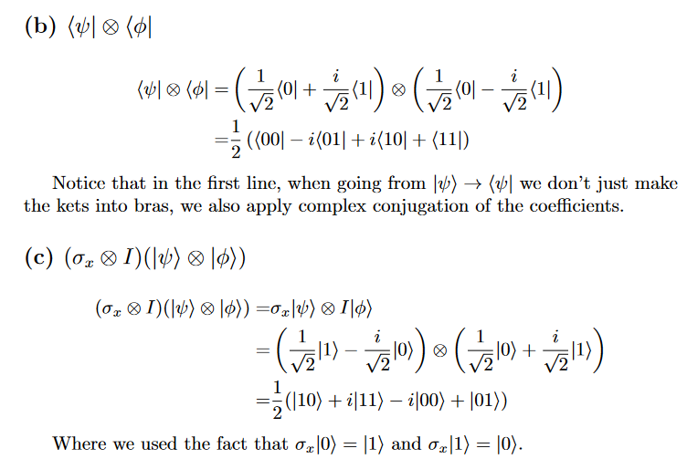
Quantum entanglement & Quantum Computing
Some Practice on concepts: Basics Solution 3

Slide 15
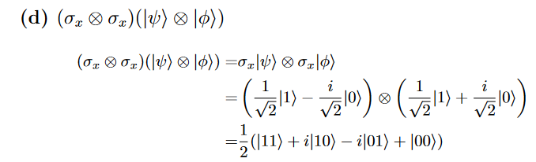
Quantum entanglement & Quantum Computing
Some Practice on concepts: Basics Solution 3

Slide 16
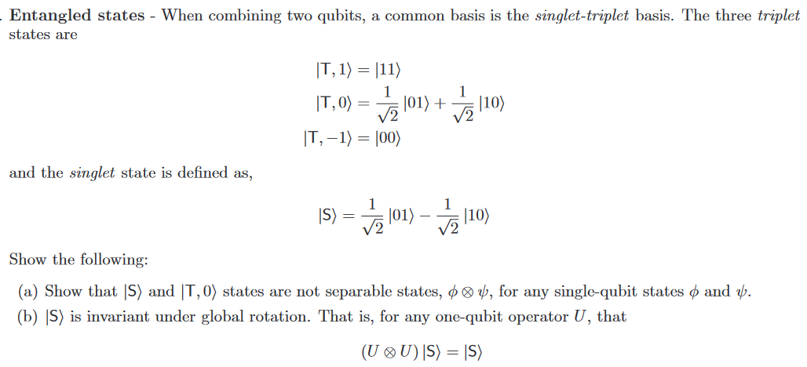
Quantum entanglement & Quantum Computing
Some Practice on concepts: Basics Problem 4

Slide 17
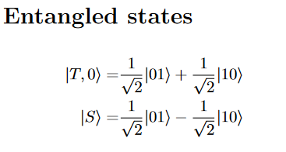
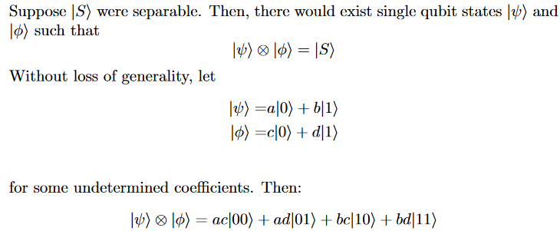
Quantum entanglement & Quantum Computing
Some Practice on concepts: Basics Solution 4

Slide 18
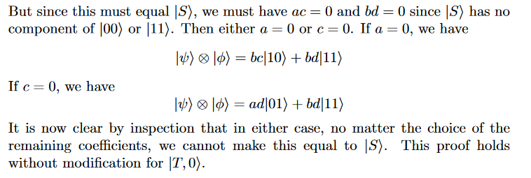
Quantum entanglement & Quantum Computing
Some Practice on concepts: Basics Solution 4

Slide 19
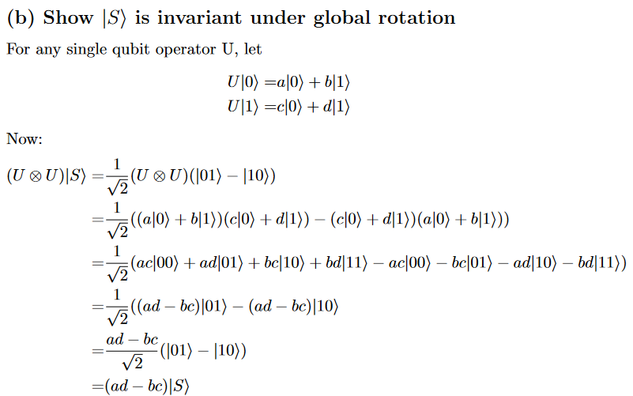
Quantum entanglement & Quantum Computing
Some Practice on concepts: Basics Solution 4

Slide 20
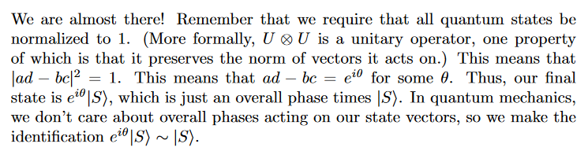
Quantum entanglement & Quantum Computing
Some Practice on concepts: Basics Solution 4

Slide 21
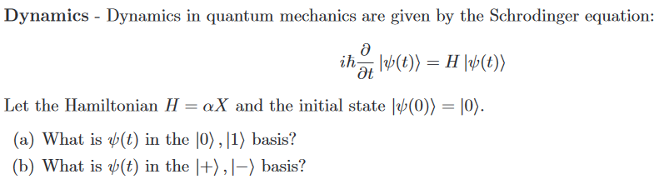
Quantum entanglement & Quantum Computing
Some Practice on concepts: Basics Problem 5

Slide 22

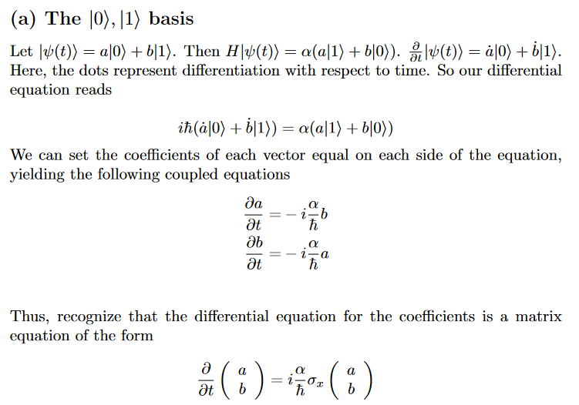
Quantum entanglement & Quantum Computing
Some Practice on concepts: Basics Solution 5

Slide 23
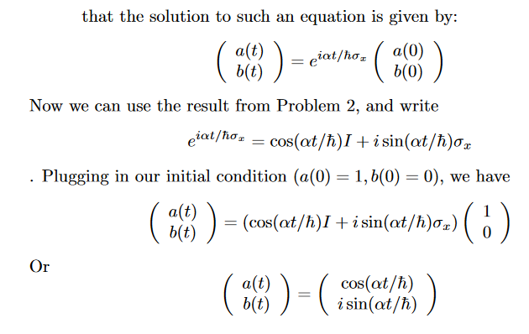

Quantum entanglement & Quantum Computing
Some Practice on concepts: Basics Solution 5

Slide 24
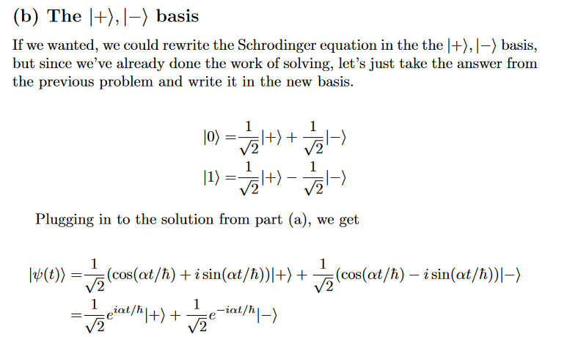
Quantum entanglement & Quantum Computing
Some Practice on concepts: Basics Solution 5

Slide 25
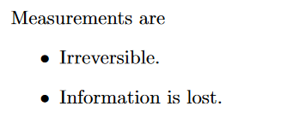
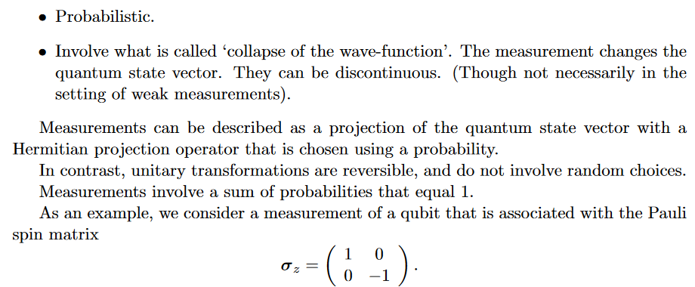
Quantum entanglement & Quantum Computing
Measurement operator

Slide 26
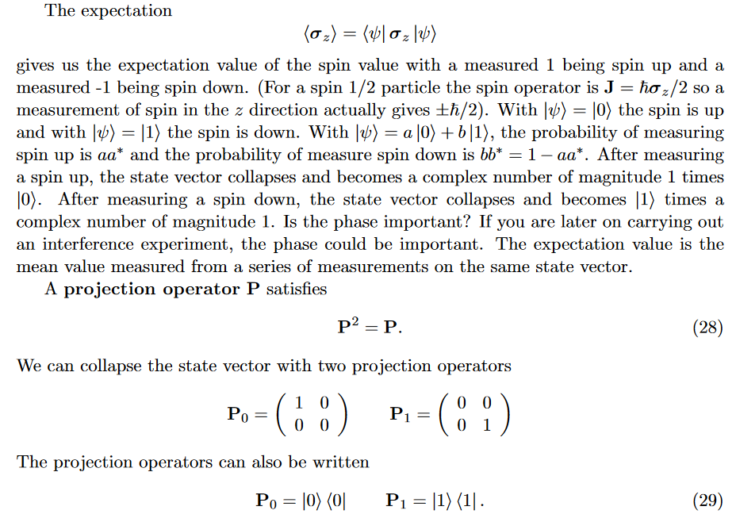
Quantum entanglement & Quantum Computing
Measurement operator

Slide 27
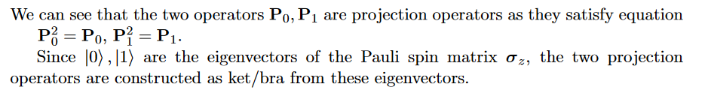
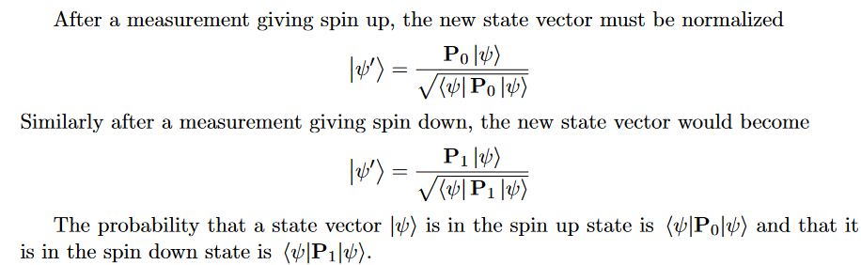
Quantum entanglement & Quantum Computing
Measurement operator

Slide 28
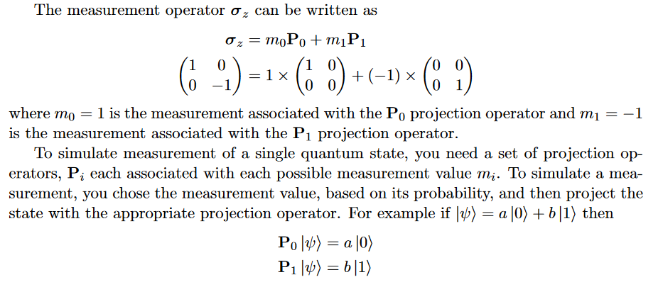
Quantum entanglement & Quantum Computing
Measurement operator

Slide 29
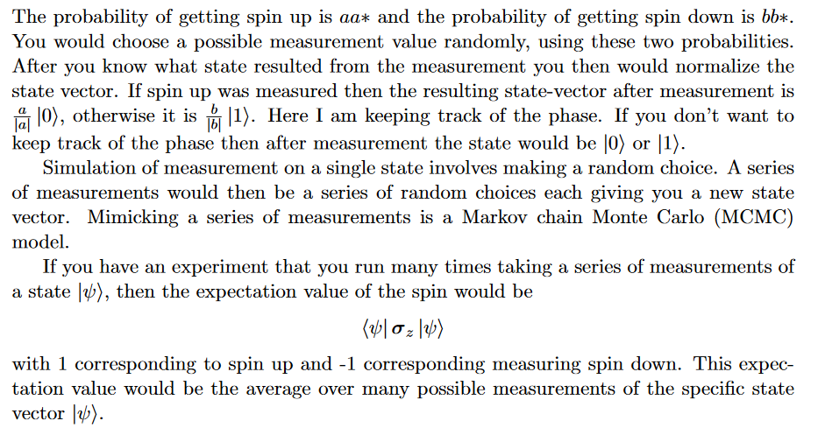
Quantum entanglement & Quantum Computing
Measurement operator

Slide 30
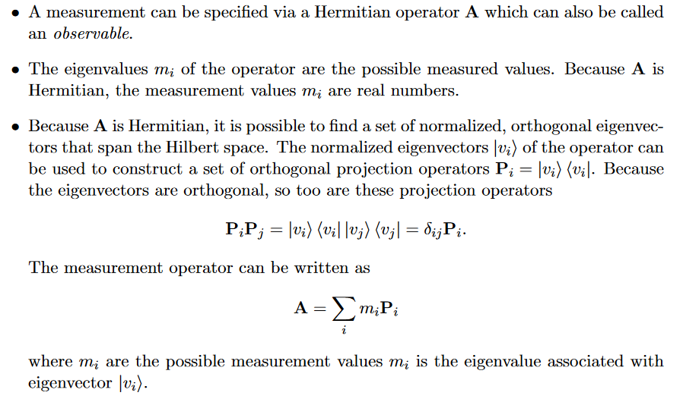
Quantum entanglement & Quantum Computing
Measurement operator
https://quantummechanics.ucsd.edu/ph130a/130_notes/node134.html

Slide 31
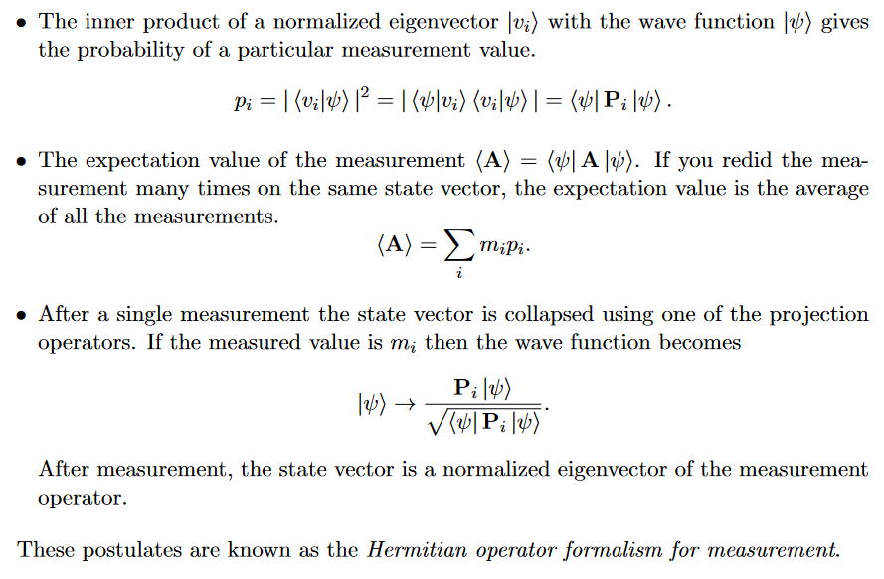
Quantum entanglement & Quantum Computing
Measurement operator
https://quantummechanics.ucsd.edu/ph130a/130_notes/node134.html

Slide 32
THANK YOU
Dr. Kaustav Bhowmick
Department of Electronics & Communication
Engineering
kaustavbhowmick@pes.edu

