Slide 1

Quantum Entanglement and Quantum Computing
Dr. Kaustav Bhowmick
Electronics & Communication
Engineering

Slide 2

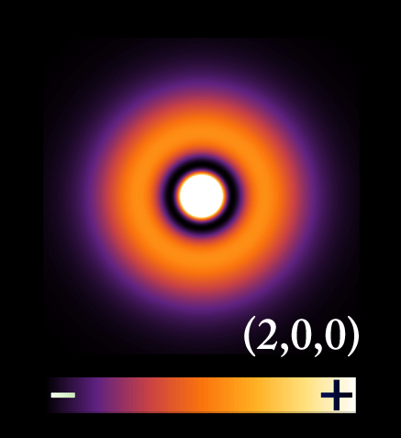
Quantum Entanglement and Quantum Computing
Entanglement and Quantum Information
Dr. Kaustav Bhowmick
Electronics & Communication Engineering
Source: Google images

Slide 3
Quantum entanglement & Quantum Computing
Contents
No cloning theorem
Distinguishing non-orthogonal states

Slide 4
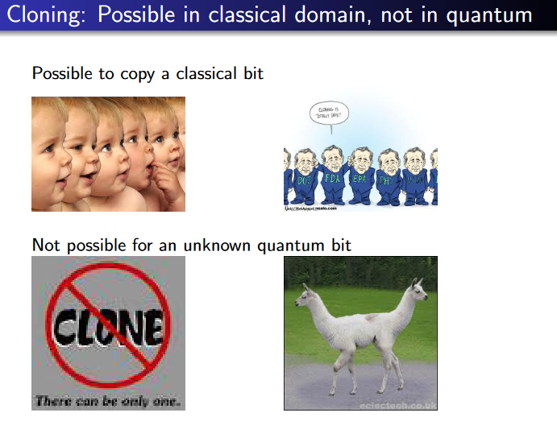
Quantum entanglement & Quantum Computing
1. No Cloning theorem

Slide 5
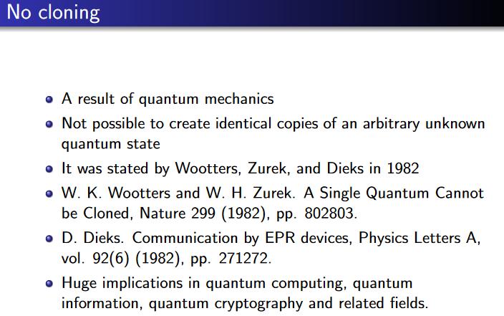
Quantum entanglement & Quantum Computing
1. No Cloning theorem

Slide 6
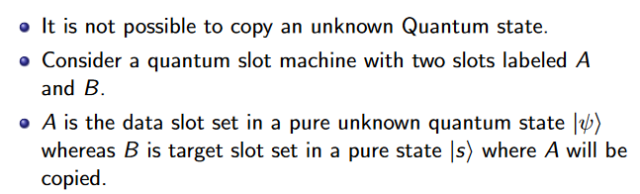
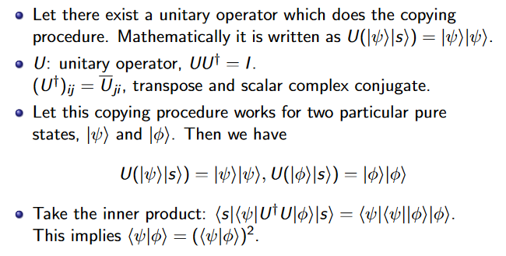
Quantum entanglement & Quantum Computing
1. No Cloning theorem

Slide 7
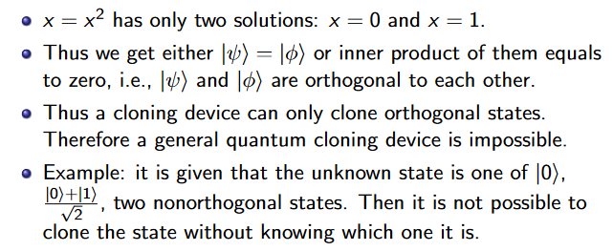
Quantum entanglement & Quantum Computing
1. No Cloning theorem

Slide 8
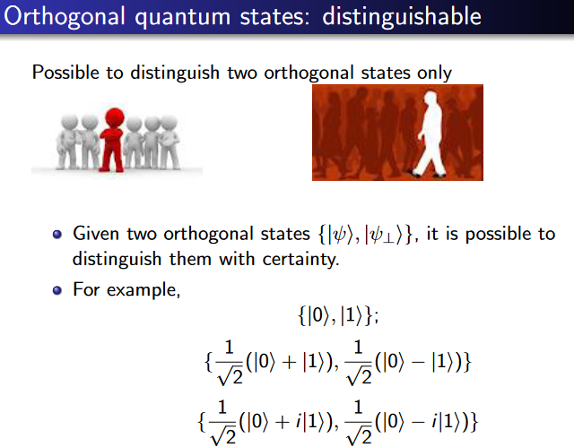
Quantum entanglement & Quantum Computing
1. No Cloning theorem

Slide 9
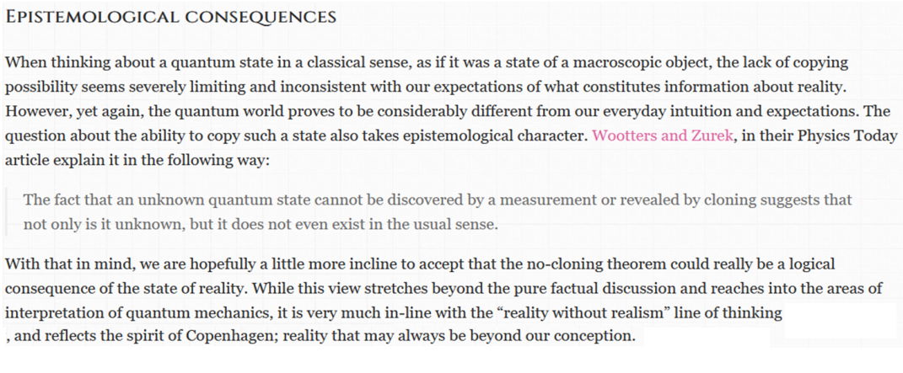
Quantum entanglement & Quantum Computing
1. No Cloning theorem

Slide 10
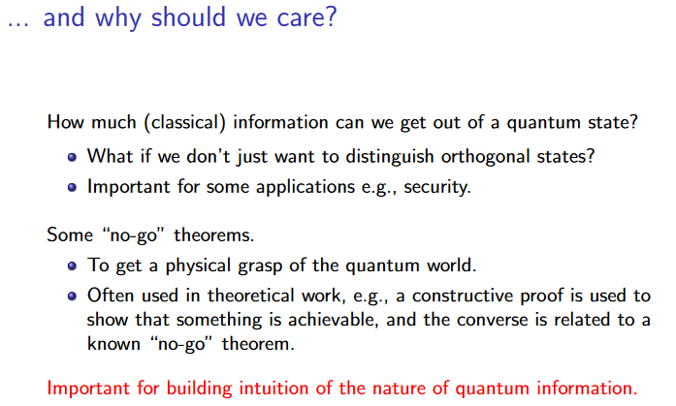
Quantum entanglement & Quantum Computing
2. Distinguishing non-orthogonal states

Slide 11
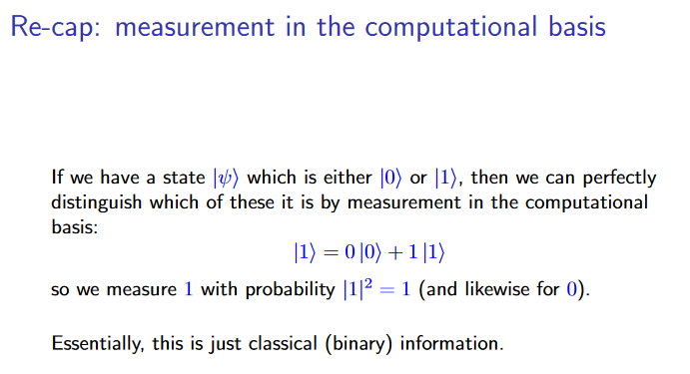
Quantum entanglement & Quantum Computing
2. Distinguishing non-orthogonal states

Slide 12
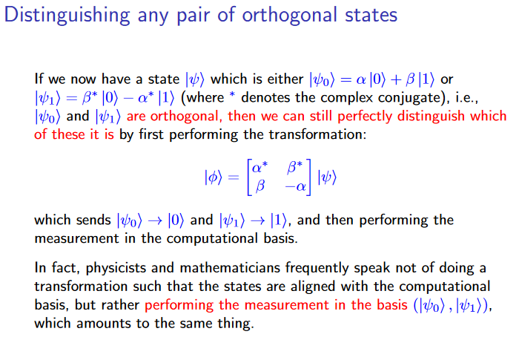
Quantum entanglement & Quantum Computing
2. Distinguishing non-orthogonal states

Slide 13
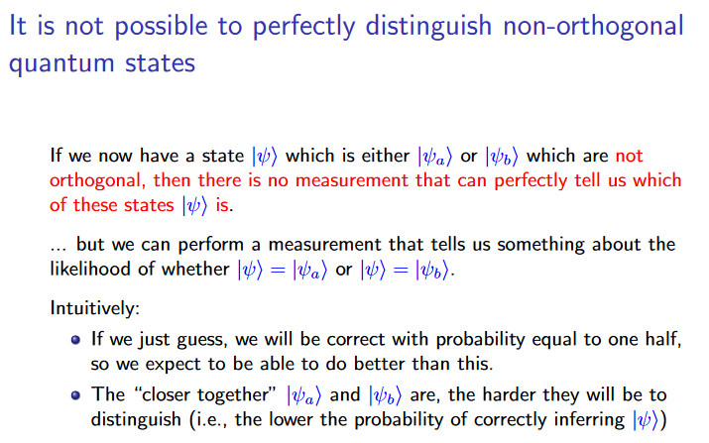
Quantum entanglement & Quantum Computing
2. Distinguishing non-orthogonal states

Slide 14
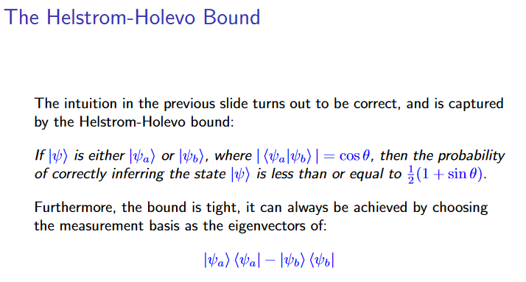
Quantum entanglement & Quantum Computing
2. Distinguishing non-orthogonal states

Slide 15
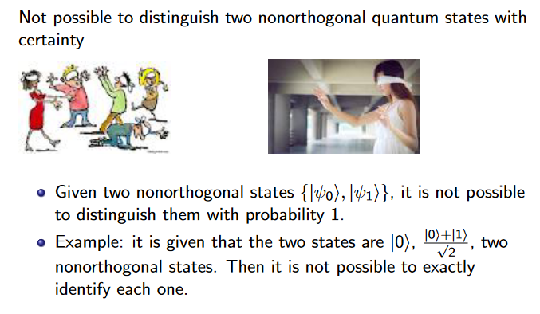
Quantum entanglement & Quantum Computing
2. Distinguishing non-orthogonal states

Slide 16
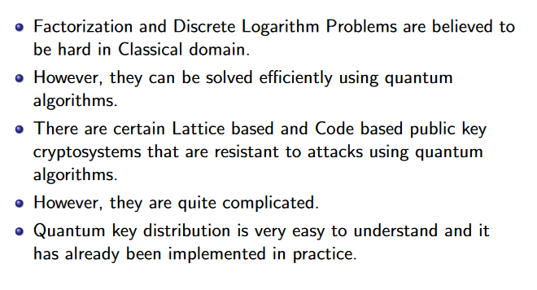
Quantum entanglement & Quantum Computing
2. Distinguishing non-orthogonal states

Slide 17
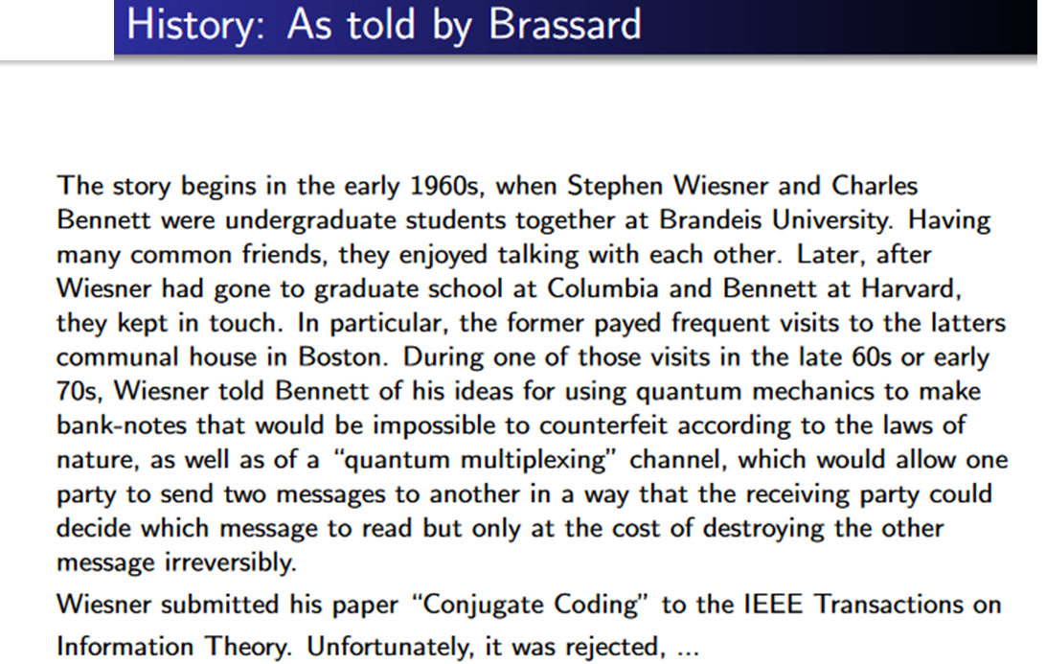
Quantum entanglement & Quantum Computing
2. Distinguishing non-orthogonal states

Slide 18
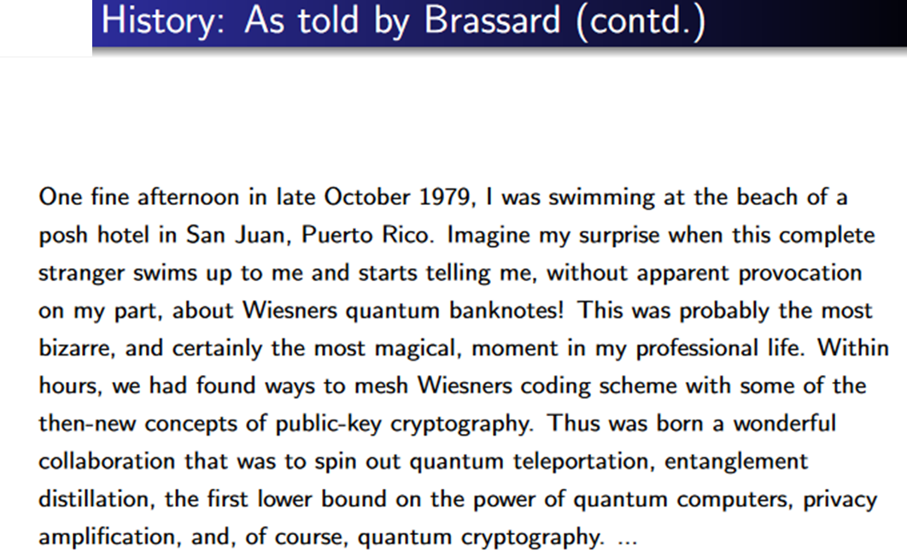
Quantum entanglement & Quantum Computing
2. Distinguishing non-orthogonal states

Slide 19
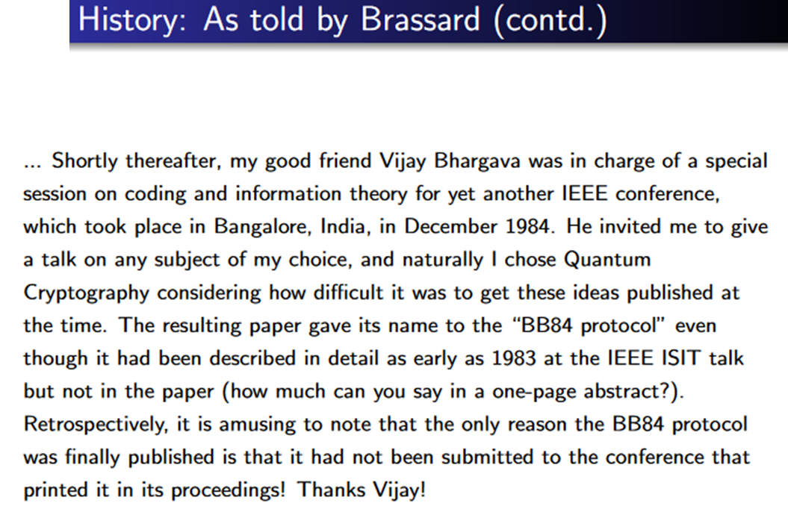
Quantum entanglement & Quantum Computing
2. Distinguishing non-orthogonal states

Slide 20
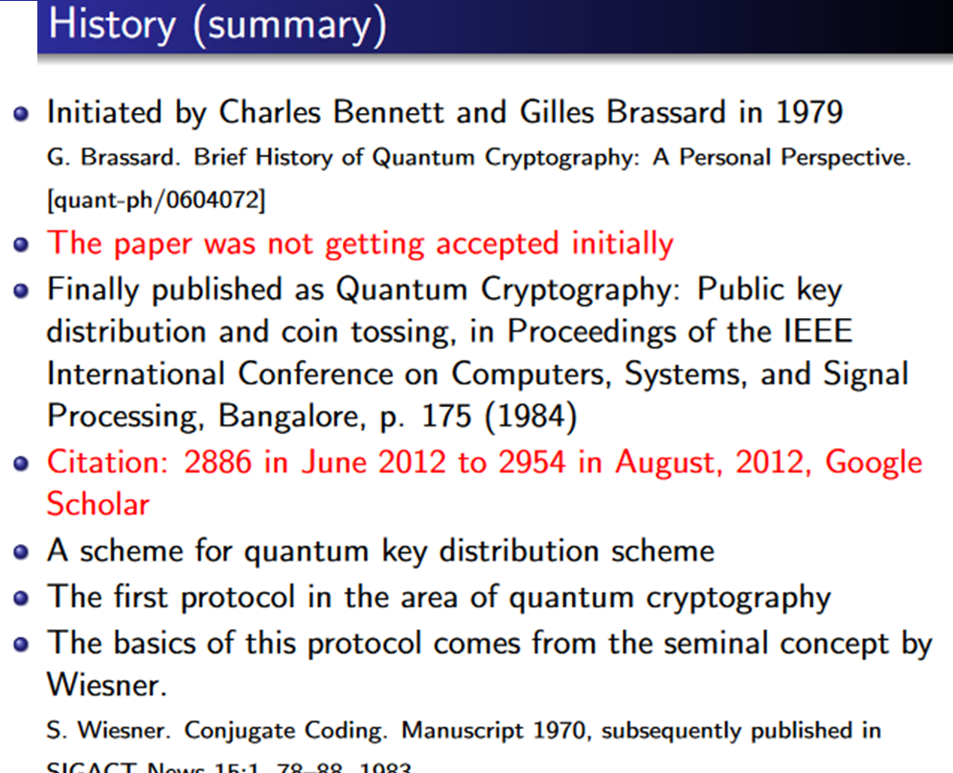
Quantum entanglement & Quantum Computing
2. Distinguishing non-orthogonal states

Slide 21
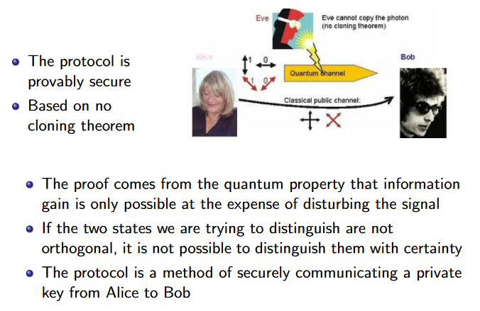
Quantum entanglement & Quantum Computing
2. Distinguishing non-orthogonal states

Slide 22
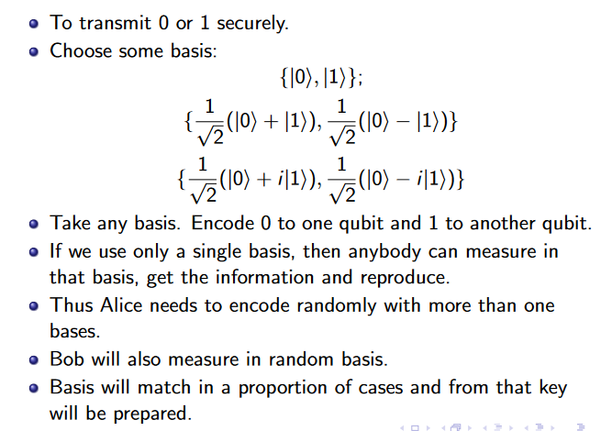
Quantum entanglement & Quantum Computing
2. Distinguishing non-orthogonal states

Slide 23
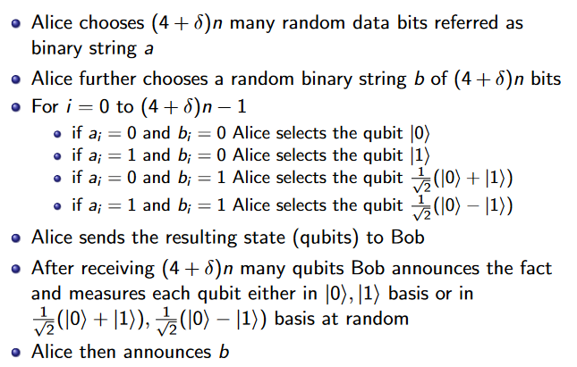
Quantum entanglement & Quantum Computing
2. Distinguishing non-orthogonal states

Slide 24
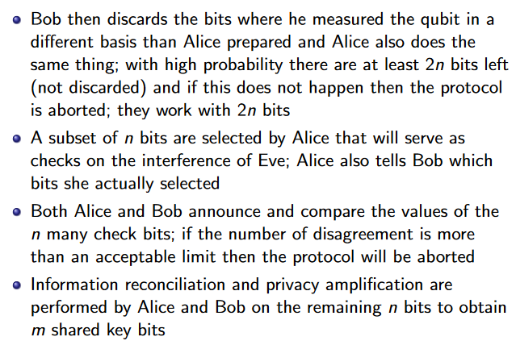
Quantum entanglement & Quantum Computing
2. Distinguishing non-orthogonal states

Slide 25
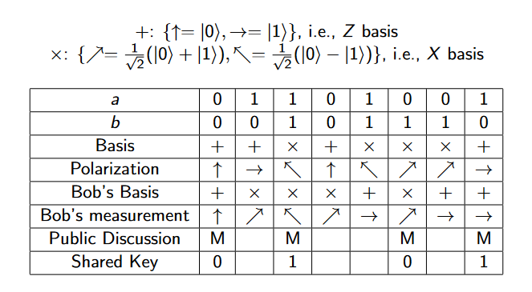
Quantum entanglement & Quantum Computing
2. Distinguishing non-orthogonal states

Slide 26
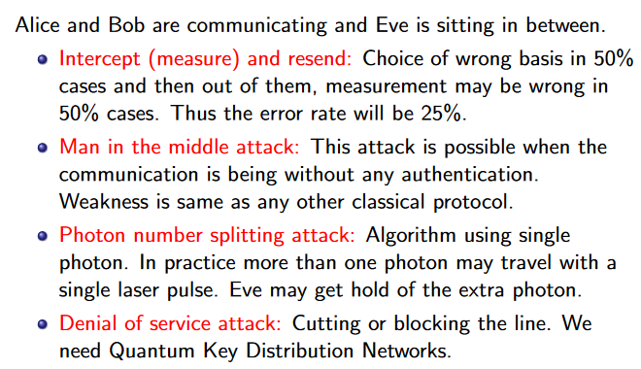
Quantum entanglement & Quantum Computing
2. Distinguishing non-orthogonal states

Slide 27
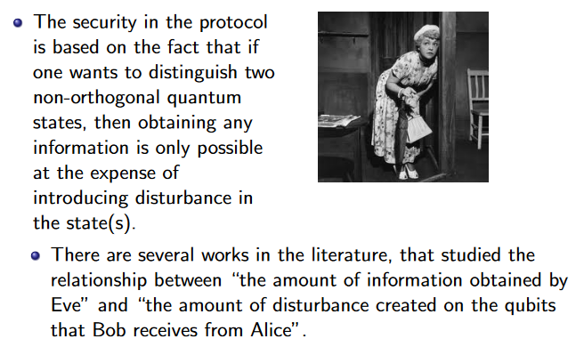
Quantum entanglement & Quantum Computing
2. Distinguishing non-orthogonal states

Slide 28
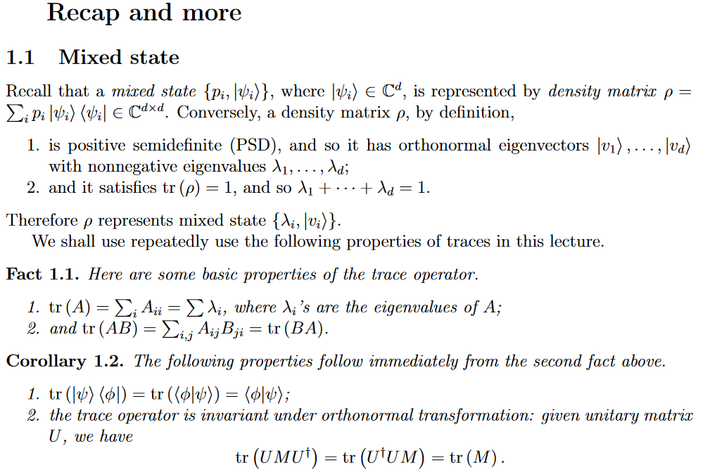
Quantum entanglement & Quantum Computing
2. Distinguishing non-orthogonal states

Slide 29
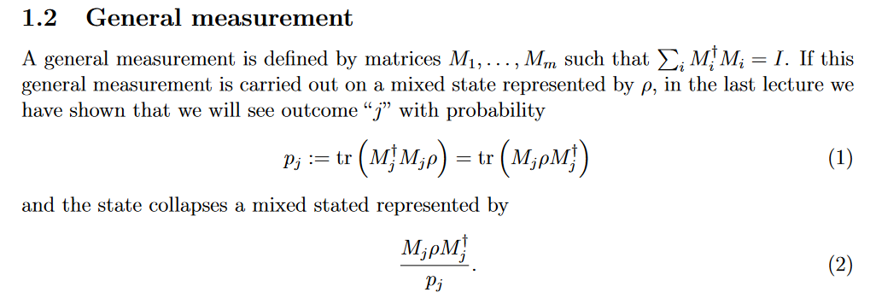
Quantum entanglement & Quantum Computing
2. Distinguishing non-orthogonal states

Slide 30
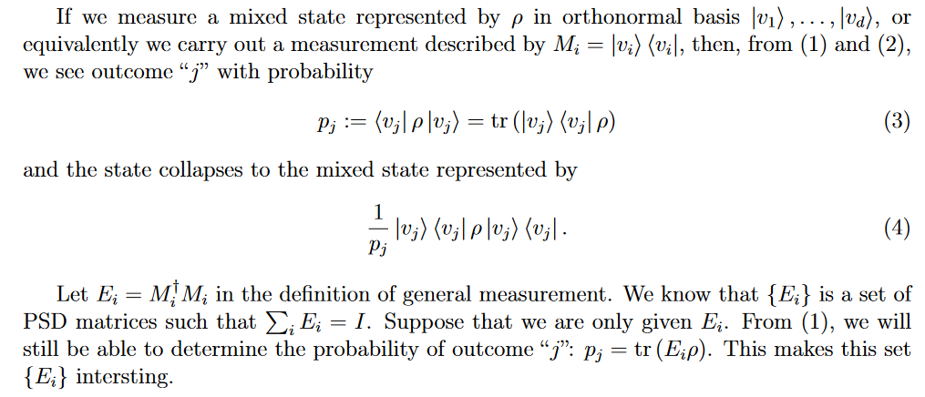
Quantum entanglement & Quantum Computing
2. Distinguishing non-orthogonal states

Slide 31
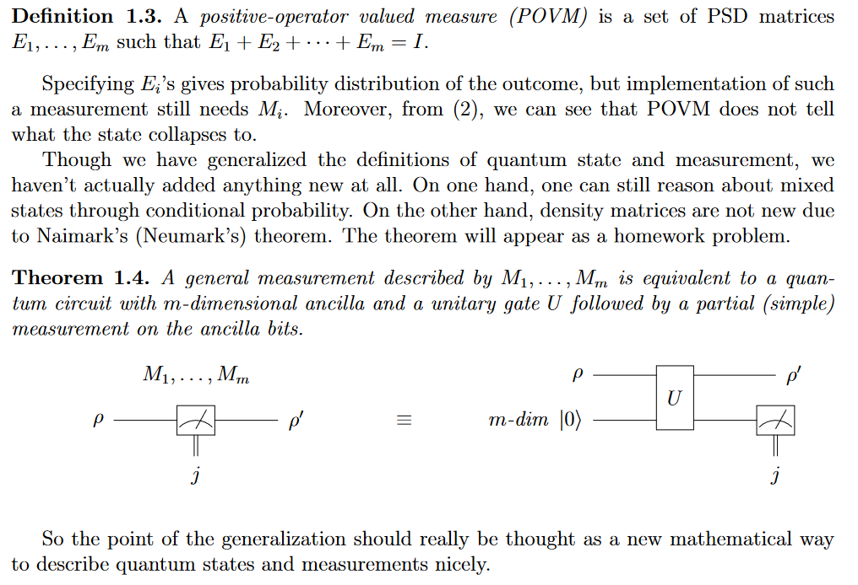
Quantum entanglement & Quantum Computing
2. Distinguishing non-orthogonal states
https://books.google.co.in/books?id=bDXwFHJNKFAC&pg=PA275&lpg=PA275&dq=ancillary+bit&source=bl&ots=itkB1rnFEY&sig=Gi8KMlhNL4UeAURsfE0vHsrjezo&hl=en&sa=X&ei=Yxl9U7G7B6TgsAT1rIHADg&redir_esc=y#v=onepage&q=ancillary%20bit&f=false

Slide 32
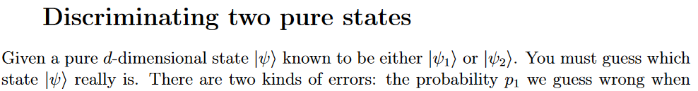
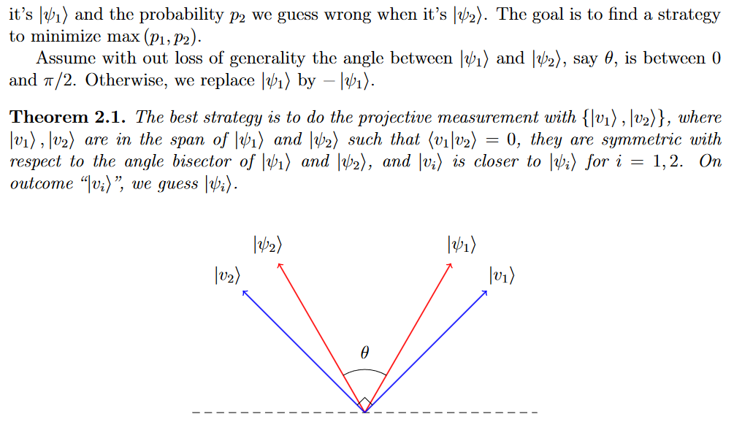
Quantum entanglement & Quantum Computing
2. Distinguishing non-orthogonal states

Slide 33
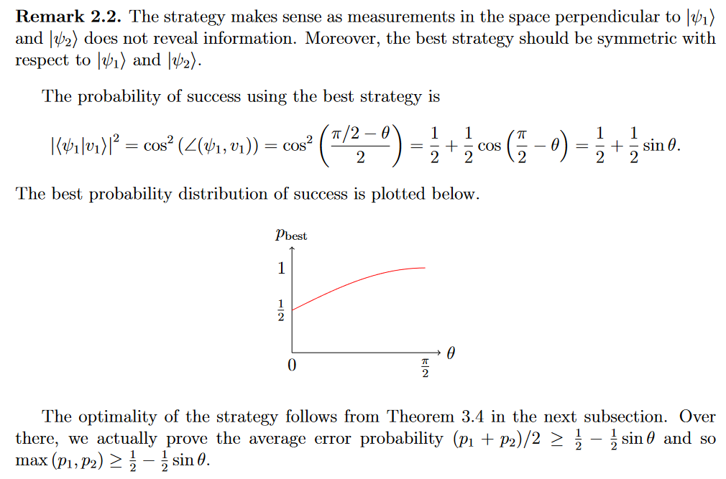
Quantum entanglement & Quantum Computing
2. Distinguishing non-orthogonal states

Slide 34
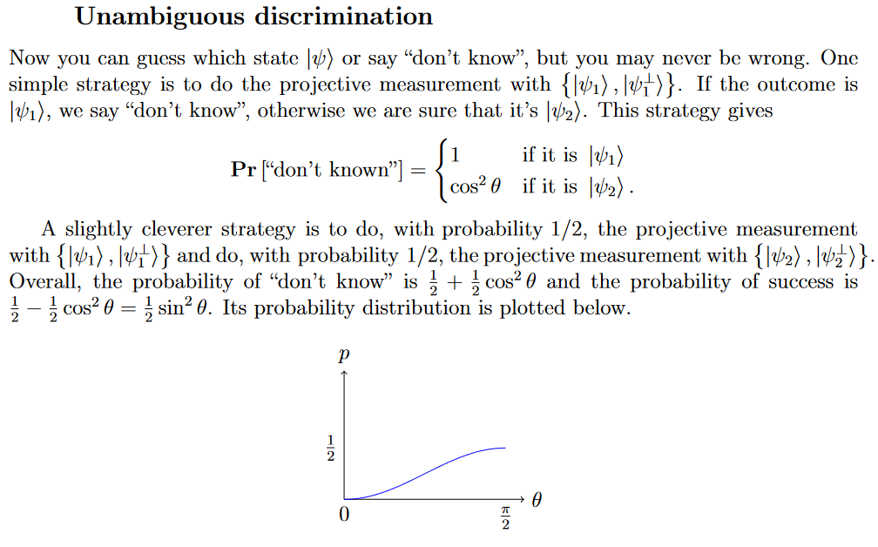
Quantum entanglement & Quantum Computing
2. Distinguishing non-orthogonal states

Slide 35
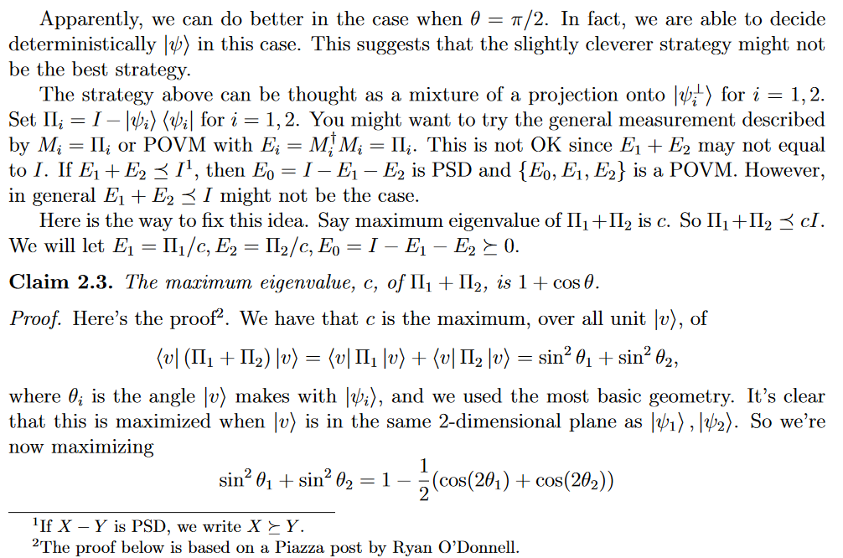
Quantum entanglement & Quantum Computing
2. Distinguishing non-orthogonal states

Slide 36
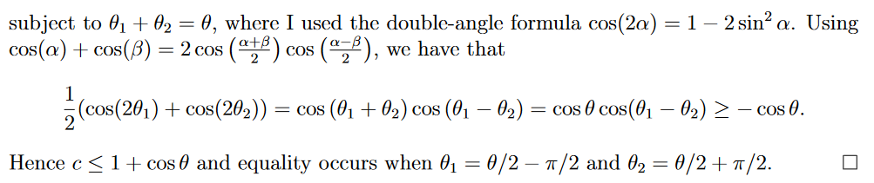
Quantum entanglement & Quantum Computing
2. Distinguishing non-orthogonal states

Slide 37
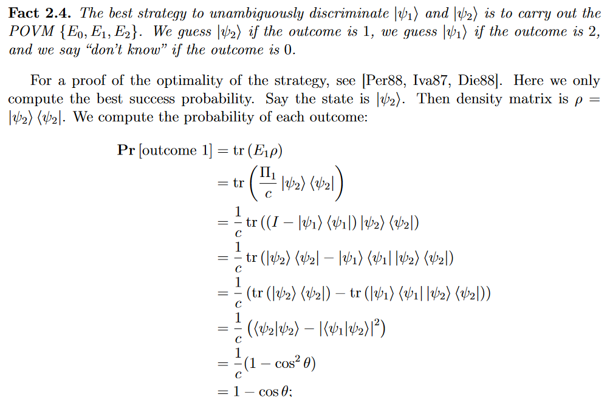
Quantum entanglement & Quantum Computing
2. Distinguishing non-orthogonal states

Slide 38
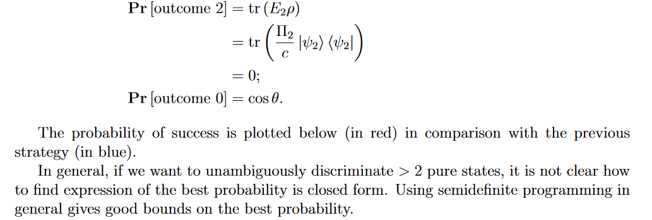
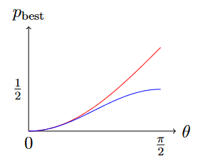
Quantum entanglement & Quantum Computing
2. Distinguishing non-orthogonal states

Slide 39
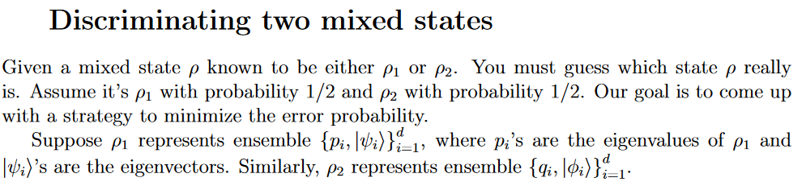
Quantum entanglement & Quantum Computing
2. Distinguishing non-orthogonal states

Slide 40
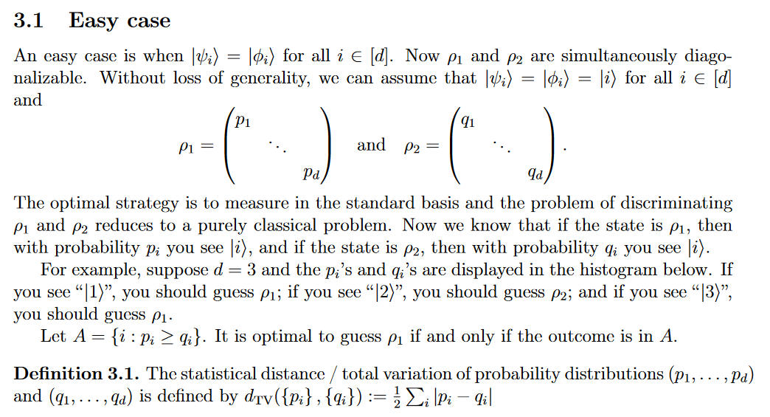
Quantum entanglement & Quantum Computing
2. Distinguishing non-orthogonal states

Slide 41
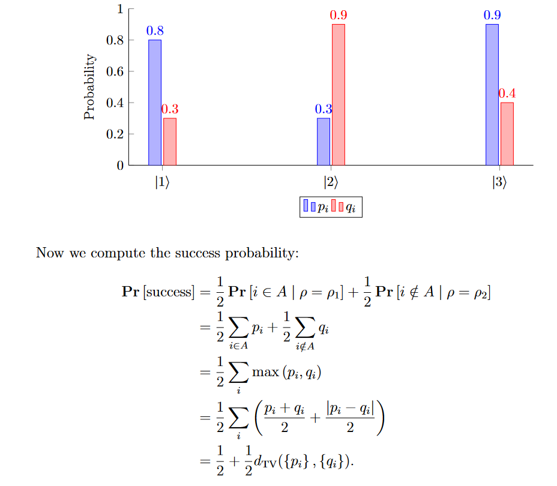
Quantum entanglement & Quantum Computing
2. Distinguishing non-orthogonal states

Slide 42
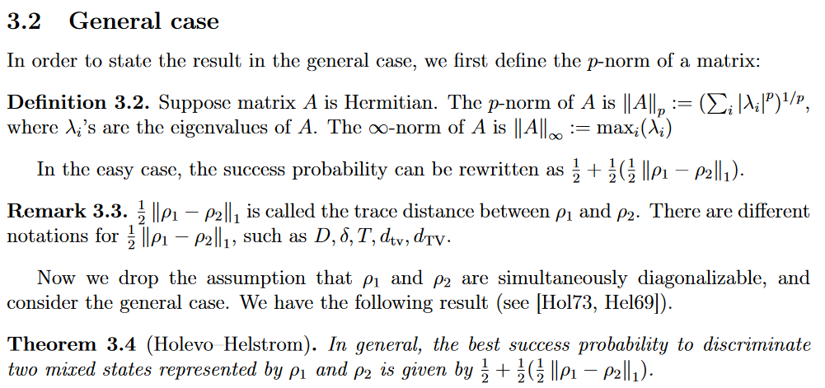
Quantum entanglement & Quantum Computing
2. Distinguishing non-orthogonal states

Slide 43
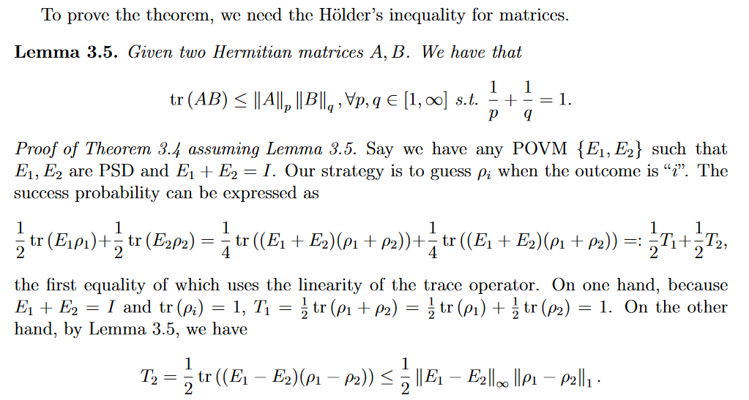
Quantum entanglement & Quantum Computing
2. Distinguishing non-orthogonal states

Slide 44
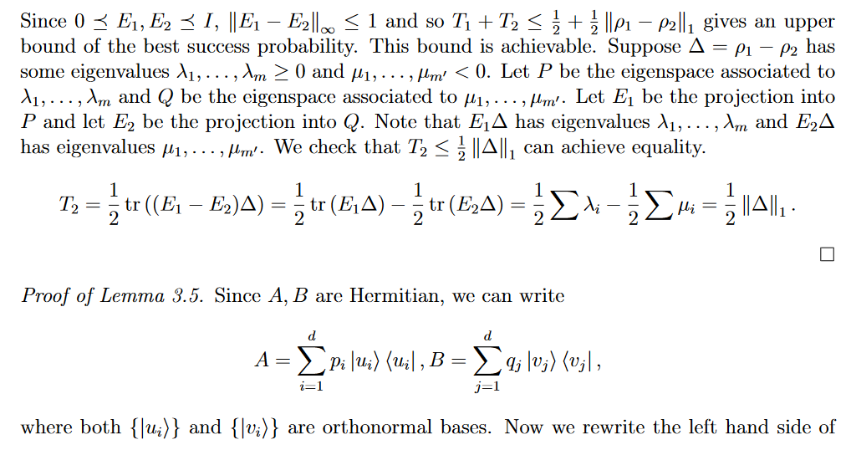
Quantum entanglement & Quantum Computing
2. Distinguishing non-orthogonal states

Slide 45
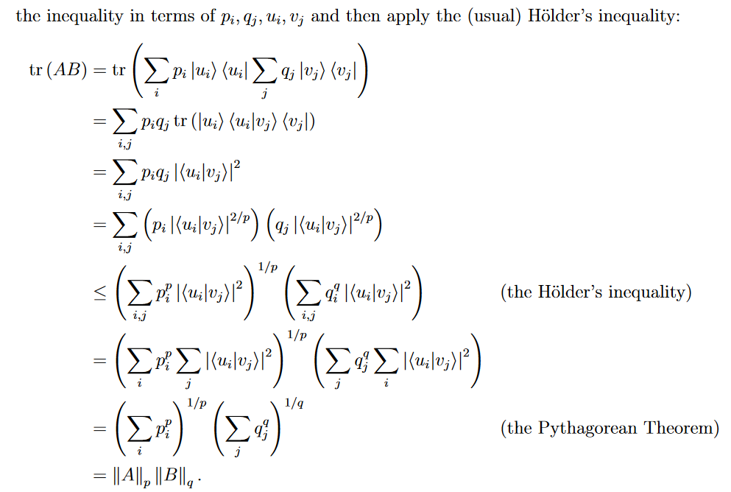
Quantum entanglement & Quantum Computing
2. Distinguishing non-orthogonal states

Slide 46
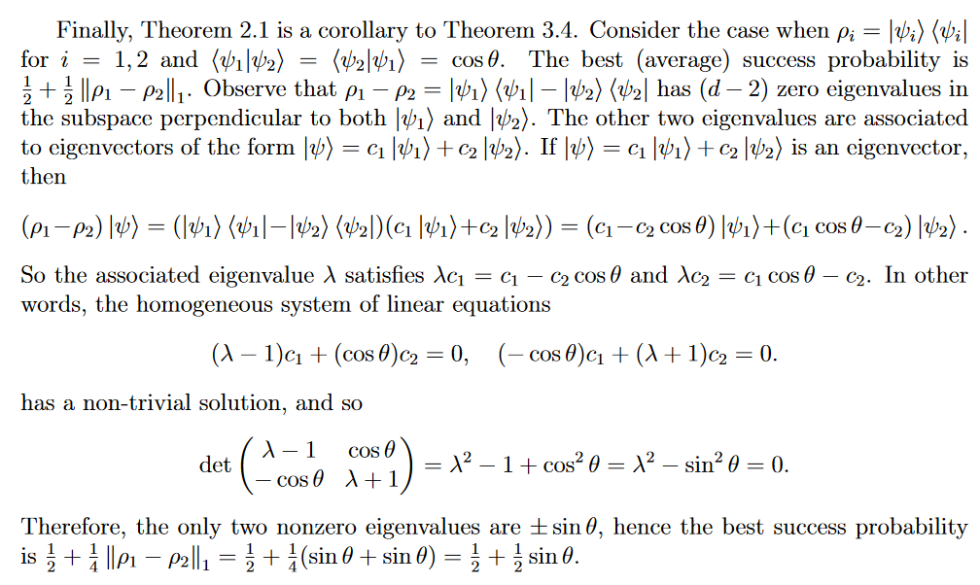
Quantum entanglement & Quantum Computing
2. Distinguishing non-orthogonal states

Slide 47
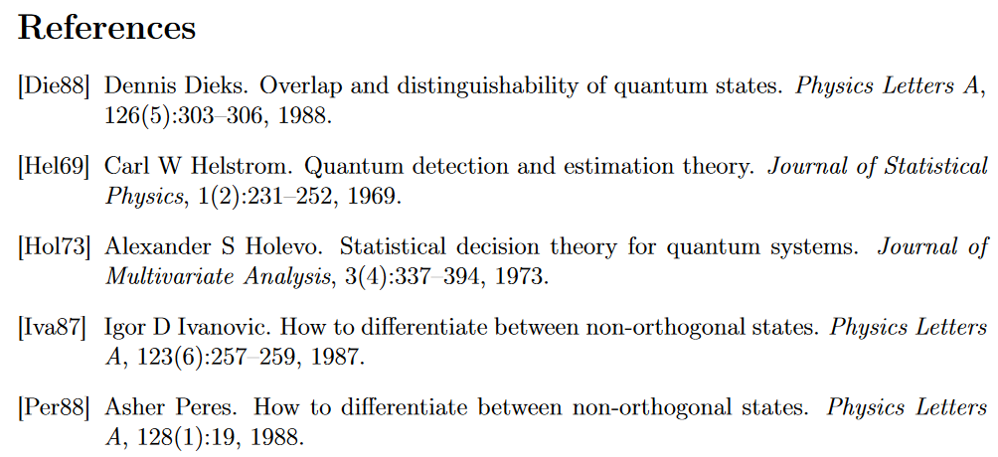
Quantum entanglement & Quantum Computing
2. Distinguishing non-orthogonal states

Slide 48
THANK YOU
Dr. Kaustav Bhowmick
Department of Electronics & Communication
Engineering
kaustavbhowmick@pes.edu

