Slide 1

Quantum Entanglement and Quantum Computing
Dr. Kaustav Bhowmick
Electronics & Communication
Engineering

Slide 2

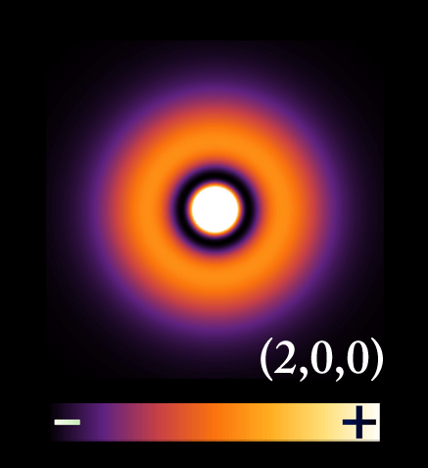
Quantum Entanglement and Quantum Computing
Entanglement and Quantum Information
Dr. Kaustav Bhowmick
Electronics & Communication Engineering
Source: Google images

Slide 3
Quantum entanglement & Quantum Computing
Contents
No cloning theorem
Distinguishing non-orthogonal states

Slide 4
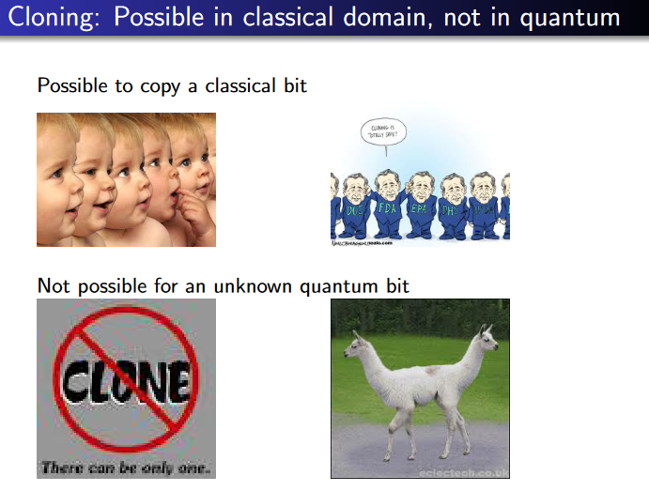
Quantum entanglement & Quantum Computing
1. No Cloning theorem

Slide 5
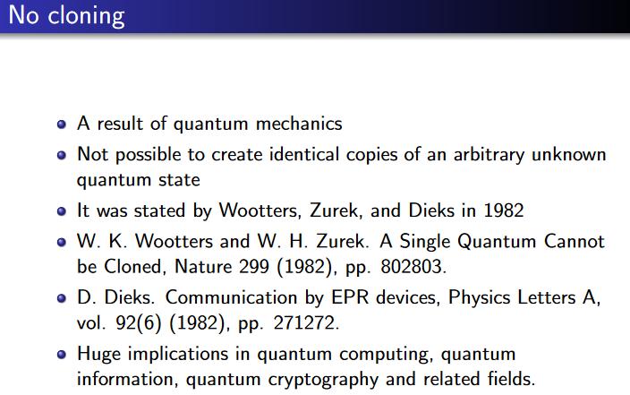
Quantum entanglement & Quantum Computing
1. No Cloning theorem

Slide 6
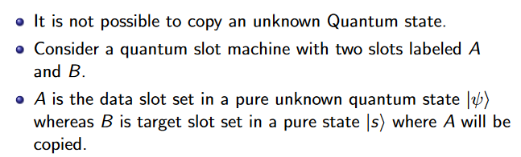
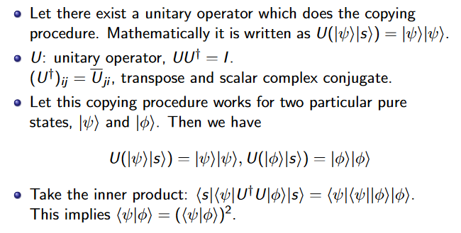
Quantum entanglement & Quantum Computing
1. No Cloning theorem

Slide 7
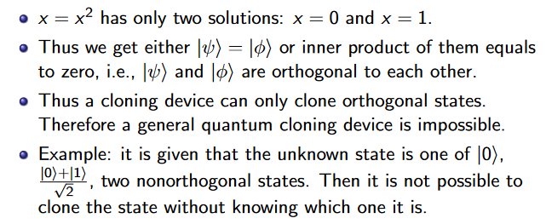
Quantum entanglement & Quantum Computing
1. No Cloning theorem

Slide 8
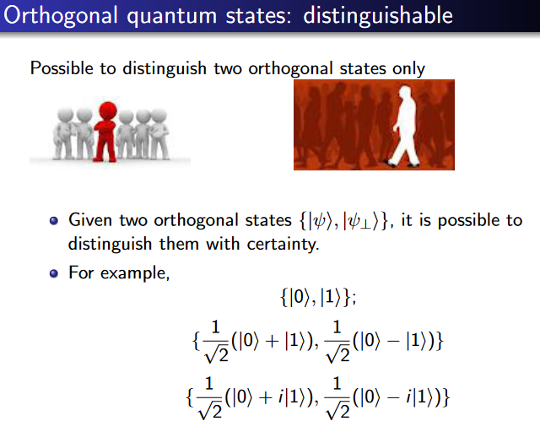
Quantum entanglement & Quantum Computing
1. No Cloning theorem

Slide 9
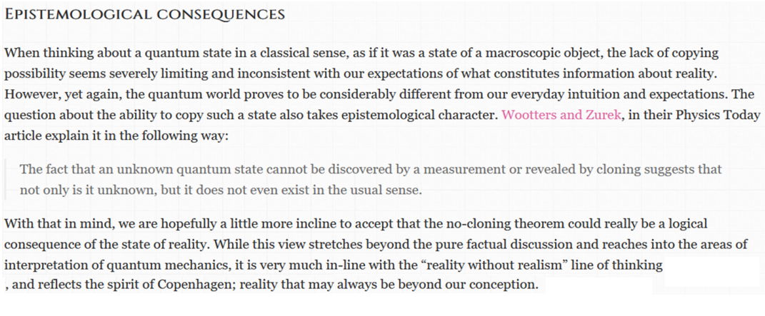
Quantum entanglement & Quantum Computing
1. No Cloning theorem

Slide 10
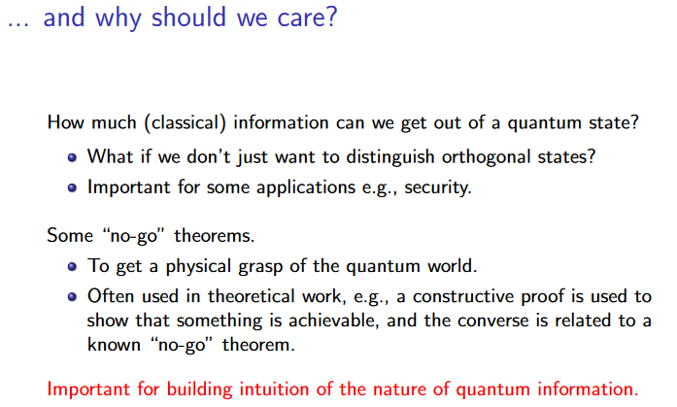
Quantum entanglement & Quantum Computing
2. Distinguishing non-orthogonal states

Slide 11
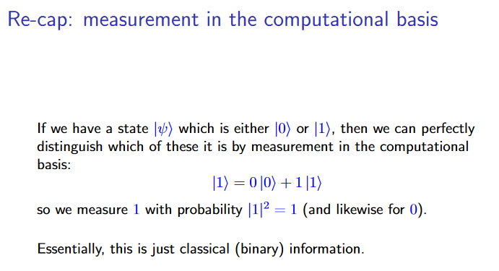
Quantum entanglement & Quantum Computing
2. Distinguishing non-orthogonal states

Slide 12
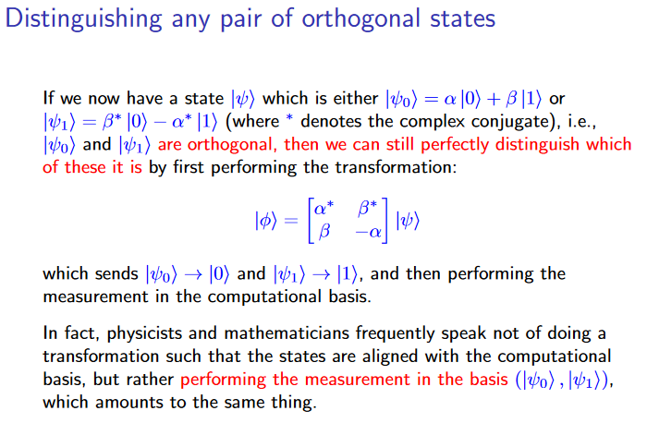
Quantum entanglement & Quantum Computing
2. Distinguishing non-orthogonal states

Slide 13
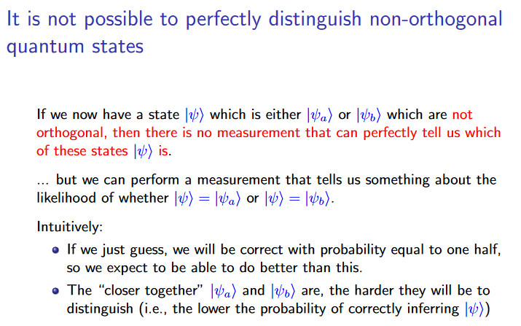
Quantum entanglement & Quantum Computing
2. Distinguishing non-orthogonal states

Slide 14
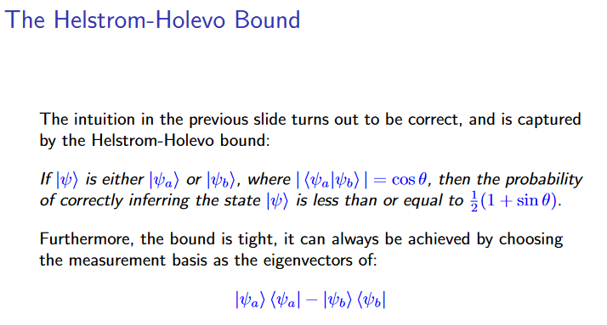
Quantum entanglement & Quantum Computing
2. Distinguishing non-orthogonal states

Slide 15
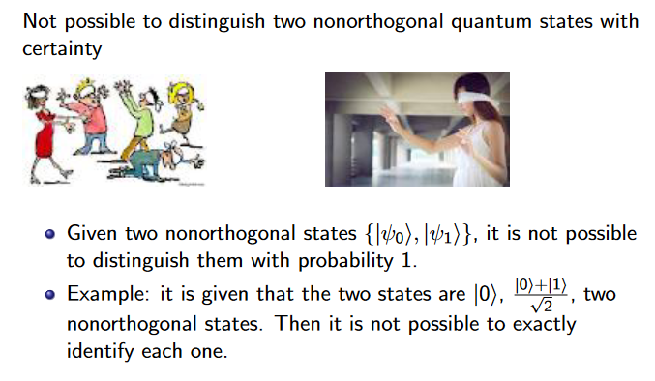
Quantum entanglement & Quantum Computing
2. Distinguishing non-orthogonal states

Slide 16
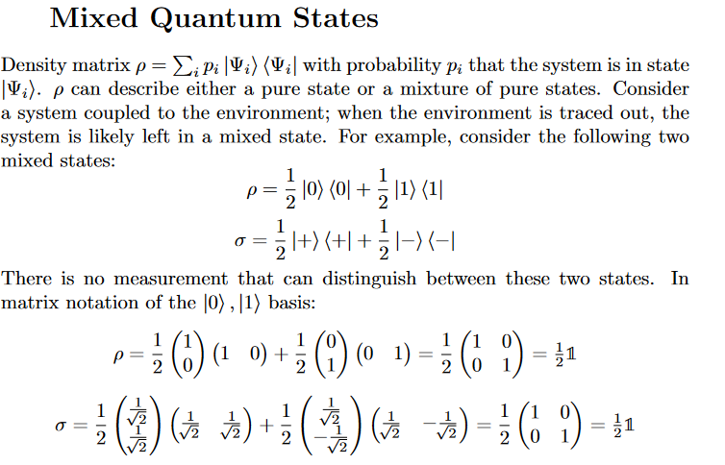
Quantum entanglement & Quantum Computing
2. Distinguishing non-orthogonal states

Slide 17
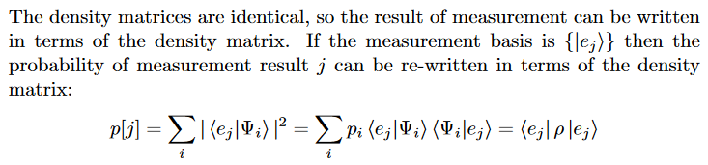
Quantum entanglement & Quantum Computing
2. Distinguishing non-orthogonal states

Slide 18
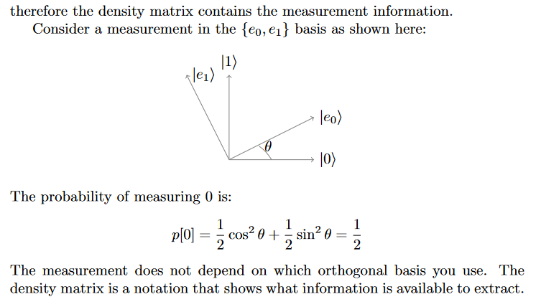
Quantum entanglement & Quantum Computing
2. Distinguishing non-orthogonal states

Slide 19
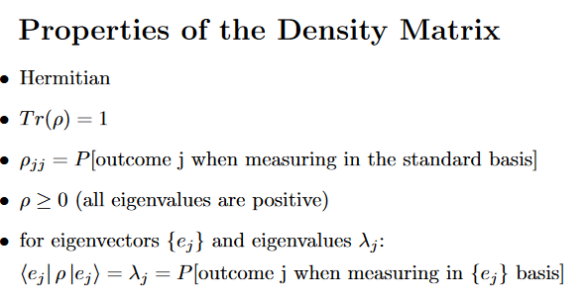
Quantum entanglement & Quantum Computing
2. Distinguishing non-orthogonal states

Slide 20
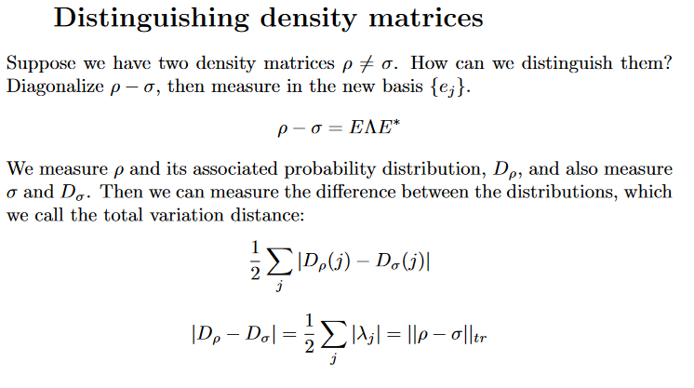
Quantum entanglement & Quantum Computing
2. Distinguishing non-orthogonal states

Slide 21
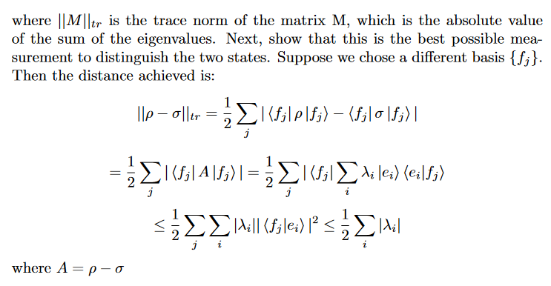
Quantum entanglement & Quantum Computing
2. Distinguishing non-orthogonal states

Slide 22
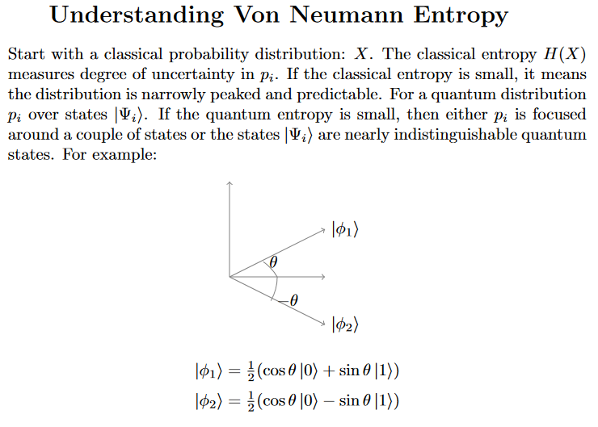
Quantum entanglement & Quantum Computing
2. Distinguishing non-orthogonal states

Slide 23
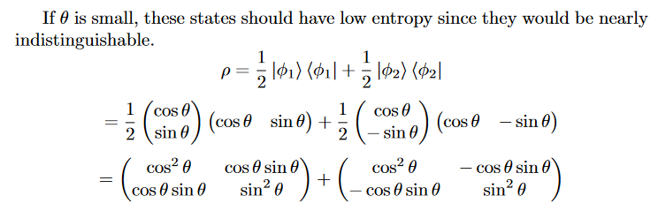
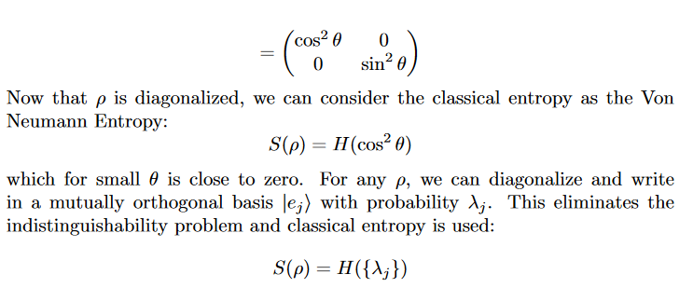
Quantum entanglement & Quantum Computing
2. Distinguishing non-orthogonal states

Slide 24
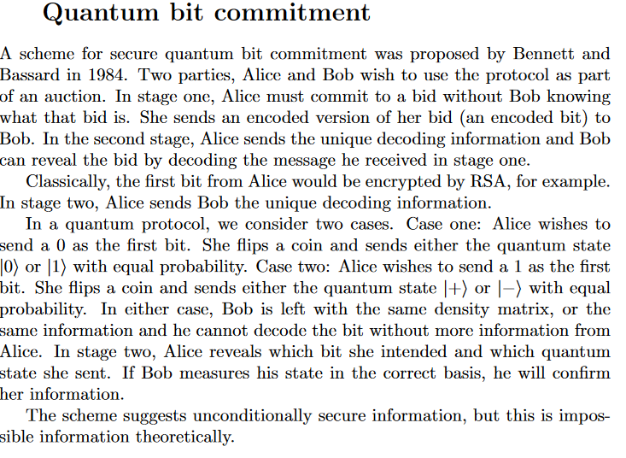
Quantum entanglement & Quantum Computing
2. Distinguishing non-orthogonal states

Slide 25
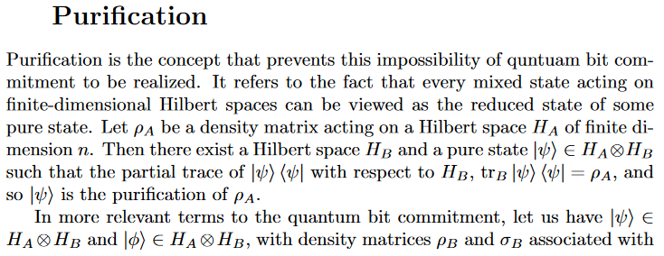
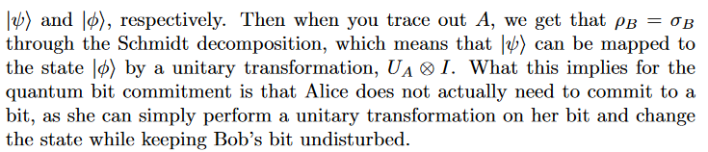
Quantum entanglement & Quantum Computing
2. Distinguishing non-orthogonal states

Slide 26
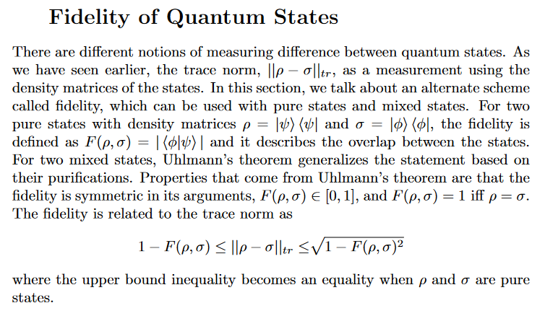
Quantum entanglement & Quantum Computing
2. Distinguishing non-orthogonal states

Slide 27
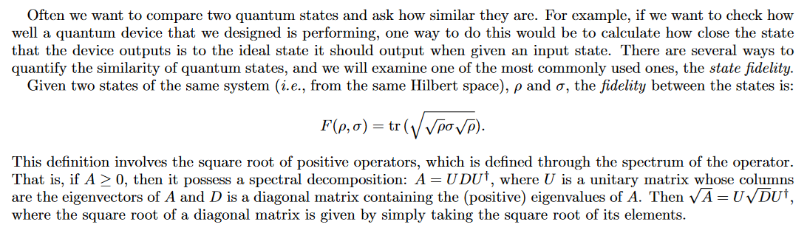
Quantum entanglement & Quantum Computing
2. Distinguishing non-orthogonal states

Slide 28
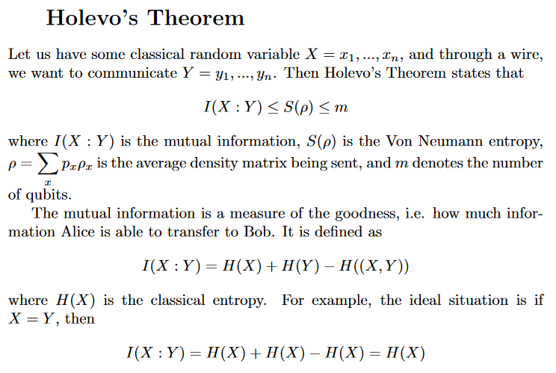
Quantum entanglement & Quantum Computing
2. Distinguishing non-orthogonal states

Slide 29
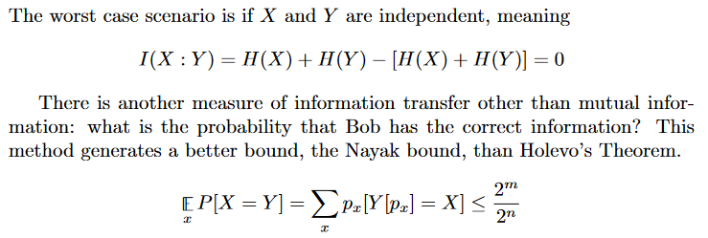
Quantum entanglement & Quantum Computing
2. Distinguishing non-orthogonal states

Slide 30
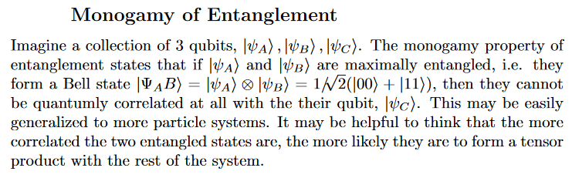
Quantum entanglement & Quantum Computing
2. Distinguishing non-orthogonal states

Slide 31
THANK YOU
Dr. Kaustav Bhowmick
Department of Electronics & Communication
Engineering
kaustavbhowmick@pes.edu

