Slide 1

Quantum Entanglement and Quantum Computing
Dr. Kaustav Bhowmick
Electronics & Communication
Engineering

Slide 2

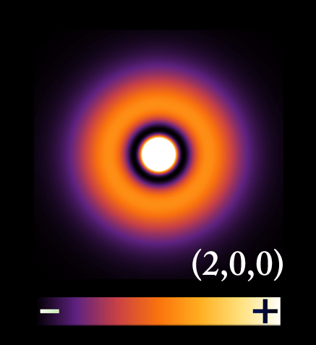
Quantum Entanglement and Quantum Computing
Entanglement and Quantum Information
Dr. Kaustav Bhowmick
Electronics & Communication Engineering
Source: Google images

Slide 3
Quantum entanglement & Quantum Computing
Contents
Quantum Gates
Quantum Circuits

Slide 4
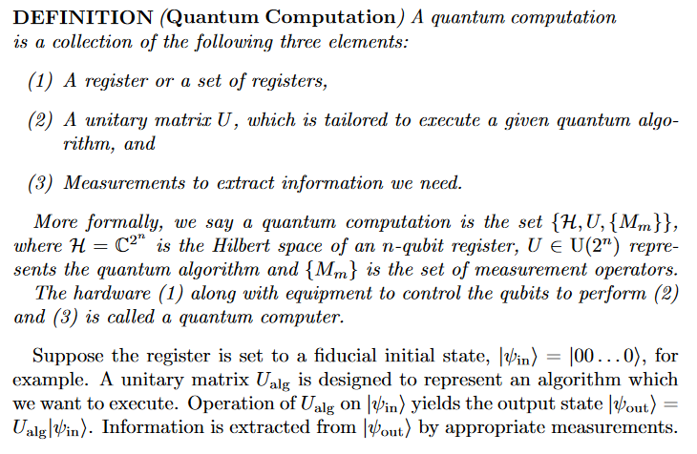
Quantum entanglement & Quantum Computing
1. Quantum Gates

Slide 5

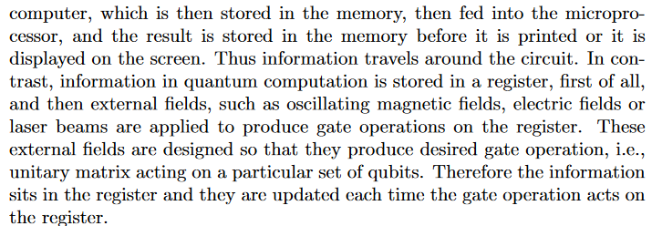
Quantum entanglement & Quantum Computing
1. Quantum Gates

Slide 6
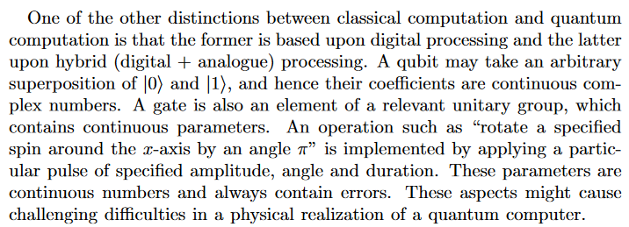
Quantum entanglement & Quantum Computing
1. Quantum Gates

Slide 7
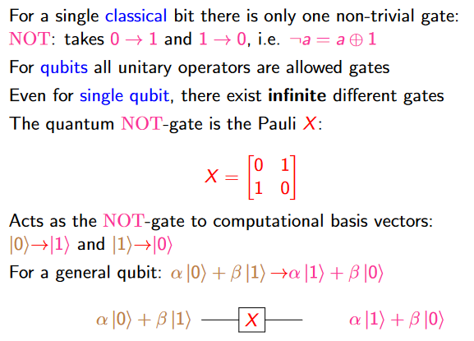
Quantum entanglement & Quantum Computing
1. Quantum Gates

Slide 8
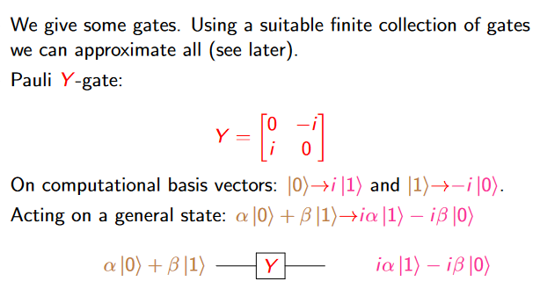
Quantum entanglement & Quantum Computing
1. Quantum Gates

Slide 9
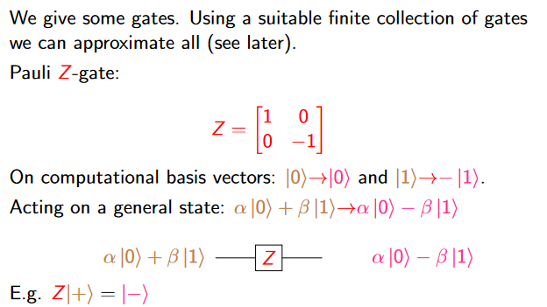
Quantum entanglement & Quantum Computing
1. Quantum Gates

Slide 10
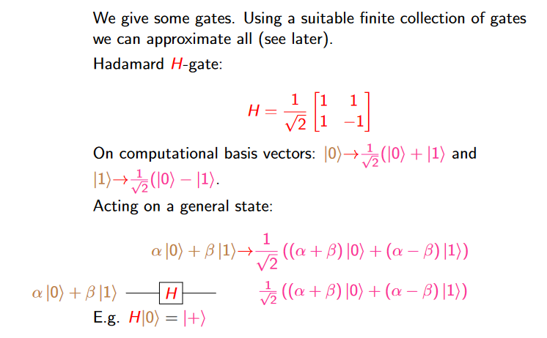
Quantum entanglement & Quantum Computing
1. Quantum Gates

Slide 11
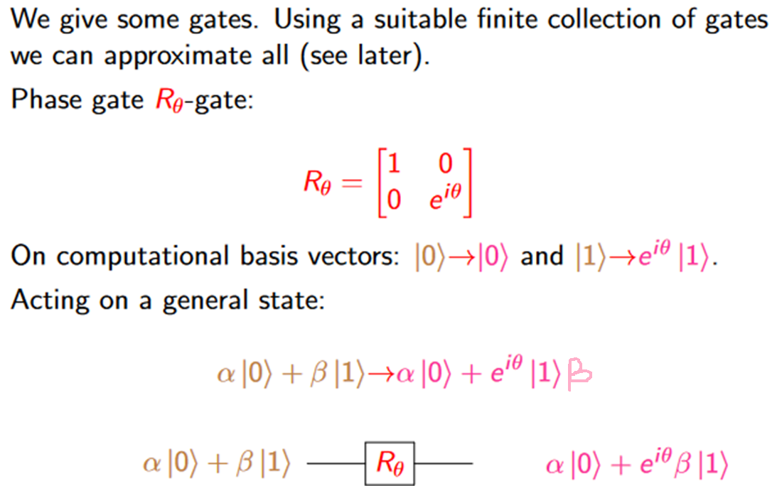
Quantum entanglement & Quantum Computing
1. Quantum Gates

Slide 12
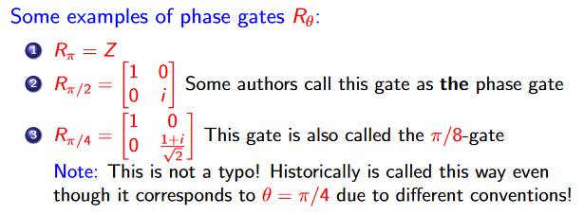
Quantum entanglement & Quantum Computing
1. Quantum Gates

Slide 13
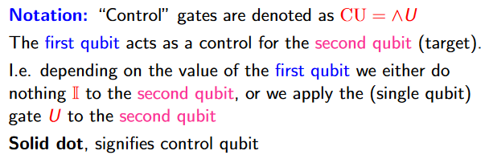
Quantum entanglement & Quantum Computing
1. Quantum Gates

Slide 14
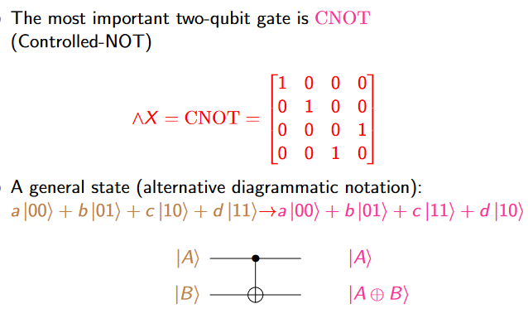
Quantum entanglement & Quantum Computing
1. Quantum Gates

Slide 15
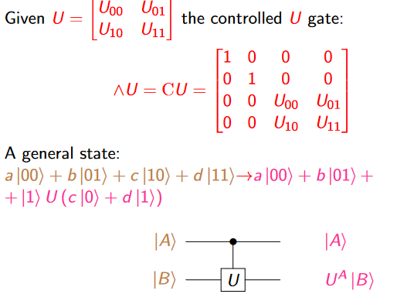
Quantum entanglement & Quantum Computing
1. Quantum Gates

Slide 16
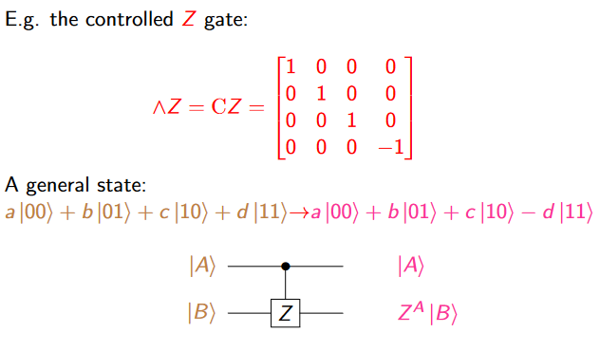
Quantum entanglement & Quantum Computing
1. Quantum Gates

Slide 17
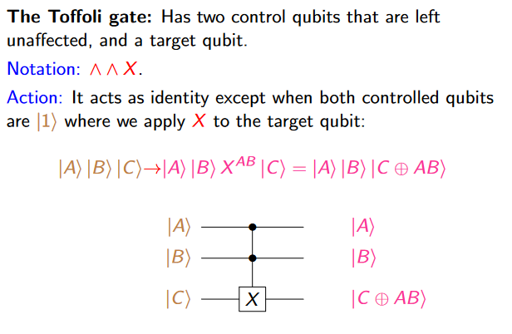
Quantum entanglement & Quantum Computing
1. Quantum Gates

Slide 18
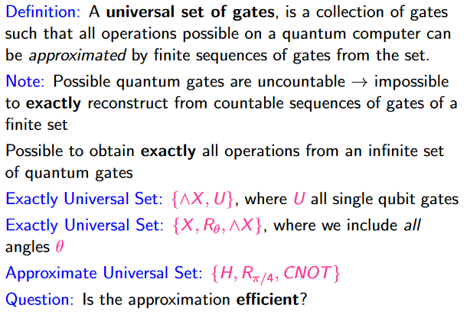
Quantum entanglement & Quantum Computing
1. Quantum Gates

Slide 19
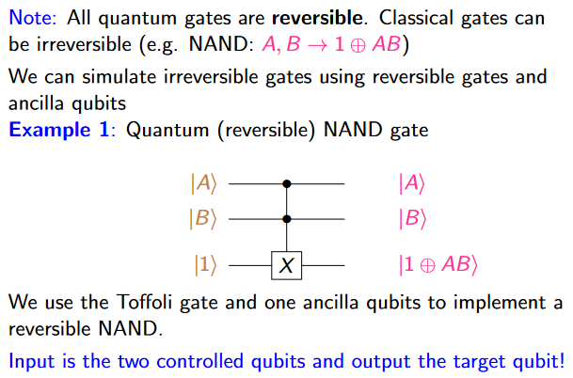
Quantum entanglement & Quantum Computing
1. Quantum Gates
For ancilla basics:
https://etheses.whiterose.ac.uk/12920/1/Proctor_TJP_Physics_PhD_2016.pdf

Slide 20
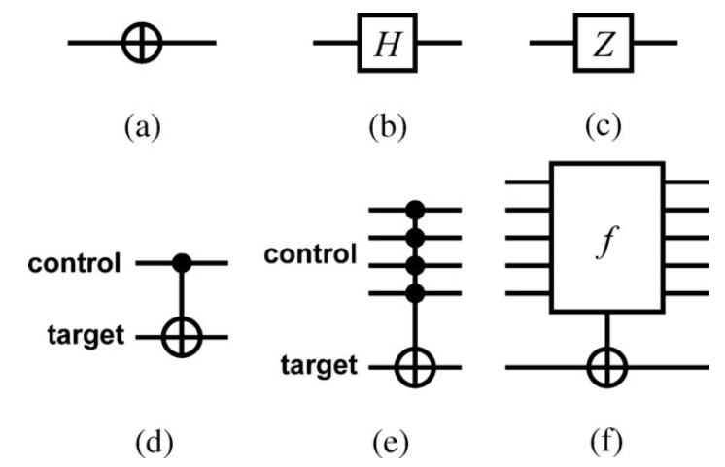
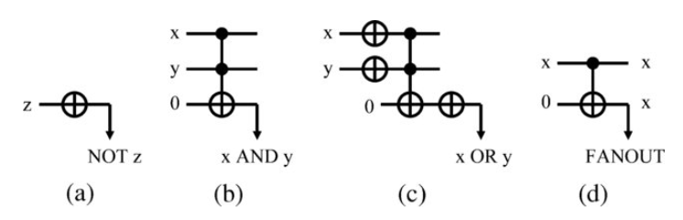
Quantum entanglement & Quantum Computing
1. Quantum Gates: some symbols

Slide 21
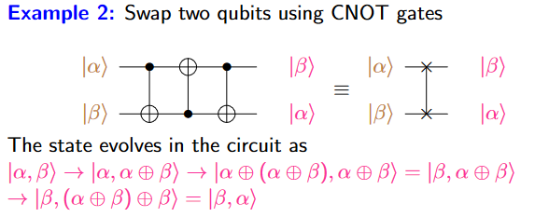
Quantum entanglement & Quantum Computing
1. Quantum Gates

Slide 22
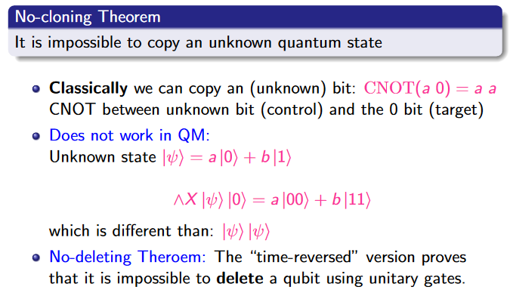
Quantum entanglement & Quantum Computing
1. Quantum Gates

Slide 23
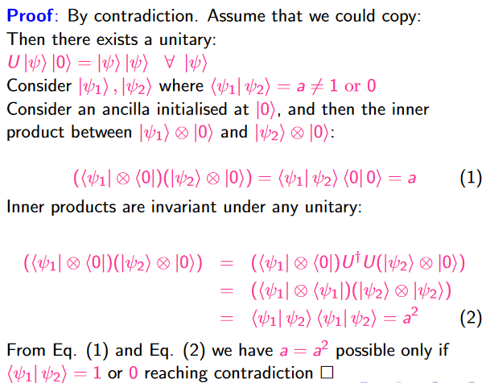
Quantum entanglement & Quantum Computing
1. Quantum Gates

Slide 24
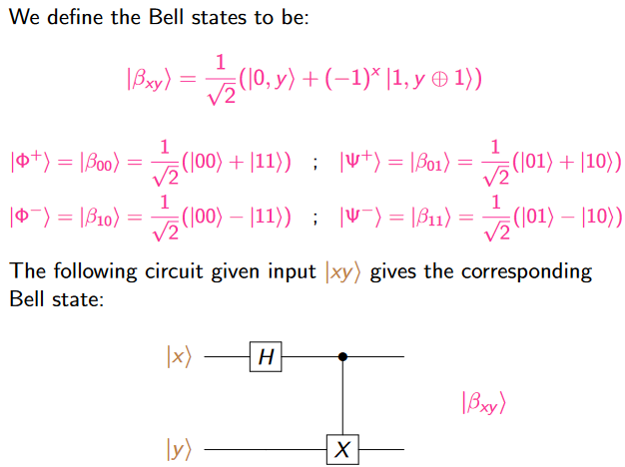
Quantum entanglement & Quantum Computing
1. Quantum Gates: Bell state

Slide 25
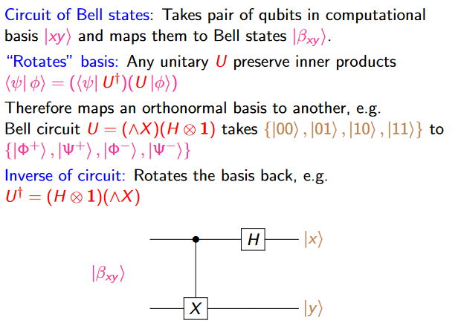
Quantum entanglement & Quantum Computing
1. Quantum Gates: Bell state

Slide 26
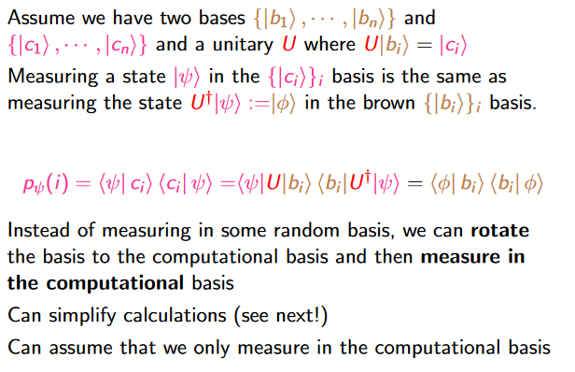
Quantum entanglement & Quantum Computing
Quantum Gates: Measurement in different bases

Slide 27
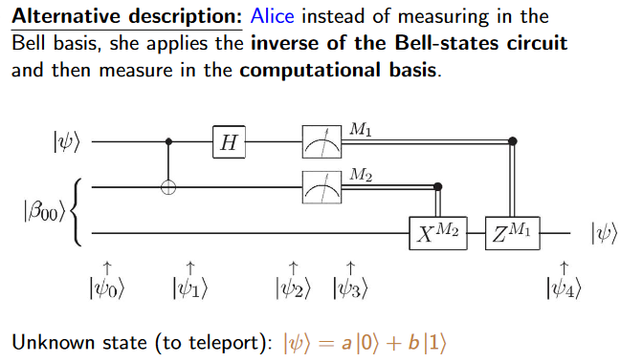
Quantum entanglement & Quantum Computing
1. Quantum Gates: Teleportation

Slide 28
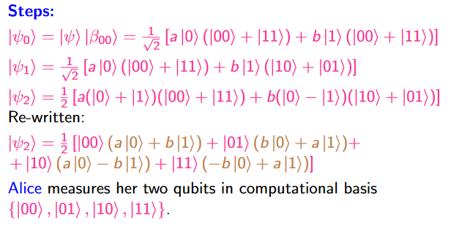
Quantum entanglement & Quantum Computing
1. Quantum Gates: Teleportation

Slide 29
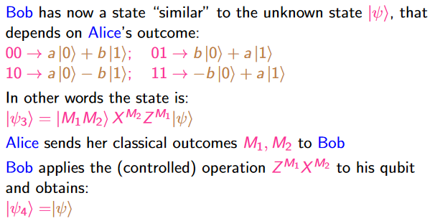
Quantum entanglement & Quantum Computing
1. Quantum Gates: Teleportation

Slide 30
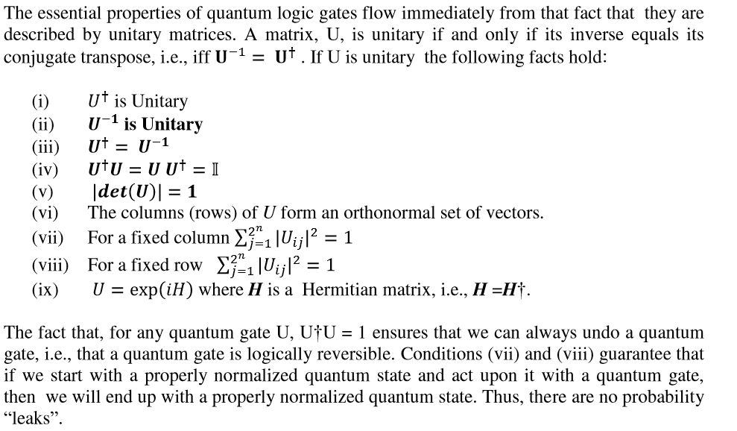
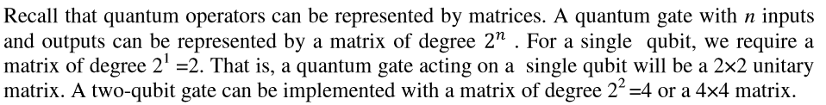
Quantum entanglement & Quantum Computing
1. Quantum Gates: some details and examples

Slide 31
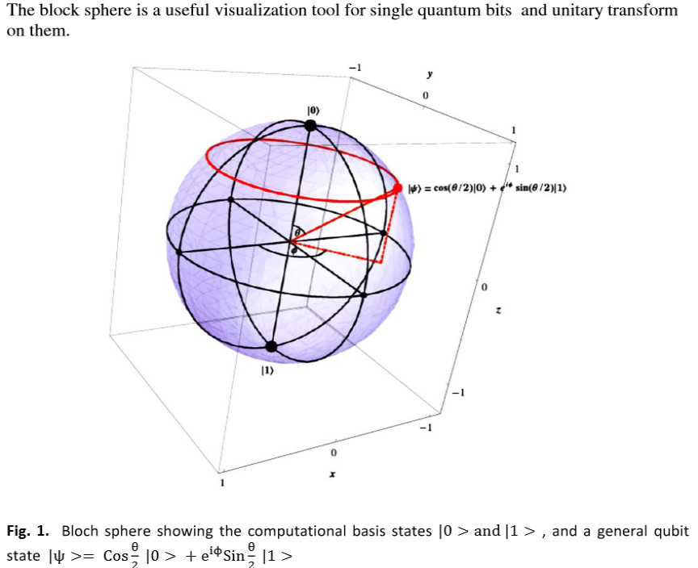
Quantum entanglement & Quantum Computing
1. Quantum Gates: some details and examples

Slide 32
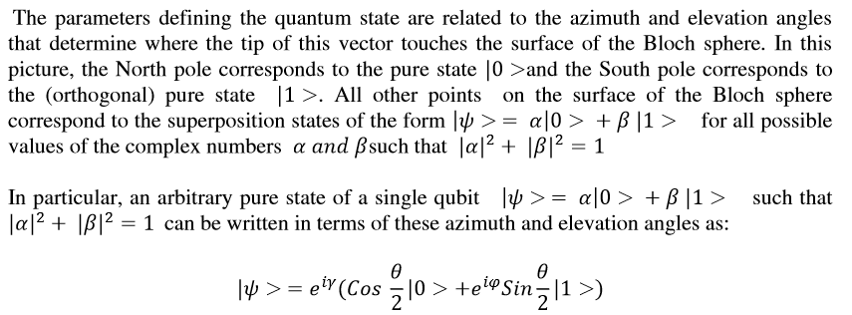

Quantum entanglement & Quantum Computing
1. Quantum Gates: some details and examples

Slide 33
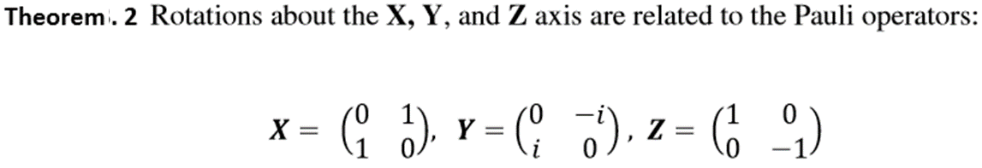
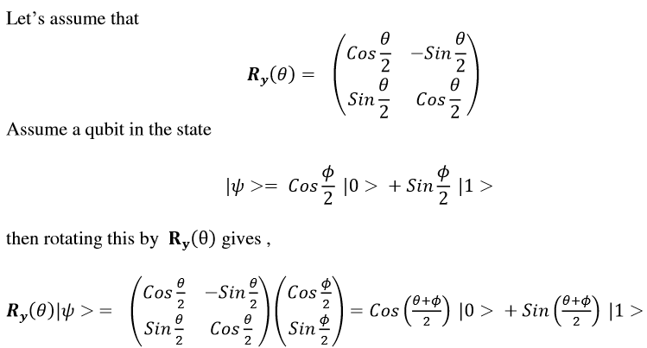
Quantum entanglement & Quantum Computing
1. Quantum Gates: some details and examples

Slide 34
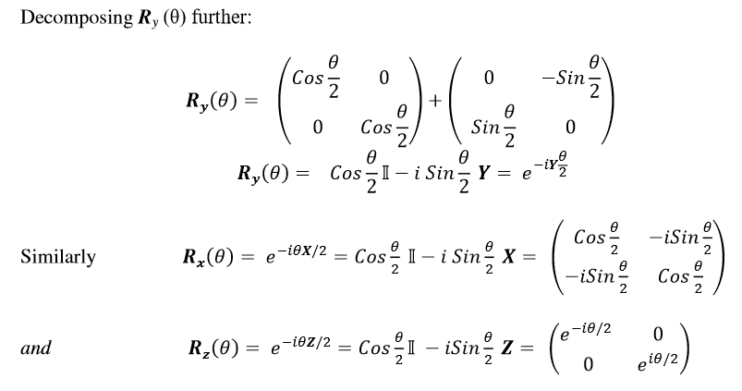

Quantum entanglement & Quantum Computing
1. Quantum Gates: some details and examples

Slide 35
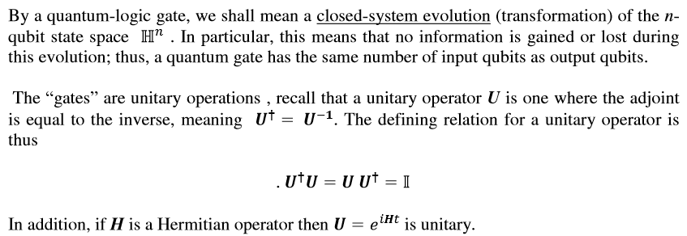
Quantum entanglement & Quantum Computing
1. Quantum Gates: some details and examples

Slide 36
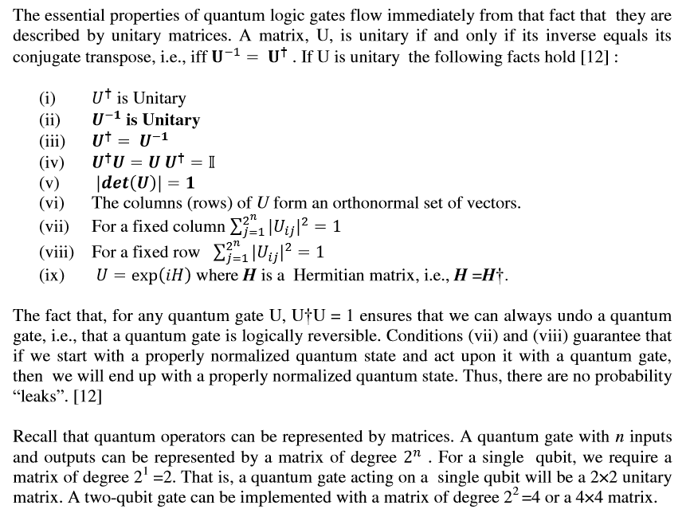
Quantum entanglement & Quantum Computing
1. Quantum Gates: some details and examples

Slide 37
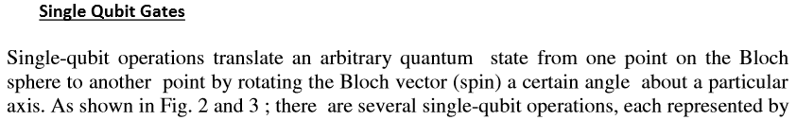
Quantum entanglement & Quantum Computing
1. Quantum Gates: some details and examples

Slide 38
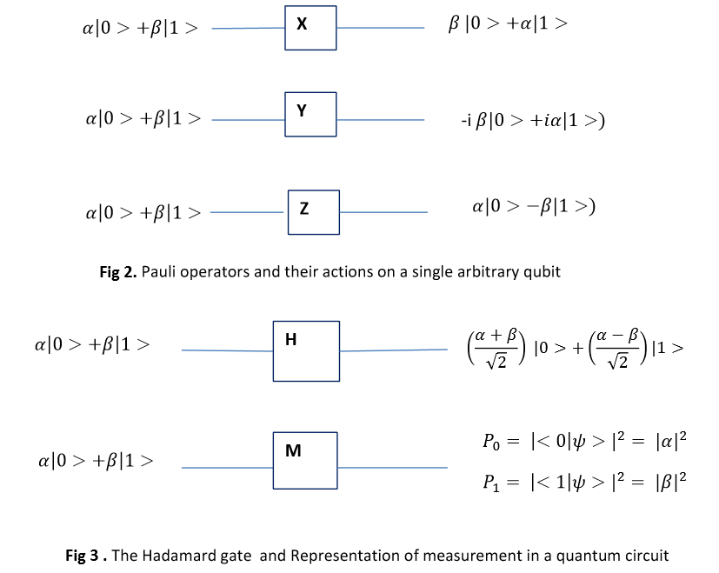
Quantum entanglement & Quantum Computing
1. Quantum Gates: some details and examples

Slide 39
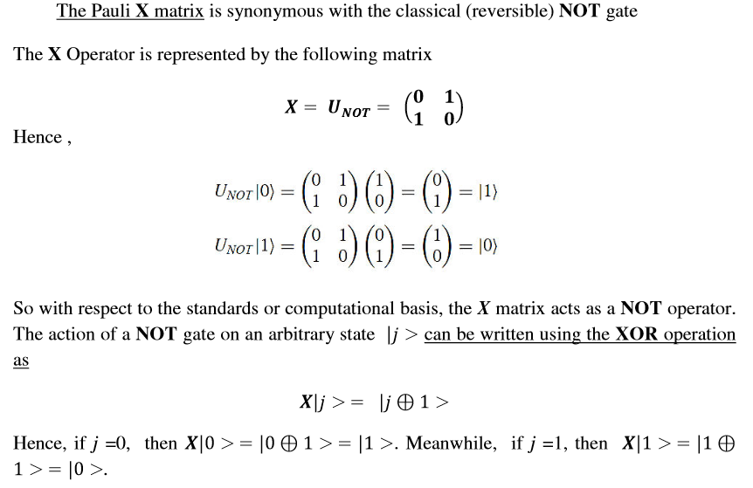
Quantum entanglement & Quantum Computing
1. Quantum Gates: some details and examples

Slide 40
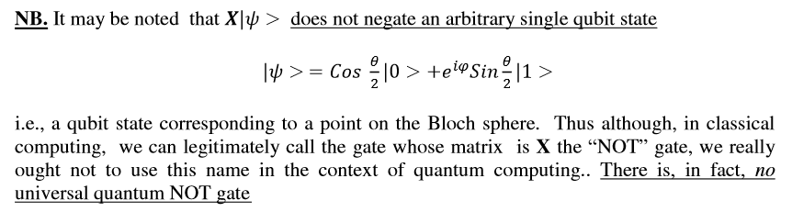
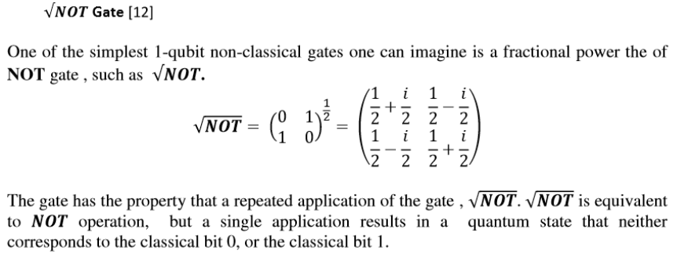
Quantum entanglement & Quantum Computing
1. Quantum Gates: some details and examples

Slide 41
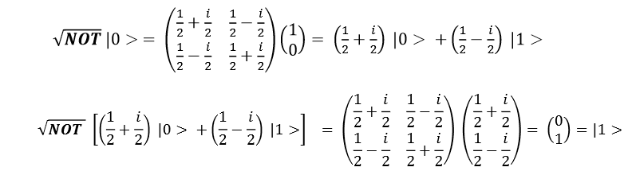
Quantum entanglement & Quantum Computing
1. Quantum Gates: some details and examples

Slide 42
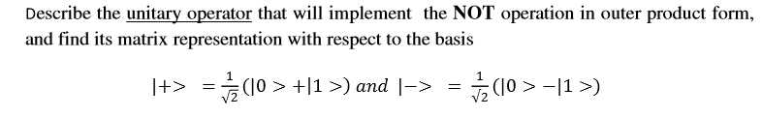
Quantum entanglement & Quantum Computing
1. Quantum Gates: some details and examples, Example 1

Slide 43
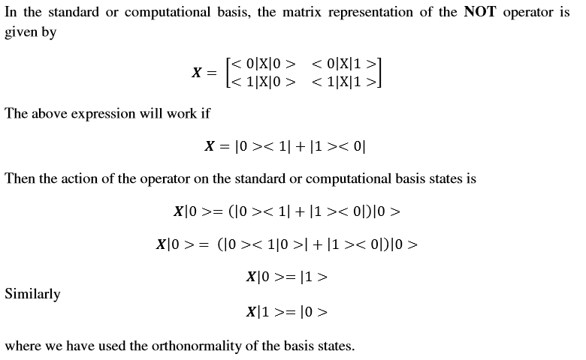
Quantum entanglement & Quantum Computing
1. Quantum Gates: some details and examples, Example 1

Slide 44
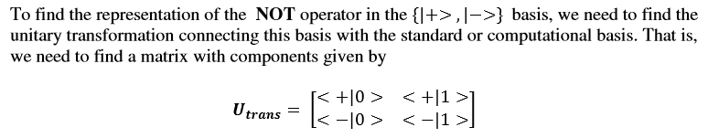
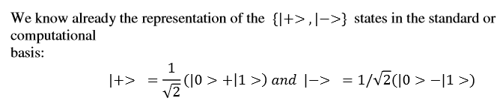
Quantum entanglement & Quantum Computing
1. Quantum Gates: some details and examples, Example 1

Slide 45
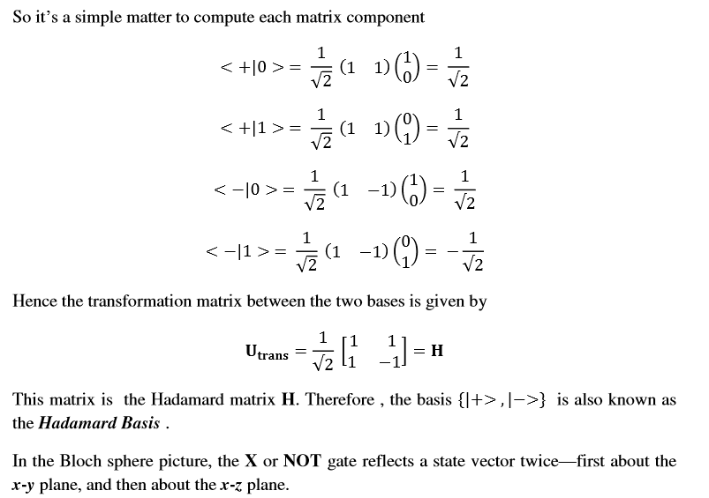
Quantum entanglement & Quantum Computing
1. Quantum Gates: some details and examples, Example 1

Slide 46
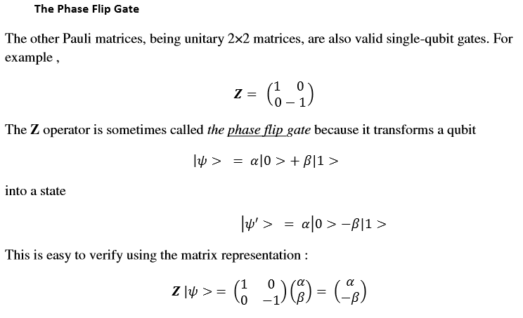
Quantum entanglement & Quantum Computing
1. Quantum Gates: some details and examples

Slide 47
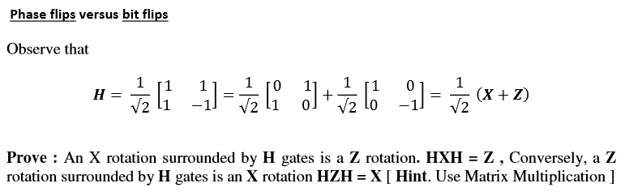

Quantum entanglement & Quantum Computing
1. Quantum Gates: some details and examples

Slide 48
Quantum entanglement & Quantum Computing
1. Quantum Gates: some details and examples Example 2

Slide 49

Quantum entanglement & Quantum Computing
1. Quantum Gates: some details and examples Example 2

Slide 50

Quantum entanglement & Quantum Computing
1. Quantum Gates: some details and examples Example 2

Slide 51

Quantum entanglement & Quantum Computing
1. Quantum Gates: some details and examples

Slide 52


Quantum entanglement & Quantum Computing
1. Quantum Gates: some details and examples

Slide 53

Quantum entanglement & Quantum Computing
1. Quantum Gates: some details and examples

Slide 54

Quantum entanglement & Quantum Computing
1. Quantum Gates: some details and examples

Slide 55


Quantum entanglement & Quantum Computing
1. Quantum Gates: some details and examples

Slide 56


Quantum entanglement & Quantum Computing
1. Quantum Gates: some details and examples

Slide 57


Quantum entanglement & Quantum Computing
1. Quantum Gates: some details and examples

Slide 58


Quantum entanglement & Quantum Computing
1. Quantum Gates: some details and examples

Slide 59

Quantum entanglement & Quantum Computing
1. Quantum Gates: some details and examples

Slide 60
Quantum entanglement & Quantum Computing
1. Quantum Gates: some details and examples Example 3

Slide 61

Quantum entanglement & Quantum Computing
1. Quantum Gates: some details and examples Example 3

Slide 62

Quantum entanglement & Quantum Computing
1. Quantum Gates: some details and examples

Slide 63

Quantum entanglement & Quantum Computing
1. Quantum Gates: some details and examples Example 4

Slide 64

Quantum entanglement & Quantum Computing
1. Quantum Gates: some details and examples Example 4

Slide 65

Quantum entanglement & Quantum Computing
1. Quantum Gates: some details and examples Example 4

Slide 66

Quantum entanglement & Quantum Computing
1. Quantum Gates: some details and examples

Slide 67

Quantum entanglement & Quantum Computing
1. Quantum Gates: some details and examples

Slide 68

Quantum entanglement & Quantum Computing
1. Quantum Gates: some details and examples

Slide 69

Quantum entanglement & Quantum Computing
1. Quantum Gates: some details and examples

Slide 70
Quantum entanglement & Quantum Computing
1. Quantum Gates: some details and examples Example 5

Slide 71

Quantum entanglement & Quantum Computing
1. Quantum Gates: some details and examples Example 5

Slide 72

Quantum entanglement & Quantum Computing
1. Quantum Gates: some details and examples Example 5

Slide 73


Quantum entanglement & Quantum Computing
1. Quantum Gates: some details and examples Example 5

Slide 74

Quantum entanglement & Quantum Computing
1. Quantum Gates: some details and examples Example 5

Slide 75

Quantum entanglement & Quantum Computing
1. Quantum Gates: some details and examples Example 5

Slide 76

Quantum entanglement & Quantum Computing
1. Quantum Gates: some details and examples Example 5

Slide 77

Quantum entanglement & Quantum Computing
1. Quantum Gates: some details and examples Example 5

Slide 78

Quantum entanglement & Quantum Computing
1. Quantum Gates: some details and examples Example 5

Slide 79

Quantum entanglement & Quantum Computing
1. Quantum Gates: some details and examples Example 5

Slide 80

Quantum entanglement & Quantum Computing
1. Quantum Gates: some details and examples Example 5

Slide 81


Quantum entanglement & Quantum Computing
1. Quantum Gates: some details and examples Example 5

Slide 82

Quantum entanglement & Quantum Computing
1. Quantum Gates: some details and examples Example 5

Slide 83


Quantum entanglement & Quantum Computing
1. Quantum Gates: some details and examples Example 5

Slide 84

Quantum entanglement & Quantum Computing
1. Quantum Gates: some details and examples Example 5

Slide 85

Quantum entanglement & Quantum Computing
1. Quantum Gates: some details and examples Example 5

Slide 86

Quantum entanglement & Quantum Computing
1. Quantum Gates: some details and examples Example 5

Slide 87

Quantum entanglement & Quantum Computing
1. Quantum Gates: some details and examples Example 5

Slide 88

Quantum entanglement & Quantum Computing
1. Quantum Gates: some details and examples Example 5

Slide 89
Quantum entanglement & Quantum Computing
1. Quantum Gates: some details and examples Task
Make a report on Clifford gate and Peres gate. Bring out the relation of the above gates with these Gates if any. Do literature review as needed and provide list of references used.

Slide 90

Quantum entanglement & Quantum Computing
2. Quantum Circuits

Slide 91

Quantum entanglement & Quantum Computing
2. Quantum Circuits

Slide 92

Quantum entanglement & Quantum Computing
2. Quantum Circuits

Slide 93

Quantum entanglement & Quantum Computing
2. Quantum Circuits

Slide 94
THANK YOU
Dr. Kaustav Bhowmick
Department of Electronics & Communication
Engineering
kaustavbhowmick@pes.edu

