Slide 1

Quantum Entanglement and Quantum Computing
Dr. Kaustav Bhowmick
Electronics & Communication
Engineering

Slide 2

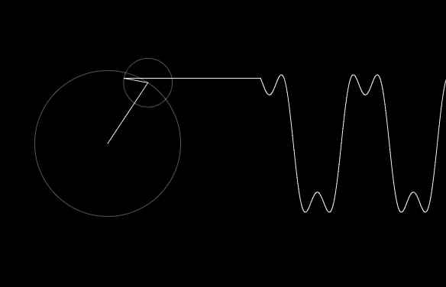
Quantum Entanglement and Quantum Computing
Entanglement and Quantum Information
Dr. Kaustav Bhowmick
Electronics & Communication Engineering
Source: Google images

Slide 3
Quantum entanglement & Quantum Computing
Contents
Deustch
Deustch Josza
Bernstein-Vazirani Algorithm
Quantum Fourier Transform
Quantum Phase Estimation
Shor’s algo
Grover Radhakrishnan

Slide 4
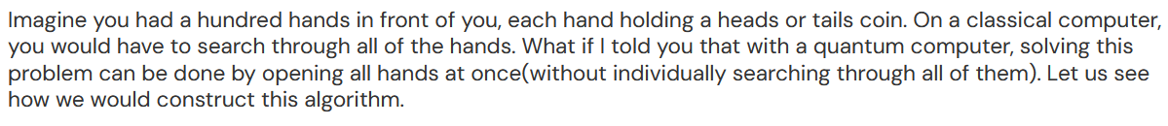
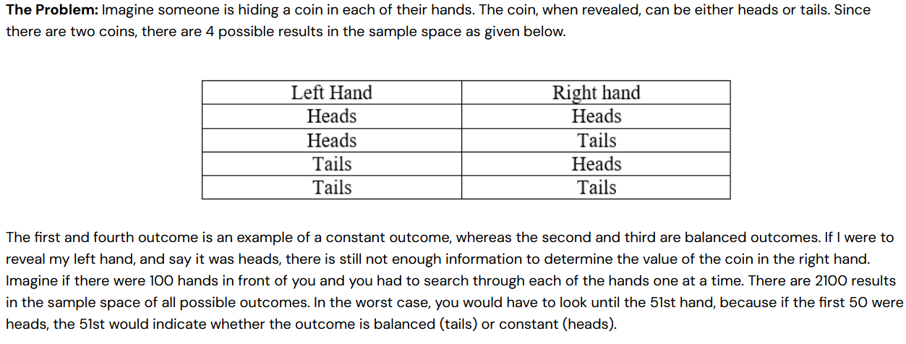
Quantum entanglement & Quantum Computing
1. Deustch

Slide 5
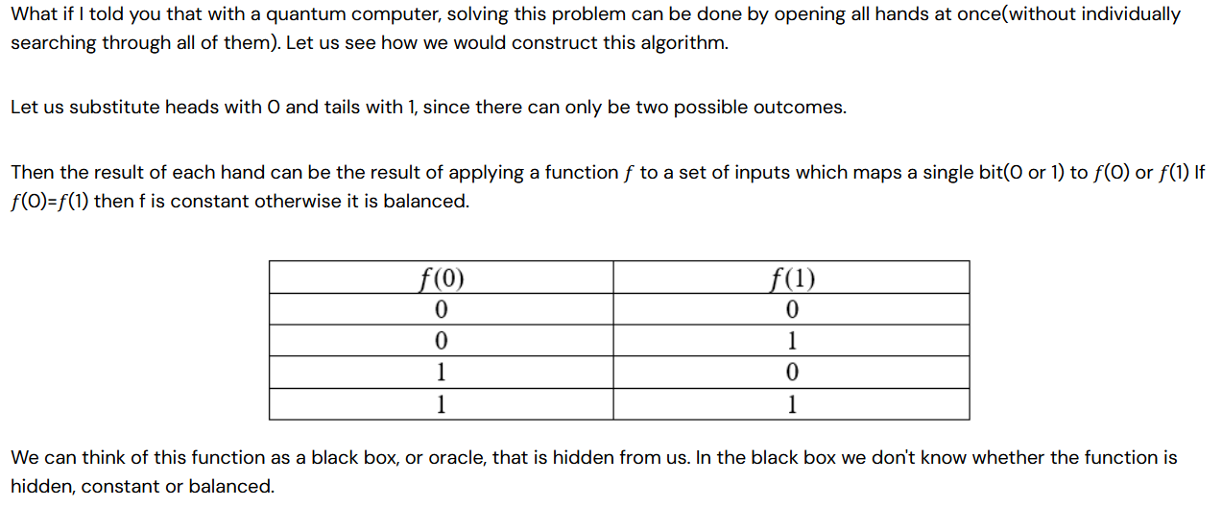
Quantum entanglement & Quantum Computing
1. Deustch

Slide 6
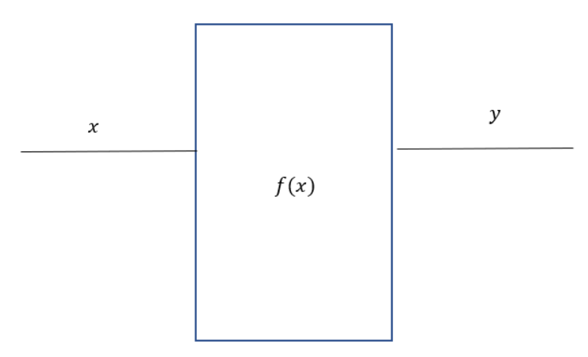
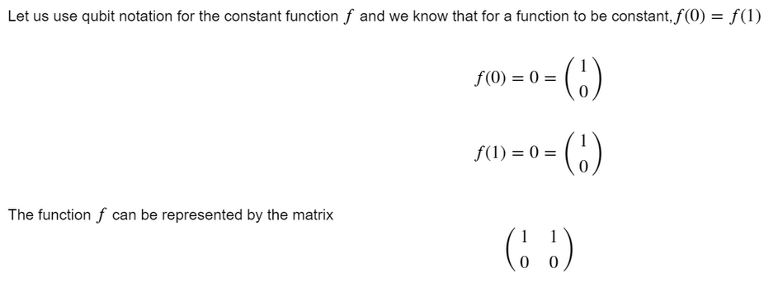
Quantum entanglement & Quantum Computing
1. Deustch

Slide 7
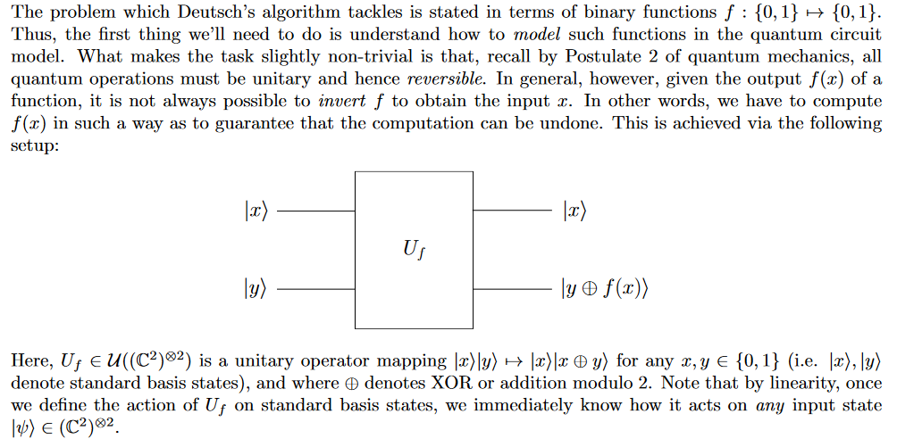
Quantum entanglement & Quantum Computing
1. Deustch

Slide 8
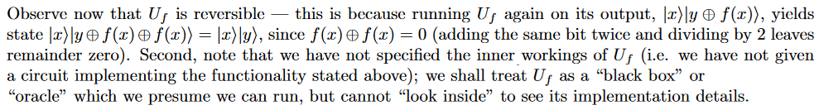
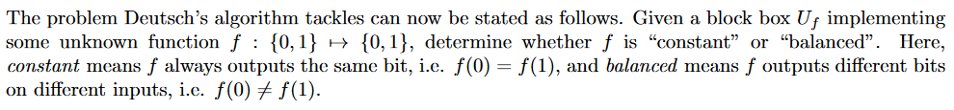
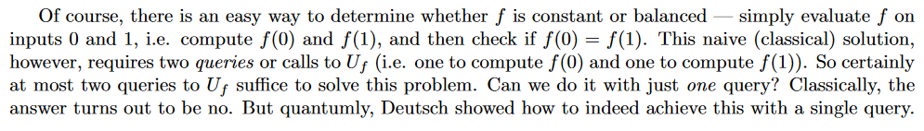
Quantum entanglement & Quantum Computing
1. Deustch

Slide 9
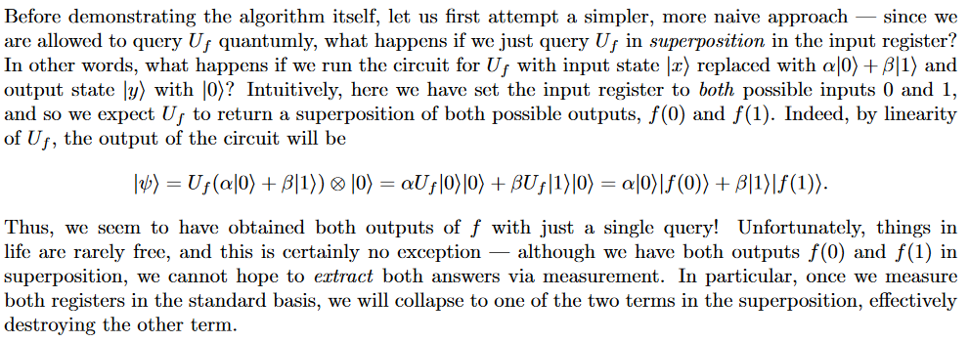
Quantum entanglement & Quantum Computing
1. Deustch

Slide 10
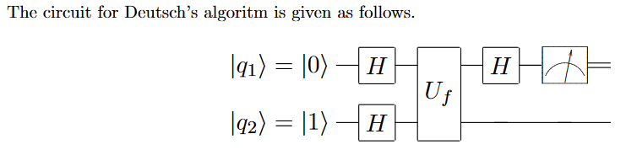
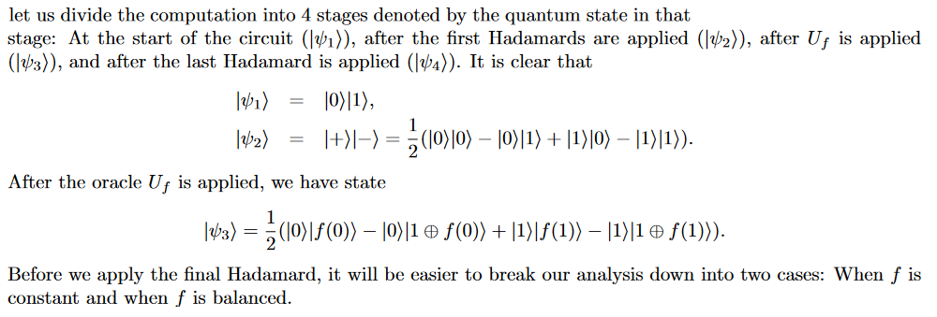
Quantum entanglement & Quantum Computing
1. Deustch

Slide 11
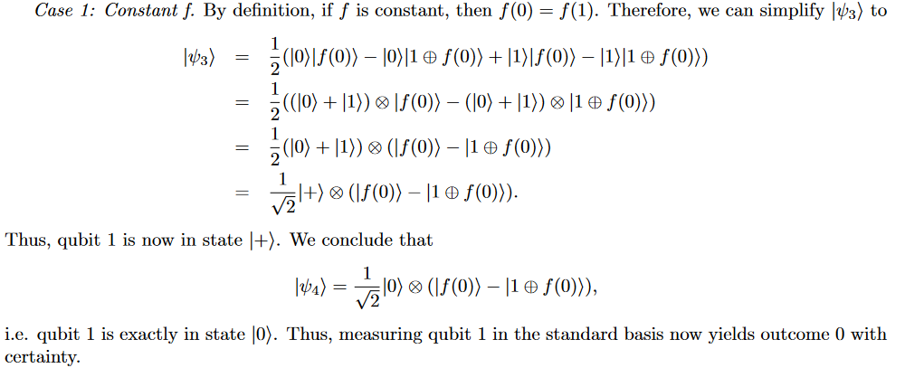
Quantum entanglement & Quantum Computing
1. Deustch

Slide 12
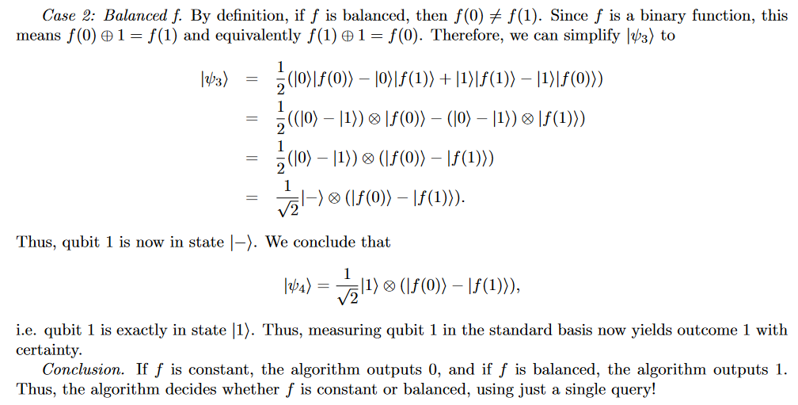
Quantum entanglement & Quantum Computing
1. Deustch

Slide 13

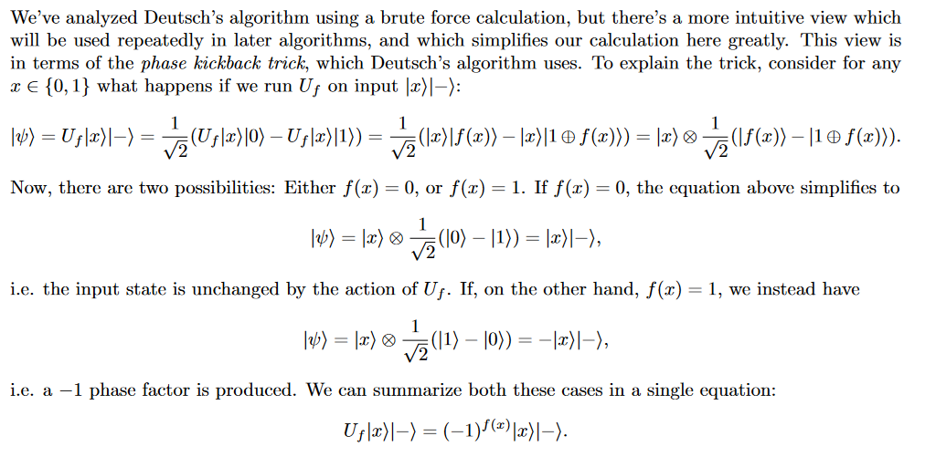
Quantum entanglement & Quantum Computing
1. Deustch

Slide 14
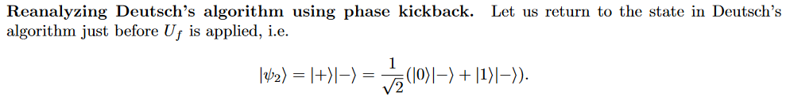
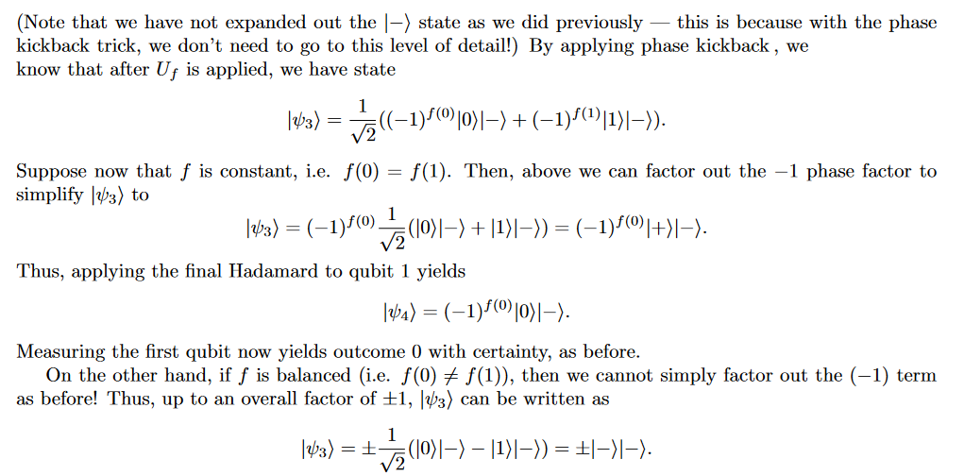
Quantum entanglement & Quantum Computing
1. Deustch

Slide 15
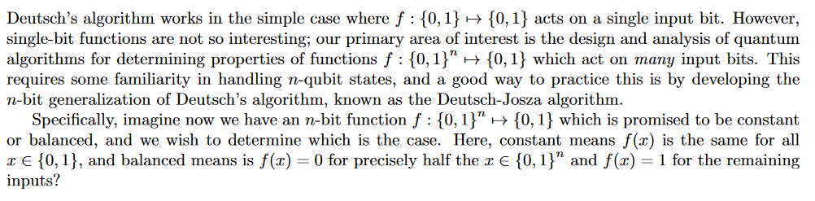
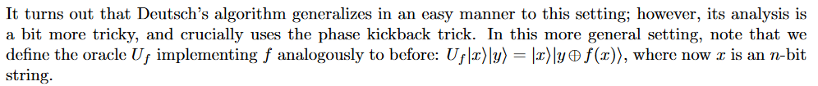
Quantum entanglement & Quantum Computing
2. Deustch Josza

Slide 16
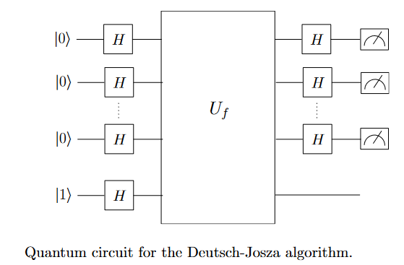
Quantum entanglement & Quantum Computing
2. Deustch Josza

Slide 17
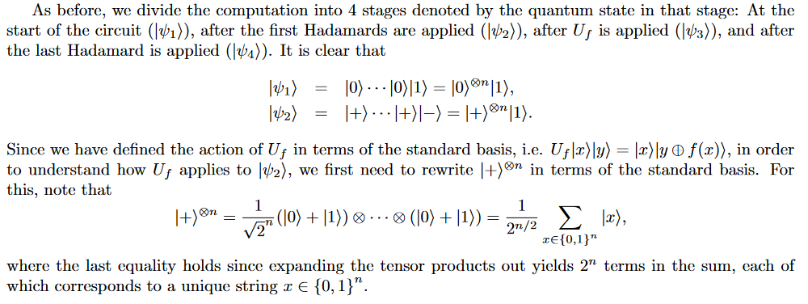
Quantum entanglement & Quantum Computing
2. Deustch Josza

Slide 18
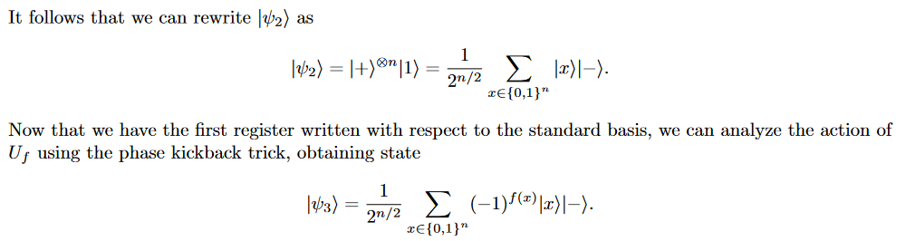
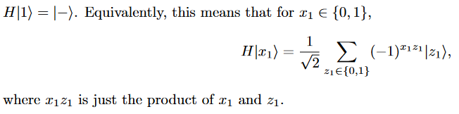
Quantum entanglement & Quantum Computing
2. Deustch Josza

Slide 19
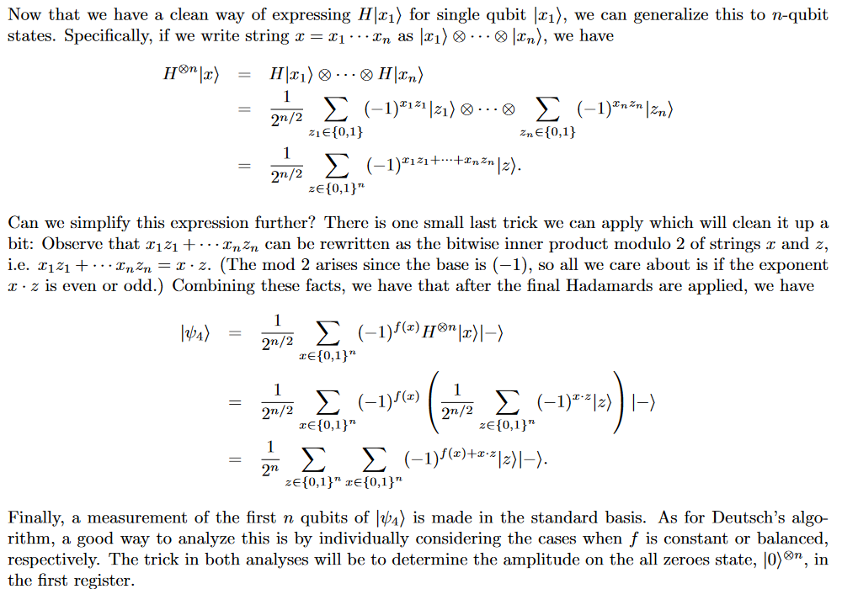
Quantum entanglement & Quantum Computing
2. Deustch Josza

Slide 20
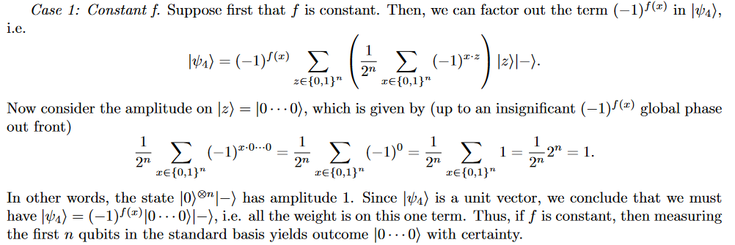
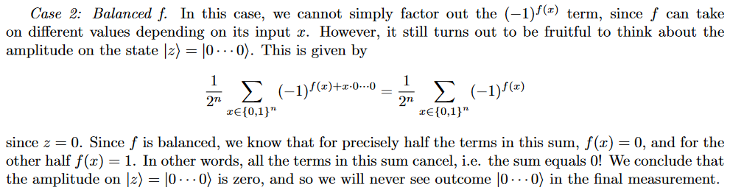
Quantum entanglement & Quantum Computing
2. Deustch Josza

Slide 21
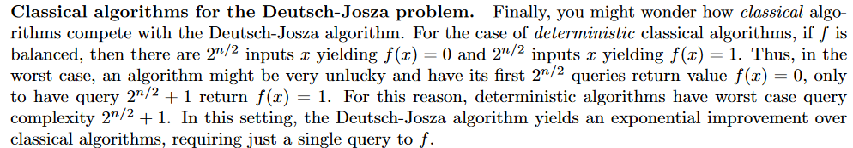
Quantum entanglement & Quantum Computing
2. Deustch Josza

Slide 22
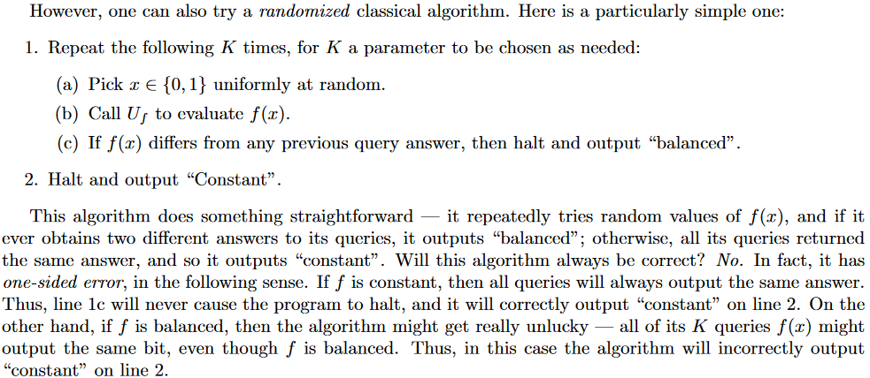
Quantum entanglement & Quantum Computing
2. Deustch Josza

Slide 23
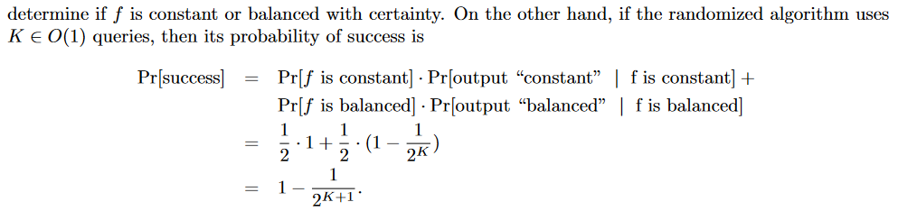
Quantum entanglement & Quantum Computing
2. Deustch Josza
Complexity: O(1) or O(logN)

Slide 24
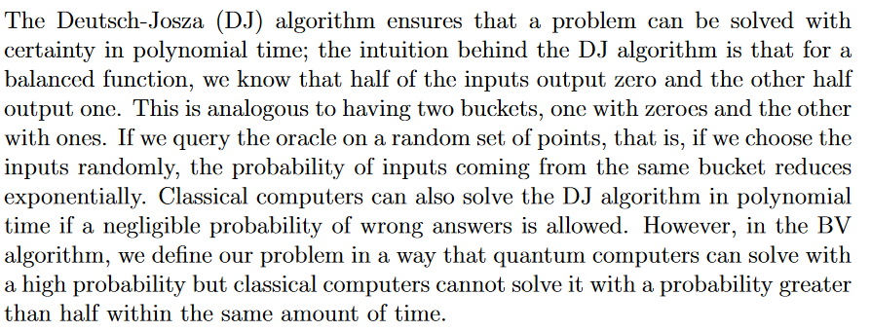

Quantum entanglement & Quantum Computing
3. Bernstein-Vazirani Algorithm
https://physlab.org/wp-content/uploads/2023/05/BernsteinVazirani_23100071_Fin.pdf

Slide 25
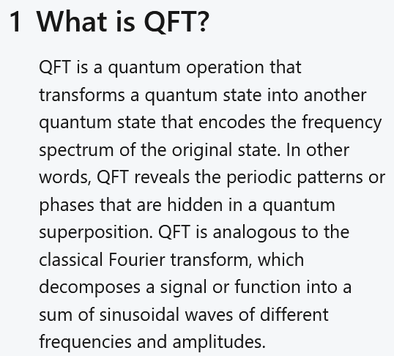
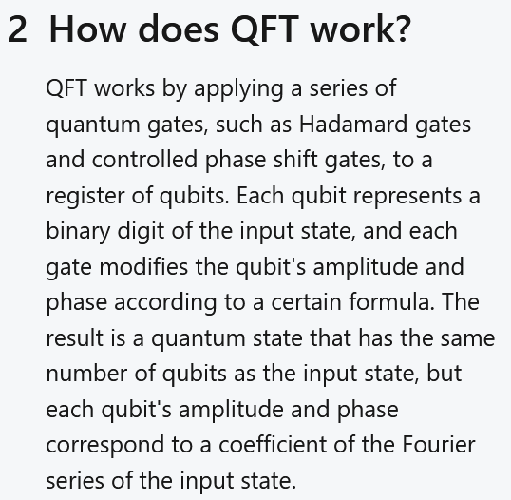
Quantum entanglement & Quantum Computing
4. Quantum Fourier transform

Slide 26
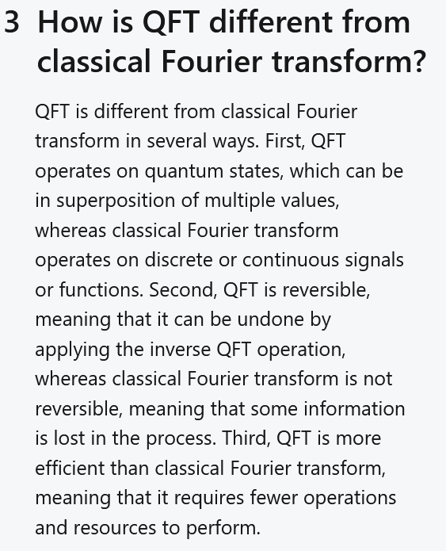
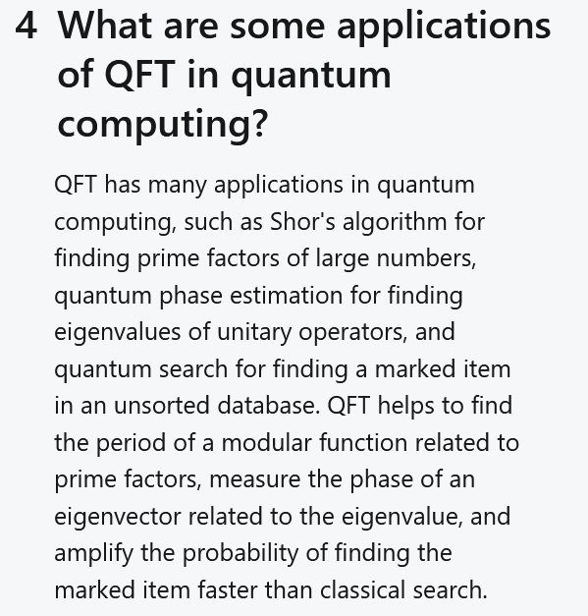
Quantum entanglement & Quantum Computing
4. Quantum Fourier transform

Slide 27
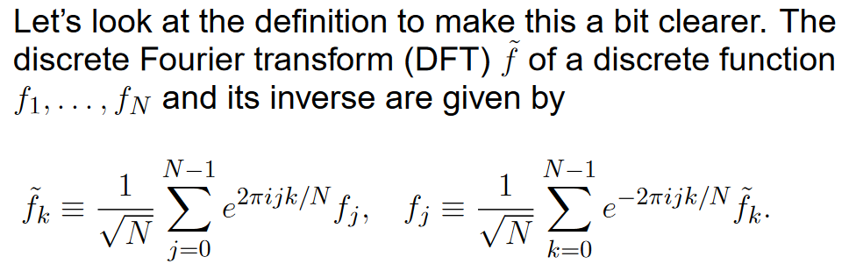
Quantum entanglement & Quantum Computing
4. Quantum Fourier transform

Slide 28
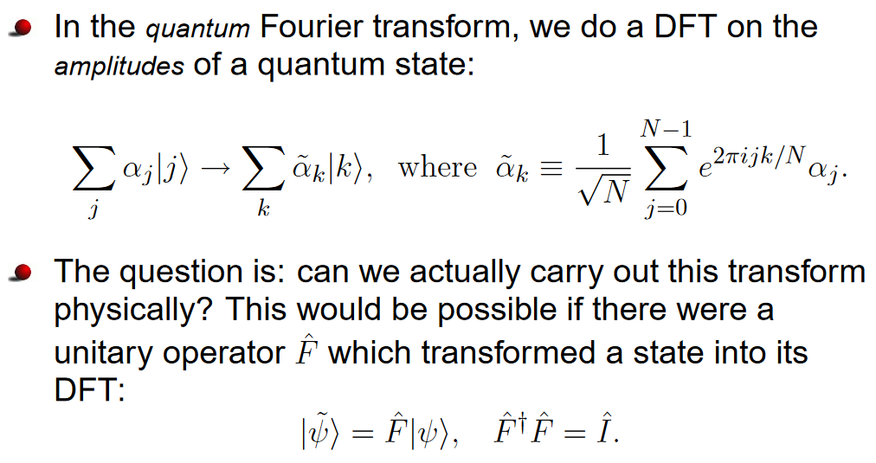
Quantum entanglement & Quantum Computing
4. Quantum Fourier transform

Slide 29
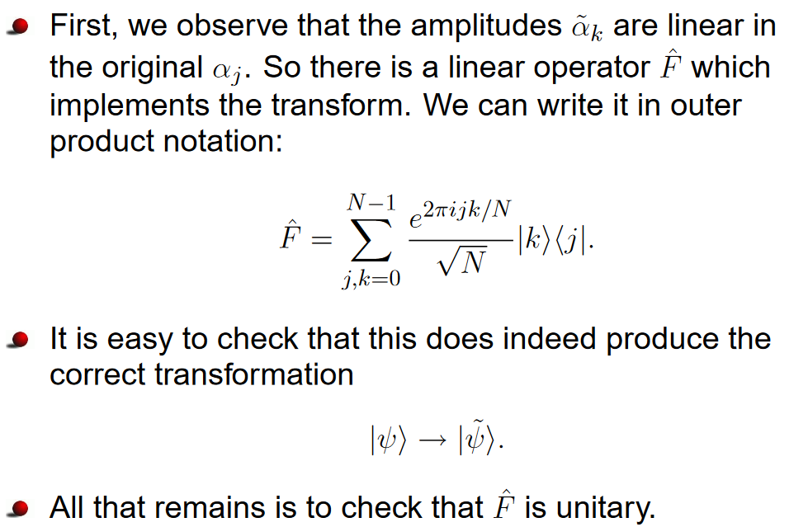
Quantum entanglement & Quantum Computing
4. Quantum Fourier transform

Slide 30
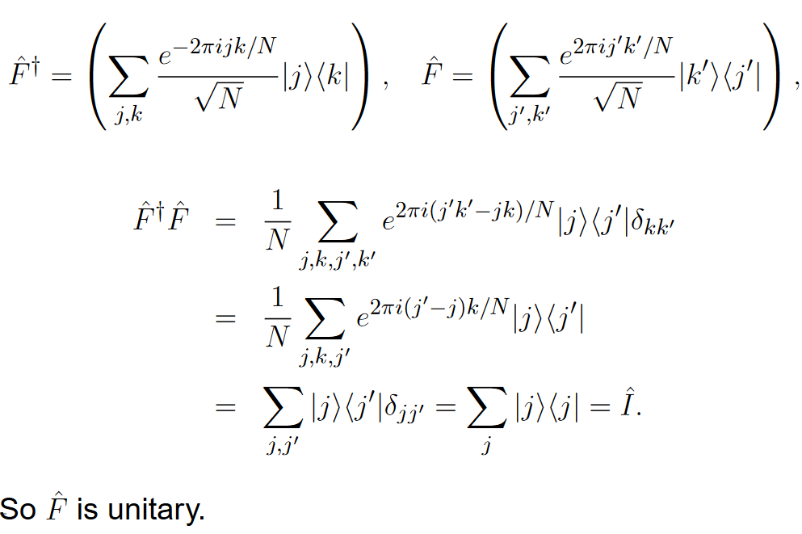
Quantum entanglement & Quantum Computing
4. Quantum Fourier transform

Slide 31

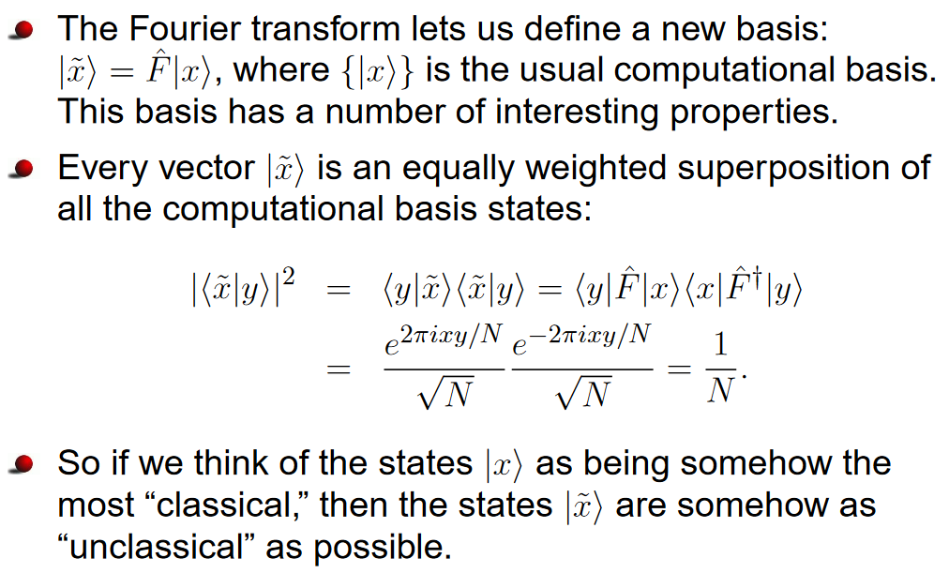
Quantum entanglement & Quantum Computing
4. Quantum Fourier transform

Slide 32
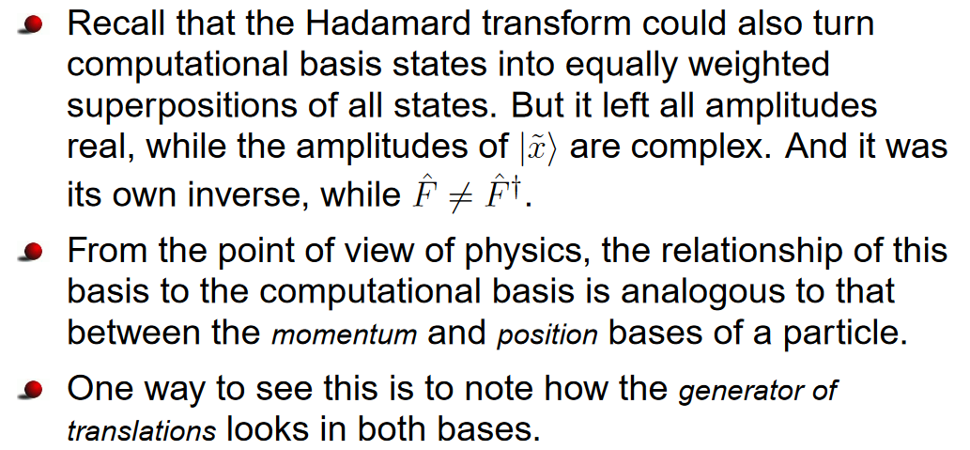
Quantum entanglement & Quantum Computing
4. Quantum Fourier transform

Slide 33

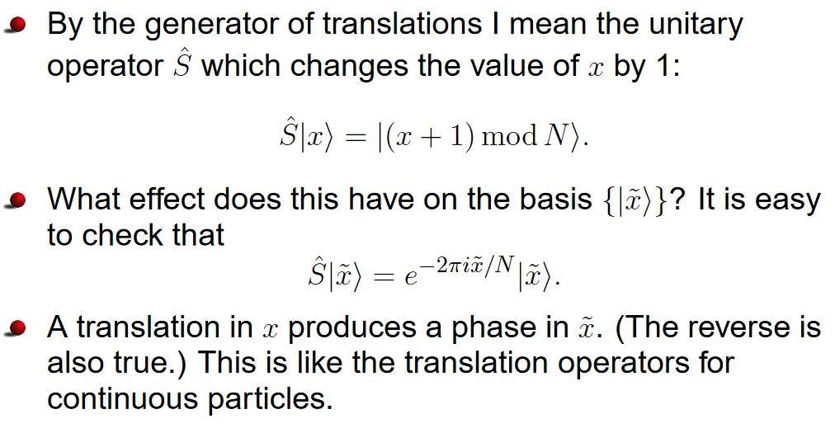
Quantum entanglement & Quantum Computing
4. Quantum Fourier transform

Slide 34
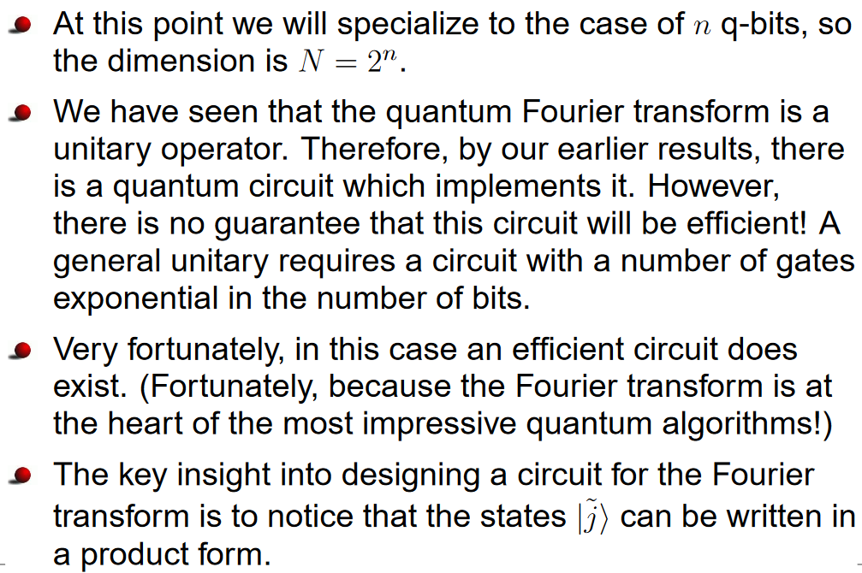
Quantum entanglement & Quantum Computing
4. Quantum Fourier transform

Slide 35
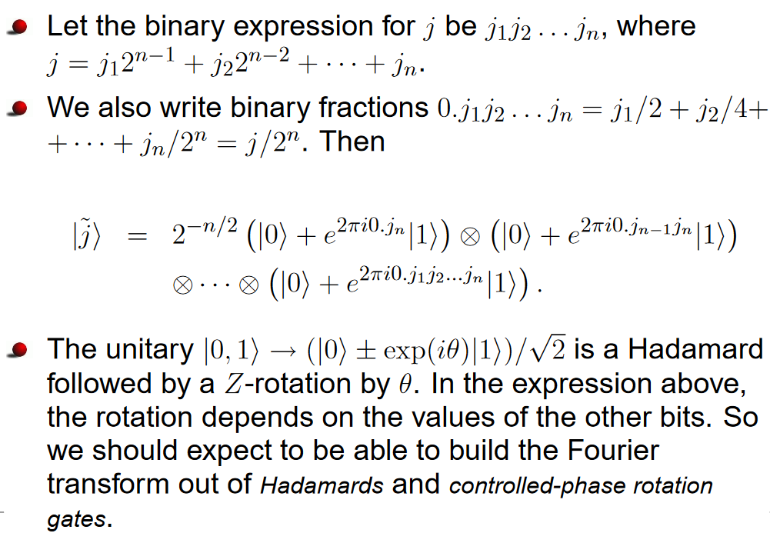
Quantum entanglement & Quantum Computing
4. Quantum Fourier transform

Slide 36
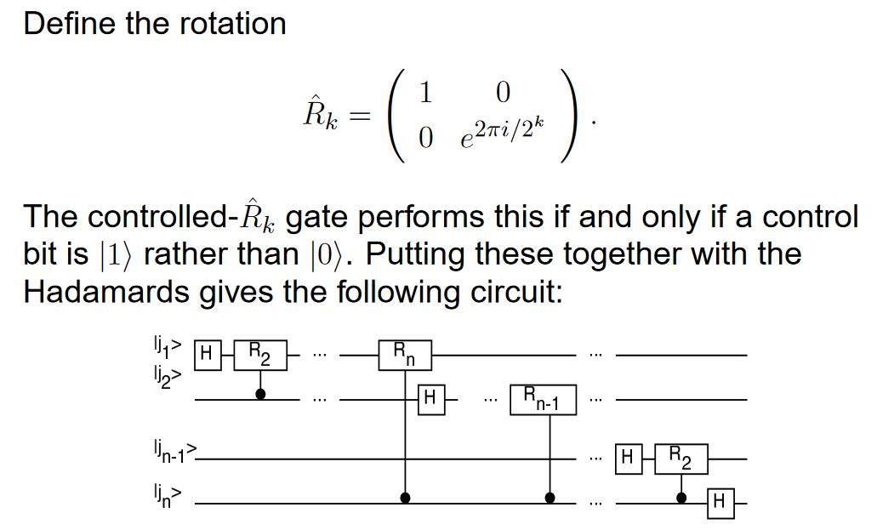
Quantum entanglement & Quantum Computing
4. Quantum Fourier transform

Slide 37
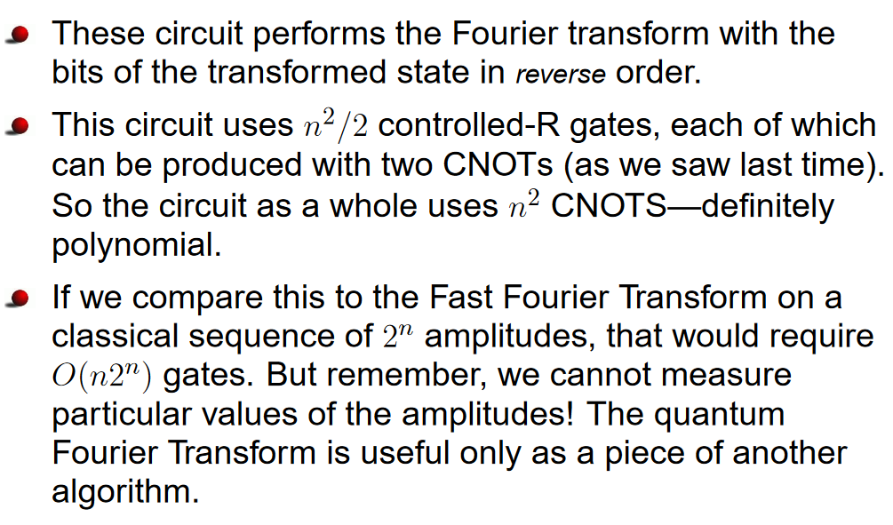
Quantum entanglement & Quantum Computing
4. Quantum Fourier transform

Slide 38

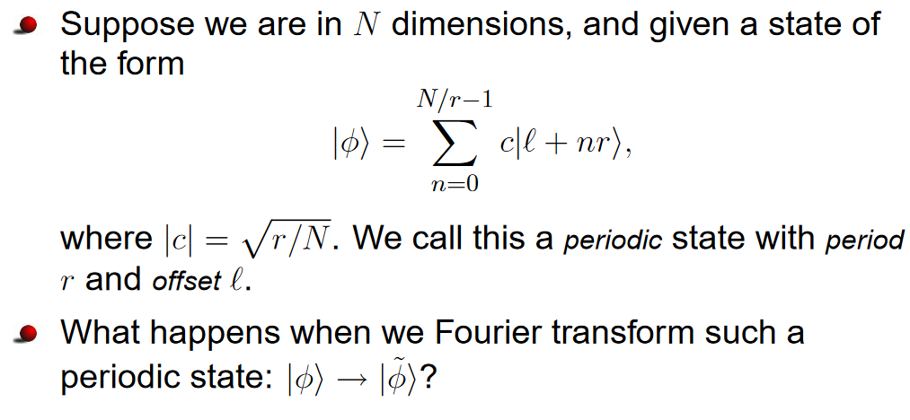
Quantum entanglement & Quantum Computing
4. Quantum Fourier transform

Slide 39
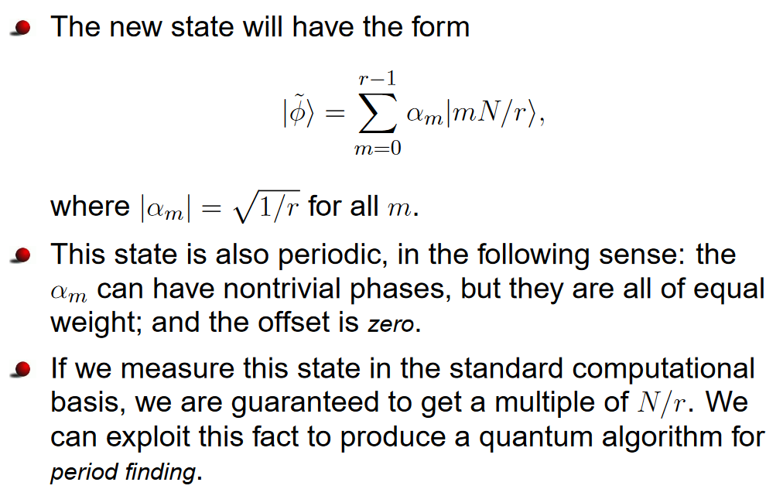
Quantum entanglement & Quantum Computing
4. Quantum Fourier transform

Slide 40

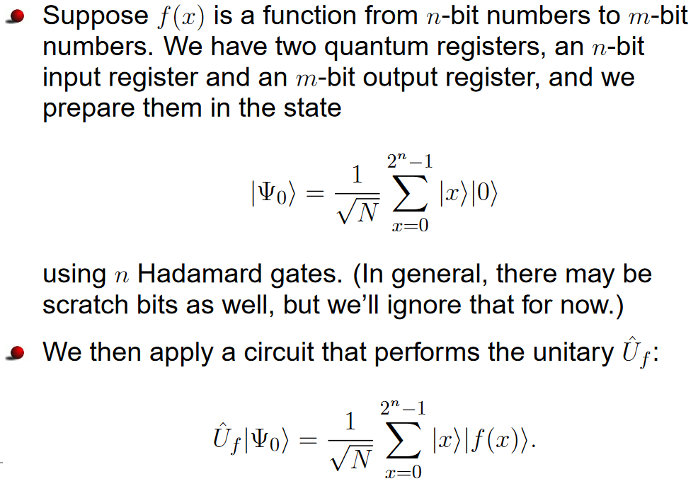
Quantum entanglement & Quantum Computing
4. Quantum Fourier transform

Slide 41
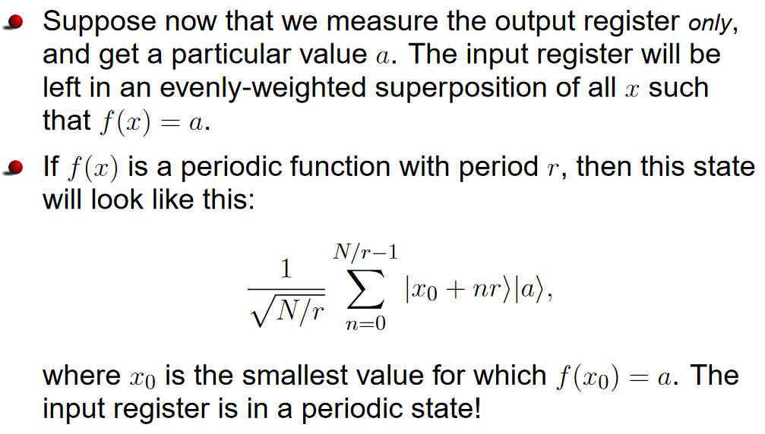
Quantum entanglement & Quantum Computing
4. Quantum Fourier transform

Slide 42

Quantum entanglement & Quantum Computing
4. Quantum Fourier transform

Slide 43

Quantum entanglement & Quantum Computing
4. Quantum Fourier transform

Slide 44

Quantum entanglement & Quantum Computing
4. Quantum Fourier transform

Slide 45

Quantum entanglement & Quantum Computing
4. Quantum Fourier transform

Slide 46

Quantum entanglement & Quantum Computing
4. Quantum Fourier transform
Time and Gate complexity
https://pubs.aip.org/aip/acp/article-abstract/1444/1/465/815455/Time-complexity-and-gate-complexity-of-the-quantum?redirectedFrom=PDF

Slide 47

Quantum entanglement & Quantum Computing
5. Quantum Phase Estimation

Slide 48

Quantum entanglement & Quantum Computing
5. Quantum Phase Estimation

Slide 49


Quantum entanglement & Quantum Computing
5. Quantum Phase Estimation

Slide 50

Quantum entanglement & Quantum Computing
5. Quantum Phase Estimation

Slide 51


Quantum entanglement & Quantum Computing
5. Quantum Phase Estimation

Slide 52

Quantum entanglement & Quantum Computing
5. Quantum Phase Estimation

Slide 53

Quantum entanglement & Quantum Computing
5. Quantum Phase Estimation

Slide 54


Quantum entanglement & Quantum Computing
5. Quantum Phase Estimation

Slide 55

Quantum entanglement & Quantum Computing
5. Quantum Phase Estimation

Slide 56


Quantum entanglement & Quantum Computing
5. Quantum Phase Estimation

Slide 57

Quantum entanglement & Quantum Computing
5. Quantum Phase Estimation

Slide 58


Quantum entanglement & Quantum Computing
6. Shor’s algo

Slide 59

Quantum entanglement & Quantum Computing
6. Shor’s algo
https://kaustubhrakhade.medium.com/shors-factoring-algorithm-94a0796a13b1
https://medium.com/mit-6-s089-intro-to-quantum-computing/a-general-implementation-of-shors-algorithm-da1595694430
Complexity: O(logN)²

Slide 60
Quantum entanglement & Quantum Computing
7. Grover Radhakrishnan vs Grover Korepin
https://arxiv.org/pdf/quant-ph/0407122.pdf
https://arxiv.org/pdf/quant-ph/0504157.pdf

Slide 61
THANK YOU
Dr. Kaustav Bhowmick
Department of Electronics & Communication
Engineering
kaustavbhowmick@pes.edu

