Slide 1
C/C++ Program Design
CS205
Prof. Shiqi Yu (于仕琪)
yusq@sustech.edu.cn
http://faculty.sustech.edu.cn/yusq/

Slide 2
Class Templates

Slide 3
Review: Function Templates
A function template is not a type, or a function, or any other entity.
No code is generated from a source file that contains only template definitions.
The template arguments must be determined, then the compiler can generate an actual function
"Function templates" vs "template functions".
template<typename T>
T sum(T x, T y)
{
cout << "The input type is " << typeid(T).name() << endl;
return x + y;
}
// instantiates sum<double>(double, double)
template double sum<double>(double, double);
// instantiates sum<char>(char, char), template argument deduced
template char sum<>(char, char);
// instantiates sum<int>(int, int), template argument deduced
template int sum(int, int);

Slide 4
Review: Function Templates
Implicit instantiation occurs when a function template is not explicitly instantiated.
template<typename T>
T product(T x, T y)
{
cout << "The input type is " << typeid(T).name() << endl;
return x * y;
}
// Implicitly instantiates product<int>(int, int)
cout << "product = " << product<int>(2.2f, 3.0f) << endl;
// Implicitly instantiates product<float>(float, float)
cout << "product = " << product(2.2f, 3.0f) << endl;

Slide 5
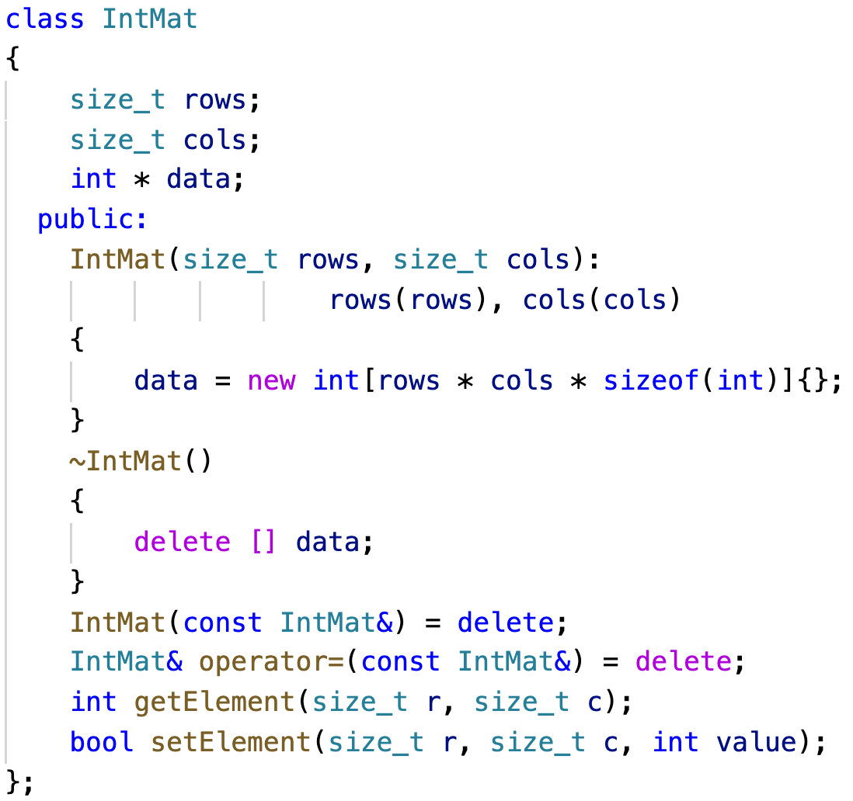
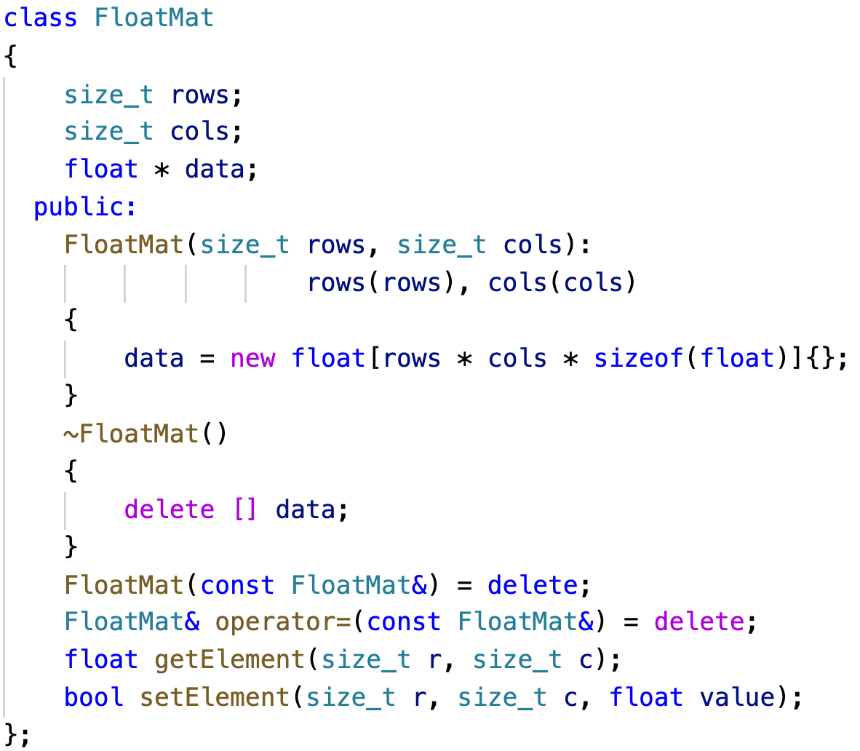
Different Classes for Different Type Matrices
Matrix with int elements, Matrix with float elements
matclass.cpp

Slide 6
Class Templates
A class template defines a family of classes.
Class template instantiation.
// Explicitly instantiate
template class Mat<int>;
template<typename T>
class Mat
{
size_t rows;
size_t cols;
T * data;
public:
Mat(size_t rows, size_t cols): rows(rows), cols(cols)
{
data = new T[rows * cols * sizeof(T)]{};
}
~Mat()
{
delete [] data;
}
T getElement(size_t r, size_t c);
bool setElement(size_t r, size_t c, T value);
};
mattemplate.cpp

Slide 7
Template Non-Type Parameters

Slide 8
Non-Type Parameters
vector<int> vec1;
vector<int, 16> vec2;
To declare a template
The parameters can be
type template parameters
template template parameters
non-type template parameters
integral types
floating-point type
pointer types
lvalue reference types
...
template < parameter-list > declaration

Slide 9
Non-Type Parameters
If we want to create a static matrix (no dynamic memory allocation inside)
template<typename T, size_t rows, size_t cols>
class Mat
{
T data[rows][cols];
public:
Mat(){}
T getElement(size_t r, size_t c);
bool setElement(size_t r, size_t c, T value);
};
int r=3, r=3;
Mat<int> vec1(r, c);
Mat<int> vec2(3, 3);
Mat<int, 3, 3> vec3;
nontypeparam.cpp

Slide 10
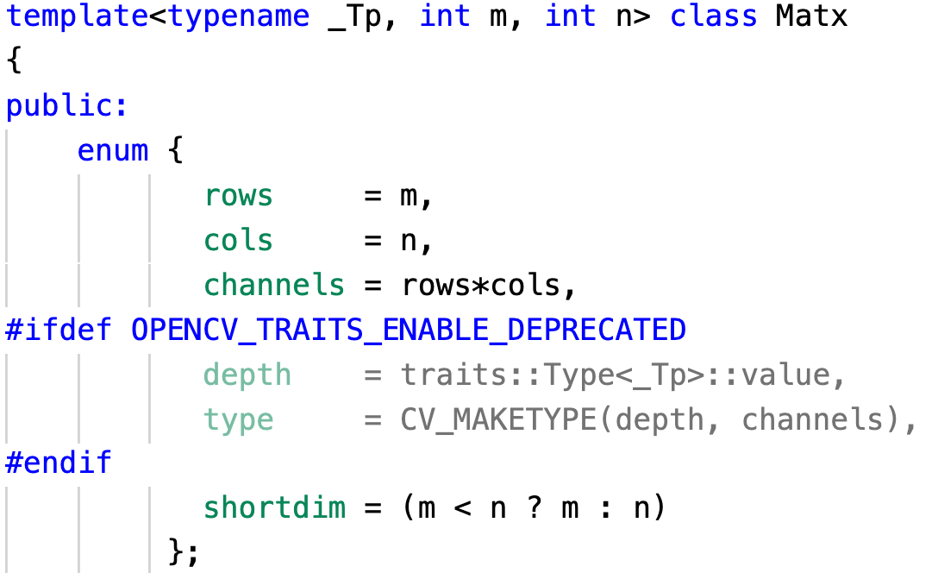
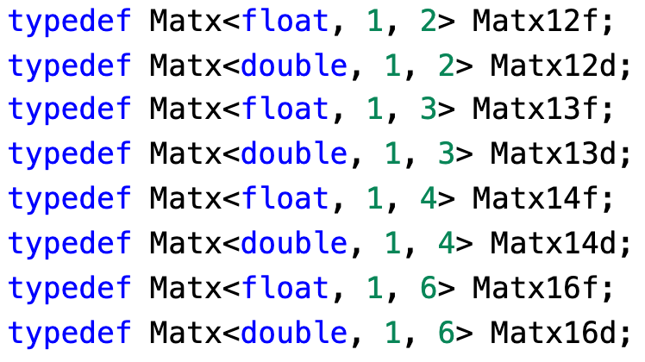
Template in OpenCV

Slide 11
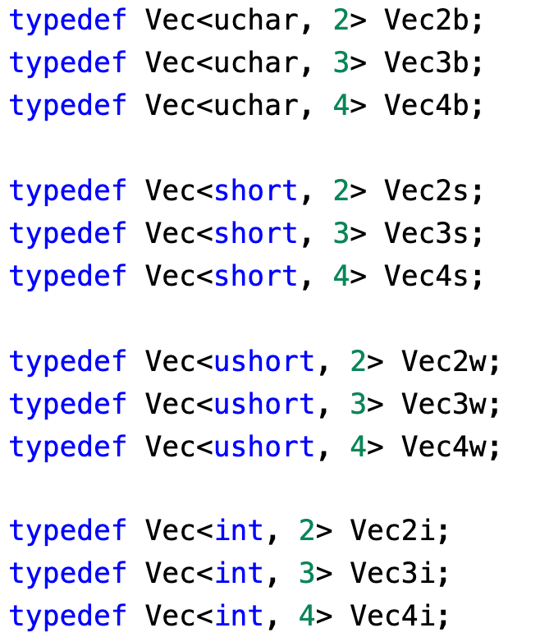
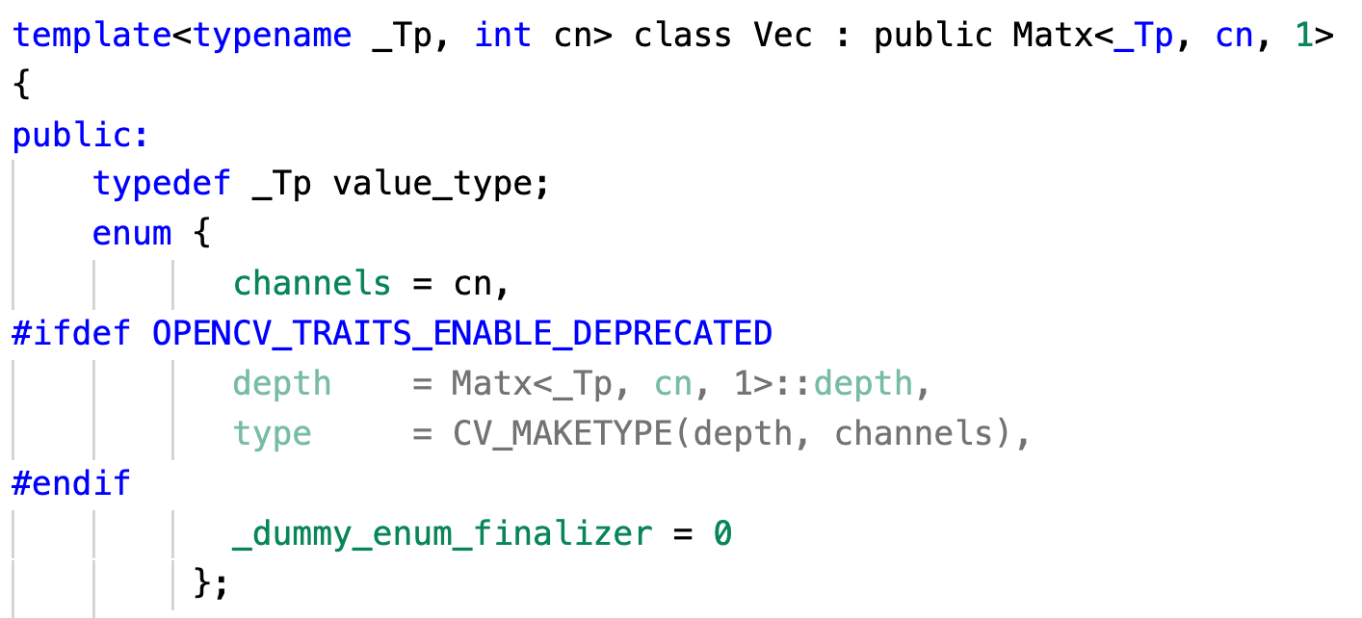
Template in OpenCV

Slide 12
Class Template Specialization

Slide 13
Class template specialization
The class template can be for most types
But we want to save memory for type bool (1 byte or 1 bit).
template<typename T>
class MyVector
{
size_t length;
T * data;
public:
MyVector(size_t length): length(length)
{ data = new T[length * sizeof(T)]{}; }
~MyVector()
{ delete [] data; }
MyVector(const MyVector&) = delete;
MyVector& operator=(const MyVector&) = delete;
T getElement(size_t index);
bool setElement(size_t index, T value);
};

Slide 14
Class template specialization
template<>
class MyVector<bool>
{
size_t length;
unsigned char * data;
public:
MyVector(size_t length): length(length)
{
int num_bytes = (length - 1) / 8 + 1;
data = new unsigned char[num_bytes]{};
}
~MyVector()
{
delete [] data;
}
MyVector(const MyVector&) = delete;
MyVector& operator=(const MyVector&) = delete;
bool getElement(size_t index);
bool setElement(size_t index, bool value);
};
Specialize MyVector for bool
specialization.cpp

Slide 15
std classes

Slide 16
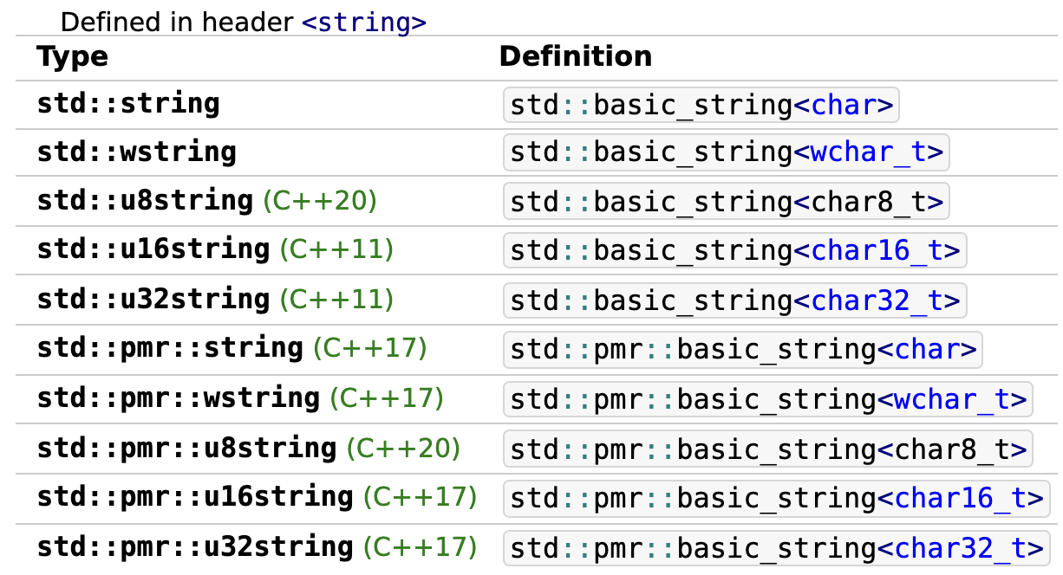
std::basic_string
Store and manipulate sequences of char-like objects.

Slide 17
std::array
a container that encapsulates fixed size arrays.
template<
class T,
std::size_t N
> struct array;
std::array<int, 3> a2 = {1, 2, 3};
*Keyword: typename/class, class/struct

Slide 18
Some other templates
template< class T, class Allocator = std::allocator<T>
> class list;
template< class Key, class Compare = std::less<Key>, class Allocator = std::allocator<Key>
> class set;
template< class T, class Allocator = std::allocator<T>
> class vector;
template< class Key, class T, class Compare = std::less<Key>, class Allocator = std::allocator<std::pair<const Key, T> >
> class map;
template< class T, class Container = std::deque<T>
> class stack;

