Slide 1
C/C++ Program Design
Lab 6, functions
廖琪梅，王大兴

Slide 2
Functions
Function declaration, definition and call
Function parameters and arguments
Function return values
Building shared libraries.

Slide 3
Functions
Functions implements the modularizing a program. It enables the software to reuse, avoiding code repetition and makes the program easier to test, debug and maintain.
Function definition:
function header
return_type function_name (datatype parameter1, datatype parameter2, …)
{
// function body
}
return type: suggests what type the function will return. It can be int,char, string, pointer or even a class object. If a function does not return anything, it is mentioned with void.
function name: is the name of the function, using the function name it is called.
parameters: are variables to hold values of arguments passed while function is called. A function may or may not contain parameter list(void).
A function prototype is required unless the function is defined before it’s used.The simplest way to get a prototype is to copy the function header and add a semicolon.

Slide 4
Function call:
function_name (arguments list);
When a function is invoked, the values of arguments are passed to the parameters one by one according to the order in which the parameters are defined. The program flow proceeds to execute the function body until it encounters a return statement or closed brace at last.

Slide 5
An variable’s scope is where the variable can be referenced in a program. Some identifiers can be referenced throughout a program, others from only portions of a program.
Scope and duration of variable
A variable defined inside a function is referred to as a local variable. A global variable is defined outside functions.
An variable’s storage duration is the period during which that variable exits in memory.

Slide 6
int a;
void main( )
{ …….
…….
f2;
…….
f1;
…….
}
f1( )
{ auto int b;
………
f2;
……..
}
f2( )
{ static int c;
………
}
scope of a
main
f2
main
f1
f2
f1
main
duration of a:
duration of b:
duration of c:
scope of b
scope of c

Slide 7
Parameters and Arguments
A variable that’s used to receive passed values is called a formal parameter or formal argument(or parameter for short). The value passed to the function is called the actual parameter or actual argument(or argument for short).

Slide 8
Actual parameter and Formal parameter
Actual parameters(arguments)
When calling a function, the values of arguments are assigned to the parameters
Formal parameters(parameters)

Slide 9
Passing Parameters
Parameters can be passed in two ways: by value or by reference(or by address).
When you invoke a function with a parameter, the value of the argument is passed to the parameter. This is referred to as pass-by-value, which means the copy of argument is assigned to the parameter. The value of argument is not affected, regardless of the changes made to the parameter inside the function.
For an argument of a pointer or a reference or an array type passing to the parameter is known as pass-by-reference(or by address), the reference or the address of argument is assigned to the parameter, which means both parameter and argument are pointed to the same memory, if you modify the content of parameter inside the function, you will see the same change of the argument outside the function.
Using const pointer(or const reference) in parameter can protect the value of the argument from modifying.

Slide 10
Return value
A function can return a value(primitive type, pointer type, reference type, structure type and so on) to the caller. Use return statement to get the return value in function definition.
Note:
Do not return the address(or reference) of a local variable to the caller.
You can return dynamically allocated memory address or a static array or parameter pointer in the function definition.

Slide 11
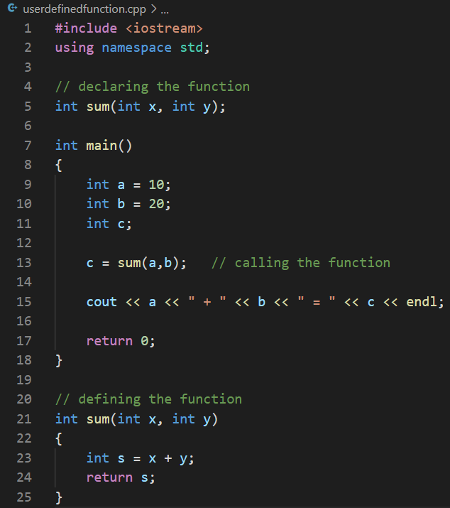
Process of the calling a function:
The values of arguments are assigned to the
those of parameters by the sequence of their
definition from left to right one by one.
The control flows into the function body and
executes the statements inside the body.
When it encounters the return statement, the
control flow returns back to the calling function
with a return value.
30
10
20

Slide 12
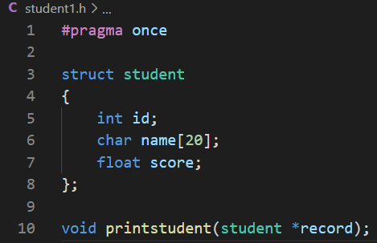
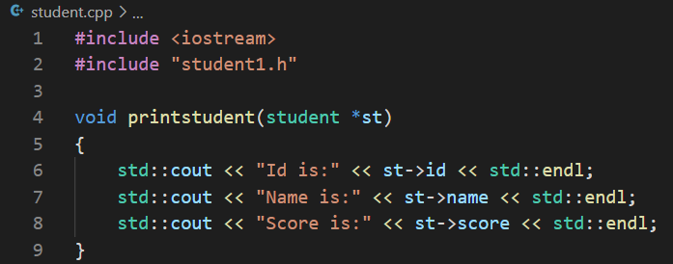
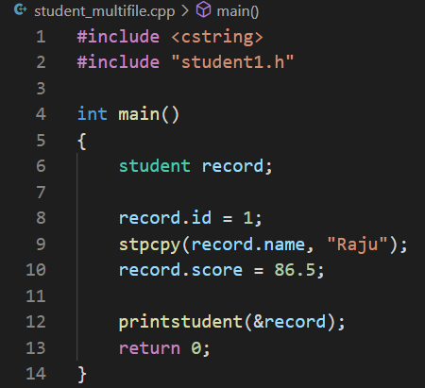
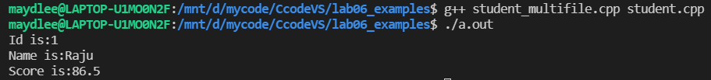
Multiple files
Header file:
const variable or macro definition
structure declaration
function prototype
just include once
When the preprocessor spots an #include directive, it looks for the
following filename and includes the contents of that file within the
current file.
look for file in standard system directories
look for file in your current directory first, and then in the standard system directories.
compile all the source files, with default executable name

Slide 13
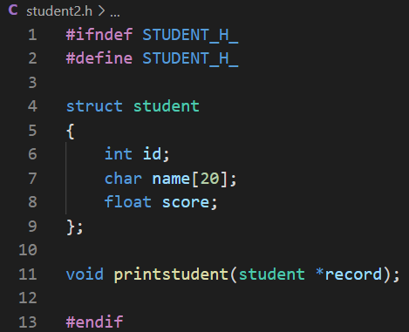
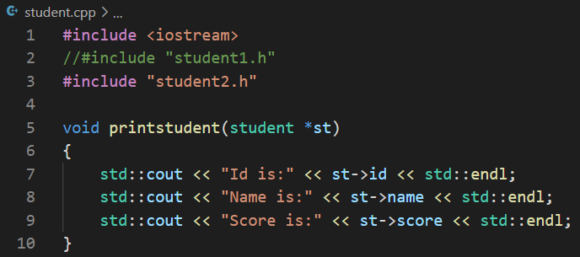
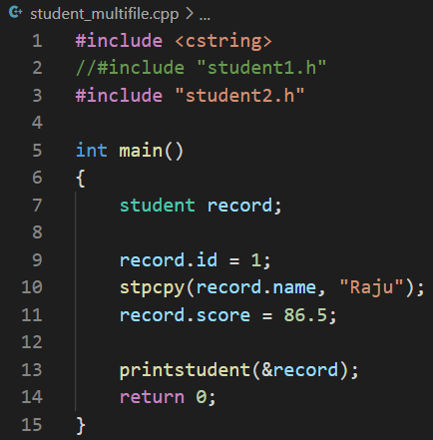

Multiple files
Using conditional compilation directives to avoid duplicate including.
compile all the source files, with a given executable name

Slide 14
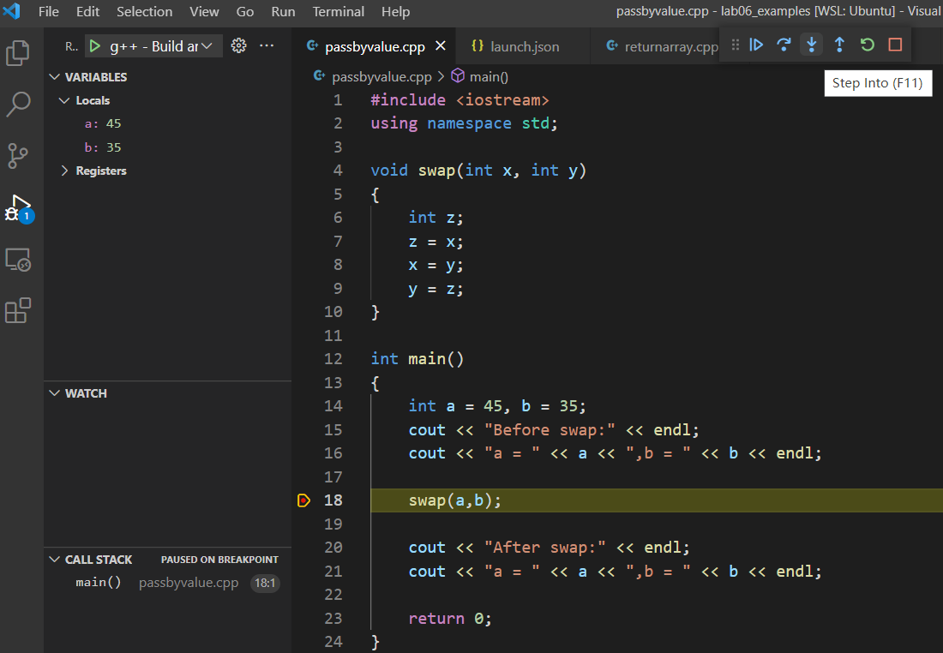
Debugging program inside function by step into
Click the “step into” button
variables in main function
Passing by value
break point

Slide 15
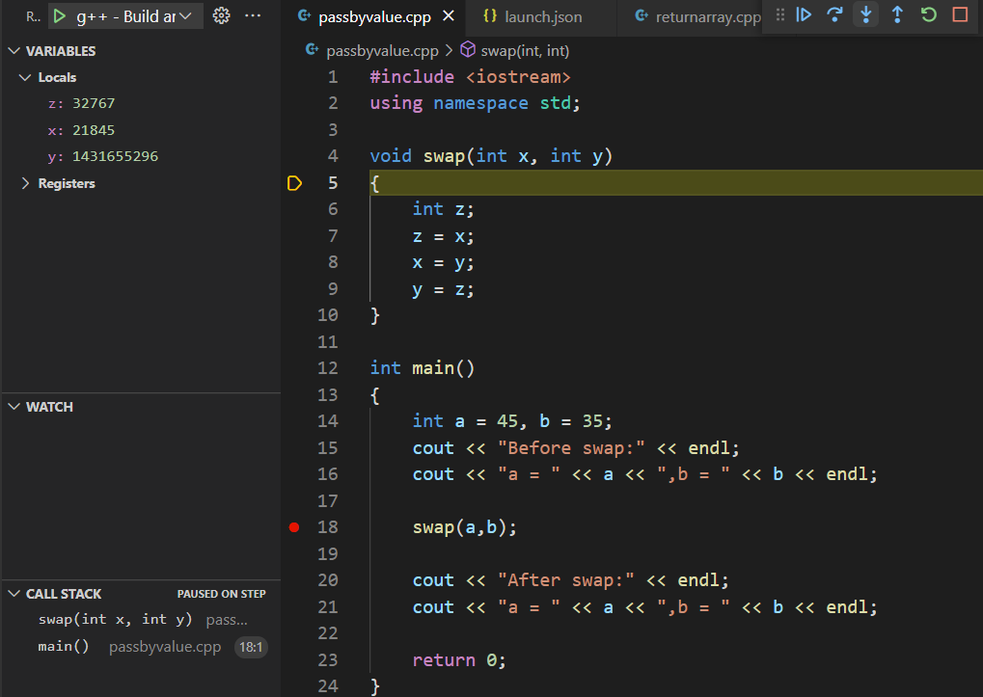
variables in swap function

Slide 16
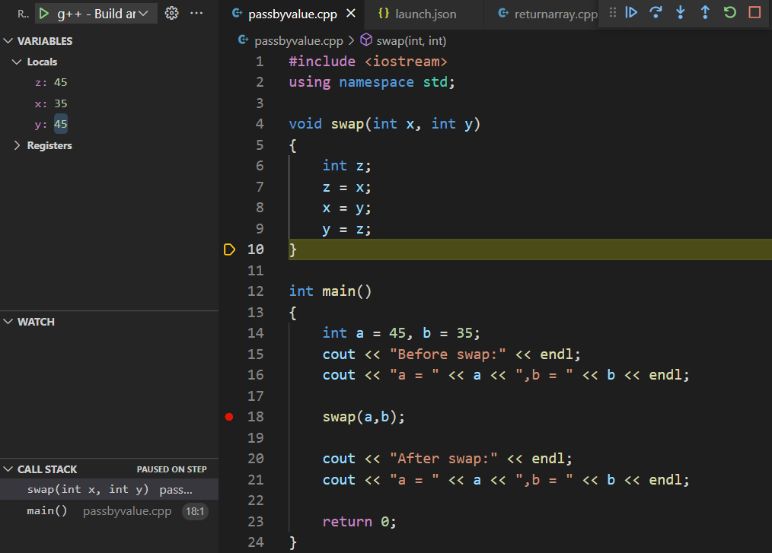
The values of x and y are exchanged, but after swap calling, they are not existed.

Slide 17
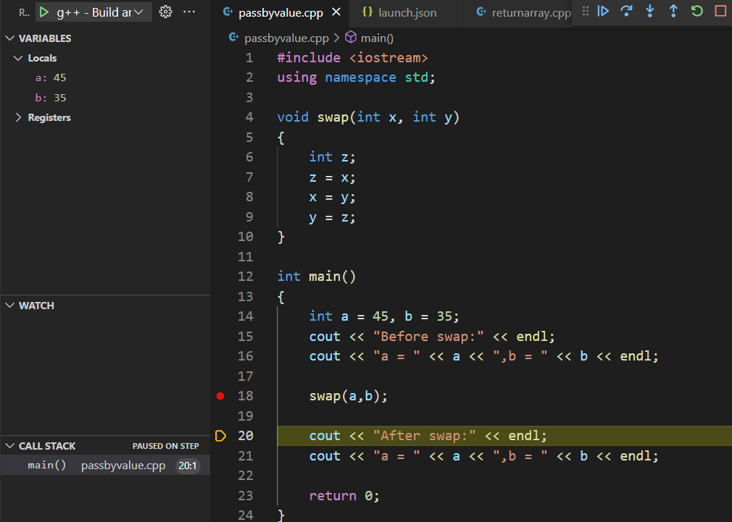
The values of a and b remain unchanged

Slide 18
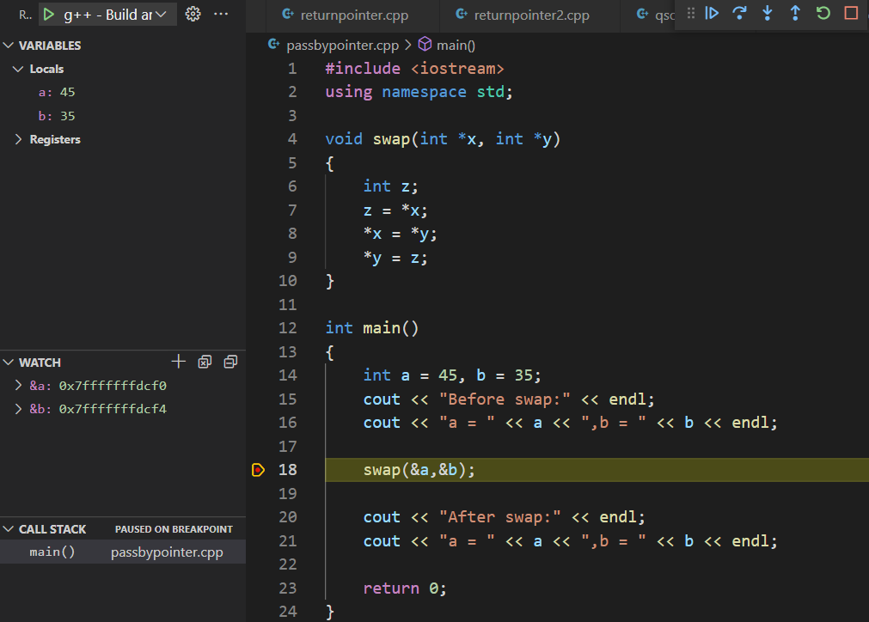
Passing by pointer
The addresses of a and b

Slide 19
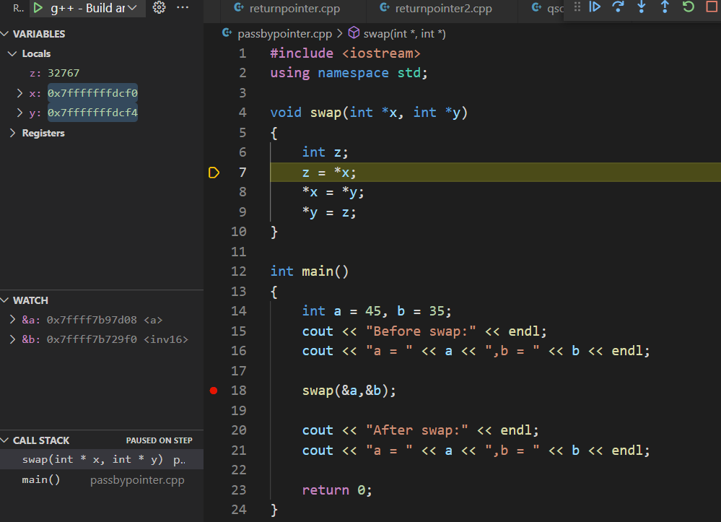
x points to a and y points to b, because their values are the address of a and b respectively.

Slide 20
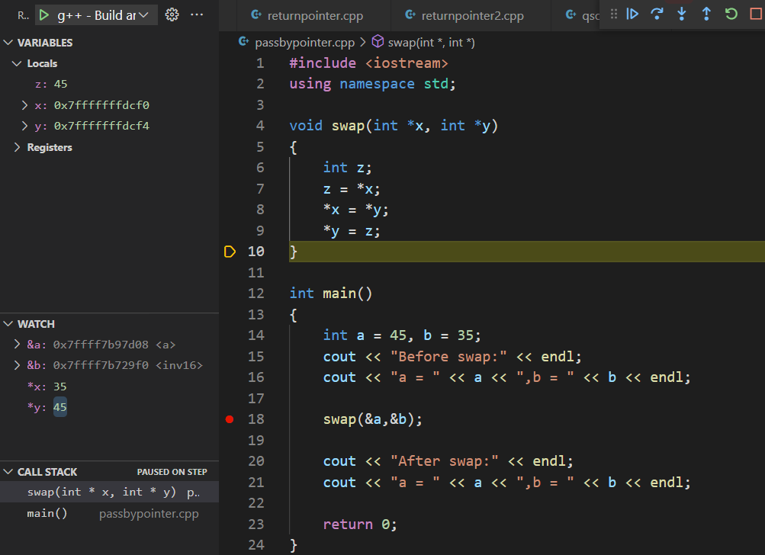
The two values are exchanged in swap function.

Slide 21
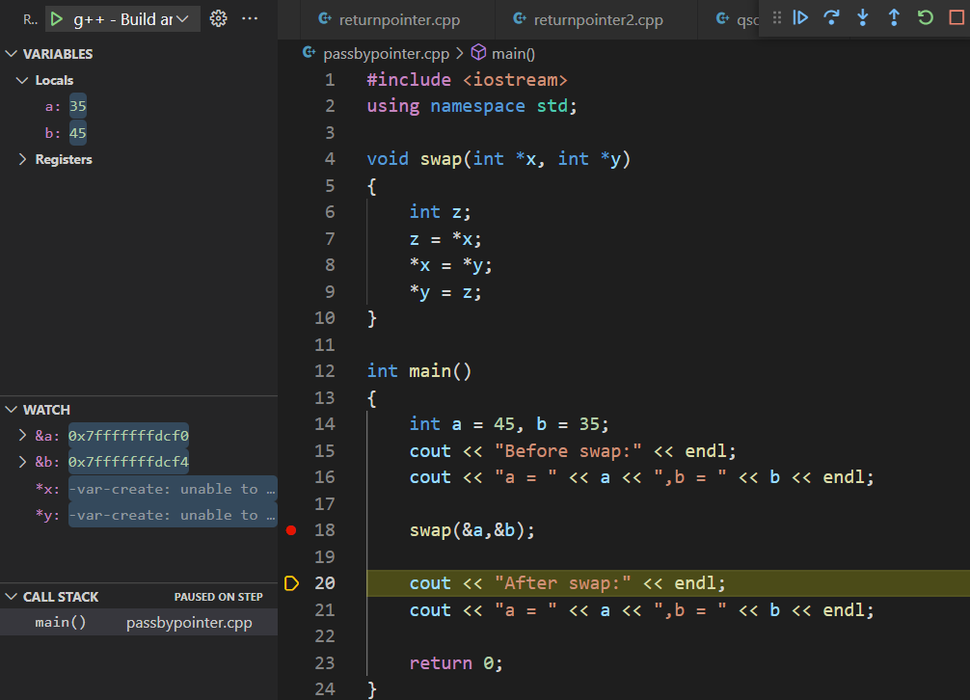
The two values are exchanged after calling swap function.

Slide 22
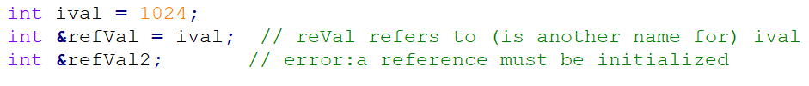

Reference in functions
A reference defines an alternative name (or alias) for an object. A reference type “refer to“
another variable. Using “&” to declare a reference.
Once initialized, a reference remains bound to its initial object. There is no way to rebind a reference to refer to a different object.
After a reference has been defined, all operations on that reference are actually operations on the object to which the reference is bound.

Slide 23
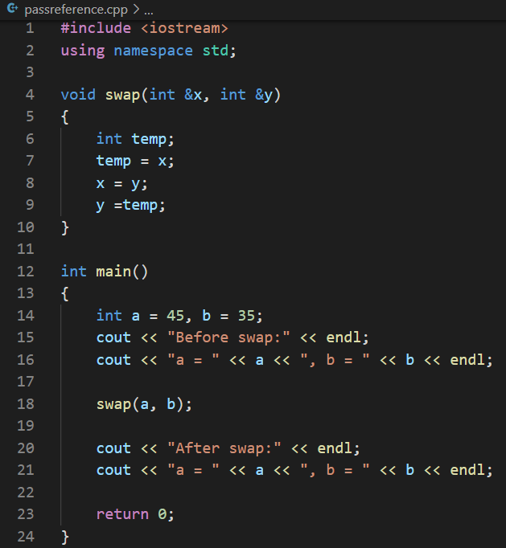

Reference as function parameters –passing by reference
Only by checking the function prototype or function definition can you tell whether the function passing by value or by reference.
In the called function’s body, the reference parameter actually refers to the original variable in the calling function, and the original variable can be modified directly by the called function.
The style of the arguments are like common variables

Slide 24
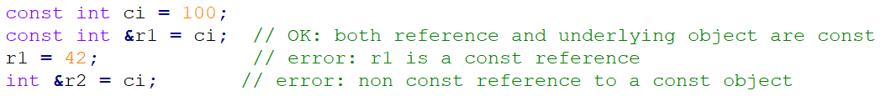
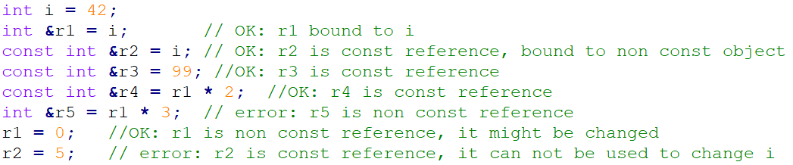
const reference: reference that refers to a const type. A reference to const cannot be used to change the object to which the reference is bound.
The type of a reference must match the type of the object to which it refers. But there are two exceptions to the rule. The one is that a const reference can refer to an non const object. The other is that we can initialize a const reference from any expression that can be converted to the type of the reference.

Slide 25
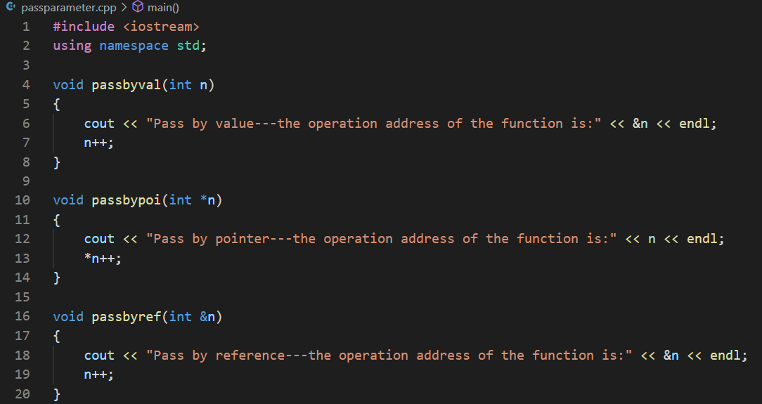
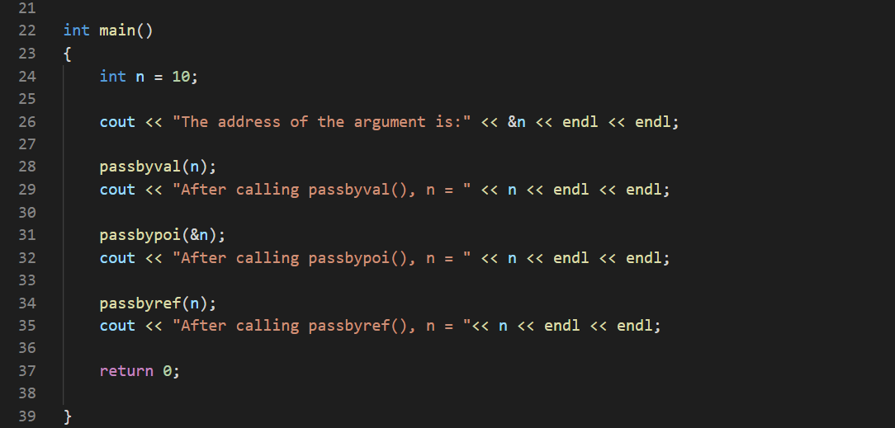
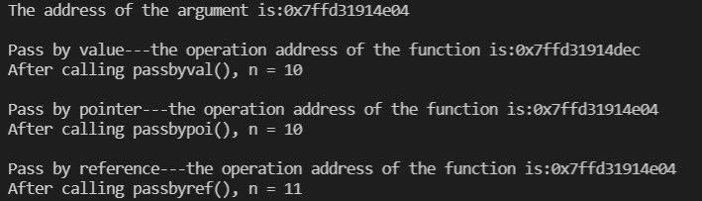
Pass by value
Passing by value, the address that the function operates is not that of the argument; but passing by reference( or pointer ), the function operates the address of argument.
Pass by pointer
Pass by reference
different
the same
the same

Slide 26
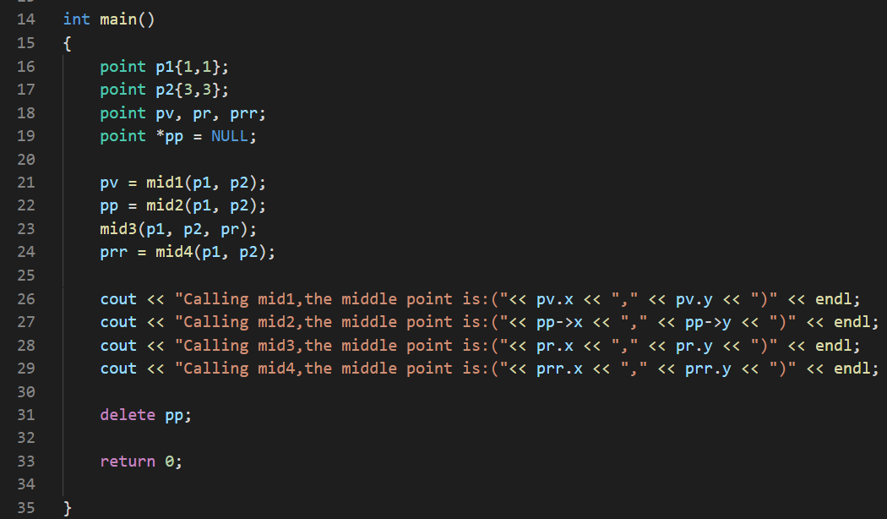
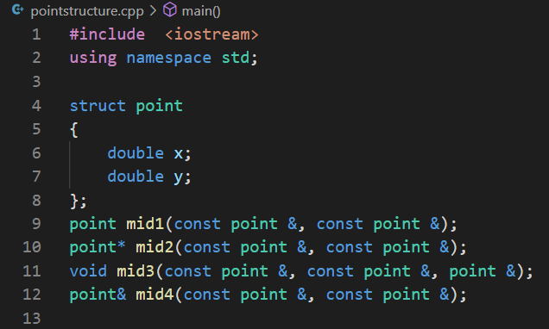
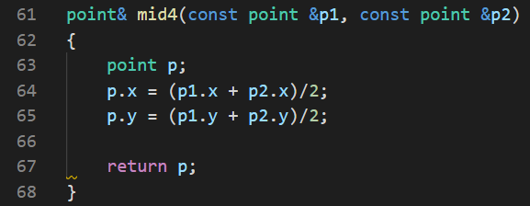
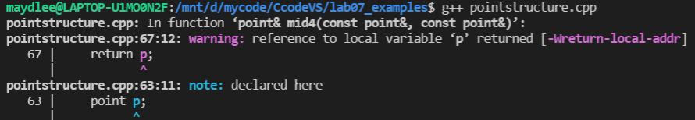
Return a Reference
Do not return a reference of a local variable.
You can return a reference parameter.
The program can not be executed.

Slide 27
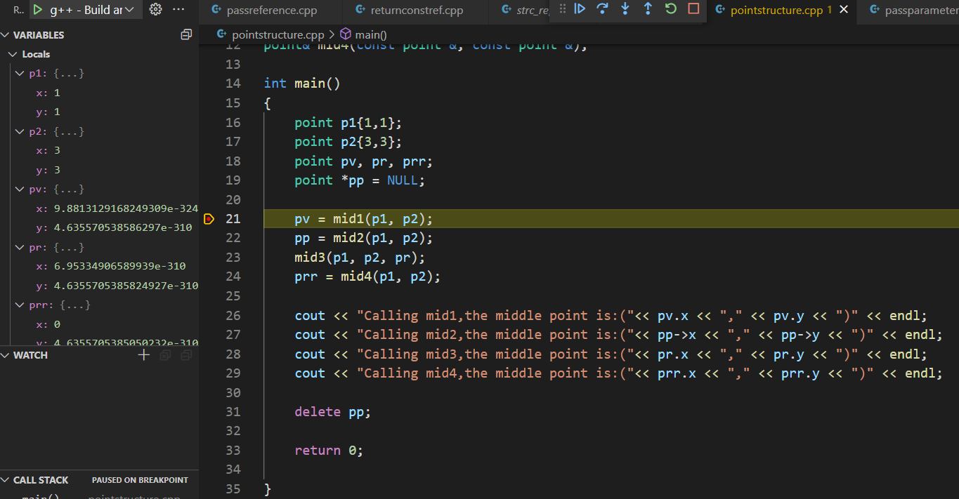

Slide 28
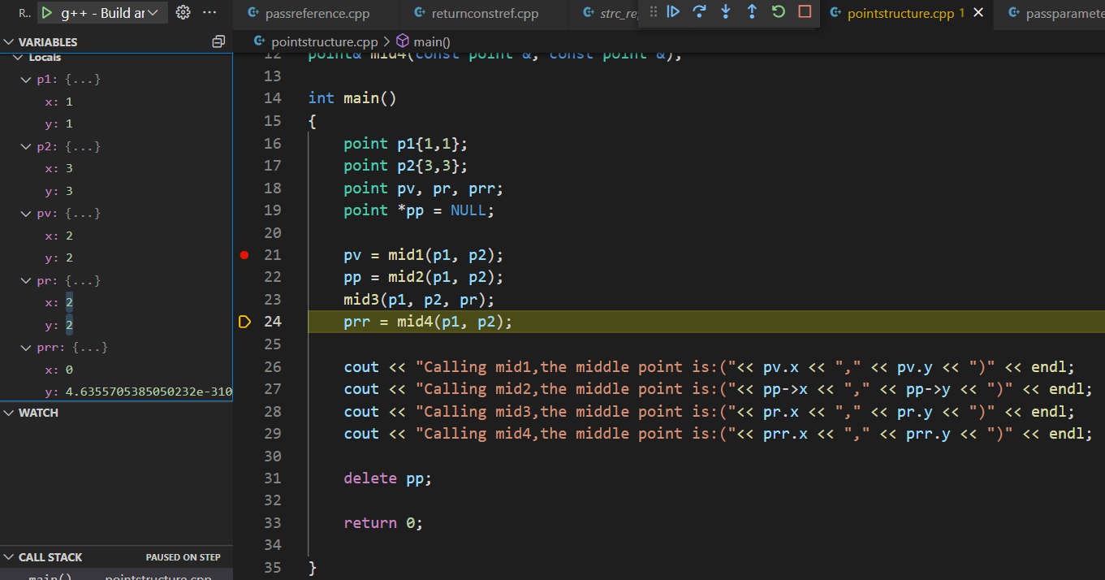

Slide 29
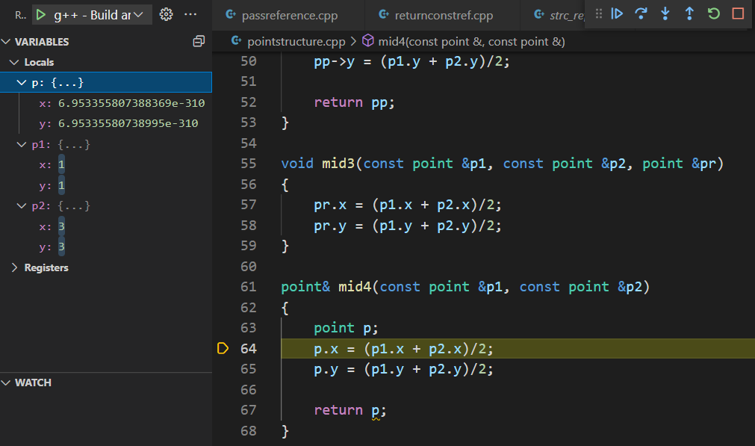

Slide 30
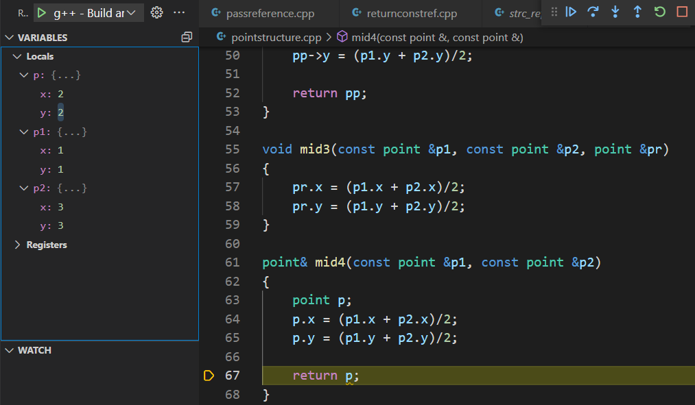

Slide 31
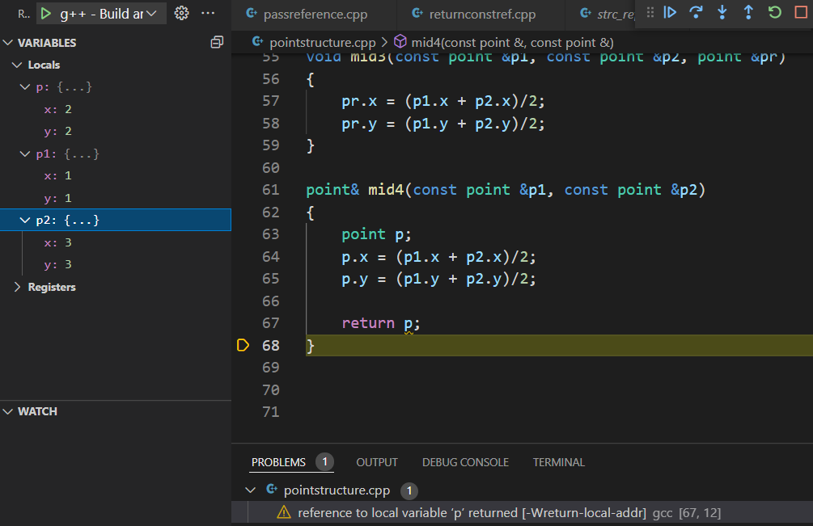

Slide 32
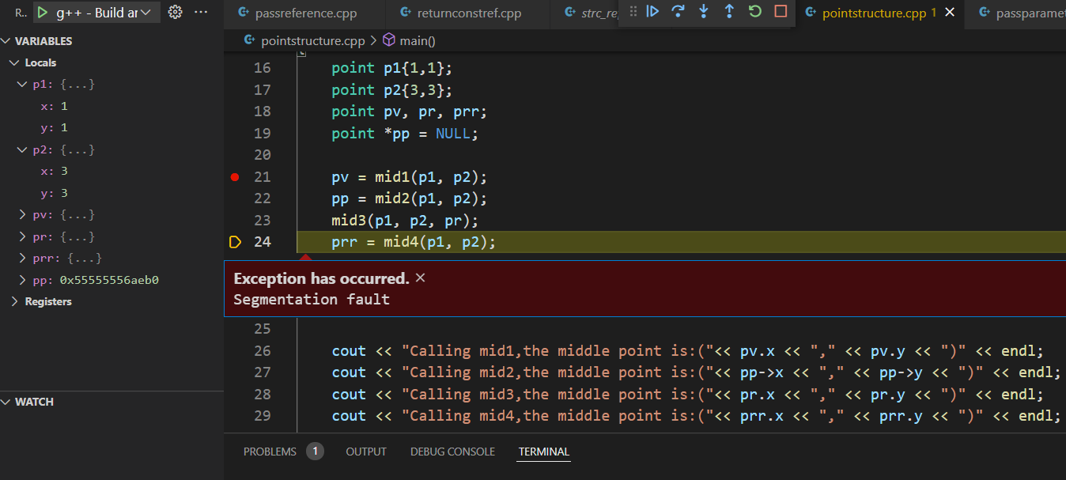

Slide 33
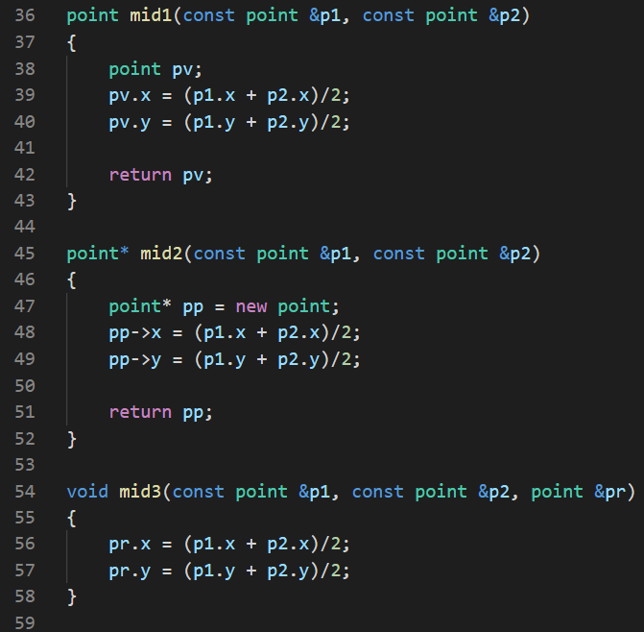
return a local structure variable
is ok, but less efficient
return a local structure pointer
which is allocated memory by
new, is ok.
The function does not return anything.
The third parameter is a reference parameter,
modifying the value of the parameter is exactly
changing that of the argument.

Slide 34
Difference between reference and pointer
The reference must be initialized when it is created; the pointer can be assigned later.
The reference can not be initialized by NULL; the pointer can.
Once the reference is initialized, it can not be reassigned to other variable; a pointer
can be changed to point to other object.
sizeof(reference) operation returns the size of the variable; sizeof(pointer) operation
returns the size of pointer itself.

Slide 35
Building shared libraries
Many compilers allows you to build your functions into shared libraries so that you can use those functions later.
Shared library in linux are .so files.

Slide 36
Building shared libraries
Suppose we have written the following code:
// function.cpp
#include <iostream>
#include "function.h"
using std::endl;
using std::cout;
void printHello() {
cout<<"Hello"<<endl;
}
// function.h
#pragma once
void printHello();
// main.cpp
#include <iostream>
#include "function.h"
int main() {
printHello();
return 0;
}

Slide 37

Building shared libraries
In previous class we do the following:
This will compile the “main.cpp” and “function.cpp” into “main”
And then run “main”

Slide 38

Building shared libraries
Let’s build a shared library:
Remember to use arguments “-shared” and “-fPIC” when building it.
Now we should see “libfunction.so” in the directory

Slide 39

Using shared library
Now we can use “printHello” function with the “.h” header file and the “.so” shared library.
Let’s compile “main” again:
Use “-L.” to tell it to find libraries in current directory.
Use “-lfunction” to tell it to use “libfunction.so”.

Slide 40
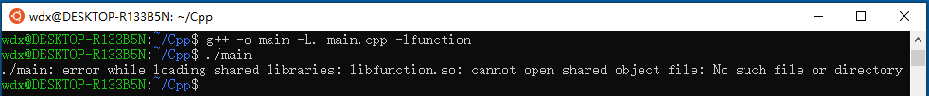
Using shared library
After the “main” has been compiled, try to run it:
It failed because “main” now relys on “libfunction.so”. You must tell the terminal where to find “libfunction.so”.

Slide 41
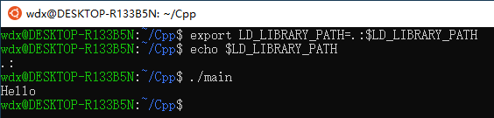

Using shared library
Using export command to set environment variable “LD_LIBRARY_PATH”
And then run “main” again
export LD_LIBRARY_PATH=.:$LD_LIBRARY_PATH
There is no space on either side of the equal sign
. indicates the current directory
Another choice is to move(or copy) your .so file to /usr/lib folder by mv or cp command

Slide 42
Exercise 1
Define three functions that swap two values of integer, please use integer arguments, pointer arguments and reference arguments respectively. Write a test program to call these functions and display the result.
You are required to compile these functions into a shared library “libswap.so”, and then compile and run your program with this shared library.

Slide 43
Exercise 2
Define a function whose prototype is char* match(char* s, char ch);
s is a C-style string, ch is a character. If the ch is in the s, return the position of s at ch; if the ch is not in the s, return NULL.
Write a test program to call the function and show the result. The output sample as follows:

Slide 44
Exercise 3
struct point{
float x;
float y;
};
Here is a structure declaration:
(1) Define a function that passes a point structure by value to set values for two points.
(2) Define another function that passes the address of a point structure to calculate the middle point of two points.
(3) Write a simple program to call these two function and display the results.

