Slide 1
C/C++ Program Design
Lab 2, data types and arithmetic operators
廖琪梅，于仕琪，王大兴

Slide 2
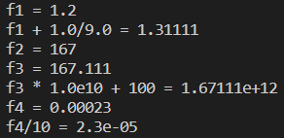
Formatting with cout
Floating-point types are displayed with a total of six digits, except that trailing zeros aren’t displayed. The float number is displayed in fixed-point notation or else in E notation depending on the value of the number. In particular, E notation is used if the exponent is 6 or larger or -5 or smaller.
int main()
{
double f1 = 1.200;
std::cout << "f1 = " << f1 << std::endl;
std::cout << "f1 + 1.0/9.0 = " << f1 + 1.0/9.0 << std::endl;
double f2 = 1.67E2;
std::cout << "f2 = " << f2 << std::endl;
double f3 = f2 + 1.0/9.0;
std::cout << "f3 = " << f3 << std::endl;
std::cout << "f3 * 1.0e10 + 100 = " << f3 * 1.0e10 + 100 << std::endl;
double f4 = 2.3e-4;
std::cout << "f4 = " << f4 << std::endl;
std::cout << "f4/10 = " << f4/10 << std::endl;
return 0;
}

Slide 3
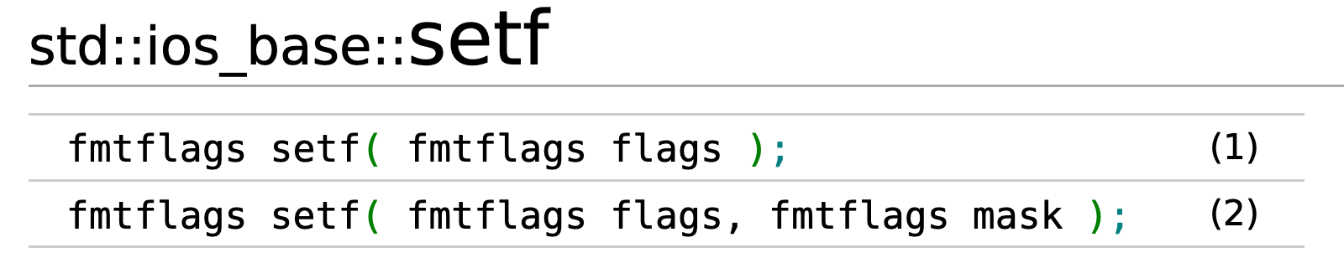
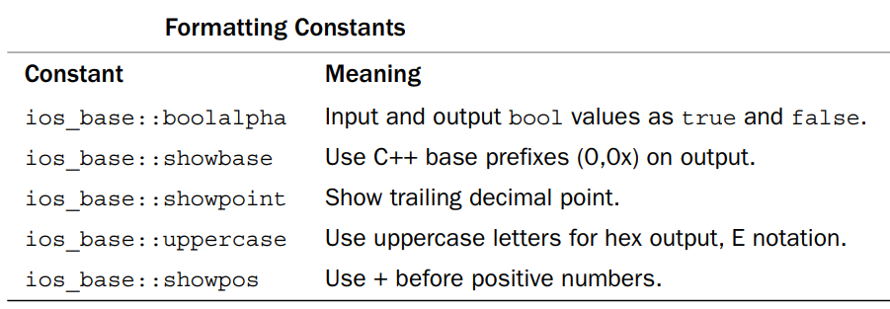
C++ provides two methods to control the output formats
Using member functions of ios class
Using iomanip manipulators
Using member functions of ios class
cout.setf(): The setf() function has two prototypes, the first one is:
cout.set(fmtflags);

Slide 4
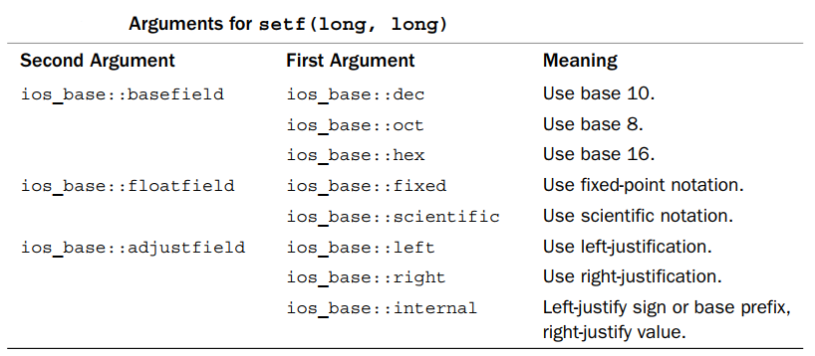
Using member functions of ios class
The second one is:
cout.set(fmtflags,fmtflags);

Slide 5


Using member functions of ios class
2. cout.width(len) //set the field width
3. cout.fill(ch) // fill character to be used with justified field
4. cout.precision(p) // set the precision of floating-point numbers
#include <iostream>
using namespace std;
int main()
{
cout << 56.8 << endl;
cout.width(12);
cout.fill('+');
cout << 456.77 << endl;
cout.precision(2);
cout << 123.356 << endl;
cout.precision(5);
cout << 3897.678485 << endl;
return 0;
}
#include <iostream>
using namespace std;
int main()
{
cout.setf(ios_base::fixed, ios_base::floatfield);
cout << 56.8 << endl;
cout.width(12);
cout.fill('+');
cout << 456.77 << endl;
cout.precision(2);
cout << 123.356 << endl;
cout.precision(5);
cout << 3897.678485 << endl;
return 0;
}
significant digits
precision of
floating number

Slide 6

The effect of calling setf() can be undone with unsef().
#include <iostream>
using namespace std;
#include <iostream>
using namespace std;
int main()
{
bool flag = true;
float f = 0.20f;
cout.setf(ios::showpoint);
cout.setf(ios::boolalpha);
cout << flag << endl;
cout << f << endl;
cout.unsetf(ios::boolalpha);
cout.unsetf(ios::showpoint);
cout << flag << endl;
cout << f << endl;
return 0;
}

Slide 7
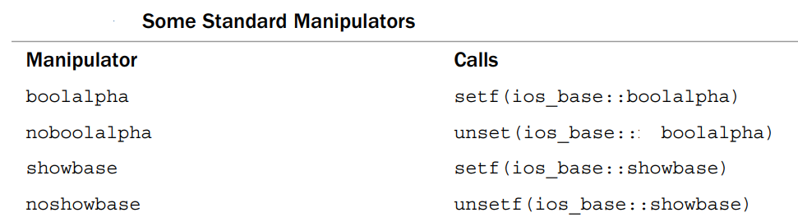
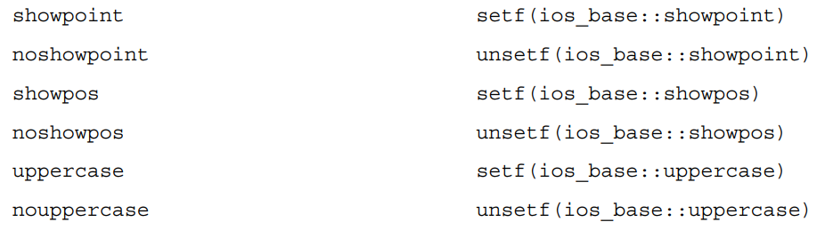
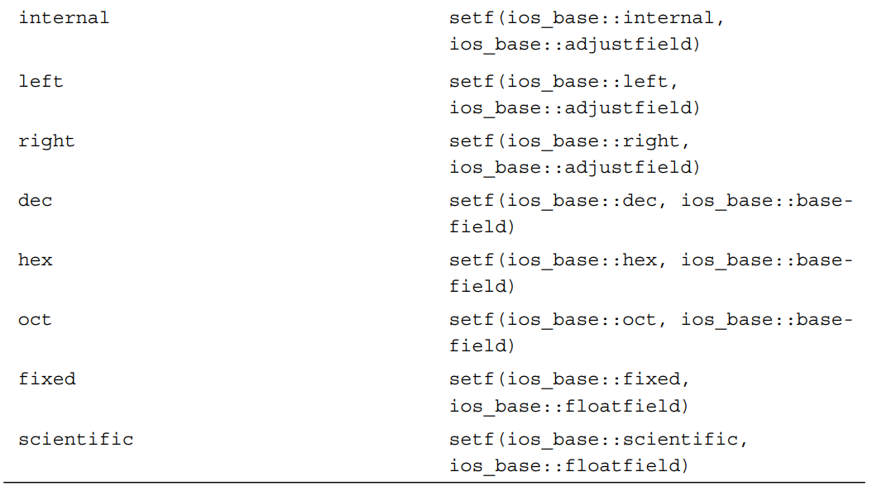
Standard Manipulators
C++ offers several manipulators to invoke setf(),automatically supplying the right arguments.

Slide 8

#include <iostream>
using namespace std;
int main()
{
bool flag = false;
double a = 2.3876;
double b = 0.46e2;
cout << boolalpha << flag << endl;
cout << fixed << a << endl;
cout << b << endl;
cout << noboolalpha << flag << endl;
cout.unsetf(ios::fixed);
cout << a << endl;
cout << b << endl;
return 0;
}

Slide 9
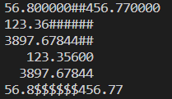
Using iomanip manipulators
#include <iomanip>
1. setw(p) 2. setfill(ch) 3. setprecision(d)
#include <iostream>
#include <iomanip>
using namespace std;
int main()
{
cout.setf(ios_base::fixed, ios_base::floatfield);
cout << 56.8 << setw(12) << setfill('#') << 456.77 << endl;
cout << left;
cout << setw(12) << setprecision(2) << 123.356 << endl;
cout << setw(12) << setprecision(5) << 3897.6784385 << endl;
cout << right;
cout << setw(12) << setfill(' ') << 123.356 << endl;
cout << setw(12) << setfill(' ') << 3897.6784385 << endl;
cout.unsetf(ios_base::fixed);
cout << 56.8 << setw(12) << setfill('$') << 456.77 << endl;
return 0;
}

Slide 10
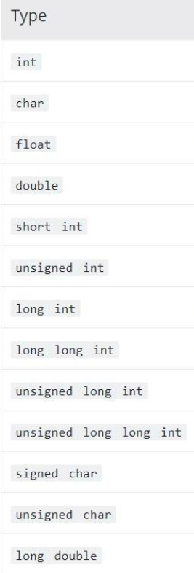
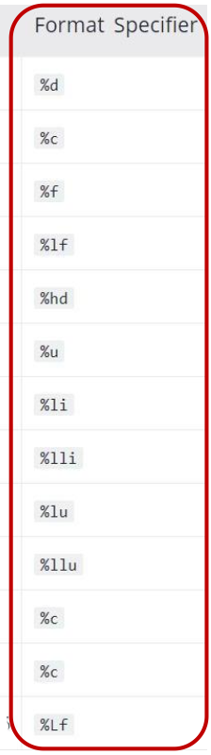
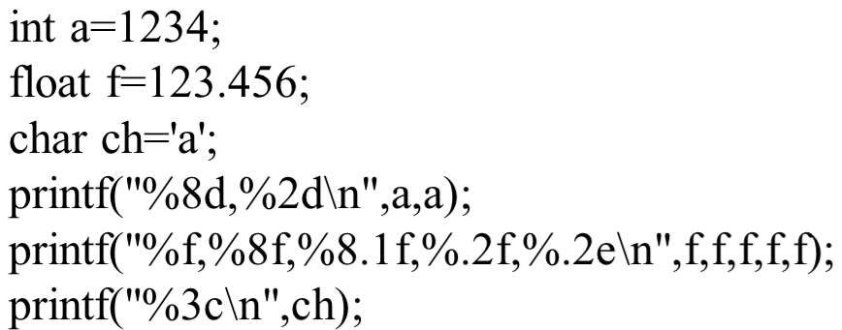
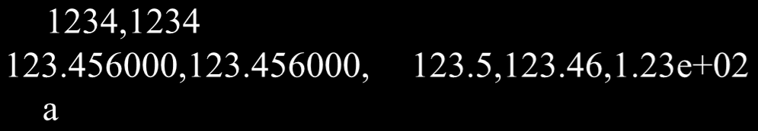
printf() vs cout
Which one do you prefer?
Example:
Sample output:

Slide 11
Exercises
1.Compile and run the following program, what is the result?
You need to explain the reason to a SA to pass the test.
#include <stdio.h>
int main()
{
char a = 127;
unsigned char b = 0xff;
unsigned char c = 0;
a++;
b++;
c--;
printf("a=%d\nb=%d\nc=%d\n",a,b,c);
return 0;
}

Slide 12
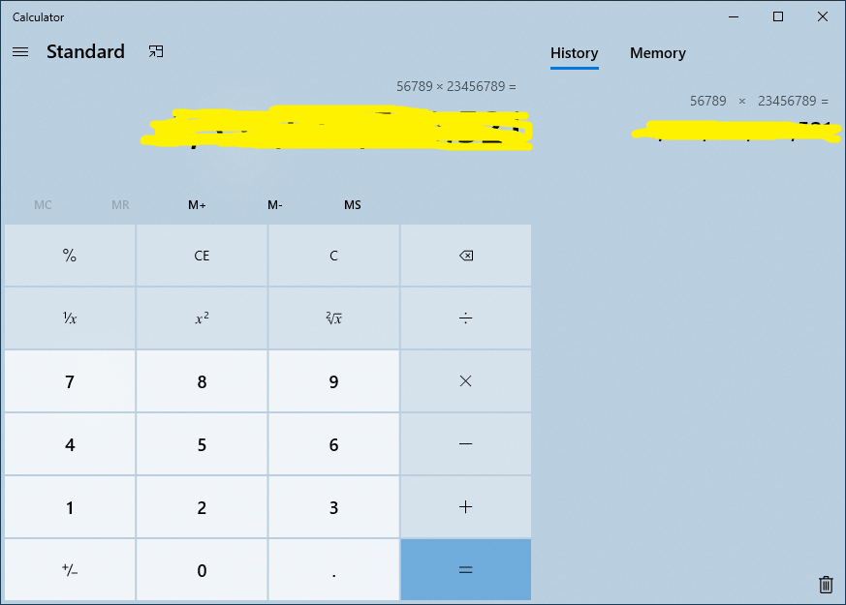
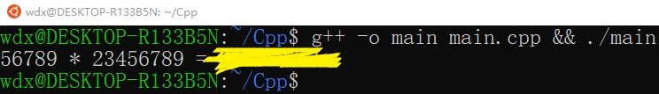
2. Write a program to calculate integer multiplication: 56789 * 23456789, and then print the result. Verify the result using a calculator. If the result is wrong, what could be the reason? How to get the correct result for this exercise? You need to explain the reason to a SA to pass the test.
Exercises

Slide 13
Exercises
3. Run the following source code and explain the result.
You need to explain the reason to a SA to pass the test.
#include <iostream>
using namespace std;
int main()
{
cout << fixed;
float f1 = 1.0f;
cout<<"f1 = "<<f1<<endl;
float a = 0.1f;
float f2 = a+a+a+a+a+a+a+a+a+a;
cout<<"f2 = "<<f2<<endl;
if(f1 == f2)
cout << "f1 = f2" << endl;
else
cout << "f1 != f2" << endl;
return 0;
}

Slide 14
Exercises
#include <iostream>
using namespace std;
int main()
{
int a, b;
double c, d;
a = 19.99 + 21.99;
b = (int)19.99 + (int)21.99;
c = 23 / 8;
d = 23 / 8.0;
cout << "a = " << a << endl;
cout << "b = " << b << endl;
cout << "c = " << c << endl;
cout << "d = " << d << endl;
cout << "0/0= " << 0/0 << endl;
return 0;
}
4. Run the following source code and explain the result. Why the value of a and b are not equal? Explain the division operation with different types.
You need to explain the reason to a SA to pass the test.

Slide 15
Exercises
5. What is the output of the code as follows? What is the meaning of auto when defines a variable in C++?
You need to explain the reason to a SA to pass the test.
#include <iostream>
int main()
{
auto a = 10;
a = 20.5;
a += 10.5;
std::cout << a << std::endl;
return 0;
}

