Slide 1
DNA存储解码课程设计

Slide 2
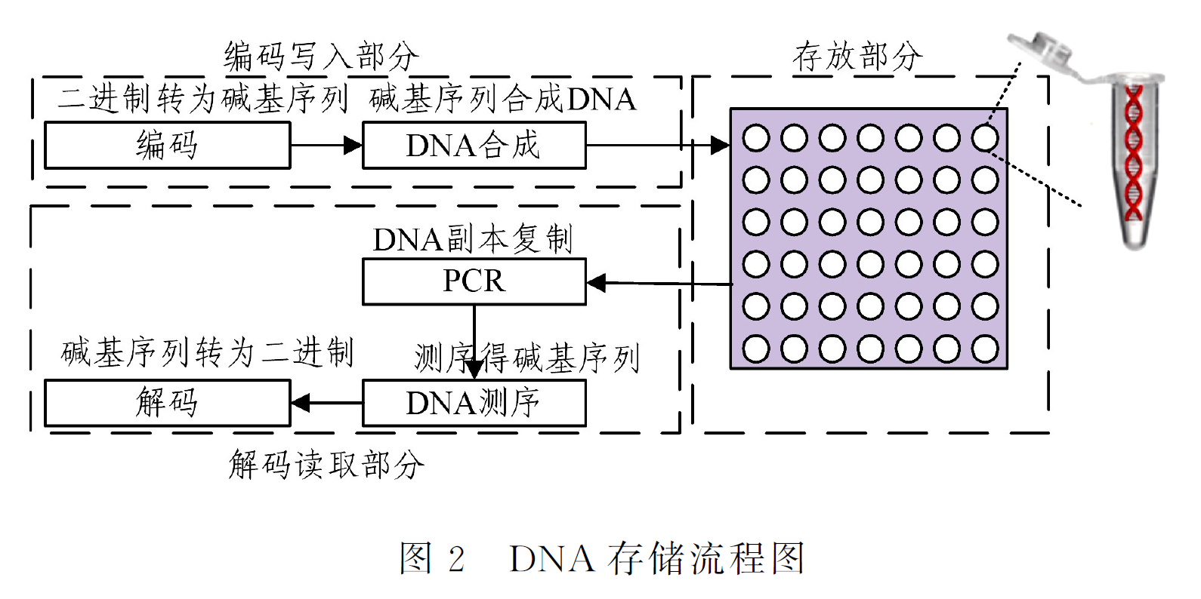
DNA存储系统概述

Slide 3
DNA存储系统概述
相比于传统存储系统的优势：
1）存储密度大、2）能耗低、3）存储周期长、等等
未来工程应用需要解决的问题—DNA测序的碱基错误:
DNA测序存在碱基测序错误（10%-30%乃至更高的错误）
碱基测序错误包括：
替换错误 （DNA测序序列中一个或者多个碱基被替换为其它碱基）
插入错误 （DNA测序序列插入一个或者多个不存在的碱基）
删除错误 （DNA测序序列中一个或者多个碱基被删除）

Slide 4

编码方案
神奈川冲浪编码方案： 2504条序列长度100碱基，地址16碱基，数据64碱基，Reed-Solomon编码20碱基，文件切割成1494条编码片段。该编码特点是只需要2025条序列就可解码，每条序列可以检测出20个替换错误，纠正10个替换错误。
Inner Code：
Reed-Solomon
第1条
Seed
Data
RS Code
16nt
64nt
20nt
Outer Code：
LT Code
第2504条
Seed
Data
RS Code
16nt
64nt
20nt

Slide 5
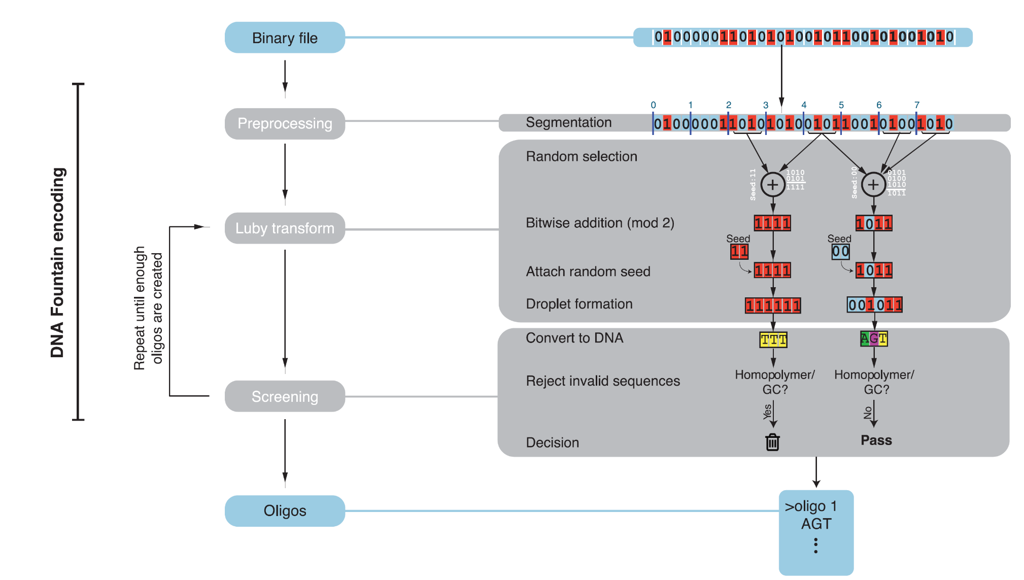
编码方案
- Erlich, Yaniv, Zielinski, et al. DNA Fountain enables a robust and efficient storage architecture.[J]. Science, 2017.
- Erlich Y , Zielinski D . Capacity-approaching DNA storage. 2016.

Slide 6
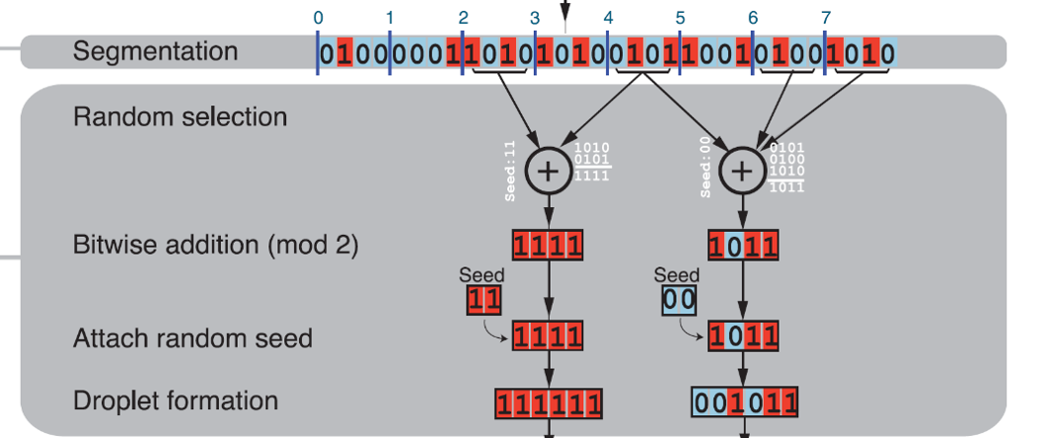
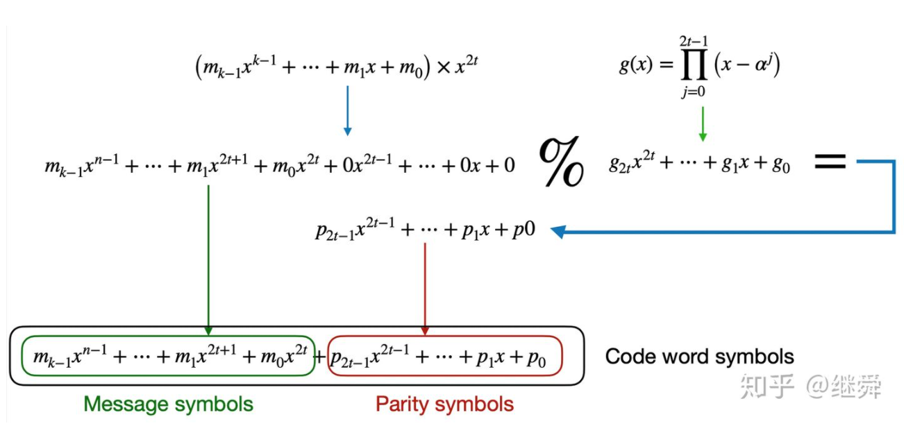
编码方案
Outer Code: LT Code
Inner Code: Reed Solomon Code
- M. Luby, “LT-codes,” in Proc. 43rd Annu. IEEE Symp. Foundations of Computer Science (FOCS), Vancouver, BC, Canada, Nov. 2002, pp. 271–280.
- Mceliece R J . The theory of information and coding:a mathematical framework for communication[M]. Addison-Wesley Pub. Co. Advanced Book Program, 1977.
LT Code
Reed-Solomon Code

Slide 7
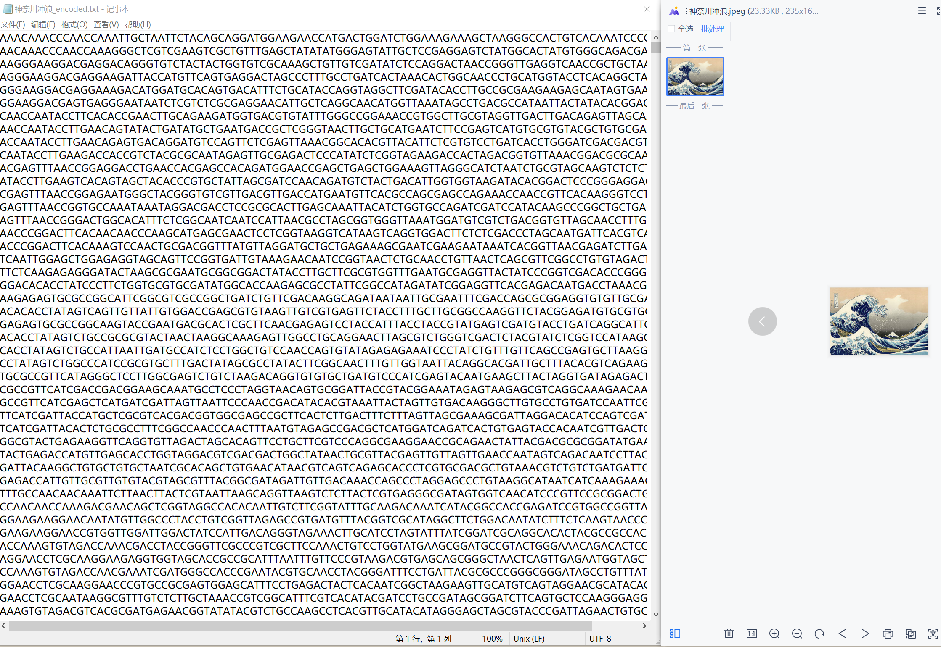
编码结果
DNA编码结果：

Slide 8
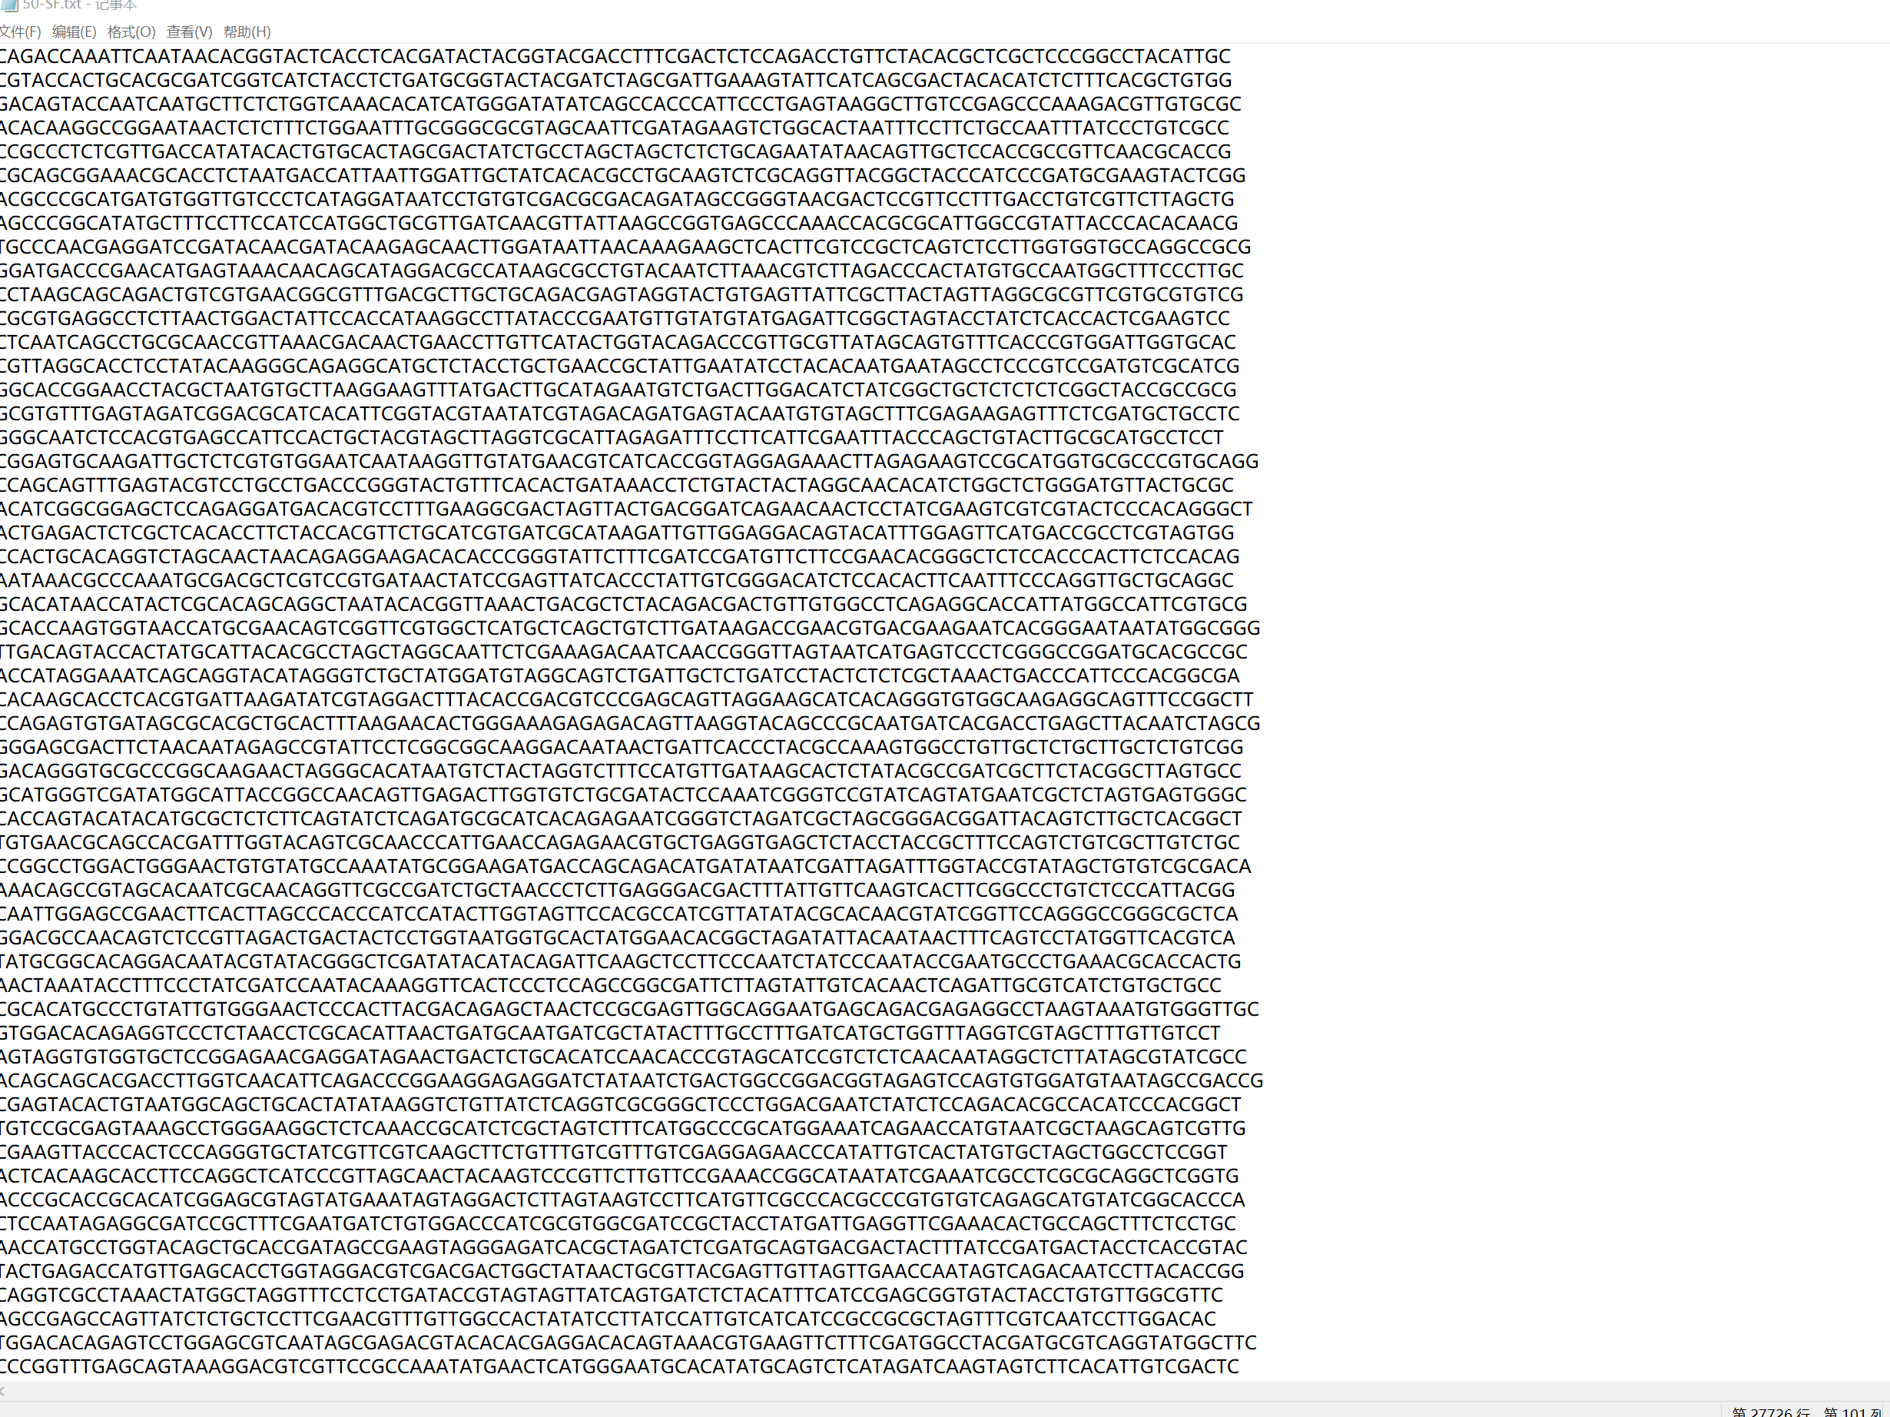
DNA测序
对DNA存储系统中储存的DNA进行测序，我们得到了文件“50-SF”文件，它包括27726个测序序列，这些序列包含了神奈川冲浪全部的信息。同时，测序结果存在插入，删除，替换错误。

Slide 9
解码方案
Divided into 3 steps: Preprocessing, droplet recovery, and segment inference
Preprocessing
Droplet Recovery
Segment Inference

Slide 10
Preprocessing
Stitch the paired-end reads using PEAR
Retain only sequences whose length is 60/100nt
Collapse identical sequence and store the collapsed sequence and number of occurrences in the data
Sort the sequences based their abundance
[1]Zhang, Jiajie, Kobert, et al. PEAR: a fast and accurate Illumina Paired-End reAd mergeR.[J]. Bioinformatics, 2014.

Slide 11
Droplet Recovery
Translating {A,C,G,T} to {0,1,2,3}
Extract Seed, data payload, and the RS code from the sequence
Exclude the sequence with error, which is founded by RS code
Attempt to correct the substitution error with RS code
By adding t check symbols to the data, a Reed-Solomon code can detect any combination of up to and including t erroneous symbols, or correct up to and including $\left\lfloor t/2\right\rfloor$symbols - Wikipedia

Slide 12
Segment Inference
Generate a list of segment identifiers
Run a message passing algorithm, which works as follows:
If the droplet contains inferred segments, the algorithm will XOR these segments from the droplet and remove them from the identity list of droplet
If the droplet has only one segment left in the list, the algorithm will set the segment to the droplet’s data payload
Recursively propagate the new inferred segment to all previous droplets until no more updates are made
If the file is not recovered, the decoder will move to the next sequence in the file and execute the droplet inference and segment inference

Slide 13
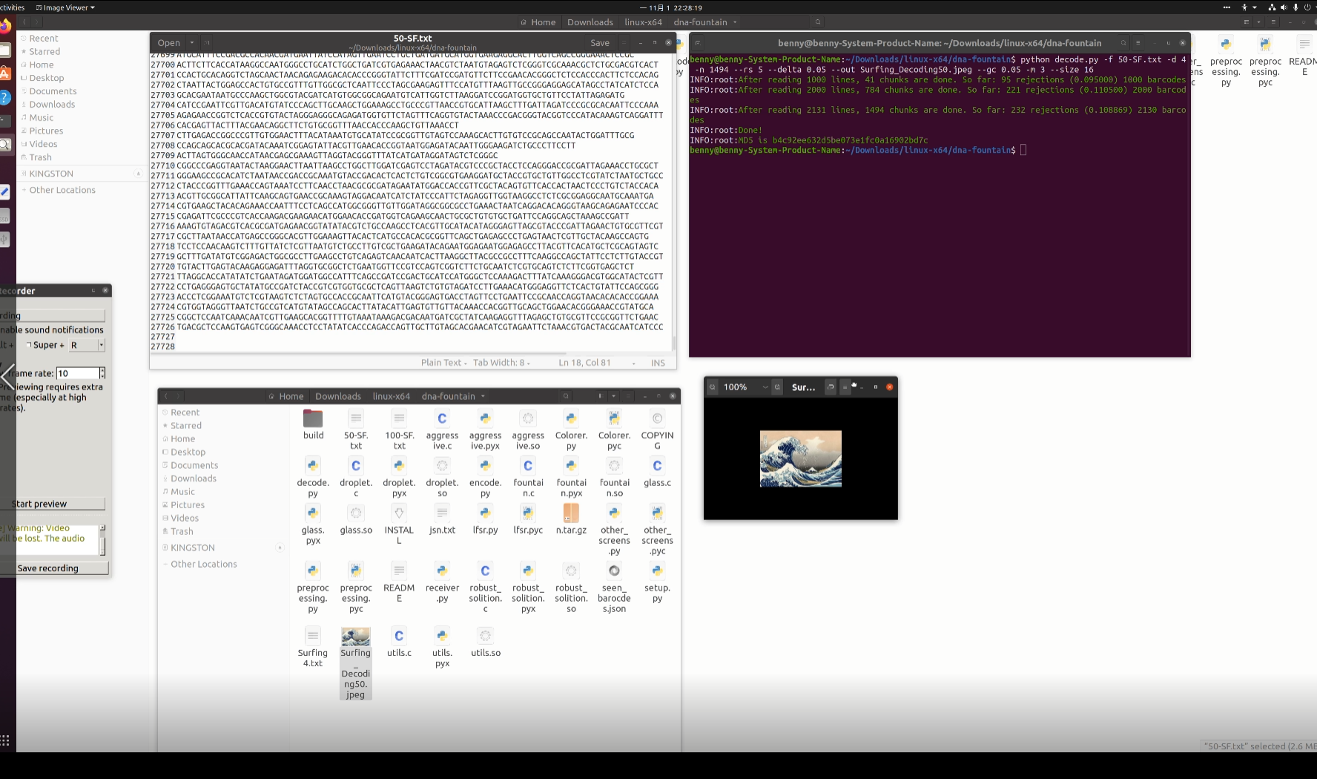
解码结果

Slide 14
课程设计
设计解码程序对DNA编码测序文件“50-SF”进行解码
成功恢复出神奈川冲浪图片

