Slide 1






AI-BASED JOB INTERVIEW ANALYZER
Presented by: Binary Bandits
Authors:
Ambar Roy
Adrija Majumder
Nilanjan Bhattacharya
Under the guidance of:
Prof. Bipasha Mahato
Department: CSE(AIML)
IEM, Kolkata

Slide 2
CONTENTS
Introduction
Literature review
Dataset Description
Proposed Methodology
Performance-based Study
Challenges
Results
Future Scope
Conclusion
References

Slide 3

INTRODUCTION
Employment competition in the current world has become stiff and time-conscious and this has made the process of hiring personnel to take the following facets. Among these innovations, the AI-based job interview analyzers have turned out to be powerful to assess candidates in a better way.
In addition, the new job interview analyzer based on artificial intelligence contains the elements of machine learning that can reveal micro-facial expressions which are the reaction of the interlocutor in response to certain questions. These together with the analysis of the vocal characteristics allows the system to identify the lack of consistency or the presence of stress points in the candidate’s answers.

Slide 4
LITERATURE REVIEW
Edge detection algorithms like Canny or Sobel are used to analyze body posture and movement in an AI-based job interview analyzer. By detecting contours and shapes in the candidate’s body from the webcam feed, the system identifies gestures such as leaning forward (indicating interest) or crossed arms (suggesting discomfort). Movement patterns, such as quick, repetitive motions, can indicate nervousness, while steady movements suggest confidence. Combined with facial expression and voice tone analysis, this method provides a comprehensive evaluation of the candidate’s emotional state and behavior. This information helps recruiters make more informed decisions by understanding the candidate's demeanor and character during the interview.

Slide 5

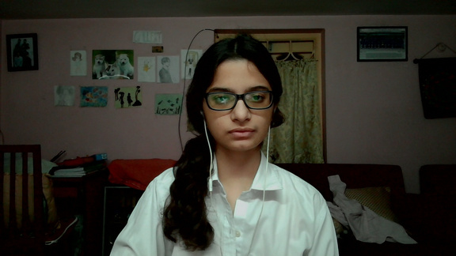
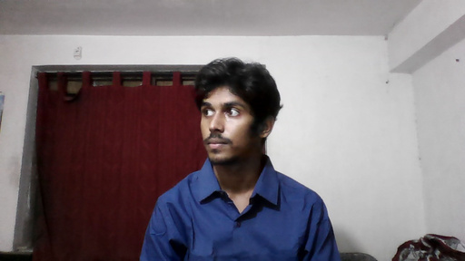
DATASET DESCRIPTION
Due to the unavailability of a suitable public dataset for posture analysis in job interview scenarios, we embarked on a data collection and labeling process. We captured a series of interview videos, ensuring diverse scenarios to capture a wide range of postures and behaviors.
Subsequently, we extracted individual frames from these videos. Each frame was meticulously labeled as either "good" or "bad" posture, based on predefined criteria such as posture, eye contact, and overall body language
Bad
Good
Bad

Slide 6
PROPOSED METHODOLOGY
Process
Implementation
Recent research in body posture detection has primarily focused on the use of mass points at various body joints. In contrast, our research aims to explore a novel approach by utilizing edge-detected grayscale images for this task. This departure from conventional methods holds the potential to offer unique insights and potentially improved performance.
Initially, video frames were extracted and subsequently converted from RGB to grayscale format. Scharr edge detection was then applied to these grayscale images to accentuate the edges, which are crucial for posture recognition. The resulting edge-detected images were then fed as input to a variety of neural network models. The performance of each model was evaluated based on its accuracy, and further experimentation was conducted to refine and optimize the process.

Slide 7
PERFORMANCE-BASED STUDY
Model | Accuracy
ResNetV18 | 70%
ResNetV50 | 73%
ResNetV152 | 73%
VGGNet16 | 100%
AlexNet | 99%
}
Noise can introduce artifacts and distortions that can mislead the model, leading to faulty predictions.
Overfitting

Slide 8
CHALLENGES
Lack of a suitable dataset : Due to limited research and projects under this topic, there is a lack of a suitable and usable dataset.
Lack of references : Good and useful references are lacking for this particular topic due to less number of projects and very limited amount of research.
Inaccessible research : Some papers which could be used for literature survey are hard to access due to lack of citations.

Slide 9
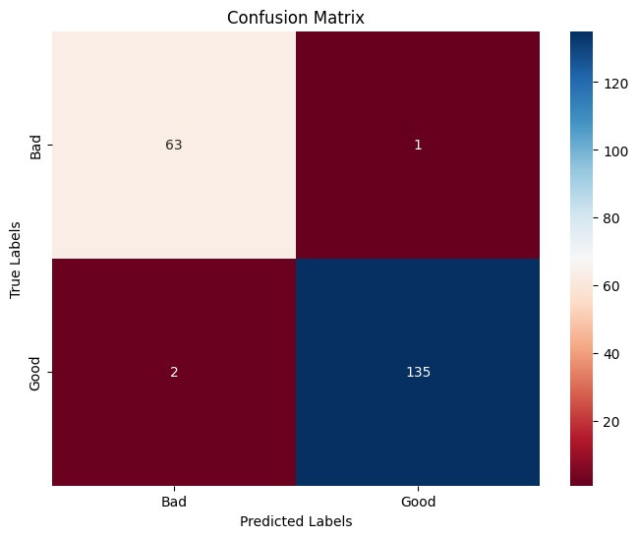
RESULTS
The AlexNet model demonstrated exceptional performance, achieving a high degree of reliability.
Accuracy: 99%
Precision: 98%
Recall: 98.5%
F1-Score: 98.5%

Slide 10
FUTURE SCOPE
With the completion of the posture detection model, our "AI-based Job Interview Analyzer" will be further enhanced by integrating a speech-to-text model. This addition will enable the system to convert spoken responses from interviewees into textual format. Subsequently, these transcribed answers will be subjected to analysis to assess their accuracy and relevance in relation to the interview questions.

Slide 11
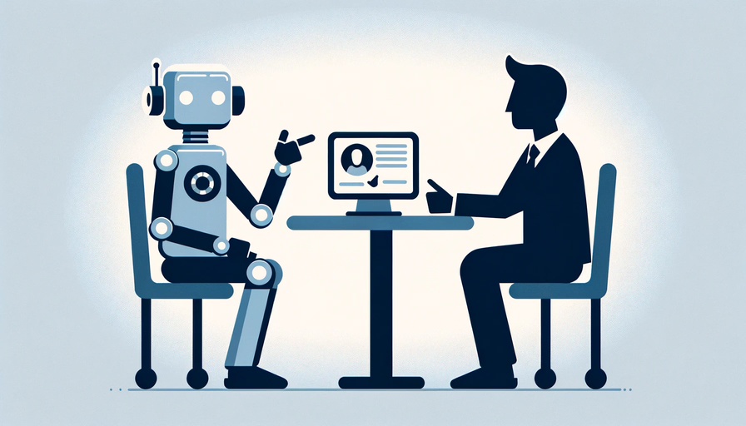
CONCLUSION
The proposed posture detection model, designed for AI-based job interview analysis, employs a novel technique that diverges from traditional approaches. Despite its innovative nature, the model consistently delivers reliable output. This breakthrough paves the way for further exploration of edge-detected images in the realm of posture detection.

Slide 12
REFERENCES
[1] Sitting Posture Assessment using Computer Vision
Mallare, John Cloie T.1, Pineda, Dianne Faye G.2, Trinidad, Gerald M.3, Serafica, Reymond D.4, Villanueva, Jules Benedict K.5, Dela Cruz, Angelo R.6,Vicerra, Ryan Rhay P.7 , Serrano, Kanny Krizzy D.8 ,Roxas, Edison A.9
Department of Electronics Engineering, University of Santo Tomas, Philippines
[2] Sitting Posture Detection using Adaptively Fused 3D Features Sun Bei1, Zeng Xing1, Liu Taocheng1, Lu Qin1
College of Mechatronics Engineering and Automation, National University of Defense Technology

Slide 13
THANK
YOU

