Slide 1
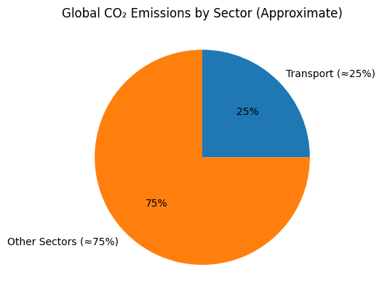
The problem
Transportation = 25% of global CO2 emission

Slide 2
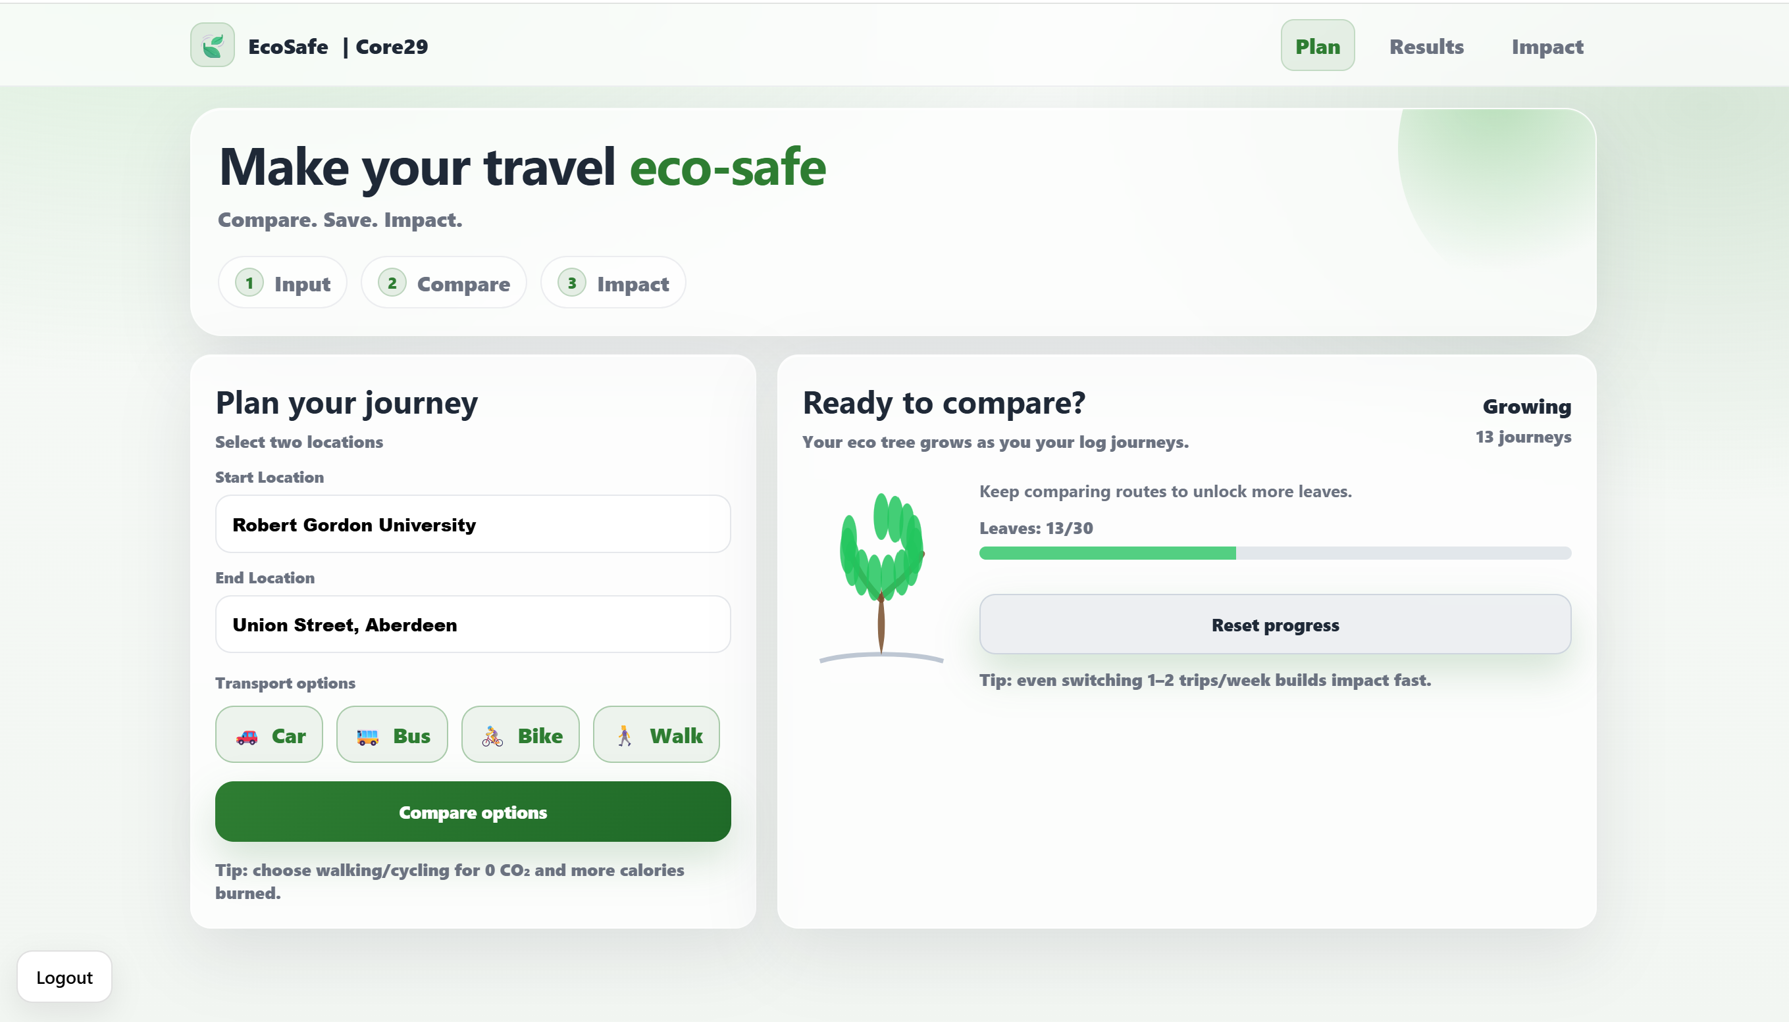
Our Solution: EcoSafe – Turning Travel decisions into Measurable Impact
Compare all transport modes instantly
Real-time CO₂ calculation
Health metrics (calories burned)
Clear sustainability scoring
CO2 vs Driving

Slide 3

Optimizing more than just time

Slide 4
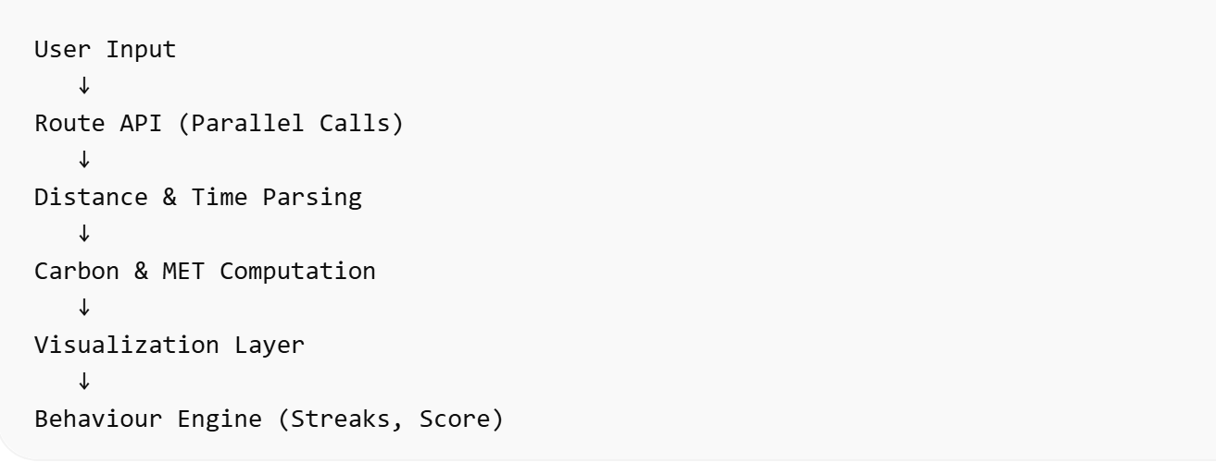
Technical Architecture

Slide 5
What happens at scale?
University integration
Corporate ESG dashboards
City council sustainability targets
Incentive partnerships with transport providers

Slide 6
Why EcoSafe Stands Out
Real-world problem
Data-driven computation
Behavioural psychology integration
Clean, scalable architecture
Immediate social impact

Slide 7

Thanks for listening

