Slide 1
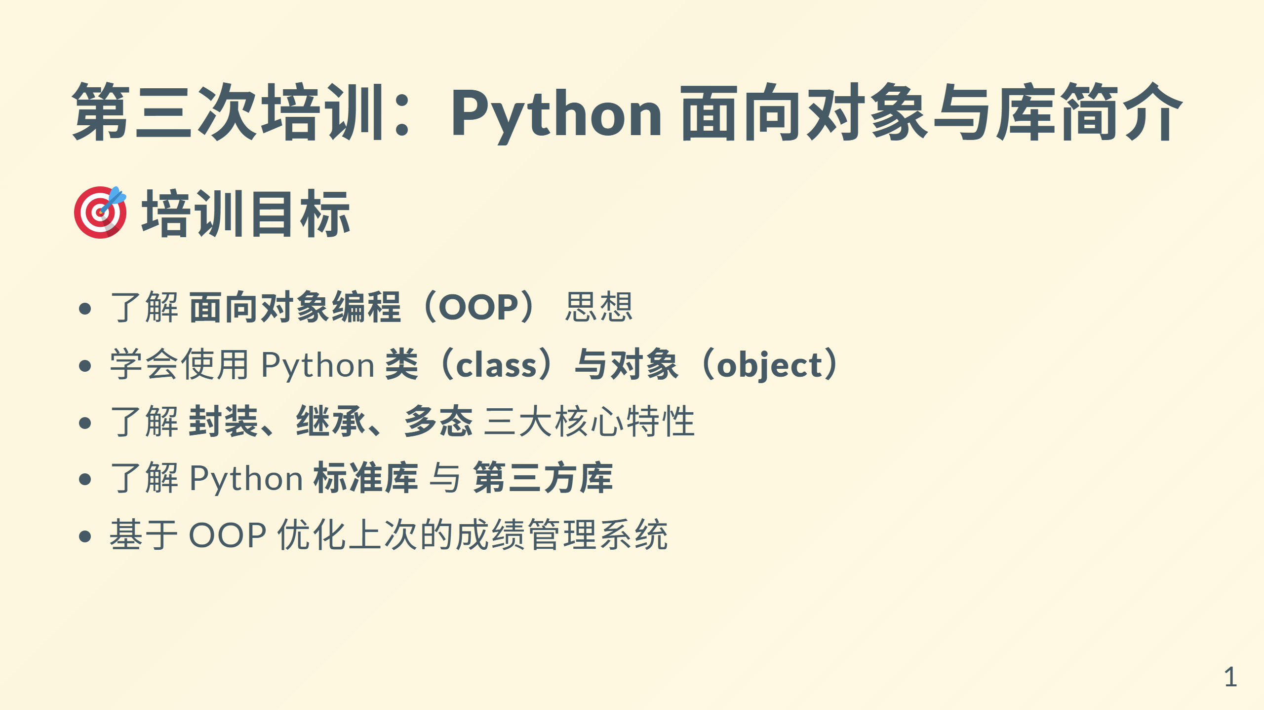

Slide 2
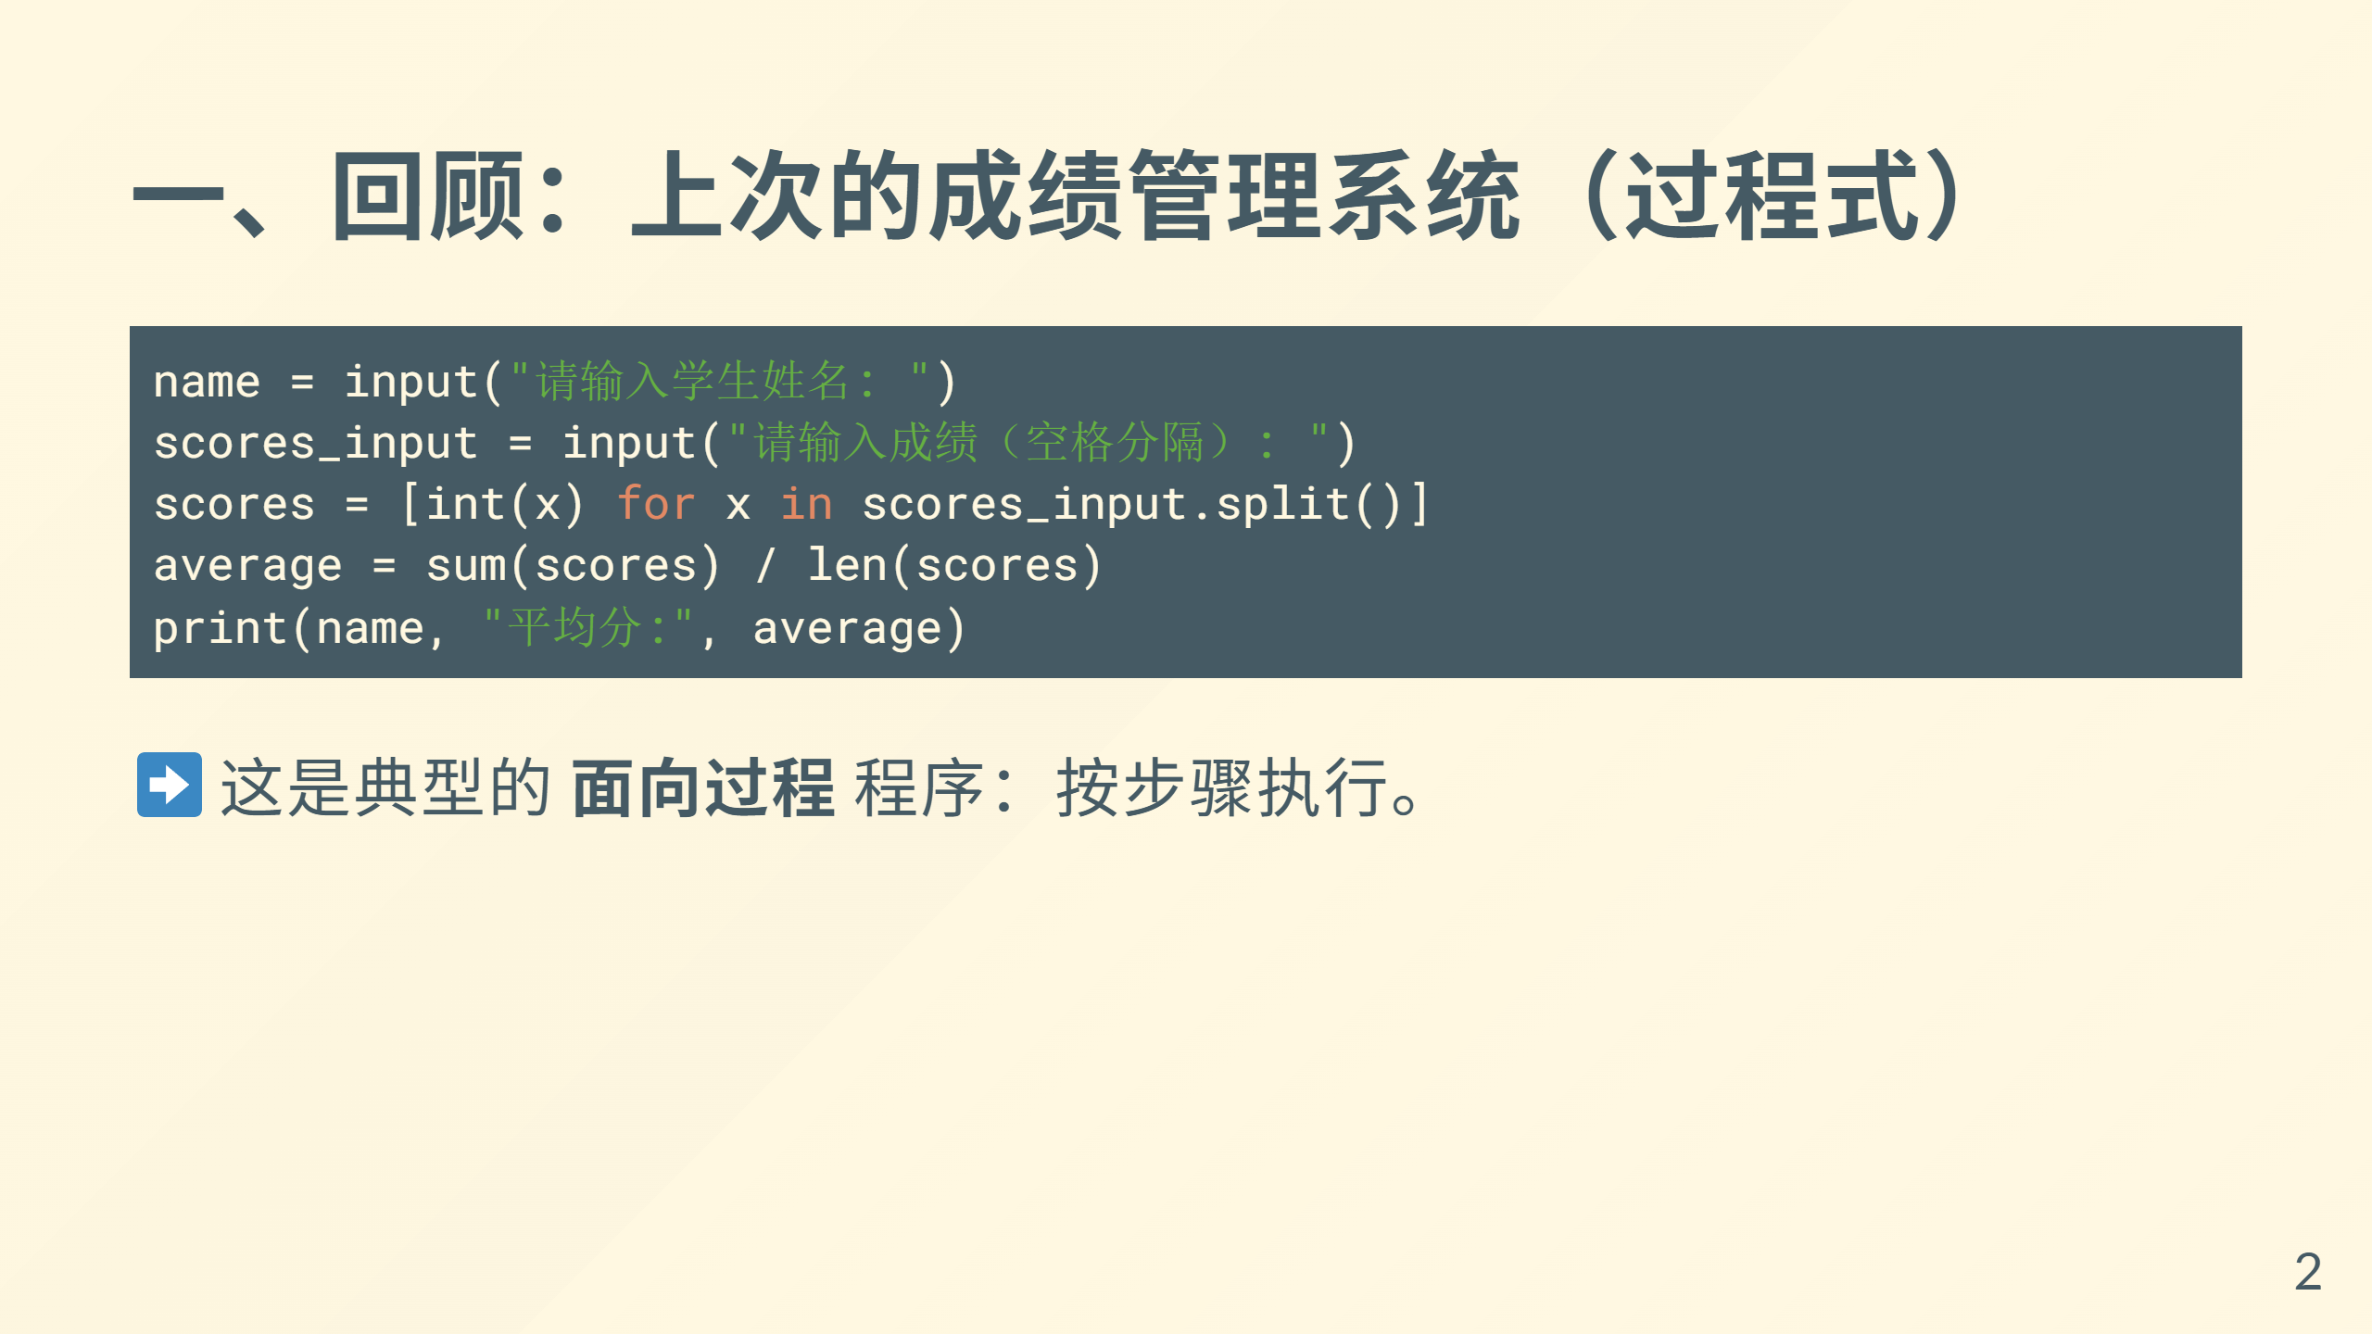

Slide 3
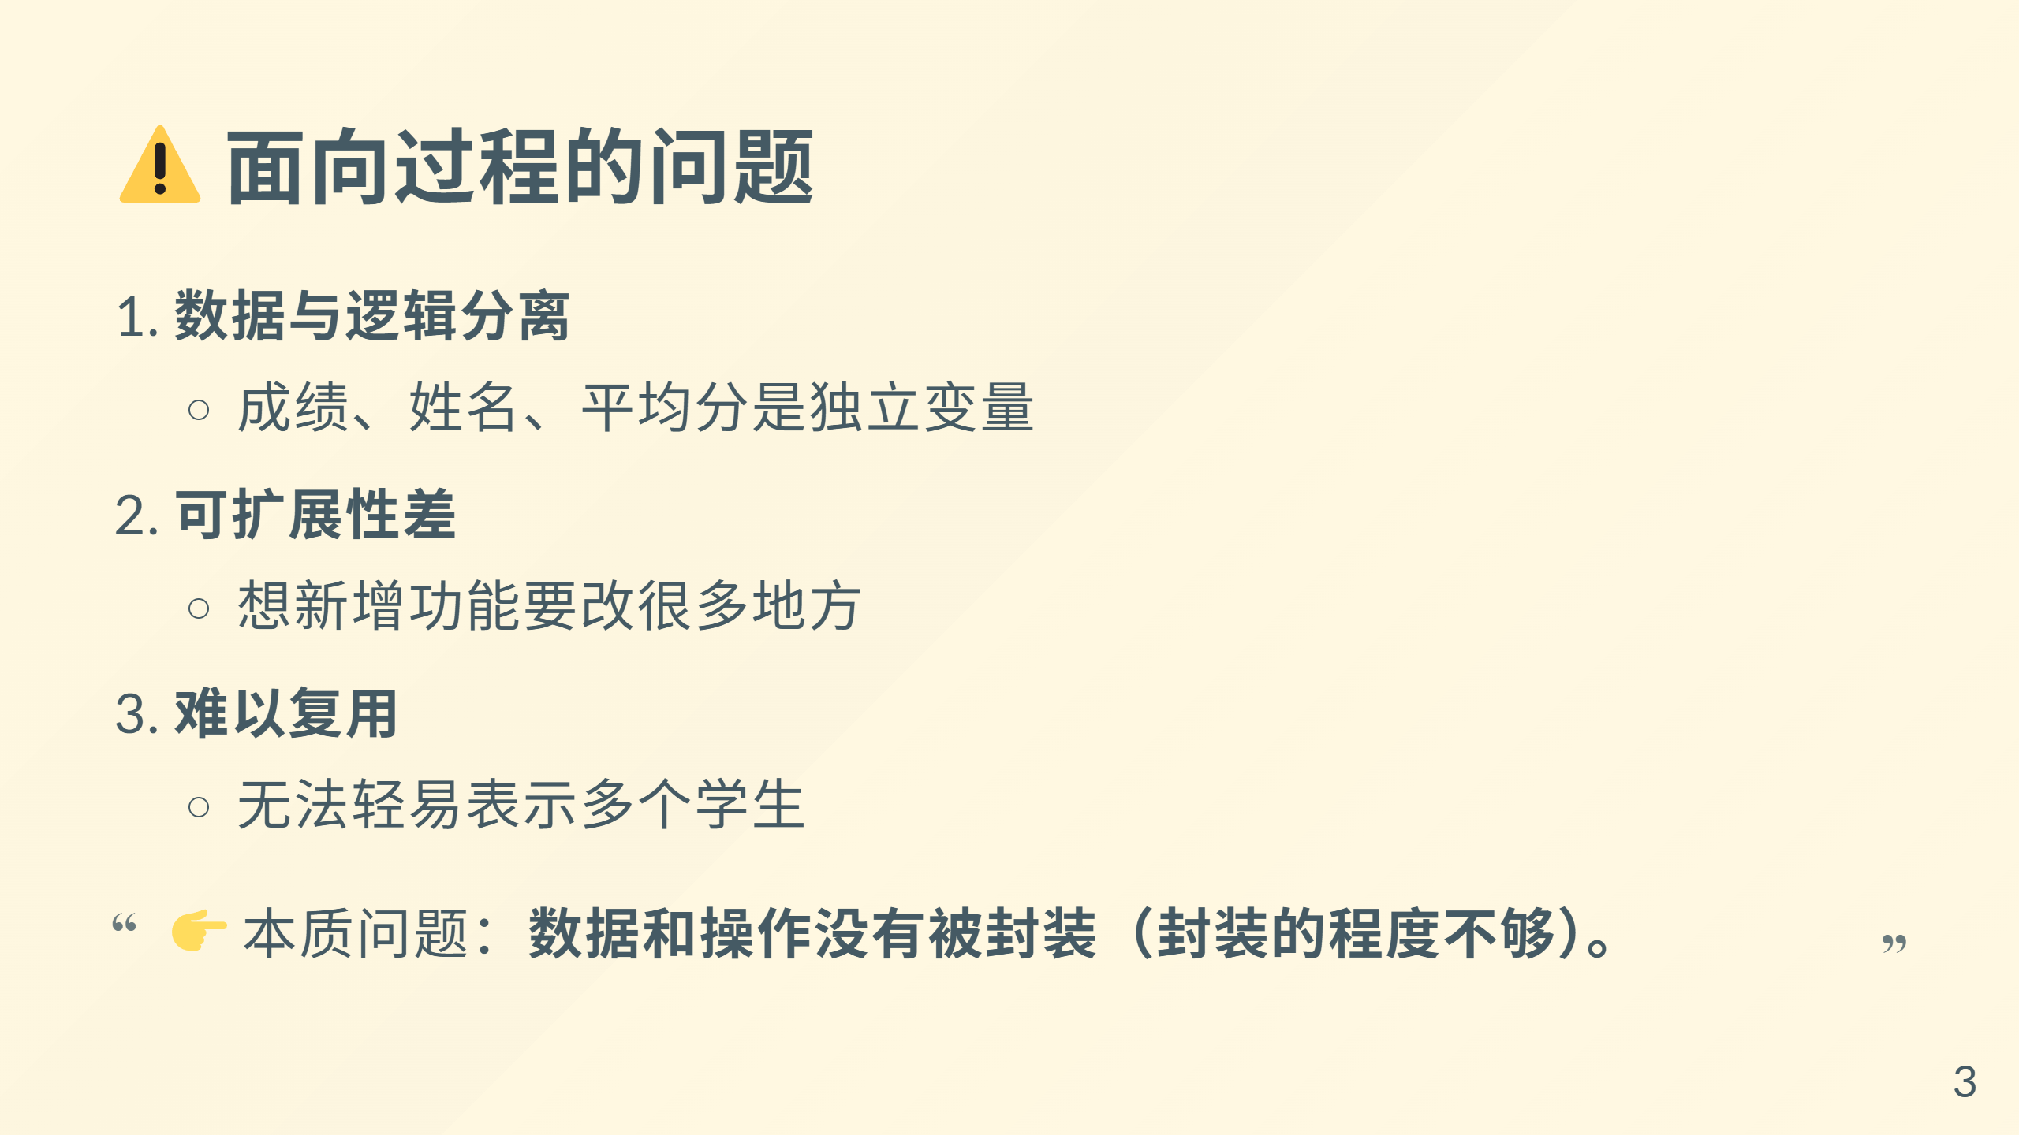

Slide 4
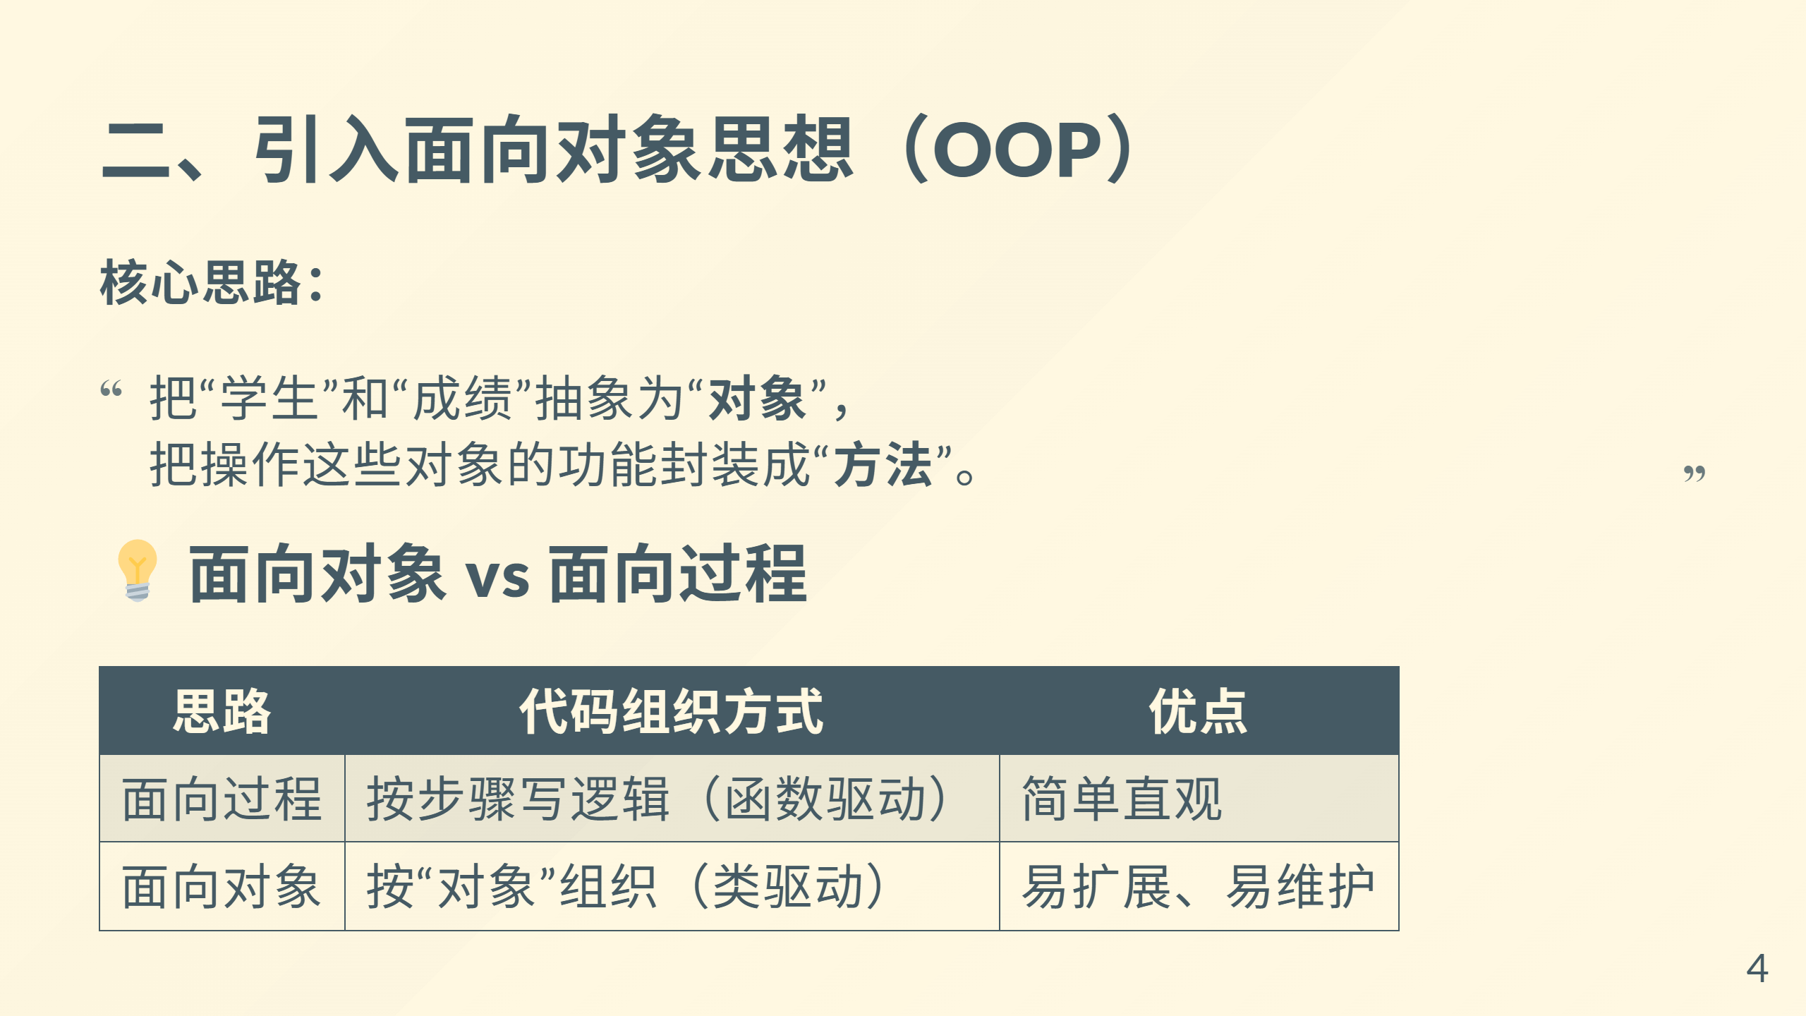

Slide 5
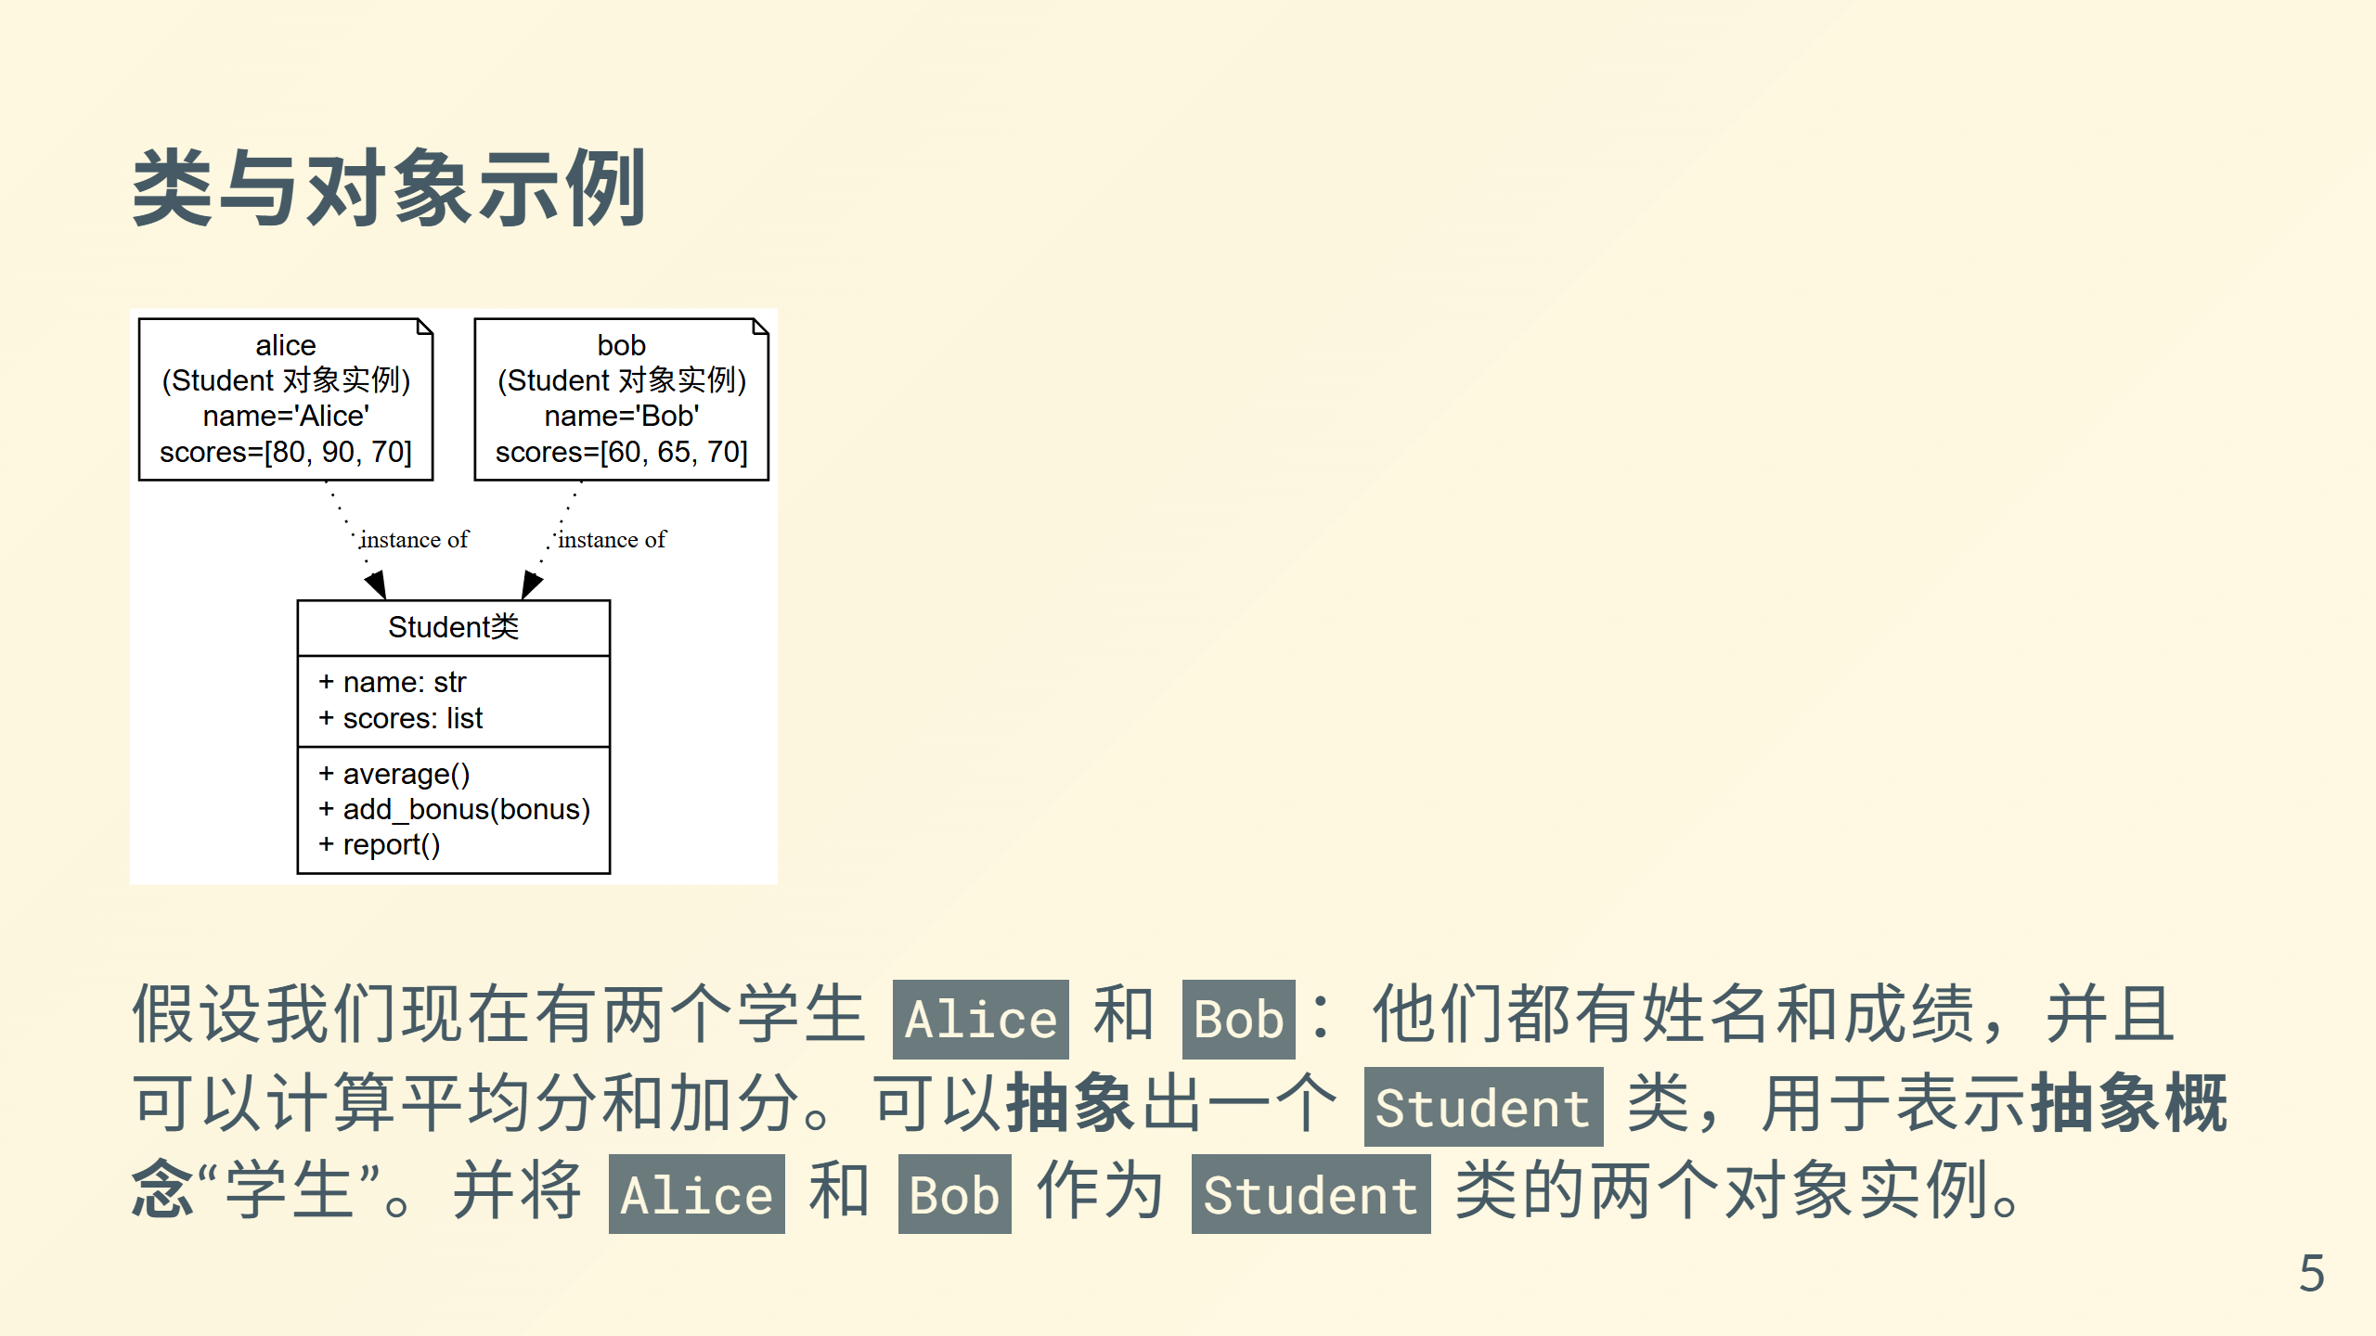
Notes:
![类与对象示例](image\第三次培训\类与对象.png)
```dot
digraph StudentOOP {
rankdir=TB;
node [fontname="Helvetica", fontsize=12];
// 定义类
Student [shape=record, label="{Student类 |+ name: str\l+ scores: list\l|+ average()\l+ add_bonus(bonus)\l+ report()\l}"];
// 定义实例对象
alice [shape=note, label="alice\n(Student 对象实例)\nname='Alice'\nscores=[80, 90, 70]"];
bob [shape=note, label="bob\n(Student 对象实例)\nname='Bob'\nscores=[60, 65, 70]"];
// 关系：对象由类实例化而来
alice -> Student [style=dotted, label="instance of", fontsize=10];
bob -> Student [style=dotted, label="instance of", fontsize=10];
}
```

Slide 6
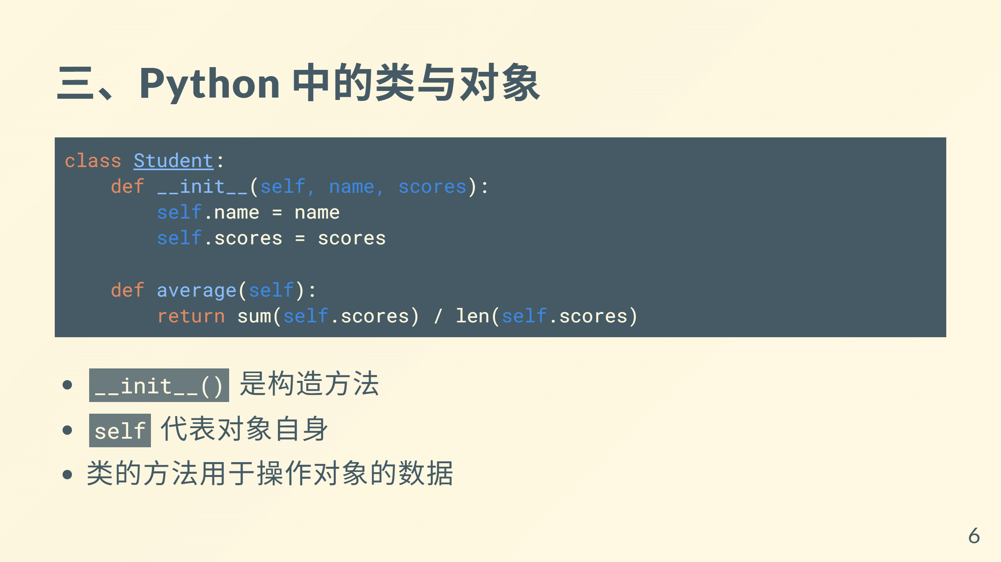

Slide 7
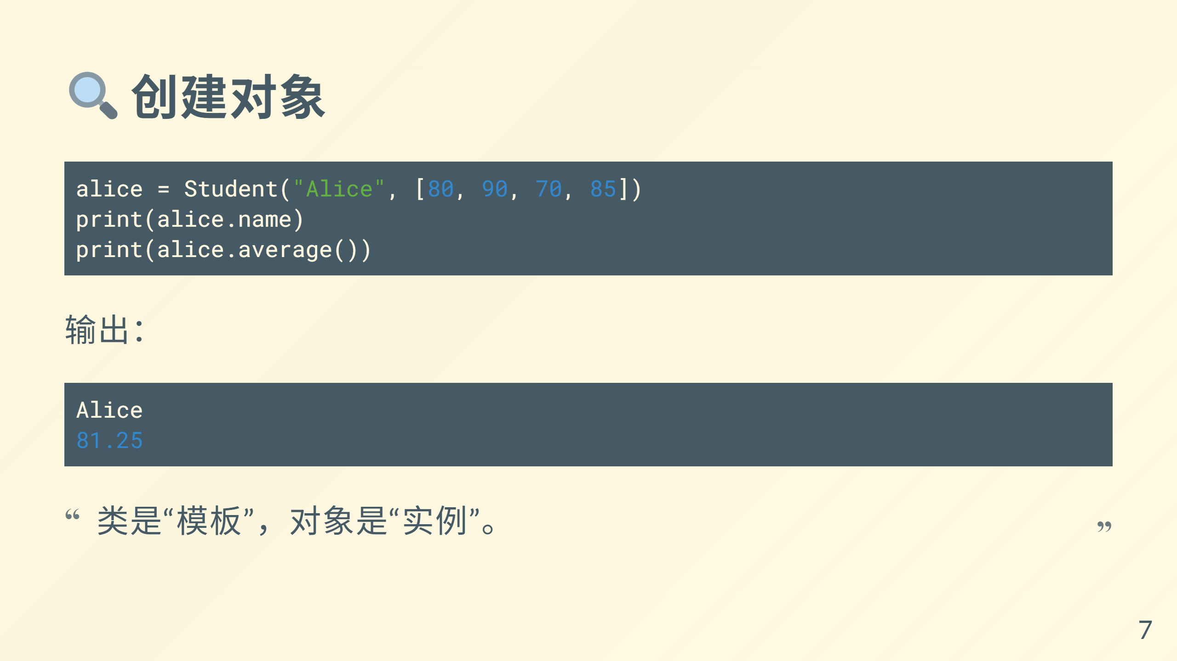

Slide 8
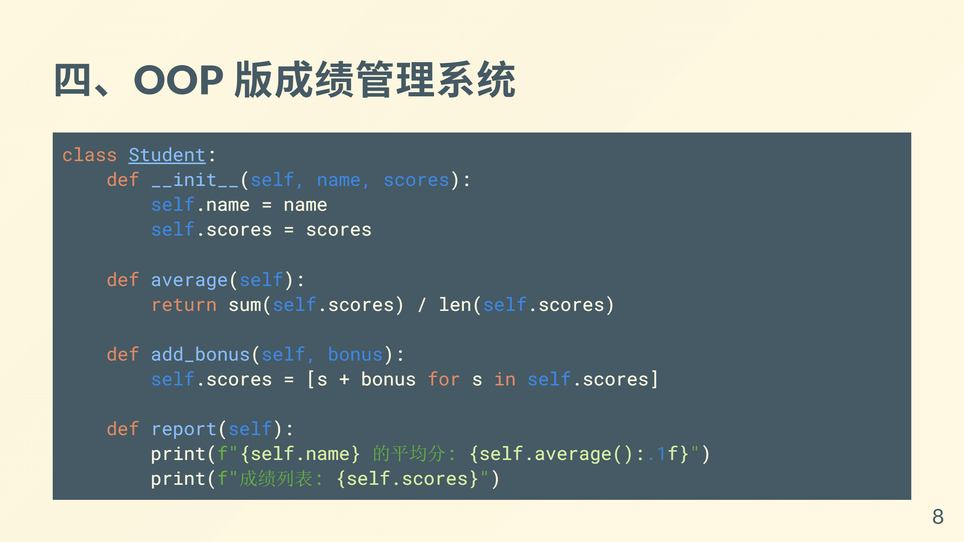

Slide 9
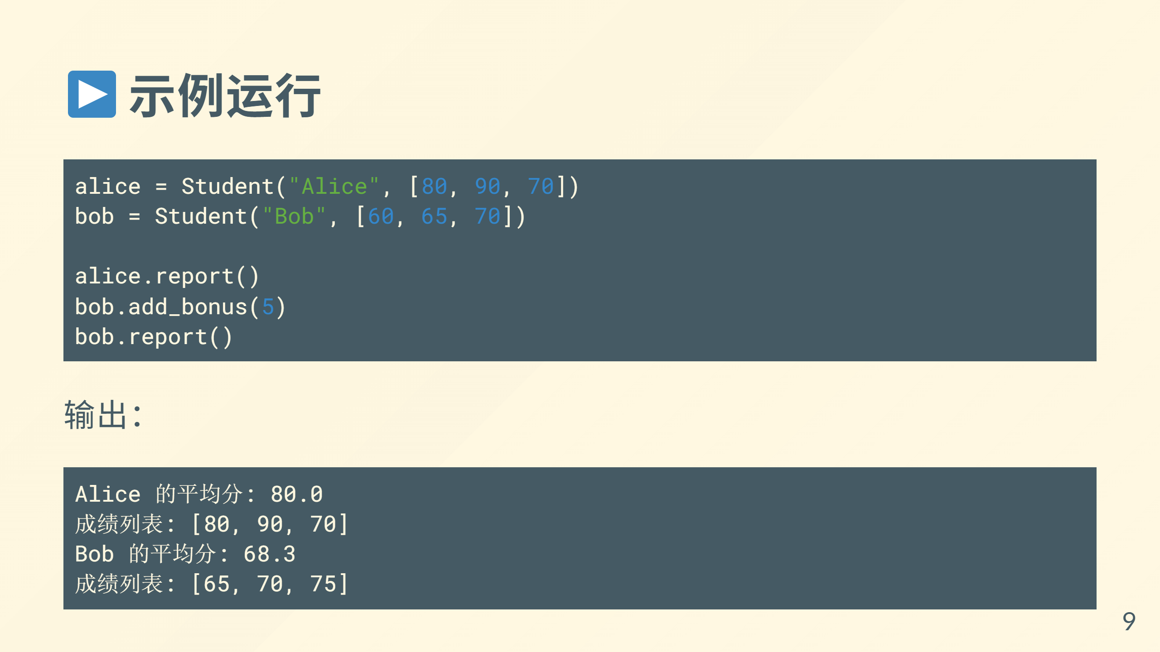

Slide 10
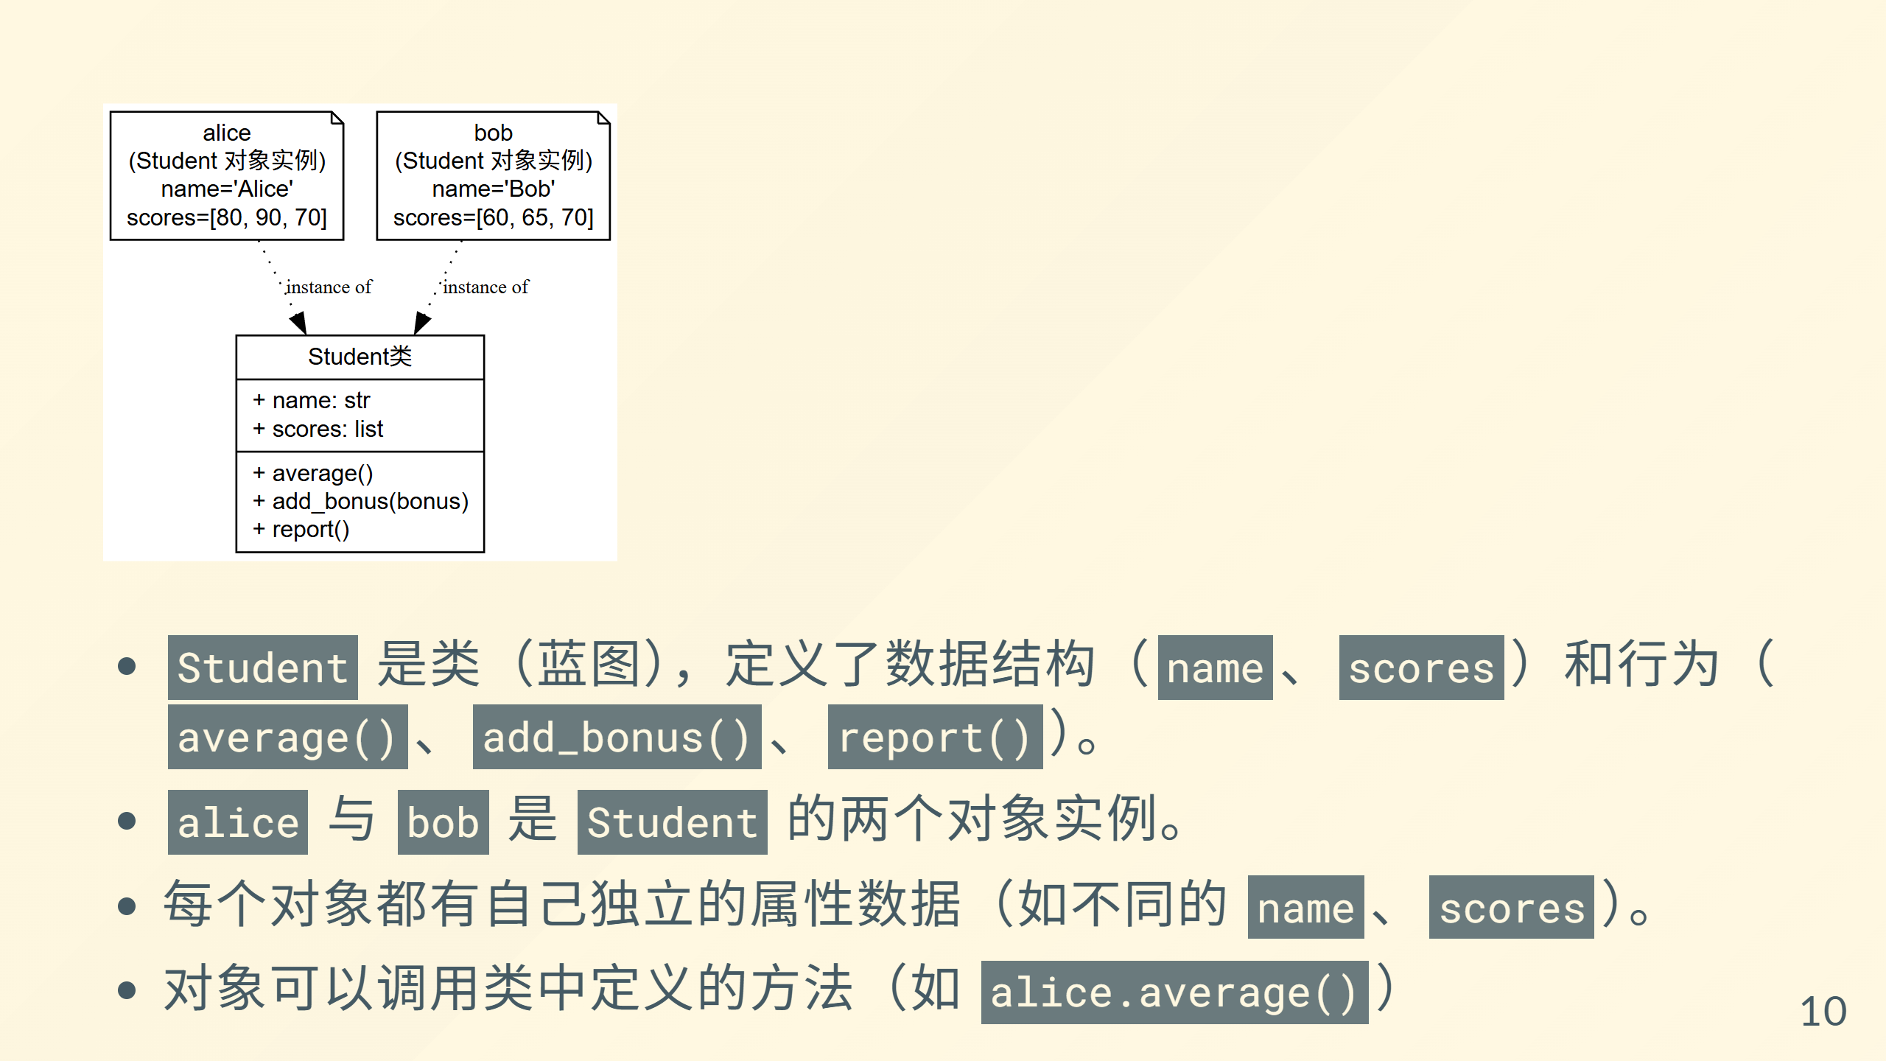
Notes:
![类与对象示例](image\第三次培训\类与对象.png)
```dot
digraph StudentOOP {
rankdir=TB;
node [fontname="Helvetica", fontsize=12];
// 定义类
Student [shape=record, label="{Student类 |+ name: str\l+ scores: list\l|+ average()\l+ add_bonus(bonus)\l+ report()\l}"];
// 定义实例对象
alice [shape=note, label="alice\n(Student 对象实例)\nname='Alice'\nscores=[80, 90, 70]"];
bob [shape=note, label="bob\n(Student 对象实例)\nname='Bob'\nscores=[60, 65, 70]"];
// 关系：对象由类实例化而来
alice -> Student [style=dotted, label="instance of", fontsize=10];
bob -> Student [style=dotted, label="instance of", fontsize=10];
}
```

Slide 11
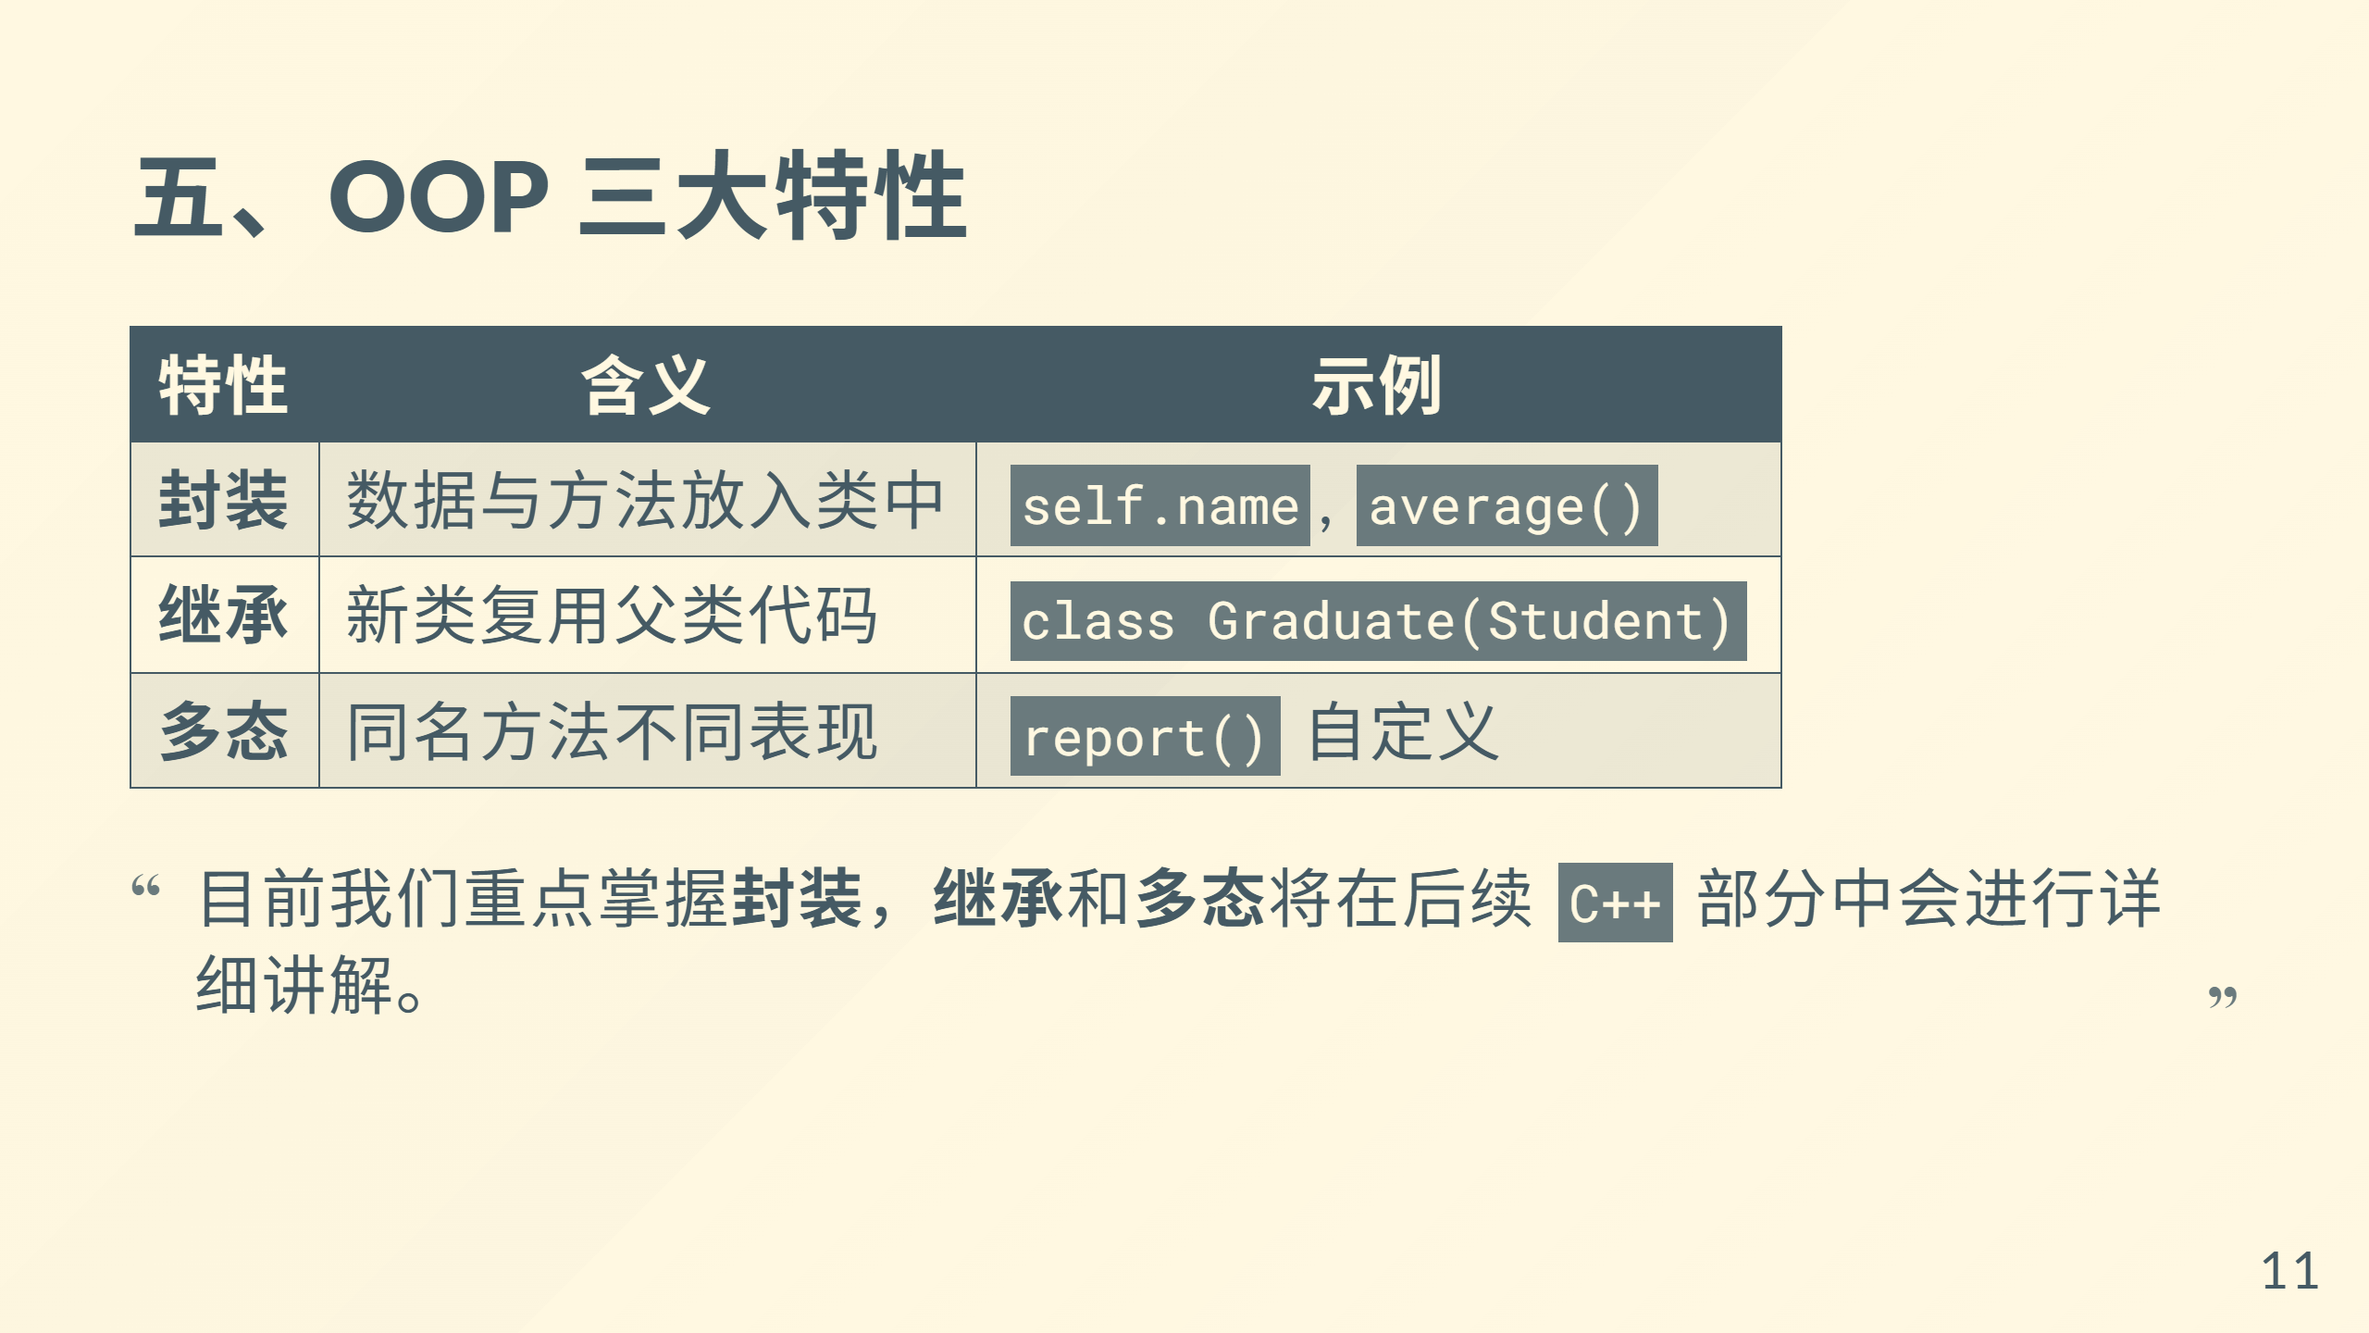

Slide 12
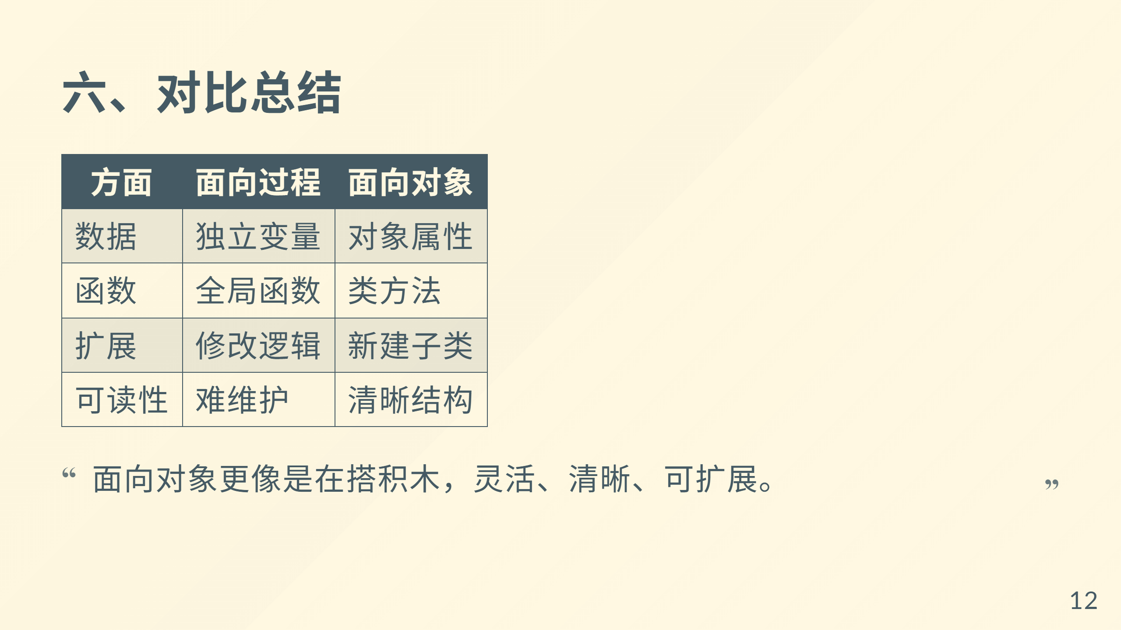

Slide 13
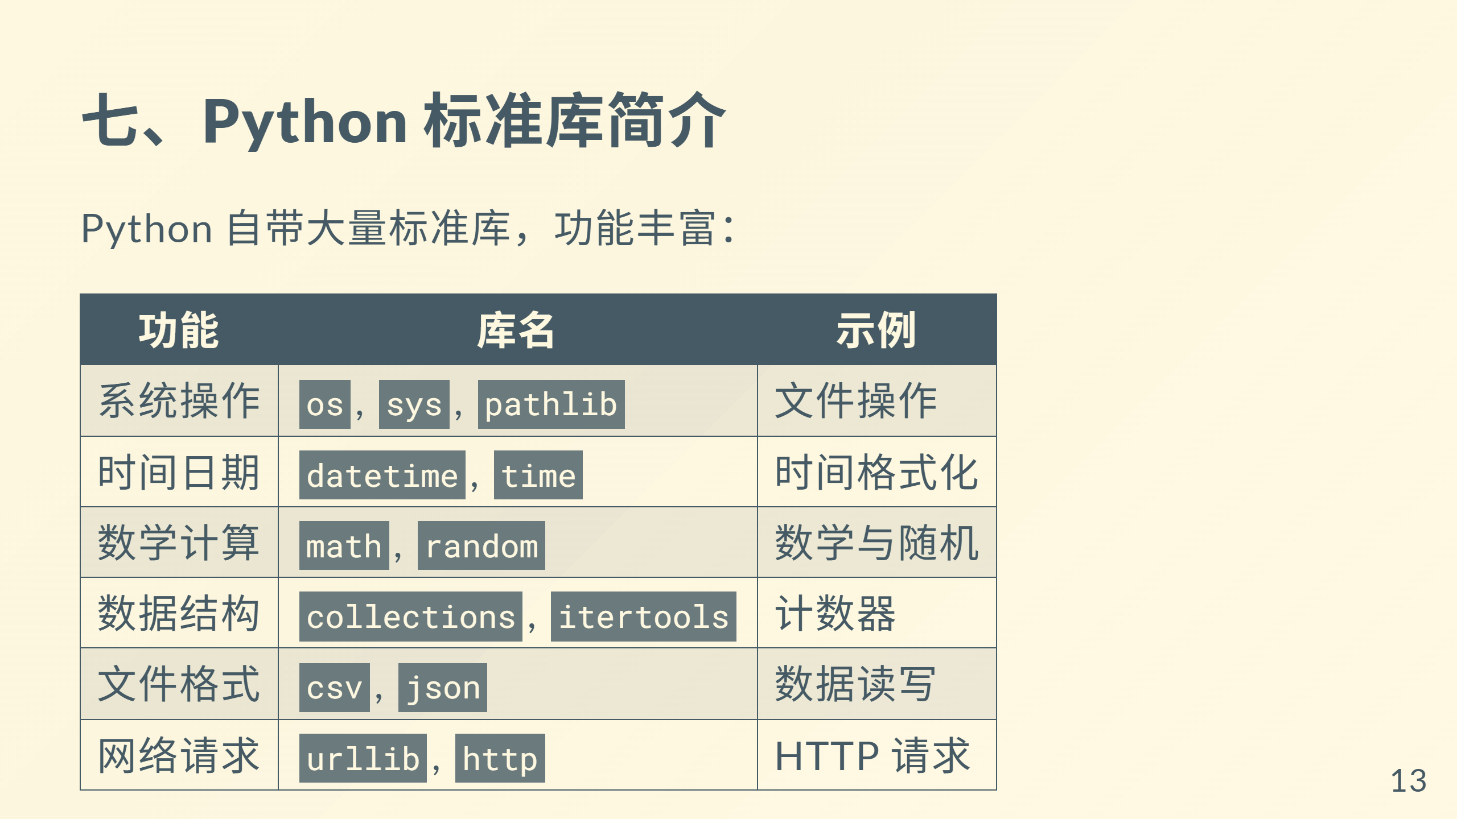

Slide 14
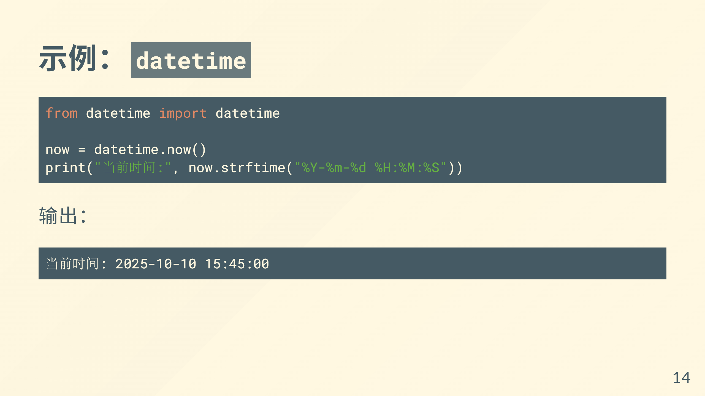

Slide 15
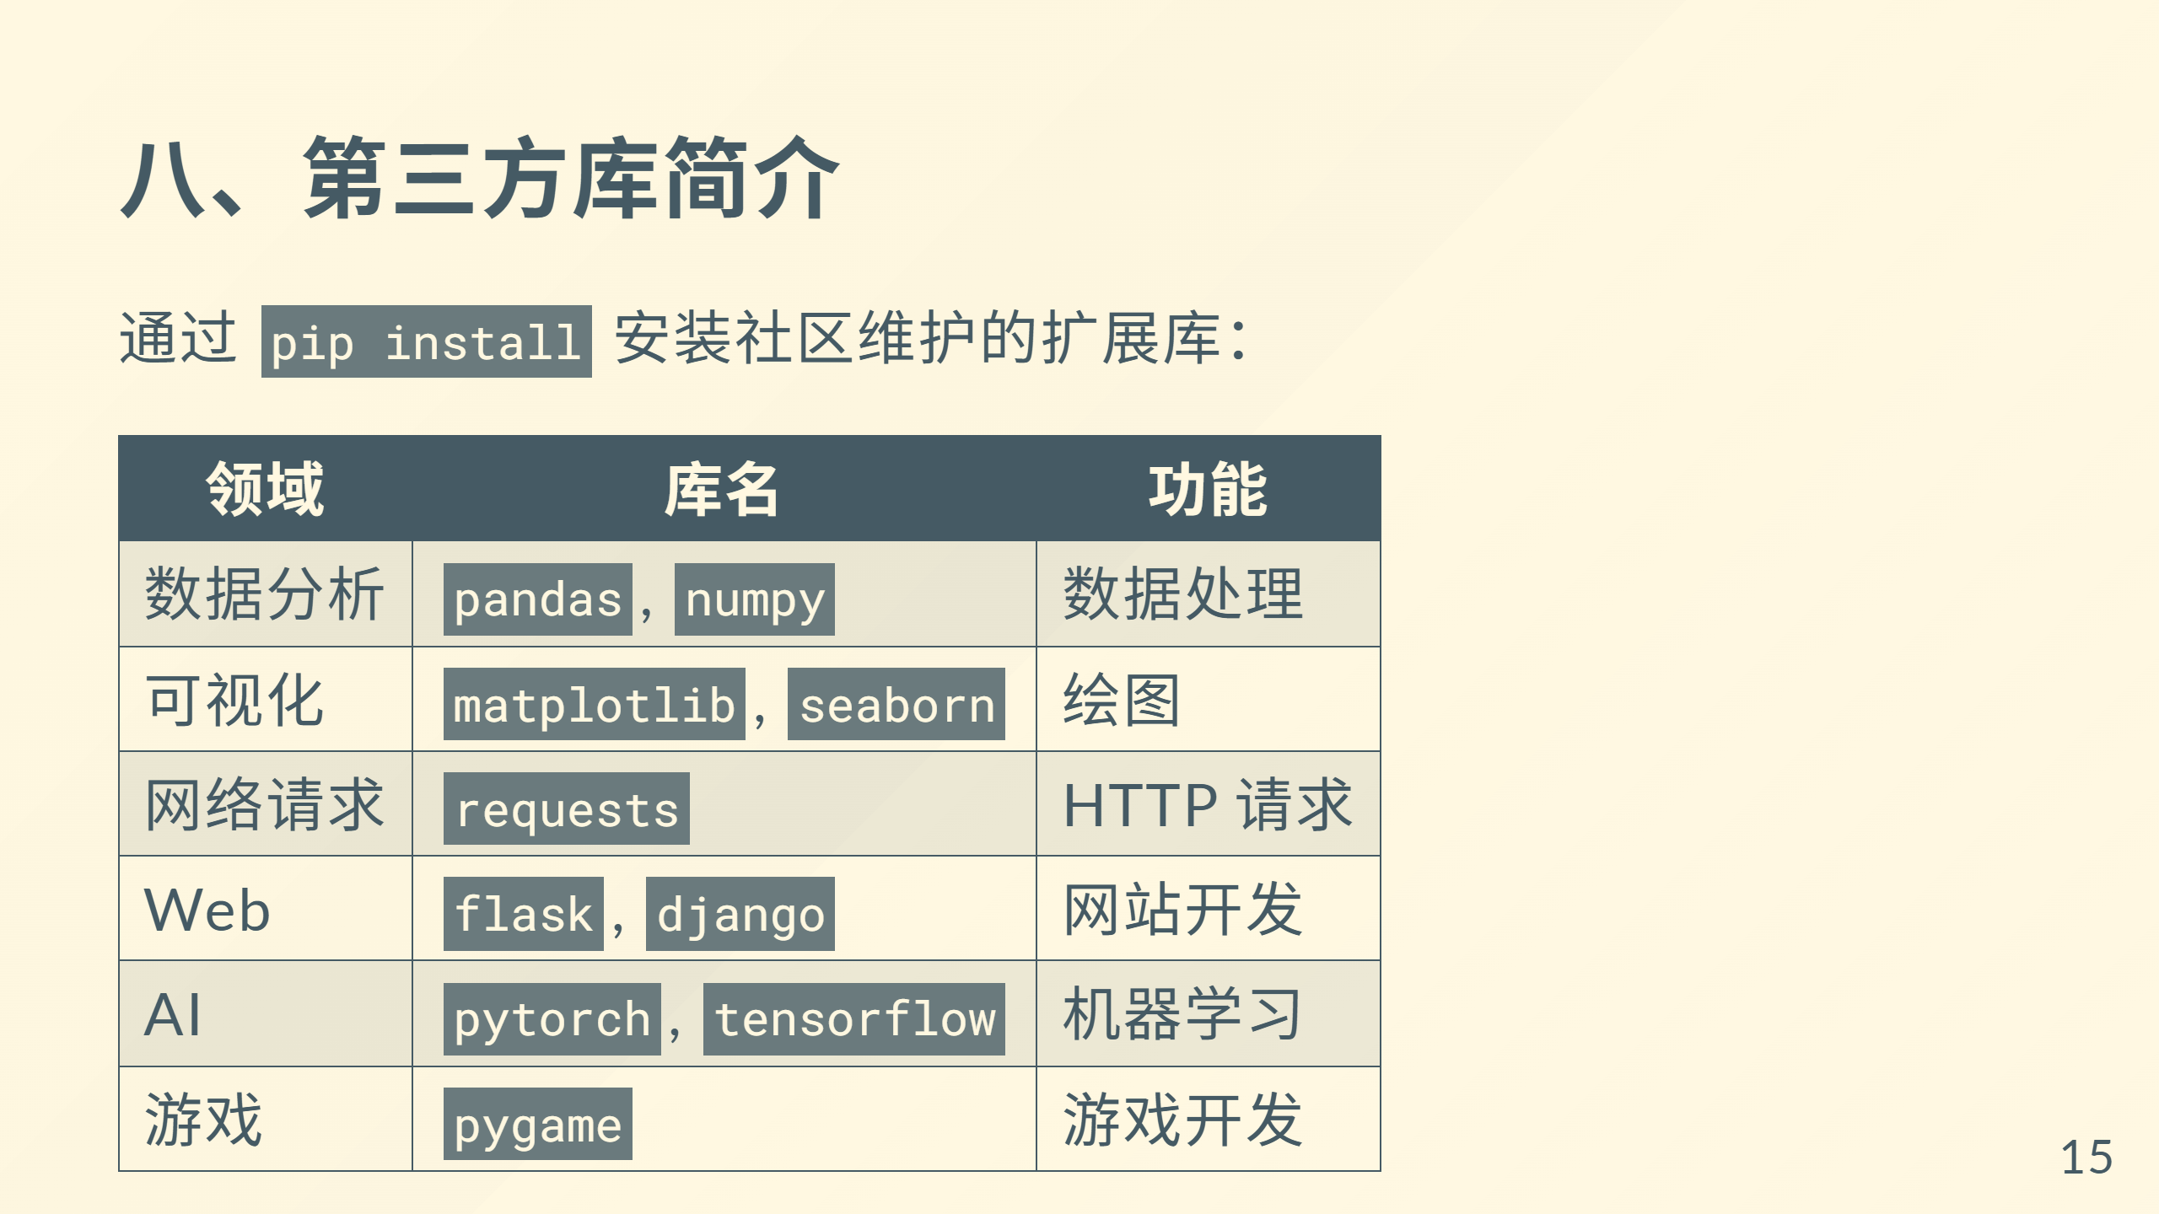

Slide 16
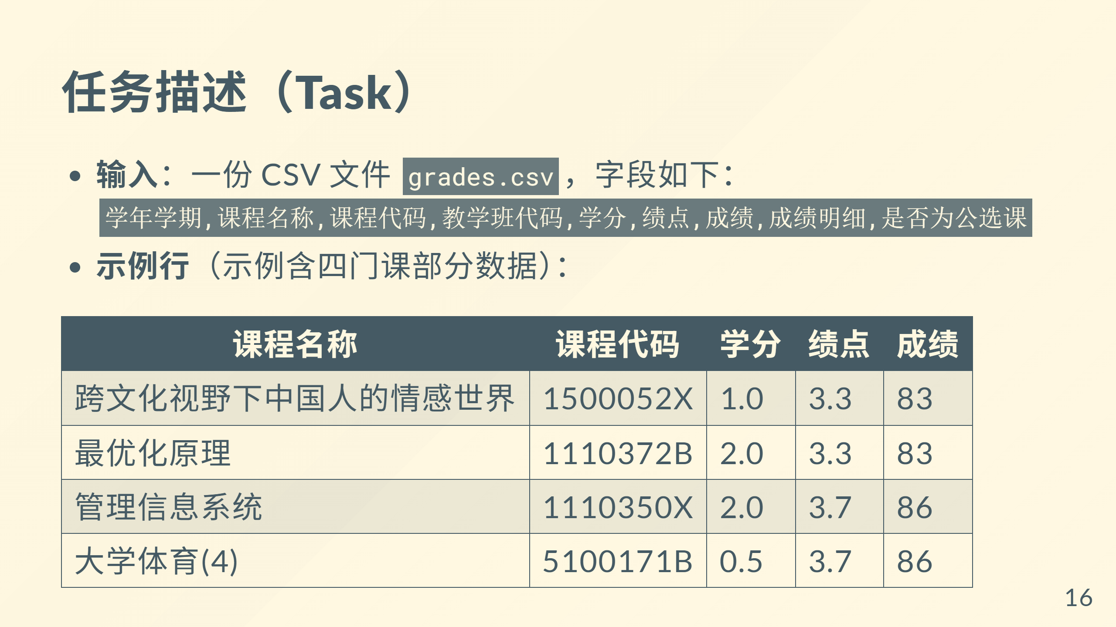

Slide 17
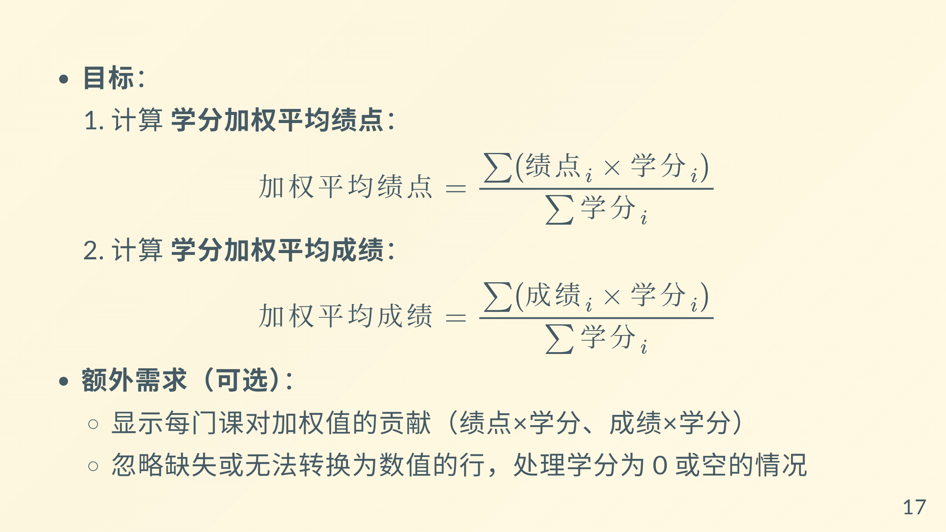

Slide 18
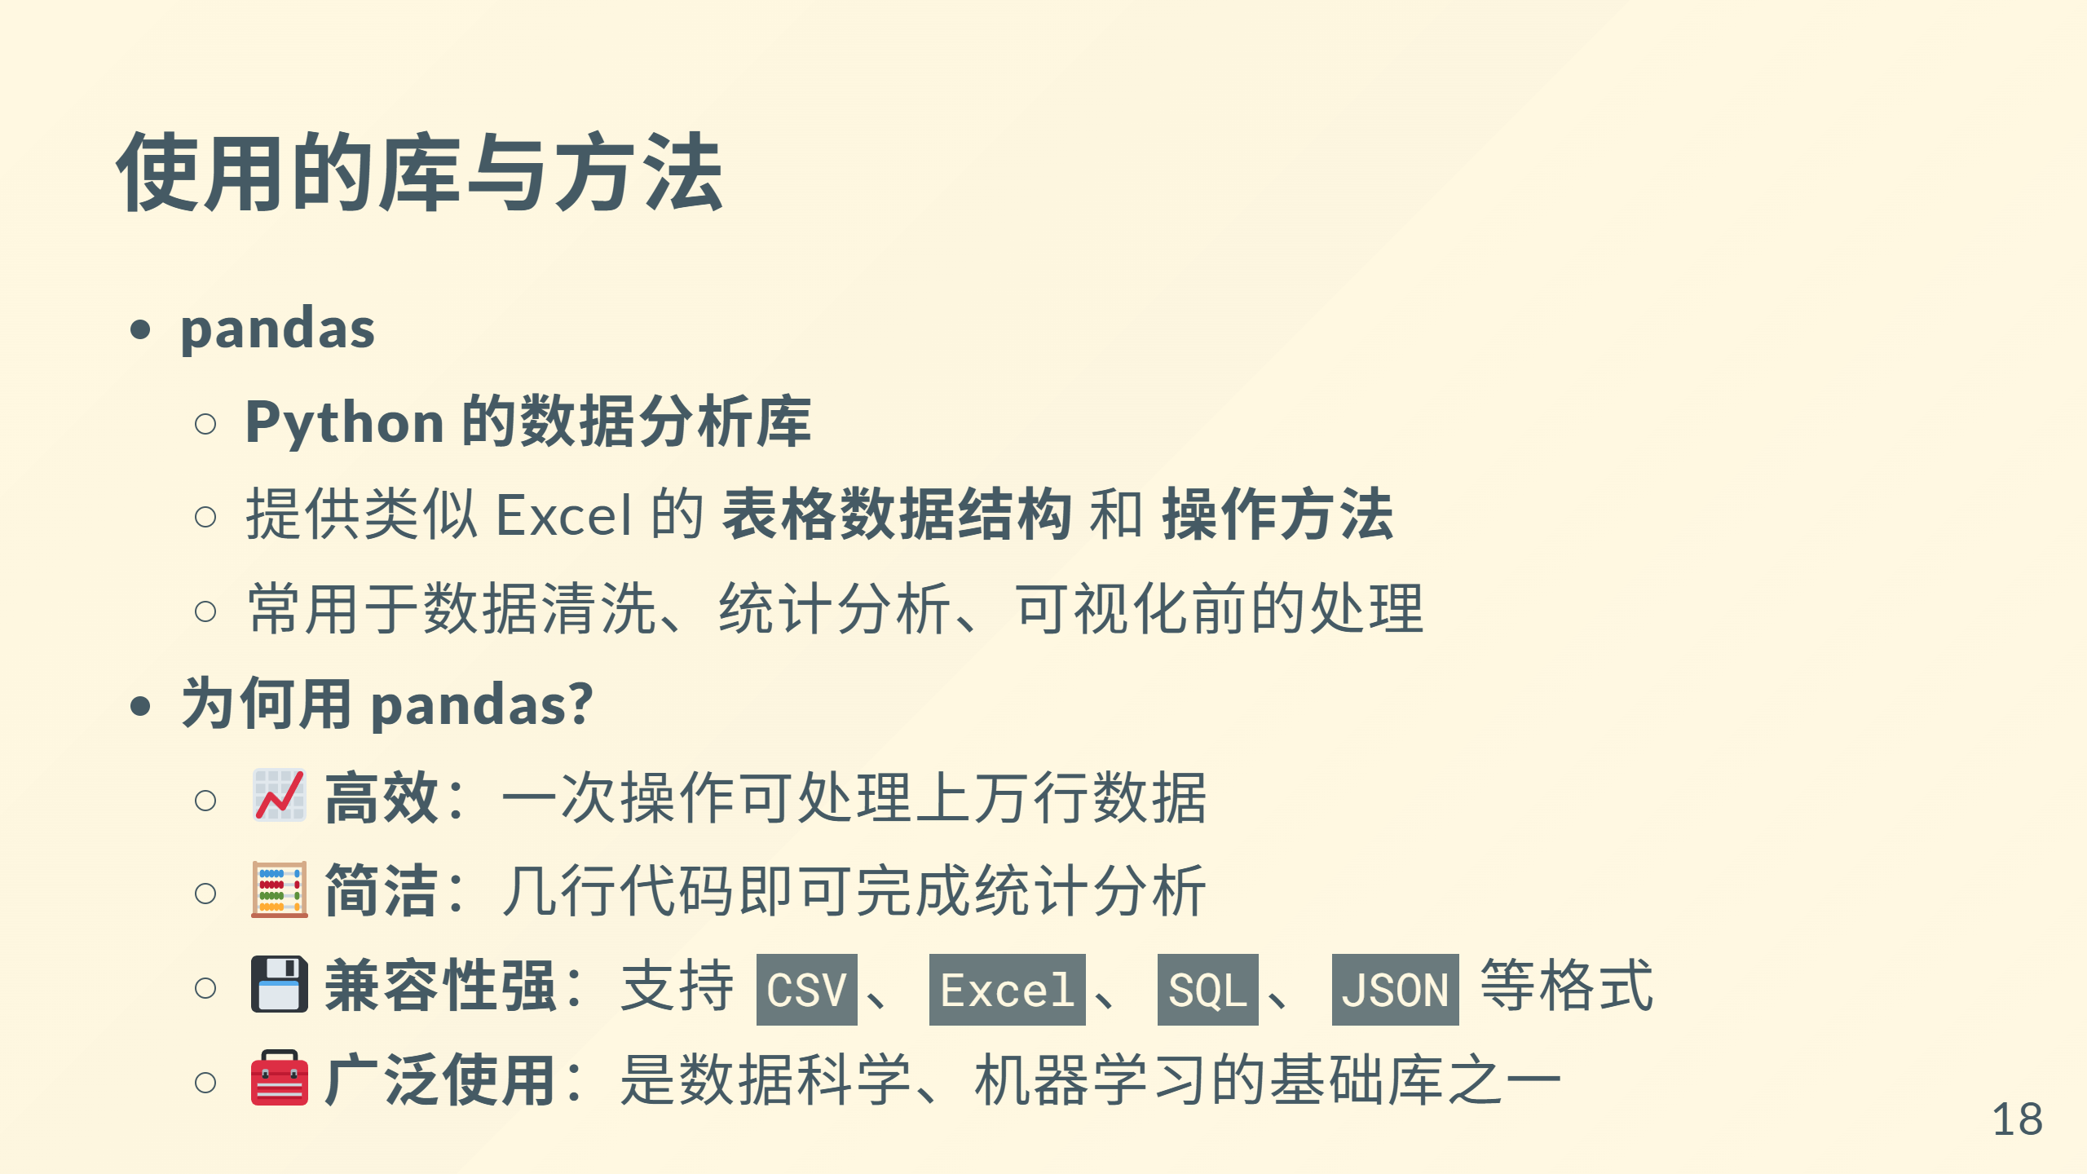

Slide 19
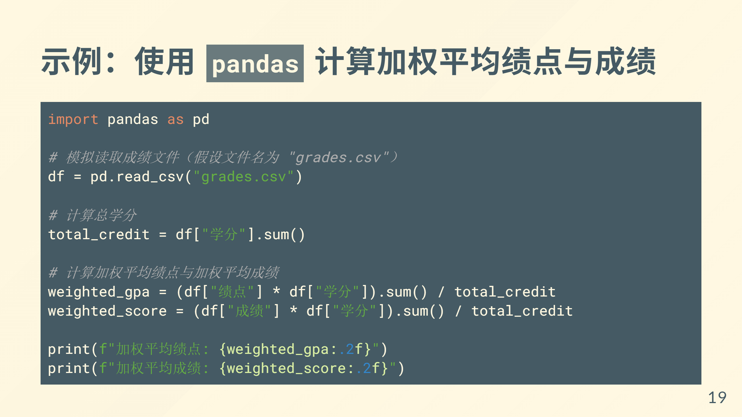

Slide 20
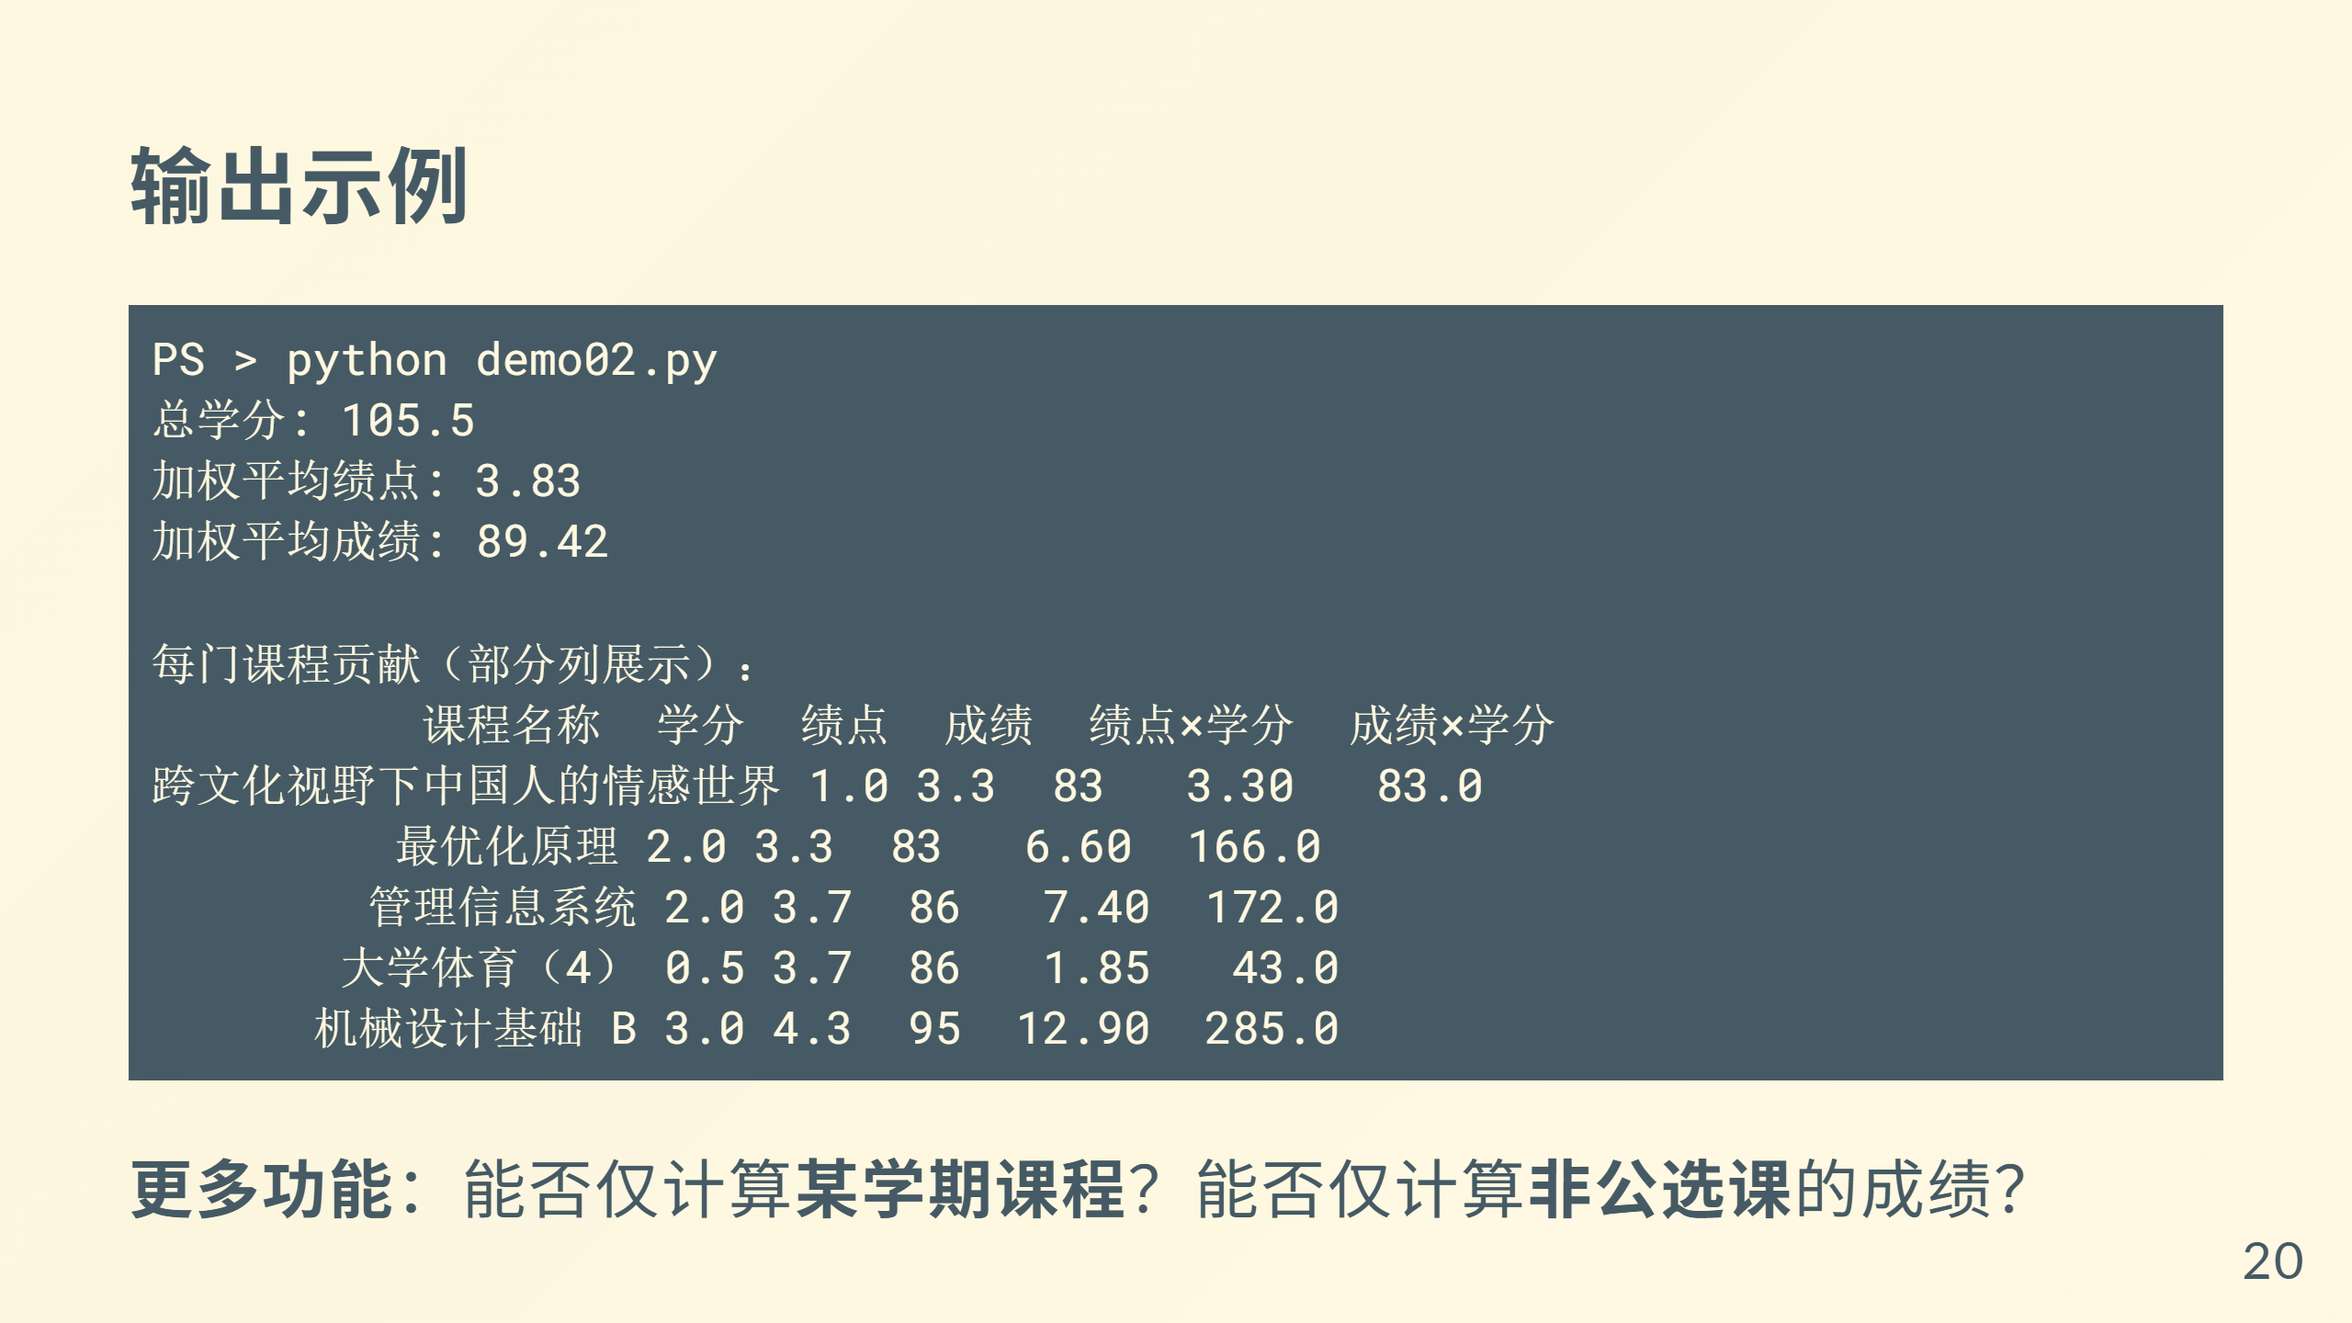

Slide 21
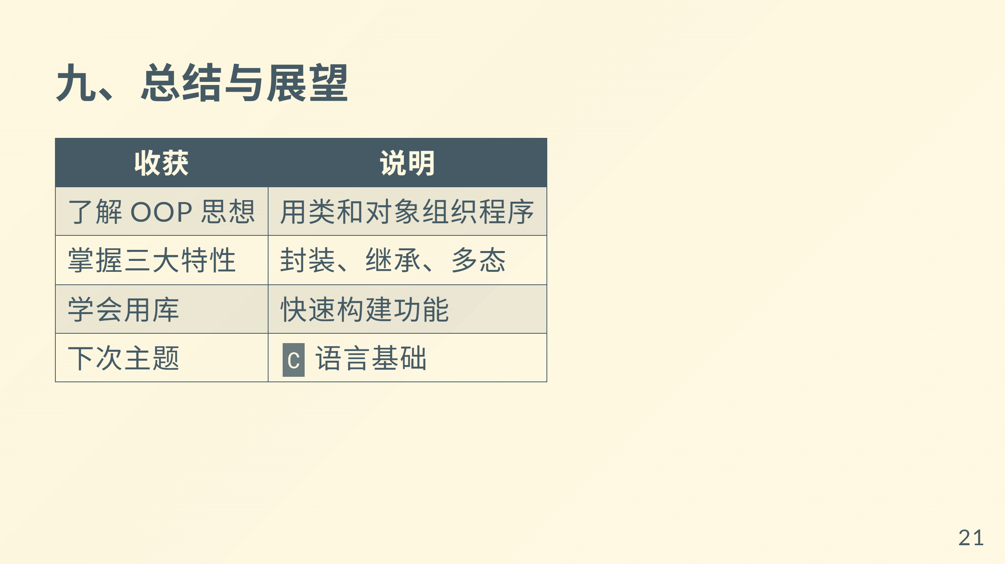

Slide 22
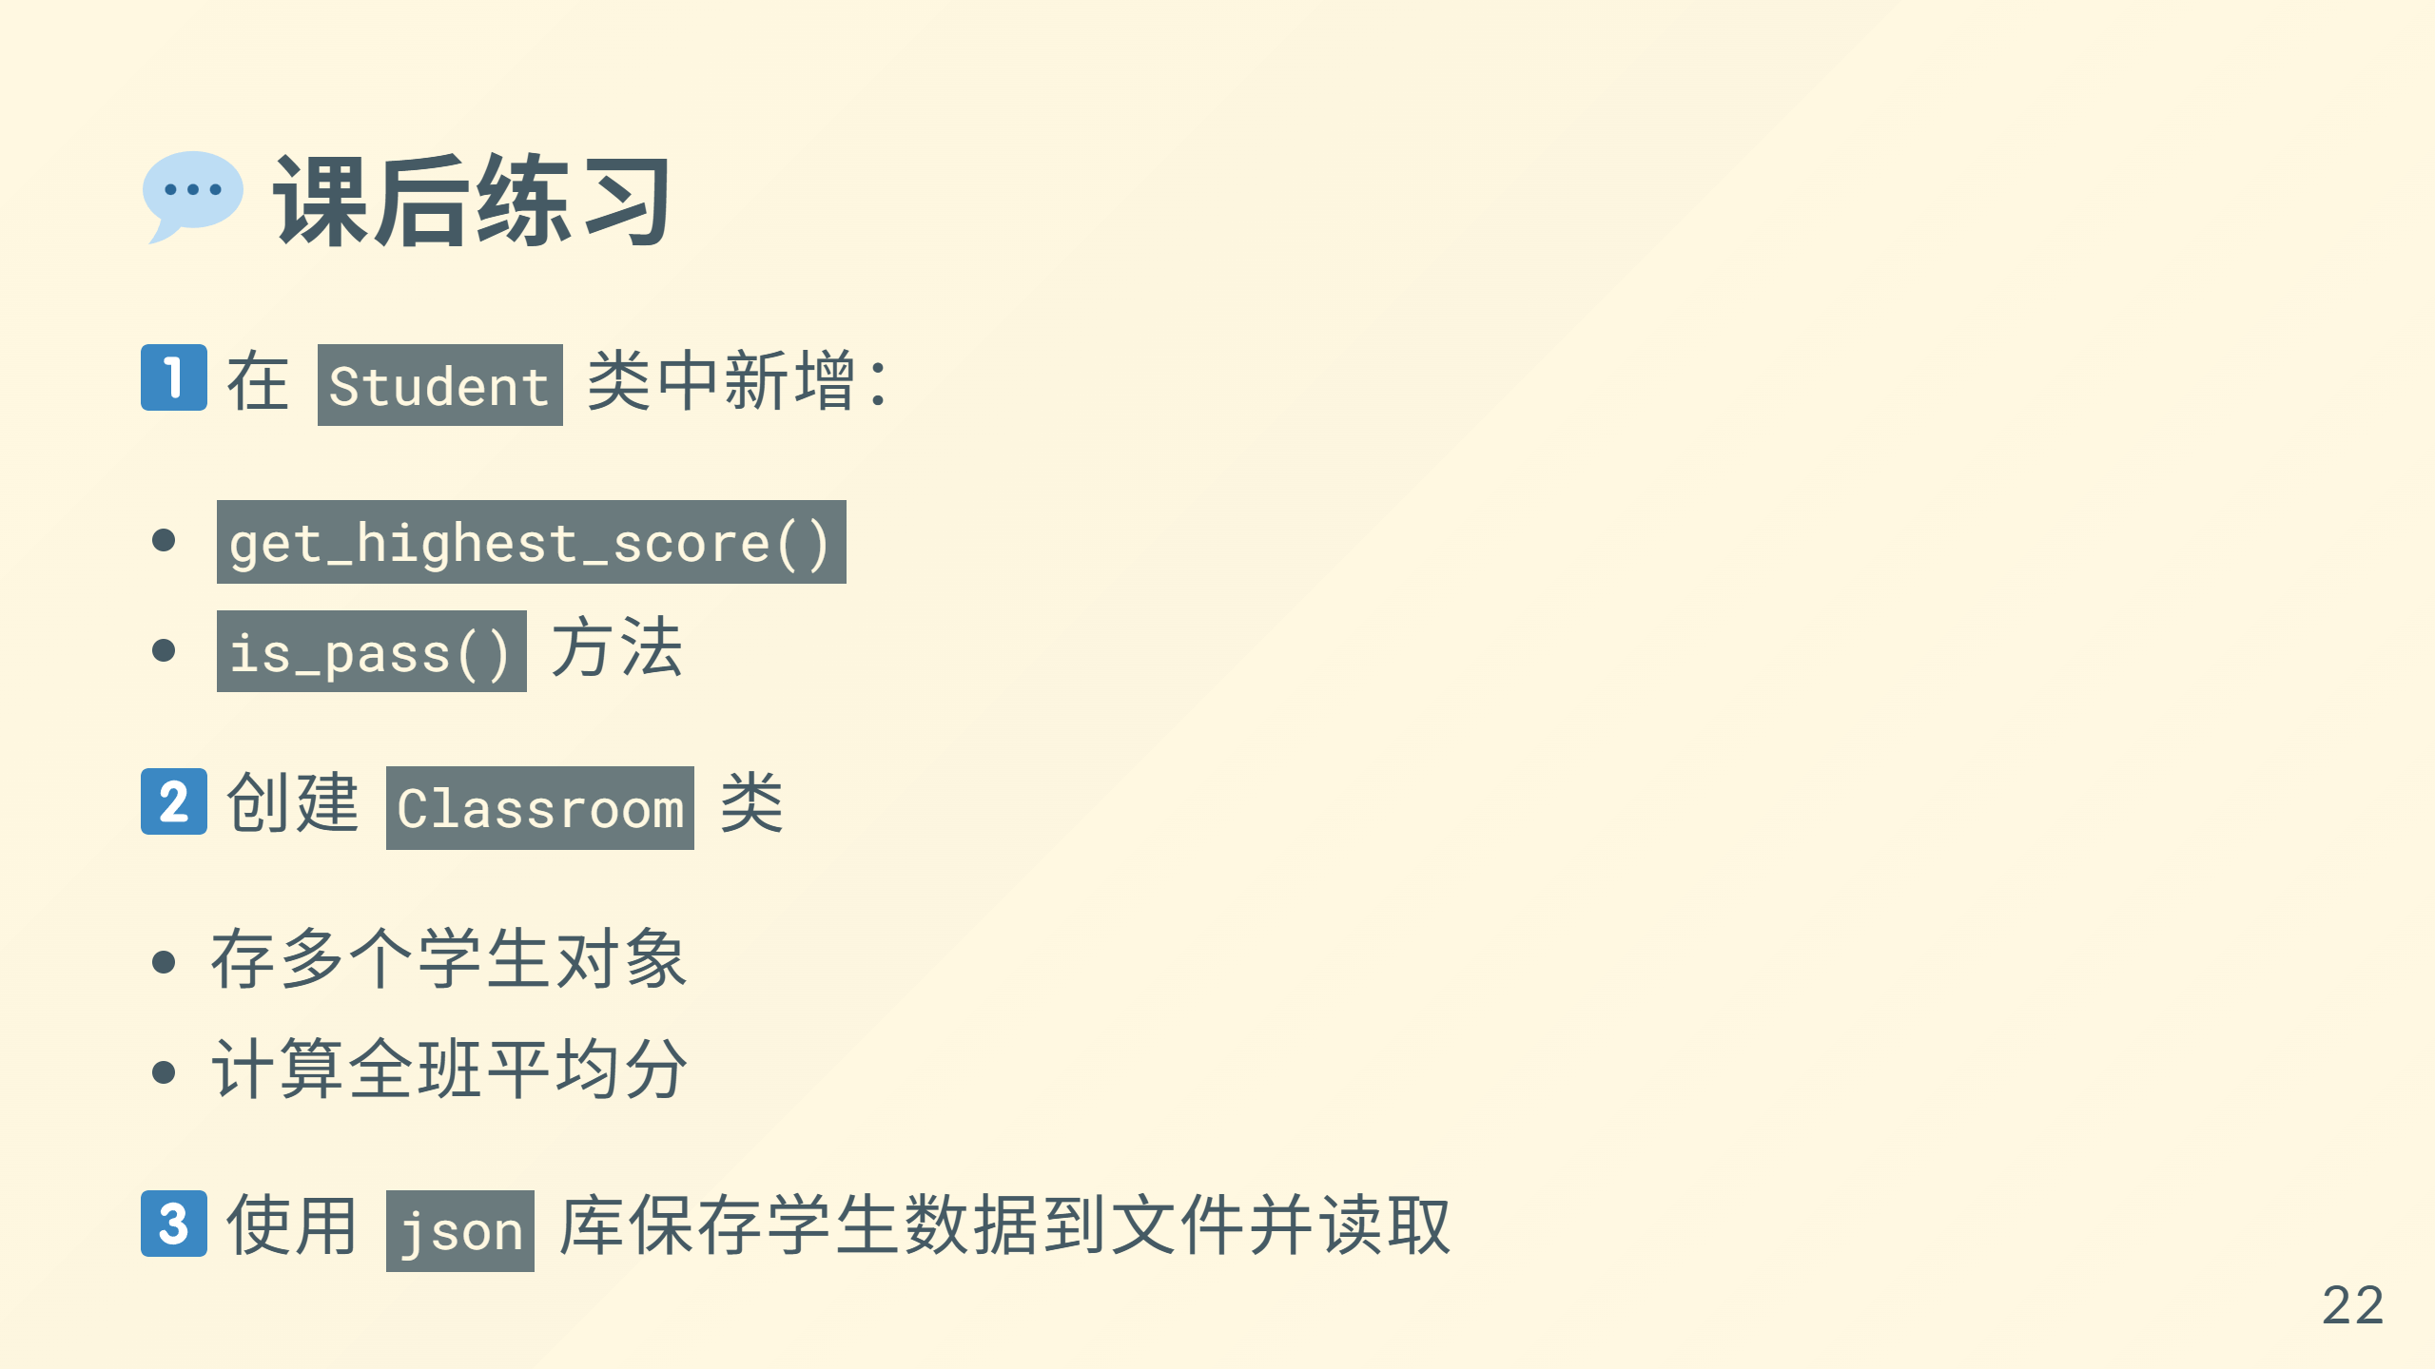

Slide 23
