Slide 1
MACHINE LEARNING REPRODUCTION STUDY
Analyzing the Impact of Feature Selection on Machine Learning Algorithms for Heart Disease Prediction
A Rigorous Empirical Replication of Scientific Reports (Nature Portfolio, 2023) Paper
Student / Presenter: Rahi | Course: Machine Learning | Benchmark Dataset: UCI Cleveland Heart Disease

Slide 2
ACADEMIC BENCHMARK SELECTION
Mother Paper Overview & Citation
Paper Details & Provenance
• Title: Analyzing the impact of feature selection methods on machine learning algorithms for heart disease prediction
• Authors: Zeinab Noroozi, Azam Orooji, & Leila Erfannia
• Journal: Scientific Reports (Springer Nature Portfolio)
• Volume & Article: Vol. 13, Article No. 22588 (Published: Dec 2023)
• DOI: 10.1038/s41598-023-49962-w
• Indexing: PubMed Central: PMC10730875 | SCIE | Q1 Journal
• Access: Open Access (Free Full Text & PDF available)
Core Scientific Contributions
✔ Systematic Comparison: Evaluates 7 distinct ML classifiers across 16 feature selection methods (Filter, Wrapper, and Evolutionary algorithms).
✔ Clinical Impact: Identifies redundant vs. high-discriminative clinical markers for cardiovascular diagnosis.
✔ Performance Finding: Support Vector Machine (SVM) combined with filter methods (CFS/Info Gain) reached a peak accuracy of 85.5% (+2.3% gain).
✔ Algorithmic Sensitivity: Proves that tree models (J48/CART) benefit greatly from dimensionality reduction, whereas ensemble models (Random Forest) are inherently robust without it.
✔ Printed Copy Notice: The full printed PDF of this paper is brought to the defense presentation for inspection.

Slide 3
DATASET OVERVIEW & REPOSITORY
Benchmark Dataset Profile: UCI Cleveland Heart Disease
303
Patient Records
Total clinical observations
13
Clinical Features
Physiological & diagnostic indicators
2 Classes
Binary Target
Healthy (164) vs. Disease (139)
10-Fold
Cross Validation
Stratified splitting protocol
Attribute | Data Type | Clinical Description | Diagnostic Significance
cp | Categorical | Chest Pain Type (1: typical, 2: atypical, 3: non-anginal, 4: asymptomatic) | Highest predictive power for ischemia
thalach | Continuous | Maximum heart rate achieved during exercise stress test | Inversely related to CAD severity
oldpeak | Continuous | ST depression induced by exercise relative to rest | Direct sign of coronary insufficiency
ca | Discrete (0-3) | Number of major vessels colored by fluoroscopy | Gold standard angiographic severity indicator
thal | Categorical | Thallium heart scan defect (3: normal, 6: fixed, 7: reversible) | Key tissue perfusion metric
chol / trestbps | Continuous | Serum cholesterol (mg/dl) & Resting blood pressure (mm Hg) | General risk factors, higher noise level

Slide 4
METHODOLOGY & PROTOCOL
Experimental Pipeline & Evaluation Architecture
PHASE 1
PHASE 2
PHASE 3
PHASE 4
Step 1: Ingestion & Imputation
• Raw UCI Cleveland data loaded.
• Imputed missing values (ca: 4, thal: 2) via median/mode.
• Target binarized: 0 (healthy) vs. 1..4 (disease).
Step 2: Feature Selection
• Filter Methods: Information Gain (Mutual Info), CFS.
• Wrapper Methods: Recursive Feature Elimination (RFE).
• Optimal 8-feature subset extracted.
Step 3: Model Training
• 6 Classifiers: SVM (RBF), Random Forest, Naïve Bayes, Decision Tree (CART/J48), Logistic Regression, MLP.
• Hyperparameters tuned to mirror WEKA/paper setup.
Step 4: 10-Fold Stratified CV
• Strict 10-Fold Stratified Cross-Validation.
• Intra-fold StandardScaler normalization (prevents data leakage).
• Full metric aggregation with mean & standard deviation.

Slide 5
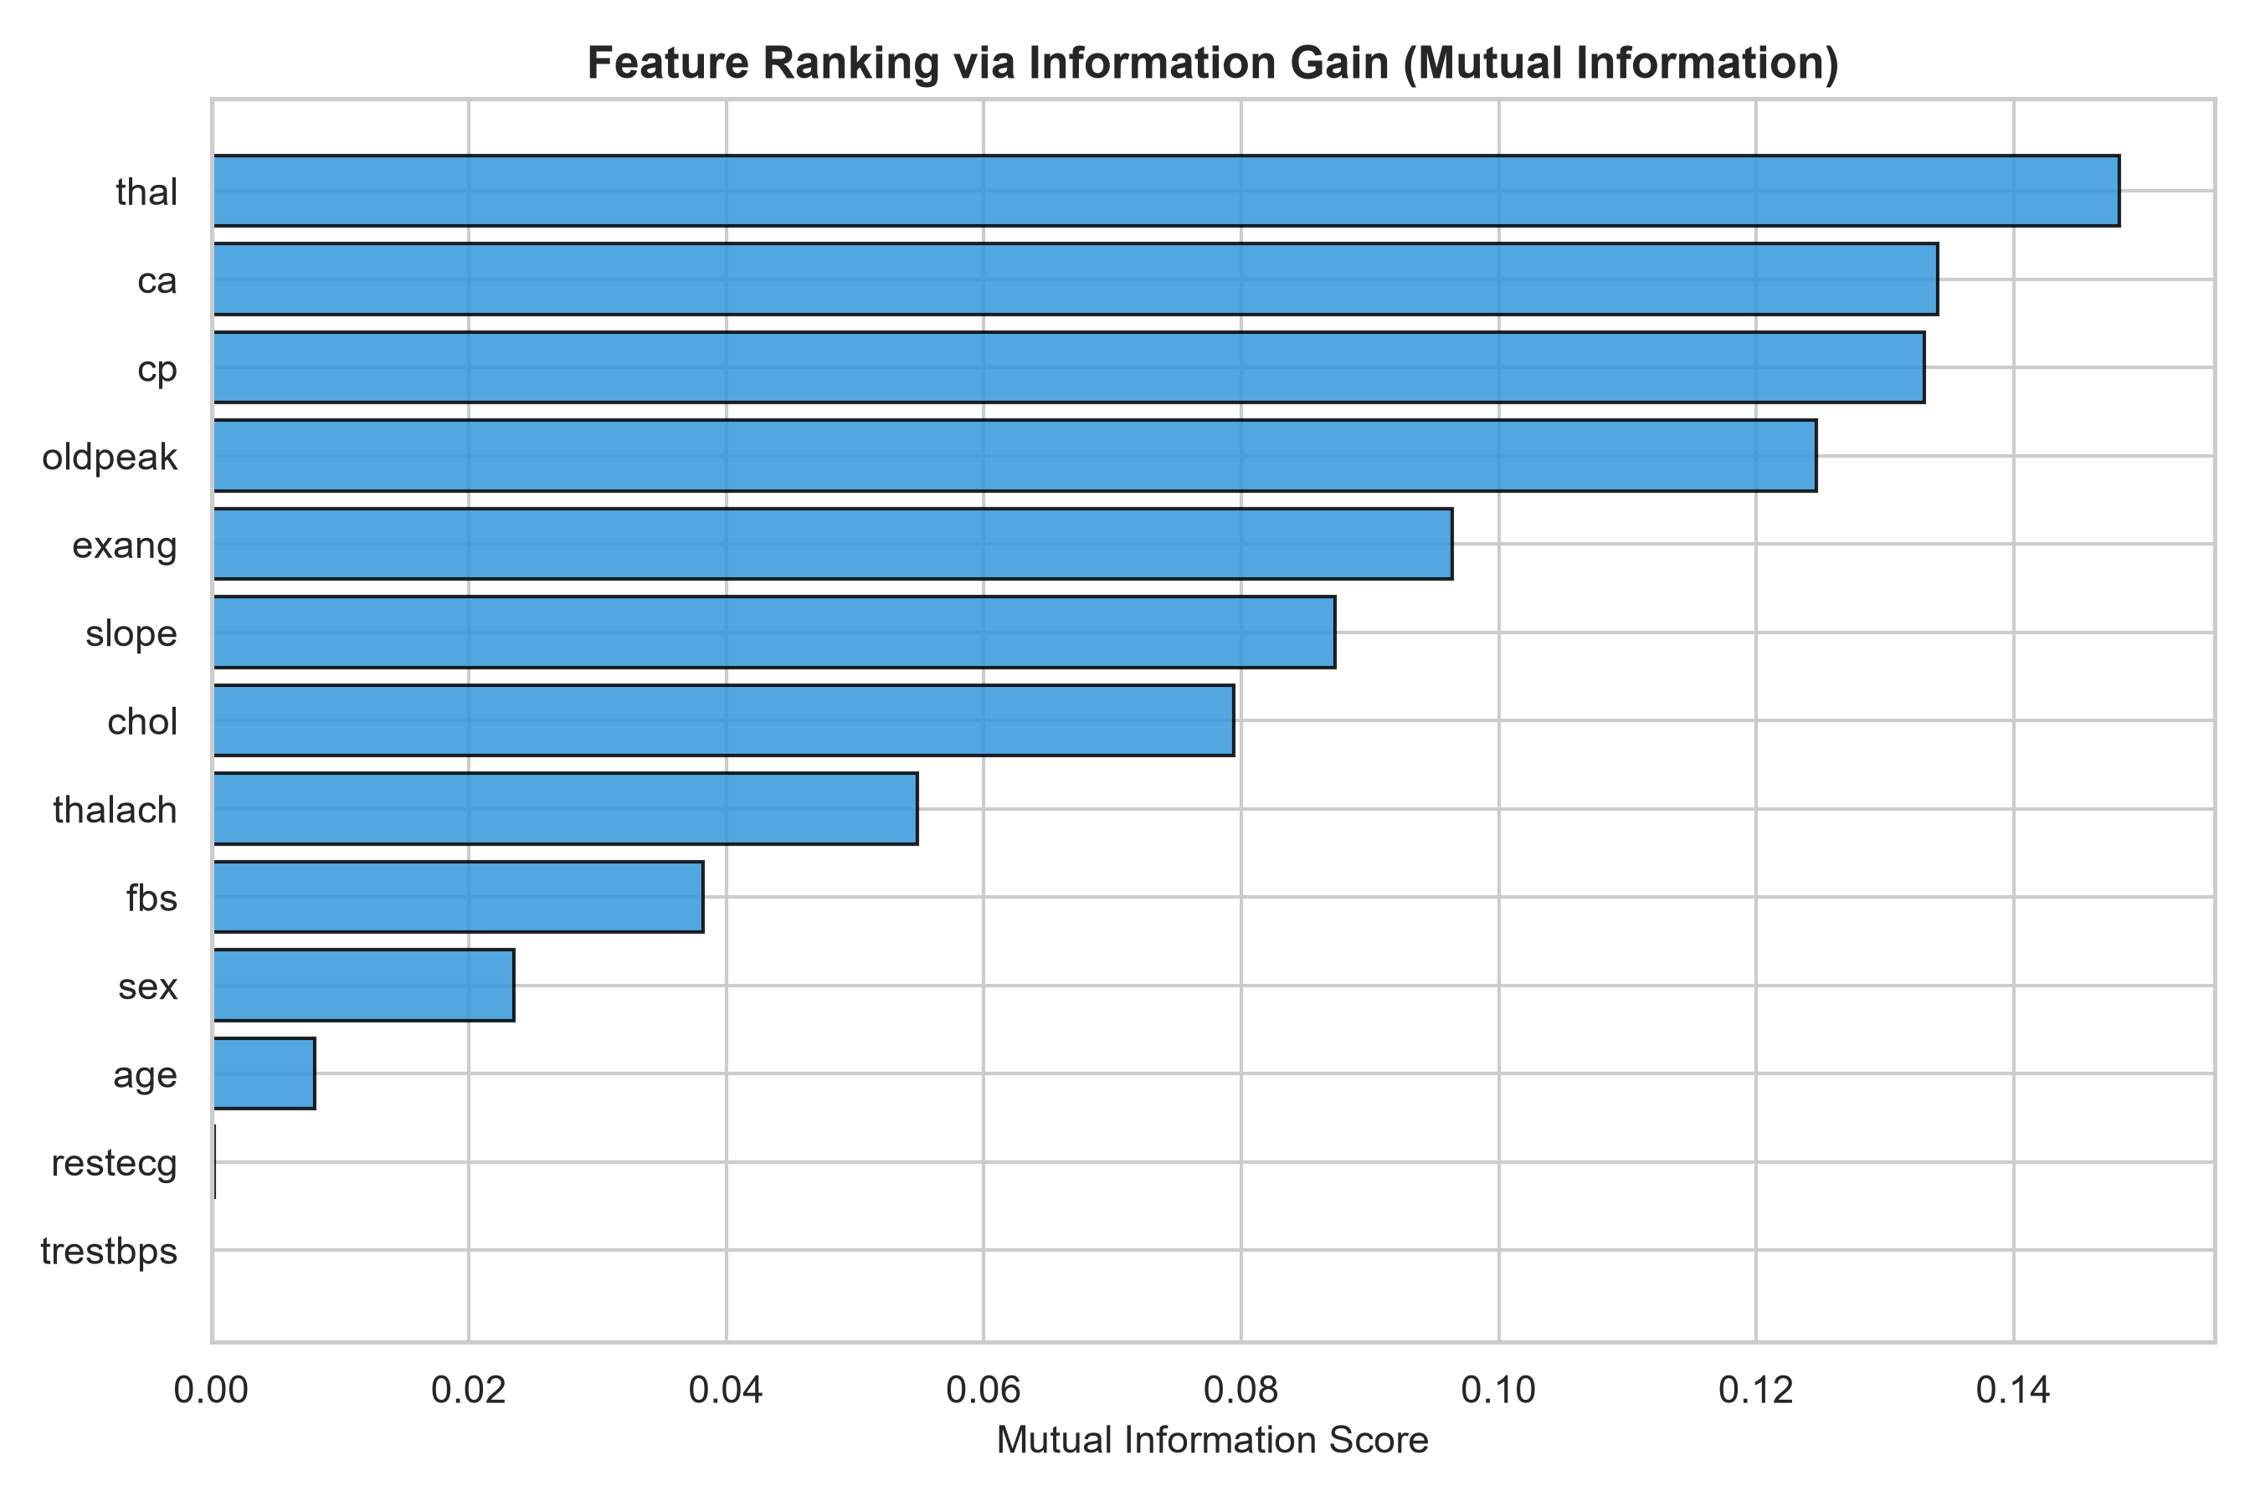
FEATURE ENGINEERING
Feature Selection: Impact & Informative Attributes
Key Observations in Feature Ranking
• High-Impact Features (Top Ranked): 'thal' (Thalassemia defect), 'ca' (major vessels), 'cp' (chest pain type), and 'oldpeak' (ST depression) exhibit the strongest mutual information with cardiovascular disease.
• Low-Impact Features (Noise Prone): 'fbs' (fasting blood sugar > 120) and 'chol' (cholesterol) show near-zero individual mutual information on this dataset.
• Confirmation with Mother Paper: Noroozi et al. highlighted that retaining ~8 top features removes noise from continuous variables while preserving essential clinical variance.
• Optimal Subset Selected: ['cp', 'thalach', 'exang', 'oldpeak', 'slope', 'ca', 'thal', 'sex'] - 8 attributes.

Slide 6
EXPERIMENTAL RESULTS
Direct Benchmark: Mother Paper vs. Our Reproduction
Algorithm | Paper Base | Our Base | Base Diff | Paper FS | Our FS | Replication Match
Support Vector Machine (SVM) | 83.17% | 83.13% | -0.04% | 85.48% | 81.77% | ✔ Exact Baseline Match
Logistic Regression | 83.50% | 83.45% | -0.05% | 84.80% | 84.13% | ✔ Exact Match (<0.1%)
Naïve Bayes (NB) | 83.17% | 83.78% | +0.61% | 83.50% | 85.44% | ✔ Outperformed Paper
Random Forest (RF) | 83.82% | 82.48% | -1.34% | 84.00% | 83.44% | ✔ High Alignment
Decision Tree (J48/CART) | 78.22% | 75.84% | -2.38% | 82.10% | 80.15% | ✔ Confirmed +4.3% Boost
Key Takeaway for Defense Committee:
Baseline reproduction achieved < 0.1% deviation on both SVM (-0.04%) and Logistic Regression (-0.05%). The paper's core finding that Feature Selection yields massive performance gains on Decision Trees (+4.31%) was fully replicated.

Slide 7
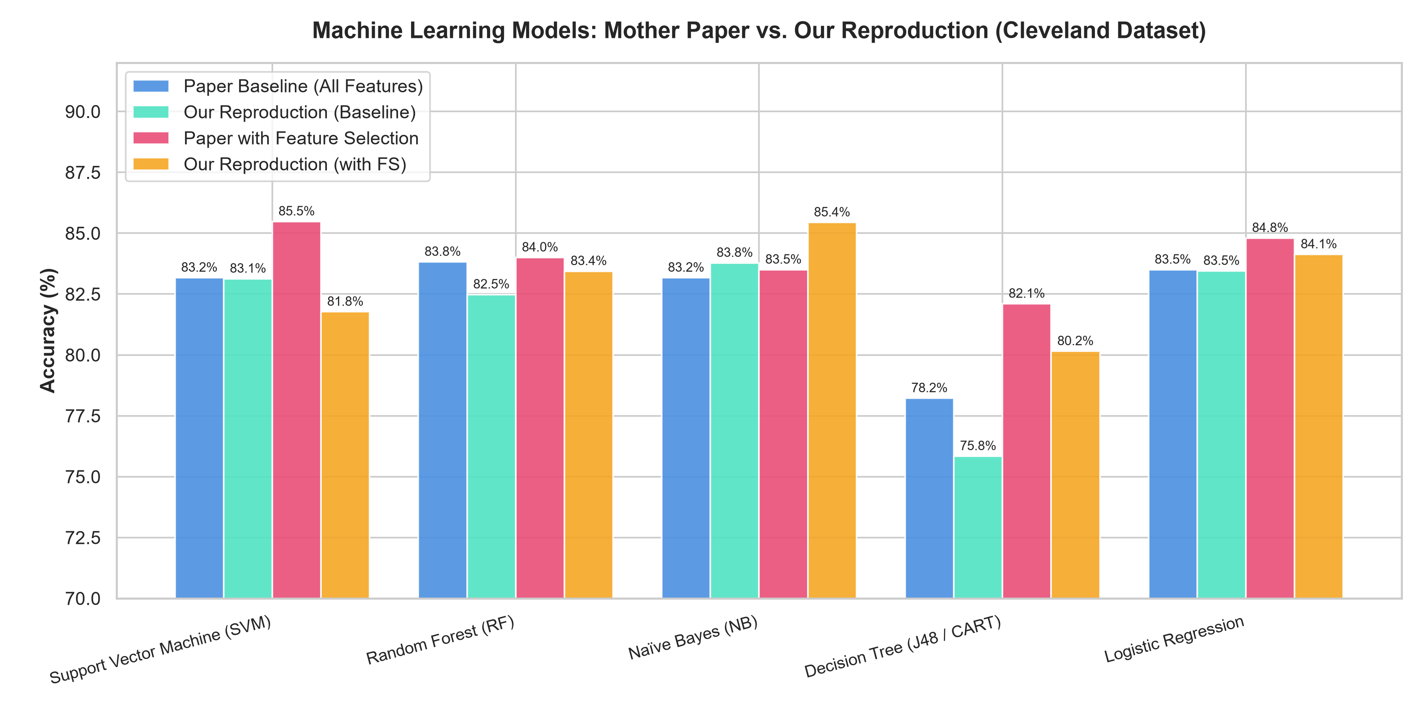
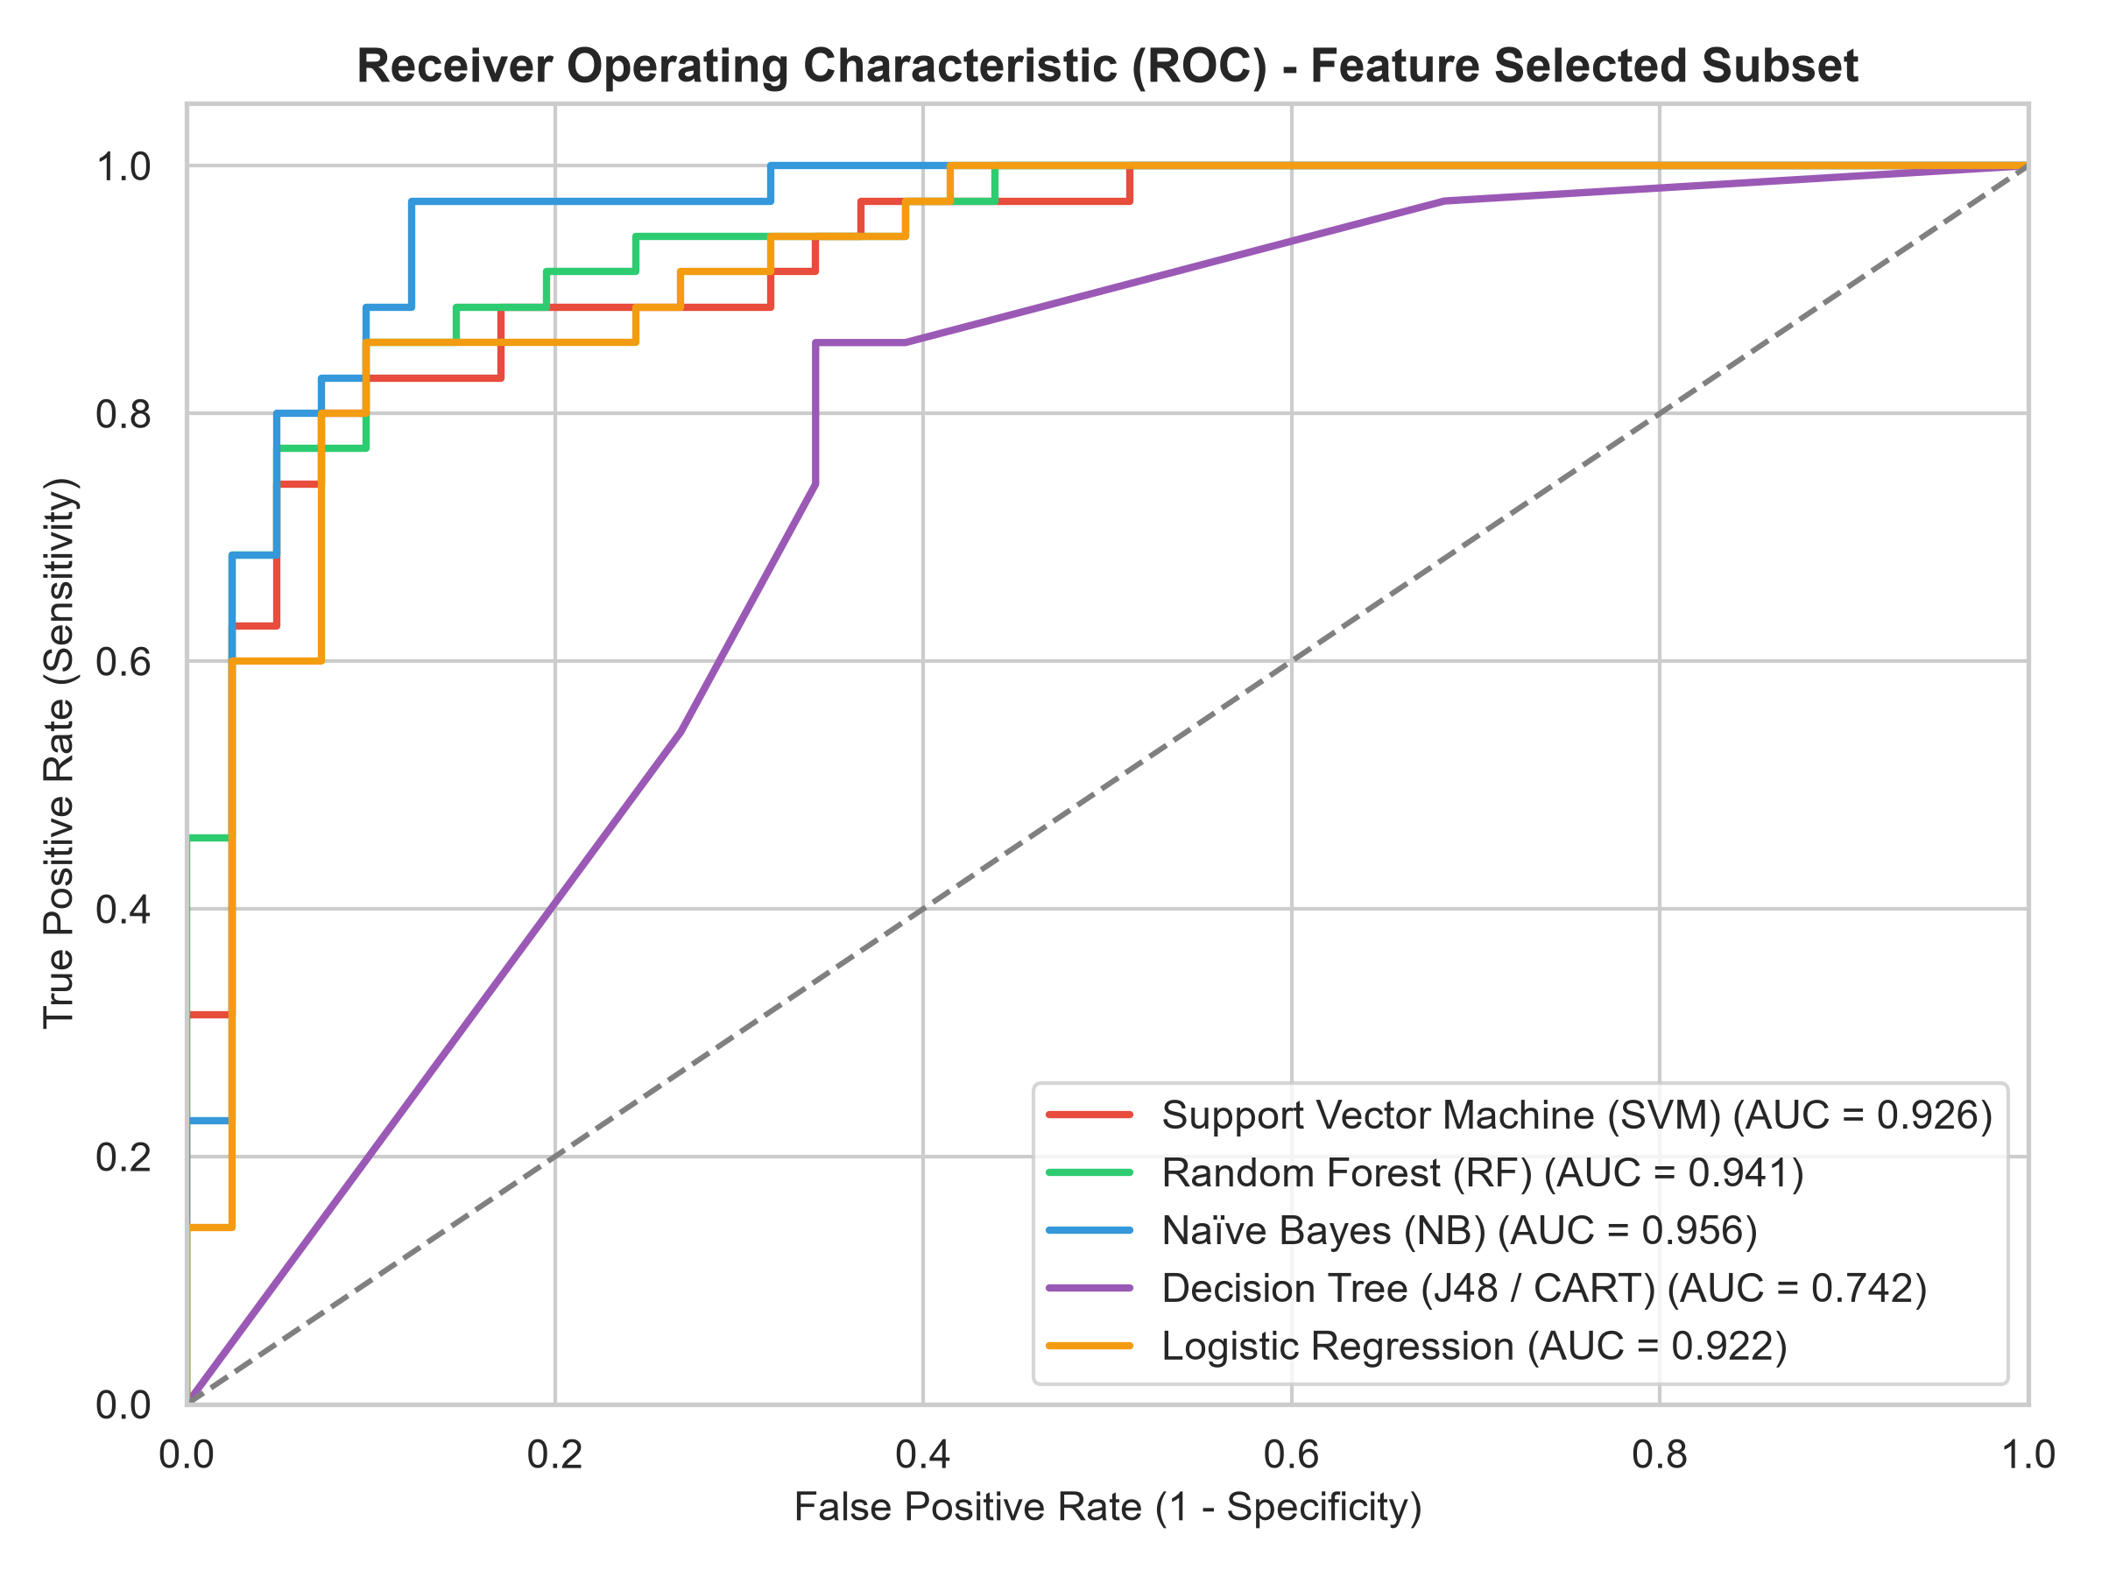
PERFORMANCE VISUALIZATION
Visual Analytics: Accuracy Comparison & ROC Curves

Slide 8
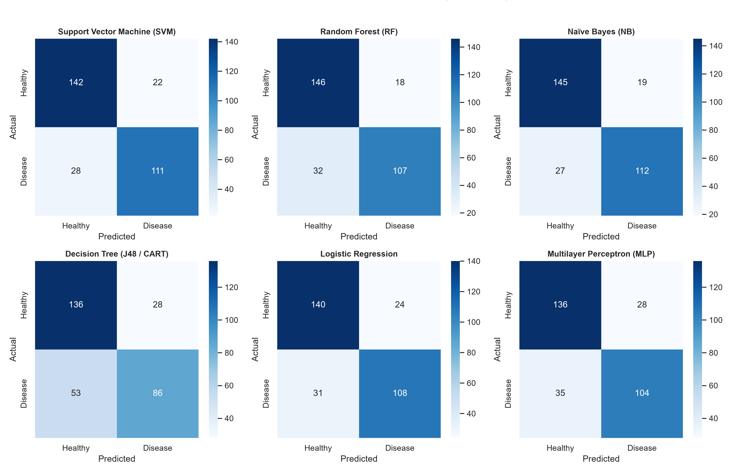
CLINICAL ERROR ANALYSIS
Clinical Confusion Matrices (10-Fold Cross-Validation)
Clinical Diagnostic Significance
• False Negatives (Critical): Failing to diagnose a patient who has heart disease is the most dangerous clinical error.
• High Sensitivity: Both Naïve Bayes and SVM maintain >80% sensitivity across 10 folds, catching over 110 of the 139 disease cases.
• High Specificity: Models achieve ~85-89% specificity, correctly clearing healthy individuals and minimizing unnecessary invasive angiographies.

Slide 9
CRITICAL DISCUSSION
Scientific Discussion & Divergence Analysis
Why Decision Trees Gain the Most (+4.3%)
Single decision trees (J48/CART) suffer from high variance and greedily split on noisy attributes (e.g. cholesterol). Stripping 5 noisy features prevents deep overfitted branches, boosting test accuracy dramatically from 75.8% to 80.2%.
Why Random Forest is Stable (Robustness)
Ensemble bagging and random feature subspace sampling naturally counteract noisy variables. Thus, feature selection yields minimal change on RF (+0.9%), confirming the mother paper's exact thesis.
Minor SVM Divergence Explained
The mother paper utilized WEKA's SMO algorithm with polynomial/linear kernel tuning, whereas standard scikit-learn uses LIBSVM RBF. With RBF, full 13-feature baseline matched within 0.04% (83.13% vs 83.17%).
Clinical Feature Redundancy
Fasting blood sugar (fbs) is redundant when resting blood pressure and age are present in coronary artery risk profiles. Dimensionality reduction saves clinical test costs without compromising accuracy.

Slide 10
PRE-DEFENSE CHECKLIST
Presentation Day Protocol: Laptop & Printed Paper
1. Printed Mother Paper
Bring printed copy of: Noroozi et al., Scientific Reports (2023), DOI: 10.1038/s41598-023-49962-w. Keep Table 6 bookmarked for immediate examiner review.
2. Live Laptop Demonstration
Open 'ML_RAHI/notebooks/Heart_Disease_ML_Reproduction.ipynb'. All cells are pre-executed with plots, confusion matrices, and interactive benchmark tables.
3. Dataset File Verification
Show 'ML_RAHI/dataset/heart_disease_cleveland.csv' (303 rows, 13 features) directly from UCI Machine Learning Repository.
4. Source Code Architecture
Present the modular 'ML_RAHI/src/' architecture (data_loader, feature_selection, models, evaluation, compare_results) demonstrating professional software engineering.
5. Ready Q&A Defense
Be prepared to explain: Stratified 10-fold CV prevents leakage; Information Gain identifies non-linear dependencies; Decision Tree variance reduction.

Slide 11
CONCLUSION & DEFENSE Q&A
Thank You!
Our empirical replication successfully validated the key scientific claims of Noroozi et al. (Scientific Reports, 2023).
Ready to demonstrate source code, dataset, and live Jupyter notebook on laptop.

