Slide 1
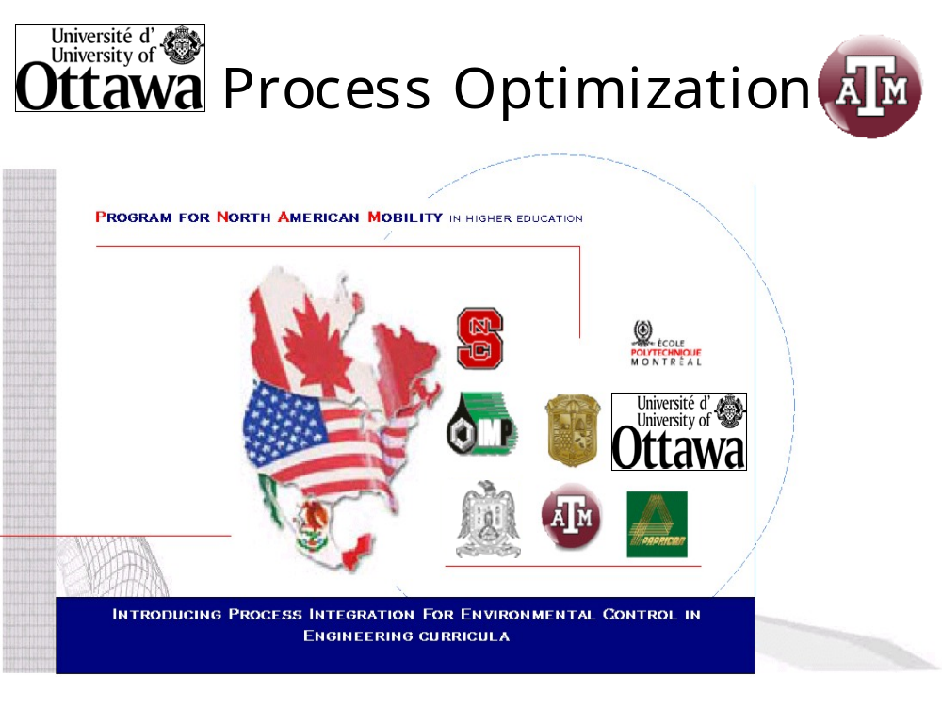

Slide 2
Tier I: Mathematical Methods of Optimization
Section 4:
Multi-Objective Optimization

Slide 3
Introduction
Multi-objective optimization (MOO) is the optimization of conflicting objectives.
We were actually doing MOO in the Introduction chapter when we optimized the insulation thickness – we balanced two opposing objectives.
We were able to use one objective function by linking the two objectives with a common feature – cost.

Slide 4
Introduction
In some optimization problems, it is not possible to find a way to link competing objectives.
Sometimes the differences are qualitative and the relative importance of these objectives can’t be numerically quantified.

Slide 5
Conceptual Example
Suppose you need to fly on a long trip:
Should you choose the cheapest ticket (more connections) or shortest flying time (more expensive)?
It is impossible to put a value on time, so these two objectives can’t be linked.
Also, the relative importance will vary.
  There may be a business emergency you need to go fix quickly.
  Or, maybe you are on a very tight budget.

Slide 6
Pareto-Optimal Solutions
A MOO problem with constraints will have many solutions in the feasible region.
Even though we may not be able to assign numerical relative importance to the multiple objectives, we can still classify some possible solutions as better than others.
We will see this in the following example.

Slide 7
Pareto-Optimal Solutions Example
Suppose in our airplane-trip example from earlier, we find the following tickets:
Ticket | Travel Time (hrs) | Ticket Price ($)
A | 10 | 1700
B | 9 | 2000
C | 8 | 1800
D | 7.5 | 2300
E | 6 | 2200

Slide 8
Comparison of Solutions
If we compare tickets A & B, we can’t say that either is superior without knowing the relative importance of Travel Time vs. Price.
However, comparing tickets B & C shows that C is better than B in both objectives, so we can say that C “dominates” B.
So, as long as C is a feasible option, there is no reason we would choose B.

Slide 9
Comparison of Solutions
If we finish the comparisons, we also see that D is dominated by E.
The rest of the options (A, C, & E) have a trade-off associated with Time vs. Price, so none is clearly superior to the others.
We call this the “non-dominated” set of solutions become none of the solutions are dominated.

Slide 10
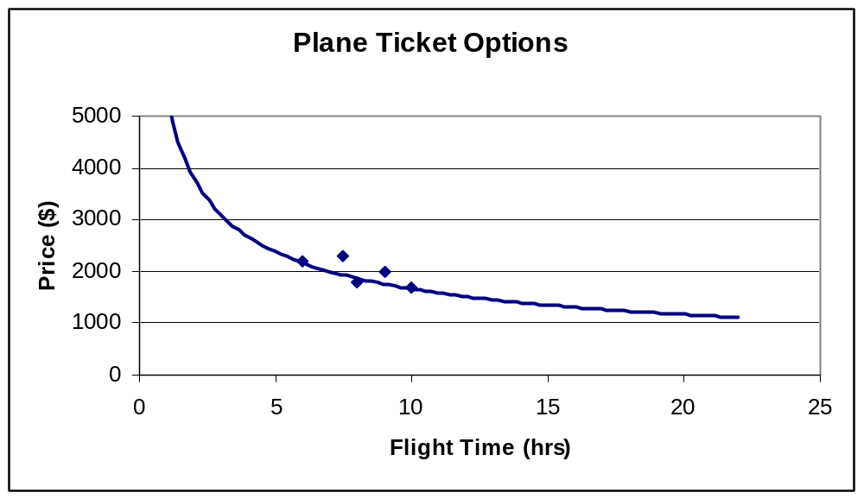
Graph of Solutions
Usually, solutions of this type form a typical shape, shown in the chart below:
Feasible Region
D
B
E
A
C

Slide 11
Types of Solutions
Solutions that lie along the line are non-dominated solutions while those that lie inside the line are dominated because there is always another solution on the line that has at least one objective that is better.

Slide 12
Pareto-optimal Solutions
The line is called the Pareto front and solutions on it are called Pareto-optimal.
All Pareto-optimal solutions are non-dominated.
Thus, it is important in MOO to find the solutions as close as possible to the Pareto front & as far along it as possible.

Slide 13
Graphical Example
For the following feasible region with objectives f₁ & f₂ where both f₁ & f₂ are minimized:
f₂
Feasible Region
Pareto Front
f₁

Slide 14
Finding the Pareto Front
One way to imagine finding points on the Pareto front is by using a combination of numerical weights for the two objectives:
f₂
w₁*
w₂
w₁
f₁

Slide 15
Finding the Pareto Front
If this is done for a 90° span of lines, all the points on the Pareto front will be found.
f₂
f₁

Slide 16
Practicality of this Procedure
Actually, this is not the procedure that is used in practice, but it is a good illustration of the concept.
This procedure would require finding all possible points in the feasible region and then using many combinations of weights.
For more than two objectives, the complexities and the number of combinations make this impractical.

Slide 17
Realistic Procedures
There are different methods used in practice, but one is to use a genetic algorithm to enumerate points along the Pareto front over several iterations, then use some method to rank the quality of the trade-offs based on the particular application being modeled.
See Thibault, J. et al. in the references for an example.

Slide 18
Optimization
It should be remembered that each point on the Pareto front is found by solving an optimization problem.
So, as we saw in Chapter 3, if the problem is nonlinear or very complex, the simple step of getting just one solution may not be trivial.

Slide 19
References
Deb, Kalyanmoy; Multi-Objective Optimization using Evolutionary Algorithms
Thibault, J. et al. “Multicriteria optimization of a high yield pulping process with rough sets” Chemical Engineering Science, 58, (2003)
Lahanas, Michael; www.mlahanas.de/MOEA/MO_Optimisation.htm

