Slide 1
PHISHING ATTACK

Slide 2
Table of Contents
What is Phishing.
Type Of Phishing Techniques.
Indicators of Phishing.
How To Avoid Phishing.
Consequences Phishing.
Example
Resource

Slide 3

What is Phishing Attack ?
Phishing attack are social engineering attack . Phishing is when attacker send a legitimate looking email "from bank or any organization " that ask you to register in fake website or ask you to click on link to steal your information .

Slide 4

Types of Phishing
1. Email Phishing
This term given to any malicious email message meant to trick users into divulging private information. Attackers generally aim to steal account credentials.

Slide 5
2. SMS Phishing (Smishing )
is a social engineering attack that uses fake mobile text messages to trick people into downloading malware, sharing sensitive information.

Slide 6
3. Voice Phishing(vishing )
is the use of fraudulent phone calls to trick people into giving money or revealing personal information.

Slide 7
4. Pharming(DNS Poising)
is online fraud that involves the use of malicious code to direct victims to spoofed websites in an attempt to steal their credentials and data. ex/ when i need to open facebook.com Suddenly I opened another website

Slide 8
5. Search Engine Phishing
Attackers manipulate search engine results to lead users to malicious websites posing as legitimate ones. This is often used in combination with other phishing techniques.

Slide 9
6. Malware-Based Phishing
Emails or messages contain malicious attachments or links that, when clicked, install malware on the victim's device. This malware can steal sensitive information or grant attackers control over the device.

Slide 10
7. Malware-Based Phishing
Emails or messages contain malicious attachments or links that, when clicked, install malware on the victim's device. This malware can steal sensitive information or grant attackers control over the device.

Slide 11
8. Spear phishing
is a phishing attack that targets a specific individual usually a person who has privileged access to sensitive data or network resources, or special authority that the scammer can exploit for fraudulent or nefarious purposes.

Slide 12
9. Image Phishing
is an attack in which hacker disguise malicious code or malware using image file . once click on the image your computer will downloading the malicious code that stored in image.

Slide 13

Indicators Of Phishing
Email Spoofing :
The attacker can forge the sender’s Email Address to appear legitimate .
Suspicious URLs:
the attacker can manipulate In the attached Links through
misspelled domain names
https://Amazon.com , https://Amaz0n.com
Extra Characters
https://Facebook.com , https://Faceboook.com

Slide 14
How To Avoid Phishing
Avoid vist unsecure (HTTP)website.
Aviod open link from unknown phone number.
Always use VPN when connecting to public W-IFI network.
Always look at Url of site before login .
Always use antivirus and think twice before click on link and attachments.

Slide 15
How To Avoid Phishing
.
Never click on or download images from a suspicious email message.
Use MFA ( Multi Factor Authentication ).
You must update the software , Browsers and security applications .
Never enter private or personal information into a popup window.
Don’t buy from an unfamiliar company

Slide 16
Consequences Of Phishing
Data Breach:
Successful phishing attack can steal
sensitive data like ( Emails , Passwords ,
Cookies , Visa card passwords )
Financial Loss
You May loss a lot of money Due fraudulent
activities resulting from phishing attacks

Slide 17
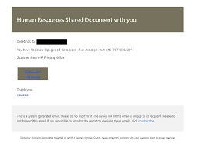
Example:
1. Message from HR scam

Slide 18
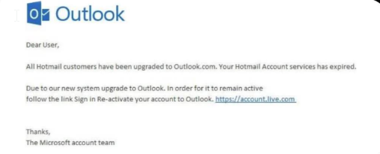
Example:
2. Email account upgrade scam

Slide 19
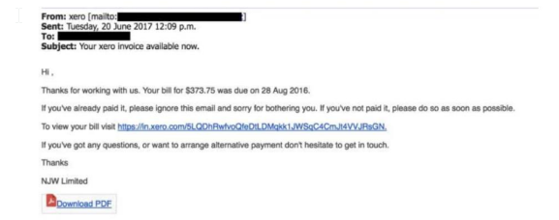
Example:
3. Fake invoice scam

Slide 20
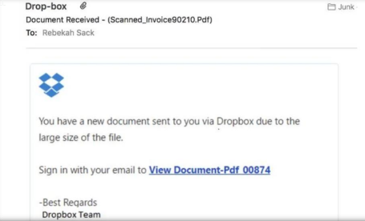
Example:
4. Dropbox scam

Slide 21
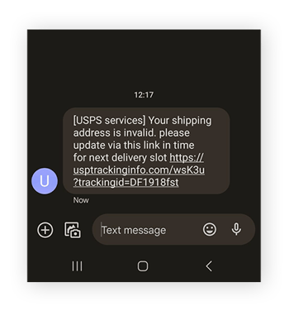
Example:
5. Smishing

Slide 22
Resources
https://www.ibm.com/topics/phishing
https://en.wikipedia.org/wiki/Phishing
https://www.mimecast.com/content/what-is-phishing/

Slide 23

Thanks!

