Slide 1
Source code review

Slide 2
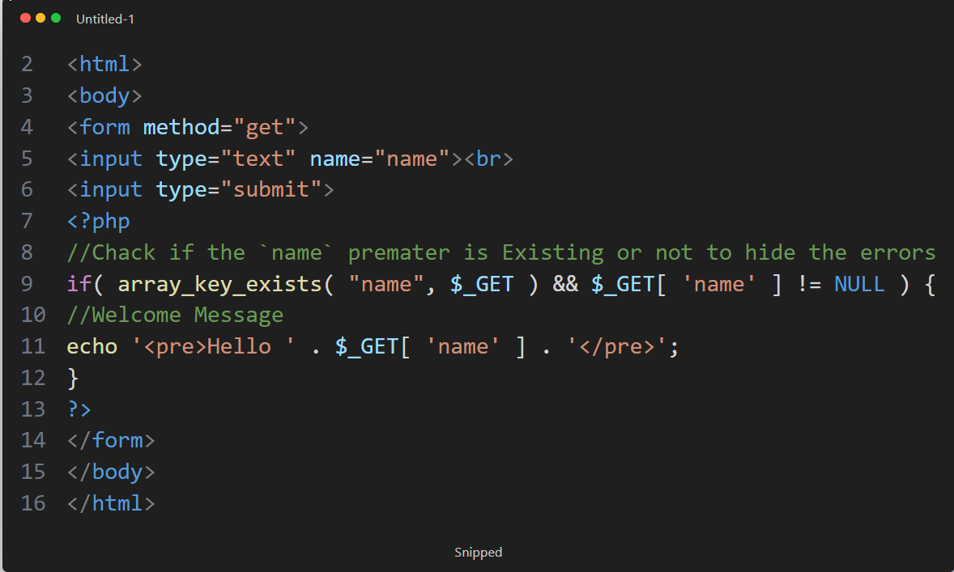
(XSS)-NOT-FIXED-CODE.php
This code represents a simple web page with a form allowing users to input their name. When the form is submitted (by clicking the "Submit" button), PHP is used to check if the "name" parameter exists in the GET request or not.
If the name is exist , the code prints out a welcoming message containing the entered name.

Slide 3
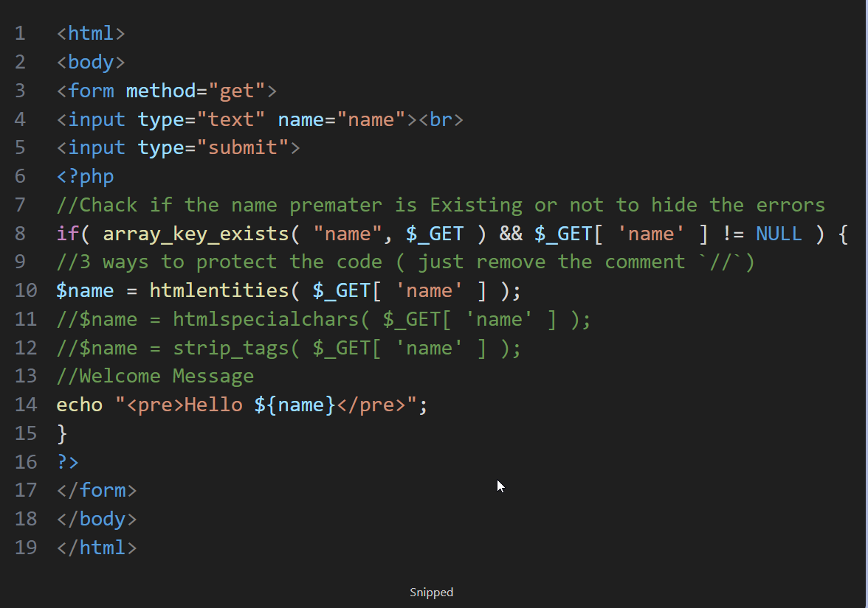
(XSS)-FIXED-CODE.php
I will use:
htmlspecialchars() function that converts special characters into HTML entities
array_key_exists() to check if a specified key or index exists in an array.
htmlentities() is used to convert characters with special HTML entities (such as <, >, ", and &) into appropriate HTML encodings.

Slide 4
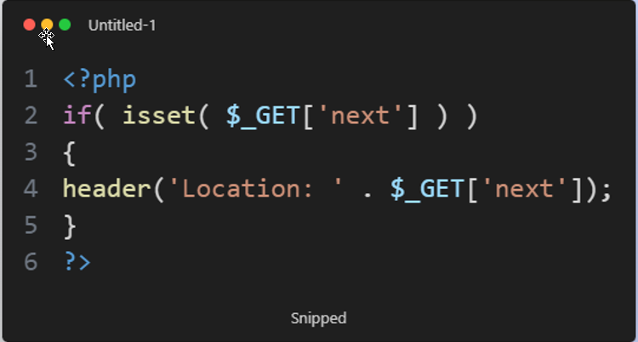
Open redirect Not- FIXED-CODE.php
Essentially, the code manages the redirection process where the user enters a new page based on the address given in the "next" operator parameter in the link.
isset() function used to determine whether a variable is set or not

Slide 5
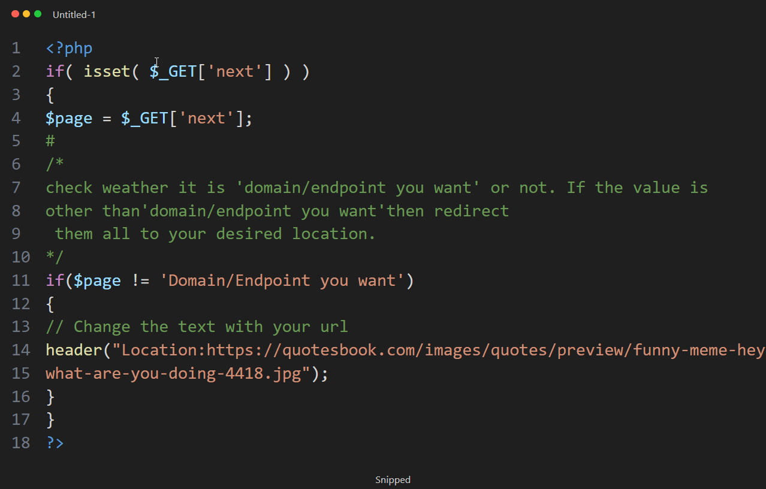
Open redirect FIXED-CODE.php
This code checks if there's a variable called "next" in the URL. If it's there, it stores its value in a variable called "$page". Then, if the value of "$page" is not equal to a specific phrase, it redirects you to another page.

Slide 6
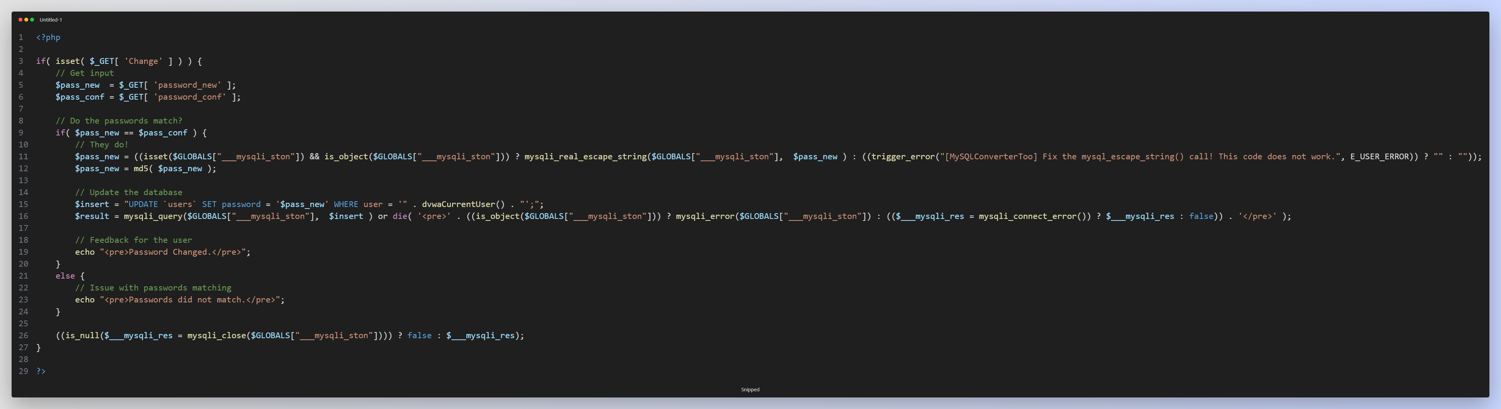
CSRF NOT-FIXED-CODE.php
This PHP script handles password changes. When the 'Change' parameter is set in a GET request, it takes the new password and its confirmation, checks if they match, then updates the password in the database if they do. It uses MD5 for hashing passwords (which isn't recommended for security) and mysqli_real_escape_string for basic input sanitization.

Slide 7
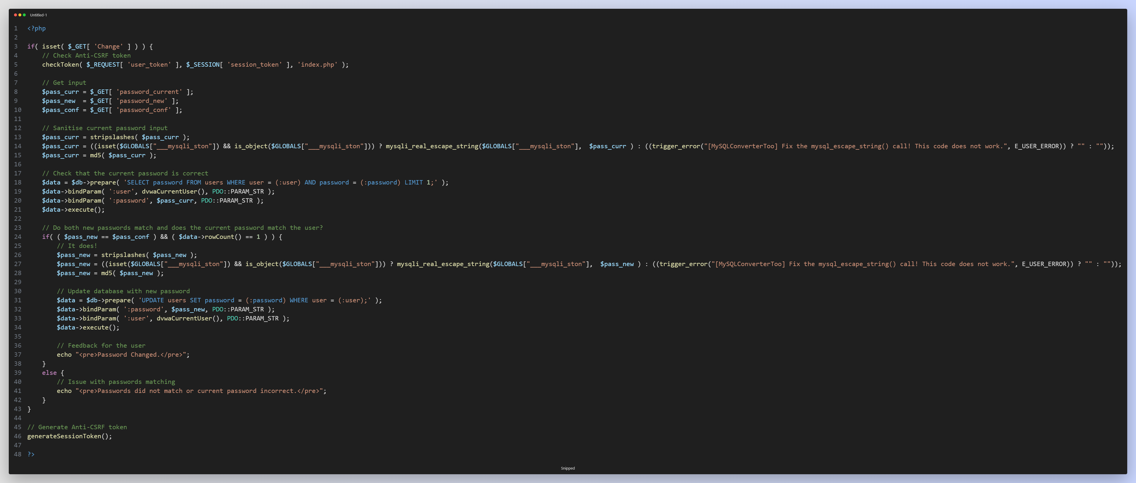
CSRF FIXED-CODE.php
This PHP script manages password changes on a website. It ensures security by verifying the current password against the one stored in the database and checks if the new password matches the confirmation. If everything checks out, it updates the password in the database. It also generates a CSRF token for added security.

Slide 8
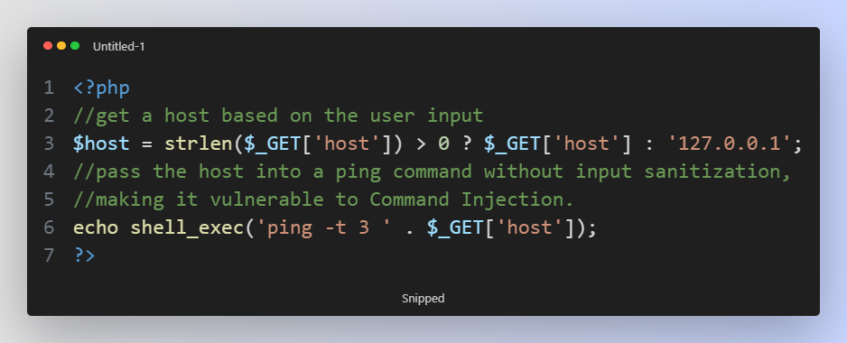
Command injection NOT-FIXED-CODE.php
This code takes a parameter named 'host' from the URL. It then pings the specified host using the 'ping' command with a timeout of 3 seconds and prints the result.
However, it's important to note that directly using user-provided input ($_GET['host']) without proper validation or sanitization can pose security risks, such as command injection attacks. So, it's recommended to validate and sanitize user input before using it in shell commands like this.

Slide 9
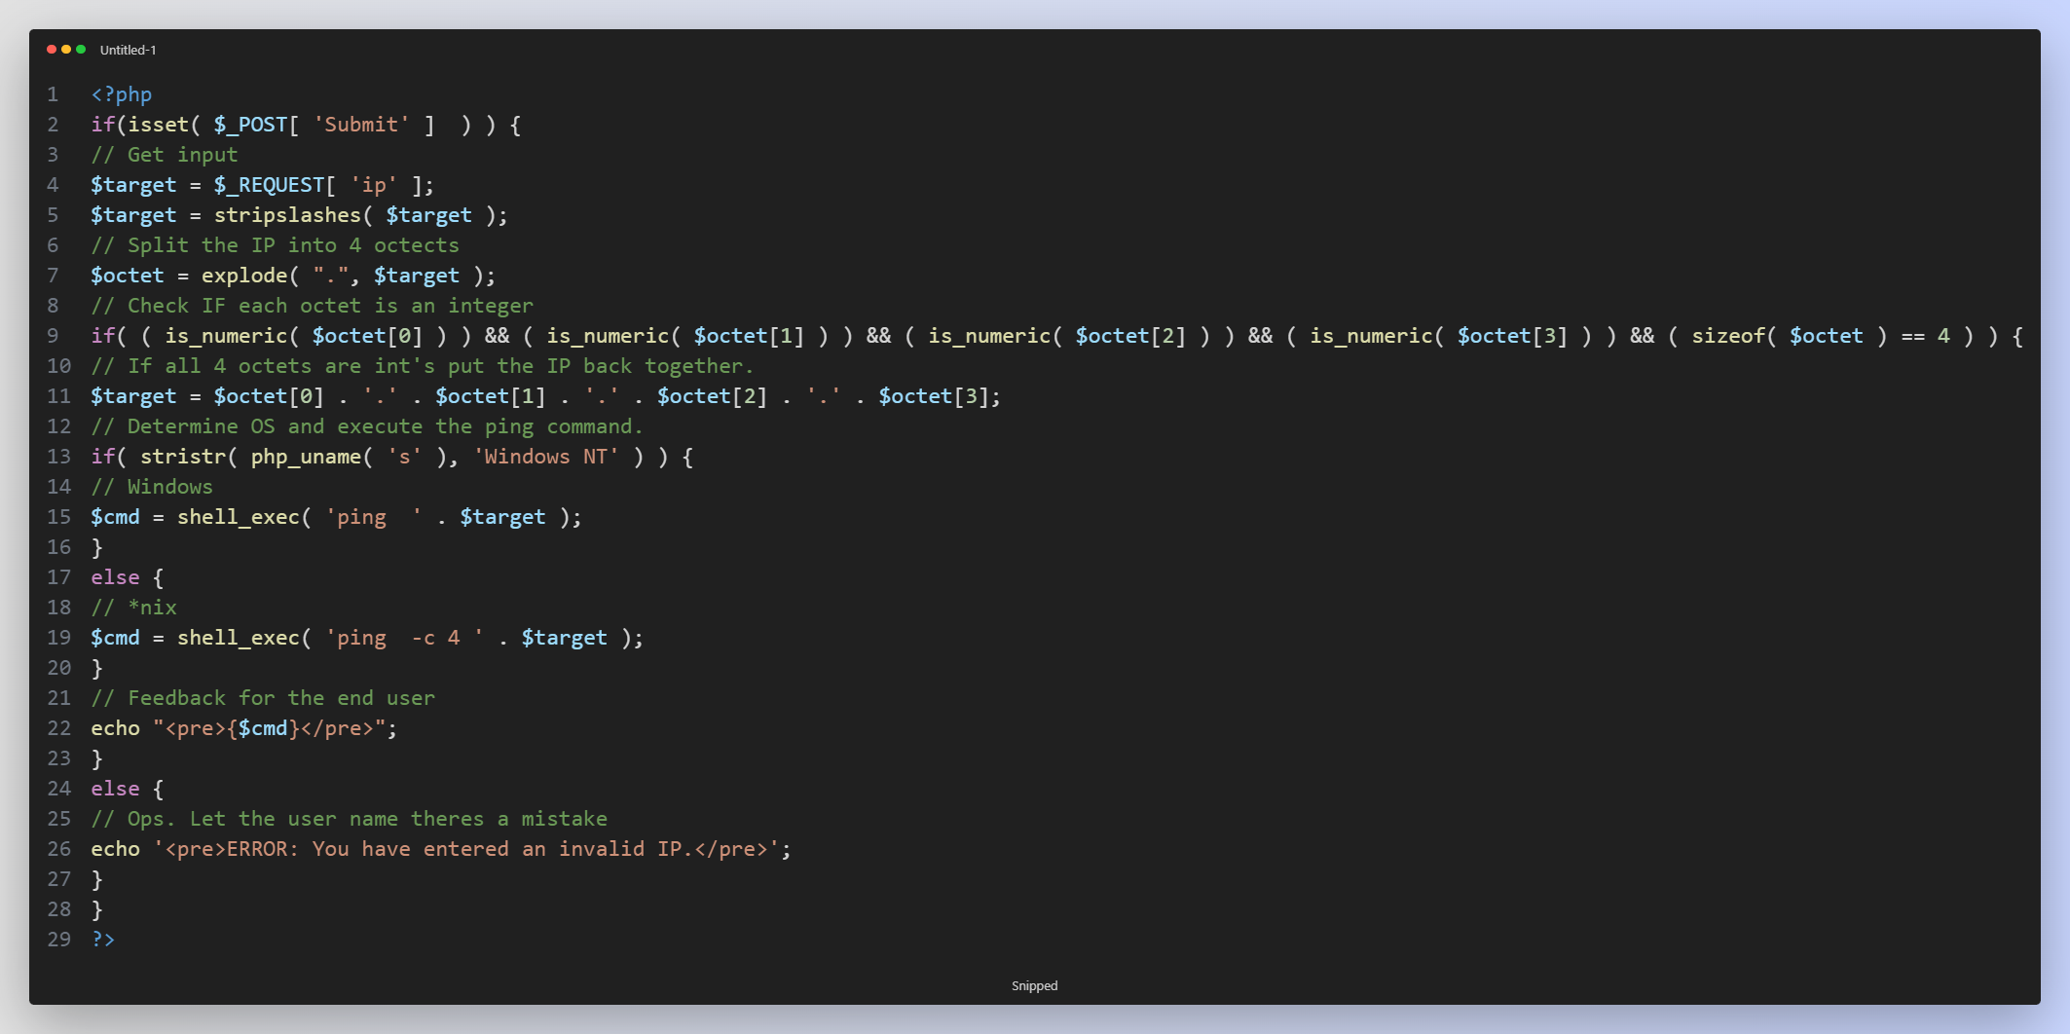
Command injection FIXED-CODE.php
This code checks if a form named 'Submit' has been submitted. If it has, it retrieves an IP address from the form. Then, it validates the IP address to ensure it consists of four numeric octets. If the IP is valid, it pings it. Finally, it displays the ping result. If the IP is invalid, it shows an error message.

Slide 10
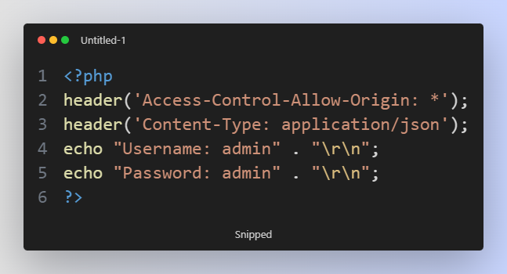
CORS NOT-FIXED-CODE.php
This code snippet sets the CORS (Cross-Origin Resource Sharing) header to allow access from any origin and specifies the Content-Type header as 'application/json'. Then, it echoes out JSON-formatted data containing the username and password.

Slide 11
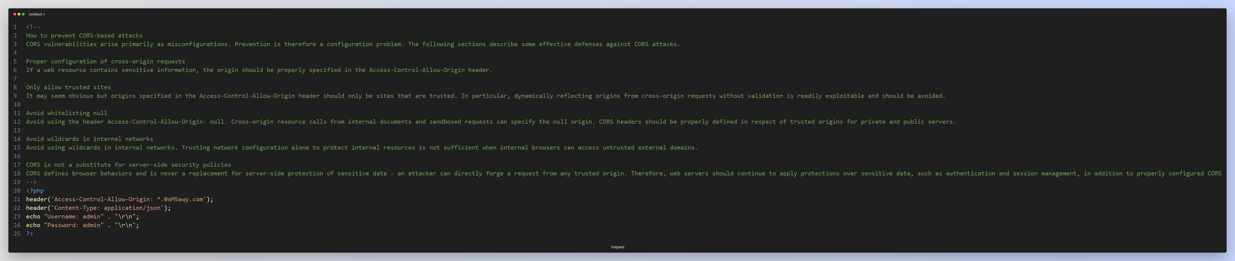
CORS FIXED-CODE.php
This code snippet sets the CORS (Cross-Origin Resource Sharing) header to allow access from any origin that ends with ".0xM5awy.com". It also specifies the Content-Type header as 'application/json'. Then, it echoes out JSON-formatted data containing the username and password.

Slide 12
THANKS

