Slide 1

IPVS
Lab presentation
information system

Slide 2
IPVS
Information Governance (IG) using Full Text Information Retrieval (IR) Techniques on Unstructured Data
Team member:
Yang Haoran
Zhou Jingyue
Soheb Hanif Teli
Liu Yuxin
Supervisor:
Cataldo Mega

Slide 3
IPVS
Part I: Motivation
Part II: Components model
1. Kubernetes
2. Microservice module
3. Solrcloud module
4. Database module
Part III: Demo
1. Sequence diagram & Demo
Content

Slide 4
IPVS
Key Words:
Information & Data assets
Business relevant data
Common corporate document repositories & enterprise archives
Load, store and index
Search and retrieval
Index metadata and full text data
Motivation
Enterprise Information Management

Slide 5
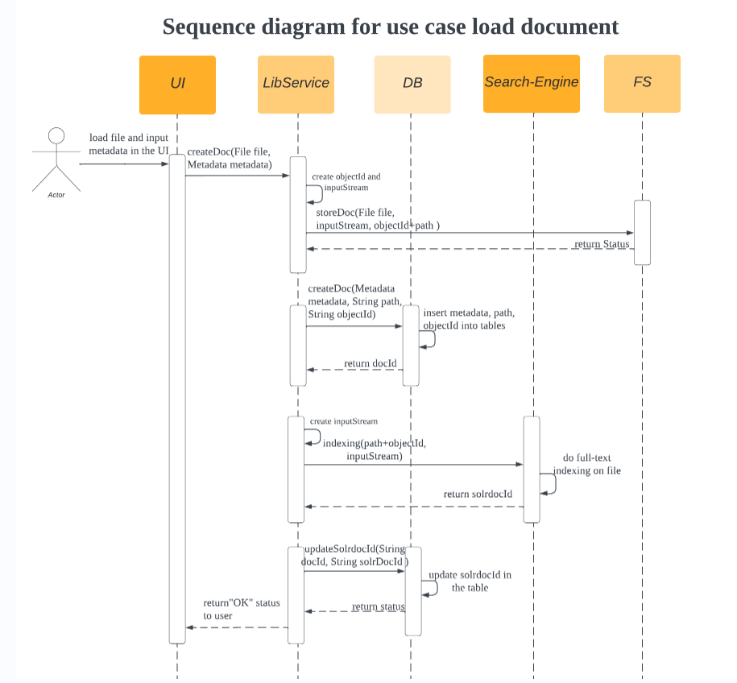

Slide 6
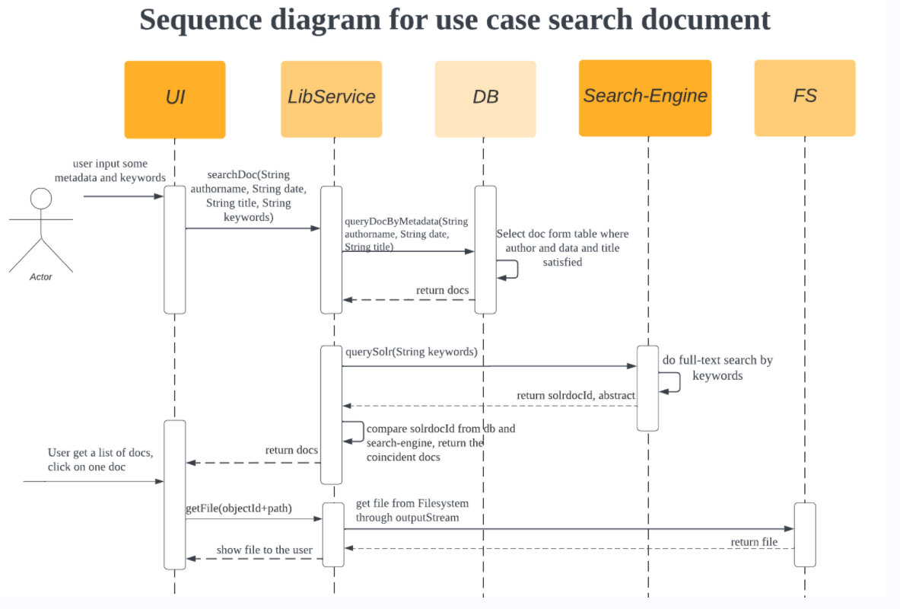

Slide 7
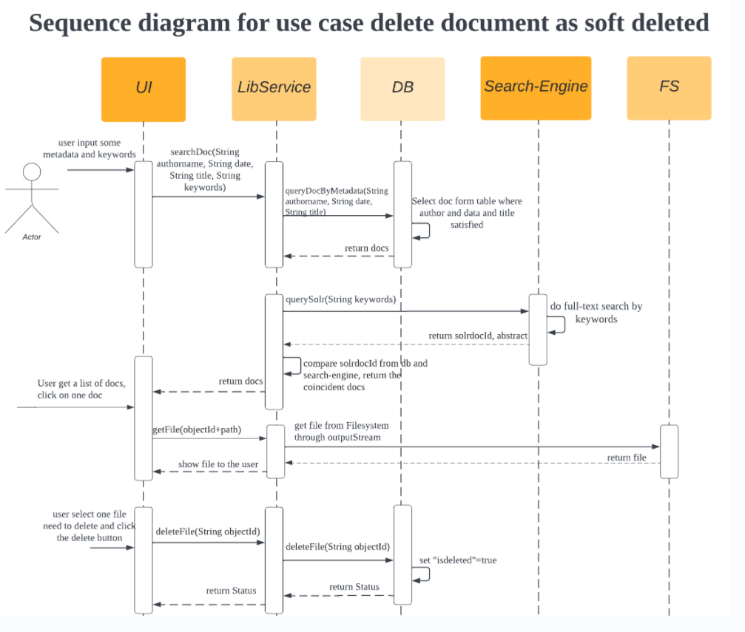

Slide 8

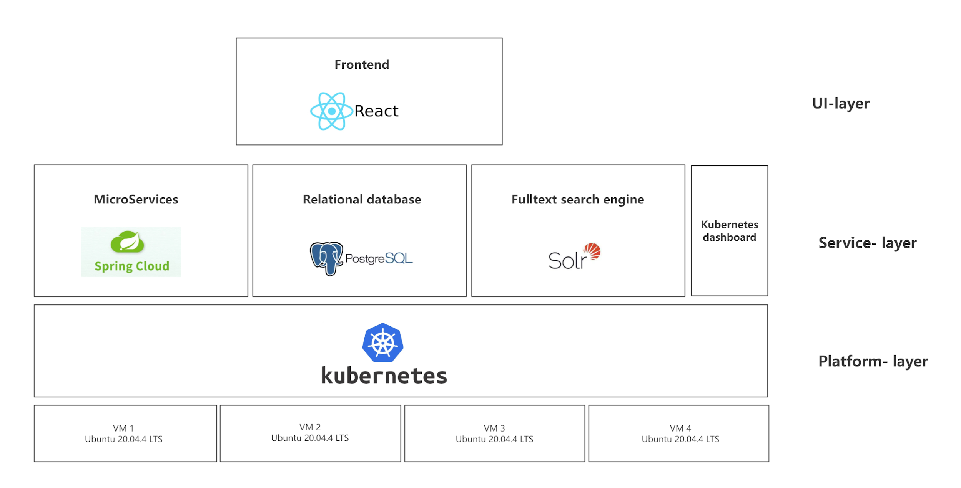
Component model
distributed database system
k8s operators
json format
Distributed cluster management system
Container technology
large scale
distributed indexing and retrieving
loose coupling

Slide 9
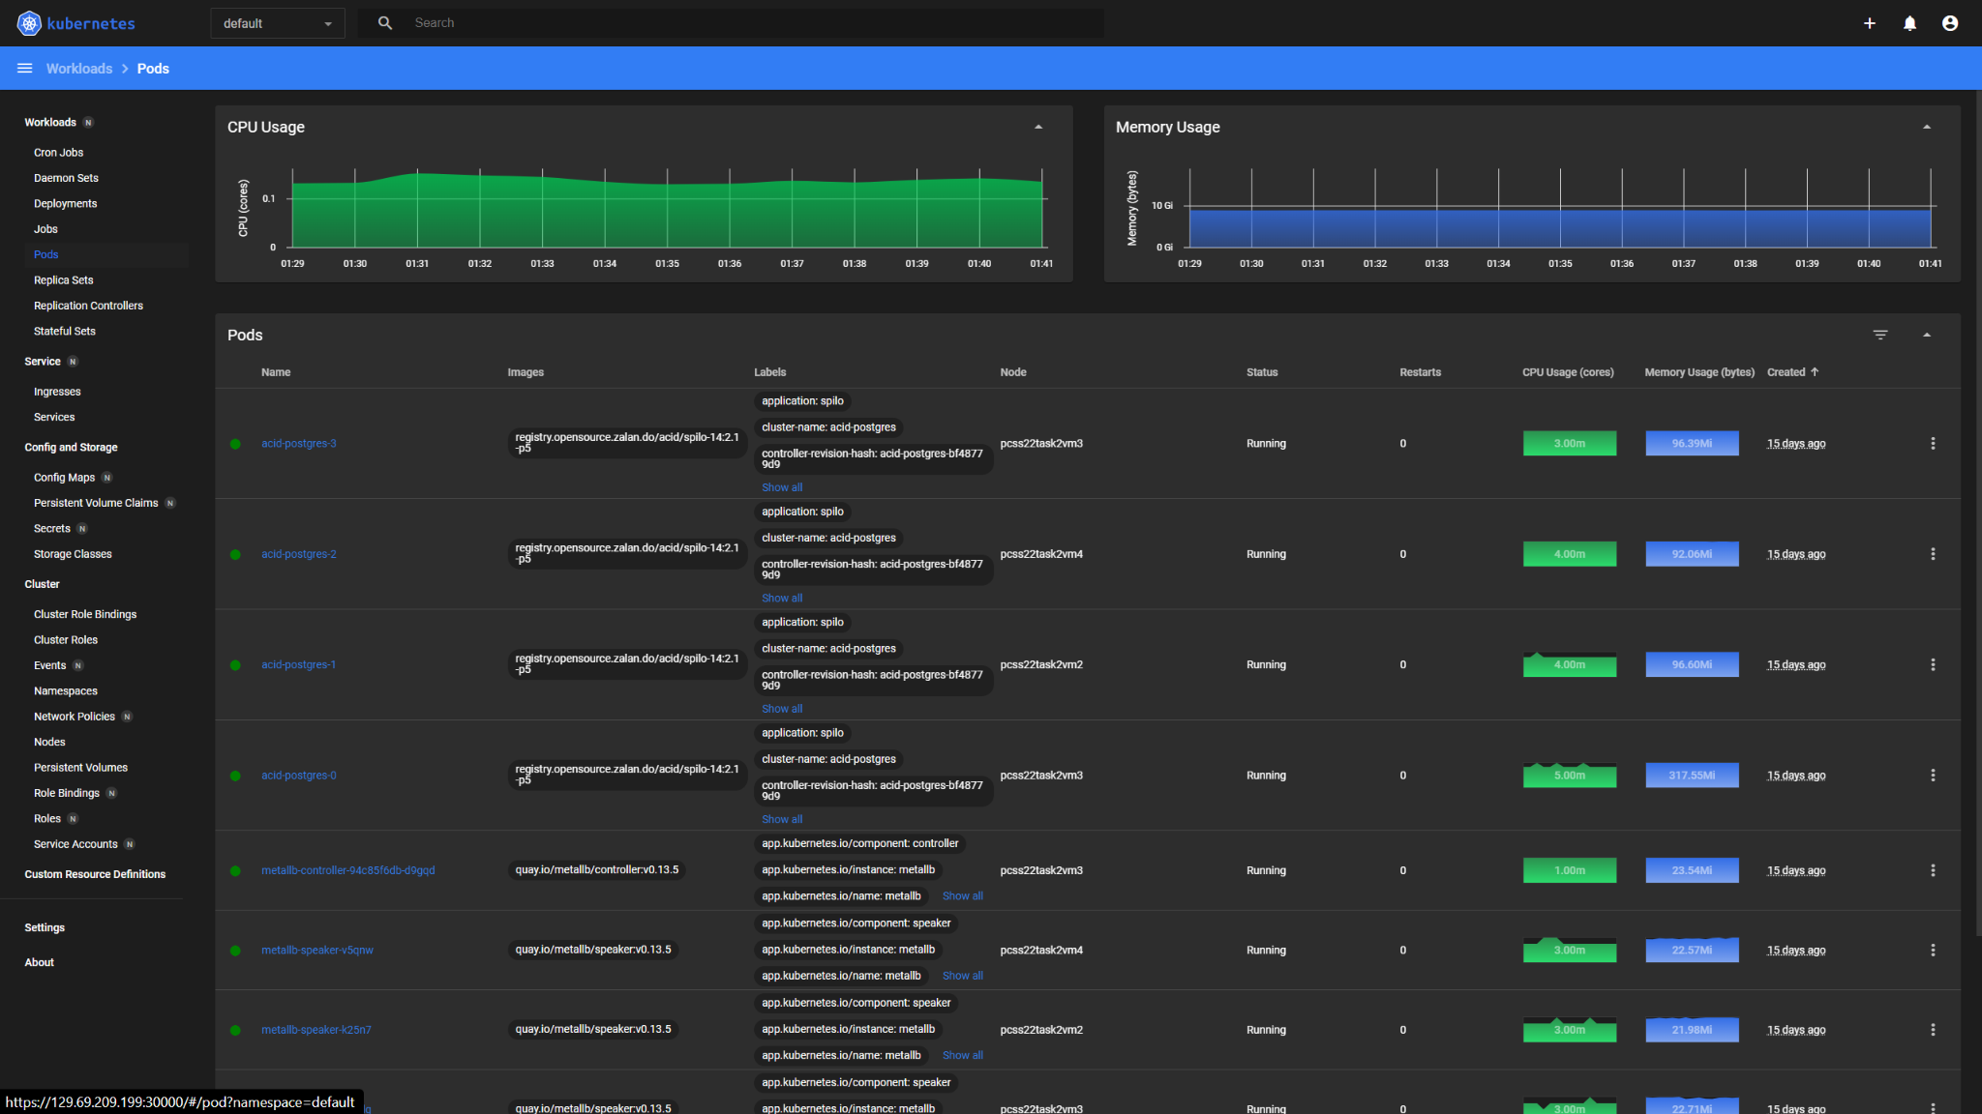
Kubernetes dashboard

Slide 10
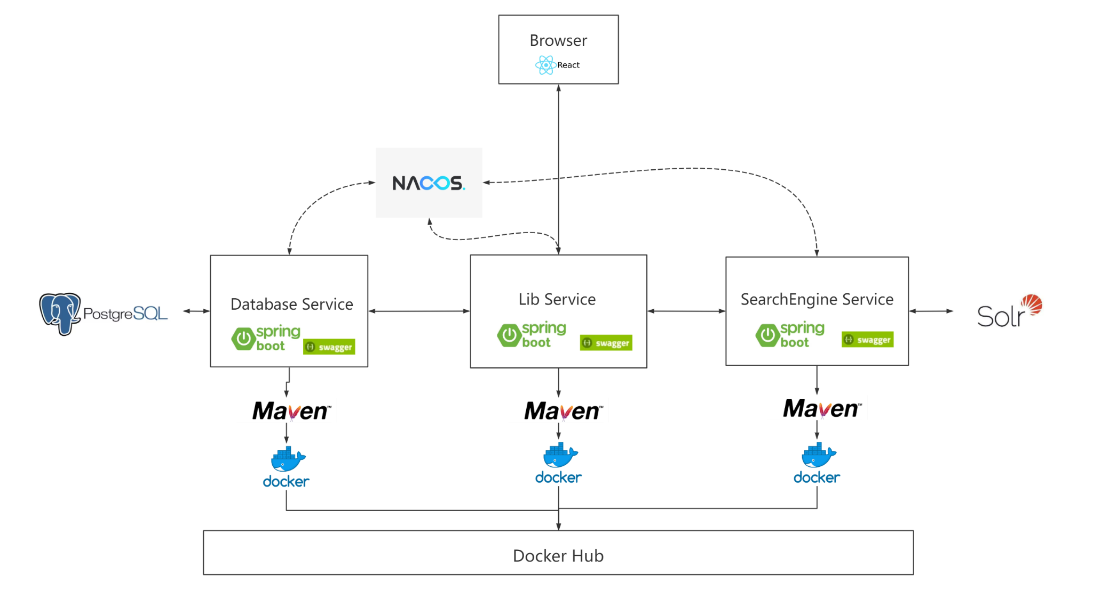
Micro Service module

Slide 11
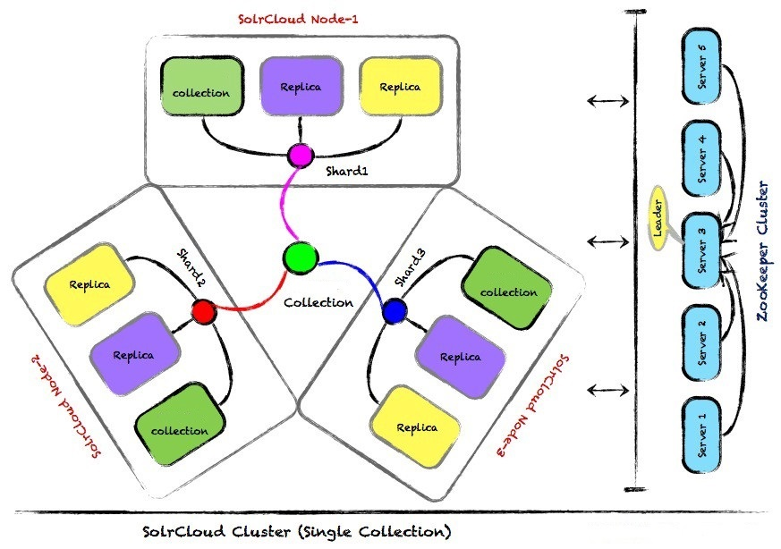
Solr Cloud - Collection and shards
from SolrCloud shards

Slide 12
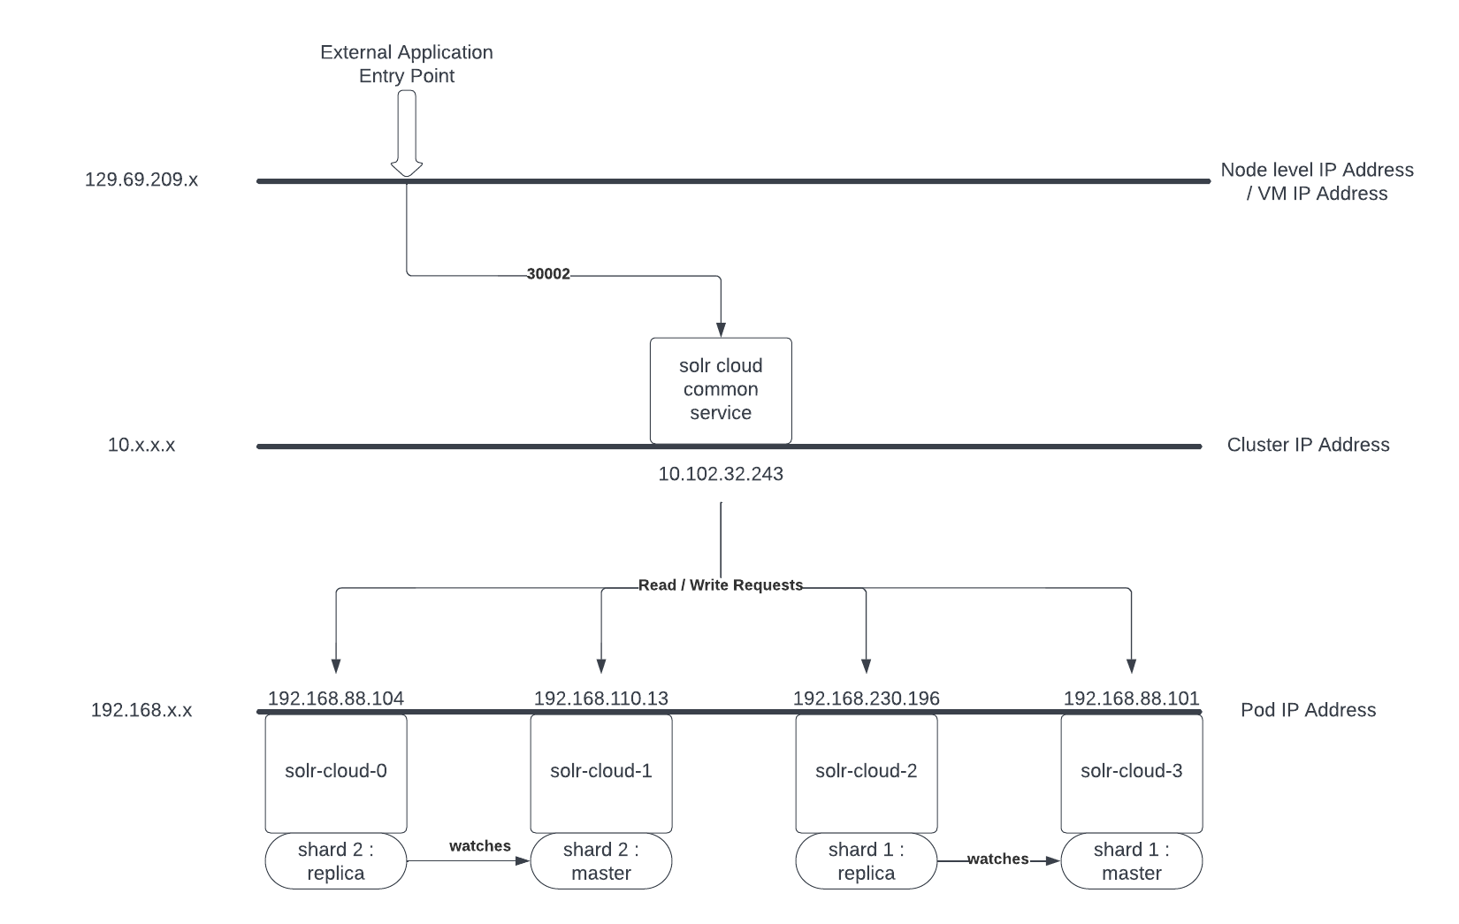
Solr Deployment Model on K8s

Slide 13
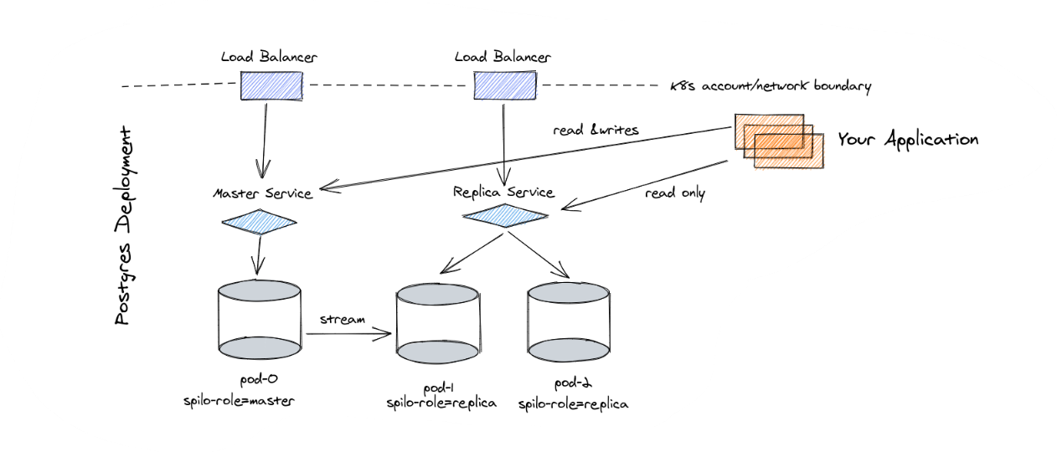

Zalando Postgres Operator Concept Model
Spilo : is a docker image that provides PostgreSQL and Patroni together
from Postgres Operator | postgres-operator (zalando.com)
etcd == k8s distributed key-value store
etcd entry template:
timestamp : role : pod IP
A
B
C
Create(role=master,
pod_IP=xxx.C,...)
etcd-c
Patrioni
Patrioni
Patrioni
fail
Notify(expire=true)
Notify(expire=true)
success
success
(periodically)
Update(role=master,
pod_IP=xxx.A,
TTL=10,
timestamp=xxx)
(pre-defined TTL: Time To Live)
Create(role=master,
pod_IP=xxx.B,
TTL=10,
timestamp=xxx)
etcd-a
etcd-b
master=A, TTL=0
expiration
master=A, TTL=10
master=B, TTL=10
patroni uses RAFT algorithm to determine the node availability associated with etcd nodes
Notes:
We use zalando postgres operator to manage the postgres clusters.
To prevent conflicts, this operator allows for read and write request by only one primary instance, and allows for read only request by one or more secondary instances.
Later there will be a synchronization done by postgres built-in feature.
For high availability, Patroni is used here to switch roles in case of a failure.
Patrioni keeps the cluster state in etcd,which is a key-value storage distributed among kubernetes cluster. It stores the pod’s role and the pod’s IP.
The master would update its master key periodically, because it has a predefined TTL attached.
if it didn't updated within the TTL due to failure, the master key will expire. Patrioni will check other node, the first healthy pod will be the new master.
Only one master is allowed.

Slide 14
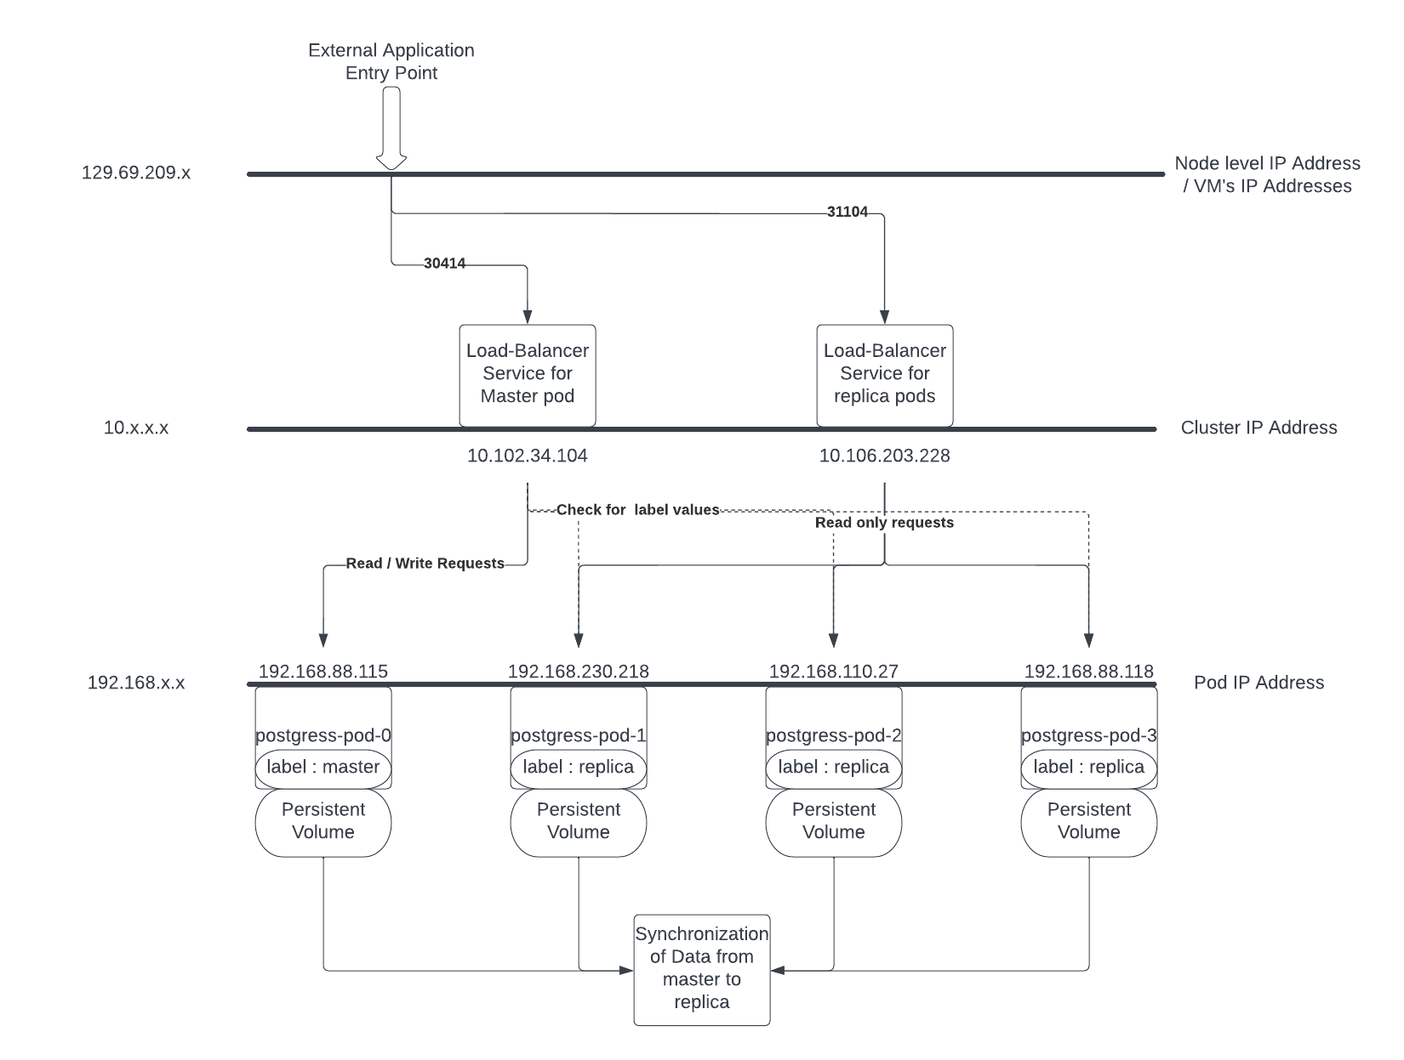
Postgres Deployment Model on K8s

Slide 15
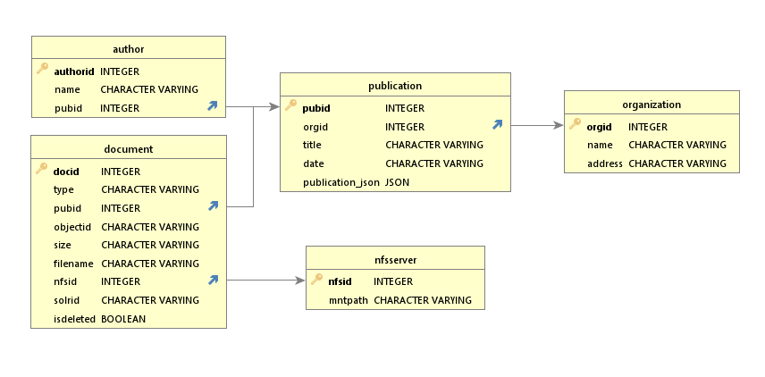
Library service Database Schema
soft delete
file path = mntpath + objetcid
/ nfsmnt / 2hhej-218sdh-347hs-dhhf.pdf
Notes:
This is the database schema in our library service. publication author and organization, are used to describe the basic information of each publication.
And the document table is to describe the files stored in the system corresponding to the publication.
When the backend retrieve a file from a path, it will combine the nfs mntpath with object id, which is a newly created identifier for each file.
ISDELETED is a soft delete field. If the user delete the file,, first this field will be set to true. This file should be deleted in later synchronization.
There is also a JSON field. Postgres allows to store json type of data, we use these to add additional information aside from these standard field.
45s

Slide 16
Demo showing
Notes:
deep learning paper: keyword-detection(copy from the title)
cloud: ICT (copy from the abstract) 2010 2009
knowledge:embeeing / graph (copy from the abstract)
This our demo. First we show the use case of create. here is a bibtex field, it’s a universal format of data to describe publications. The user can copy it to here and the front end will do the auto fulfill. And then you can still modify something. And we also allow the user to add additional arbitrary information. maybe this paper’s language is english.(upload!!!) Before submit, we can check the last id in publication table is xxx, and the last index in solr is xxx. and then we create. We can see in the database, that this one is created. And in the solr, if we query for all the document, you can see the length just growed by one, and if we query for this last one, you can see is the same paper Cloud computing we just uploaded.
Now is the use case of search. our system have both the parametric search that goes to the postgres database and full text index search that goes to the solr.
Then the backend will get the union of them and respond back to the user.
If the user only wants to search for the papers published in 2010. Then we get all the papers that is published in this year. You can see that this is the one we just created. and this is the record that the user created before. and the user says this version written in german. You can also see the abstract that returned by solr. Here you can see this paper has something to do with ICT
And if user wants to look for paper write in 2010 related with this ICT here, then we query with the keywork ICT, you can see that only this publication is returned.
Then we can retrieve the file by clicking on the download, This is the paper.
If the user wants to get this english version deleted, just click on the delete, and then you can see in the database, that this soft delete field is set to true. If we query again, we won’t see this english version any more.

Slide 17
E-Mail
Telefon +49 (0) 711 685-
www.
Universität Stuttgart

