Slide 1

Intro
Choices
True & False
Outro
Choose the Correct Answer
Dr. Naira
The bird’s beak is made of …..
همس أحمد
هند رضا
منار مجدي
ندى السيد
سما سامي
مروة عبدالله
وعد محمد
Choose the Correct Answer
Bone only
Hard keratinized epidermal structure
Cartilage
Soft connective tissue

Slide 2
Intro
Choices
True & False
Outro
Choose the Correct Answer
Dr. Naira
Esophagus
The bird’s beak is made of …..
The only tooth in birds appears …..
The esophagus in birds is …..
The function of the crop is …..
همس أحمد
هند رضا
منار مجدي
ندى السيد
سما سامي
مروة عبدالله
وعد محمد
A muscular tube connecting mouth to stomach
Bone only
During adulthood
Enzymatic digestion
Hard keratinized epidermal structure
During flight
Temporary food storage and softening
Located on the left side of the neck
While hatching
Cartilage
Absorption of nutrients
During molting
Used for enzymatic digestion
Soft connective tissue
Absent in some species
Secretion of bile

Slide 3
Intro
Choices
True & False
Outro
Choose the Correct Answer
Esophagus
Crop
Cecum
Liver
The bird’s beak is made of …..
The only tooth in birds appears …..
The esophagus in birds is …..
The function of the crop is …..
Crop milk is produced in ….. and considered to be source of …..
The main function of the intestinal ceca is …...
In birds, the liver …..
A muscular tube connecting mouth to stomach
Bone only
During adulthood
Enzymatic digestion
Secretion of bile
Has a larger left lobe
All birds - mycoplasma
Hard keratinized epidermal structure
During flight
Temporary food storage and softening
Water absorption and fiber digestion
Has a larger right lobe
Located on the left side of the neck
While hatching
Chicken only - E coli
Is white in color
Cartilage
Absorption of nutrients
Protein synthesis
During molting
Used for enzymatic digestion
Pigeons and doves - Trichomoniasis
Is not involved in digestion
Soft connective tissue
Absent in some species
Secretion of bile
Ducks - mycobacterium avium

Slide 4
Intro
Choices
True & False
Outro
Choose the Correct Answer
Crop
Cecum
Liver
The function of the crop is …..
Crop milk is produced in ….. and considered to be source of …..
The main function of the intestinal ceca is …...
In birds, the liver …..
Site for tracheal swab …..
No. of air sac is …..
in case of 7 air sac ….. is absent
9
Enzymatic digestion
Secretion of bile
Has a larger left lobe
Trachea
Cervical
All birds - mycoplasma
10
Temporary food storage and softening
Water absorption and fiber digestion
Has a larger right lobe
Lung
Thoracic
15
Chicken only - E coli
Is white in color
Larynx
Abdominal
Absorption of nutrients
Protein synthesis
Pigeons and doves - Trichomoniasis
Is not involved in digestion
Glottis
Secretion of bile
Ducks - mycobacterium avium

Slide 5
Intro
Choices
True & False
Outro
Choose the Correct Answer
Liver
In birds, the liver …..
Site for tracheal swab …..
No. of air sac is …..
in case of 7 air sac ….. is absent
Marek's ds affecting Brachial plexus causing …… wing paralysis
9
Has a larger left lobe
Trachea
Cervical
True & False
10
Has a larger right lobe
Lung
Thoracic
15
Unilateral
Is white in color
Larynx
Abdominal
Bilateral
Is not involved in digestion
Glottis

Slide 6
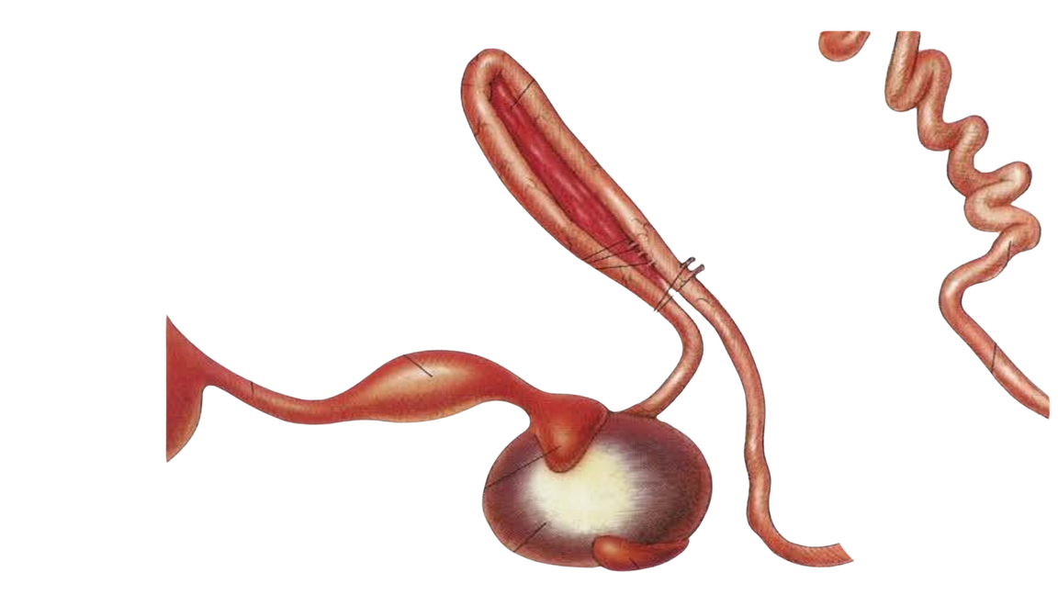
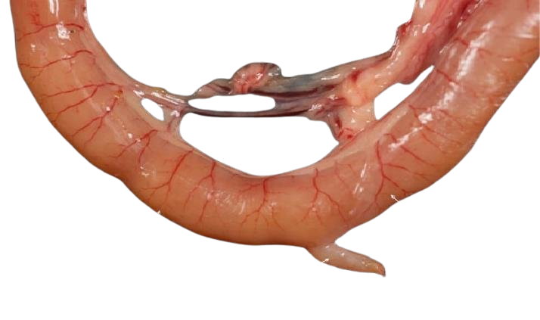


Intro
Choices
True & False
Outro
3
Choose the Correct Answer
True & False
4
Birds have teeth used for crushing food.
in case of 7 air sac ….. is absent
Marek's ds affecting Brachial plexus causing …… wing paralysis
Gizzard helps in mechanical digestion.
2
Cervical
There are two functional ovaries in hens.
Thoracic
Unilateral
Abdominal
Bilateral
Air sacs help in temperature regulation.
Bursa of Fabricius is part of the immune system.
1

Slide 7
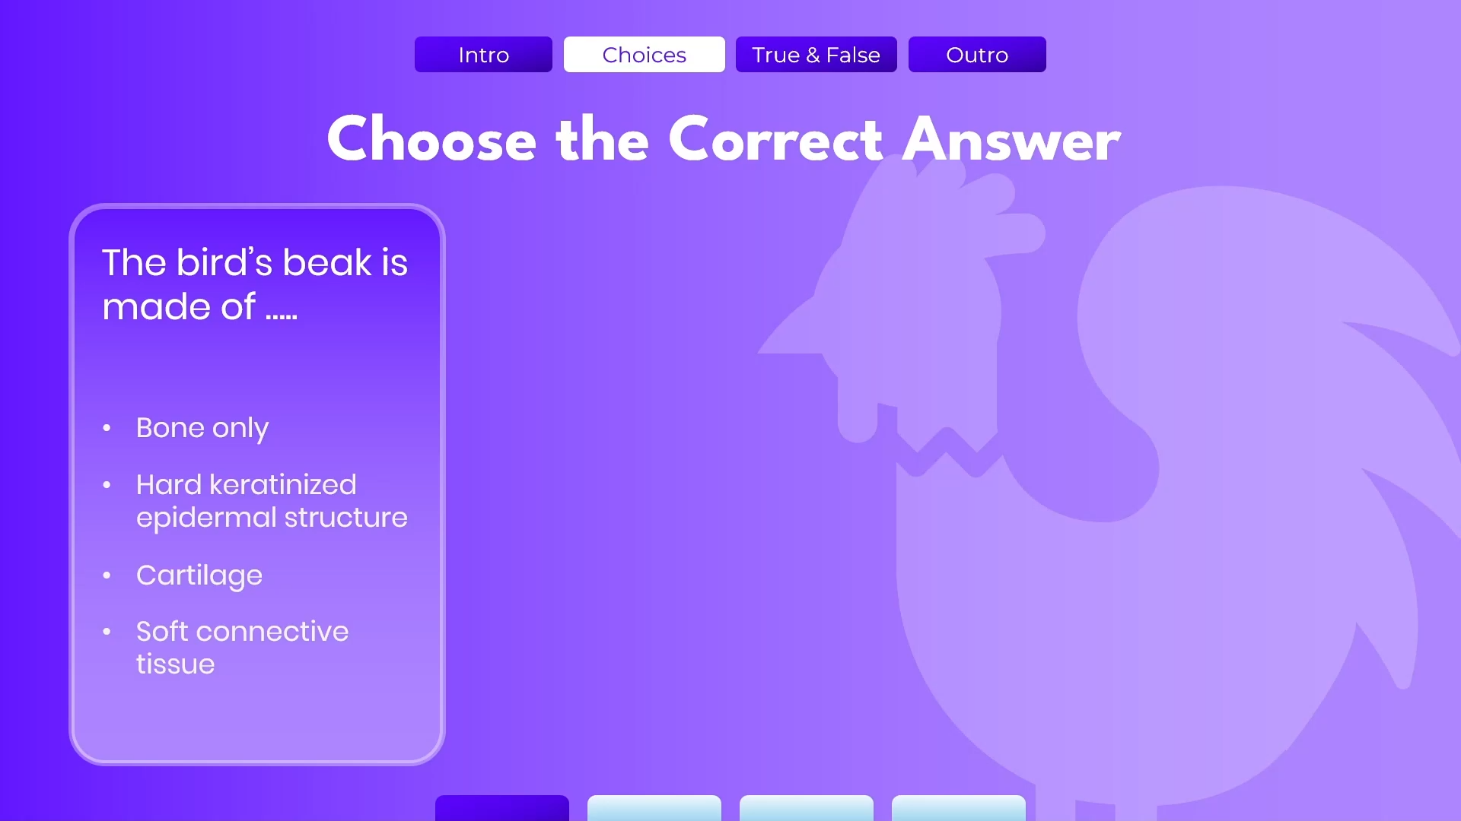
Intro
Choices
True & False
Outro
3
Duodenal loop
True & False
4
Pancreas
Thank you !
Birds have teeth used for crushing food.
همس أحمد
هند رضا
منار مجدي
ندى السيد
سما سامي
مروة عبدالله
وعد محمد
Gizzard helps in mechanical digestion.
Proventriculus
2
There are two functional ovaries in hens.
Air sacs help in temperature regulation.
Bursa of Fabricius is part of the immune system.
Meckel's diverticulum
1
Ventriculus (gizzard)

Slide 8
3
Intro
Choices
True & False
Outro
4
Duodenal loop
Thank you !
Pancreas
همس أحمد
هند رضا
منار مجدي
ندى السيد
سما سامي
مروة عبدالله
وعد محمد
2
Proventriculus
1
Meckel's diverticulum
Ventriculus (gizzard)

