Slide 1

Turnover Analysis Human Resources
Aldair Oliveira
Jan, 23

Slide 2

Introduction
Methodology
Results
Conclusion
Appendix
ACTIVITIES
Notes:
O Junta+ é uma iniciativa desenvolvida pela aceleradora da coca cola company que seleciou ideias para serem desenvolvidas

Slide 3

DATA PREPROCESSING
MISSING VALUES
COLUMN ( AGE ): -145 VALUES
Faixa_de_anos_trabalhados
(-0.001, 6.0] 29.0
(6.0, 10.0] 35.0
(10.0, 15.0] 36.0
(15.0, 40.0] 46.0
Name: Idade, dtype: float64
Utilize the column age_years_worked with parameters.
Take median group AGE of the columns
age_years_worked and inplace all my missing values
LIBRARIES
STATISTICS METHODOGY
Numpy
Pandas
Matplot
Seaborn
Scipy.Stats
Phik
SHAPIRO
TTEST_IND
WILCOXON
ANOVA

Slide 4
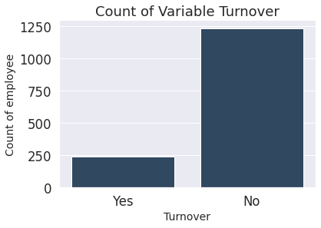
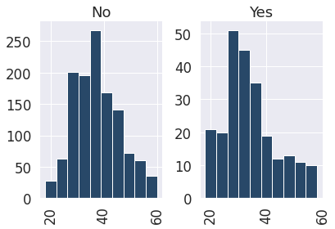
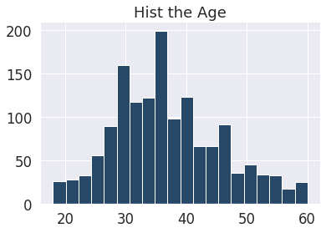
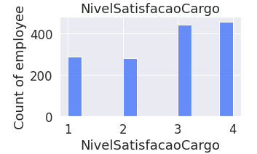
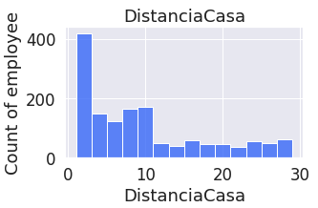
Profile of Employee

Slide 5


insight:
We have a problem with TURNOVER
How can identify the principal group?
Create actions and plan to prevent
Notes:
Hoje não possuímos nenhum vinculo com os ambulantes, não sabemos quem são, o que estão vendendo, como dorme, como saem a rua, como que correm do rapa... O que fazem quando perdem seus produtos....
Os concorrentes estão fazendo algo para atender melhor essa classe? Porque eles estõa na ainformalidade do mundo dos ambulantes?
Todas essas perguntas nos levamos para a rua para desenvolver o projeto.

Slide 6
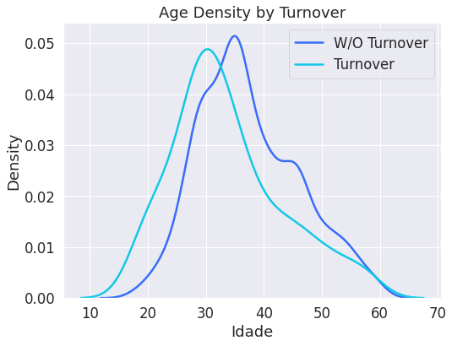
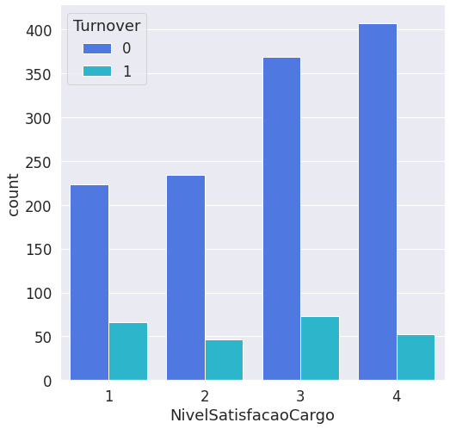
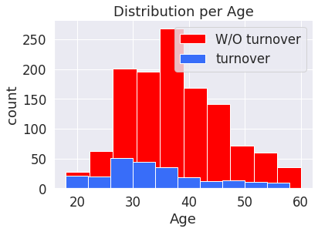
Profile of turnover
The principal AGE of employee still between 20 and 35 years.
The satisfaction concetrade in

Slide 7
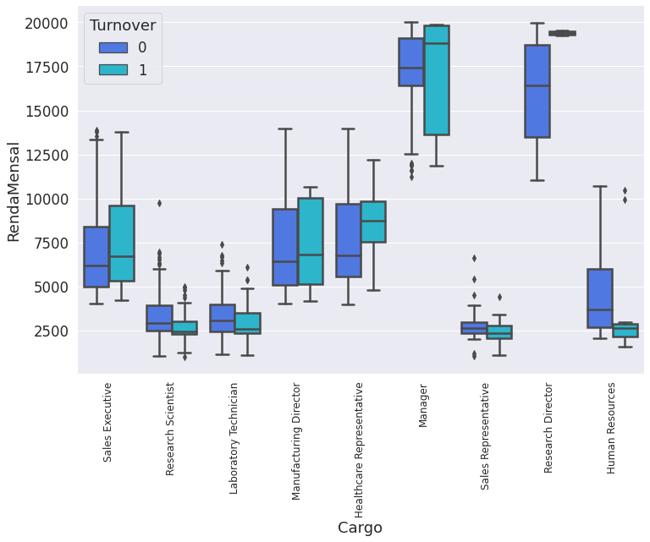
Profile of turnover
Analysis between SALARY x POSITION, special attention in big differences

Slide 8
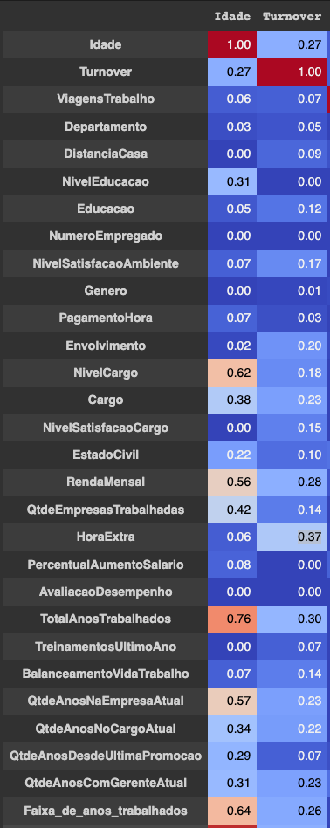
CORRELATION
CORRELATIONS:
TURNOVER x AGE – 0.27
TURNOVER x OVERTIME – 0.37
TURNOVER x SALARY – 0.28
TURNOVER x TOTAL_YEARSWORKER – 0.30
POSSIBLE ACTIONS:
OVERTIME :
Employees who work overtime are more likely to TURNOVER.
We need to make attention and create a plan.
Analyse the job activities or contract more for the critical position
AGE:
Youth are more likely to change the company. And in this case we need to create a campaign to retain the employees
Positive : One UP other UP / Negative : One DOWN other DOWN

Slide 9
Statistics Tests
STATISTICS LIBS USED:
SHAPIRO.
The Shapiro test is a statistical test used to check if a sample of data comes from a normal distribution. In Python, the "shapiro" function from the "scipy.stats" library is used to perform this test. It returns two values: the first is the p-value, which indicates the probability that the data is normal, and the second is the W value, which is a measure of normality. If the p-value is greater than the chosen significance level (usually 0.05), then the null hypothesis that the data comes from a normal distribution is not rejected.
TTEST
c
WILCOXON
C
F_ONEWAY
C
Positive : One UP other UP / Negative : One DOWN other DOWN

Slide 10
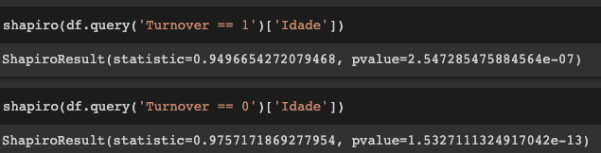
Statistics Tests – SHAPIRO, TTEST, WILCOXON, ANOVA
SHAPIRO / TTEST Indicate the AGES W/O TURNOVER are GREATER than AGES W/O TURNOVER.
And the hypothesis can’t be accepted.

Slide 11
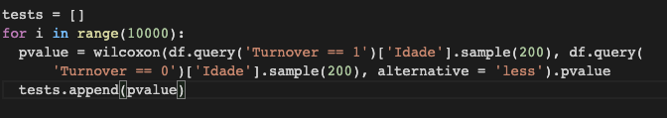
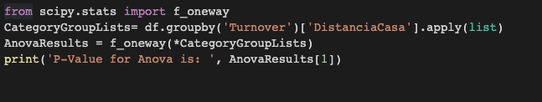
2 STATISTICS TESTS
The code is looping through a range of 10000 iterations, on each iteration it is taking a random sample of 200 observations from the "Idade" column of the dataframe, filtered by the 'Turnover' column equals to 1 and another sample of 200 observations from the "Idade" column of the dataframe, filtered by the 'Turnover' column equals to 0.
10.000 WILCOXON TEST
Results: 9996
As this value is less than the typical significance level of 0.05, it indicates that there is a statistically significant difference in the means of the groups.
Therefore, the *ANOVA *results indicate that there is a significant difference in the mean distance from home of employees who left the company and those who stayed.
This suggests that there may be a relationship between an employee's distance from home and their likelihood of leaving the company
ANOVA Distance x Turnover
P-Value for Anova is: 0.0027930600802132115

