Slide 1
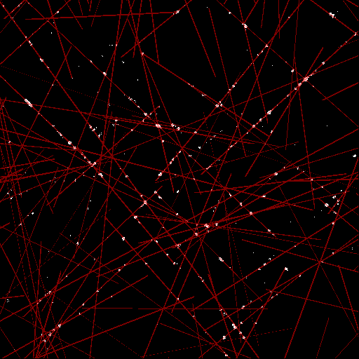

DGvGAN: Dynamic Malware Analysis
Comparing Deep Graph Convolutional Neural Networks and Generative Adversarial Networks for modern malware detection through behavioural analysis
Supervisor: (Prof.) Dr. Devesh C. Jinwala
Team:
Ameya Srivastava (U22CS102),
Auritra Dey (U22CS127),
Bittu Kumar (U22CS130),
Pavitra Kumar (U22CS121)
I.D.: Team #1

Slide 2
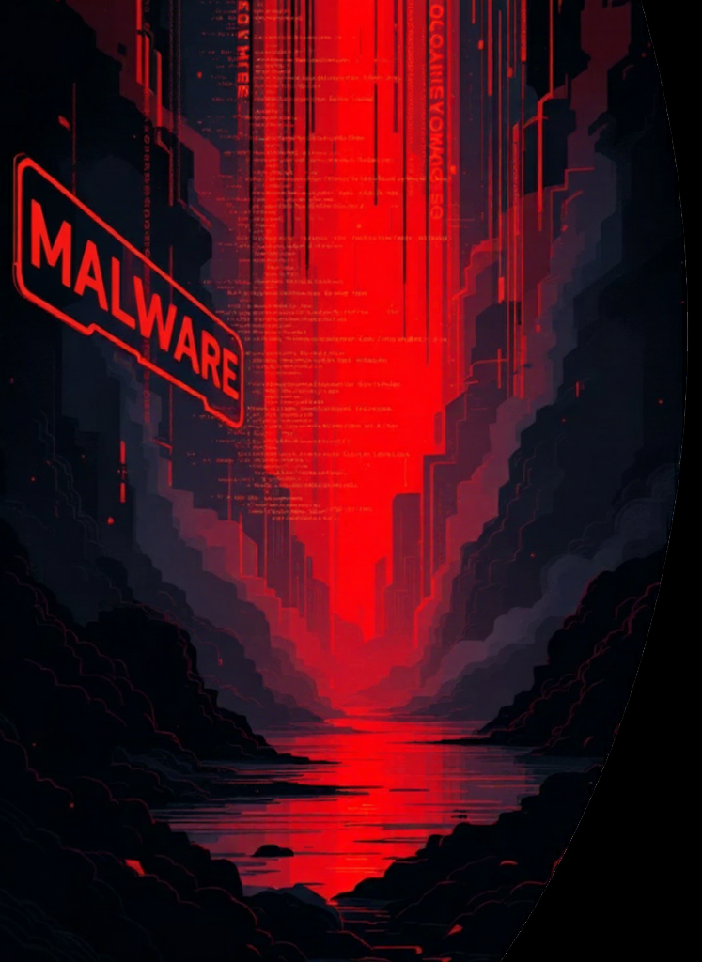
Introduction –
Detecting Modern Malware
Traditional Static Analysis
Modern Threats
Converting binaries to grayscale images for classification is computationally expensive and loses crucial runtime behaviour information.
Polymorphic malware uses obfuscation techniques that change code signatures, making traditional static detection methods unreliable.
Modern Approach: Dynamic Analysis
Analysing API call sequences captures actual program behaviour, providing resilience against many modern evasion tactics.

Slide 3
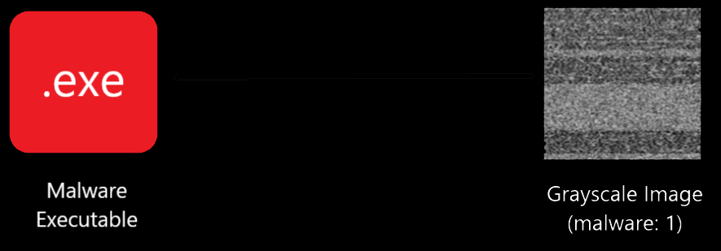
Existing Methods – Traditional Static Analysis Image Translation & CNN-based Classification
Training: Convert malware executable binaries (.exe) into grayscale images after preprocessing, label each as benign (0) or malware (1). Train a CNN for supervised image-based binary classification.
Deployment: An executable is uploaded, preprocessed and fit into a large CNN for classification.
Preprocessing

Slide 4


Why Static Analysis Fails
High Computational Cost
Information Loss
Reading and preprocessing large binaries into images introduces significant latency in deployment.
Flattening code into pixels discards key runtime behaviours (almost ~99%) and control-flow relationships.
Fragile Detection
Memory Intensive
Minor binary changes drastically alter images, making detection unreliable against modern, evasive threats.
Large CNNs and intermediate images increase processing requirements, making the methods impractical for enterprise use.
Issues:
Commonly downsampling binaries (e.g. 10MB) to small images (e.g. 256 x 256) discards ~99% of data bytes*, losing critical low-level malware cues.
Using full-resolution images is impractical for large-scale inference due to high memory & compute demands.
* $10 MB=10×2^{20}$, $256×256=2^{16}$, $Loss=\frac{{10×2}^{20}−2^{16}}{10×2^{20}}=\frac{159}{160}≡99.375\%$

Slide 5
Existing Methods – Dynamic Analysis Deep Learning Models
Sequence models like RNNs and LSTMs are widely used to model temporal sequence API calls for dynamic malware analysis
Graph models like DGCNNs (Oliveira & Sassi 2019) show superior performance to sequence models
BUT…
GAN’s, that are generative models, are understudied for this task – this provides a good research opportunity

Slide 6
Motivation
Static analysis techniques are outdated for modern malware attack vectors
Of all deep learning models, generative architectures like GANs are understudied for malware detection
Graph models are promising – comparing them with generative models will be beneficial

Slide 7
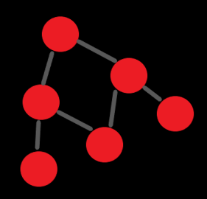
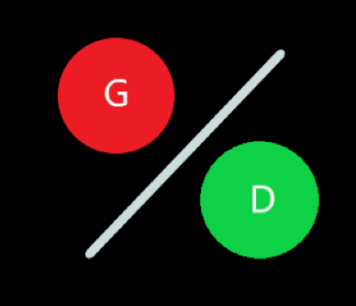
Project Abstract
Given the criticism that the common static methods face, we decided to explore the dynamic analysis of malware as anomaly detection with GANs and compare it with the Deep Graph CNN (DGCNN) as a baseline.
Our Objectives
Phase I (✔): Build a baseline DGCNN to model API call sequences as behavioural graphs, outperforming LSTMs. (Oliveira & Sassi, 2019)^{[1]}
Phase II: Develop a GAN to learn goodware API call distributions and distinguish real from fake/anomalous sequences.
Compare both dynamic analysis methods to evaluate effectiveness.

Slide 8



Research Paper
(Oliveira & Sassi 2019)
Obtain Data
(Public Domain Dataset)
Data Transformation
Transformed Data
Sequences to Graphs $(A)$
If Exp. 2
Sequences to Features $(X)$
Implementing the DGCNN Baseline Paper
If Exp. 1
Data Preprocessing
$$A,X$$
Balance the Dataset
“Behavioral Malware Detection Using Deep Graph Convolutional Neural Networks”
Graph Convolution Layer
Demo
Flatten Layer (+Dropout)
Course of Implementation of our Project (Phase-I)
Exp. 1 -> DGCNN on Balanced Dataset
Exp. 2 -> DGCNN on Imbalanced Dataset
Note:
Our dataset contains Windows API call sequences, one row each per executable file
It’s highly imbalanced, with 42,797 malware and 1,097 benign sequence samples
Hidden Dense Layer
Output Dense Layer
Model-1, DGCNN

Slide 9
Before We Begin…
Why specifically the DGCNN?
It’s a promising, novel method that demonstrates the use of graph models with performance superior to sequence models
Instead of implementing the common sequence models, we choose to implement and test two new paradigms (the DGCNN and our GAN) together
Why implement a GAN for Anomaly Detection? Why not simpler models or VAE’s?
Simpler classification models focus on maximizing class separation, but we need a model that learns the probability distribution of normal goodware behaviour instead
A GAN’s discriminator learns a sharp decision boundary of what is authentic, providing more precise anomaly signals than VAEs that don’t have discriminators
GAN’s are understudied models for this type of task, providing us the opportunity to research and compare their use for the same

Slide 10
Phase I: Baseline DGCNN Implementation
We followed A.S. Oliveira & R. J. Sassi’s paper, “Behavioral Malware Detection Using Deep Graph Convolutional Neural Networks” (2019) to implement the DGCNN baseline as our first step.
The authors collected 40,000+ benign and malicious samples of Windows Process API call sequences from controlled experiments in Cuckoo Sandbox.
They implemented the Deep Graph Convolutional Neural Network (DGCNN) on both balanced and imbalanced datasets.
Our goal was to implement the DGCNN as a comparison baseline for our GAN (yet to implement), following their methods in Experiment 1 (Balanced Data), and Experiment 2 (Imbalanced Data) of their paper.

Slide 11
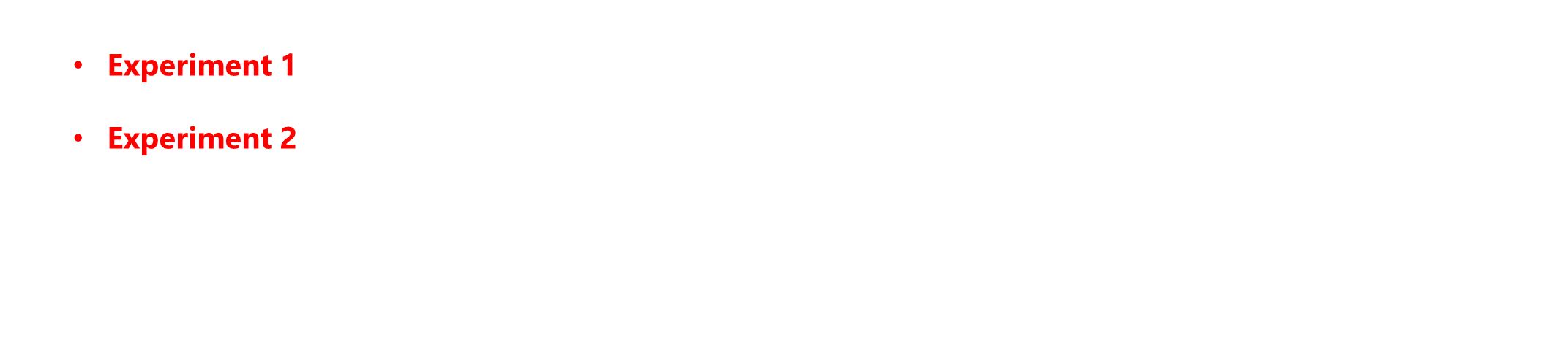
Dataset Overview
42,797
1,079
307
100
Malware Samples
Goodware Samples
Unique API Calls
Calls Per Sample
Comprehensive collection from Cuckoo Sandbox environment
Benign software for comparison and training
Global vocabulary of distinct system calls
Maximum recorded API sequences per program
NOTE: The dataset exhibits severe class imbalance, reflecting real-world malware distribution patterns.
We implemented Model-1 (Baseline) on two forms of the collected data:
Experiment 1, Balanced using Random-Under Sampling (RUS) of the majority malware class for a 50-50 class balance. There are hence a total of $2,158$ samples.
Experiment 2, On the original data distribution in the dataset itself, of $43,877$ samples.
A train-test split of 80/20 was used in both experiments.
Both experiments underwent common data transformation processes to make them fit into the DGCNN’s shape requirements.

Slide 12
API Call Vocabulary
ID | Windows API Calls
0 | NtOpenThread
1 | ExitWindowsEx
2 | FindResourceW
… | …
150 | GetSystemInfo
… | …
306 | __exception__
Dataset Sample
hash | t_1 | t_2 | t_3 | … | t_100 | malware
071e8c3j3.. | 124 | 112 | 301 |  | 123 | 1
33f8e8yu4.. | 0 | 274 | 83 |  | 222 | 0
563qe7id6.. | 200 | 150 | 306 |  | 245 | 1
87a32hk92.. | 59 | 151 | 242 |  | 40 | 0

Slide 13



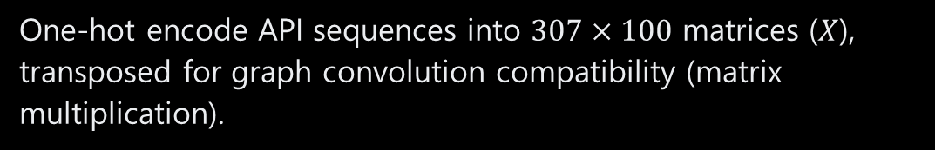
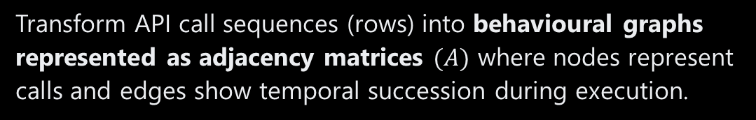
Data Preprocessing & Transformation
For Experiment 1, the data imbalance was handled by performing Random Undersampling (RUS) on the majority malware class, so that both of the classes could have a 50-50 balance.
Apart from handling the imbalance, we had to perform the following data transformations to make the data workable with the DGCNN (according to the paper):
Sample API Sequence (Top 100 Calls)
$43877$ rows, $100$ columns
Adjacency Matrix ($A)$
01 | Sequence to Graph Representation (Seq2Graph)
Shape: $307×307$
Transform API call sequences (rows) into behavioural graphs represented as adjacency matrices $(A)$ where nodes represent calls and edges show temporal succession during execution.
Node Feature Matrix ($X$)
02 | Feature Matrix Creation
One-hot encode API sequences into $307×100$ matrices ($X$), transposed for graph convolution compatibility (matrix multiplication).
Shape: $307×100$

Slide 14

Data Transformation Steps
API Sequence to Graph Adjacency Matrix $(A)$ | API Sequence to Node Feature Matrix ($X$)
$$n←len\left(sequences\right)$$ $$N←307$$ $$initialize: A \left(n, N,N\right) with 0^{′}s$$ $$for i in range\left(n\right):$$ $seq←sequences\left[i\right]$ $for j in range\left(len\left(seq\right)−1\right):$ $curr, next←seq\left[j\right], seq\left[j+1\right]$ $if 0≤curr≤N and 0≤next≤N$, then $A[i, curr, next] ← 1$ | $$n←len(sequences)$$ $$N←307$$ $$s←100$$ $$initialize:X \left(n,N,s\right) with 0^{′}s$$ $$for i in range\left(n\right):$$ $seq←sequences[i]$ $for j in range\left(len\left(seq\right)\right):$ $id←seq\left[j\right]$ $if 0≤id<N, then$ $X[i, id,j]$ $←$ $1$
Turns the API call sequences (rows) to adjacency matrix-based graphs. $n$ is the length of $sequences (43,877)$ $N$ is the total number of distinct API calls $(307)$ | Creates a node-feature matrix based on the API call sequence samples (rows). $s$ is the length of a sequence $(100)$, that is fixed in the dataset.

Slide 15

DGCNN (Model-1) Implementation
Our model implementation replicates Model-1 (DGCNN) from the paper, that has the following structure:
A single Graph Convolution Layer based on the paper’s implementation
A ReLU (Rectified Linear-Unit) activation function
A Dropout layer with a rate of 0.60 for regularization
A Flatten layer followed by Dense layers for final binary classification
Key Considerations:
The model was trained for at most 20 epochs, and early stopping was implemented to prevent overfitting, since the model had a very large number of parameters (1,260,929). This also justifies the rather aggressive dropout rate of 0.60, forcing the model to learn patterns that generalize to unseen data.
An Adam optimizer with a learning rate of $η=0.001$ was used with Binary Cross Entropy Loss for optimization, which are standard choices in binary classification tasks.
The model was built and trained using TensorFlow & Keras (2.15.0)

Slide 16

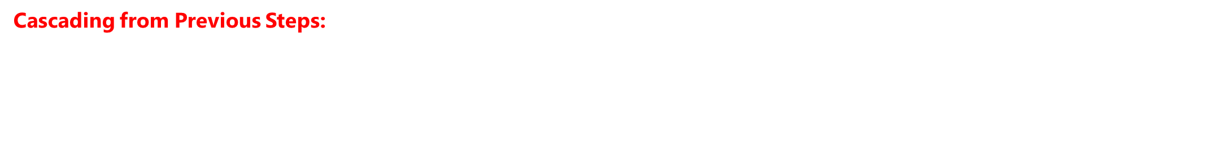

Graph Convolution Layer
The core mathematical operation that enables learning from graph structures:
$$Z=f({\tilde{D}}^{−\frac{1}{2}}\tilde{A}{\tilde{D}}^{−\frac{1}{2}}⋅XW)$$
Where,
$X$ is the node feature matrix
$W$ is the weight matrix of the model
$\tilde{A}$ is the augmented adjacency matrix $\tilde{A}=A+I$
${\tilde{D}}^{−1}$ is the inverse of the degree matrix of $\tilde{A}$
NOTE:
This is the general formula of graph convolution in a GCN formulated by Kipf & Welling (2016). Our reference paper used row normalization, but we chose to use symmetric normalization instead, since it is often recommended for stable training and better generalization.
Cascading from Previous Steps:
Node feature matrices $(X)$ and adjacency matrices ($A$) were created in the data preprocessing and transformation stage, and they were fit into the DGCNN model as input.
The original reference paper’s^{[1]} Algorithm 2 was directly implemented as code for this graph convolution layer and the larger model.

Slide 17

Graph Convolution Algorithm
Graph Convolution Algorithm | Comments
$$Input:A, X,W$$ $$I←Identity(A.shape)$$ $$\tilde{A}←A+I$$ $${\tilde{D}}_{ii}←\sum_{j}{{\tilde{A}}_{ij}}$$ $${\tilde{D}}^{−1/2}←Diagonal(\sqrt{{\tilde{D}}^{−1}})$$ $${\tilde{A}}_{norm}←{\tilde{D}}^{−\frac{1}{2}}\tilde{A}{\tilde{D}}^{−\frac{1}{2}}$$ $$O←{\tilde{A}}_{norm}XW$$ $$H=σ(O)$$ | Input the Adjacency Matrix $(A)$, Feature Matrix $(X)$, Weight Matrix $(W)$ Create an Identity matrix $(I)$ for self-loops of API calls Augment $(\tilde{A})$ the Adjacency Matrix $(A)$ with self-loops Create a diagonal degree matrix $(\tilde{D})$ by summing each row $j$ of $\tilde{A}$ to get the degree of each node Create a diagonal matrix from the inverse square root of $\tilde{D}$, this will be used in the symmetric normalization Calculate the normalized matrix ${\tilde{A}}_{norm}$ (Kipf & Welling, 2016)^{[2]} Aggregate the features and apply weight transformation Apply an activation function $σ$ (ReLU) on the output $O$ for final aggregation
References: Oliveira & Sassi (2019)^{[1]}, Kipf & Welling (2016)^{[2]}
This algorithm has been implemented as the convolution layer in our DGCNN model

Slide 18


Forward Propagation
Layer Propagation | Comments
$$Z←GraphConv(A,X, W_{conv})$$ $$H←ReLU(Z)$$ $$H_{drop}←Dropout\left(H, rate=0.60\right)$$ $$v←Flatten(H_{drop})$$ $$v_{dense}←ReLU(Dense\left(v,W_{dense1}\right))$$ $$O←σ(Dense\left(v_{dense},W_{out}\right))$$ $$return O$$ | Pass $A,X,W_{conv}$ to the $GraphConv$algorithm from the previous slide Apply ReLU activation on the convolution output Dropout nodes from the output with 60% probability to regularize Flatten the convoluted output into a single vector Pass the flattened single vector output to the Dense layers in the classification head to return raw logits, apply ReLU (standard) Pass the output logits through the sigmoid activation to return a probability score between 0 and 1 (binary classification)
It is assumed that $X$ is transposed to be compatible for matrix multiplication ($307×100$)
A dropout layer is implemented to aggressively prevent overfitting since the model is dense with $≈$1.2 Million learnable parameters, hence the high dropout rate of 60%
On a high level, the model contains 4 layers – the $GraphConv$, the $Flatten$, one hidden $Dense$ and another output $Dense$ layer (that make the classifier head).

Slide 19
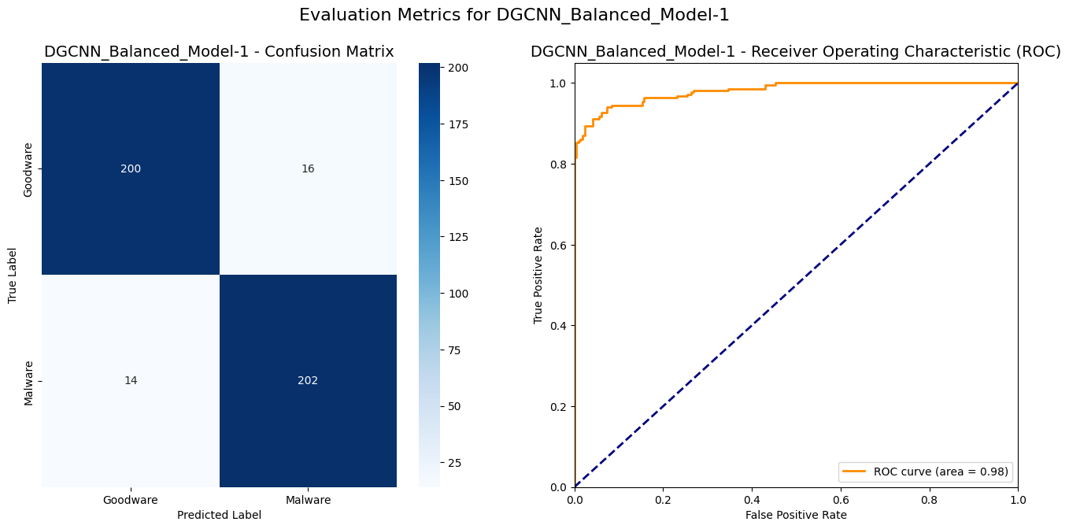
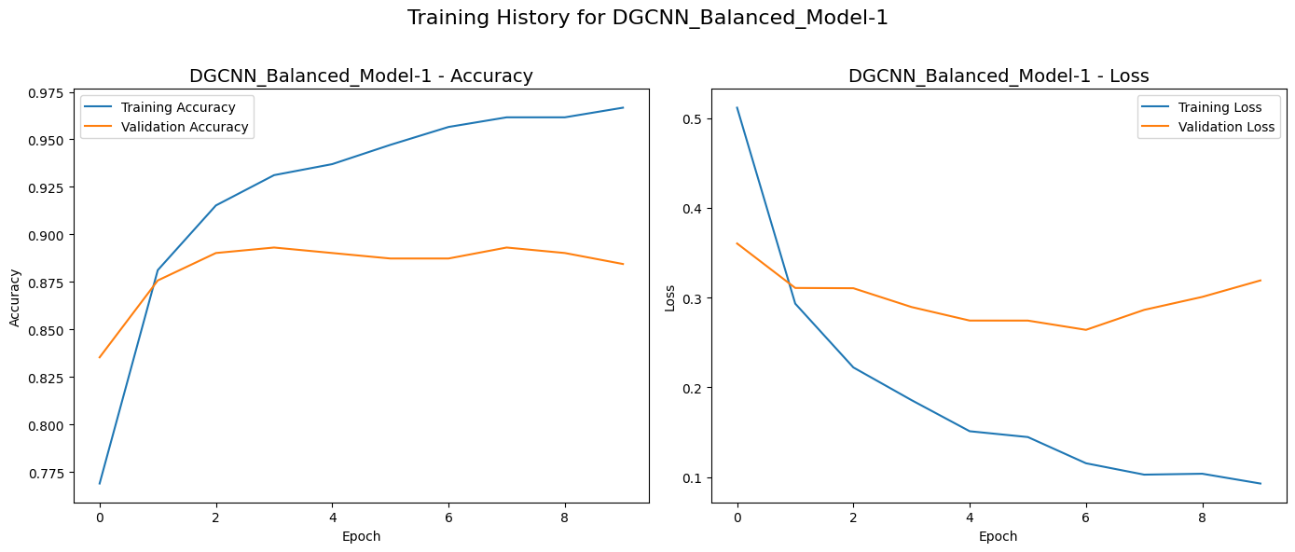
DGCNN Evaluation on Experiment 1
Our baseline DGCNN model reaches comparable, if not better performance than the reference paper’s implementation.
It correctly recalls 93.5% of Goodware (200/214), and 92.7% of Malware (202/218). It achieves an overall F1-score of 93% on the validation dataset of 432 samples.
An AUC-ROC score of 0.98 is achieved, indicating great classification performance.
Some mild overfitting tendencies can be noted in the training history around epoch 6, but that is prevented from inflating further through early-stopping.
Balanced Dataset (Experiment 1)
Metric | Our Implementation | Paper’s Baseline
Accuracy | 0.930 | 0.910
AUC-ROC | 0.966 (best) | 0.968 (best)
Precision | 0.930 | 0.887
Recall | 0.930 | 0.928

Slide 20
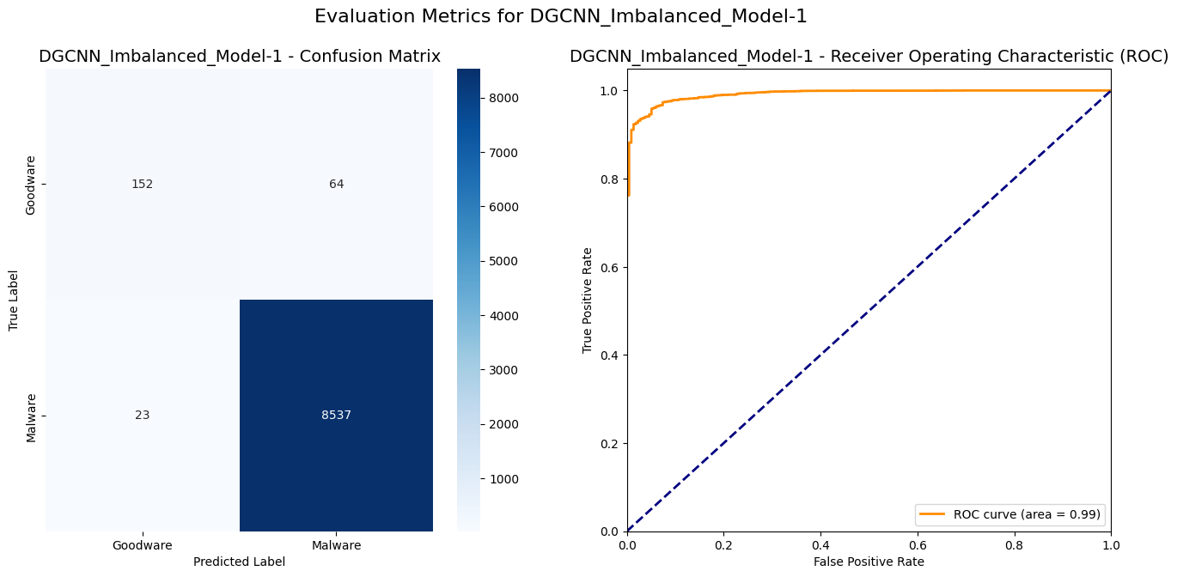
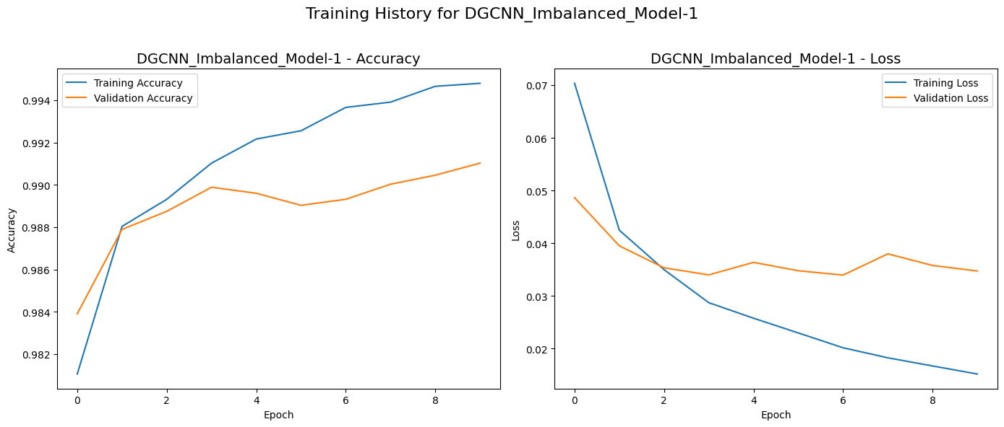
DGCNN Evaluation on Experiment 2
Our model achieves an ROC-AUC of 0.983, but this cannot be relied on since it happens to be inflated for highly imbalanced datasets.
We report our macro-average F1-score to be 0.890, which is a more balanced measure of performance than the paper’s reported overall F1-score of 0.994.
Despite the 40:1 imbalance, we report a fairly robust generalization performance.
Imbalanced Dataset (Experiment 2)
Metric | Our Implementation | Paper’s Baseline
AUC-ROC | 0.983 (best) | 0.968 (best)
F1-Score | 0.890 (macro-avg) | 0.994 (overall)

Slide 21
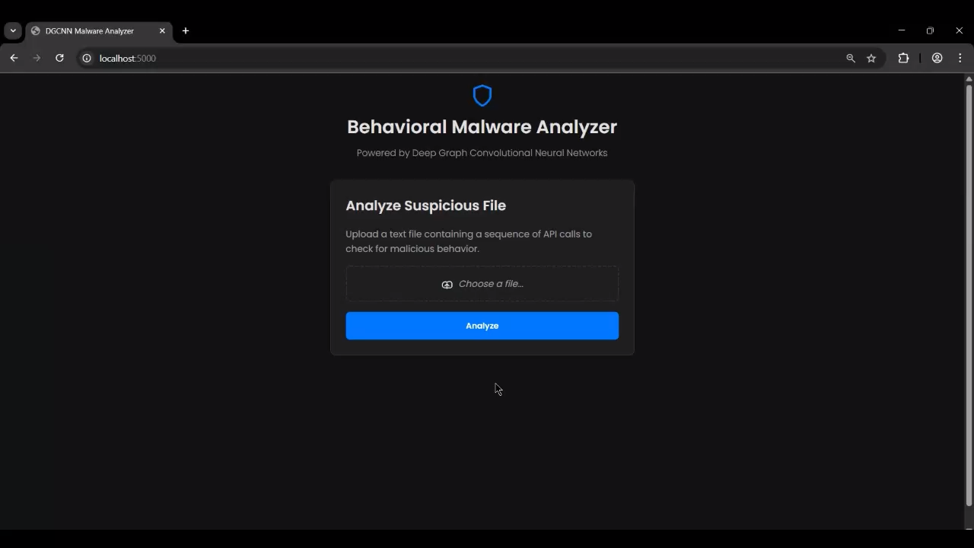
Working Demo
For safety purposes, we can’t actually download malicious .exe files (they’re not easily available too)
Instead, we decided to simulate a working demo of the model using .txt files that contain a sequence of Windows API calls – that would otherwise be obtained in a sandboxed environment
To demonstrate, we take a few samples from our validation data and upload it to the model’s interface for prediction

Slide 22

Phase II: Planned GAN Approach
With a robust baseline DGCNN implemented in Phase I, for the next section of our project - we plan to develop our proposed GAN (Generative Adversarial Network) model for analyzing malware as an anomaly detection task deviating from normal API sequence call behavior.
01 | Generator Training
Learn the distribution of normal API call sequences from the 1,079 benign samples only, producing realistic goodware sequence samples.
02 | Discriminator Learning
Distinguish between real goodware sequences and generator-produced fakes/anomalies, learning the actual distribution of goodware.
03 | Anomaly Detection
Use the trained discriminator to score new sequences - with high scores for normal, low scores flag malware anomalies.

Slide 23

Final Objectives & Impact
Malware as Anomaly
Paradigm Comparison
Study if treating malware as anomalous from normal behaviour is effective for dynamic analysis based solutions that have been deployed.
Perform a comprehensive comparison between the established graph-based approach and a new way of analyzing malware (i.e. the GAN)
Future Research
Applications
Fuel future research for the comparison of traditional malware analysis approaches with new, dynamic anomaly-based detection ones.
Deploy the GAN-based anomaly detector in real-world environments like SOCs or cloud-based scanner tools, powering Next-Gen Antivirus Engines (N-GAVs).

Slide 24
THANK YOU

