Slide 1

MOBILE Voting
Blockchain powered
anonymity + security

Slide 2
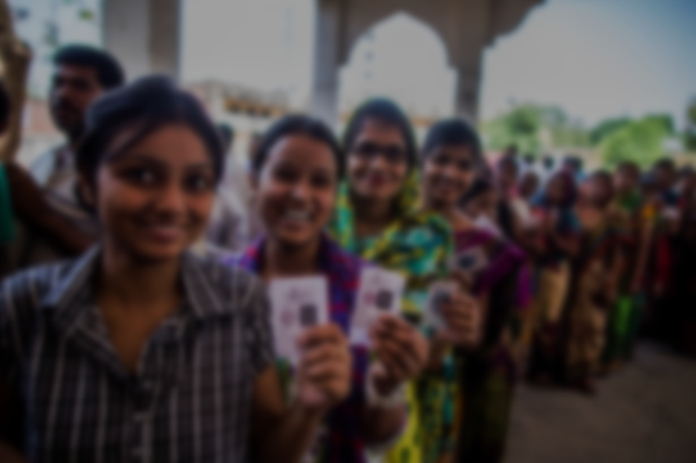
Overview
To promote higher count of young voters who’d rather vote from their homes than stand in a long queue.
An electronic voting system based on the Blockchain technology.
The system is decentralized and secure, and does not rely on trust.
Any registered voter will have the ability to vote using any device connected to the Internet.
The Blockchain will be publicly verifiable and distributed in a way that no one will be able to corrupt it.

Slide 3

Features
Authentication: Only people eligible to vote can cast a vote.
Anonymity: Our e-Voting system does not allow any links between voters’ identities and
ballots. The voter remains anonymous during and after the election.
Accuracy: The voter can vote multiple times in a specified time span; the last choice of the user is treated as the final ballot.
Security: If any of the blocks in the blockchain are to be compromised, it would be easy to find out since all blocks are connected
to each other.
Protest vote: The voter may return a blank vote to demonstrate dissatisfaction with all candidates or a refusal of the current political system and/or election.

Slide 4
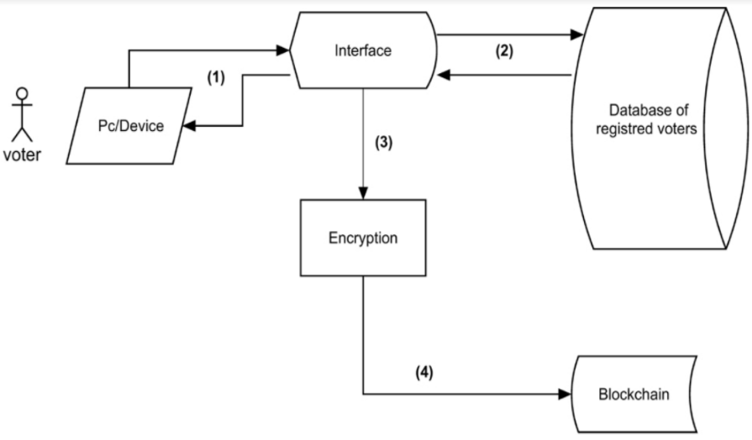
Concept

Slide 5

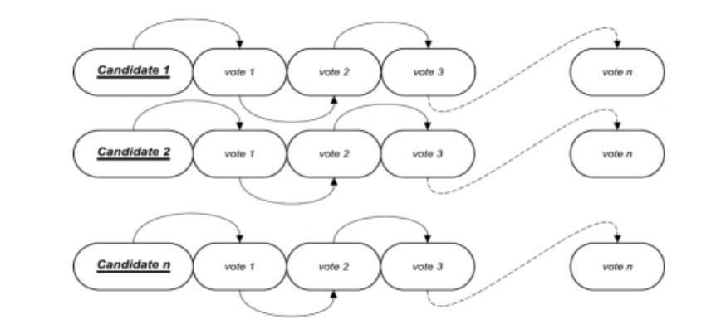
lockchain

Slide 6
Process
Requesting to vote
The user will have to log in to the voting system using his credentials.
The system will check all information entered and, if matched with a valid voter, the user will be authorized to cast a vote.
Our e-Voting system will not allow participants to generate their own identities and register to vote.
Casting a vote
Voters will have to choose to either vote for one of the candidates or cast a
protest vote. Casting the vote will be done through a friendly user interface.

Slide 7
Encrypting votes
After the user casts his vote, the system will generate an input that contains the voter identification number followed by the complete name of the voter as well as the hash of the previous vote.
This way each input will be unique and ensure that the encrypted output will be unique as well. The encrypted information will be recorded in the block header of each vote cast.
The information related to each vote will be encrypted using SHA-256, which is a one-way hash function that has no known reverse to it.
Adding the vote to the Blockchain
After a block is created, and depending on the candidate selected, the information is recorded in the corresponding Blockchain. Each block gets linked to the previously cast vote.
*Any concusses in the blockchain is solved as per the Longest Chain Rule.

Slide 8

How we ensure security (Blind Signature + Asymmetric Encryption)
Assume a scenario,
Ram is a trustee, and any ballot he certifies valid will be counted. To vote, Satish first puts his ballot in a carbon paper-lined envelope, seals it, and then mails that to Ram in an outer envelope with his return address on it. Ram checks the voter rolls to make sure Satish is eligible to vote, takes out the inner envelope and signs it (without opening it), then mails it back to Satish (since he has his return address). Satish takes out his ballot and mails that anonymously to the vote counting center, and since the ballot has Ram’s signature on it, his vote is counted.
Since Ram never saw his ballot, and the vote counters never saw his name, no one knows how he voted.

Slide 9
Mathematical Layout
Satish applies Eb to his ballot B, and sends Eb(B) to Ram, using some sort of authentication scheme.
Ram verifies Satish’s authentication, applies S′ to Eb(B), and sends S′(Eb(B)) back to Satish.
Satish applies Db to S′(Eb(B)) to get S′(B), and checks to make sure S(S′(B)) = B. This ensures that the ballot is authentic and has not been tampered.
Satish sends S′(M) to the vote counters, anonymously.
***
B = Ballot Eb = Encryption function Db = Decryption function
S′ = Signature Scheme S = Public Inverse of S′

Slide 10
Thank You!!!

