Slide 1
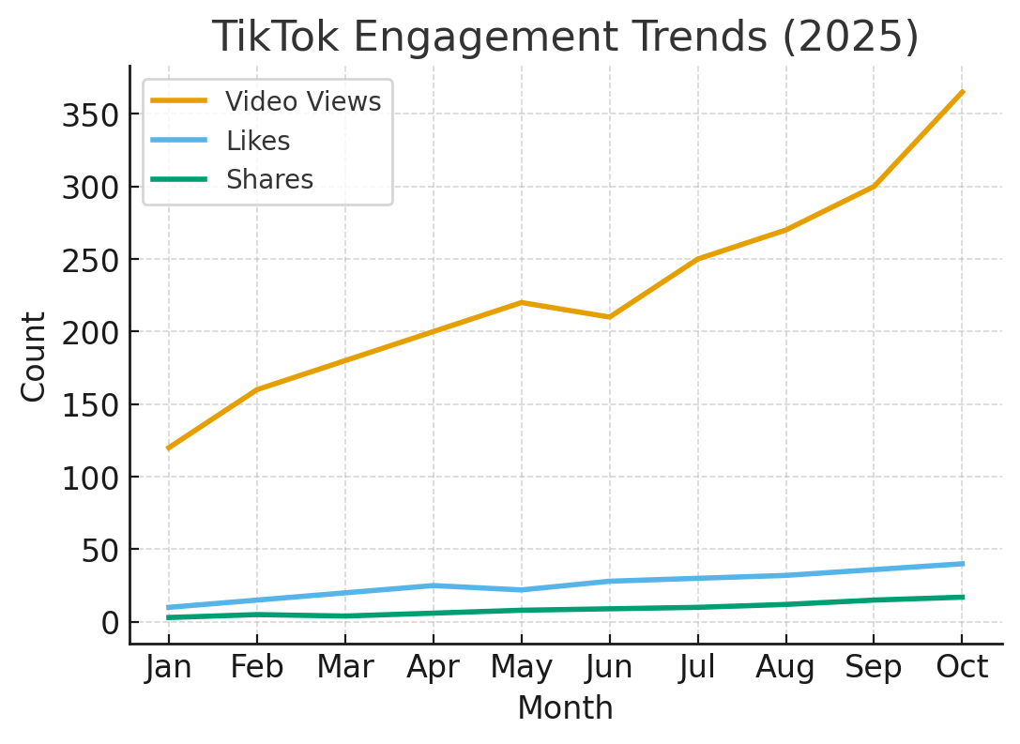
TikTok 2025 Engagement Overview – Gride Technology

Slide 2
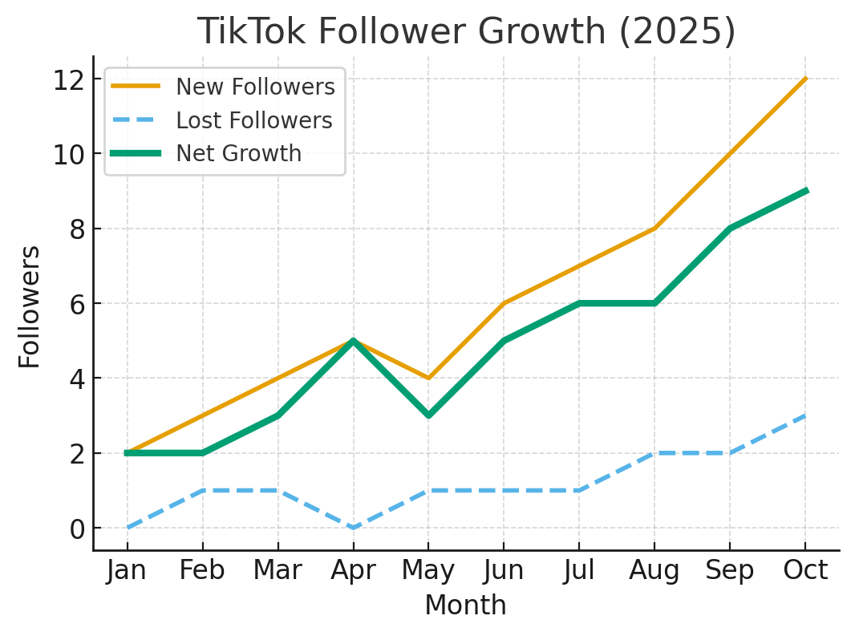
Follower Growth Summary – 2025

Slide 3
• TikTok engagement steadily increased from January to October 2025.
• Net follower growth remained positive each month.
• Consistency and creative strategy drove engagement gains.
• Learnings will guide Gride’s 2026 cross-platform campaigns.

