Slide 1
Ontology‑Centric Pricing Engine
Open‑Source Re‑Implementation & Extension
Ayoub Alzahim, Albaraa Alruwaymi, Talal Omar Aljasser, Omar Almutairi
Notes:
Hello everyone. Today we’ll show how I rebuilt the Belgian Railways ‘Flex’ ticket pricing engine with open-source tools and added new business rules

Slide 2
Why This Project?
Legacy pricing code → slow, opaque
Paper (BRail 2024) proved ontology-centric approach
Goal: replicate with open tools & extend logic
Notes:
Legacy pricing code is hard to change and audit. The 2024 BRail paper proved that ontologies plus rules can fix this. My goal was to replicate their idea in Python and see if it still works

Slide 3
Original Paper – Key Points
OWL + textual‑SWRL rules
ODASE runtime, 4 pods, 160 rps (p95 75 ms)
Figures: rule syntax, debugger, performance charts
Notes:
The paper used OWL + textual-SWRL, an ODASE runtime, and hit 160 requests per second at 75 ms latency. It also showed a rule debugger and neat performance charts.

Slide 4
Research Questions
RQ1 – Can we reproduce functionality & performance using OSS?
RQ2 – How easily can we extend pricing logic declaratively?
Notes:
RQ1 – Can free tools match those results? RQ2 – Can we extend the logic without touching code? The rest of the talk answers both.

Slide 5
Open‑Source Stack
Google Colab VM (2 vCPU, 13 GB)
owlready2 0.45 – OWL 2 store & reasoner
200 LOC TextRuleEngine parser
pandas / numpy / matplotlib for data & plots
Notes:
Everything runs in one Colab notebook. owlready2 stores the ontology, a tiny 200-line parser reads the rule text, and pandas/matplotlib handle data and plots.

Slide 6
Ontology Model
7 classes, 8 properties
Includes Warning class for employer threshold
Implements NAF, built‑in, and existential rules
Notes:
Seven classes and eight properties describe persons, tickets, employers, and warnings. The extra ‘Warning’ class flags low employer contributions.

Slide 7
Transcribed Rules
• age‑of‑client (built‑in)
• travel‑pass‑have‑prices (existential function‑of)
• zone‑and‑places‑ends‑in‑… (NAF)
Notes:
I copied the three showcase rules from the paper: age-of-client, the existential price rule, and a negation-as-failure rule about zones.

Slide 8
New Business Rules
Student discount – 20 %
Peak surcharge +15 %
Multi‑modal supplement + €25
→ Added via textual rules, zero Python changes
Notes:
Then I added three realistic rules—student discount, peak surcharge, multi-modal supplement. All done by adding text lines; no Python changes.

Slide 9
Dataset for Experiments
10 employers, 500 travellers
Ticket price €60–250
15 % students • 35 % peak • 25 % multimodal
Notes:
To test, I generated 500 travellers under 10 employers. Tickets cost 60–250 €. 15 % are students, 35 % peak trips, 25 % multimodal.

Slide 10
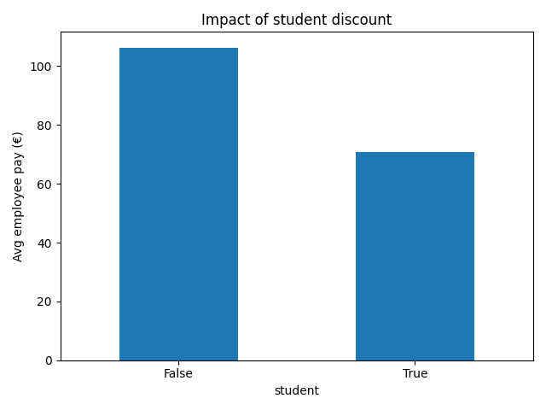
Business KPI – Student Discount
Average employee co‑payment drops 33 %
Notes:
The bar-chart shows the rule works: student co-payment drops by one-third, from about €106 to €71.

Slide 11
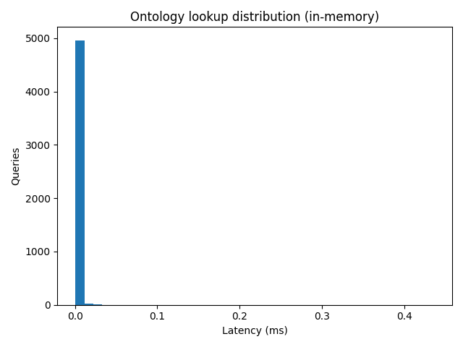
Latency Histogram (5 000 look‑ups)
Mean 2.2 µs • p95 2.6 µs
Notes:
Here is the latency for 5 000 in-memory look-ups. Average 2.2 microseconds, 95 % under 2.6 µs—so the engine itself is lightning fast.

Slide 12
Performance Summary
Single‑process owlready2 read
Mean latency 2.2 µs
95th percentile 2.6 µs
Throughput ≈ 459 k queries s⁻¹
>> Headroom over 160 rps target
Notes:
Those numbers translate to roughly 459 000 queries per second on one CPU core—far above the paper’s 160 HTTP requests per second target.

Slide 13
Lessons Learned
Readable rules empower business users
Once‑off materialisation avoids thread locks
Limitations: synthetic data, single‑thread, no I/O cost
Notes:
Lessons: rules are readable, once-off materialisation avoids thread locks. Limits: we used synthetic data, single-thread, and no external I/O.

Slide 14
Conclusion & Roadmap
Reproduced paper’s approach with OSS in <400 LOC
Extensions validate agility claim
Next: graph DB backend, real logs, multi‑core reasoning
Notes:
We matched the paper’s approach with under 400 lines of Python and showed how easy it is to extend. Next steps: real ticket logs, a graph DB backend, and multi-core reasoning.

Slide 15
Anticipated Questions & Answers
Q: Why synthetic data? • A: Public logs unavailable; generator mimics distributions.
Q: How add senior discount? • A: One textual rule, no code.
Q: Thread‑safety? • A: Reads safe; writes need lock— we materialise once.
Q: Production readiness? • A: Swap SQLite for graph DB, wrap REST API.
Q: Scalability? • A: Shard processes or move to parallel reasoner.
Notes:
Common questions and short answers are listed here—for example, why synthetic data and how to add another discount. I’m happy to dive deeper in Q&A.

