Slide 1
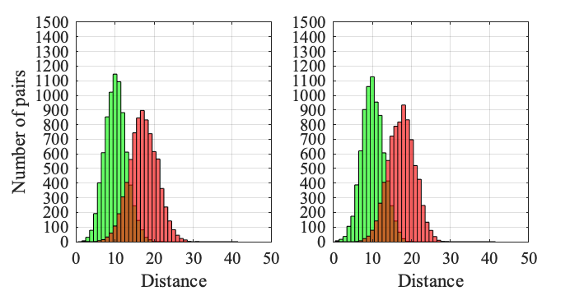
Route length = 10
Union Square (16.8%)
Wall Street (33.4%)

Slide 2
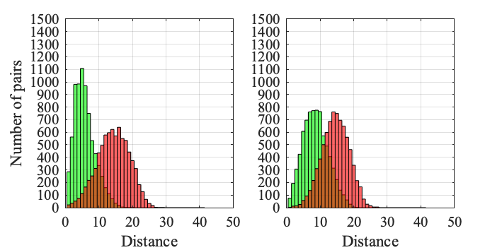
Route length = 10
Union Square (7%)
Wall Street (15.4%)

Slide 3
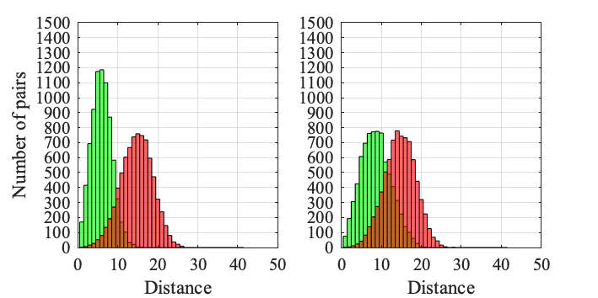
Route length = 10
Union Square (24.6%)
Wall Street (16.8%)

Slide 4
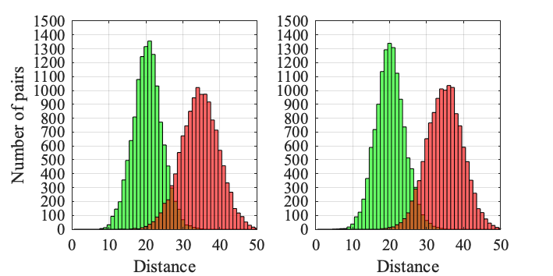
Route length = 20
Union Square (64.8%)
Wall Street (87.2%)

Slide 5
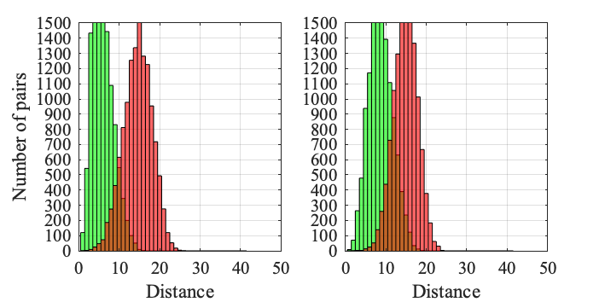
Route length = 20
Union Square (26.8%)
Wall Street (62.6%)

Slide 6
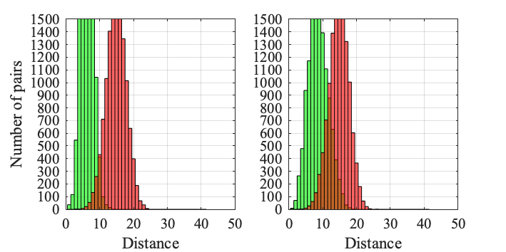
Route length = 20
Union Square (77.2%)
Wall Street (66.8%)

Slide 7
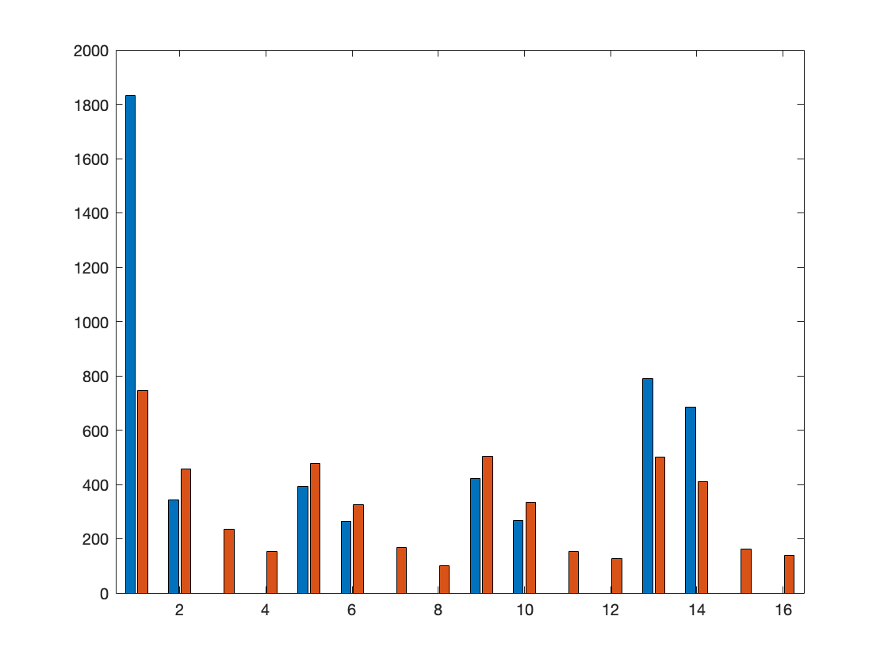
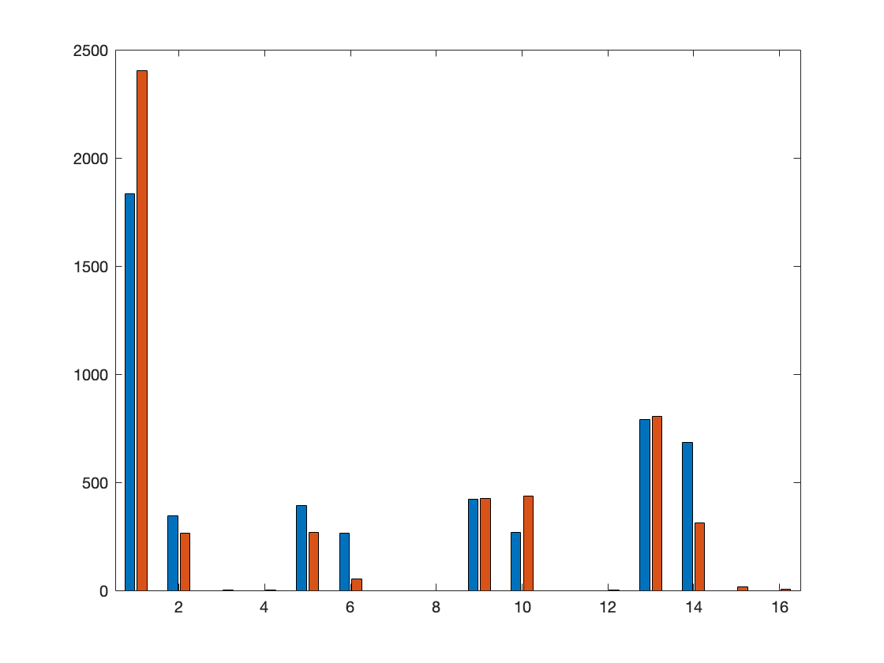
Union Square
Simulated Classifier
Real Classifier

Slide 8
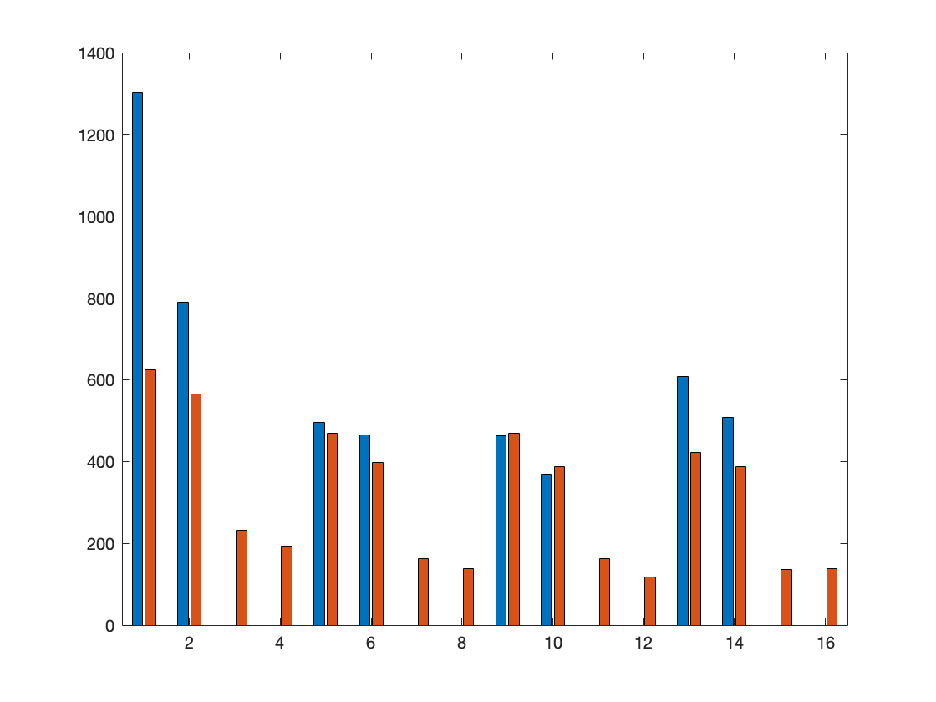
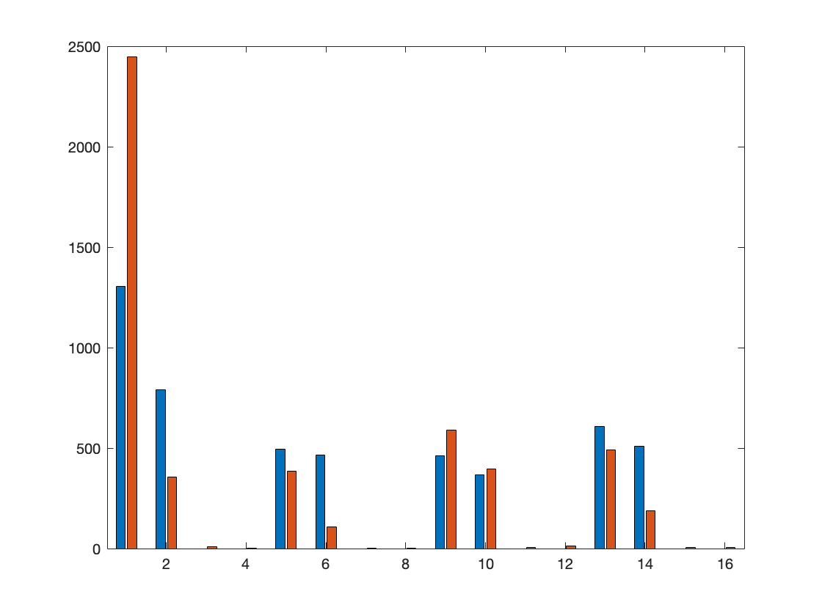
Wall Street
Simulated Classifier
Real Classifier

Slide 9
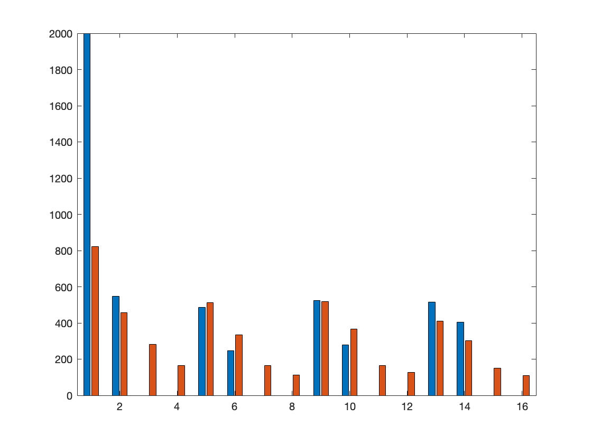
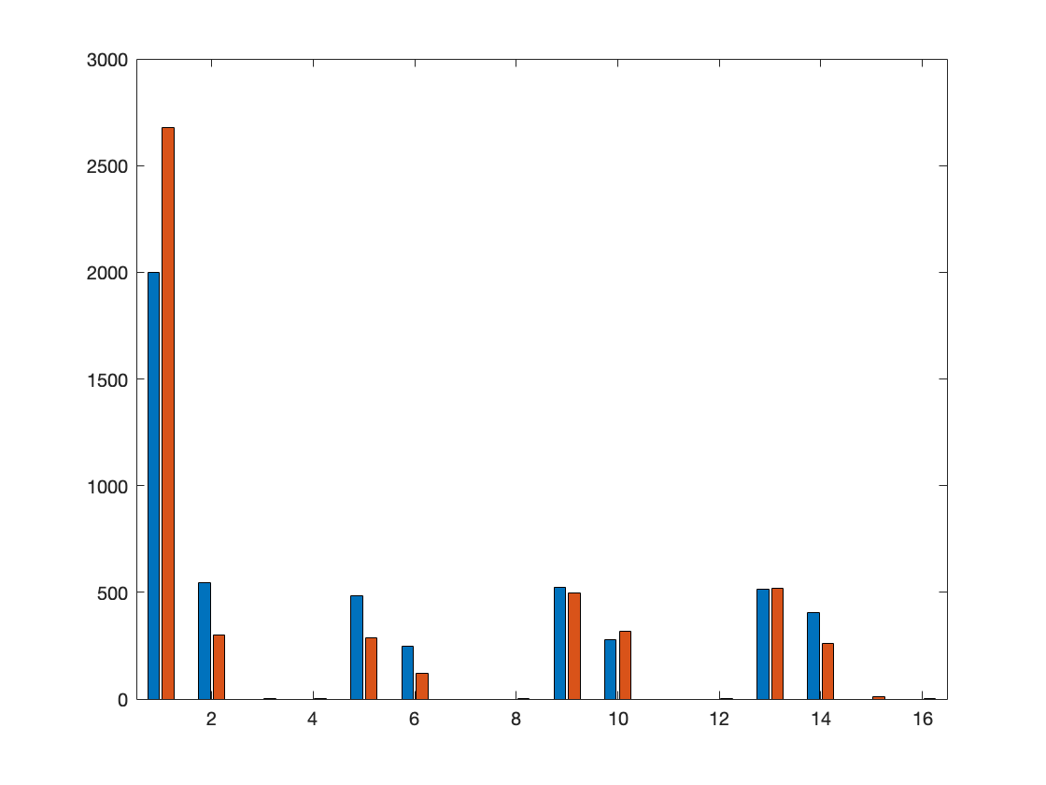
Hudson River
Simulated Classifier
Real Classifier

Slide 10
Training Set
Num of junctions | Num of non_junctions | Num of gaps | Num of non_gaps
75736 | 111798 | 43455 | 144079
187534 |  | 187534
375068
Validation Set (Hudson River)
Num of junctions | Num of non_junctions | Num of gaps | Num of non_gaps
3127 | 6873 | 1721 | 8279
51.487% | 91.256% | 73.736% | 95.555%
78.82% |  | 91.8%

Slide 11
Testing Set (Wall Street)
Num of junctions | Num of non_junctions | Num of gaps | Num of non_gaps
4208 | 5792 | 1946 | 8054
39.259% | 89.624% | 66.495% | 94.574%
68.43% |  | 89.11%
Testing Set (Union Square)
Num of junctions | Num of non_junctions | Num of gaps | Num of non_gaps
3693 | 6307 | 2165 | 7835
57.352% | 93.246% | 79.215% | 95.903%
79.99% |  | 92.29%

Slide 12
Testing Set (Wall Street)
 |  | Bit 1 | Bit 2 | Bit 3 | Bit 4
Real classifier | Whole area | 71.52% | 99.16% | 65.34% | 79.06%
 | test routes | 76.75% | 99.06% | 64.52% | 82.16%
simulated | Whole area | 74.48% | 74.44% | 75.26% | 74.34%
 | test routes | 74.67% | 75.09% | 75.11% | 75.22%

Slide 13
Testing Set (Union Square)
 |  | Bit 1 | Bit 2 | Bit 3 | Bit 4
Real classifier | Whole area | 84.4% | 99.4% | 75.58% | 85.18%
 | test routes | 84.47% | 99.44% | 77.14% | 85.80%
simulated | Whole area | 74.94% | 75.14% | 73.68% | 75.06%
 | test routes | 75.05% | 74.49% | 73.5% | 75.64%

Slide 14
Testing Set (Hudson River)
 |  | Bit 1 | Bit 2 | Bit 3 | Bit 4
Simulated | Whole area | 74.48% | 74.44% | 75.26% | 74.34%
 | test routes | 74.9% | 74.1% | 75.05% | 74.29%
Real Classifer | Whole area | 82.26% | 99.48% | 75.38% | 84.21%
 | test routes | 84.19% | 99.52% | 75% | 85.25%

Slide 15
Localisation Accuracy With Real Classifier (with Turns)
 | 5 | 10 | 15 | 20 | 25 | 30 | 35 | 40
Wall street | 0.034 | 0.154 | 0.396 | 0.626 | 0.728 | 0.842 | 0.9 | 0.914
v2 | 0.066 | 0.27 | 0.558 | 0.782 | 0.89 | 0.95 | 0.964 | 0.954
v3 | 0.028 | 0.168 | 0.454 | 0.688 | 0.814 | 0.904 | 0.936 | 0.946
Union square | 0.01 | 0.07 | 0.156 | 0.268 | 0.42 | 0.578 | 0.708 | 0.796
v2 | 0.074 | 0.34 | 0.65 | 0.854 | 0.936 | 0.984 | 0.986 | 0.98
v3 | 0.038 | 0.246 | 0.542 | 0.772 | 0.912 | 0.962 | 0.984 | 0.974
Hudson river | 0.036 | 0.144 | 0.266 | 0.402 | 0.548 | 0.64 | 0.716 | 0.752
v2 | 0.086 | 0.424 | 0.66 | 0.85 | 0.948 | 0.98 | 0.978 | 0.972
v3 | 0.072 | 0.244 | 0.5 | 0.668 | 0.804 | 0.866 | 0.912 | 0.938

Slide 16
Localisation Accuracy With Real Classifier (without Turns)
 | 5 | 10 | 15 | 20 | 25 | 30 | 35 | 40
Wall street | 0.01 | 0.04 | 0.088 | 0.116 | 0.164 | 0.22 | 0.248 | 0.286
v2
v3
Union square | 0.004 | 0.01 | 0.03 | 0.056 | 0.068 | 0.124 | 0.186 | 0.228
v2
v3
Hudson river | 0.008 | 0.04 | 0.068 | 0.124 | 0.186 | 0.216 | 0.264 | 0.303
v3

Slide 17
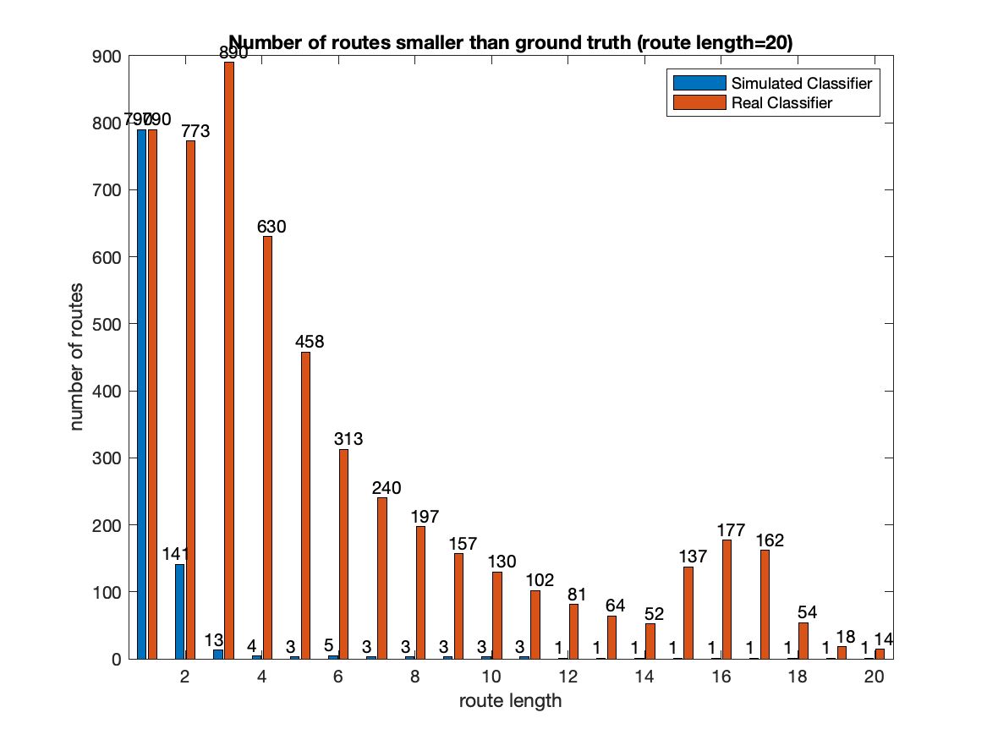
Road index = 1

Slide 18
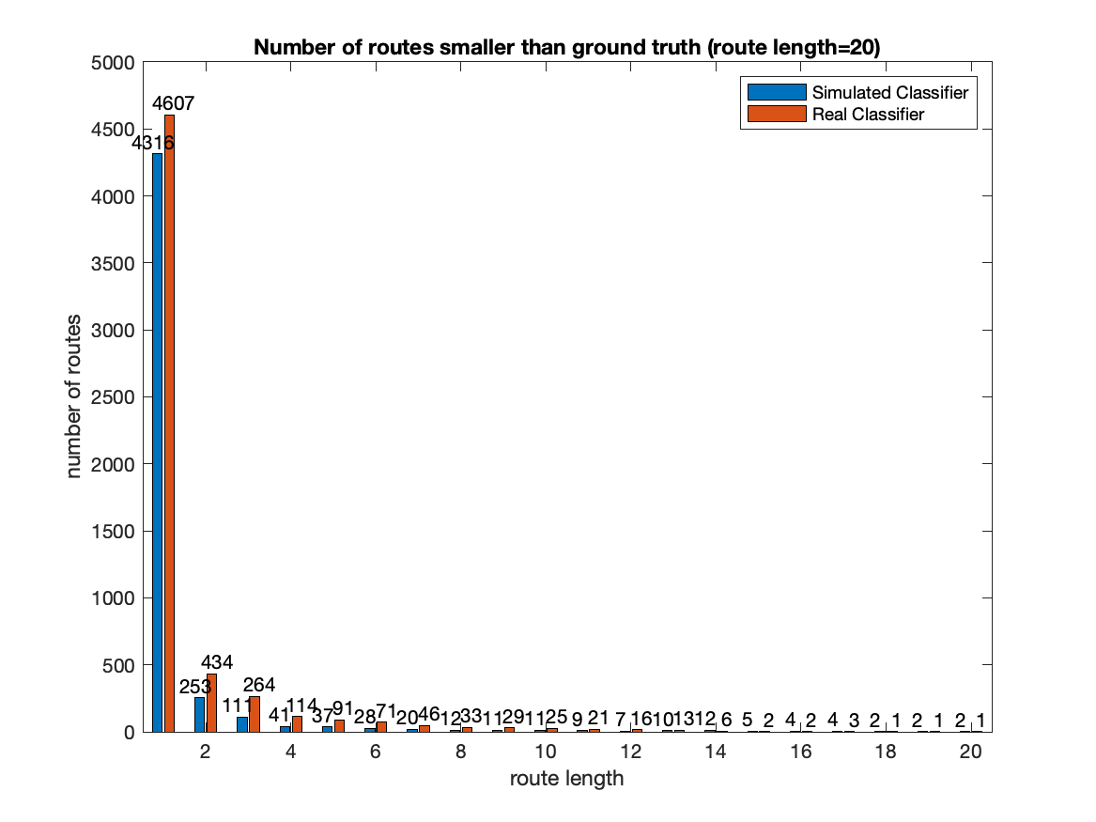
Road index = 30

