Slide 2
AR949 GME T4 SO
Executive Summary
Purpose
Analysis
Conclusions
Next Steps

Slide 3
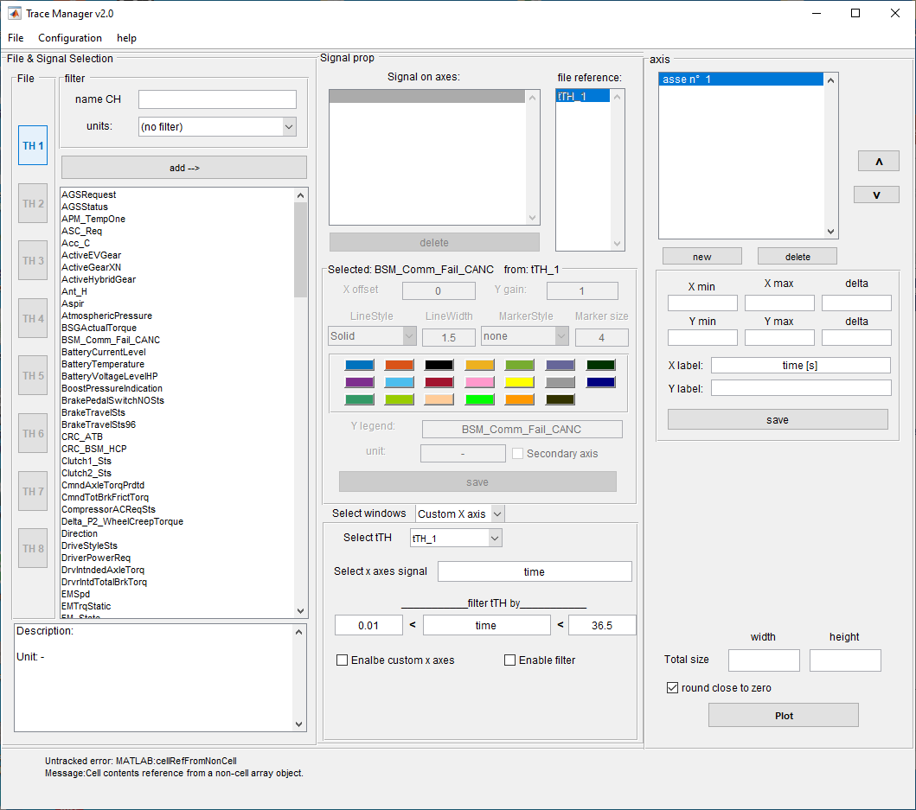
Trace Manager v2 main program
Main program
7
Trace Manager v2
Main program
File Selection
Load a signal
Create new axis
Create a figure
Define line properties
Panel selector
custom x axis
channel calculator
Save, load and export
Info box
Output Figure
Main window
Tool panel
Export Figure
Zoom
Legend
Data Cursor
Resize subplots
Vertical Cursor
1
5
3
2
6
6.a
4
8

Slide 4
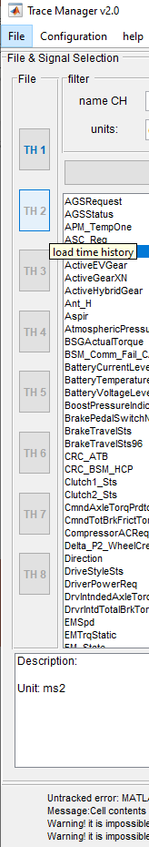
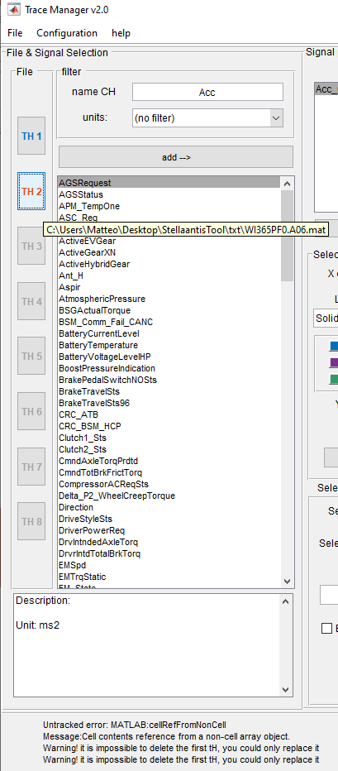
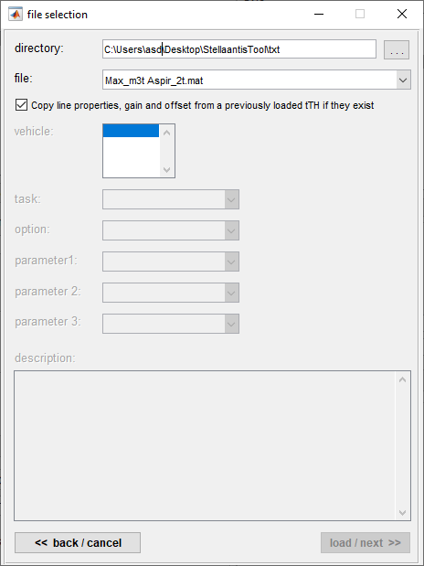
File Selection
Trace Manager v2
Main program
File Selection
1
1.a
1.c
1.b
File selection
Select folder
Choice the time history that you want to load
Check the checkbox if you want to load the configuration of a previous time history
After you have load the file correctly, when you drag the mouse on the button appear the full path of the time history
in the signal list box appear all signal contain in the time history
1.d
1.e
Notes:
Load the time history in order is it’s possible
Don’t close the file selection windows with the X use back/cancel button instead
It’s impossible to remove the first time history, you could replace it perform a new tTH load

Slide 5
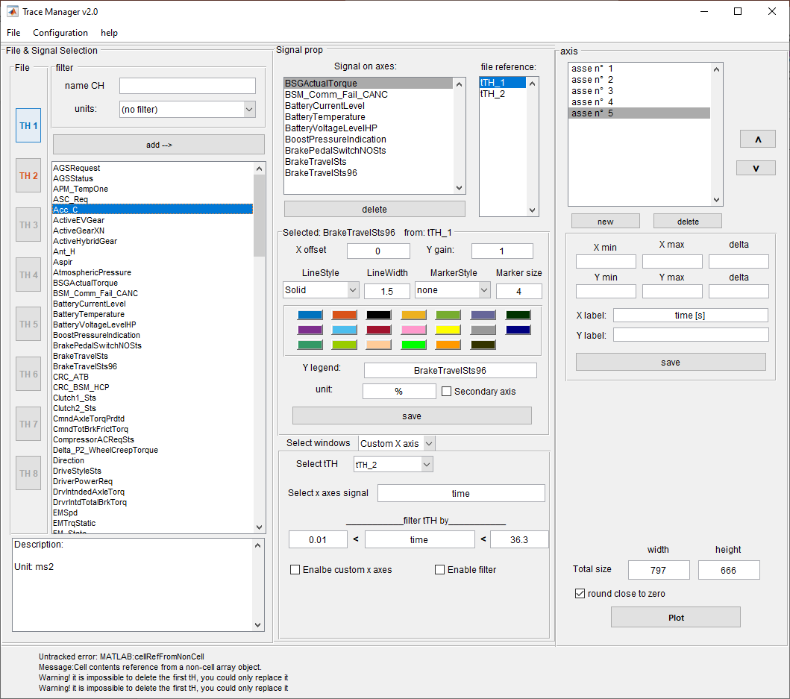
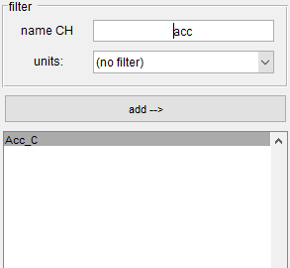
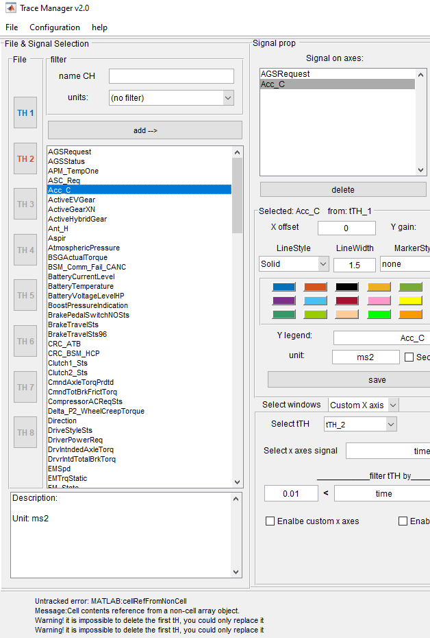
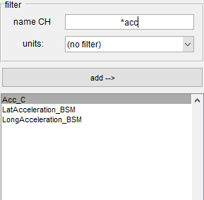
Load a Signal
Trace Manager v2
Main program
…
Load a Signal
2.f
2.f.i
2.f.ii
2.b
2.c
File selection
List of signals for all time histories
Select one or more signals in the signals list than push add button. The signals will load in the window 2.c
In this windows there are all signals on single axis.
Removes a signal form axis select them and push on delete button
After selecting a signal in the window 2.e appear info on unit and a description if exist.
Filter Panel
Filter by name.
Filter by unit
2.3: Push enter to apply the mod
Search signals name that start with acc
2.d
2.a
2.e: Push enter to apply the mod
Search signals name that contain acc
2.e
Notes:
before creating a plot make sure that there is at least one signal (in window 2.c) for each axis (in window 3) you have created.

Slide 6
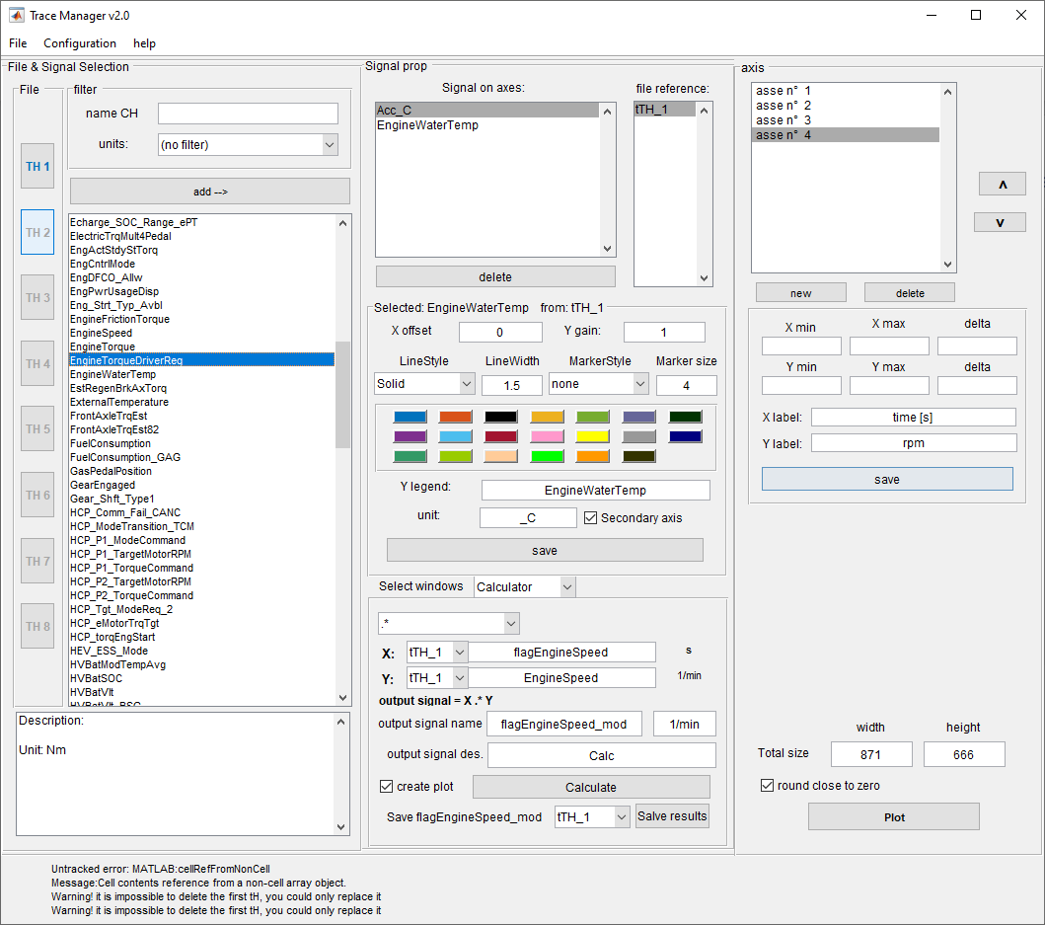
Create new axis
Trace Manager v2
Main program
…
Create new axis
2.c
3.c
Create new axis
List of axes window
Create a new axis
Delete selected axis
Change the order of the axes
3
3.a
3.b
3.d
3.e
3.g
3.f
3.h
Notes:
before creating a plot make sure that there is at least one signal (in window 2.c) for each axis (in window 3) you have created.
Before change the order of the axes make sure that all axes has at least one signal

Slide 7
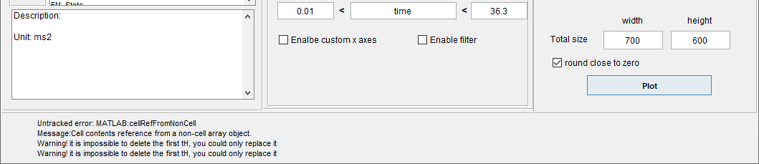
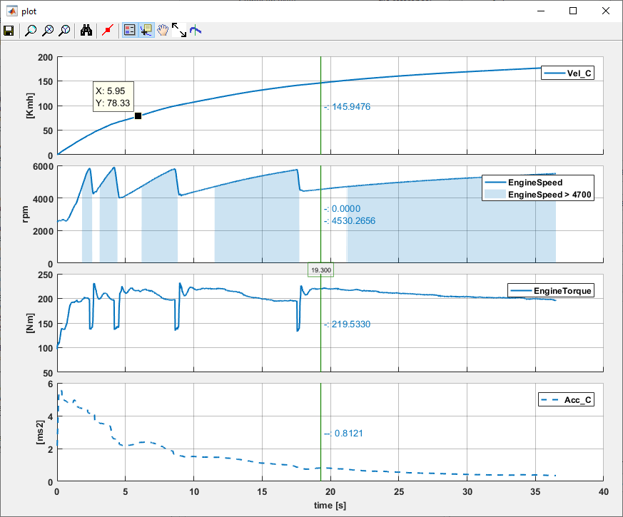
Create a Figure
4.a
Trace Manager v2
Main program
…
Create a Figure
Create a Figure
With a click on plot button appear a figure with the signals loaded (2.c) and the axes created (3) in the Main Program
Choice the width and height dimension of the output figure
For more information on the output figure and figure tools go to the Output figure section.
4
600
Notes:
before creating a plot make sure that there is at least one signal (in window 2.c) for each axis (in window 3) you have created.
If the figure don’t appear correctly try to:
close the previous figure
Check if all axes contain at least one signal
Check if all signal in all axes exist in the time histories loaded
700

Slide 8
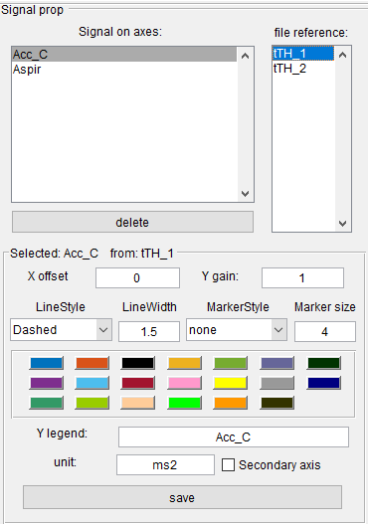
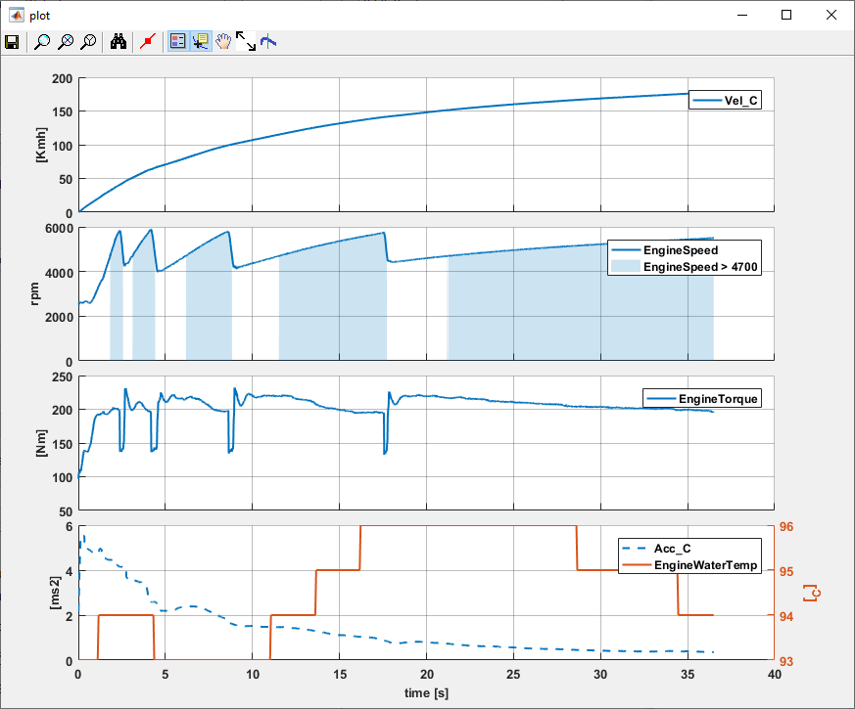
Define line properties
Trace Manager v2
Main program
…
Define line properties
5.a
5.b
5.i
5.h
Define line properties
Select a signal target on 5.a window
Select the time history target on 5.b window. If the signal exist in more than one time histories
In this label appear the signal target that you are modifier
5.c
5.d
5.e
5.f
5.j
5.g
5.h
Translate the time history on x axes by this value. This value are applied to all signals of the time history
The selected signal will be multiplied by this value before it is plotted.
Define the line style, the weight or the marker of the line.
Choice the line colours.
Change the signal string in the legend
Change the unit of the signal write in the figure. Note, the unit written on the subplot is the unit of the first signal in the axis
Check the checkbox to plot the signal on a secondary axis
After you set the property of the line, push save button to apply the mods.
The changes on this section is not automatically apply to the output figure, you have to create another output figure with plot button.
5.i
5.j
5.k
Notes:
be sure that the changes you are making will be applied to the signal you want by always executing the steps a, b and c before.

Slide 9
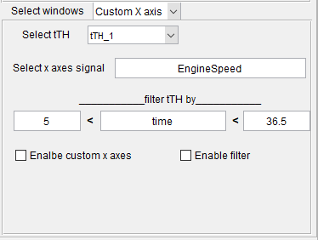
Panel selector & custom x axis
6
Trace Manager v2
Main program
…
Panel selector
custom x axis
channel calculator
6.a
6.b
6.c
6.d
6.e

Slide 10
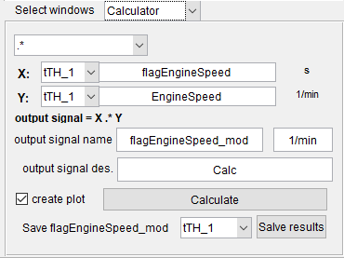
Panel selector & channel calculator
6
Trace Manager v2
Main program
…
Panel selector
custom x axis
channel calculator
6.a
6.c
6.d
6.b
6.e
6.f
6.g
6.h
6.i

Slide 11
Output figure
Output figure
4
6
Trace Manager v2
Main program
…
Output Figure
Main window
Tool panel
Export Figure
Zoom
Legend
Data Cursor
Resize subplots
Vertical Cursor
2
3
5
7
1

Slide 12
Backup

Slide 13



