Slide 1
Ameen Khan T1/2A
Final Project: Computer Assisted Gambling
Core Functionality:
Dynamic Memory
Pointers
Processing of Array Data
File I/O
Structs
Advanced Features
2D dynamic Memory Manipulation
Notes:
Presentation details:
10 points of Final Project grade
Max time limit … 5 minutes
Your instructor will grade you on the following:
Quality of evaluation of deviations in design, as explained
Quality of evaluation of test plan oversights, as explained
Inclusion of time spent and most difficult aspect
Quality of presentation materials
Quality of presentation (delivery)

Slide 2
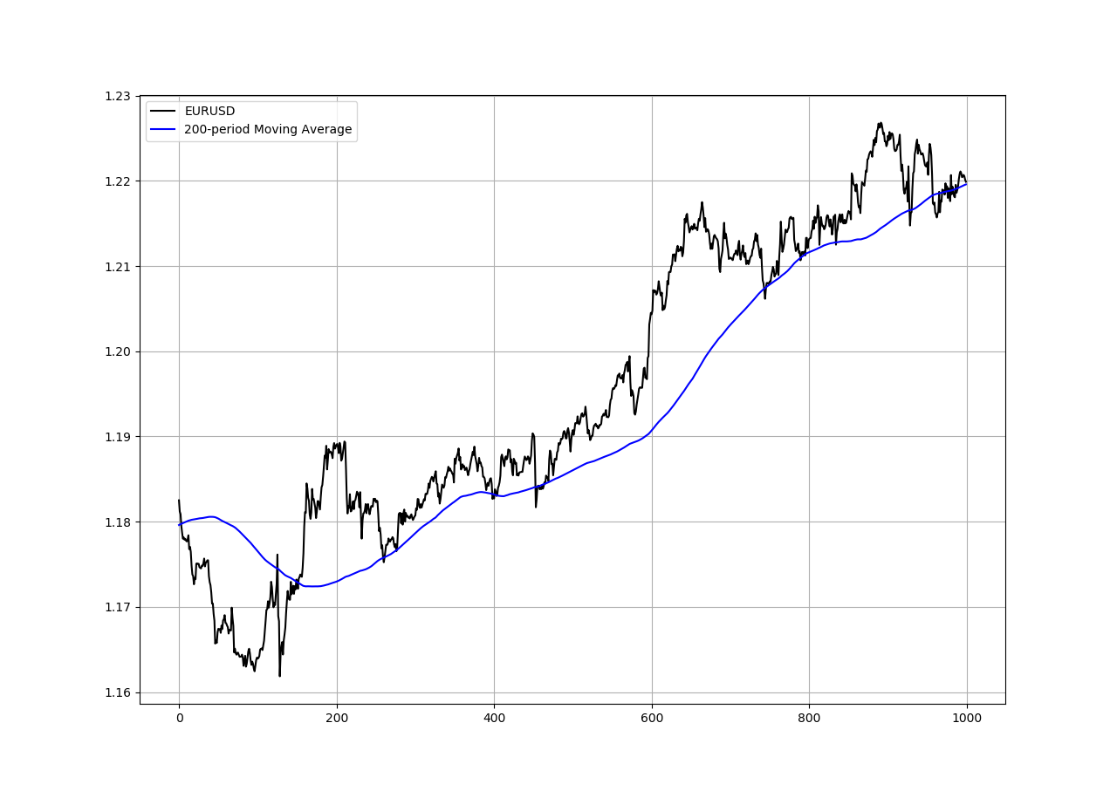
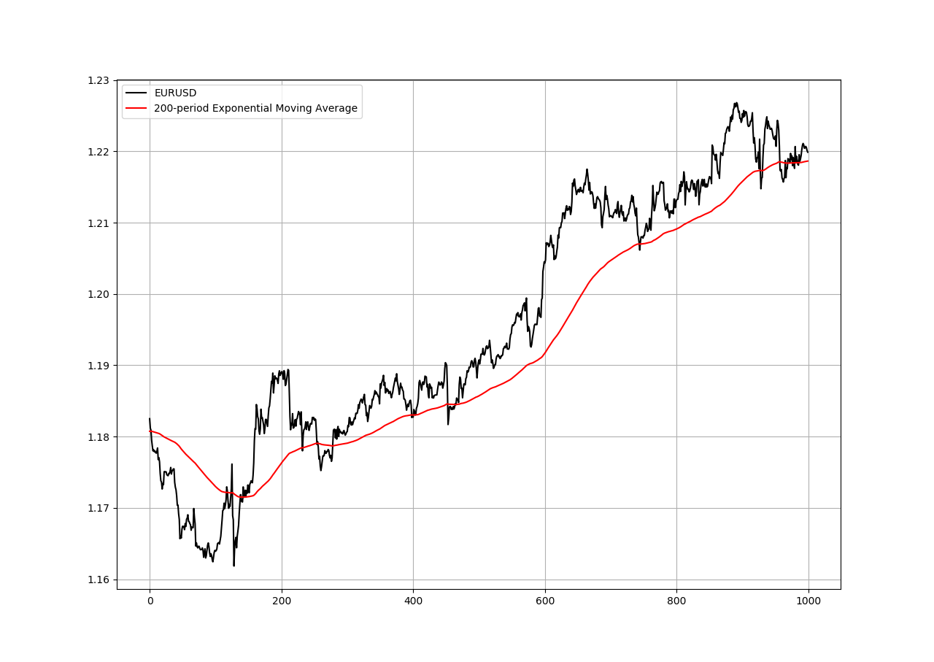
Background

Slide 3
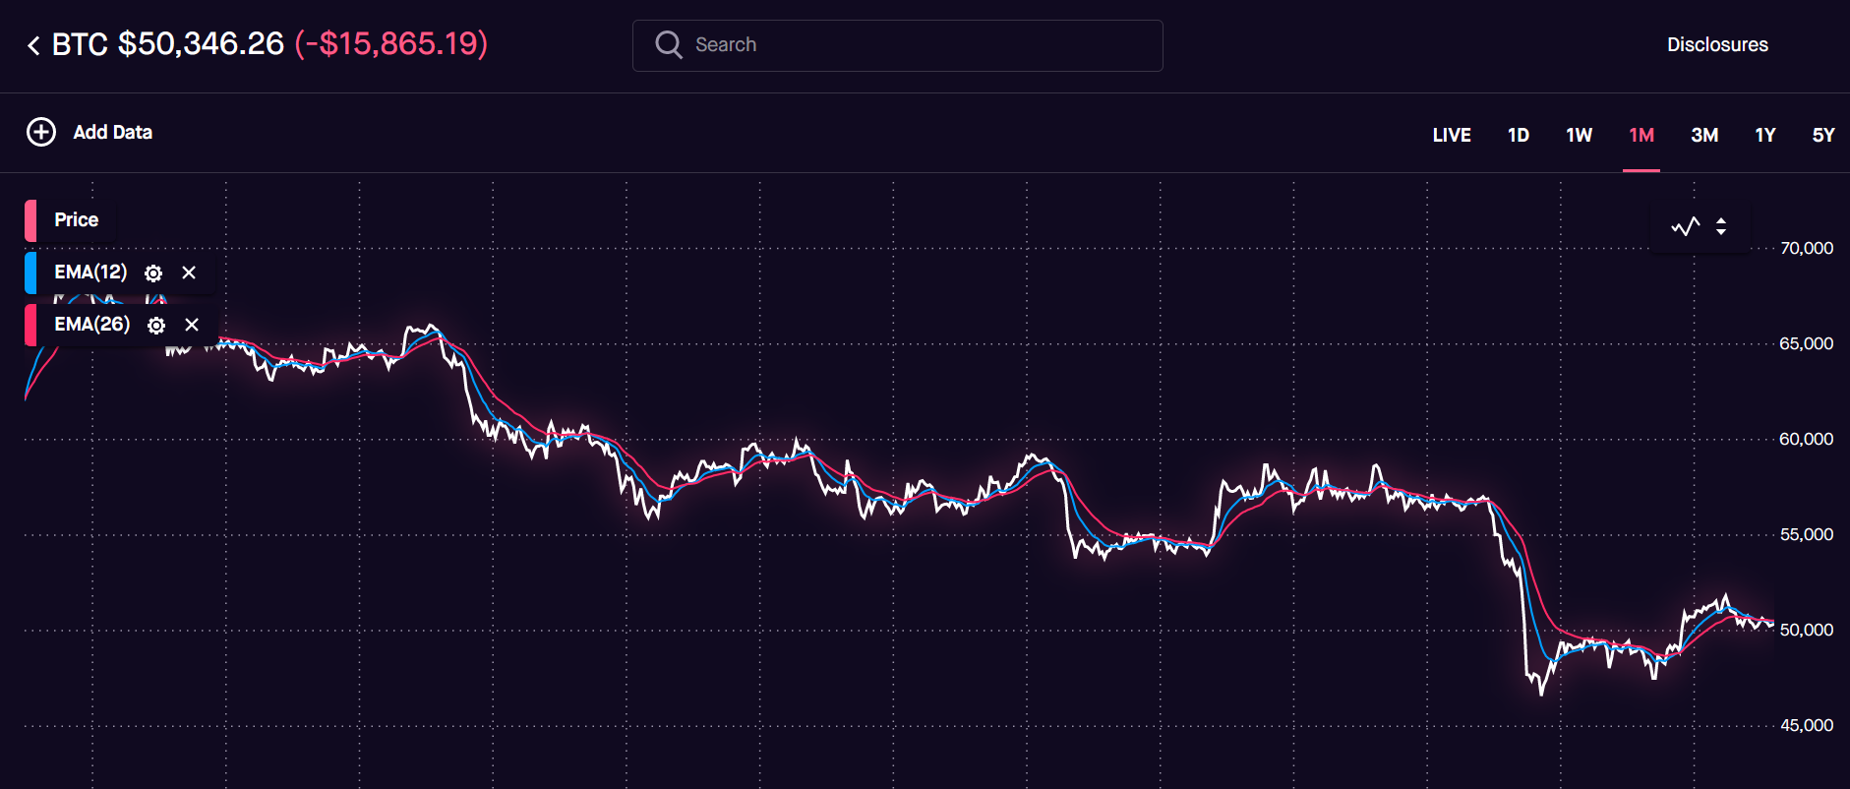
Background

Slide 4
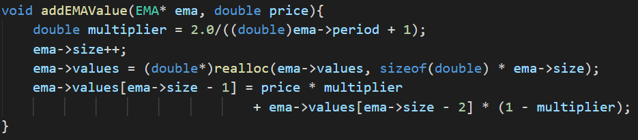
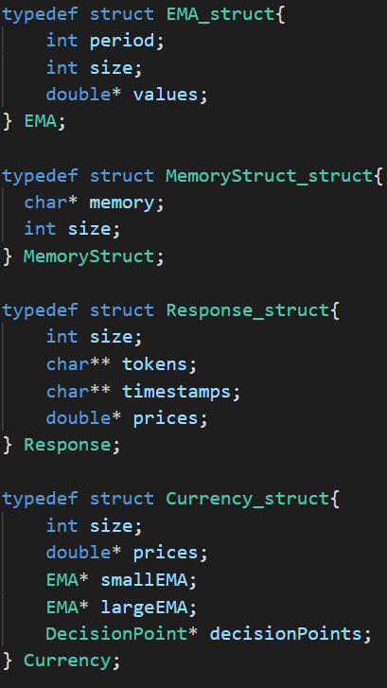
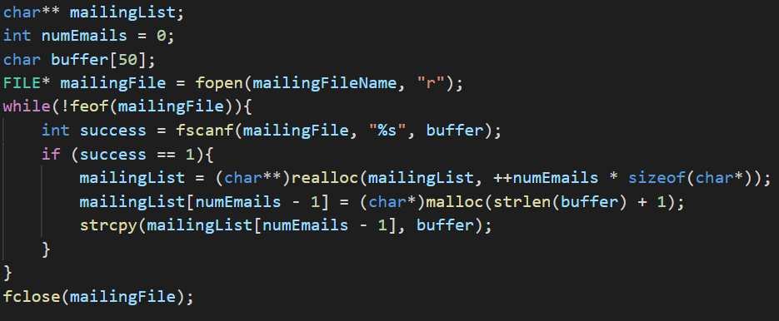
Programming Concepts
Dynamic Memory, Pointers, Array Data
Structs
Dynamic 2D Memory Manipulation

Slide 5
CS210 Final Project Evaluation
Deviations from Design
sendEmail function needed different parameters
Errors are communicated through the terminal
Test Plan Oversights
Improper data in JSON
Handling network failures

Slide 6
CS210 Final Project Evaluation
Most difficult aspect: Dynamic Everything
All data is stored in dynamically allocated memory
Getting data from the internet
Working with JSON structure in C
Time spent (design, test, implementation)
Design: 3 hours
Test: 5 hours
Implementation: 10 hours

Slide 7
CS210 Final Project Demonstration

