Slide 1
XS-Search
Based on timing attacks

Slide 2

Whoami
Email c1h2e1@dafsec.org
@MST Team
Twitter @C1h2e11
Security Researcher
Bug bounty hunter
Telegram @C1h2e1
QQ Group ID 666452960

Slide 3

AGENDA
-About Timing Attacks
-Why XS-Search?
-From Gmail XS-Search talk about XS-search
-Soul artist C1h2e1 Draw mindmap
-How to find it
-Reference

Slide 4
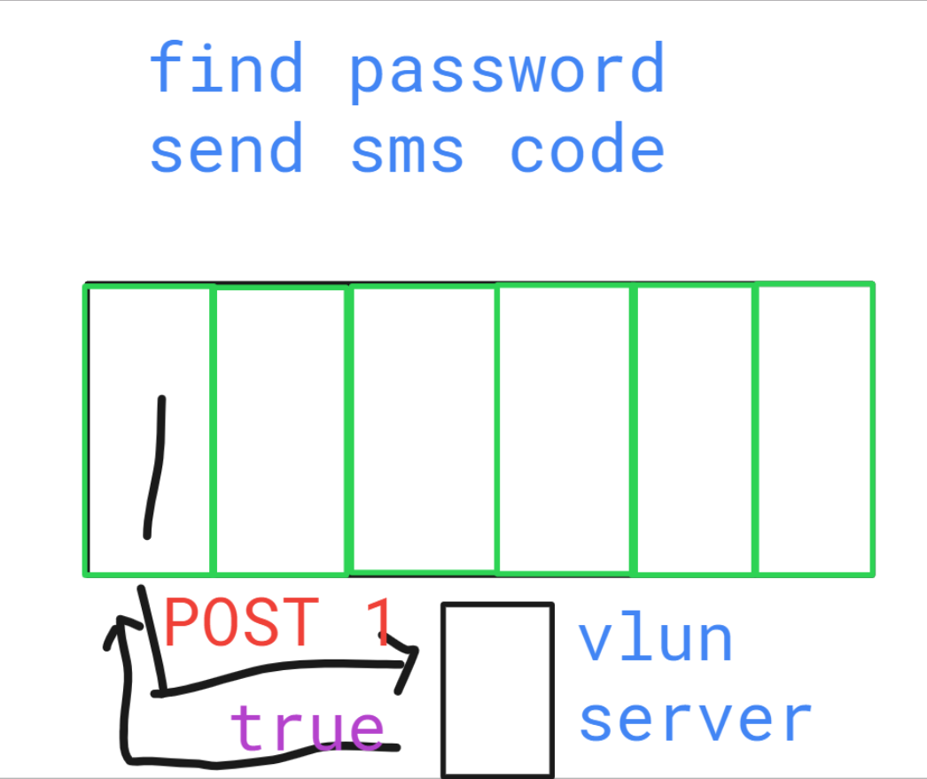
Easy and clearly
Example
Forget Password
Thieves steal Bike

Slide 5
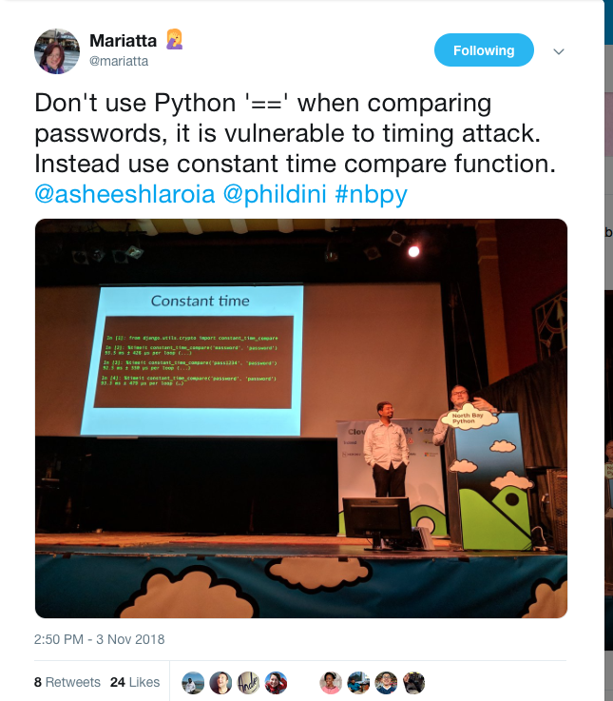
A case of python
"hunter2" == "password123" # False. 51μs
F
"hunter2" == "obama" # False. 50μs
F
"hunter2" == "havana" # False. 73μs
TF
"hunter2" == "humana" # False. 90μs
TTF
...
"hunter2" == "hunter1" # False. 170μs
TTTTTTF
"hunter2" == "hunter2" # True. 190μs
TTTTTTT

Slide 6

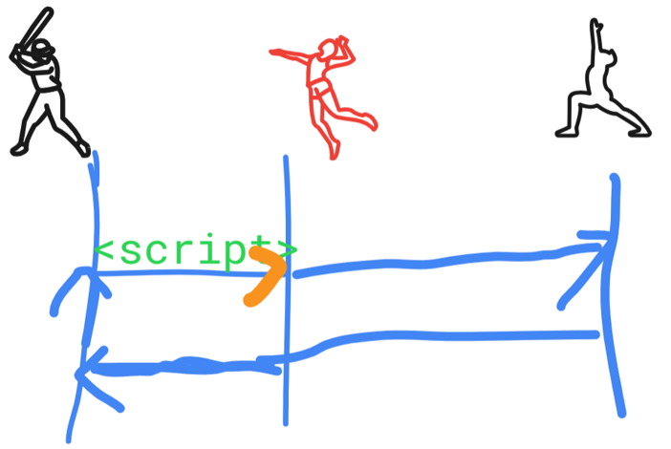
XS-Search
Cross site Search
But why it based on Timing Attack

Slide 7
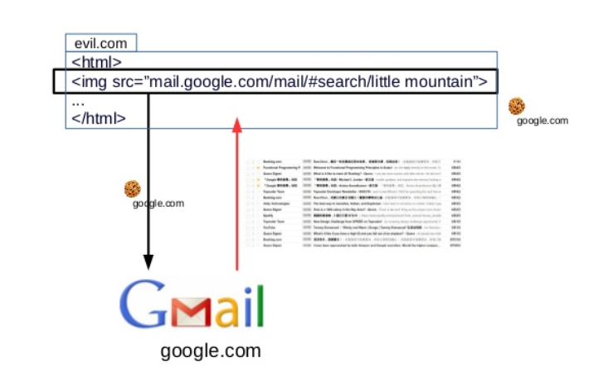
Try it
Dream
Reality
(SOP)
Same Origin
Policy

Slide 8
XS-Search
XS-Search
=XS-Search Timing Attack on search service
Example
Condition
Advanced search
`OR`
T ~= F ? try inflation

Slide 9
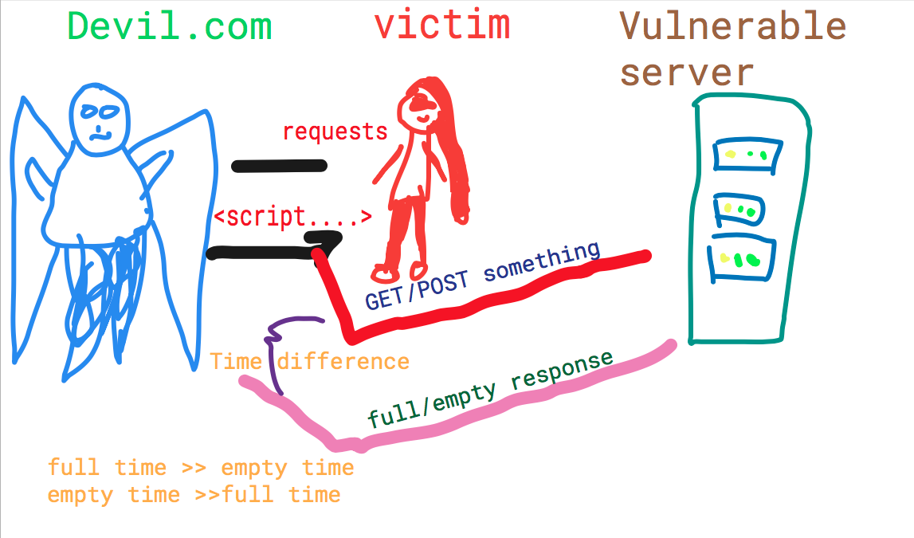

Slide 10
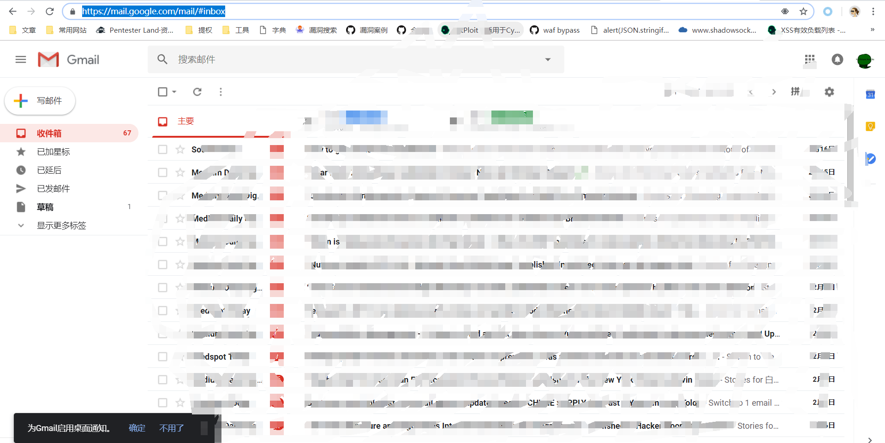
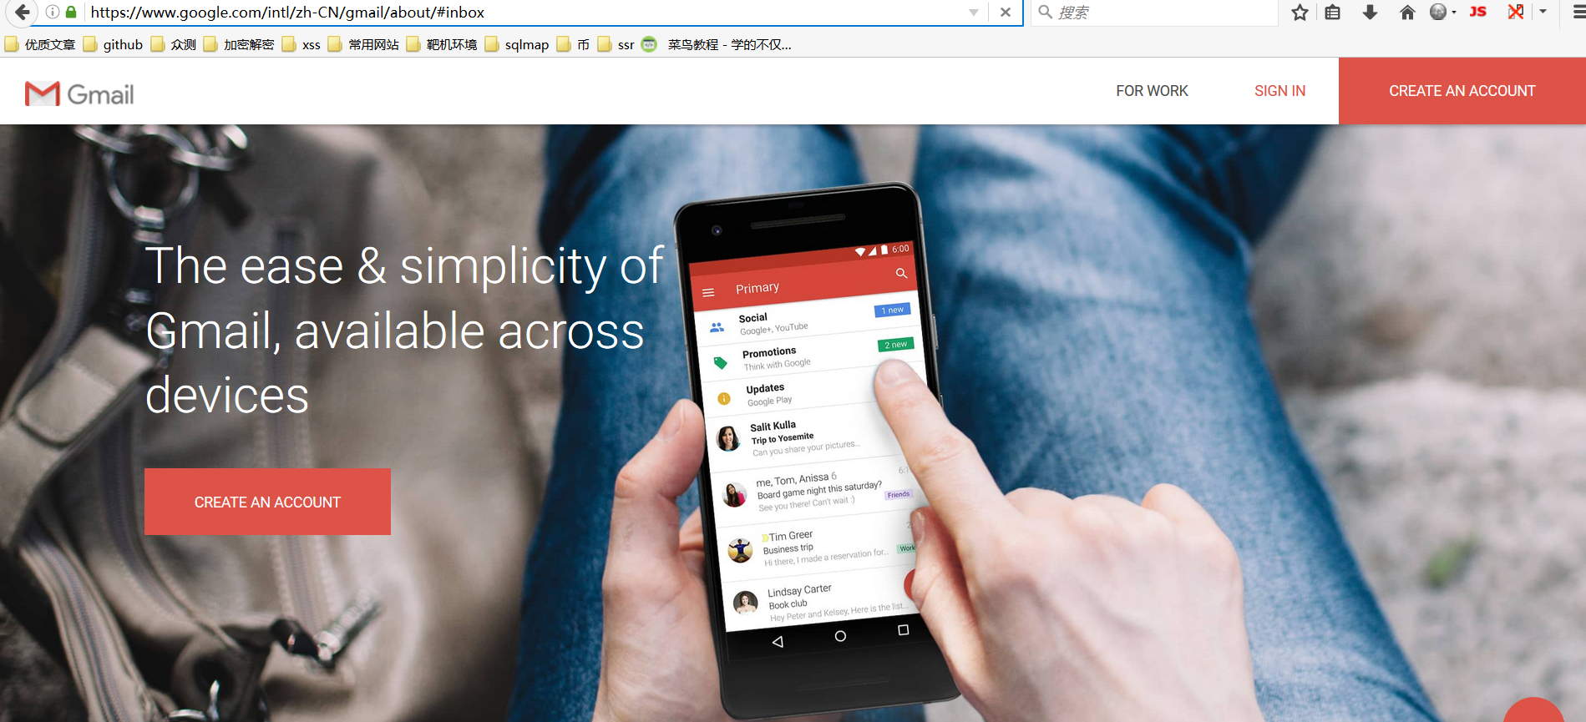
Gmail home page
<script src =“https://mail.google.com/mail/#inbox”>
Demo
Logged >slowly
Not-logged >fast

Slide 11
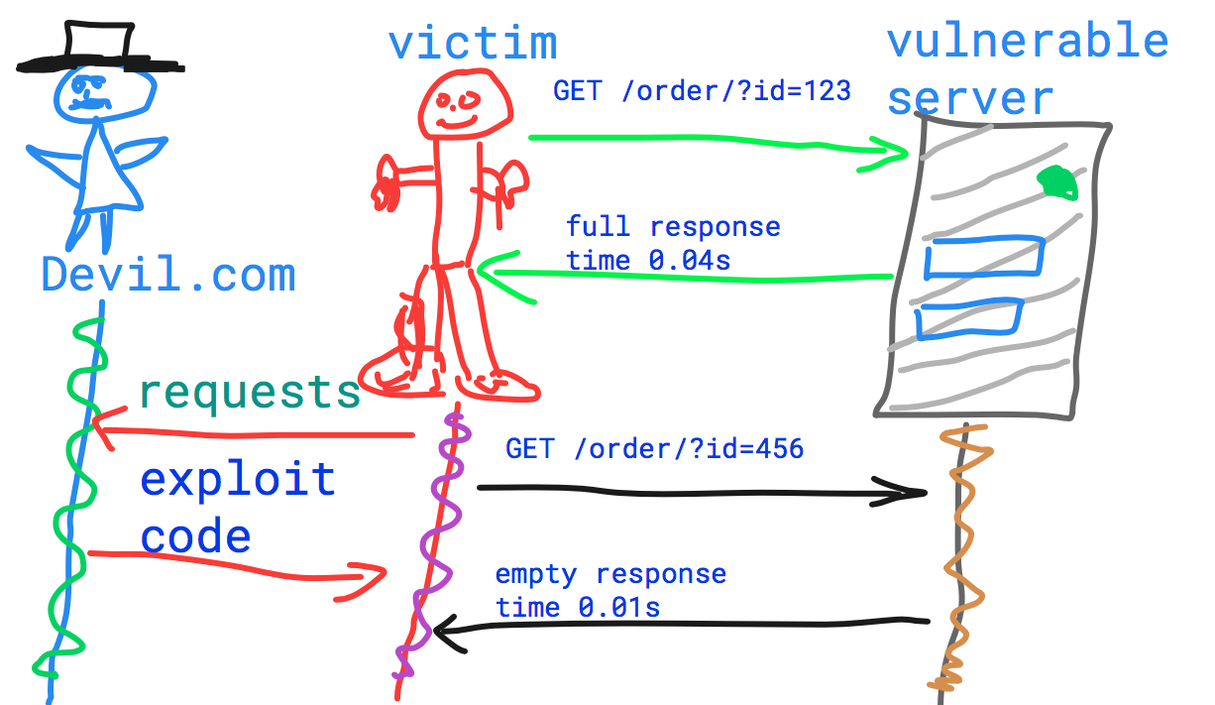
Single match

Slide 12
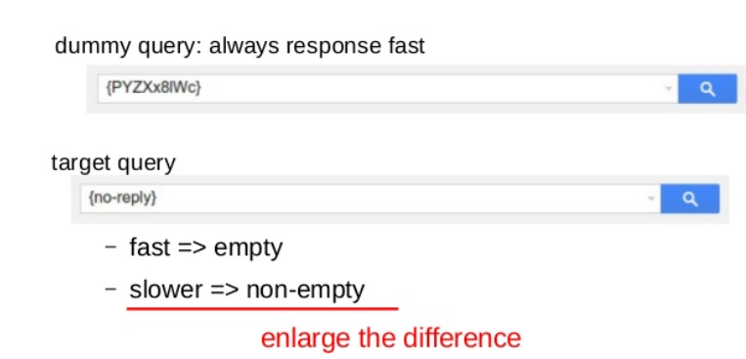
Exploit Problem
Response time = T (communication) +T (cumputiation)

Slide 13
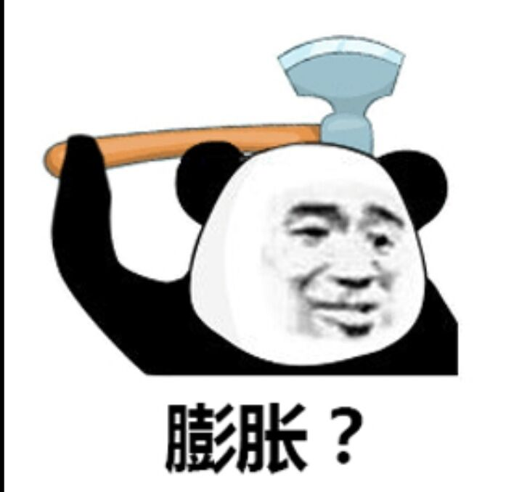

INFLATION make response more different

Slide 14
A case
https://medium.com/@luanherrera/xs-searching-googles-bug-tracker-to-find-out-vulnerable-source-code-50d8135b7549
Inflation with CSV

Slide 15
END
-Keep going
Pentest Explorer
2/17/2019

