Slide 1

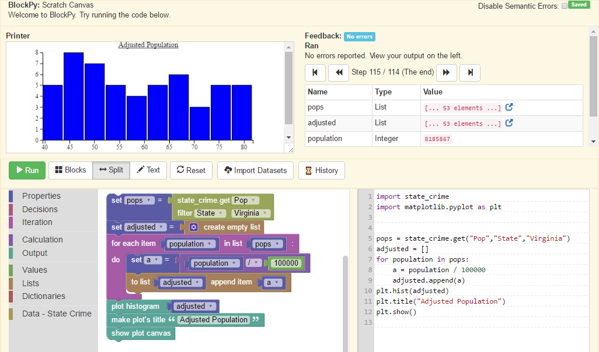
BlockPy
Web-based Programming Environment for Python
Blocks, Text, or Both | Avoid syntax headaches and transition gracefully.
Python in the Browser | Full local Python execution with Skulpt, not remote servers.
Guided Feedback | Helpful feedback instantly when the program is run.
Semantic Checking | Static program analysis provides deep insight.
Data Science | Work with real world data and create meaningful visualizations.
Full LTI Integration | Embed in your favorite LMS with no student registration required.
Free and Open Source | Use, extend, and change the environment to suit your needs.
Try it now at
www.blockpy.com
Austin Cory Bart (acbart@vt.edu)
Luke Gusukuma, Javier Tibau,
Dennis Kafura, Clifford A. Shaffer, Eli Tilevich
We gratefully acknowledge the support of Virginia Tech and the National Science Foundation under Grants NSF DGE 0822220, NSF DUE 1444094, and NSF IUSE 1624320.

Slide 2
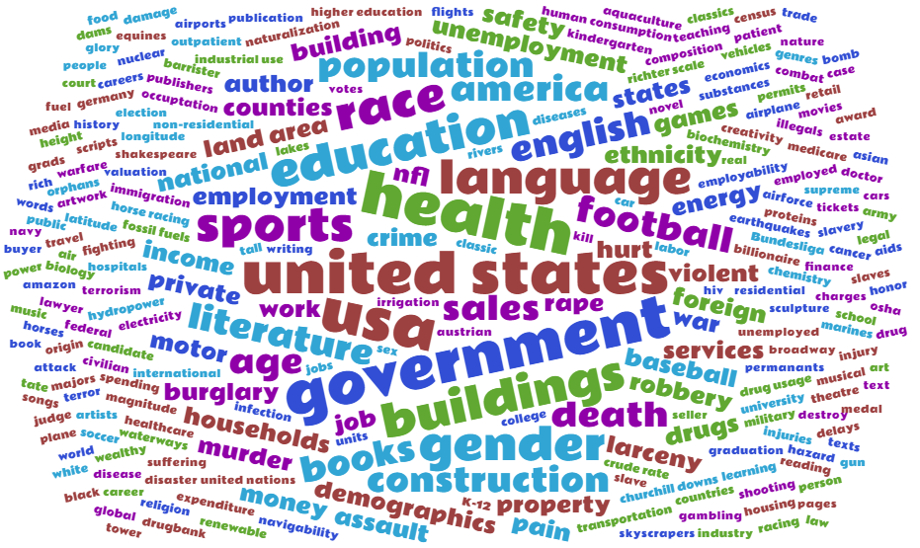






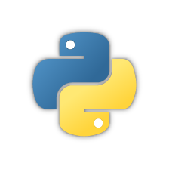

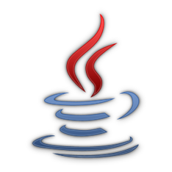



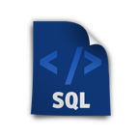

CORGIS
The Collection Of Really Great, Interesting, Situated Datasets
SIGCSE ‘17
Best Research Paper Award
40+ Datasets in History, Medicine, Geology, Education, Finance, Construction, Literacy, Politics, and more
Crime
Immigration
Theater
Construction
Airlines
Available across multiple languages, interfaces, and file formats
Python
Racket
Java
BlockPy
JSON
CSV
SQL
The Visualizer
Free, open-source, and open-access at
think.cs.vt.edu/corgis
Austin Cory Bart (acbart@vt.edu)
Dennis Kafura, Clifford A. Shaffer, Eli Tilevich
We gratefully acknowledge the support of Virginia Tech and the National Science Foundation under Grants NSF DGE 0822220, NSF DUE 1444094, and NSF IUSE 1624320.

