Slide 1
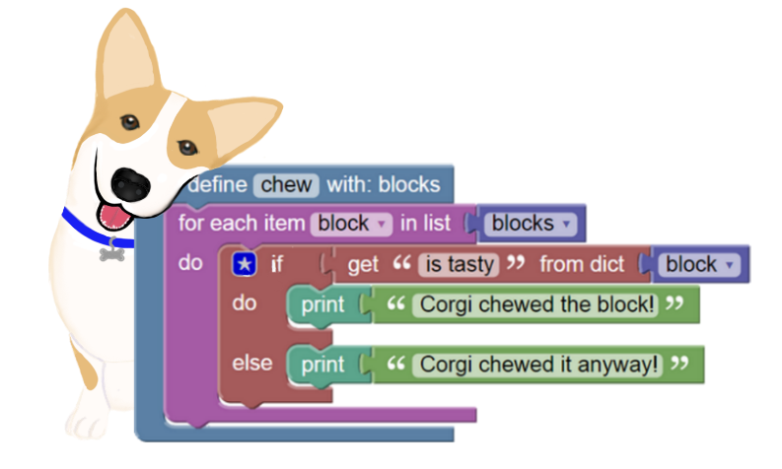
BlockPy
https://blockpy.com
Blocks, Text, or Both – Your choice!
Real-world Data and Visualizations
Problets with Guided Feedback

