Slide 1



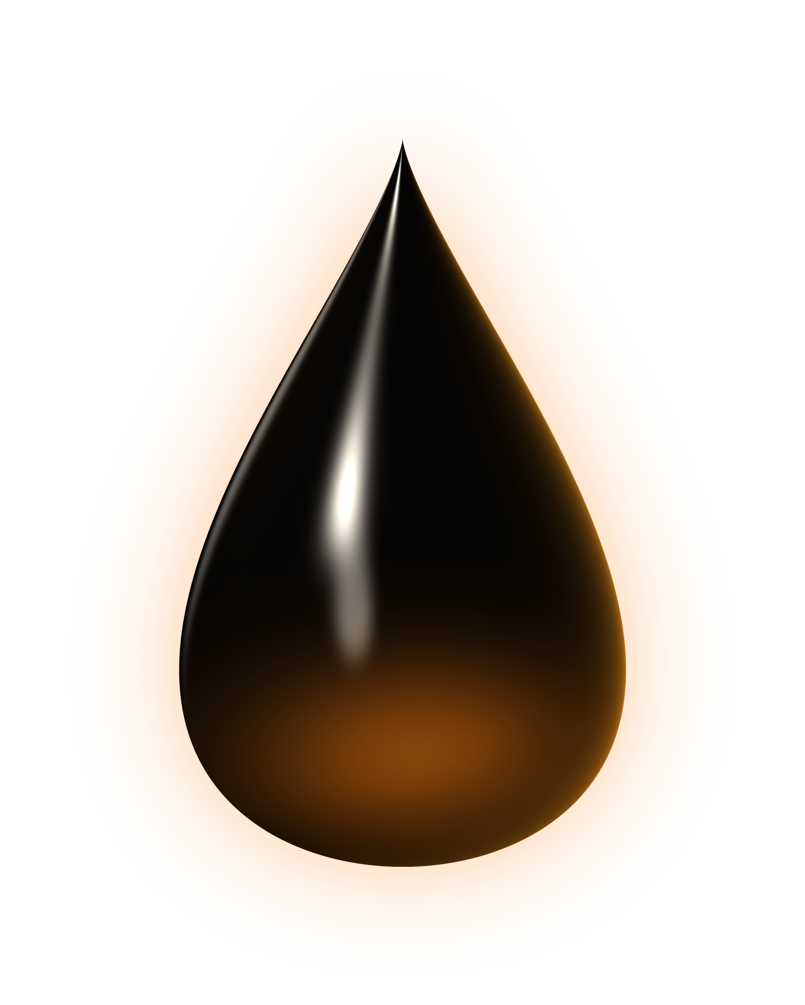
EGCH2230 · PETROLEUM AND PETROCHEMICAL PROCESSING
Kuwait
A Century of Oil & Gas
History · Resources · Reservoirs · Markets
Shahad Issa Obaid Alghriabi
University of Technology and Applied Sciences · Salalah
Notes:
Welcome. This presentation summarises my EGCH2230 research on the State of Kuwait: the history and types of its oil and gas, its resources and industrial growth, where its reservoirs are, and where its exports go and what they cost. Key sources are listed on slide 27; the full APA reference list is in the written report.

Slide 2






The story in five chapters
CONTENTS
01
02
03
04
05
History
& Types
Resources
& Growth
Reservoir
Locations
Exports
& Costs
Conclusion
& Sources
1934 to today
Reserves & output
Fields & rocks
Markets & prices
Key takeaways
Click a chapter to jump to it. The grid button at the bottom of each slide returns here.
Kuwait Oil & Gas · EGCH2230
2
Notes:
This slide is the navigation hub. Each tile is a link to its chapter; the small grid button on every slide links back here, so questions can be answered by jumping straight to the relevant chapter.

Slide 3






A small country with a giant reservoir
AT A GLANCE
101.5
2.4
1.4
90%+
billion barrels
million b/d
million b/d
of exports
proven crude oil reserves, about 6.5% of world total
crude oil output in 2024, under OPEC+ cuts
domestic refining capacity since Al-Zour came on line
are petroleum; oil funds most of the state budget
Sources: OPEC (2025b, 2026a); JODI (2026); KNPC (n.d.-b, n.d.-c); KIPIC (2024); World Bank (2026); Britannica (n.d.-b).
Kuwait Oil & Gas · EGCH2230
3
Notes:
Kuwait is a small country, but it holds 101.5 billion barrels of proven crude reserves (OPEC), about 6.5% of the world total. In 2024 it produced about 2.4 million barrels per day of crude while OPEC+ cuts were in force (JODI). Refining capacity reached about 1.4 million b/d once the Al-Zour refinery was fully on line in 2023–2024. Fuels are more than 90% of merchandise exports (World Bank) and petroleum provides most government revenue (Britannica).

Slide 4
01
History & Types
From a pearling port to a petroleum state
Kuwait Oil & Gas · EGCH2230
4
Notes:
Chapter one: how Kuwait’s oil industry began and developed, and which types of crude oil and natural gas it produces.

Slide 5
Ninety years in nine moments
01 — HISTORY & TYPES
1934
1946
1975
1991
2024
Oil concession
signed with KOC
First crude
export
KOC fully
nationalised
Well fires after
the 1990 invasion
Al-Zour refinery
at full 615 kb/d
1938
1960
1980
2018
Oil strikes at
Burgan No. 1
Co-founds OPEC;
KNPC formed
KPC created
Jurassic super-light
crude and gas
Sources: KOC (n.d.-a); KPC (n.d.-b); KNPC (n.d.-a); Britannica (n.d.-a); S&P Global (2018a, 2024); KIPIC (2024).
Kuwait Oil & Gas · EGCH2230
5
Notes:
1934: Sheikh Ahmad Al-Jaber signed the concession with the Kuwait Oil Company, a 50/50 venture of Anglo-Persian (later BP) and Gulf Oil. 1938: Burgan No. 1 struck oil at about 1,120 m in the Wara sandstone (23 Feb 1938 per GeoExpro and KPC; some sources say 22 Feb). 1946: first crude export on 30 June. 1960: Kuwait co-founded OPEC in Baghdad and created KNPC. 1974–75: the state took 60%, then 100%, of KOC. 1980: Kuwait Petroleum Corporation formed as the holding company. 1990–91: the Iraqi invasion and the well fires. 2018: Jurassic production facilities started and Kuwait Super Light crude was first exported. 2024: Al-Zour refinery reached its full 615,000 b/d capacity.

Slide 6

When the desert burned
1991 — THE OIL FIRES
700+
> 1 billion
barrels of crude oil lost
4–6 million b/d
oil wells set ablaze by retreating Iraqi forces in February 1991
of oil burning at the peak
6 November 1991
Recovery: 27 international teams and Kuwait’s own
Wild Well Killers; pre-war output back within about four years.
last fire capped: Burgan well 118
Sources: KOC (n.d.-b); OSAGWI (1998, 2000); Britannica (n.d.-a). KOC: 700+ wells ablaze; OSAGWI: 750+ of 943 ignited or damaged.
Kuwait Oil & Gas · EGCH2230
6
Notes:
Between August 1990 and February 1991 about 80% of KOC’s producing wells and facilities were destroyed (KOC). More than 700 wells were set on fire; the U.S. Department of Defense counted over 750 of 943 wells ignited or damaged. At the peak an estimated 4–6 million barrels per day of oil and 70–100 million cubic metres per day of gas were burning, and more than one billion barrels were lost. The last fire, Burgan 118, was capped on 6 November 1991. Kuwait’s own team, the Kuwait Wild Well Killers, capped 41 wells in 54 days. Spilled oil formed more than 100 oil lakes covering about 19 square kilometres (U.S. DoD).

Slide 7
Four crudes on one scale
01 — HISTORY & TYPES
Kuwait Export Heavy
16° API · 4.93% S
Heavy, very sour
Kuwait Export Crude
30.5° API · 2.50% S
Main export blend (KEC)
Kuwait Super Light
48° API · 0.38% S
Jurassic, North Kuwait
HEAVY
MEDIUM
LIGHT
10°
20°
30°
40°
50°
Khafji
28.5° API · 2.85% S
Partitioned Zone, offshore
API gravity = 141.5 / SG − 131.5 · higher API = lighter oil · S = sulfur content (wt%)
Sources: Mehdi (2021); Energy Intelligence (n.d.); S&P Global (2018b, 2020); EIA (2023a). Class limits: 22.3° and 31.1° API.
Kuwait Oil & Gas · EGCH2230
7
Notes:
Kuwait Export Crude (KEC) is the main export blend: medium and sour, about 30.5 degrees API and 2.5% sulfur, mostly from the Cretaceous reservoirs of Greater Burgan. Since July 2018 Kuwait also exports Kuwait Super Light Crude from the deep Jurassic reservoirs of North Kuwait: about 48 degrees API and only about 0.4% sulfur. Kuwait Export Heavy is about 16 degrees API with almost 5% sulfur. Khafji crude from the offshore Partitioned Zone shared with Saudi Arabia is about 28.5 degrees API and 2.85% sulfur. For refiners, sour crudes need hydrotreating capacity, which is why Kuwait’s new refineries have large desulfurisation units.

Slide 8


Gas: mostly a by-product of oil
01 — HISTORY & TYPES
Associated gas
Released with crude oil, so its output follows oil quotas
30%
70%
Non-associated Jurassic gas
Deep, high-pressure sour gas in North Kuwait, since 2018
associated gas,
share of 2021 output
Imported LNG
Imported since 2009; about 40% of the gas used in 2024
63 Tcf (1.78 trillion m³) proven gas reserves, < 1% of world
Sources: EIA (2023a); Energy Institute (2025); S&P Global (2018a); OPEC (2025b).
Kuwait Oil & Gas · EGCH2230
8
Notes:
About 70% of Kuwait’s gas production in 2021 was associated gas, released when crude oil is produced, so gas supply follows oil output and OPEC+ quotas. The second type is non-associated gas from deep Jurassic reservoirs in North Kuwait: high-pressure, sour gas produced with light oil and condensate through the Jurassic Production Facilities since 2018. Because demand, mainly for power and desalination, exceeds supply, Kuwait has imported LNG since 2009. In 2024 about 40% of the gas it consumed was imported (Energy Institute data). Proven gas reserves are about 63 trillion cubic feet.

Slide 9
02
Resources & Growth
Reserves, output and an industry built around them
Kuwait Oil & Gas · EGCH2230
9
Notes:
Chapter two: how much oil and gas Kuwait has, how its production has changed over eighty years, and how its industry grew from a single concession into a full value chain.

Slide 10
Seventh-largest oil reserves on Earth
02 — RESOURCES & GROWTH
101.5
6.5%
billion barrels of proven crude oil
of world reserves
Unchanged in official statistics since about 2010: additions have offset about one billion barrels produced each year.
≈ 100 years of output left at today’s rate
Sources: OPEC (2025b, 2026a), world 1,567–1,572 bn bbl; EIA (2023a); bp (2021). Includes half of the Partitioned Zone.
Kuwait Oil & Gas · EGCH2230
10
Notes:
OPEC’s 2025 and 2026 bulletins both list Kuwait’s proven crude reserves at 101.5 billion barrels, about 6.5% of the world’s 1,567–1,572 billion barrels, which ranks Kuwait seventh in the world (EIA). The figure includes Kuwait’s half of the Partitioned Zone shared with Saudi Arabia. Reserves jumped from about 68 billion barrels in 1980 to 97 billion in 1990 and have stayed at 101.5 billion since about 2010. At about one billion barrels produced per year, that is roughly a century of output; bp’s 2021 review gave a reserves-to-production ratio of 103 years.

Slide 11
Eight decades of output
02 — RESOURCES & GROWTH
mb/d = million barrels per day (total oil, incl. NGLs)
2012 · ≈ 3.2 mb/d
post-war high (est.)
1972 · 3.34 mb/d
all-time peak
2024 · ≈ 2.7 mb/d
incl. NGLs; crude 2.4
1946
first exports
1991 · 0.19 mb/d
invasion and fires
Sources: Energy Institute (2025) via Our World in Data (2025), incl. NGLs; some years (e.g. 2012, 2024) derived; 1946–55: KPC (n.d.-b).
Kuwait Oil & Gas · EGCH2230
11
Notes:
Output rose from about 16 thousand b/d in 1946 to an all-time peak of 3.34 million b/d in 1972 (Energy Institute, total oil including NGLs). After nationalisation, conservation policy and the 1980s price collapse it fell to around one million b/d. The 1990–91 invasion and fires cut it to only 185 thousand b/d in 1991. It recovered within four years and reached an estimated post-war high of about 3.2 million b/d in 2012 (derived from Energy Institute energy data). Since 2017 OPEC+ agreements have set Kuwait’s production; in 2024 crude alone averaged about 2.4 million b/d (JODI), or about 2.7 million b/d including NGLs.

Slide 12
Burning more gas than it produces
02 — RESOURCES & GROWTH
billion m³ (bcm) per year
40%
LNG
imports
of the gas Kuwait used in 2024 was imported as LNG
Domestic production
≈ 15 bcm produced vs ≈ 25 bcm consumed. Imports began in 2009 at Mina Al-Ahmadi; Al-Zour now has a permanent LNG terminal.
Sources: Energy Institute (2025) via Our World in Data (2025); EIA (2011a); KIPIC (n.d.). Converted at 10 TWh ≈ 1 bcm.
Kuwait Oil & Gas · EGCH2230
12
Notes:
Until 2008 Kuwait consumed exactly the gas it produced. Demand for power generation and desalination grew faster than associated-gas supply, so since 2009 the gap has been filled with imported LNG. In 2024 Kuwait produced about 15 billion cubic metres and consumed about 25 billion, so roughly 40% was imported. Gas now generates about 62% of Kuwait’s electricity, up from 33% in 2000, replacing much of the crude oil and fuel oil burned in power stations (Our World in Data, based on Energy Institute data).

Slide 13



One state company, the whole chain
02 — RESOURCES & GROWTH
KUWAIT PETROLEUM CORPORATION (KPC) · state-owned holding company, est. 1980
Upstream
Shipping
Refining
Petrochemicals
Marketing
KOC: Kuwait fields
KGOC: Partitioned Zone
KUFPEC: abroad
KOTC tankers
(since 1957)
KNPC: two refineries
KIPIC: Al-Zour
PIC (since 1963)
EQUATE group
KPI: Q8 brand
fuels & refining abroad
Sources: KPC (n.d.-c); KOC (n.d.-a); KNPC (n.d.-a); KIPIC (n.d.); KOTC (n.d.); PIC (n.d.); Britannica (n.d.-b).
Kuwait Oil & Gas · EGCH2230
13
Notes:
Since 1980 the Kuwait Petroleum Corporation has owned the whole chain. KOC explores and produces onshore and offshore Kuwait; KGOC manages Kuwait’s share of the Partitioned Zone with Saudi Arabia; KUFPEC invests in upstream projects abroad. KOTC ships crude, products and LPG. KNPC runs the Mina Al-Ahmadi and Mina Abdullah refineries and KIPIC runs the new Al-Zour refinery. PIC, founded in 1963 as the region’s first petrochemical company, holds stakes in the EQUATE group with Dow. Kuwait Petroleum International sells fuel under the Q8 brand and holds refining stakes abroad, including the Duqm refinery in Oman.

Slide 14
Refining capacity more than doubled
02 — RESOURCES & GROWTH
1.4
Al-Zour
615
KIPIC · full capacity 2024
Mina Abdullah
454
0.6
KNPC · Clean Fuels Project
Mina Al-Ahmadi
346
KNPC · Clean Fuels Project
= 1,415 kb/d of crude distillation in Kuwait
Jan 2021
Jul 2023
million b/d
Sources: EIA (2023b); KNPC (n.d.-b, n.d.-c); KIPIC (2024); S&P Global (2024). Capacities in kb/d (thousand b/d).
Kuwait Oil & Gas · EGCH2230
14
Notes:
According to the EIA, Kuwait’s refining capacity rose from about 600,000 b/d in January 2021 to about 1.4 million b/d in July 2023. Two things drove this: the new Al-Zour refinery (615,000 b/d, three crude units, run by KIPIC) and KNPC’s Clean Fuels Project, which upgraded and integrated Mina Al-Ahmadi (346,000 b/d) and Mina Abdullah (454,000 b/d). Al-Zour first ran at full capacity on 4 February 2024. As a result Kuwait exports far more refined products than before; in 2024 product exports briefly overtook crude.

Slide 15
03
Reservoir Locations
Fields, regions and the rocks that hold them
Kuwait Oil & Gas · EGCH2230
15
Notes:
Chapter three: the location of Kuwait’s oil and gas fields, grouped into four producing areas, and the reservoir rocks they produce from.

Slide 16

Kuwait’s oil and gas map
03 — RESERVOIR LOCATIONS
IRAQ
Raudhatain
Abdali
● Oil ● Gas ◆ Refinery / port ○ Town
Ratqa (heavy oil)
Click an area to zoom in and see every field
Sabriya
South & East Kuwait
Bahra
Kra Al-Maru
Kuwait City
Al-Nokhatha (2024)
North Kuwait
ARABIAN GULF
Minagish
Mina Al-Ahmadi
West Kuwait
Dorra (gas)
Umm Gudair
Greater Burgan
Partitioned Zone & offshore
Al-Zour
Wafra
Khafji
SAUDI ARABIA
Sources: KPC (n.d.-a); Horn (2014); Naqi et al. (2023); EIA (2023a). Field positions approximate. Base map: Natural Earth (n.d.).
Kuwait Oil & Gas · EGCH2230
16
Notes:
Kuwait’s fields fall into four areas. South and East Kuwait is dominated by Greater Burgan (Burgan, Magwa and Ahmadi), the world’s second-largest oil field after Ghawar, covering roughly 800 square kilometres; in 2013 it still produced about half of Kuwait’s oil (EIA, 2013). North Kuwait has Raudhatain and Sabriya, the deep Jurassic gas and light-oil fields served by the Jurassic Production Facilities, and Ratqa, where heavy oil is produced from the shallow Lower Fars sands with steam. West Kuwait has Minagish and Umm Gudair, which produce from the Minagish Oolite. The Partitioned Zone is shared 50:50 with Saudi Arabia: Wafra onshore and Khafji and Hout offshore, plus the Dorra gas field, which Iran also claims. Since 2024 KOC has announced offshore discoveries at Al-Nokhatha (about 3.2 billion barrels of oil equivalent) and Al-Jlaiaa. Click an area on the right to zoom in. Field positions were taken from the KOC fields map and the Horn giant-field database and are approximate.

Slide 17

South & East Kuwait
IRAQ
Raudhatain
Abdali
Ratqa (heavy oil)
Sabriya
03 — RESERVOIR LOCATIONS · ZOOM
Bahra
Kra Al-Maru
Al-Nokhatha (2024)
Kuwait City
Greater Burgan
1938 · the world’s second-largest oil field
Magwa and Ahmadi (Greater Burgan)
1950–52 · same Burgan and Wara sandstones
Mina Al-Ahmadi · Mina Abdullah
refineries and crude export terminals
Al-Zour
615 kb/d refinery and LNG import terminal
ARABIAN GULF
Minagish
Ahmadi (KOC HQ)
Mina Al-Ahmadi
Mina Abdullah
Dorra (gas)
Greater Burgan
Umm Gudair
Al-Zour
South & East
North
Wafra
West
PZ & offshore
Back to map
Khafji
Sources: KPC (n.d.-a), KOC field map; Horn (2014); Naqi et al. (2023); KUNA (2024); Offshore Engineer (2025). Positions approximate.
Kuwait Oil & Gas · EGCH2230
16
SAUDI ARABIA
Notes:
Zoomed view of South & East Kuwait. Use the area buttons under the map to switch to another area, or Back to map on the right to return.

Slide 18
North Kuwait
03 — RESERVOIR LOCATIONS · ZOOM
IRAQ
Raudhatain
1955 · Ratawi, Zubair, Burgan, Mauddud
Sabriya
1956–57 · Mauddud, Burgan; deep Marrat gas
Bahra
1956 · Mauddud and Zubair
Ratqa
1977–80 · Lower Fars heavy oil, cyclic steam
Abdali
1990 · oil, on the Iraqi border
Umm Niqa
part of the deep Jurassic gas play
Abdali
Umm Niqa
Raudhatain
Ratqa (heavy oil)
Sabriya
Bahra
South & East
North
West
PZ & offshore
Back to map
Al-Nokhatha (2024)
Kra Al-Maru
Kuwait City
Sources: KPC (n.d.-a), KOC field map; Horn (2014); Naqi et al. (2023); KUNA (2024); Offshore Engineer (2025). Positions approximate.
Kuwait Oil & Gas · EGCH2230
16
ARABIAN GULF
Minagish
Mina Al-Ahmadi
Dorra (gas)
Umm Gudair
Greater Burgan
Al-Zour
Wafra
Khafji
SAUDI ARABIA
Notes:
Zoomed view of North Kuwait. Use the area buttons under the map to switch to another area, or Back to map on the right to return.

Slide 19
West Kuwait
IRAQ
Raudhatain
Abdali
Ratqa (heavy oil)
Sabriya
03 — RESERVOIR LOCATIONS · ZOOM
Bahra
Minagish
1959 · Minagish Oolite, 22–26° API oil
Umm Gudair
1962 · Minagish Oolite and Ratawi
Abduliyah · Dharif
smaller West Kuwait oil fields
Kra Al-Maru
1995 · Ratawi; Jurassic light oil
Al-Nokhatha (2024)
Kra Al-Maru
Kuwait City
Dharif
ARABIAN GULF
Abduliyah
Mina Al-Ahmadi
Minagish
Dorra (gas)
Greater Burgan
Umm Gudair
Al-Zour
South & East
North
West
PZ & offshore
Back to map
Wafra
Sources: KPC (n.d.-a), KOC field map; Horn (2014); Naqi et al. (2023); KUNA (2024); Offshore Engineer (2025). Positions approximate.
Khafji
Kuwait Oil & Gas · EGCH2230
16
SAUDI ARABIA
Notes:
Zoomed view of West Kuwait. Use the area buttons under the map to switch to another area, or Back to map on the right to return.

Slide 20
Partitioned Zone & offshore
IRAQ
Raudhatain
Abdali
03 — RESERVOIR LOCATIONS · ZOOM
Ratqa (heavy oil)
Sabriya
Bahra
Wafra
1953 · onshore, shared with Saudi Arabia
Khafji
1959–60 · offshore, shared, medium-sour
Hout
1963 · offshore, shared
Dorra
1967 · gas field; Iran claims part of it
Al-Nokhatha
2024 · offshore find, ≈ 3.2 bn boe
Al-Jlaiaa
2025 · offshore find in Kuwaiti waters
Kra Al-Maru
Kuwait City
Al-Nokhatha
ARABIAN GULF
Minagish
Mina Al-Ahmadi
Dorra (gas)
Umm Gudair
Greater Burgan
Hout
Al-Jlaiaa
Al-Zour
Wafra
Khafji
SAUDI ARABIA
South & East
North
West
PZ & offshore
Back to map
Sources: KPC (n.d.-a), KOC field map; Horn (2014); Naqi et al. (2023); KUNA (2024); Offshore Engineer (2025). Positions approximate.
Kuwait Oil & Gas · EGCH2230
16
Notes:
Zoomed view of Partitioned Zone & offshore. Use the area buttons under the map to switch to another area, or Back to map on the right to return.

Slide 21

Kuwait’s oil and gas map
03 — RESERVOIR LOCATIONS
IRAQ
Raudhatain
Abdali
● Oil ● Gas ◆ Refinery / port ○ Town
Ratqa (heavy oil)
Click an area to zoom in and see every field
Sabriya
South & East Kuwait
Bahra
Kra Al-Maru
Kuwait City
Al-Nokhatha (2024)
North Kuwait
ARABIAN GULF
Minagish
Mina Al-Ahmadi
West Kuwait
Dorra (gas)
Umm Gudair
Greater Burgan
Partitioned Zone & offshore
Al-Zour
Wafra
Khafji
Continue
SAUDI ARABIA
Sources: KPC (n.d.-a); Horn (2014); Naqi et al. (2023); EIA (2023a). Field positions approximate. Base map: Natural Earth (n.d.).
Kuwait Oil & Gas · EGCH2230
16
Notes:
Map hub: choose another area to zoom into, or press Continue to move on to the overview of the four producing areas.

Slide 22
Four producing areas
03 — RESERVOIR LOCATIONS
South & East Kuwait
Greater Burgan (Burgan, Magwa, Ahmadi); Al-Zour
World’s second-largest oil field; Burgan and Wara sandstones
North Kuwait
Raudhatain, Sabriya, Bahra, Ratqa, Abdali, Umm Niqa
Cretaceous oil, deep Jurassic gas and Lower Fars heavy oil
West Kuwait
Minagish, Umm Gudair, Abduliyah, Dharif, Kra Al-Maru
Minagish Oolite and Ratawi reservoirs; 22–26° API oil
Partitioned Zone & offshore
Wafra, Khafji, Hout, Dorra gas; new: Al-Nokhatha, Al-Jlaiaa
Shared 50:50 with Saudi Arabia; offshore finds since 2024
Sources: KPC (n.d.-a); Naqi et al. (2023); EIA (2013, 2023a); S&P Global (2018a); KUNA (2024). Click a card to zoom in.
Kuwait Oil & Gas · EGCH2230
17
Notes:
In 1990 Greater Burgan supplied about two-thirds of KOC’s output (Office of the Special Assistant for Gulf War Illnesses, 2000), and in 2013 it still produced about half of Kuwait’s oil (EIA, 2013). North Kuwait holds Raudhatain and Sabriya and the deep Jurassic gas and light-oil play; West Kuwait holds Minagish and Umm Gudair. The Partitioned Zone, shared 50:50 with Saudi Arabia, contains Wafra onshore and Khafji and Hout offshore. Offshore discoveries since 2024 include Al-Nokhatha, about 3.2 billion barrels of oil equivalent (KUNA, 2024), and Al-Jlaiaa (Offshore Engineer, 2025). Click a card to zoom into an area.

Slide 23
Reservoirs from shallow to deep
03 — RESERVOIR LOCATIONS
Lower Fars Miocene sandstone
Heavy oil
Shallow Lower Fars sands, Ratqa, North Kuwait
Mishrif Mid-Cretaceous carbonate
Wara Mid-Cretaceous sandstone
Mauddud Mid-Cretaceous carbonate
Kuwait Export Crude
Cretaceous sandstones and carbonates of the Burgan, Raudhatain, Sabriya, Minagish and Umm Gudair fields
Burgan Mid-Cretaceous (Albian) sandstone
Zubair Early Cretaceous sandstone
Ratawi Early Cretaceous limestone and shale
Minagish Early Cretaceous oolitic limestone
Najmah / Sargelu Middle–Late Jurassic carbonates
Super-light oil & sour gas
Deep Jurassic carbonates of North Kuwait, high pressure and temperature
Marrat Early Jurassic carbonate
Sources: Naqi et al. (2023); S&P Global (2018b); MEES (2025a). Simplified, not to scale.
Kuwait Oil & Gas · EGCH2230
18
Notes:
Kuwait’s oil comes from a stack of reservoirs; the column builds in the order the rocks were deposited, oldest first. Deepest are the Jurassic Marrat, Najmah and Sargelu carbonates, which produce Kuwait Super Light crude and sour, high-pressure non-associated gas in the north. Most production and the Kuwait Export Crude blend come from Cretaceous rocks: the Burgan Formation sandstones are the most important reservoir in the country, together with Wara, Mauddud, Mishrif, Zubair, Ratawi and the Minagish Oolite, which is the main reservoir of the Minagish and Umm Gudair fields in the west. Near the surface, the Miocene Lower Fars sands of North Kuwait hold heavy oil. The diagram is simplified and not to scale.

Slide 24
04
Exports & Costs
Who buys Kuwait’s oil, and what it costs
Kuwait Oil & Gas · EGCH2230
19
Notes:
Chapter four: where Kuwait’s oil exports go, what they earn, what they cost to produce, and how much the gas it imports costs.

Slide 25
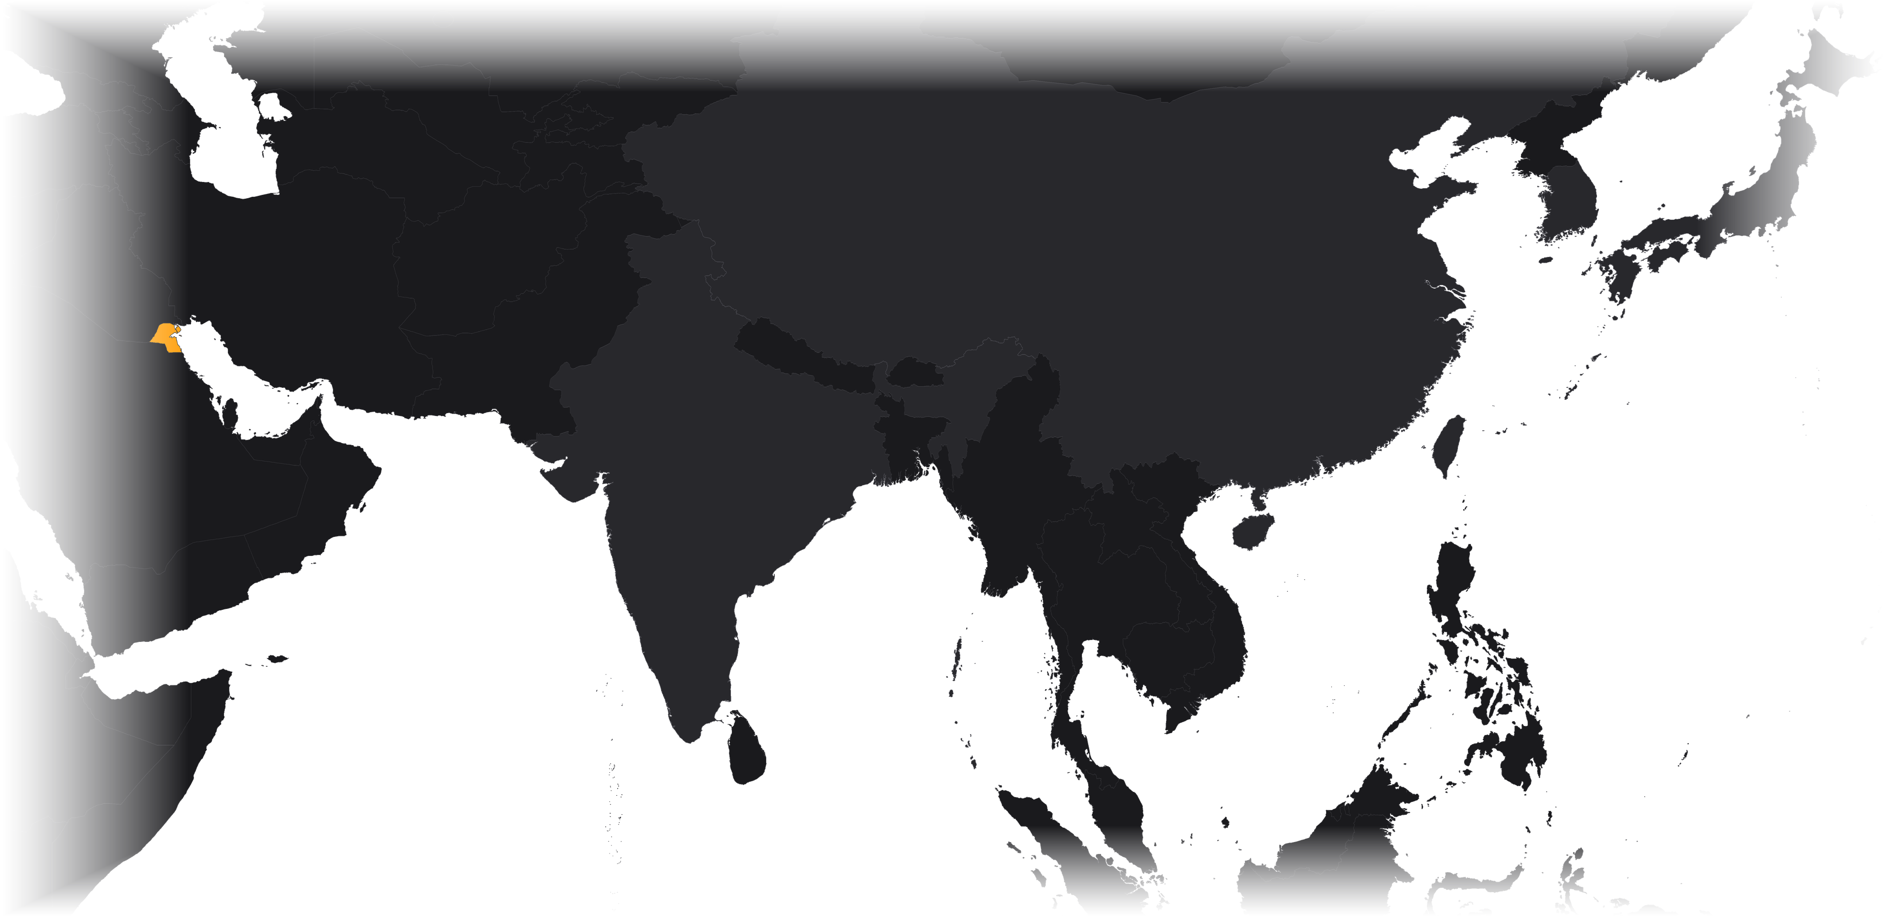
Nine in ten barrels sail to Asia
04 — EXPORTS & COSTS
93%
Japan 17%
S. Korea 23%
Kuwait
Strait of Hormuz
China 33%
of crude exports by volume went to Asia-Pacific in 2024
Taiwan 11%
India 11%
OPEC as a whole sent about 72% to Asia. China alone took 27% of the volume and a third of the value.
Labels and line widths: share of 2024 crude export value (OEC)
Sources: Energy Institute (2025), by volume; OEC (n.d.), 2024 data by value; OPEC (2025b). Routes stylised; map: Natural Earth (n.d.).
Kuwait Oil & Gas · EGCH2230
20
Notes:
Kuwait’s crude goes almost entirely east. In 2024, 93% of its crude exports by volume went to the Asia-Pacific region (Energy Institute): China 27%, Japan 14%, India 10% and the rest of Asia-Pacific, mainly South Korea and Taiwan, 43%. By value (OEC), China took 33%, South Korea 23%, Japan 17%, Taiwan 11% and India 11%, so the top five buyers, all Asian, account for about 95%. For comparison, OPEC as a whole sent about 72% of its crude to Asia (OPEC, 2025b). Notice that every route starts in the Gulf and passes through the Strait of Hormuz.

Slide 26
Exporting fuels, not just crude
04 — EXPORTS & COSTS
Exports, kb/d (thousand barrels per day)
2024
Crude oil
the first year product exports (1,196 kb/d) beat crude exports (1,176 kb/d)
Al-Zour ran at full capacity, so crude went to Kuwaiti refineries instead of tankers. Crude led again in 2025.
Refined products (incl. LPG)
Sources: JODI (2026), annual averages of monthly data; MEES (2026); EIA (2023b).
Kuwait Oil & Gas · EGCH2230
21
Notes:
The new refining capacity changed what Kuwait sells. According to JODI data, crude exports fell from about 2.0 million b/d in 2017–2019 to 1.18 million b/d in 2024, while exports of refined products, mainly diesel, jet fuel, naphtha and very-low-sulfur fuel oil from Al-Zour, rose to a record 1.20 million b/d. 2024 was the first year in which Kuwait exported more products than crude (MEES). In 2025 the mix swung back towards crude, partly because of an outage at Al-Zour in October 2025.

Slide 27
The price of a barrel, 2000–2025
04 — EXPORTS & COSTS
Brent crude, annual average (US$ per barrel)
Kuwait Export Crude
$84.26 (2023)
$80.65 (2024)
Medium-sour; KPC sets a monthly official selling price for each grade.
2008
$97 average, $144 peak
2022
war in Ukraine: $101
2026 so far: Brent averaged $93.03 up to 29 September, peaking at $138 on 7 April.
2016
$44 average, $26 low
2020
COVID-19: $42
2000
2005
2010
2015
2020
2025
Sources: EIA (2026), annual averages of daily Brent prices; OPEC (2025a), Kuwait Export Crude.
Kuwait Oil & Gas · EGCH2230
22
Notes:
Kuwait sells its crude at prices linked to Middle East benchmarks, so its income follows the world oil price. Brent averaged $97 in 2008, with a daily peak of $144, stayed above $100 in 2011–2013, fell to a $44 average in 2016 (low: $26 in January) and $42 in 2020 during COVID-19, then jumped to $101 in 2022 after Russia invaded Ukraine (EIA). Kuwait Export Crude averaged $84.26 in 2023 and $80.65 in 2024 (OPEC), close to the OPEC Reference Basket ($82.95 and $79.89) because it is a medium-sour grade. In 2026, the Hormuz disruption pushed Brent to $138 on 7 April.

Slide 28
One of the cheapest barrels on Earth
04 — EXPORTS & COSTS
Kuwait: cost per barrel
≈ $8.50
Rystad Energy via WSJ, 2016 estimate
UK North Sea: cost per barrel
≈ $44
same study, for comparison
Kuwait crude: selling price
$80.65
Kuwait Export Crude, OPEC, 2024
≈ $72 per barrel above cost: 2024 price minus the 2016 cost estimate, before taxes
Sources: Wall Street Journal (2016), Rystad Energy data; OPEC (2025a).
Kuwait Oil & Gas · EGCH2230
23
Notes:
Kuwait’s oil is among the cheapest in the world to produce. Rystad Energy data published by the Wall Street Journal in 2016 put Kuwait’s total cost, capital plus operating spending, at about $8.50 per barrel, the lowest of the countries compared; the UK North Sea was about $44. In 2024 Kuwait Export Crude sold for $80.65 on average (OPEC), leaving a gross margin of roughly $72 per barrel. The real constraint is fiscal: because oil pays for most of the state budget, Kuwait needs high prices to balance its budget even though production itself is cheap. Note that the cost figure is a 2016 estimate.

Slide 29
Where Kuwait’s LNG comes from
04 — EXPORTS & COSTS
Qatar 61.4%
≈ 7.15 Mt
Nigeria 16.6%
of LNG (= 9.73 bcm of gas), about 40% of all the gas Kuwait used in 2024
United States 9.5%
9.73
Angola 3.7%
$33.98 → $11.91
Oman 3.0%
bcm imported, 2024
Asian spot LNG price (JKM) per MMBtu, 2022 → 2024
Russia 3.0%
Others 2.9%
≈ $4 bn
estimated 2024 import bill at spot prices
Source: Energy Institute (2025), LNG trade and JKM prices; shares rounded. Bill = 7.15 Mt × 46.4 million MMBtu/Mt × $11.91 (estimate).
Kuwait Oil & Gas · EGCH2230
24
Notes:
Because associated gas cannot keep up with demand for power and water desalination, Kuwait imported 9.7 billion cubic metres of LNG in 2024, about 7.2 million tonnes or 40% of its gas use (Energy Institute). Qatar supplied 61.4%, Nigeria 16.6% and the United States 9.5%; Oman supplied 3.0%. Gas is bought at international prices: the Asian spot benchmark JKM averaged $33.98 per MMBtu in 2022 and $11.91 in 2024. At 2024 spot prices the import bill would be roughly $4 billion; Kuwait’s actual contract prices are not published, so this is only an estimate.

Slide 30
When the Strait of Hormuz closed
2026 — A LIVE STRESS TEST
Kuwait crude exports, 2026 (kb/d = thousand barrels per day)
7 March
1,254
Hormuz disruption
1,213
1,129
KPC declares force majeure as tankers stop transiting Hormuz
1,060
−98%
crude exports from 1,213 kb/d (Feb) to 24 kb/d (May)
500
$138
41
24
Brent peak on 7 April 2026
Jan
Feb
Mar
Apr
May
Jun
Jul
0
$67
$71
$103
$117
$107
$85
$84
export routes that bypass the Gulf: every terminal is inside it
Row above: Brent, monthly average (US$ per barrel)
Sources: JODI (2026), monthly data; EIA (2026), Brent spot prices; CNBC (2026), Reuters report. 2026 data are preliminary.
Kuwait Oil & Gas · EGCH2230
25
Notes:
2026 tested Kuwait’s export model. During the U.S.–Iran conflict, tanker traffic through the Strait of Hormuz stopped and on 7 March 2026 KPC declared force majeure and cut output (Reuters). Official JODI data show crude exports collapsing from 1.21 million b/d in February to only 41,000 b/d in April and 24,000 b/d in May, before recovering to about 1.1 million b/d by July. Brent rose from $71 in February to a monthly average of $117 in April, peaking at $138 on 7 April (EIA). Kuwait has no pipeline that bypasses the Gulf, so every export cargo must pass through Hormuz. These 2026 figures are preliminary.

Slide 31

What the numbers say
05 — CONCLUSION & SOURCES
Vast, low-cost oil
A growing gas gap
101.5 billion barrels (6.5% of the world) at one of the lowest costs per barrel
About 40% of the gas Kuwait uses is imported LNG, mostly from Qatar
From crude to products
Asia-bound via Hormuz
Al-Zour and the Clean Fuels Project lifted refining to 1.4 million b/d; in 2024 product exports beat crude
93% of crude goes to Asia, and every export cargo must pass Hormuz
Next: KPC targets 4 million b/d of crude capacity by 2035 (JPT, n.d.), plus new offshore fields and more gas.
Kuwait Oil & Gas · EGCH2230
26
Notes:
To conclude: Kuwait has one of the world’s largest and cheapest oil resource bases, but fuels make up more than 90% of its exports and oil provides most of its state revenue. Its gas is mostly associated with oil, so it now imports about 40% of its gas as LNG. The Al-Zour refinery and the Clean Fuels Project have turned Kuwait into a large exporter of refined products. Its customers are overwhelmingly Asian, and the 2026 Hormuz disruption showed how exposed a Gulf-only export route is. Looking ahead, KPC’s strategy targets 4 million b/d of crude production capacity by 2035 (JPT), development of the new offshore discoveries, and more non-associated Jurassic gas.

Slide 32
Key sources
05 — CONCLUSION & SOURCES
CNBC. (2026, March 7). Kuwait cuts oil production as Strait of Hormuz closure disrupts global energy market.
Encyclopaedia Britannica. (n.d.-b). Kuwait: Resources and power.
Energy Institute. (2025). Statistical review of world energy 2025 (74th ed.) [Data set].
Horn, M. K. (2014). Giant oil and gas fields of the world [Data set].
Joint Organisations Data Initiative. (2026). JODI-Oil world database [Data set].
Kuwait Integrated Petroleum Industries Company. (2024). His Highness the Amir of Kuwait inaugurates full operation of Al-Zour Refinery [Press release].
Kuwait National Petroleum Company. (n.d.-a). KNPC timeline.
Kuwait Oil Company. (n.d.-a). Brief history of KOC.
Kuwait Oil Company. (n.d.-b). Oil fires.
Kuwait Petroleum Corporation. (n.d.-a). Kuwaiti oil fields [Map].
Naqi, M., Alsalem, O., & Qabazard, S. (2023). Petroleum geology of Kuwait. In The geology of Kuwait. Springer.
Observatory of Economic Complexity. (n.d.). Crude petroleum in Kuwait trade [2024 data].
Office of the Special Assistant for Gulf War Illnesses. (2000). Environmental exposure report: Oil well fires.
Organization of the Petroleum Exporting Countries. (2025a). Annual report 2024.
Organization of the Petroleum Exporting Countries. (2025b). Annual statistical bulletin 2025 (60th ed.).
Organization of the Petroleum Exporting Countries. (2026a). Annual statistical bulletin 2026 (61st ed.).
U.S. Energy Information Administration. (2023a). Country analysis brief: Kuwait.
U.S. Energy Information Administration. (2026). Europe Brent spot price FOB [Data set].
Wall Street Journal. (2016, April 15). Barrel breakdown [Rystad Energy data].
The full APA 7th-edition reference list (63 sources) is in the written report.
Kuwait Oil & Gas · EGCH2230
27
Notes:
These are the main sources. The written report contains the complete APA reference list and in-text citations.

Slide 33
Thank you
Questions?
Shahad Issa Obaid Alghriabi
EGCH2230 · Petroleum and Petrochemical Processing
University of Technology and Applied Sciences · Salalah
Back to contents
Notes:
Thank you. I am happy to take questions; the contents slide links to every chapter, and the map slide links to a zoomed view of each producing region.

