Slide 1
Craft Cataloger
Identifying Indian handicrafts from a photo using deep learning
Leela Sai Charan Putti · Suneet Reddy
Deep Learning Lab · CBIT Hyderabad
Notes:
Both speakers: introduce yourselves and the project. Craft Cataloger takes a photo of an Indian handicraft and tells you which craft it is, then fills in a catalog card.

Slide 2
The problem
To sell a handicraft online, every item needs a category, a title and a description
Writing these takes time and skill
Small artisans often find this hard
Category
?
Title
?
Description
?
Notes:
Speaker: Leela. The problem is that cataloging every product is slow, especially for small artisans.

Slide 3
Our idea
Photo
Model
Catalog card
The seller uploads one picture of the product
A deep learning model predicts the craft style
Name, category, description and tags are filled in
This is the smart-cataloging step of the ShilpSetu AI idea, built as a deep learning lab project.
Notes:
Speaker: Leela. Our system has three steps: photo, model, catalog card. ShilpSetu AI is the bigger hackathon idea; we implemented only the cataloging part.

Slide 4
The dataset
Indian Handicraft Products, from Kaggle
Product listings from the web, each with a photo
Fields: title, description, price, image and art form
The art form is what we want the model to predict
37,273
product listings
Notes:
Speaker: Leela. The data comes from a public Kaggle dataset. The art form column gives us ready-made labels.

Slide 5
Preparing the data
1
2
3
Clean the labels
Pick 8 classes
Split the data
Use the first art-form tag. Remove generic tags such as handmade.
400 images each, so 3,200 images in total and every class is balanced.
Train 70%, validation 15%, test 15%, split evenly across classes.
Number of images
Train 2,240
Val 480
Test 480
Notes:
Speaker: Leela. We cleaned the labels, kept the eight most common craft classes with 400 images each, and split them into train, validation and test sets. The test set is never used during training.

Slide 6
The model: ResNet18
Photo
224 × 224
Layers 1–3
already trained on ImageNet
layer4
adjusted for our crafts
New classifier
512 → 8 crafts
ResNet18 is a CNN that was already trained on ImageNet, a very large photo collection
It already knows edges, textures and shapes
We have only 400 images per class, so we reuse this knowledge instead of starting from zero
Notes:
Speaker: Leela. We use ResNet18 with ImageNet weights. We replace its last layer with a new one that outputs our 8 craft classes. This is fine-tuning of a pre-trained model.

Slide 7
Fine-tuning in two stages
Stage 1
Stage 2
Train only the new classifier
Also adjust layer4 gently
Learning rate 1e-3 · 6 epochs
Learning rates 1e-4 and 1e-3 · 8 epochs
72.1%
86.3%
validation accuracy
best validation accuracy
Optimiser: Adam · Loss: cross-entropy · Batch size: 32
Notes:
Speaker: Leela. Stage 1 trains only the new head, which is fast and safe. Stage 2 also unfreezes layer4 with a ten times smaller learning rate so the pre-trained weights change gently. Training images get random flips and colour jitter.

Slide 8
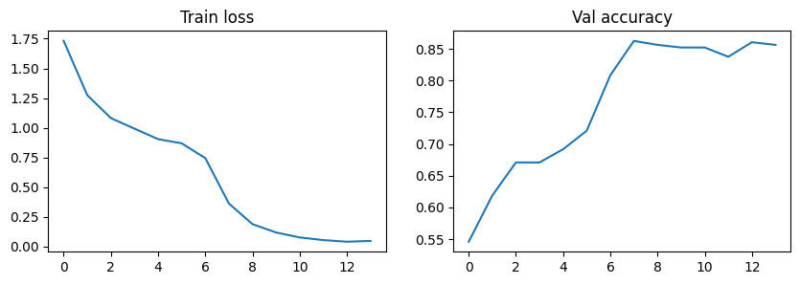
Training results
Accuracy jumps once layer4 is fine-tuned
Loss falls from 1.73 to 0.05
Validation accuracy levels off at 84–86%: mild overfitting
Left: training loss. Right: validation accuracy. Fine-tuning starts at 6 on the x-axis.
Notes:
Speaker: Suneet. Validation accuracy goes from 72.1% after stage 1 to 80.8% in the first fine-tuning epoch and peaks at 86.3%. The training loss near zero while validation accuracy stays flat shows mild overfitting.

Slide 9
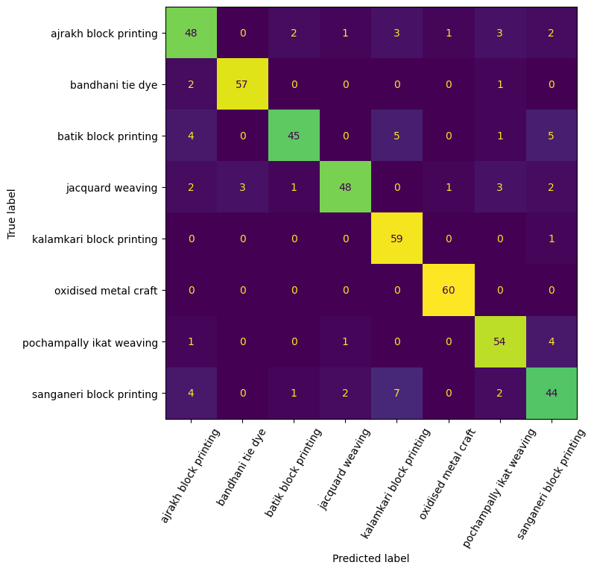
Test results
86.5%
0.86
accuracy (415 of 480)
macro F1-score
Each row is the true craft and each column is the predicted craft. Numbers on the diagonal are correct predictions.
Notes:
Speaker: Suneet. On the 480 unseen test images the model gets 415 right, which is 86.5%. The test set has 60 images per class.

Slide 10
Which crafts are easy or hard?
Easy: oxidised metal craft looks very different from the fabrics
Hard: sanganeri and batik are block prints that look alike
Biggest mix-up: sanganeri predicted as kalamkari (7 images)
Notes:
Speaker: Suneet. Recall is the share of each craft that the model found. Metal craft is perfect. Block-printed textiles share motifs and colours, so they get confused with each other at 224 by 224 pixels.

Slide 11
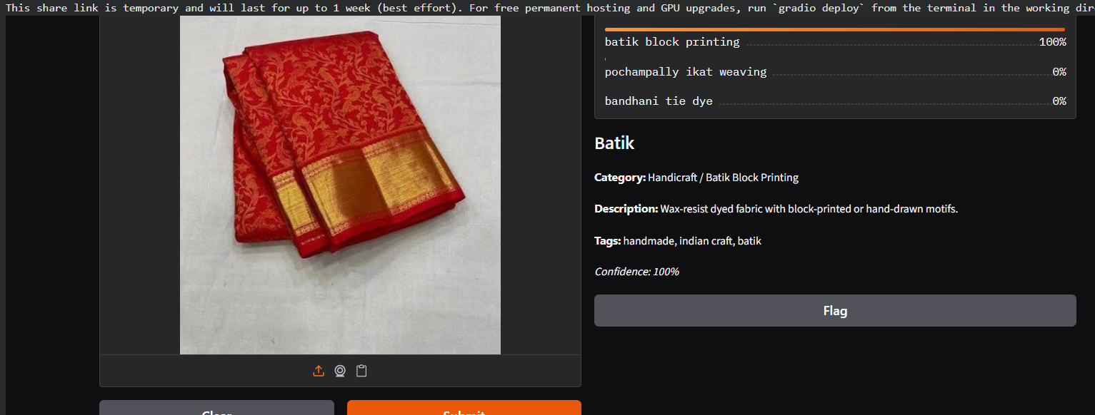
Demo
Upload a photo
See the top 3 predicted crafts
Get a catalog card with name, category, description and tags
Gradio interface: top classes and the catalog card.
This saree was predicted as batik with 100% confidence, which looks wrong. The model is sometimes very sure and still wrong.
Notes:
Speaker: Suneet. Live demo if possible. We show a wrong example on purpose: the model must pick one of its eight classes and its confidence is not calibrated.

Slide 12
Limitations and future scope
Limitations
Web labels can be noisy
Only 8 crafts and one data split
Overconfident predictions
Descriptions are fixed templates
Future scope
Try EfficientNet or MobileNetV2
Early stopping and Grad-CAM
Use the title and description text
Mobile app and voice input
Notes:
Speaker: Suneet. Be honest about limitations: noisy web labels, a small class set, a single split, and overconfident predictions. Future work includes better backbones, early stopping, Grad-CAM, using text, and a mobile app.

Slide 13
Conclusion
Fine-tuning a pre-trained ResNet18 reached 86.5% test accuracy on 8 crafts
Metal craft is easy; look-alike block prints are hard
The pipeline works end to end: photo, craft class, catalog card
Thank you
Notes:
Both speakers: summarise the three takeaways and close with thank you.

