Slide 1
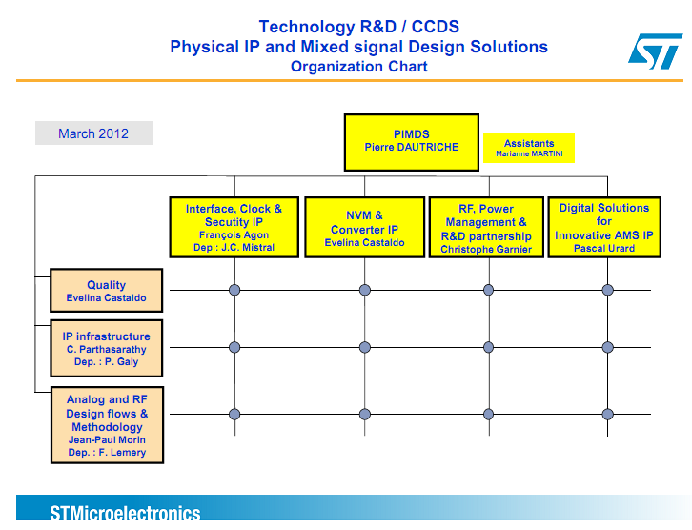

Slide 2













High Speed Link :: Organization Chart
Interface, Clock & Security IP
Francois Agon
High Speed Link
Tapas Nandy
M-PHY & DigRF4
Vivek Uppal
D-PHY
Kirtiman S Rathore
HDMI & Ethernet
Nitin Gupta
USB2
Hiten Advani
LVDS & FlatPanel
Anchal Jain
USB2 SubSystem
Swati Jha
AFE Team 1
Hiten Advani
Architecture &
AFE Team 2
Tapas Nandy
Prog Management
Monica S
SubSystem : Swati Jha
Quality
Monica S

Slide 3









High Speed Link :: Organization Chart (Continued)
AFE team 1
Hiten Advani
AFE team 2
Tapas Nandy
Shashi Prakash Singh (D-PHY AFE)
Sanjeev Chopra (Custom HS Datapath)
Surendra Kumar (DigRF , USB2, M-PHY AFE)
Daljeet Kumar (USB2, DigRF AFE)
Suresh Ch. Joshi (M-PHY, D-PHY AFE)
Phalguni Bala (USB2, HDMI AFE)
Venkat Suryam (USB2 BCD, OTG)
Manish Garg (HDMI)
Ajit Parida (BE)
Pradosh Prakash (BE)
Balajee (BE)
Alok Kaushik (Architect, USB2, MPHY, DP)
Sajal Kumar Mandal (Architect, MPHY AFE, DP)
Paramjeet Singh Sahani (Eth AFE)
Vijay Kumar Singh (SI/PI)
Monika Lilani(BE & PnR)
|
Surya Prakash (BE)
HDMI & Ethernet
Nitin Gupta
M-PHY & DigRF
Vivek Uppal
USB2 SubSystem
Swati Jha
Nidhi Chopra Gautam
Naresh C Sharma
Abhishek Agarwal
Abhishek Bharti
Abhishek Chowdhary (DFE)
Aashish Ram Bhide

